Slide 1
CS302 Design and Analysis of Algorithm
5

Slide 2
Merge and Quick Sort

Slide 3
Merge Sort

Slide 4
Merge Sort
(Divide:) split A down the middle into two subsequences, each of size roughly n/2
(Conquer:) sort each subsequence by calling merge sort recursively on each.
(Combine:) merge the two sorted subsequences into a single sorted list

Slide 5
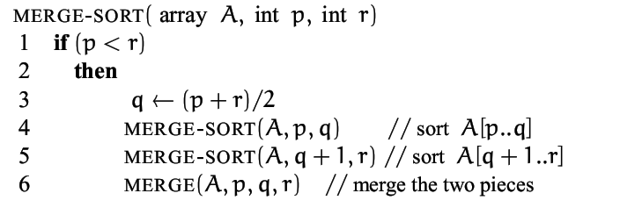
Merge Sort

Slide 6
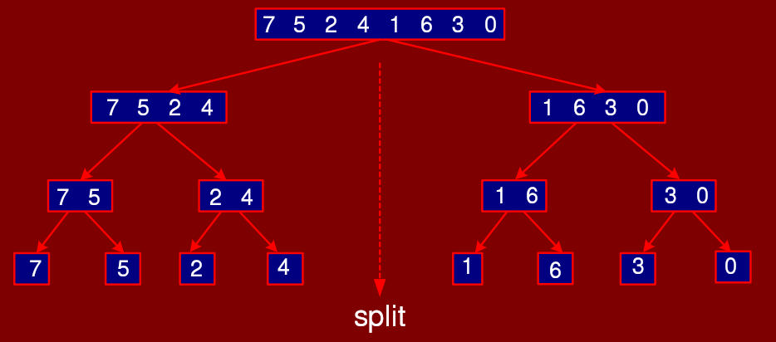
Split part

Slide 7
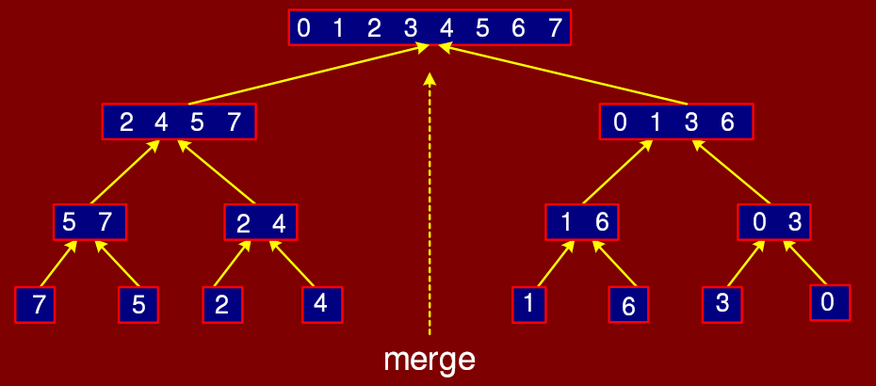
Merge Part

Slide 8
Merge Sort
The fundamental operation in this algorithm is merging two sorted lists.
Because the lists are sorted, this can be done in one pass through the input, if the output is put in a third list.
The basic merging algorithm takes
two input arrays: a and b,
an output array: c
three counters: aptr, bptr, and cptr,
which are initially set to the beginning of their respective arrays.
The smaller of a[aptr] and b[bptr] is copied to the next entry in c, and the appropriate counters are advanced.
When either input list is exhausted, the remainder of the other list is copied to c.

Slide 9
Merge Sort
void m_sort( input_type a[], input_type tmp_array[ ], int left, int right )
{
int center;
if( left < right )
{
center = (left + right) / 2;
m_sort( a, tmp_array, left, center );
m_sort( a, tmp_array, center+1, right );
merge( a, tmp_array, left, center+1, right );
}
}
Calculate the centre index of the input list
Recursively call the m_sort procedure
for the left-half of the input data
Recursively call the m_sort procedure
for the right-half of the input data
Merge the two sorted lists

Slide 10
Merge Sort Example (recursive Function Calls)
Mergesort(a, 8)
m_sort( a, tmp_array, 0, 7 )
62 ⁽⁰⁾ | 58 ⁽¹⁾ | 55 ⁽²⁾ | 10 ⁽³⁾ | 45 ⁽⁴⁾ | 44 ⁽⁵⁾ | 6 ⁽⁶⁾ | 90 ⁽⁷⁾
Merge(a, tmp_array, 0, 4, 7 )
m_sort( a, tmp_array, 0, 3)
m_sort( a, tmp_array, 4, 7)
62 ⁽⁰⁾ | 58 ⁽¹⁾ | 55 ⁽²⁾ | 10 ⁽³⁾
45 ⁽⁴⁾ | 44 ⁽⁵⁾ | 6 ⁽⁶⁾ | 90 ⁽⁷⁾
62 ⁽⁰⁾ | 58 ⁽¹⁾
55 ⁽²⁾ | 10 ⁽³⁾
45 ⁽⁴⁾ | 44 ⁽⁵⁾
6 ⁽⁶⁾ | 90 ⁽⁷⁾
m_sort(0, 1)
m_sort(2, 3 )
m_sort(4, 5)
m_sort(6, 7 )
Merge(a, tmp_array, 0, 2, 3 )
Merge(a, tmp_array, 4, 6, 7 )
62 ⁽⁰⁾
58 ⁽¹⁾
55 ⁽²⁾
10 ⁽³⁾
45 ⁽⁴⁾
44 ⁽⁵⁾
6 ⁽⁶⁾
90 ⁽⁷⁾
m_sort(0,0)
m_sort(1,1)
m_sort(2,2)
m_sort(3,3)
m_sort(4,4)
m_sort(5,5)
m_sort(6,6)
m_sort(7,7)
Merge(0, 1, 1 )
Merge(2, 3, 3 )
Merge(4, 5, 5 )
Merge(6, 7, 7 )

Slide 11
Merge Sort Example (Merging process)
Mergesort(a, 8)
m_sort( a, tmp_array, 0, 7 )
62 ⁽⁰⁾ | 58 ⁽¹⁾ | 55 ⁽²⁾ | 10 ⁽³⁾ | 45 ⁽⁴⁾ | 44 ⁽⁵⁾ | 6 ⁽⁶⁾ | 90 ⁽⁷⁾
6 ⁽⁰⁾ | 10 ⁽¹⁾ | 44 ⁽²⁾ | 45 ⁽³⁾ | 55 ⁽⁴⁾ | 58 ⁽⁵⁾ | 62 ⁽⁶⁾ | 90 ⁽⁷⁾
Merge(a, tmp_array, 0, 4, 7 )
m_sort( a, tmp_array, 0, 3)
m_sort( a, tmp_array, 4, 7)
62 ⁽⁰⁾ | 58 ⁽¹⁾ | 55 ⁽²⁾ | 10 ⁽³⁾
45 ⁽⁴⁾ | 44 ⁽⁵⁾ | 6 ⁽⁶⁾ | 90 ⁽⁷⁾
62 ⁽⁰⁾ | 58 ⁽¹⁾
55 ⁽²⁾ | 10 ⁽³⁾
45 ⁽⁴⁾ | 44 ⁽⁵⁾
6 ⁽⁶⁾ | 90 ⁽⁷⁾
m_sort(0, 1)
m_sort(2, 3 )
m_sort(4, 5)
m_sort(6, 7 )
10 ⁽⁰⁾ | 55 ⁽¹⁾ | 58 ⁽²⁾ | 62 ⁽³⁾
6 ⁽⁴⁾ | 44 ⁽⁵⁾ | 45 ⁽⁶⁾ | 90 ⁽⁷⁾
Merge(a, tmp_array, 0, 2, 3 )
Merge(a, tmp_array, 4, 6, 7 )
62 ⁽⁰⁾
58 ⁽¹⁾
55 ⁽²⁾
10 ⁽³⁾
45 ⁽⁴⁾
44 ⁽⁵⁾
6 ⁽⁶⁾
90 ⁽⁷⁾
m_sort(0,0)
m_sort(1,1)
m_sort(2,2)
m_sort(3,3)
m_sort(4,4)
m_sort(5,5)
m_sort(6,6)
m_sort(7,7)
Merge(0, 1, 1 )
Merge(2, 3, 3 )
Merge(4, 5, 5 )
Merge(6, 7, 7 )
58 ⁽⁰⁾ | 62 ⁽¹⁾
10 ⁽²⁾ | 55 ⁽³⁾
44 ⁽⁴⁾ | 45 ⁽⁵⁾
6 ⁽⁶⁾ | 90 ⁽⁷⁾

Slide 12
Merge two arrays
10 ⁽⁰⁾ | 55 ⁽¹⁾ | 58 ⁽²⁾ | 62 ⁽³⁾
6 ⁽⁴⁾ | 44 ⁽⁵⁾ | 45 ⁽⁶⁾ | 90 ⁽⁷⁾
aptr
bptr
cptr
62 ⁽⁰⁾ | 58 ⁽¹⁾ | 55 ⁽²⁾ | 10 ⁽³⁾ | 45 ⁽⁴⁾ | 44 ⁽⁵⁾ | 6 ⁽⁶⁾ | 90 ⁽⁷⁾

Slide 13
Merge two arrays
10 ⁽⁰⁾ | 55 ⁽¹⁾ | 58 ⁽²⁾ | 62 ⁽³⁾
6 ⁽⁴⁾ | 44 ⁽⁵⁾ | 45 ⁽⁶⁾ | 90 ⁽⁷⁾
aptr
bptr
6 ⁽⁰⁾
cptr

Slide 14
Merge two arrays
10 ⁽⁰⁾ | 55 ⁽¹⁾ | 58 ⁽²⁾ | 62 ⁽³⁾
6 ⁽⁴⁾ | 44 ⁽⁵⁾ | 45 ⁽⁶⁾ | 90 ⁽⁷⁾
aptr
bptr
6 ⁽⁰⁾ | 10 ⁽¹⁾
cptr

Slide 15
Merge two arrays
10 ⁽⁰⁾ | 55 ⁽¹⁾ | 58 ⁽²⁾ | 62 ⁽³⁾
6 ⁽⁴⁾ | 44 ⁽⁵⁾ | 45 ⁽⁶⁾ | 90 ⁽⁷⁾
aptr
bptr
6 ⁽⁰⁾ | 10 ⁽¹⁾ | 44 ⁽²⁾
cptr

Slide 16
Merge two arrays
10 ⁽⁰⁾ | 55 ⁽¹⁾ | 58 ⁽²⁾ | 62 ⁽³⁾
6 ⁽⁴⁾ | 44 ⁽⁵⁾ | 45 ⁽⁶⁾ | 90 ⁽⁷⁾
aptr
bptr
6 ⁽⁰⁾ | 10 ⁽¹⁾ | 44 ⁽²⁾ | 45 ⁽³⁾
cptr

Slide 17
Merge two arrays
10 ⁽⁰⁾ | 55 ⁽¹⁾ | 58 ⁽²⁾ | 62 ⁽³⁾
6 ⁽⁴⁾ | 44 ⁽⁵⁾ | 45 ⁽⁶⁾ | 90 ⁽⁷⁾
aptr
bptr
6 ⁽⁰⁾ | 10 ⁽¹⁾ | 44 ⁽²⁾ | 45 ⁽³⁾ | 55 ⁽⁴⁾
cptr

Slide 18
Merge two arrays
10 ⁽⁰⁾ | 55 ⁽¹⁾ | 58 ⁽²⁾ | 62 ⁽³⁾
6 ⁽⁴⁾ | 44 ⁽⁵⁾ | 45 ⁽⁶⁾ | 90 ⁽⁷⁾
aptr
bptr
6 ⁽⁰⁾ | 10 ⁽¹⁾ | 44 ⁽²⁾ | 45 ⁽³⁾ | 55 ⁽⁴⁾ | 58 ⁽⁵⁾
cptr

Slide 19
Merge two arrays
10 ⁽⁰⁾ | 55 ⁽¹⁾ | 58 ⁽²⁾ | 62 ⁽³⁾
6 ⁽⁴⁾ | 44 ⁽⁵⁾ | 45 ⁽⁶⁾ | 90 ⁽⁷⁾
aptr
bptr
6 ⁽⁰⁾ | 10 ⁽¹⁾ | 44 ⁽²⁾ | 45 ⁽³⁾ | 55 ⁽⁴⁾ | 58 ⁽⁵⁾ | 62 ⁽⁶⁾
cptr

Slide 20
Merge two arrays
10 ⁽⁰⁾ | 55 ⁽¹⁾ | 58 ⁽²⁾ | 62 ⁽³⁾
6 ⁽⁴⁾ | 44 ⁽⁵⁾ | 45 ⁽⁶⁾ | 90 ⁽⁷⁾
aptr
bptr
6 ⁽⁰⁾ | 10 ⁽¹⁾ | 44 ⁽²⁾ | 45 ⁽³⁾ | 55 ⁽⁴⁾ | 58 ⁽⁵⁾ | 62 ⁽⁶⁾ | 90 ⁽⁷⁾
cptr

Slide 21
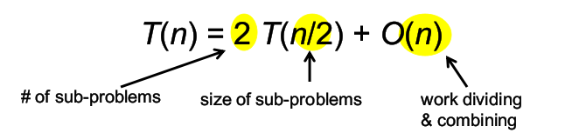
Home work: Find Time Complexity of merge sort using Iteration method, Recursion tree method and Master theorem

Slide 22
Task
Solve
T(n) = 2T(n/2) + n²:
T(n) = 2T(n/2) + n:
T(n) = T(n-1) + n:
Solve these by all three methods.
Iteration, Recursion tree, and Master theorem.

Slide 23
Quick sort

Slide 24
Quick Sort
As its name implies, quicksort is the fastest known sorting algorithm in practice.
It is very fast, mainly due to a very tight and highly optimized inner loop
Its average running time is O(n log n)
It has O(n²) worst-case performance,
The quicksort algorithm is simple to understand and prove correct
Like mergesort, quicksort is a divide-and-conquer recursive algorithm

Slide 25
Quick Sort
The basic algorithm to sort an array S consists of the following four easy steps:
If the number of elements in S is 0 or 1, then return
2. Pick any element v in S. This is called the pivot.
3. Partition S - {v} (the remaining elements in S) into two disjoint groups: S₁ = {x ∈ S - {v}| x ≤ v} and S₂ = {x ∈ S - {v}| x ≥ v}
4. Return { quicksort(S₁) followed by v followed by quicksort(S₂) }

Slide 26
Quick Sort
Since the partition step ambiguously describes what to do with elements equal to the pivot, this becomes a design decision.
Part of a good implementation is handling this case as efficiently as possible.
Intuitively, we would hope that
about half the keys that are equal to the pivot go into S₁
while the other half into S₂, much as we like binary search trees to be balanced.

Slide 27
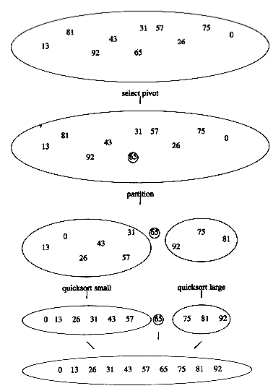
Quick Sort – Selecting the Pivot

Slide 28
Quick Sort – Selecting the Pivot
1- The popular, uninformed choice:
Use the first element as the pivot
This is acceptable if the input is random
But, if the input is presorted or in reverse order, then the pivot provides a poor partition, because virtually all the elements go into S₁ or S₂
It happens consistently throughout the recursive calls
➔ Quicksort will take quadratic time to do essentially nothing at all, which is quite embarrassing
2- A Safe Maneuver
A safe course is merely to choose the pivot randomly
This strategy is generally perfectly safe, unless the random number generator has a flaw
However, random number generation is generally an expensive commodity and does not reduce the average running time of the rest of the algorithm at all

Slide 29
Quick Sort – Selecting the Pivot
The best choice of pivot would be the median of the file.
The median of a group of n numbers is the (n/2)-th largest number
Unfortunately, this is hard to calculate and would slow down quicksort considerably
A good estimate can be obtained by picking three elements randomly and using the median of these three as pivot.
The randomness turns out not to help much
So, the common course is to use as pivot the median of the left, right and center elements
A = {8, 1, 4, 9, 6, 3, 5, 2, 7, 0}
center = A[left + right)/2]
= A [(0+9)/2] = A[4] = 6
pivot: v= median(8, 6, 0) = 6

Slide 30
QuickSort :Partitioning strategy Example
8 ⁽⁰⁾ | 1 ⁽¹⁾ | 4 ⁽²⁾ | 9 ⁽³⁾ | 6 ⁽⁴⁾ | 3 ⁽⁵⁾ | 5 ⁽⁶⁾ | 2 ⁽⁷⁾ | 7 ⁽⁸⁾ | 0 ⁽⁹⁾
i
pivot
j
The basic algorithm
While i is to the left of j,
we move i right, skipping over elements smaller than the pivot
We move j left, skipping over elements larger than the pivot
When i and j have stopped,
i is pointing at a large element, and
j is pointing at a small element
If i is to the left of j,
those elements are swapped
The effect is to push a large element to the right and a small element to the left.
In the example above, i would not move and same for the j

Slide 31
QuickSort :Partitioning strategy Step 1
8 ⁽⁰⁾ | 1 ⁽¹⁾ | 4 ⁽²⁾ | 9 ⁽³⁾ | 6 ⁽⁴⁾ | 3 ⁽⁵⁾ | 5 ⁽⁶⁾ | 2 ⁽⁷⁾ | 7 ⁽⁸⁾ | 0 ⁽⁹⁾
i
j
pivot

Slide 32
QuickSort :Partitioning strategy Step 1
8 ⁽⁰⁾ | 1 ⁽¹⁾ | 4 ⁽²⁾ | 9 ⁽³⁾ | 0 ⁽⁴⁾ | 3 ⁽⁵⁾ | 5 ⁽⁶⁾ | 2 ⁽⁷⁾ | 7 ⁽⁸⁾ | 6 ⁽⁹⁾
i
j
pivot
Start by swapping the pivot with the right,
starting j at right -1
A[i] = 8 > pivot
Stop i right over here

Slide 33
QuickSort :Partitioning strategy Step 1
8 ⁽⁰⁾ | 1 ⁽¹⁾ | 4 ⁽²⁾ | 9 ⁽³⁾ | 0 ⁽⁴⁾ | 3 ⁽⁵⁾ | 5 ⁽⁶⁾ | 2 ⁽⁷⁾ | 7 ⁽⁸⁾ | 6 ⁽⁹⁾
i
j
j
pivot
A[j] = 7 > pivot
Move Left
A[j] = 2 < pivot
Stop j right over here
Swap A[i] and A[j]

Slide 34
QuickSort :Partitioning strategy Step 1
2 ⁽⁰⁾ | 1 ⁽¹⁾ | 4 ⁽²⁾ | 9 ⁽³⁾ | 0 ⁽⁴⁾ | 3 ⁽⁵⁾ | 5 ⁽⁶⁾ | 8 ⁽⁷⁾ | 7 ⁽⁸⁾ | 6 ⁽⁹⁾
i
j
pivot
A[j] = 7 > pivot
Move Right
A[j] = 2 < pivot
Stop j right over here
Swap A[i] and A[j]

Slide 35
QuickSort :Partitioning strategy Step 2
2 ⁽⁰⁾ | 1 ⁽¹⁾ | 4 ⁽²⁾ | 9 ⁽³⁾ | 0 ⁽⁴⁾ | 3 ⁽⁵⁾ | 5 ⁽⁶⁾ | 8 ⁽⁷⁾ | 7 ⁽⁸⁾ | 6 ⁽⁹⁾
i
i
i
i
j
j
pivot
A[i] = 2 < pivot
Move Right
A[i] = 1 < pivot
Move Right
A[i] = 4 < pivot
Move Right
A[i] = 9 > pivot
Stop i right over here
A[j] = 8 > pivot
Move Left
A[j] = 5 < pivot
Stop j right over here

Slide 36
QuickSort :Partitioning strategy Step 2
2 ⁽⁰⁾ | 1 ⁽¹⁾ | 4 ⁽²⁾ | 5 ⁽³⁾ | 0 ⁽⁴⁾ | 3 ⁽⁵⁾ | 9 ⁽⁶⁾ | 8 ⁽⁷⁾ | 7 ⁽⁸⁾ | 6 ⁽⁹⁾
i
j
pivot
A[i] = 2 < pivot
Move Right
A[i] = 1 < pivot
Move Right
A[i] = 4 < pivot
Move Right
A[i] = 9 > pivot
Stop i right over here
A[j] = 8 > pivot
Move Left
A[j] = 5 < pivot
Stop j right over here
Swap A[i] and A[j]

Slide 37
QuickSort :Partitioning strategy Step 3
2 ⁽⁰⁾ | 1 ⁽¹⁾ | 4 ⁽²⁾ | 5 ⁽³⁾ | 0 ⁽⁴⁾ | 3 ⁽⁵⁾ | 9 ⁽⁶⁾ | 8 ⁽⁷⁾ | 7 ⁽⁸⁾ | 6 ⁽⁹⁾
i
i
i
j
i
pivot
A[i] = 5 < pivot
Move Right
A[i] = 0 < pivot
Move Right
A[i] = 3 < pivot
Move Right
A[i] = 9 > pivot
Stop i right over here

Slide 38
QuickSort :Partitioning strategy Step 3
2 ⁽⁰⁾ | 1 ⁽¹⁾ | 4 ⁽²⁾ | 5 ⁽³⁾ | 0 ⁽⁴⁾ | 3 ⁽⁵⁾ | 9 ⁽⁶⁾ | 8 ⁽⁷⁾ | 7 ⁽⁸⁾ | 6 ⁽⁹⁾
j
j
i
pivot
A[i] = 5 < pivot
Move Right
A[i] = 0 < pivot
Move Right
A[i] = 3 < pivot
Move Right
A[i] = 9 > pivot
Stop i right over here
A[j] = 9 > pivot
Move Left
A[j] = 3 < pivot
Stop j right over here
i and j have crossed
So no swap for A[i] and A[j]
Instead Swap A[i] and A[pivot]

Slide 39
QuickSort :Partitioning strategy Step 3
2 ⁽⁰⁾ | 1 ⁽¹⁾ | 4 ⁽²⁾ | 5 ⁽³⁾ | 0 ⁽⁴⁾ | 3 ⁽⁵⁾ | 6 ⁽⁶⁾ | 8 ⁽⁷⁾ | 7 ⁽⁸⁾ | 9 ⁽⁹⁾
j
i
pivot
A[i] = 5 < pivot
Move Right
A[i] = 0 < pivot
Move Right
A[i] = 3 < pivot
Move Right
A[i] = 9 > pivot
Stop i right over here
A[j] = 9 > pivot
Move Left
A[j] = 3 < pivot
Stop j right over here
i and j have crossed
So no swap for A[i] and A[j]
Instead Swap A[i] and A[pivot]

Slide 40
QuickSort : Recursive calls
2 ⁽⁰⁾ | 1 ⁽¹⁾ | 4 ⁽²⁾ | 5 ⁽³⁾ | 0 ⁽⁴⁾ | 3 ⁽⁵⁾ | 6 ⁽⁶⁾ | 8 ⁽⁷⁾ | 7 ⁽⁸⁾ | 9 ⁽⁹⁾
pivot
2 ⁽⁰⁾ | 1 ⁽¹⁾ | 4 ⁽²⁾ | 5 ⁽³⁾ | 0 ⁽⁴⁾ | 3 ⁽⁵⁾ | 6 ⁽⁶⁾ | 8 ⁽⁷⁾ | 7 ⁽⁸⁾ | 9 ⁽⁹⁾
i
0
i -1
i + 1
N -1

Slide 41
QuickSort : Left Recursive call
2 ⁽⁰⁾ | 1 ⁽¹⁾ | 4 ⁽²⁾ | 5 ⁽³⁾ | 0 ⁽⁴⁾ | 3 ⁽⁵⁾

Slide 42
Always select pivot in one manner. If you select pivot as first/middle/Last element always select that element as pivot in recursive calls Better approach. Select pivot as Array[(L+R)/2] as pivot

Slide 43
QuickSort : Left Recursive call An example to select last element as pivot
2 ⁽⁰⁾ | 1 ⁽¹⁾ | 4 ⁽²⁾ | 5 ⁽³⁾ | 0 ⁽⁴⁾ | 3 ⁽⁵⁾
i
j
pivot

Slide 44
QuickSort : Left Recursive call Movements
2 ⁽⁰⁾ | 1 ⁽¹⁾ | 4 ⁽²⁾ | 5 ⁽³⁾ | 0 ⁽⁴⁾ | 3 ⁽⁵⁾
i
j
pivot

Slide 45
QuickSort : Left Recursive call Swap
2 ⁽⁰⁾ | 1 ⁽¹⁾ | 4 ⁽²⁾ | 5 ⁽³⁾ | 0 ⁽⁴⁾ | 3 ⁽⁵⁾
i
j
pivot

Slide 46
QuickSort : Left Recursive call Step 1: Swap
2 ⁽⁰⁾ | 1 ⁽¹⁾ | 0 ⁽²⁾ | 5 ⁽³⁾ | 4⁽⁴⁾ | 3 ⁽⁵⁾
i
j
pivot

Slide 47
QuickSort : Left Recursive call Movements
2 ⁽⁰⁾ | 1 ⁽¹⁾ | 0 ⁽²⁾ | 5 ⁽³⁾ | 4⁽⁴⁾ | 3 ⁽⁵⁾
i
j
pivot
i & j crossed

Slide 48
QuickSort : Left Recursive call Swap with the pivot
2 ⁽⁰⁾ | 1 ⁽¹⁾ | 0 ⁽²⁾ | 5 ⁽³⁾ | 4⁽⁴⁾ | 3 ⁽⁵⁾
i
pivot

Slide 49
QuickSort : Left Recursive call Swap with the pivot
2 ⁽⁰⁾ | 1 ⁽¹⁾ | 0 ⁽²⁾ | 3 ⁽³⁾ | 4⁽⁴⁾ | 5 ⁽⁵⁾
i
pivot

Slide 50
QuickSort :Recursive Calls
2 ⁽⁰⁾ | 1 ⁽¹⁾ | 0 ⁽²⁾ | 3 ⁽³⁾ | 4⁽⁴⁾ | 5 ⁽⁵⁾
i
pivot
pivot
2 ⁽⁰⁾ | 1 ⁽¹⁾ | 0 ⁽²⁾ | 3 ⁽³⁾ | 4⁽⁴⁾ | 5 ⁽⁵⁾
i
0
i -1
i + 1
Right

Slide 51
QuickSort
void quick_sort( input_type a[ ], unsigned int n )
{
q_sort( a, 0, n-1 );
}

Slide 52
QuickSort: Core Function
void q_sort( input_type a[], int left, int right )
{
int i, j; int pivot;
if( left + CUTOFF <= right )
{
pivot = median3( a, left, right );
i = left; j = right - 1;
for ( ; ; )
{
while( a[++i] < pivot );
while( a[--j] > pivot );
if( i < j )
swap( &a[i], &a[j] );
else
break;
} //end for loop
swap( &a[i], &a[right-1] ); /*restore pivot*/
q_sort( a, left, i -1 ); // left recursive call
q_sort( a, i +1, right ); // lright recursive call
}
}

Slide 53
QuickSort: Medians
/* Return median of left, center, and right. */
/* Order these and hide pivot */
int median3( input_type a[], int left, int right )
{
int center;
center = (left + right) / 2;
if ( a[left] > a[center] )
swap( &a[left], &a[center] );
if ( a[left] > a[right] )
swap( &a[left], &a[right] );
if ( a[center] > a[right] )
swap( &a[center], &a[right] );
/* a[left] <= a[center] <= a[right] */
swap( &a[center], &a[right-1] );
return a[right-1]; /* return pivot */
}

Slide 54
QuickSort: Medians
/* Return median of left, center, and right. */
/* Order these and hide pivot */
int median3( input_type a[], int left, int right )
{
int center;
center = (left + right) / 2;
if ( a[left] > a[center] )
swap( &a[left], &a[center] );
if ( a[left] > a[right] )
swap( &a[left], &a[right] );
if ( a[center] > a[right] )
swap( &a[center], &a[right] );
/* a[left] <= a[center] <= a[right] */
swap( &a[center], &a[right-1] );
return a[right-1]; /* return pivot */
}
8 ⁽⁰⁾ | 1 ⁽¹⁾ | 4 ⁽²⁾ | 9 ⁽³⁾ | 6 ⁽⁴⁾ | 3 ⁽⁵⁾ | 5 ⁽⁶⁾ | 2 ⁽⁷⁾ | 7 ⁽⁸⁾ | 0 ⁽⁹⁾
8 ⁽⁰⁾
6 ⁽⁴⁾
0 ⁽⁹⁾
left
center
right
8 > 6
6 > 0
8 > 6

Slide 55
QuickSort: Core Function
void q_sort( input_type a[], int left, int right )
{
int i, j; int pivot;
if( left + CUTOFF <= right )
{
pivot = median3( a, left, right );
i=left; j=right-1;
for ( ; ; )
{
while ( a[++i] < pivot );
while ( a[--j] > pivot );
if ( i < j )
swap( &a[i], &a[j] );
else
break;
} //end for loop
swap( &a[i], &a[right-1] );
q_sort( a, left, i-1 );
q_sort( a, i+1, right );
}
}
8 ⁽⁰⁾ | 1 ⁽¹⁾ | 4 ⁽²⁾ | 9 ⁽³⁾ | 7 ⁽⁴⁾ | 3 ⁽⁵⁾ | 5 ⁽⁶⁾ | 2 ⁽⁷⁾ | 6 ⁽⁸⁾ | 0 ⁽⁹⁾
0 ⁽⁰⁾
6 ⁽⁴⁾
7 ⁽⁴⁾
6 ⁽⁸⁾
8 ⁽⁹⁾
i = left
center
j = right -1
pivot
/* while i is to the left of j,
move i right, skipping over elements smaller than the pivot
move j left, skipping over elements larger than the pivot. */
/* If i is to the left of j,
those elements are swapped */

Slide 56
QuickSort: Core Function
void q_sort( input_type a[], int left, int right )
{
int i, j; int pivot;
if( left + CUTOFF <= right )
{
pivot = median3( a, left, right );
i=left; j=right-1;
for ( ; ; )
{
while ( a[++i] < pivot );
while ( a[--j] > pivot );
if ( i < j )
swap( &a[i], &a[j] );
else
break;
} //end for loop
swap( &a[i], &a[right-1] );
q_sort( a, left, i-1 );
q_sort( a, i+1, right );
}
}
8 ⁽⁰⁾ | 1 ⁽¹⁾ | 4 ⁽²⁾ | 2 ⁽³⁾ | 5 ⁽⁴⁾ | 3 ⁽⁵⁾ | 7 ⁽⁶⁾ | 9 ⁽⁷⁾ | 6 ⁽⁸⁾ | 0 ⁽⁹⁾
0 ⁽⁰⁾
7 ⁽⁴⁾
6 ⁽⁸⁾
8 ⁽⁹⁾
left
j
i
right
right -1
pivot
/* loop terminated when ( i > j ) i.e., i and j have crossed → so no swap is performed */
/*restore pivot*/
// left recursive call
// lright recursive call

Slide 57

QuickSort Analysis
2 cases of Quick sort
Best/average case
where the partition of array is in middle like merge sort
Worst case (Imaginary)
Array is partition into two parts ( 1 items & n-1 items) in division
For best/Average case mathematical function?
For worst case mathematical function?
$$T\left(n\right)=2 T\left(\frac{n}{2}\right)+cn$$
$$T\left(n\right)=T\left(n−1\right)+T(0)+cn$$

Slide 58

QuickSort Analysis
For best/Average case mathematical function
This is exactly same as merge sort algorithm
Try to solve is again by all of the three method discuss last week
Complexity?
$$T\left(n\right)=2 T\left(\frac{n}{2}\right)+cn$$

Slide 59
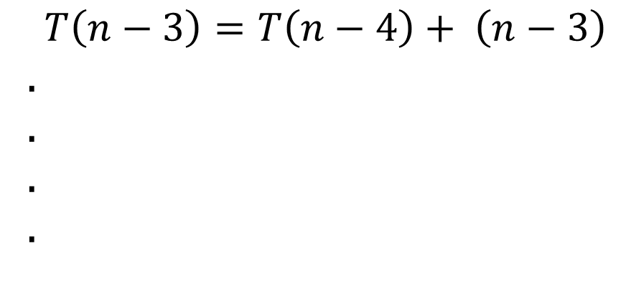

QuickSort Analysis Worst case
For worst case mathematical equation will be
By iterative method
$$T\left(n\right)=T\left(n−1\right)+T(0)+cn$$
$$T\left(n\right)=T\left(n−1\right)+ cn$$
$$T\left(n−1\right)=T\left(n−2\right)+ (n−1)$$
$$T\left(n−2\right)=T\left(n−3\right)+ (n−2)$$
$$T\left(n−3\right)=T\left(n−4\right)+ \left(n−3\right)$$
.
.
.
.

Slide 60

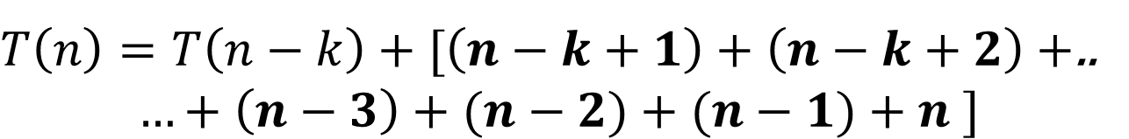

QuickSort Analysis Worst case
$$T\left(n\right)=T\left(n−1\right)+cn$$
$$T\left(n\right)=[T\left(n−1\right)]+n$$
$$T\left(n\right)=[T\left(n−2\right)+ (n−1)]+n$$
$$T\left(n\right)=T\left(n−2\right)+[(n−1)+n ]$$
$$T\left(n\right)=[T(n−3)+ (n−2)]+[(n−1)+n ]$$
$$T\left(n\right)=T\left(n−3\right)+[(n−2)+(n−1)+n ]$$
$$T\left(n\right)=T(n−4)+[\left(n−3\right)+(n−2)+(n−1)+n ]$$
$T\left(n\right)=T\left(n−k\right)+[\left(n−k+1\right)+\left(n−k+2\right)+$..
$$…+\left(n−3\right)+(n−2)+(n−1)+n ]$$
Put k = n this will make series 1+2+3 … + n

Slide 61
Thank you

