Slide 1
Sorting techniques Continue

Slide 2
Radix sort
Bucket Sort
Heap Sort
Count Sort

Slide 3
Heap Sort

Slide 4
Tree
Binary tree : A tree in which every node other than the leaves has two children.
Complete Binary tree: A complete binary tree is a binary tree in which every level, except possibly the last, is completely filled.
Height of node: The height of a node is the number of edges on the longest path from the node to a leaf.
Height of tree: It is equal to the height of root node
Depth of node: The depth of a node is the number of edges in the path from root to that node
The height of a tree is equal to the max depth of a tree.

Slide 5
Binary Heap
A heap is a complete binary tree which satisfy heap ordering property (max heap or min heap)
Can be implemented efficiently in an array.
It can be used for heap sort and the efficient representation of certain dynamic priority lists, such the list of tasks to be scheduled by an operating system.

Slide 6
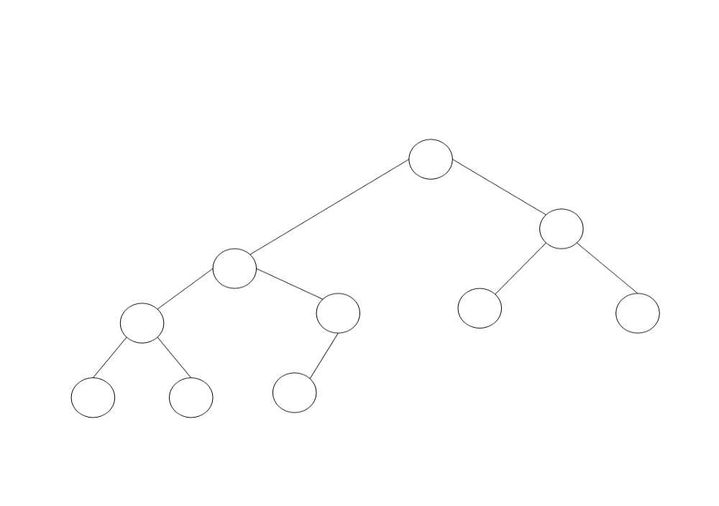
Heap : A complete binary tree
T[1]
T[3]
T[2]
T[4]
T[5]
T[6] T[7]
A complete binary tree containing 10 nodes.
Five internal nodes occupy level3 (the root), level 2, and the left side of level 1.
Five leaves fill the right side of level 1 and then continue at the left of level 0.
T[8] T[9]
T[10]

Slide 7
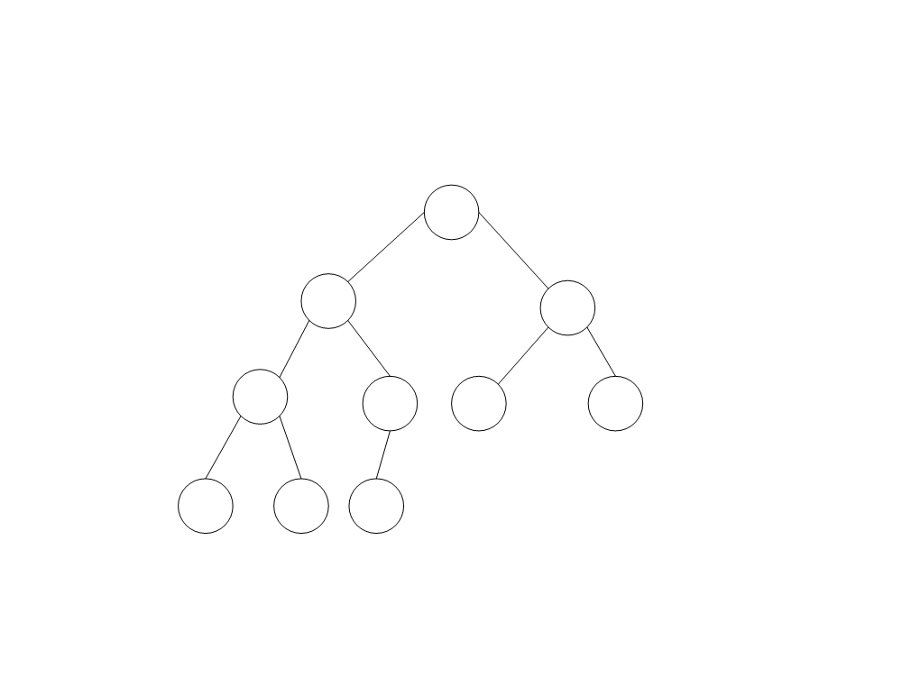
A heap
Now we have marked each node with its value
10
7
9
4
7
5
2
2
1
6
Figure shows an example of a heap with 10 nodes.

Slide 8
Heap
This same heap can be represented by the following array.
The crucial characteristic of this data structure is that the heap property can be restored efficiently if the value of a node is modified.
If the value of a node increases to the extent that it becomes greater than the value of its parent, it should be sufficient to exchange these two values, and then to continue the same process upwards in the tree if necessary until the heap property is restored.

Slide 9
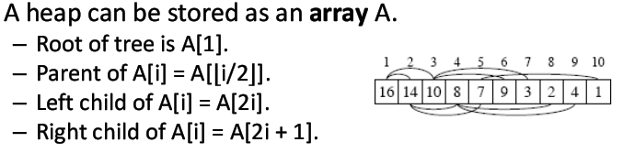
Heap
The modified value is moved up to its new position in the heap
This operation is often called sifting up

Slide 10
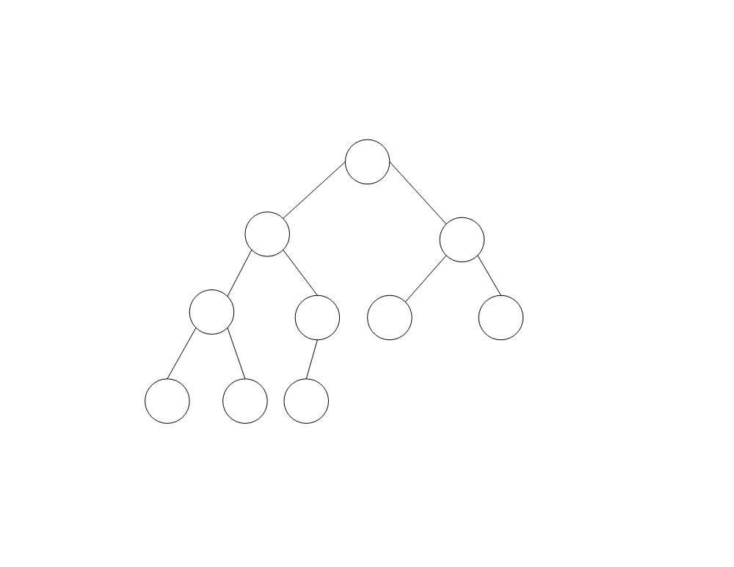
Heap - Purculate Up
Replace 1 with 8:
The heap, after moving 8 to its place
10
8
9
7
7
5
2
2
4
6
If the value “1” in Figure is modified so that it becomes “8”, we can restore the heap property by exchanging the 8 with its parent “4” and then exchanging it again with its new parent “7”.

Slide 11
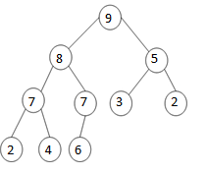
Heap – Purculate Down
If on the contrary the value of a node is decreased so that it becomes less than the value of at least one of its children, it suffices to exchange the modified value with the larger of the values in the children, and then to continue this process downwards in the tree if necessary until the heap property is restored.
The heap, after sifting 3 (originally 10) down to its place
The modified value has been sifted down
to its new position.

Slide 12
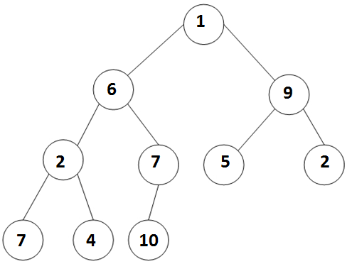
Making Heaps
There exists a clever algorithm for making a heap. Suppose, for example, that our starting point is the following array represented by the tree in Figure.
1 | 6 | 9 | 2 | 7 | 5 | 2 | 7 | 4 | 10
The starting situation

Slide 13
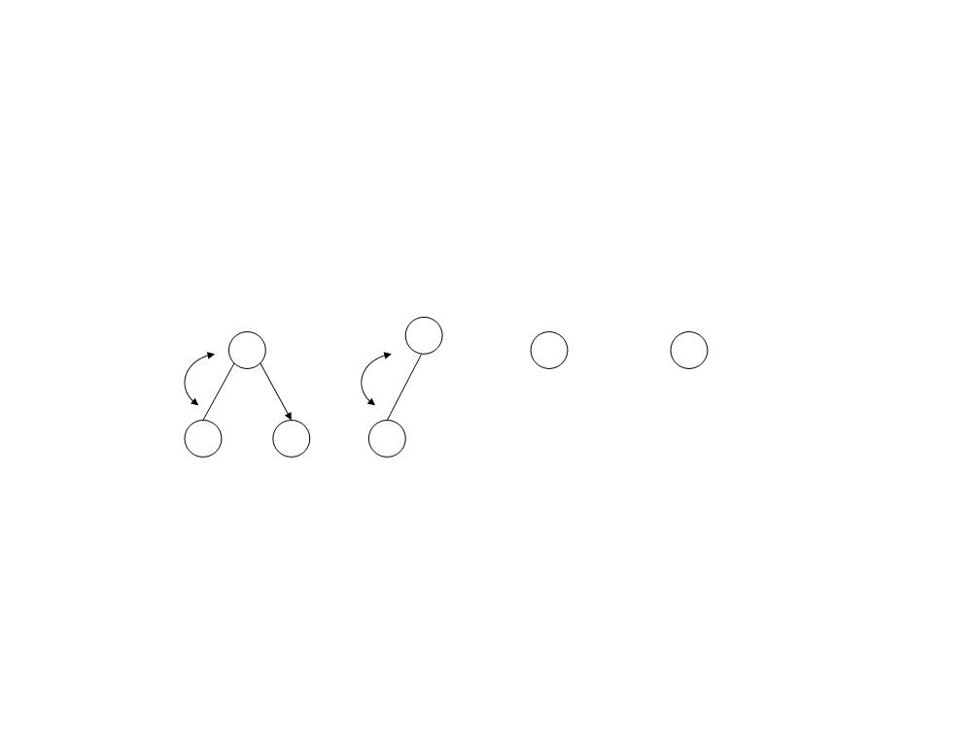
Heaps
We first make each of the subtrees whose roots are at level 1 into a heap, this is done by sifting down these nodes, as illustrated in Figure.
7
10
5 2
2 4 7
The level 1 subtrees are made into heaps

Slide 14
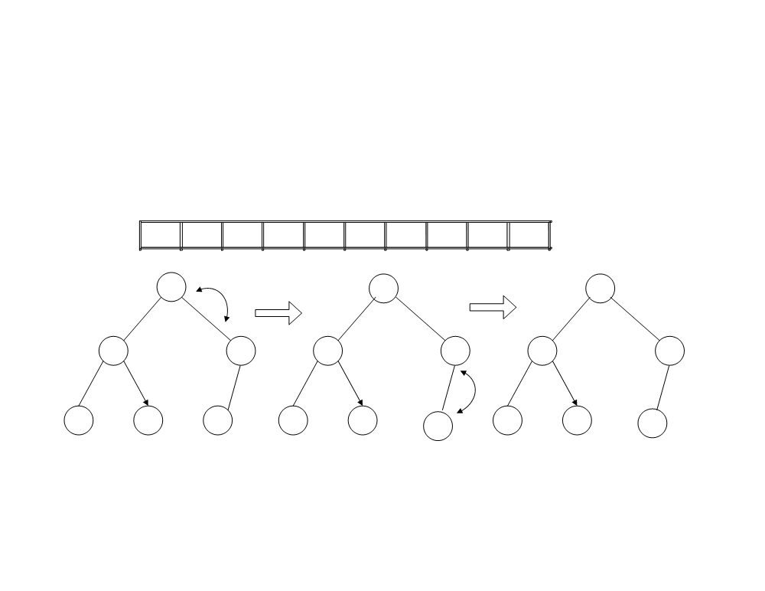
Heaps
This figure shows the process for the left subtree. The other subtree at level 2 is already a heap. This results in an essentially complete binary tree corresponding to the array.
1
10
9
7
7
5
2
2
4
6
6
10
10
7
10
7
6
7
7
2
4
7
2
4
7
2
4
6
One level 2 subtree is made into a heap (the other already is a heap)

Slide 15
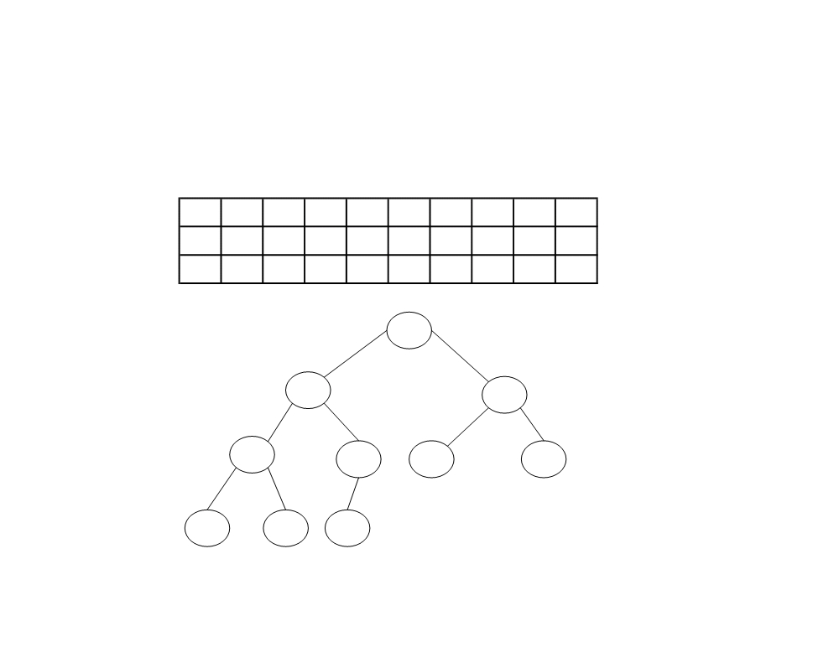
It only remains to sift down its root to obtain the desired heap. This process thus goes as follows:
10
1
9
7
7
5
2
2
4
6
10
7
9
1
7
5
2
2
4
6
10
7
9
4
7
5
2
2
1
6
10
7
9
4
7
5
2
2
1
6

Slide 16
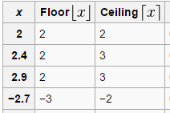
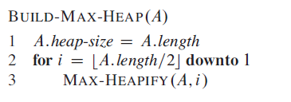
Build Heap

Slide 17
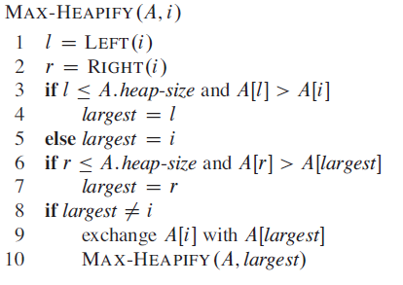
Max Heapify
// l = 2i
// r = 2i+1

Slide 18
Example
A=(16, 4, 10, 14, 7, 9, 3, 2, 8, 1)

Slide 19
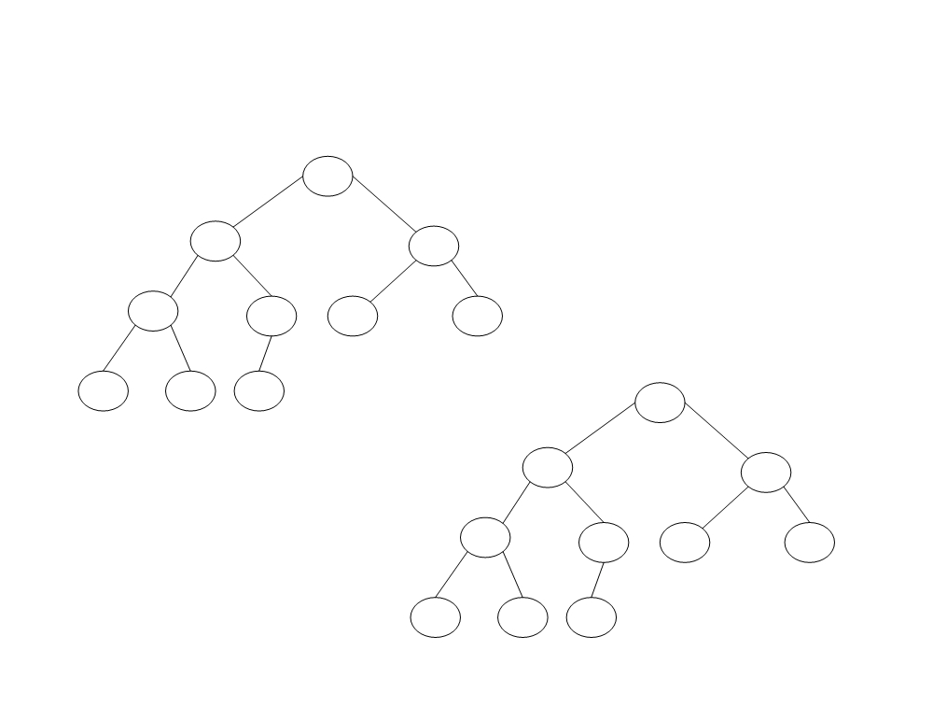
Build Heap
Construct the heap using the array A=(16, 4, 10, 14, 7, 9, 3, 2, 8, 1)
16
4 10
The initial configuration
14 7 9 3
2 8 1
16
14 10
8
7 9 3
Maintaining heap property
2
4 1

Slide 20

Build Heap analysis of heap sort
Build heap (A) :
Time taken by max-heapify for nodes at lowest height is 0
Time taken by max-heapify for one node at height 1 is O(1)
How many nodes at height h of complete binary tree?
( n / 2^{h+1} )
Time taken by max-heapify for all node at h level is

Slide 21
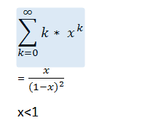





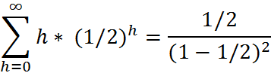

=

Slide 22
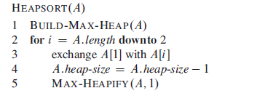
Heap sort
The heapsort algorithm consists of two phases: In the first phase, the array to be sorted is converted into a max heap. And in the second phase, the largest element (i.e., the one at the tree root) is removed, and a new max heap is created from the remaining elements.

Slide 23
Heap sort
Ascending order
Build Max heap tree
In a max heap, the keys of parent nodes are always greater than or equal to those of the children and the highest key is in the root node.
Descending order
Build Min heap tree
In a min heap, the keys of parent nodes are less than or equal to those of the children and the lowest key is in the root node.

Slide 24
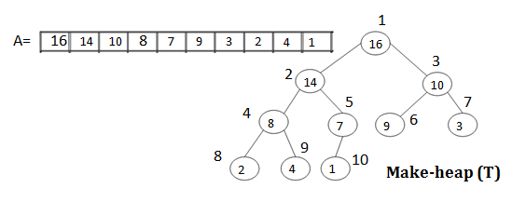
How to sort heap

Slide 25
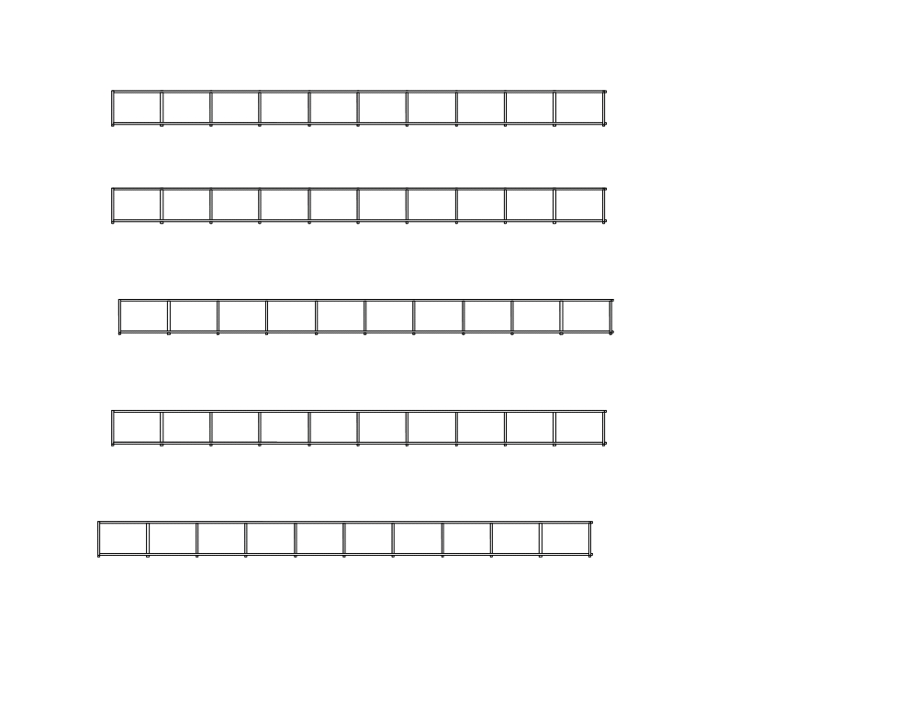
i = 10, exchange T[1] & T[10] and Max-heapify (T[1..9],1)
14
8
10
4
7
9
3
2
1
16
1
2
3
4
5
6
7
8
9
10
i = 9, exchange T[1] & T[9] and Max-heapify (T[1..8],1)
10
8
9
4
7
1
3
2
14
16
1
2
3
4
5
6
7
8
9
10
i = 8, exchange T[1] & T[8] and Max-heapify (T[1..7],1)
9
8
3
4
7
1
2
10
14
16
1
2
3
4
5
6
7
8
9
10
i = 7, exchange T[1] & T[7] and Max-heapify(T[1..6],1)
8
7
3
4
2
1
9
10
14
16
1
2
3
4
5
6
7
8
9
10
i = 6, exchange T[1] & T[6] and Max-heapify (T[1..5],1)
7
4
3
1
2
8
9
10
14
16
1
2
3
4
5
6
7
8
9
10

Slide 26
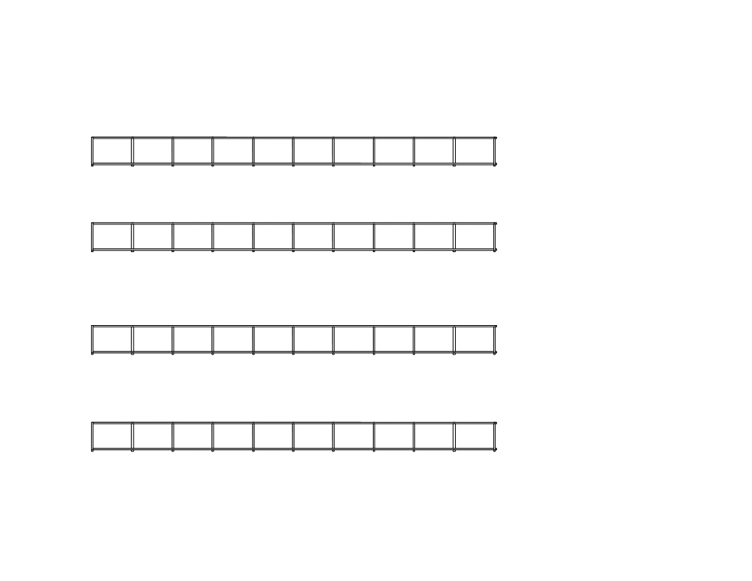
i = 5, exchange T[1] & T[5] and Max-heapify (T[1..4],1)
4
2
3
1
7
8
9
10
14
16
1
2
3
4
5
6
7
8
9
10
i = 4, exchange T[1] & T[4] and Max-heapify (T[1..3],1)
1
2
3
4
7
8
9
10
14
16
1
2
3
4
5
6
7
8
9
10
i = 3, exchange T[1] & T[3] and Max-heapify (T[1..2],1)
2
1
3
4
7
8
9
10
14
16
1
2
3
4
5
6
7
8
9
10
i = 2, exchange T[1] & T[2] and Max-heapify (T[1..1],1)
1
2
3
4
7
8
9
10
14
16
1 2 3 4
5 6 7 8 9 10
End of Sorting

Slide 27
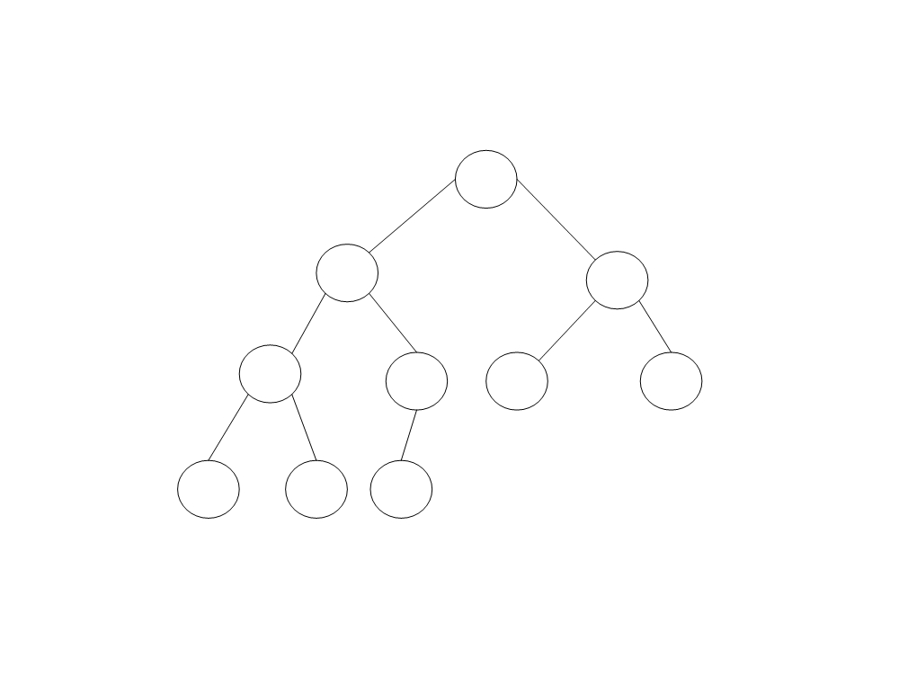
Sorted heap
1
2 3
4
7 8 9
10 14
16

Slide 28
Analysis of heap sort
Max-heapify (A,i) :
n-1 calls to Max-heapify = O(n log n)
(every time root value is shifted down to the leaf)
O(n) + O(n log(n)) = O(n log(n))
all you care about is the dominant term.
n log(n) dominates n so that's the only term that you care about.
Both worst and average case : O(nlogn)

Slide 29
Heap sort (Analysis) extra
log 1 + log 2 + log 3 + · · · + log n
<=log n + log n + log n + · · · + log n
<=n log n
O(n log n)

Slide 30
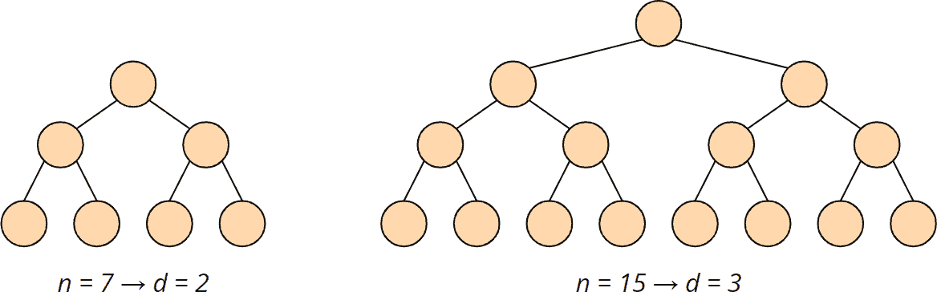
Time Complexity of the heapify() Method Let's start with the heapify() method since we also need it for the heap's initial build. In the heapify() function, we walk through the tree from top to bottom. The height of a binary tree (the root not being counted) of size n is log2 n at most, i.e., if the number of elements doubles, the tree becomes only one level deeper: The complexity for the heapify() function is accordingly O(log n).

Slide 31
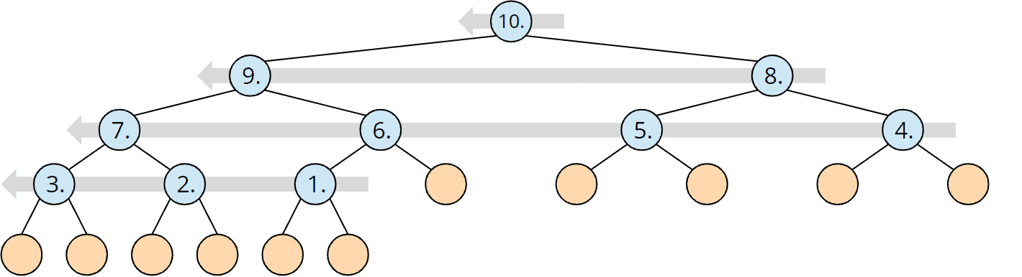
Time Complexity of the buildHeap() Method To initially build the heap, the heapify() method is called for each parent node – backward, starting with the last node and ending at the tree root. A heap of size n has n/2 (rounded down) parent nodes:
Since the complexity of the heapify() method is O(log n) as shown above, the complexity for the buildHeap() method is, therefore, maximum* O(n log n).

Slide 32
Total Time Complexity of Heapsort
The heapify() method is called n-1 times. So the total complexity for repairing the heap is also O(n log n).
Both sub-algorithms, therefore, have the same time complexity. Hence:
The time complexity of Heapsort is:O(n log n)

Slide 33
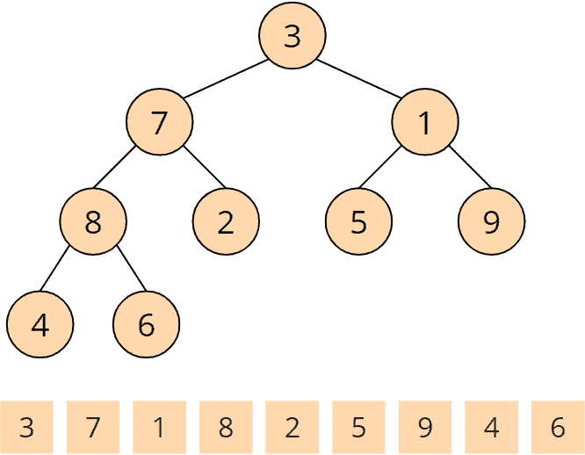
[3, 7, 1, 8, 2, 5, 9, 4, 6]
This tree does not yet represent a max heap
The definition of a max heap is that children are always greater than or equal to their parents.
To create a max heap, we now visit all parent nodes
– backward from the last one to the first
– and make sure that the heap condition for the respective node and the one below is fulfilled.
We do this using the so-called heapify() method.

Slide 34
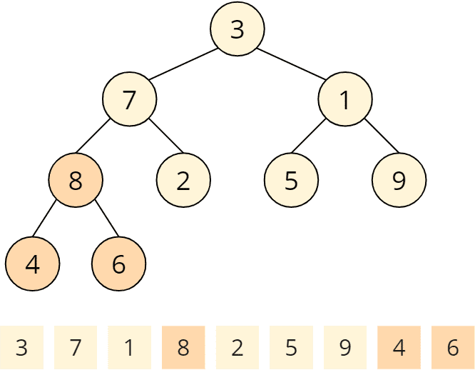
The heapify() method is called first for the last parent node. Parent nodes are 3, 7, 1, and 8. The last parent node is 8. The heapify() function checks if the children are smaller than the parent node. 4 and 6 are smaller than 8, so at this parent node, the heap condition is fulfilled, and the heapify() function is finished.

Slide 35
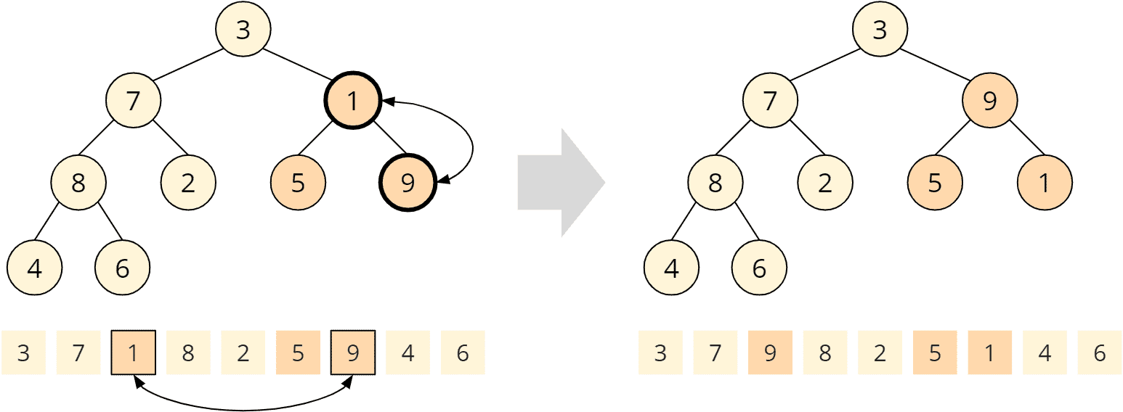
Second, heapify() is called for the penultimate node: the 1. Its children 5 and 9 are both greater than 1, so the heap condition is violated. To restore the heap condition, we now swap the larger child with the parent node, i.e., the 9 with the 1. The heapify() method is now finished again.

Slide 36
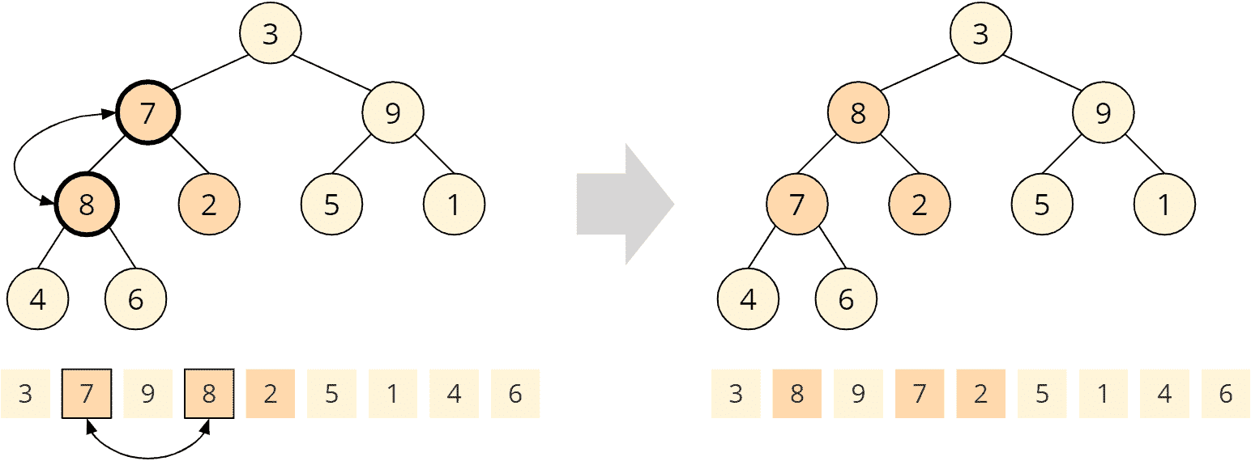
Now heapify() is called on the 7. Child nodes are 8 and 2; only the 8 is larger than the parent node. So we exchange the 7 with the 8:

Slide 37

Since the child node we just swapped has two children itself, the heapify() method must now check if the heap condition for this child node is still valid. In this case, the 7 is greater than 4 and 6; the heap condition is fulfilled, and the heapify() function is finished.

Slide 38
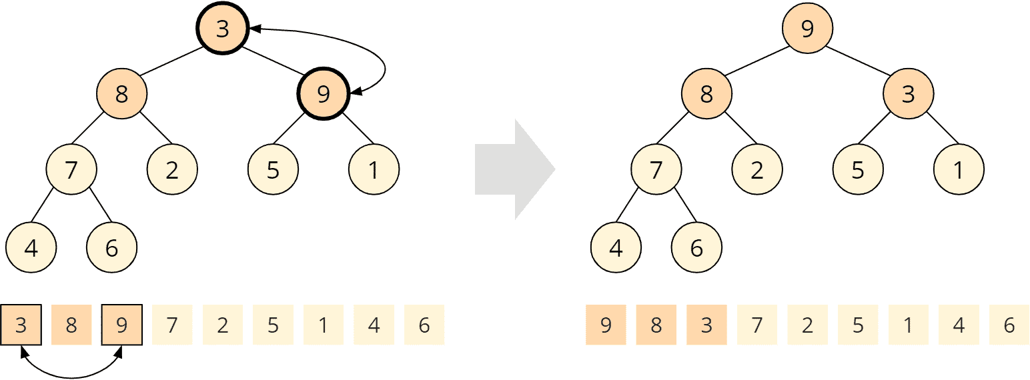
Now we have arrived at the root node with element 3. Both child nodes, 8 and 9 are larger, while 9 is the largest child and is, therefore, swapped with the parent node:

Slide 39
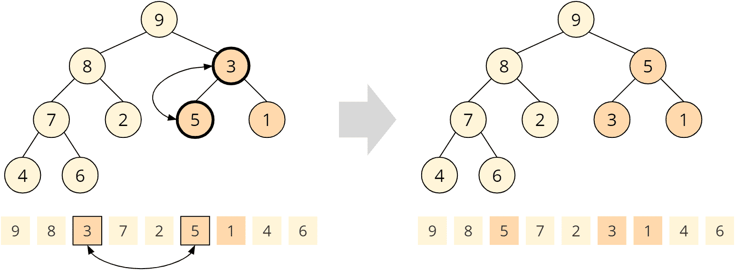
Again, the swapped child node has children itself, so we need to check the heap condition on this child node. The 5 is greater than the 3, i.e., the heap condition is not fulfilled. It must be restored by swapping the 5 and the 3:

Slide 40
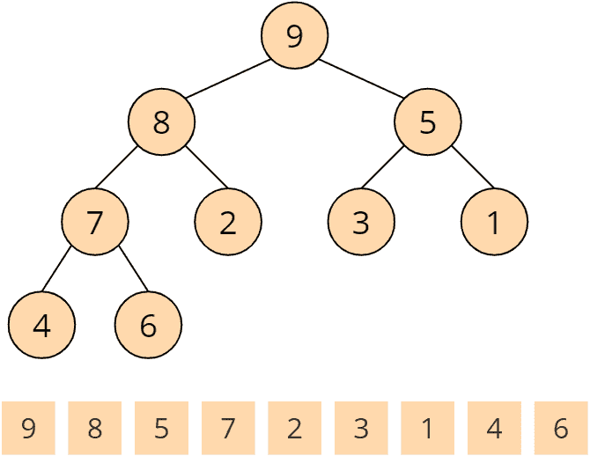
The fourth and last call of the heapify() function has finished. A max heap has been created:

Slide 41
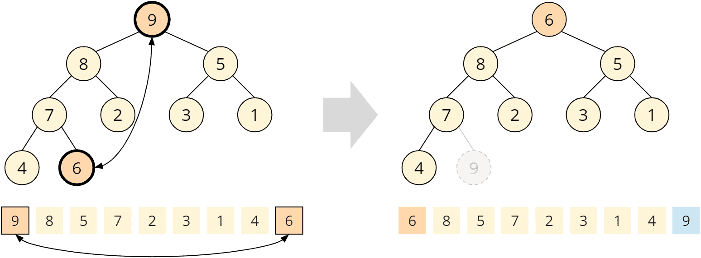
Phase 2: Sorting the Array

Slide 42
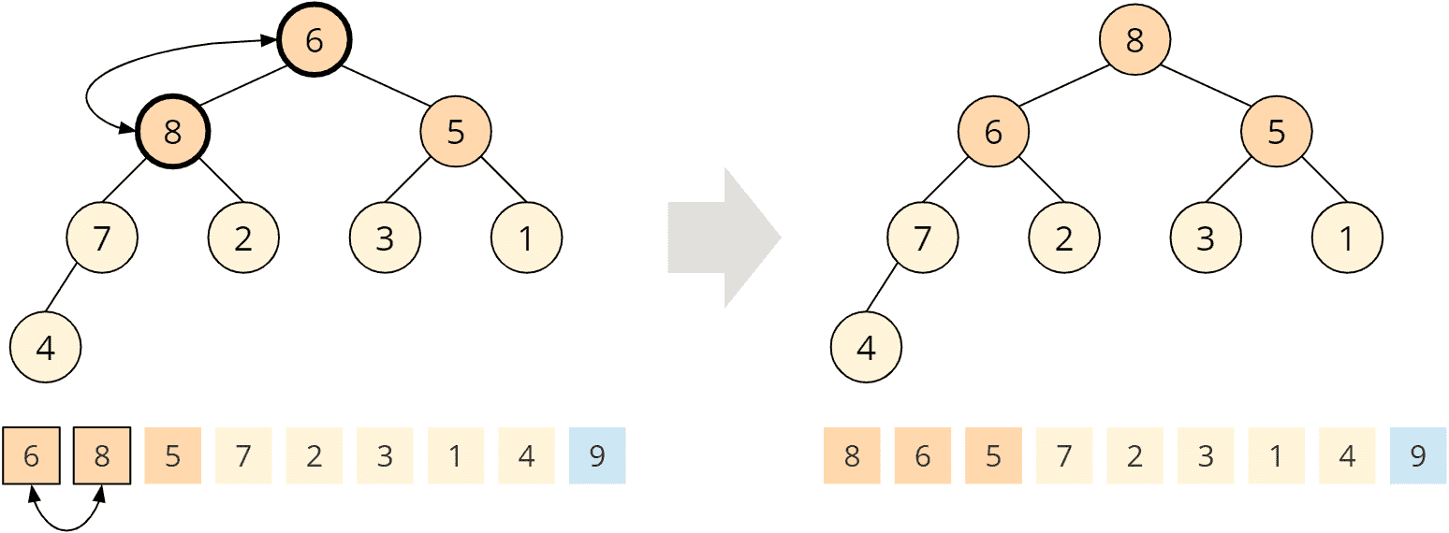

Slide 43
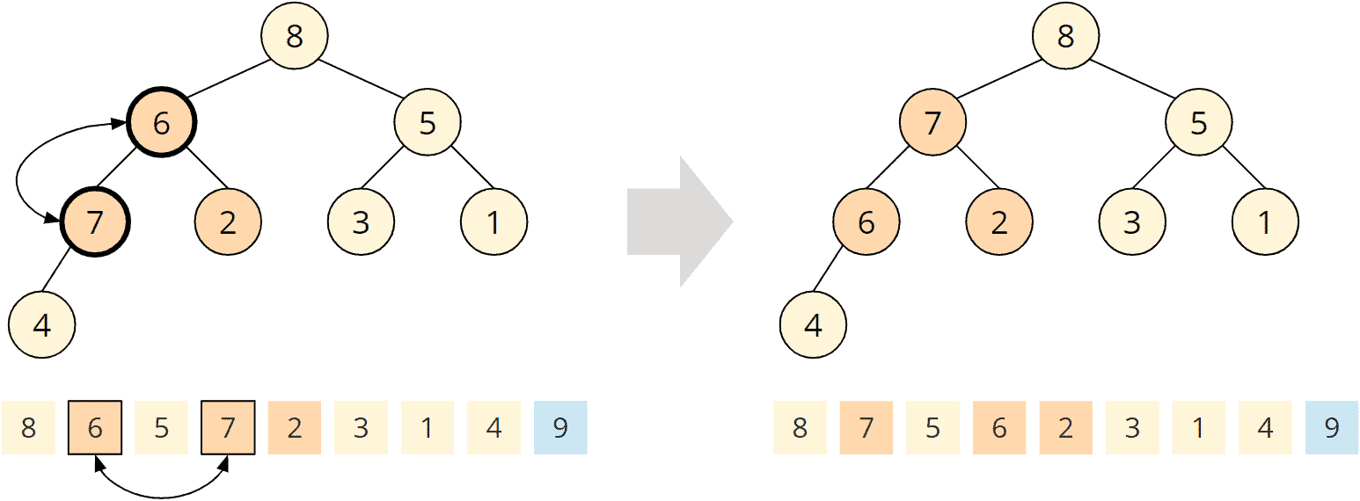

Slide 44
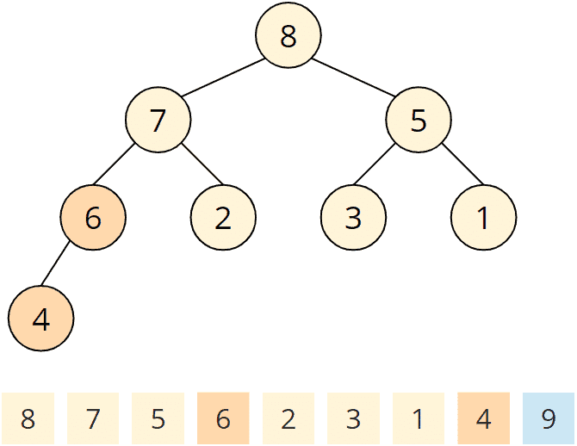

Slide 45
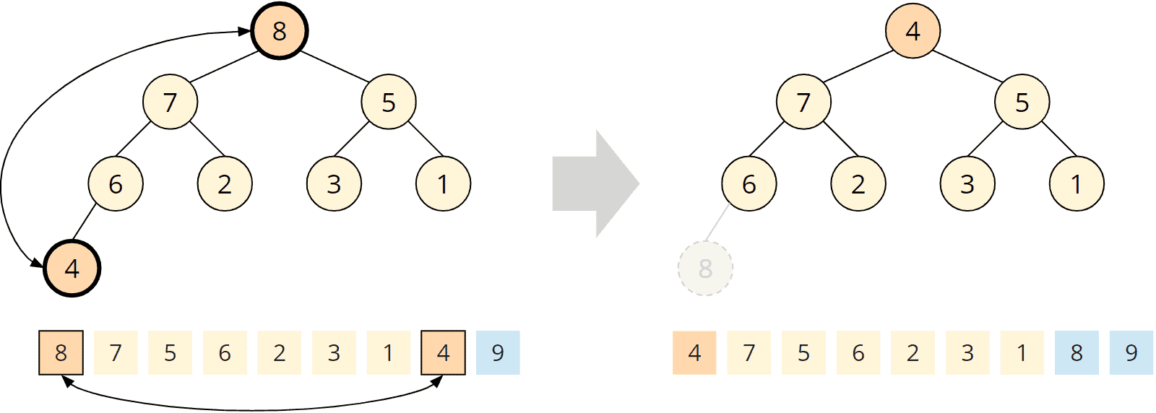

Slide 46
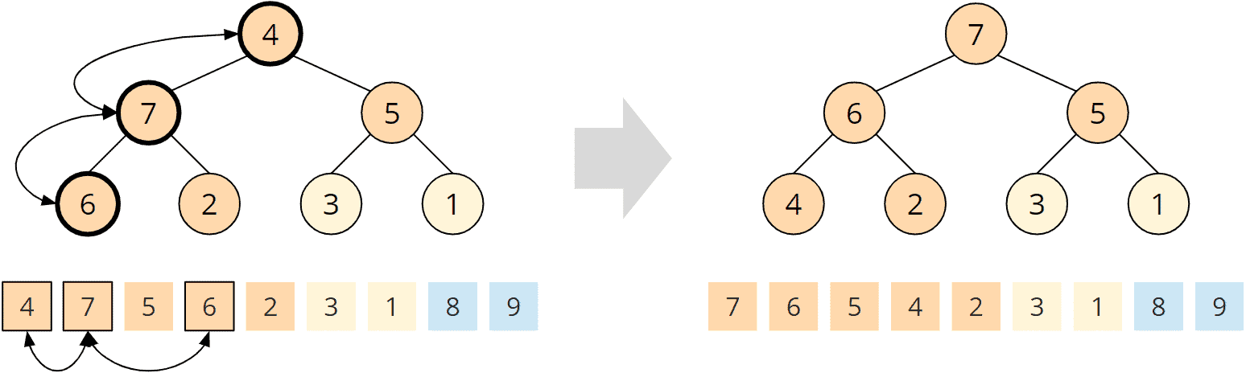

Slide 47
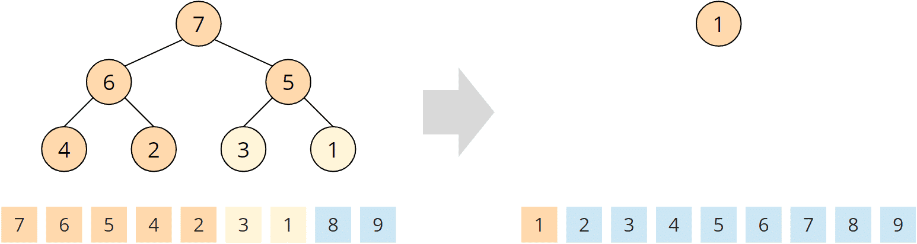
We repeat the process until there is only one element left in the tree:

Slide 48
Class Task:
1 | 6 | 9 | 2 | 7 | 5 | 2 | 7 | 4 | 10
Maintain minimum heap tree
Sort heap in descending order

Slide 49
Home Task1
Sort the array in descending order using heap sort algorithm
24
21
23
22
36
29
30
34
28
27

Slide 50
Home Task2
Sort the array in descending order using heap sort algorithm
5
3
1
9
8
2
4
7

Slide 51
Thank you

