Slide 1
Sorting techniques Continue

Slide 2
Radix sort
Bucket Sort
Heap Sort
Count Sort

Slide 3
Count Sort

Slide 4
Counting Sort
Basic Idea
For each input element x, determine the number of elements less than or equal to x
For each integer i (0 ≤ i ≤ k), count how many elements whose values are i
Then we know how many elements are less than or equal to i
Algorithm storage
A[1..n]: input elements
B[1..n]: sorted elements
C[0..k]: holds the number of elements less than or equal to i where (0 ≤ i ≤ k)

Slide 5
Count Sort
Strengths: Linear time. Counting sort runs in time, making it asymptotically faster than comparison-based sorting algorithms like quicksort or merge sort.
Weaknesses: Restricted inputs. Counting sort only works when the range of potential items in the input is known ahead of time. Space cost. If the range of potential values is big, then counting sort requires a lot of space (perhaps more than )
Complexity O(n)
Worst case time
Best case time
Average case time
Space

Slide 6

COUNTING SORT(A,B,k)
1 for i = 0 to k
2
do C[i] = 0
3 for j = 1 to length[A]
4
do C[A[j]] = C[A[j]] + 1
5 //C[i] now contains the number of elements equal to i
6 for i = 1 to k
7
do C[i] = C[i] + C[i-1]
8 //C[i] now contains the number of elements less than or equal to i
9 for j = length[A] downto 1
10
do B[C[A[j]]] = A[j]
11
C[A[j]] = C[A[j]] - 1

Slide 7
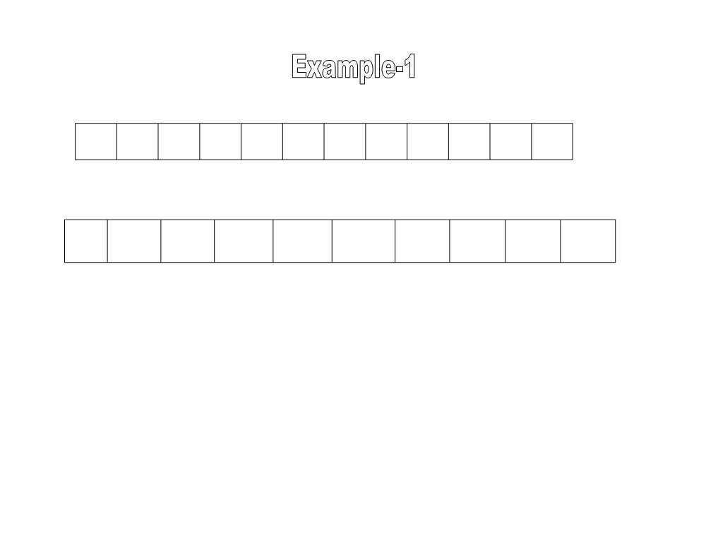
1 2 3
4 5 6 7
8 9 10
11 12
0 2 4
5 1 1 1
8 6 1
A
3 9
0
1
2
3
4
5
6
7
8
9
0
0
0
0
0
0
0
0
0
0
C
1 - for i = 0 to k
2 - do C[i] = 0

Slide 8
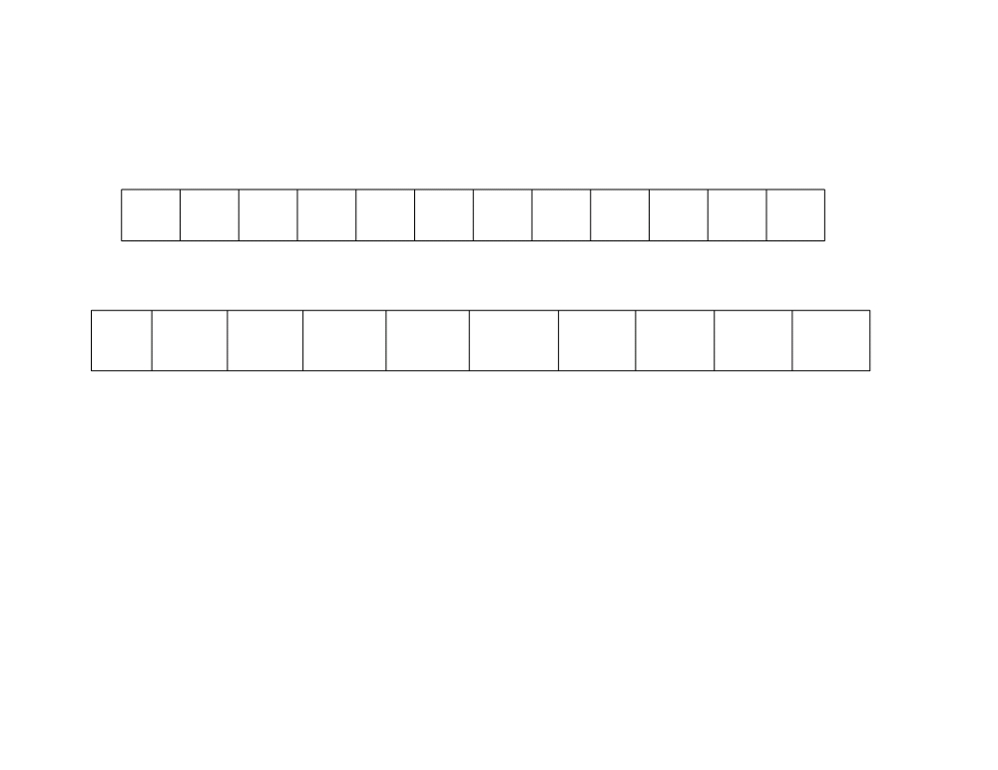
1 2 3
4 5 6 7
8 9 10
11 12
0 2 4
5 1 1 1
8 6 1
A
3 9
0
1
2
3
4
5
6
7
8
9
1
0
0
0
0
0
0
0
0
0
C
3 - for j = 1 to length [A]
for j = 1
4 - do C [A [j]] = C [A [j]] + 1
do C [A [1]] = C [A [1]] + 1 =>C [0] = C [0] + 1

Slide 9
1 2 3
4 5 6 7
8 9 10
11 12
0 2 4
5 1 1 1
8 6 1
A
3 9
0
1
2
3
4
5
6
7
8
9
1
0
1
0
0
0
0
0
0
0
C
3 - for j = 1 to length [A]
for j = 2
4 - do C [A [j]] = C [A [j]] + 1
do C [A [2]] = C [A [2]] + 1 =>C [2] = C [2] + 1

Slide 10
1 2 3
4 5 6 7
8 9 10
11 12
0 2 4
5 1 1 1
8 6 1
A
3 9
0
1
2
3
4
5
6
7
8
9
1
0
1
0
1
0
0
0
0
0
C
3 - for j = 1 to length [A]
for j = 3
4 - do C [A [j]] = C [A [j]] + 1
do C [A [3]] = C [A [3]] + 1 =>C [4] = C [4] + 1

Slide 11
1 2 3
4 5 6 7
8 9 10
11 12
0 2 4
5 1 1 1
8 6 1
A
3 9
0
1
2
3
4
5
6
7
8
9
1
0
1
0
1
1
0
0
0
0
C
3 - for j = 1 to length [A]
for j = 4
4 - do C [A [j]] = C [A [j]] + 1
do C [A [4]] = C [A [4]] + 1 =>C [5] = C [5] + 1

Slide 12
1 2 3
4 5 6 7
8 9 10
11 12
0 2 4
5 1 1 1
8 6 1
A
3 9
0
1
2
3
4
5
6
7
8
9
1
1
1
0
1
1
0
0
0
0
C
3 - for j = 1 to length [A]
for j = 5
4 - do C [A [j]] = C [A [j]] + 1
do C [A [5]] = C [A [5]] + 1 =>C [1] = C [1] + 1

Slide 13
1 2 3
4 5 6 7
8 9 10
11 12
0 2 4
5 1 1 1
8 6 1
A
3 9
0
1
2
3
4
5
6
7
8
9
1
2
1
0
1
1
0
0
0
0
C
3 - for j = 1 to length [A]
for j = 6
4 - do C [A [j]] = C [A [j]] + 1
do C [A [6]] = C [A [6]] + 1 =>C [1] = C [1] + 1

Slide 14
1 2 3
4 5 6 7
8 9 10
11 12
0 2 4
5 1 1 1
8 6 1
A
3 9
0
1
2
3
4
5
6
7
8
9
1
3
1
0
1
1
0
0
0
0
C
3 - for j = 1 to length [A]
for j = 7
4 - do C [A [j]] = C [A [j]] + 1
do C [A [7]] = C [A [7]] + 1 =>C [1] = C [1] + 1

Slide 15
1 2 3
4 5 6 7
8 9 10
11 12
0 2 4
5 1 1 1
8 6 1
A
3 9
0
1
2
3
4
5
6
7
8
9
1
3
1
0
1
1
0
0
1
0
C
3 - for j = 1 to length [A]
for j = 8
4 - do C [A [j]] = C [A [j]] + 1
do C [A [8]] = C [A [8]] + 1 =>C [8] = C [8] + 1

Slide 16
1 2 3
4 5 6 7
8 9 10
11 12
0 2 4
5 1 1 1
8 6 1
A
3 9
0
1
2
3
4
5
6
7
8
9
1
3
1
0
1
1
1
0
1
0
C
3 - for j = 1 to length [A]
for j = 9
4 - do C [A [j]] = C [A [j]] + 1
do C [A [9]] = C [A [9]] + 1 =>C [6] = C [6] + 1

Slide 17
1 2 3
4 5 6 7
8 9 10
11 12
0 2 4
5 1 1 1
8 6 1
A
3 9
0
1
2
3
4
5
6
7
8
9
1
4
1
0
1
1
1
0
1
0
C
3 - for j = 1 to length [A]
for j = 10
4 - do C [A [j]] = C [A [j]] + 1
do C [A [10]] = C [A [10]] + 1 =>C [1] = C [1] + 1

Slide 18
1 2 3
4 5 6 7
8 9 10
11 12
0 2 4
5 1 1 1
8 6 1
A
3 9
0
1
2
3
4
5
6
7
8
9
1
4
1
1
1
1
1
0
1
0
C
3 - for j = 1 to length [A]
for j = 11
4 - do C [A [j]] = C [A [j]] + 1
do C [A [11]] = C [A [11]] + 1 =>C [3] = C [3] + 1

Slide 19
1 2 3
4 5 6 7
8 9 10
11 12
0 2 4
5 1 1 1
8 6 1
A
3 9
0
1
2
3
4
5
6
7
8
9
1
4
1
1
1
1
1
0
1
1
C
3 - for j = 1 to length [A]
for j = 12
4 - do C [A [j]] = C [A [j]] + 1
do C [A [12]] = C [A [12]] + 1 =>C [9] = C [9] + 1

Slide 20
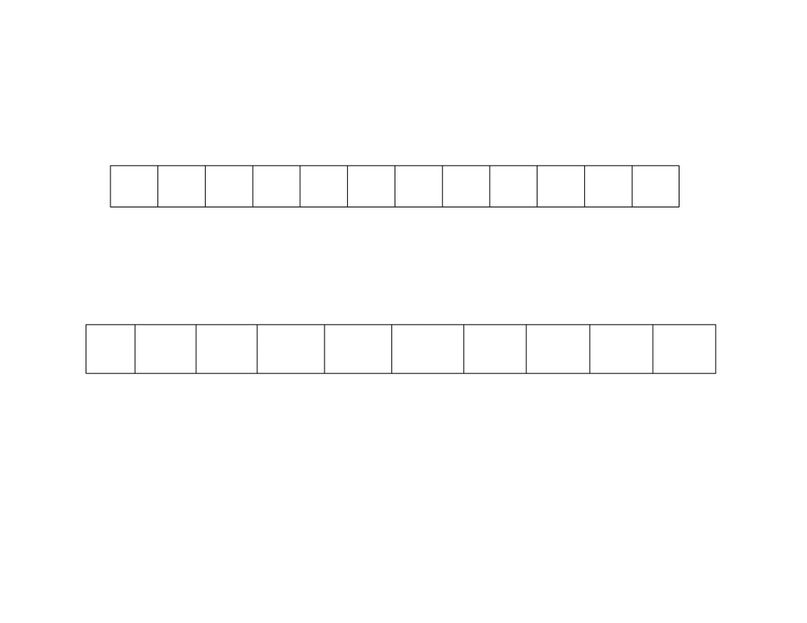
1 2 3
4 5 6 7
8 9 10
11 12
0 2 4
5 1 1 1
8 6 1
A
3 9
0
1
2
3
4
5
6
7
8
9
1
5
1
1
1
1
1
0
1
1
C
6 -
for i = 1 to k
7 -
do C [i] = C [i] + C[i-1]
C [1] = C [1] + C [0]

Slide 21
1 2 3
4 5 6 7
8 9 10
11 12
0 2 4
5 1 1 1
8 6 1
A
3 9
0
1
2
3
4
5
6
7
8
9
1
5
6
1
1
1
1
0
1
1
C
6 -
for i = 1 to k
7 -
do C [i] = C [i] + C[i-1]
C [2] = C [2] + C [1]

Slide 22
1 2 3
4 5 6 7
8 9 10
11 12
0 2 4
5 1 1 1
8 6 1
A
3 9
0
1
2
3
4
5
6
7
8
9
1
5
6
7
1
1
1
0
1
1
C
6 -
for i = 1 to k
7 -
do C [i] = C [i] + C[i-1]
C [3] = C [3] + C [2]

Slide 23
1 2 3
4 5 6 7
8 9 10
11 12
0 2 4
5 1 1 1
8 6 1
A
3 9
0
1
2
3
4
5
6
7
8
9
1
5
6
7
8
1
1
0
1
1
C
6 -
for i = 1 to k
7 -
do C [i] = C [i] + C[i-1]
C [4] = C [4] + C [3]

Slide 24
1 2 3
4 5 6 7
8 9 10
11 12
0 2 4
5 1 1 1
8 6 1
A
3 9
0
1
2
3
4
5
6
7
8
9
1
5
6
7
8
9
1
0
1
1
C
6 -
for i = 1 to k
7 -
do C [i] = C [i] + C[i-1]
C [5] = C [5] + C [4]

Slide 25
1 2 3
4 5 6 7
8 9 10
11 12
0 2 4
5 1 1 1
8 6 1
A
3 9
0
1
2
3
4
5
6
7
8
9
1
5
6
7
8
9
10
0
1
1
C
6 -
for i = 1 to k
7 -
do C [i] = C [i] + C[i-1]
C [6] = C [6] + C [5]

Slide 26
1 2 3
4 5 6 7
8 9 10
11 12
0 2 4
5 1 1 1
8 6 1
A
3 9
0
1
2
3
4
5
6
7
8
9
1
5
6
7
8
9
10
10
1
1
C
6 -
for i = 1 to k
7 -
do C [i] = C [i] + C[i-1]
C [7] = C [7] + C [6]

Slide 27
1 2 3
4 5 6 7
8 9 10
11 12
0 2 4
5 1 1 1
8 6 1
A
3 9
0
1
2
3
4
5
6
7
8
9
1
5
6
7
8
9
10
10
11
1
C
6 -
for i = 1 to k
7 -
do C [i] = C [i] + C[i-1]
C [8] = C [8] + C [7]

Slide 28
1 2 3
4 5 6 7
8 9 10
11 12
0 2 4
5 1 1 1
8 6 1
A
3 9
0
1
2
3
4
5
6
7
8
9
1
5
6
7
8
9
10
10
11
12
C
6 -
for i = 1 to k
7 -
do C [i] = C [i] + C[i-1]
C [9] = C [9] + C [8]

Slide 29
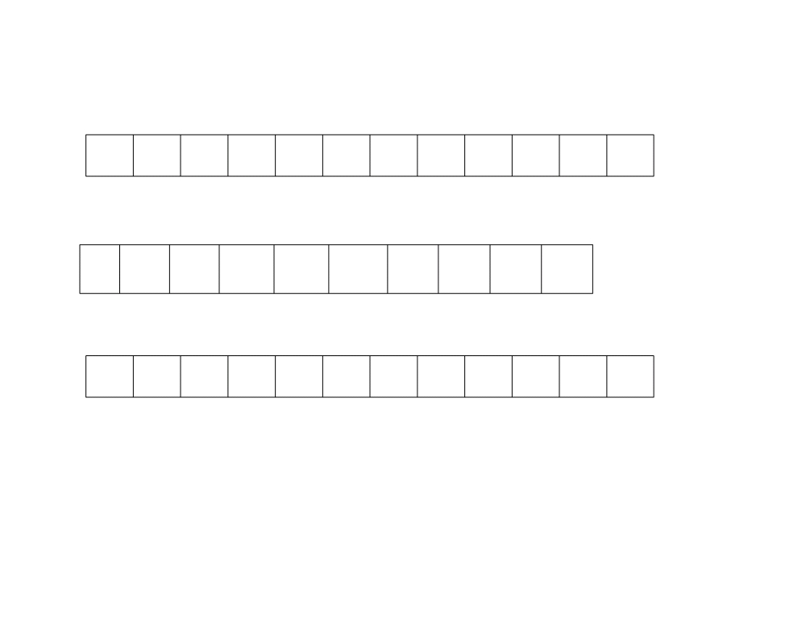
1
2
3
4
5
6
7
8
9
10
11
12
0
2
4
5
1
1
1
8
6
1
3
A
0
1
2
3
4
5
6
7
8
9
1 5 6 7
8 9 10
10 11 11
C
1
2
3
4
5
6
7
8
9
10
11
12
9 B
9 for j = length [A] down to 1 10 do B [C [A [j]]] = A [j] 11 C [A [j]] = C[A[J]] - 1
for j =12
do B [C [A [12]]] = A [12] ⇒B [C [9]] = 9 =>B [12] = 9 C [A [12]] = C[A[12]] - 1 =>C [9] = C[9] - 1

Slide 30
1
2
3
4
5
6
7
8
9
10
11
12
0
2
4
5
1
1
1
8
6
1
A
0
1
2
3
4
5
6
7
8
9
1 5 6 6
8 9 10
10 11 11
C
1
2
3
4
5
6
7
8
9
10
11
12
3
9
B
9 for j = length [A] down to 1 10 do B [C [A [j]]] = A [j] 11 C [A [j]] = C[A[J]] - 1
for j =11
do B [C [A [11]]] = A [11] ⇒B [C [3]] = 3 =>B [7] = 3 C [A [11]] = C[A[11]] - 1 =>C [3] = C[3] - 1

Slide 31
1
2
3
4
5
6
7
8
9
10
11
12
0
2
4
5
1
1
1
8
6
A
0
1
2
3
4
5
6
7
8
9
1 4 6 6
8 9 10
10 11 11
C
1
2
3
4
5
6
7
8
9
10
11
12
1
3
9
B
9 for j = length [A] down to 1 10 do B [C [A [j]]] = A [j] 11 C [A [j]] = C[A[J]] - 1
for j =10
do B [C [A [10]]] = A [10] ⇒B [C [1]] = 1 =>B [5] = 1 C [A [10]] = C[A[10]] - 1 =>C [1] = C[1] - 1

Slide 32
1
2
3
4
5
6
7
8
9
10
11
12
0
2
4
5
1
1
1
8
A
0
1
2
3
4
5
6
7
8
9
1 4 6 6
8 9 9
10 11 11
C
1
2
3
4
5
6
7
8
9
10
11
12
1
3
6
9
B
9 for j = length [A] down to 1 10 do B [C [A [j]]] = A [j] 11 C [A [j]] = C[A[J]] - 1
for j =9
do B [C [A [9]]] = A [9] ⇒B [C [6]] = 6 =>B [10] = 6 C [A [9]] = C[A[9]] - 1 =>C [6] = C[6] - 1

Slide 33
1
2
3
4
5
6
7
8
9
10
11
12
0
2
4
5
1
1
1
A
0
1
2
3
4
5
6
7
8
9
1 4 6 6
8 9 9
10 10 11
C
1
2
3
4
5
6
7
8
9
10
11
12
1
3
6
8
9
B
9 for j = length [A] down to 1 10 do B [C [A [j]]] = A [j] 11 C [A [j]] = C[A[J]] - 1
for j =8
do B [C [A [8]]] = A [8] ⇒B [C [8]] = 8 =>B [11] = 8 C [A [8]] = C[A[8]] - 1 =>C [8] = C[8] - 1

Slide 34
1
2
3
4
5
6
7
8
9
10
11
12
0
2
4
5
1
1
A
0
1
2
3
4
5
6
7
8
9
1 3 6 6
8 9 9
10 10 11
C
1
2
3
4
5
6
7
8
9
10
11
12
1
1
3
6
8
9
B
9 for j = length [A] down to 1 10 do B [C [A [j]]] = A [j] 11 C [A [j]] = C[A[J]] - 1
for j =7
do B [C [A [7]]] = A [7] ⇒B [C [1]] = 1 =>B [4] = 1 C [A [7]] = C[A[7]] - 1 =>C [1] = C[1] - 1

Slide 35
1
2
3
4
5
6
7
8
9
10
11
12
0
2
4
5
1
A
0
1
2
3
4
5
6
7
8
9
1 2 6 6
8 9 9
10 10 11
C
1
2
3
4
5
6
7
8
9
10
11
12
1
1
1
3
6
8
9
B
9 for j = length [A] down to 1 10 do B [C [A [j]]] = A [j] 11 C [A [j]] = C[A[J]] - 1
for j =6
do B [C [A [6]]] = A [6] ⇒B [C [1]] = 1 =>B [3] = 1 C [A [6]] = C[A[6]] - 1 =>C [1] = C[1] - 1

Slide 36
1
2
3
4
5
6
7
8
9
10
11
12
0
2
4
5
A
0
1
2
3
4
5
6
7
8
9
1 1 6 6
8 9 9
10 10 11
C
1
2
3
4
5
6
7
8
9
10
11
12
1
1
1
1
3
6
8
9
B
9 for j = length [A] down to 1 10 do B [C [A [j]]] = A [j] 11 C [A [j]] = C[A[J]] - 1
for j =5
do B [C [A [5]]] = A [5] ⇒B [C [1]] = 1 =>B [2] = 1 C [A [5]] = C[A[5]] - 1 =>C [1] = C[1] - 1

Slide 37
1
2
3
4
5
6
7
8
9
10
11
12
0
2
4
A
0
1
2
3
4
5
6
7
8
9
1 1 6 6
8 8 9
10 10 11
C
1
2
3
4
5
6
7
8
9
10
11
12
1
1
1
1
3
5
6
8
9
B
9 for j = length [A] down to 1 10 do B [C [A [j]]] = A [j] 11 C [A [j]] = C[A[J]] - 1
for j =4
do B [C [A [4]]] = A [4] ⇒B [C [5]] = 5 =>B [9] = 5 C [A [4]] = C[A[4]] - 1 =>C [5] = C[5] - 1

Slide 38
1
2
3
4
5
6
7
8
9
10
11
12
0
2
A
0
1
2
3
4
5
6
7
8
9
1 1 6 6
7 8 9
10 10 11
C
1
2
3
4
5
6
7
8
9
10
11
12
1
1
1
1
3
4
5
6
8
9
B
9 for j = length [A] down to 1 10 do B [C [A [j]]] = A [j] 11 C [A [j]] = C[A[J]] - 1
for j =3
do B [C [A [3]]] = A [3] ⇒B [C [4]] = 4 =>B [8] = 4 C [A [3]] = C[A[3]] - 1 =>C [4] = C[4] - 1

Slide 39
1
2
3
4
5
6
7
8
9
10
11
12
0
A
0
1
2
3
4
5
6
7
8
9
1 1 5 6
7 8 9
10 10 11
C
1
2
3
4
5
6
7
8
9
10
11
12
1
1
1
1
2
3
4
5
6
8
9
B
9 for j = length [A] down to 1 10 do B [C [A [j]]] = A [j] 11 C [A [j]] = C[A[J]] - 1
for j =2
do B [C [A [2]]] = A [2] ⇒B [C [2]] = 2 =>B [6] = 2 C [A [2]] = C[A[2]] - 1 =>C [2] = C[2] - 1

Slide 40
1
2
3
4
5
6
7
8
9
10
11
12
A
0
1
2
3
4
5
6
7
8
9
0 1 5 6
7 8 9
10 10 11
C
1
2
3
4
5
6
7
8
9
10
11
12
0
1
1
1
1
2
3
4
5
6
8
9
B
9 for j = length [A] down to 1 10 do B [C [A [j]]] = A [j] 11 C [A [j]] = C[A[J]] - 1
for j =1
do B [C [A [1]]] = A [1] ⇒B [C [0]] = 0 =>B [1] = 0 C [A [1]] = C[A[1]] - 1 =>C [0] = C[0] - 1

Slide 41
Analysis COUNTING SORT(A,B,k)
1 for i = 0 to k
2
do C[i] = 0
3 for j = 1 to length[A]
4
do C[A[j]] = C[A[j]] + 1
5 //C[i] now contains the number of elements equal to i
6 for i = 1 to k
7
do C[i] = C[i] + C[i-1]
8 //C[i] now contains the number of elements less than or equal to i
9 for j = length[A] downto 1
10
do B[C[A[j]]] = A[j]
11
C[A[j]] = C[A[J]] - 1

Slide 42
Analysis of Algorithm
The first for loop initializes C[ ] to zero.
The second for loop increments the values in C[], according to their frequencies in the data.
The third for loop adds all previous values, making C[] contain a cumulative total.
The fourth for loop writes out the sorted data into array B[].
Running time: O(n+k)

Slide 43
Two of the for loops take O(k) time, and two take O(n) time.
The algorithm makes two passes over A and two pass over C. If size of the range k is smaller than size of input n, then time complexity=O(n).
An important point to note is that Counting Sort is stable: All elements of the same value will appear in the same order in the output array that they do in the input array.
Suitable if range is less
The major disadvantage is that counting sort can be used only to sort integers, because otherwise the array of frequencies cannot be constructed.

Slide 44
Count sort in Descending order
6 4 1 3 4 1 4

Slide 45

Home Task
3 6 4 1 3 4 1 4

Slide 46
Thank you

