Slide 1
CS302 Design and Analysis of Algorithm
9

Slide 2
Design and Analysis of Algorithms Maximum-subarray problem

Slide 3
Maximum Subarray Problem
You can buy a unit of stock, only one time, then sell it at a later date
Buy/sell at end of day
Strategy: buy low, sell high
Assume you know future prices
Can you maximize profit by buying at lowest price and selling at highest price?

Slide 4
Problem
Look at the daily in price
E.g price on days
(88 initial price then 100, 97, 73, 93, 90, 74, 51, 69, 89, 82, 94, …..)
Find contiguous subarray with largest sum
maximum subarray
E.g.: when to buy and when to sale

Slide 5
Transformation
Find sequence of days so that:
the net change from last to first is maximized
Look at the daily change in price
E.g price on days
(88 initial price then 100, 97, 73, 93, 90, 74, 51, 69, 89, 82, 94, …..)
Change on day i: price day i minus price day i-1
We now have an array of changes (numbers), e.g.
12,-3,-24,20,-3,-16,-23,18,20,-7,12,-5,-22,14,-4,6
Find contiguous subarray with largest sum
maximum subarray
E.g.: when to buy and when to sale

Slide 6
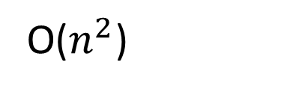
10 (Init) | 11 | 7 | 10 | 12
Target array :
1
-4
3
2
What is a maximum subarray?
1
1
All the sub arrays:
-4
-4
3
3
2
The subarray with the largest sum
2
1
-4
-3
-4
3
-1
Max!
3
2
5
What is the brute-force T(n)?
1
-4
3
0
-4
3
2
1
O($n^{2}$)
1
-4
3
2
2

Slide 7


Slide 8
Maximum-subarray
Can we do it in a divide-and-conquer manner?
Yes, we can

Slide 9
Target array :
1
-4
3
2
Divide target array into 2 arrays
1
1
We then have 3 types of subarrays:
All the sub arrays:
-4
-4
The problem can be then solved by:
The ones belong to the left array
3
3
1. Find the max in left sub arrays
The ones belong to the right array
2
2
2. Find the max in right sub arrays
1
-4
-3
The ones crossing the mid point
-4
3
-1
3. Find the max in crossing sub arrays
3
2
5
1
-4
3
0
4. Choose the largest one from those 3 as the final result
-4
3
2
1
1
-4
3
2
2

Slide 10
How to find the max subarray crossing the midpoint?
1
-4
3
2
Find the left part
-4
Sum=-4
1
-4
Sum=-3
largest
Find the right part
3
Sum=3
3
2
Sum=5
largest
The largest crossing subarray is :

Slide 11
The whole algorithm
1
-4
3
2
FindMaxSub ( )
1. Find the max in left sub arrays
1
-4
FindMaxSub ( )
2. Find the max in right sub arrays
3
2
FindMaxSub ( )
3. Find the max in crossing sub arrays
1
-4
3
2
Scan once, and scan once
4. Choose the largest one from those 3 as the final result

Slide 12

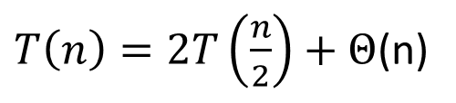
Maximum-subarray problem – divide-and-conquer algorithm
Input: array A[i, …, j]
Ouput: sum of maximum-subarray, start point of maximum-subarray, end point of maximum-subarray
FindMaxSubarray:
if(j<=i) return (A[i], i, j);
mid = floor(i+j);
(sumCross, startCross, endCross) = FindMaxCrossingSubarray(A, i, j, mid);
(sumLeft, startLeft, endLeft) = FindMaxSubarray(A, i, mid);
(sumRight, startRight, endRight) = FindMaxSubarray(A, mid+1, j);
Return the largest one from those 3
$T\left(n\right)=2T\left(\frac{n}{2}\right)+Θ$(n)
$$O\left(nlgn\right)$$
Time complexity?

Slide 13
Maximum-subarray problem – divide-and-conquer algorithm
FindMaxCrossingSubarray(A, i, j, mid)
Scan A[i, mid] once, find the largest A[left, mid]
Scan A[mid+1, j] once, find the largest A[mid+1, right]
Return (sum of A[left, mid] and A[mid+1, right], left, right)
Try it in C++

Slide 14
Example on Maximum sub array
7, -2, 14, -7, 4, -3, 5,0

Slide 15
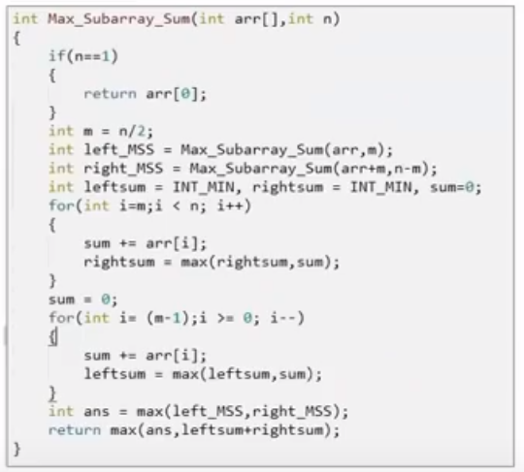

Slide 16

Can be solve in O(n)??????

Slide 17
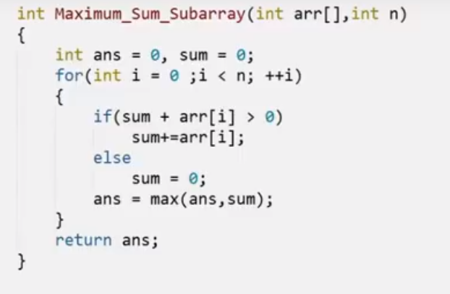
Kadanes Algorithm

Slide 18
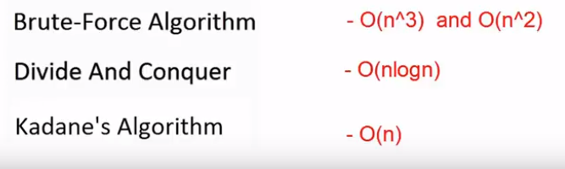
Time complexity

