Slide 1


Proposal Defense
Supervisor
Team Members
Mr. Usman Ghous
19F-0170 Danish Ahmad
19F-0228 Muhammad Zain
19F-0328 Muhammad Umar
Co-Supervisor
Dr Umar Aftab

Slide 2
Introduction
01.
Animals are one of the most common and important parts of our daily life.
02.
With our system, people can engage and solve their daily life queries about their pets and other stray animals.
03.
So, our project is based on a community filled with animal enthusiasts.
01.

Slide 3
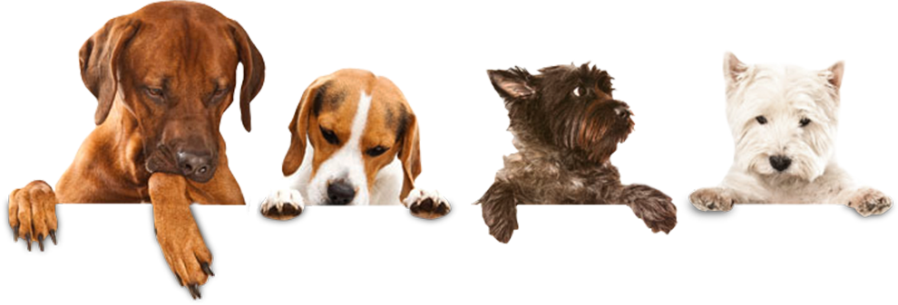
Problem Statement
.
Taking care of pets is not easy at all. They require the same amount
of love and care as human beings.
.
Many pet owners do not have enough knowledge about how to take care of their pets.
.
There are numerous health issues that arise in animals due to a lack
of awareness and education among pet owners.
02.

Slide 4
Motivation
01.
We need a community to develop an interest about pets and their needs.
02.
There is a need for a system to educate pet owners that how to take care of their pets.
03.
It will also provide earning opportunities to people related to animal businesses and fields.
03.

Slide 5
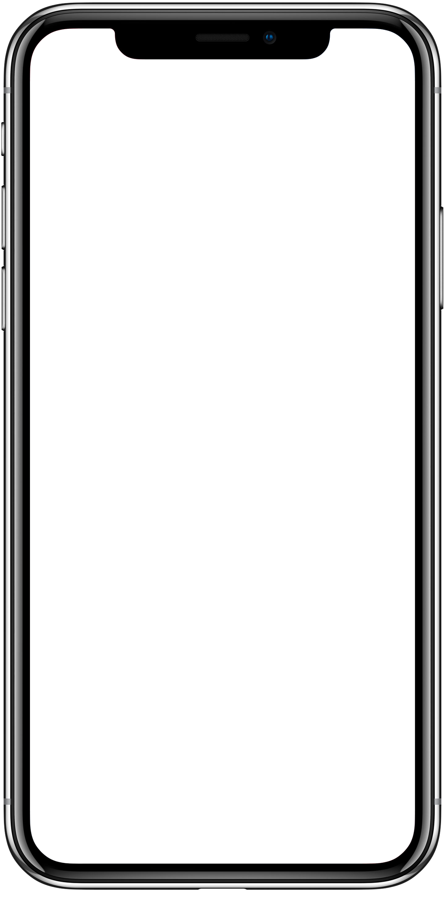
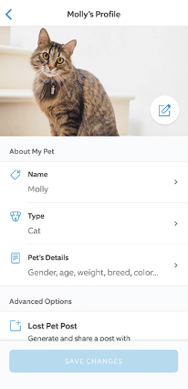
Proposed Solution
.
Pet Book will provide a community to solve daily
life problems related to pets faced by their owners.
.
It also provides an earning opportunity for vets,
animal experts, and other animal business entities.
.
Our system will provide an authentic marketplace
for buying and selling pets and animal accessories.
04.

Slide 6
Modules/Features
.
.
Authentication
Pet Shows
.
.
Buying and selling
Pet trainers
.
.
Alerts
Animal Photography
.
.
Blogs
Communication with experts
.
.
Ads Posting
Animal Shelters
.
.
Nearby pet shops
Rent a pet
.
.
Food and Habitat
Filters
05.
Notes:
Lo..last walay b implement krnay hain
st pet

Slide 7






Tools & Technologies
01.
02.
03.
04.
05.
06.
Flutter
Firebase
Google Maps
Figma
Photoshop
GitHub
App Dev
Backend
Location Tracking
Prototyping
Illustrations
Version Control
06.

Slide 8
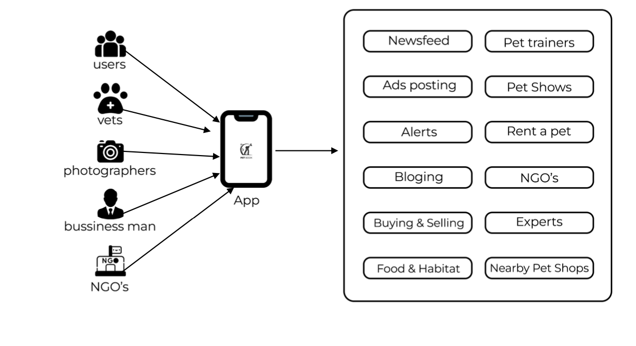
High Level Diagram
07.

Slide 9
Related Projects
Petgeeks
Adoptpets
08.

Slide 10

Any Suggestions?

Slide 11
Thank you!

