Slide 1


Proposal Defense
Supervisor
Team Members
Mr. Usman Ghous
19F-0170 Danish Ahmad
19F-0228 Muhammad Zain
19F-0328 Muhammad Umar
Co-Supervisor
Dr Umar Aftab

Slide 2
Introduction
01.
Animals are one of the most common and important parts of daily life. So, our project is based on a community filled with pet enthusiasts.
02.
With our system, people can engage and solve their daily life queries about their pets and other stray animals.
03.
So, our project is based on a community filled with animal enthusiasts.
01.

Slide 3
Modules/Features
.
.
Chat
Payments
.
.
Newsfeed
Contact NGO’s
.
.
Alerts
Nearby Pet shops
.
.
Post Ad’s
Avail Services
.
.
Pet Shows
Search Items
.
.
Rent/Adopt Pet’s
Authentic Pet
.
Add to cart
02.

Slide 4
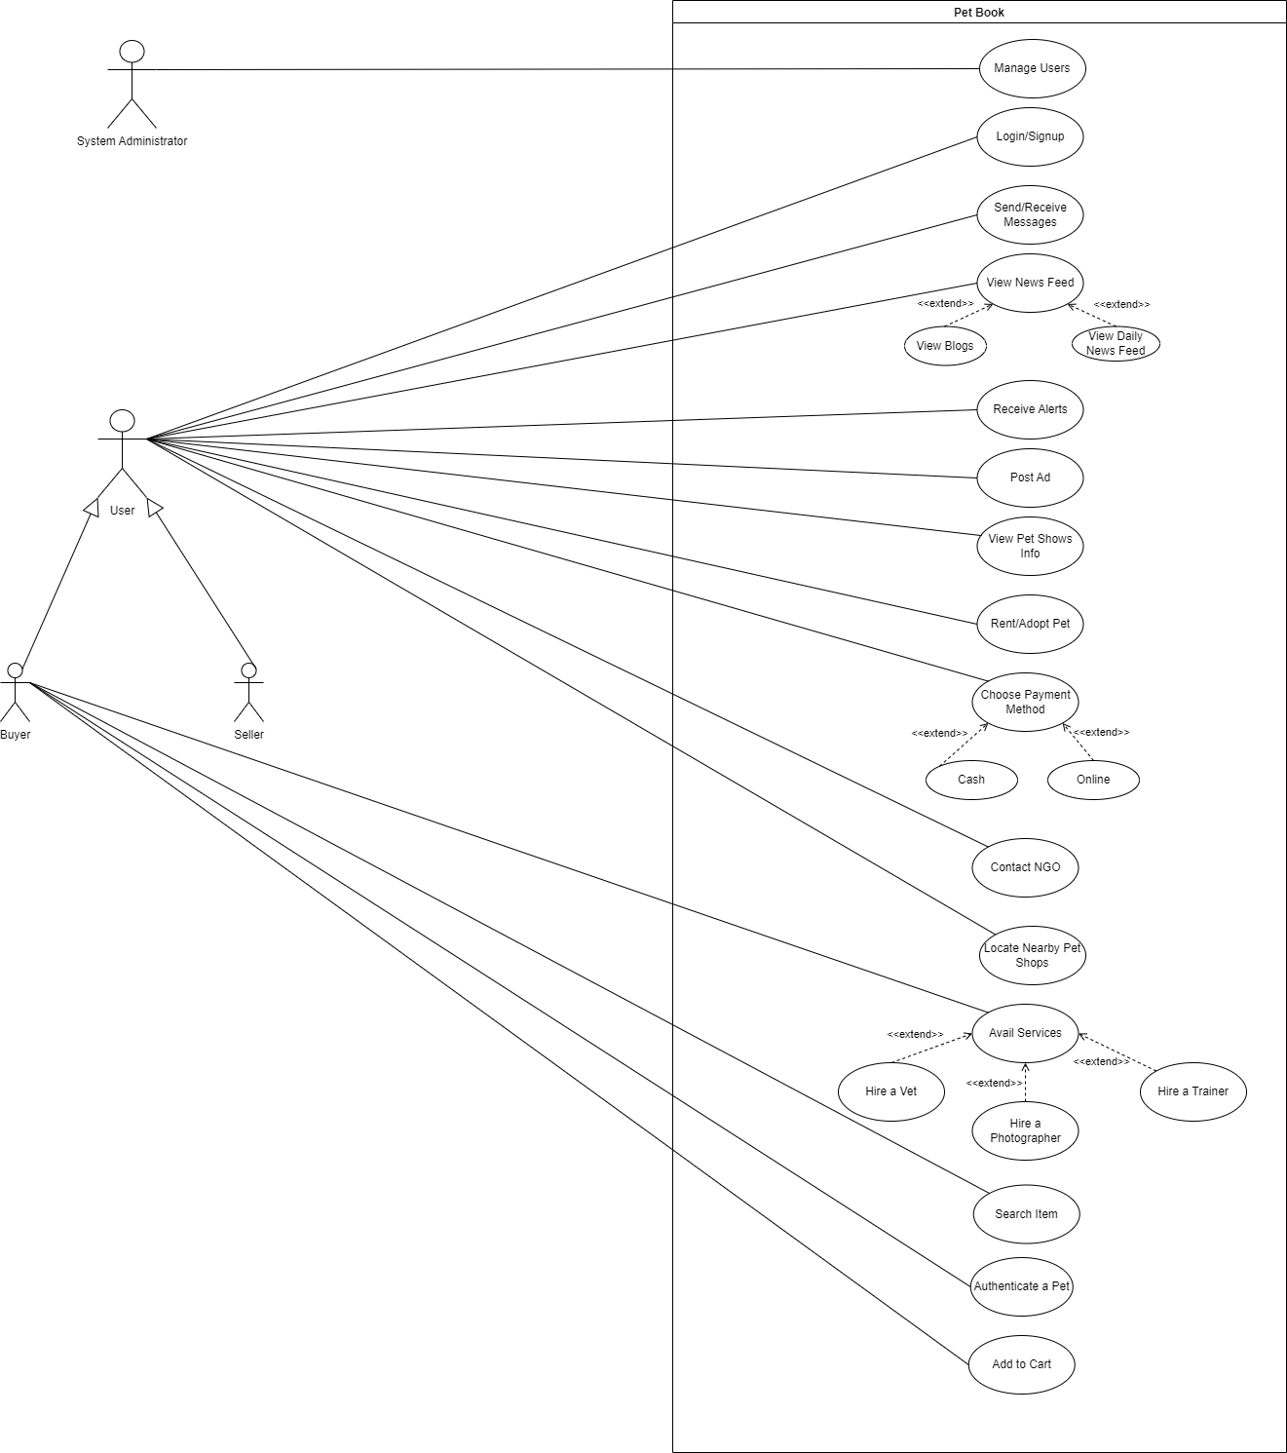
Use Case Diagram

Slide 5
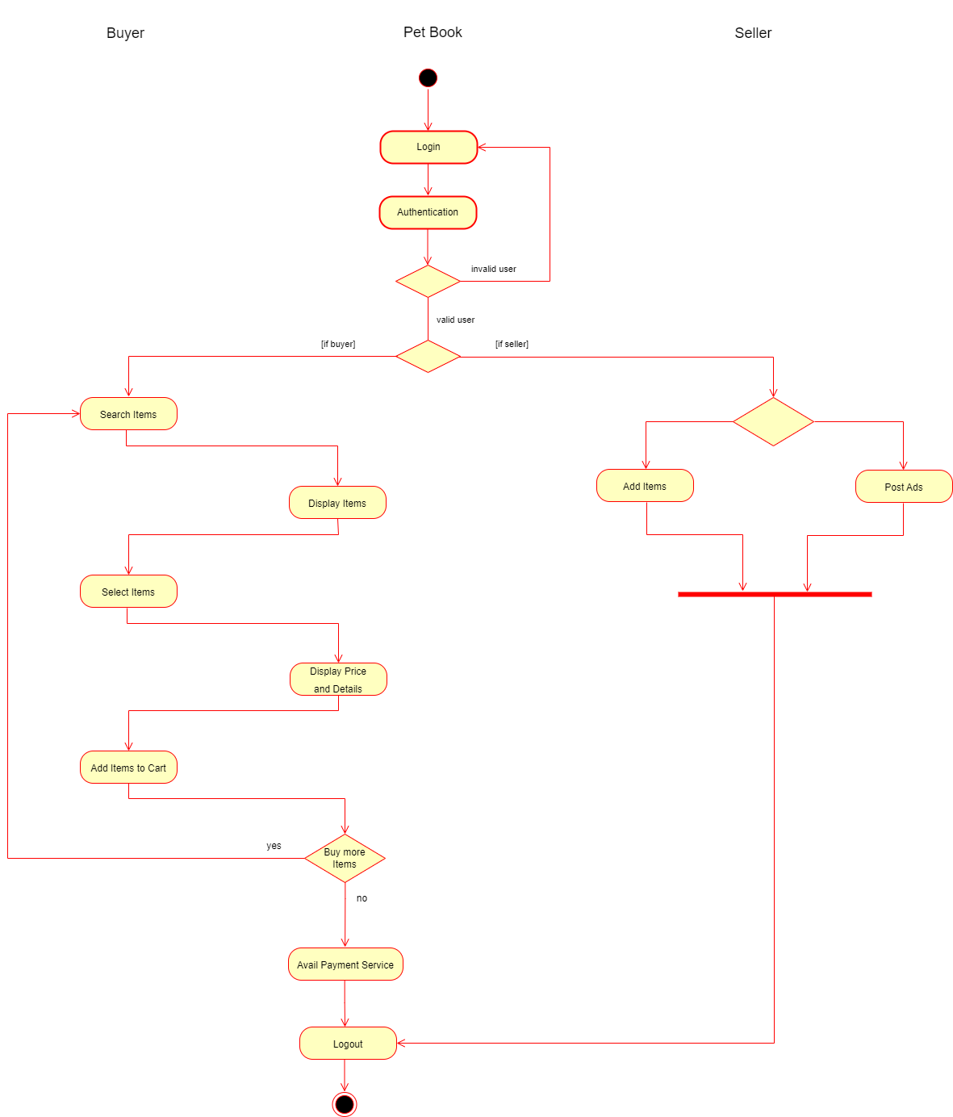

Slide 6
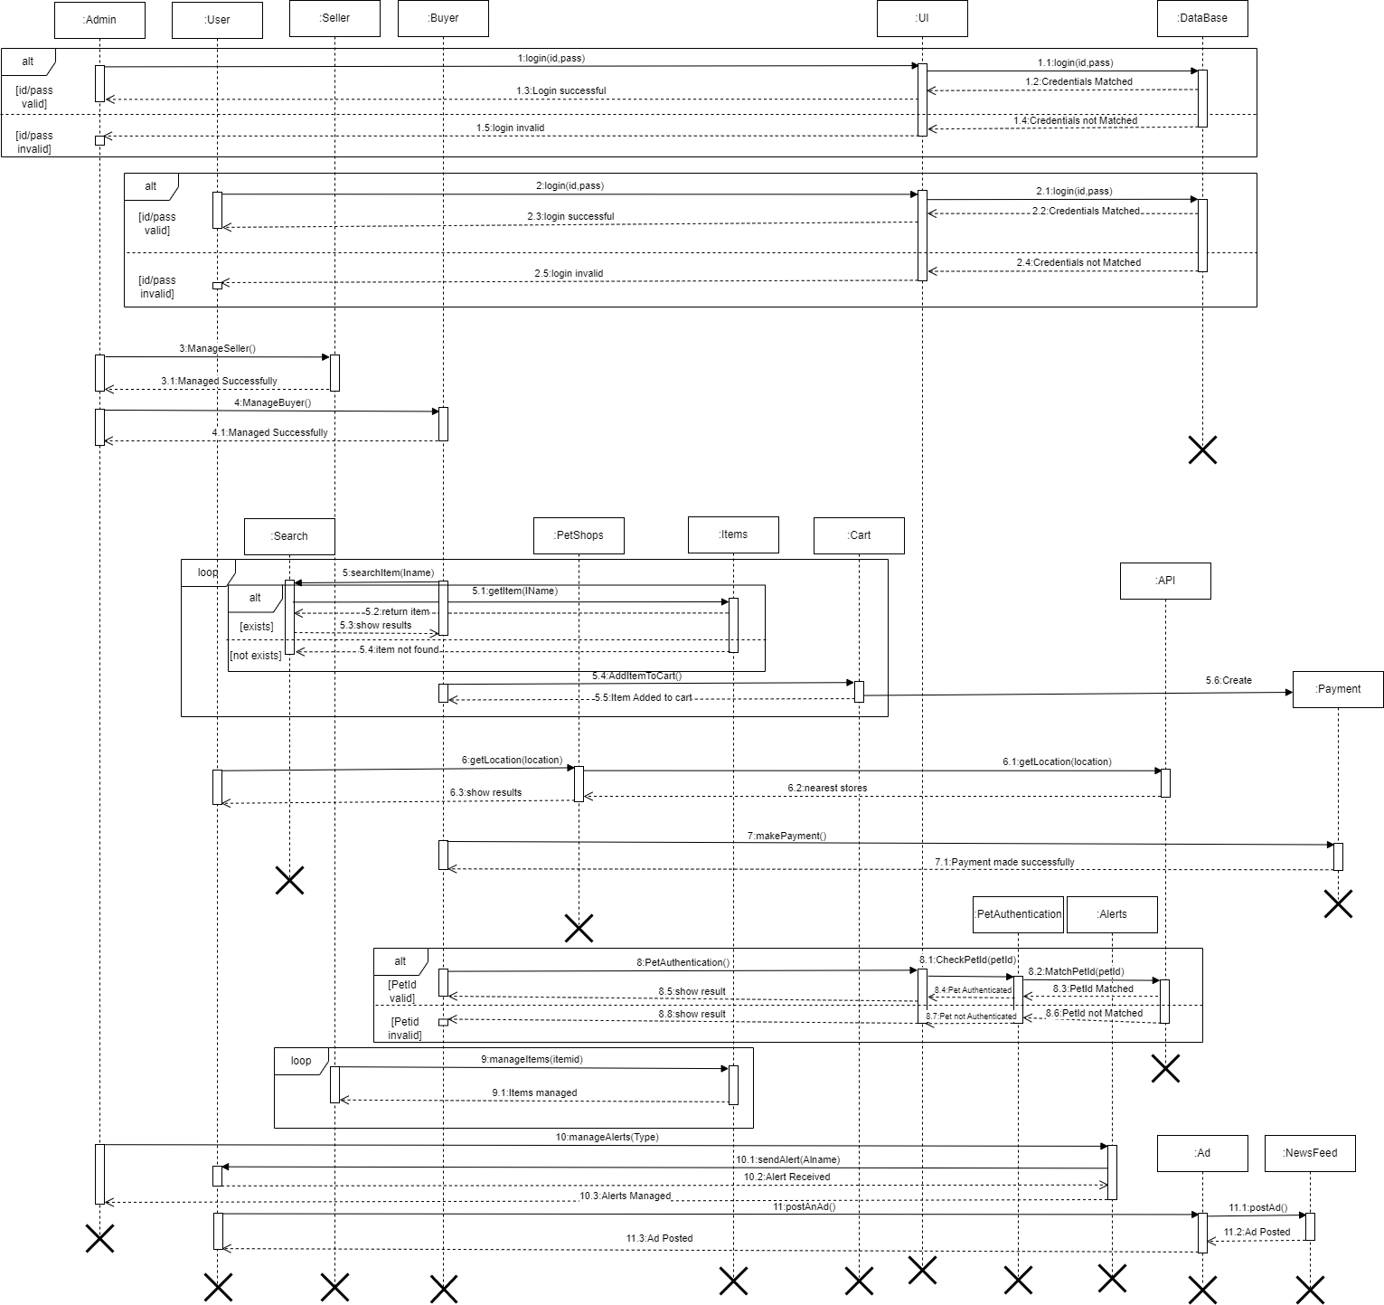
Sequence
Diagram

Slide 7
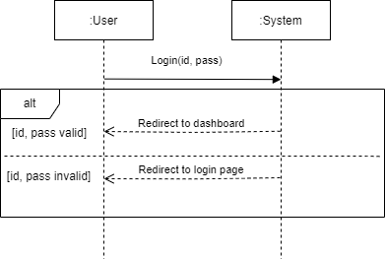
SSD
Login/Signup

Slide 8
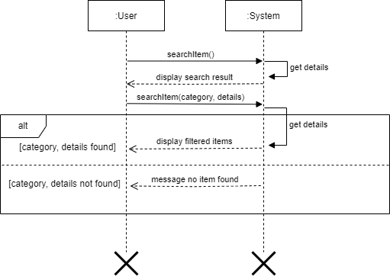
SSD
Search Item

Slide 9
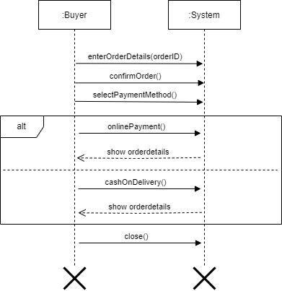
SSD
Choose Payment Method

Slide 10
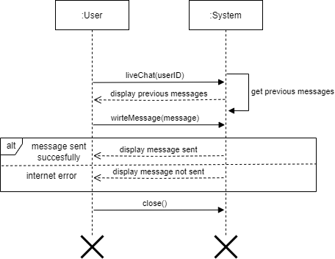
SSD
Send/Receive Messages

Slide 11
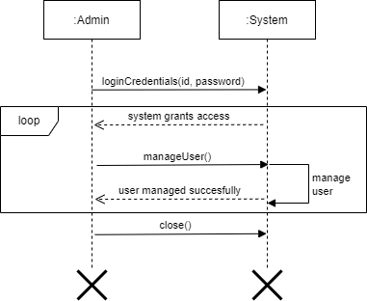
SSD
Manage User

Slide 12
SSD
Manage User

Slide 13
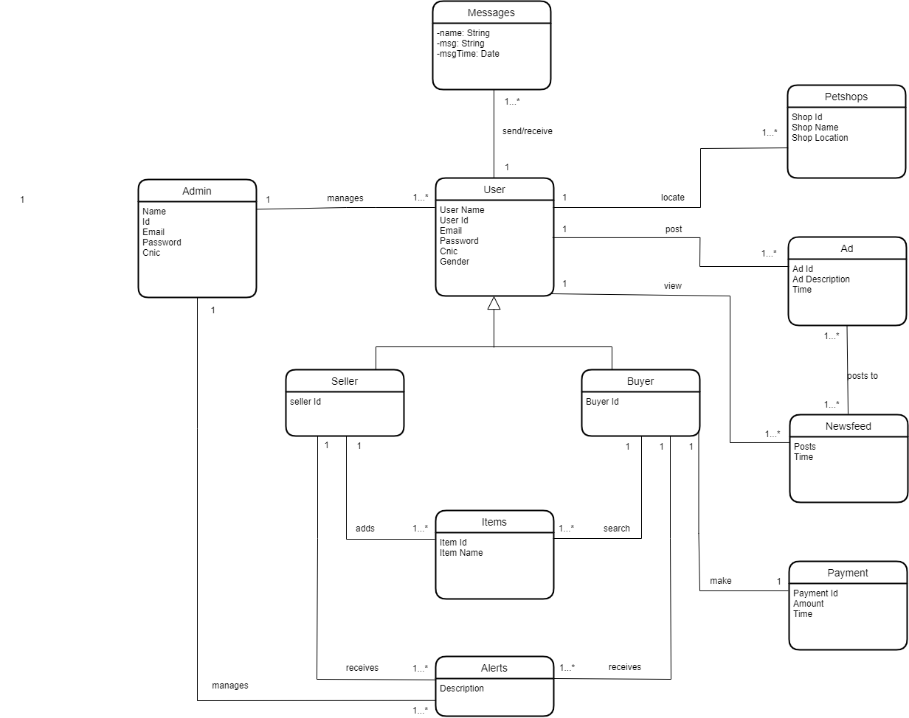
Domain Model

Slide 14
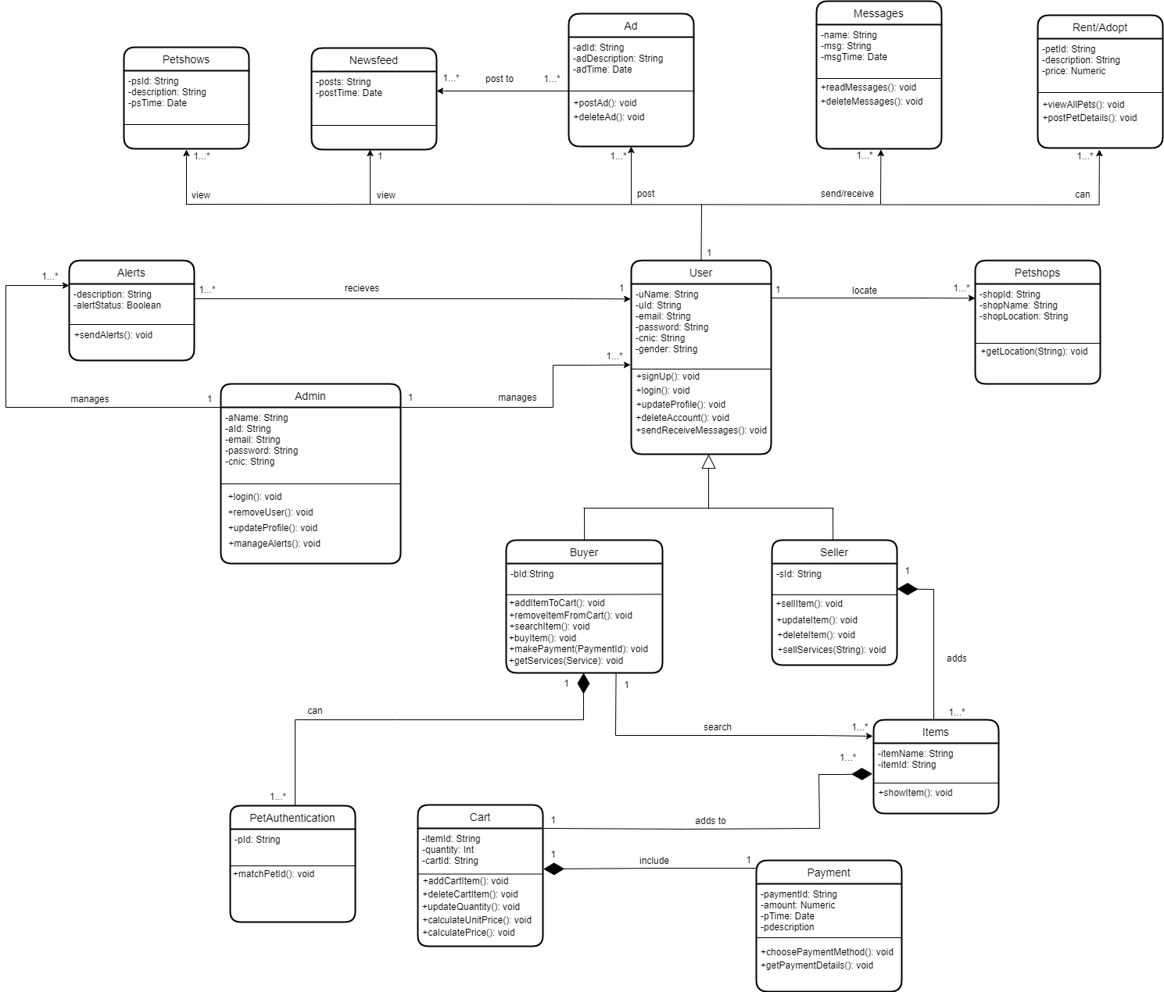
Class
Diagram

Slide 15
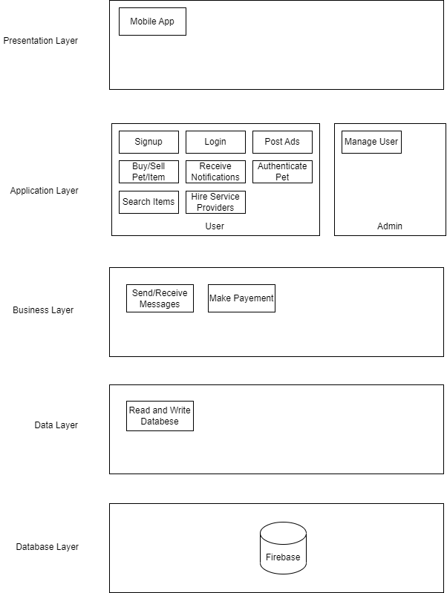
Layer
Diagram

Slide 16
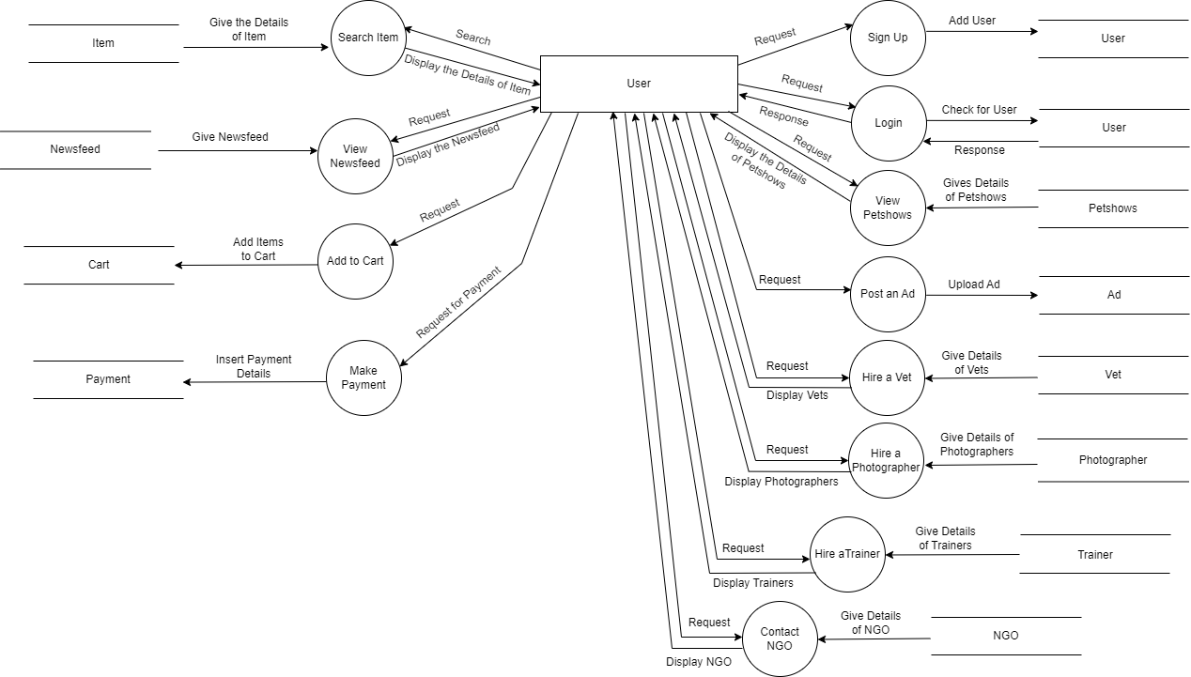
DFD

Slide 17
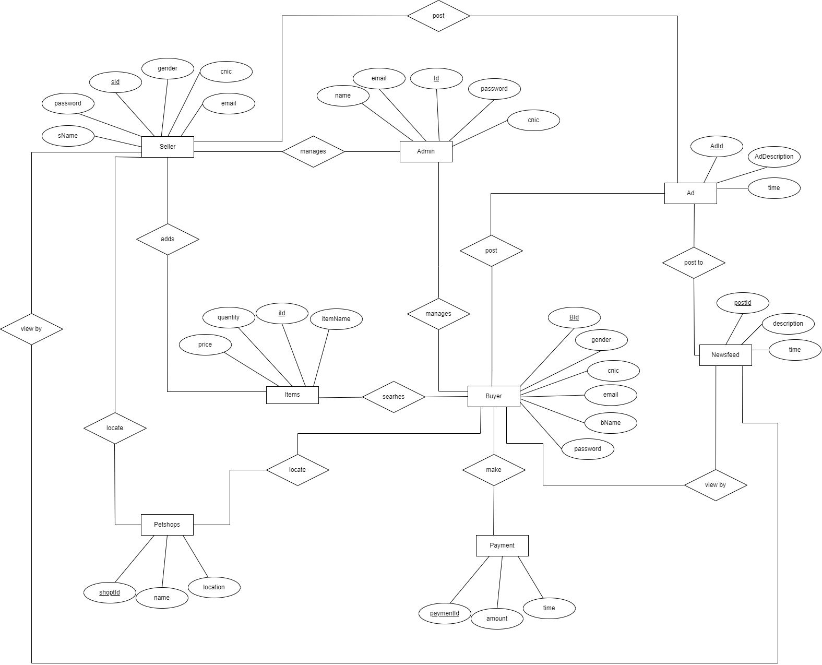
ERD

Slide 18
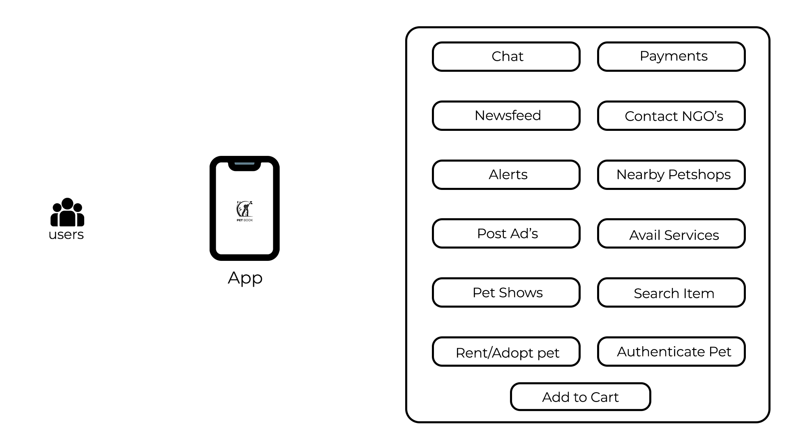
Architecture Diagram

Slide 19
Committed Use Cases
Login/Signup
View Newsfeed
Post Ad’s
Search Items
Locate Nearby Pet Shops

Slide 20
Thank you!

