Slide 1
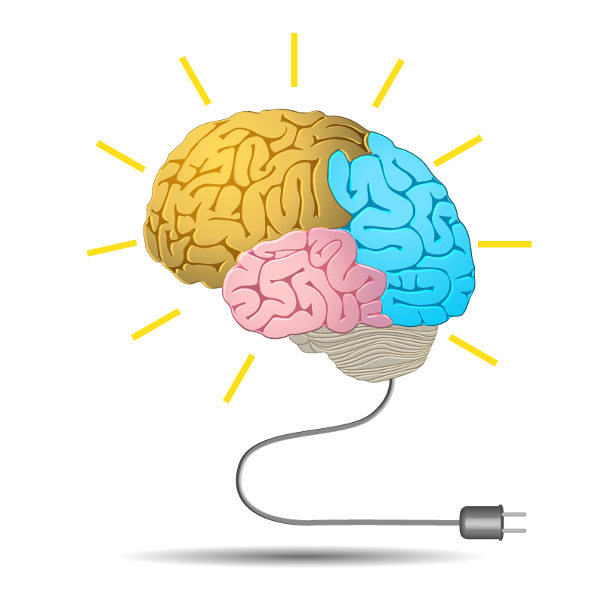


MEMORY
Miss Aisha Bano
aisha.bano@nu.edu.pk

Slide 2

Memory
The ability to retain knowledge
(Cacioppo & Freberg, 2013)
The process by which we encode, store, and retrieve information. (Feldman, 2011)
Information Processing
A continuum including attention, sensation, perception, learning, memory and cognition.

Slide 3



Memory Processes
3 R ’s of Memory
01
Recording
(encoding)
Retrieval
(recall)
Retention
(storage)
03
02

Slide 4

Recording
(ENCODING)
The process of transforming information into a form that can be entered and retained in the memory system.
The process of transforming the information from one form to another is called recording.
(Feldman, 2011)
start now
information

Slide 5

Retention
(STORAGE)
The process of retaining information in memory so that it can be used later.
The process of storing the information is called retention.
(Feldman, 2011)
start now
information

Slide 6

Retrieval
(RECALL)
The process of recovering information stored in memory so that we are consciously aware of it.
The recovery of stored information is called retrieval. (Feldman, 2011)
start now
information

Slide 7
THREE STAGES OF MEMORY
Three memory stores that differ in function, capacity and duration are :
01
02
03
Sensory
memory
Short-term
memory
Long-term
memory
(also called working memory)

Slide 8
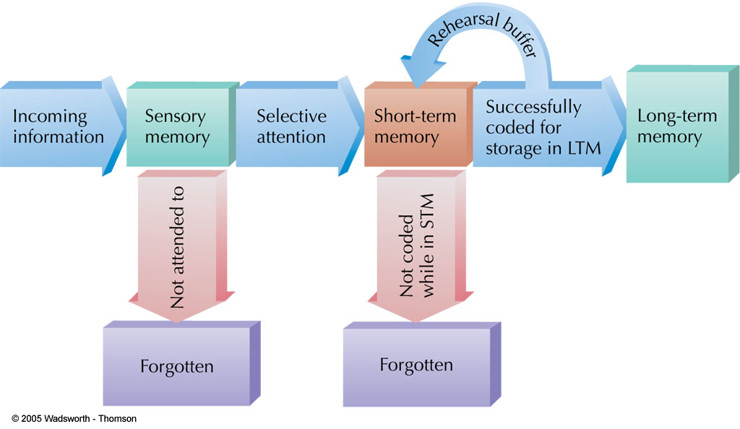
STAGES OF MEMORY

Slide 9


1. Sensory Memory
The first stage of A-S (Atkinson-Shiffrin) model that holds large amounts of incoming data for very brief amounts of time. (Cacioppo & Freberg, 2013)
The initial, momentary storage of information, lasting only an instant.
(Feldman, 2011)

Slide 10
Sensory Memory
Function : process for basic physical characteristics
Capacity : large
can hold many items at once
Duration : very brief retention of images
3 sec for visual info
2 sec for auditory info
Divided into two types:
iconic memory–visual information
echoic memory– auditory information
Attention is needed to transfer information to working memory
Sensory
Memory
Sensory
Input

Slide 11


Sensory Memory
Visual sensory memory brief memory of an image or icon. Also called iconic memory.
Auditory sensory memory brief memory of a sound or echo. Also called echoic memory.

Slide 12

2. Short-Term Memory
(STM) /( Working Memory)
The second stage of A-S model that holds a small amount of information for a limited time. (Cacioppo & Freberg, 2013)
Memory that holds information for 15-25 seconds called STM. (Feldman, 2011)

Slide 13
3. Short-Term Memory
(STM) /( Working Memory)
Function : conscious processing of information
where information is actively worked on
Capacity : limited (holds 7+/-2 items)
Duration : brief storage (about 25 Sec)
Sensory
Memory
Working or
Short-term
Memory
Sensory
Input
Attention

Slide 14
Maintenance Rehearsal of STM
Maintenance
Rehearsal
Sensory
Memory
Working
or
Short-term
Sensory
Input
Attention

Slide 15

CHUNKING
A meaningful grouping of stimuli that can be stored as a unit in Short Term Memory. (Feldman, 2011)
The process of grouping similar or meaningful information together.
(Cacioppo & Freberg, 2013)
Chunks expand working memory load

Slide 16
ACTIVITY
Which is easier to remember?
4 8 3 7 9 2 5 1 6
483 792 516
t h e o c e a n i s b l u e a n d b e a u t I f u l
The ocean is blue and beautiful

Slide 17

Long-Term Memory (LTM)
The final stage of the A-S Model that is the location of permanent memory.
(Cacioppo & Freberg, 2013)
Memory that stores information on a relatively permanent basis, although it may be difficult to retrieve. (Feldman, 2011)
start now
information

Slide 18
Long-Term Memory (LTM)
Once information passes from sensory to working memory, it can be encoded into long-term memory.
Function—LTM
organizes and stores information
more passive form of storage than working memory
Capacity: Unlimited
Duration—Relatively permanent
start now
information

Slide 19

Maintenance Rehearsal of LTM
Maintenance Rehearsal
Sensory
Memory
Working
or
Short-term
Long Term
Memory
Attention
Encoding
Sensory
Input
Retrieval

Slide 20
Long-Term Memory (LTM)
Encoding—process that controls movement from working to long-term memory store
Retrieval—process that controls flow of information from long-term to working memory store

Slide 21

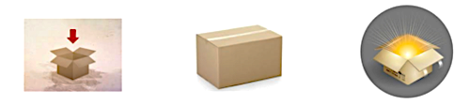
Long-Term Memory (LTM)
Encoding
Storage
Retrieval

Slide 22
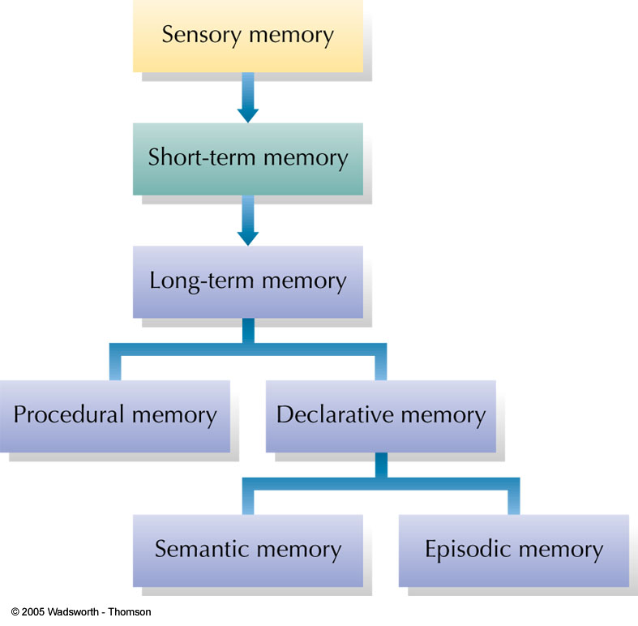
Classification Model of Memory
In the model shown here, long-term memory is divided into procedural memory (learned actions and skills) and declarative memory (stored facts).
Declarative memories can be either semantic (impersonal knowledge) or episodic (personal experiences associated with specific times and places).

Slide 23
Types of Long-term Memory
Declarative memory
memory with awareness.
information can be consciously recollected
Also known as Explicit memory
Non-Declarative memory/Procedural memory
memory without awareness.
Memory that affects behavior but cannot consciously be recalled
Also known as Implicit memory

Slide 24
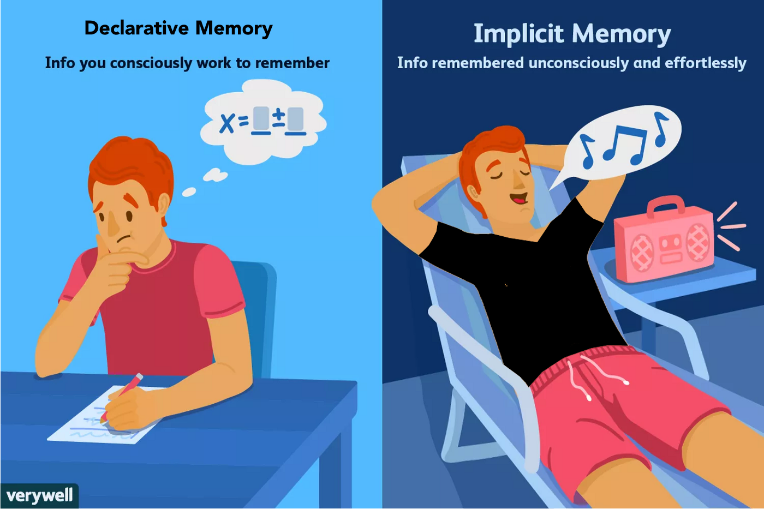

Non-Declarative memory

Slide 25
1: Declarative Memory (Explicit memory)
Information based on facts.
Memory consciously recalled or declared.
Can use explicit memory to directly respond to a question
Two subtypes of declarative memory
Semantic memory
Episodic memory

Slide 26
Type of Declarative Memory
Semantic Memory
(General memory)
Information about impersonal facts and general knowledge
e.g., North is cold and beautiful
Memory not tied to personal events.
General facts and definitions about the world.
Examples:
Usually, a car has four wheels.
Color of strawberry is red and it’s useful for health
Does NOT depend on tying the item to your past.

Slide 27
Type of Declarative Memory
Episodic Memory
(Personal knowledge)
Information about events or “episodes”.
Memory tied to your own personal experiences.
General facts and definitions about the world
Examples:
Remembering your visit to any picnic place.
Birthday or wedding ceremony.
Your birth month.
Your best memory till date.

Slide 28
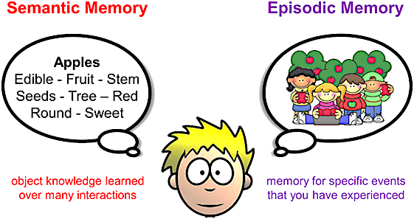
Type of Declarative Memory

Slide 29




2: Non-Declarative Memory
(Procedural Memory)
Memory that enables a person to perform specific learned skills or habitual responses.
Don’t have to consciously remember the steps involved in the actions to perform them.
Examples
02
04
01
03
Riding a
bike
Knowing
how to swim.
Using the shift stick while driving.
Tying your
shoelaces.

Slide 30
Cognitive domain of LTM
Retrospective memory is memory of people, words, and events encountered or experienced in past
i.e., the recollection of past episodes.
Prospective memory is where the content is to be remembered in the future and may be defined as “remembering to remember” or remembering to perform an intended action.
It includes semantic , episodic
and autobiographical memory, and declarative memory in general, although it can be either explicit or implicit.
It may be either event-based or time-based, often triggered by a cue, such as going to the doctor (action) at 4 pm (cue), or remembering to post a letter (action) after seeing a mailbox (cue)

Slide 31
How are memories organized?
Clustering--organizing items into related groups during recall from long-term memory.
Mental links between concepts
common properties provide basis for mental link
Shorter path between two concepts == stronger association in memory

Slide 32
The Neuroscience of Memory
Hippocampus: Brain structure associated with information passing from short-term memory into long-term memory.
If damaged, person can no longer “create” long-term memories
Memories prior to damage will remain intact.
Amygdala: Another part of brain associated with memories involving emotions.
Engram: Physical memory trace in the brain.

Slide 33
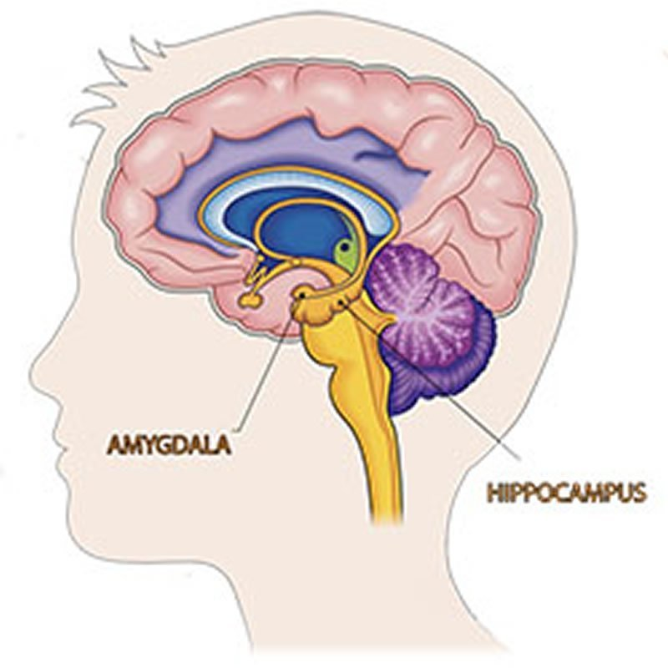

Slide 34




Ways to Improve Memory
Knowledge of Results
Feedback allowing you to check your progress
Recitation
Summarizing aloud while you are rehearsing material
Rehearsal
Reviewing information mentally (silently)
Elaborative Rehearsal
Looks for connections to existing knowledge
Selection
Selecting most important concepts to memorize
Organization
Organizing difficult items into chunks; a type of reordering

Slide 35



Ways to Improve Memory
Whole Learning
Studying an entire package of information at once, like a poem
Part Learning
Studying subparts of a larger body of information (like text chapters)
Progressive Part Learning
Breaking learning task into a series of short sections

Slide 36





Ways to Improve Memory
Spaced Practice
Alternating study sessions with brief rest periods
Massed Practice
Studying for long periods without rest periods
Sleep
Lack of sleep decreases retention whereas sleep aids consolidation
Hunger
Hunger decreases retention so requires gratification
Cognitive Interview
Technique used to improve memories of eyewitnesses

Slide 37
Mnemonics
Any kind of memory system or aid
Use mental pictures
Make things meaningful
Make information familiar
Form bizarre, unusual or exaggerated mental associations
Keyword Method: Memory aid; using a familiar word or image to link two items.

Slide 38
Using Mnemonics to Remember Things in Order
Form a Chain: Remember lists in order, forming an exaggerated association connecting item one to two, and so on.
Take a Mental Walk: Mentally walk along a familiar path, placing objects or ideas along the path (it’s also called method of loci).
"loci" is the plural of locus, which means location, or place

Slide 39
Why do we forget ?
Sensory memory
The senses momentarily register amazing detail
Short-term memory
A few items are both noticed
and encoded
Forgetting can occur at any memory stage.
Long-term storage
Some items are altered or lost
Retrieval from long-term memory
Depending on interference, retrieval
cues, moods, and motives, some
things get retrieved, some don’t

Slide 40
Forgetting
Encoding Failure: When a memory was never formed in the first place
Memory Traces: Physical changes in nerve cells or brain activity that occur when memories are stored
Memory Decay: When memory traces become weaker; fading or weakening of memories; happens frequently for sensory memories and short-term memories.
Disuse: Theory that long-term memory traces weaken when memories are not used or retrieved often

Slide 41
Amnesia
Amnesia : severe memory loss
Retrograde amnesia : inability to remember past episodic information; common after head injury; need for consolidation
Anterograde amnesia : inability to form new memories; related to hippocampus damage

