Slide 1


Goals of Psychology
Aisha Bano
aisha.bano@nu.edu.pk

Slide 2
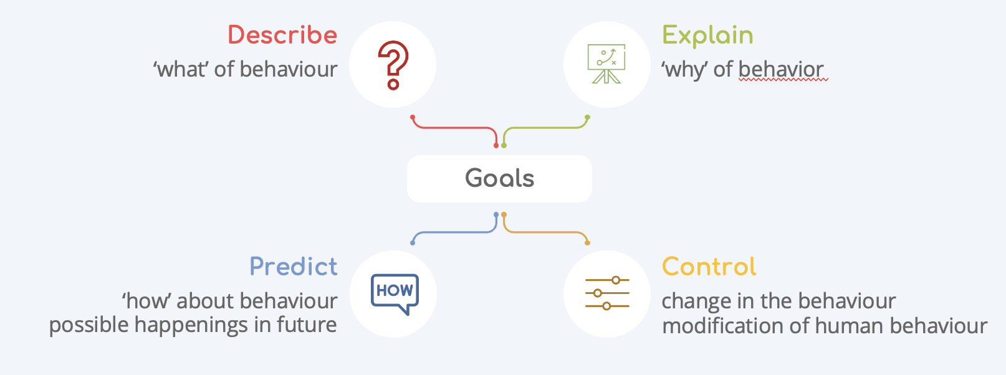

Slide 3
Fields of Psychology

Slide 4
Fields of Psychology
=
Developmental Psychology
Clinical Psychology
=
=
Physiological Psychology
Counseling Psychology
=
Experimental Psychology
Social Psychology
=
=
Personality Psychology
Forensic Psychology
=
=
Health Psychology
Military Psychology
=
=
=
Industrial Psychology
=
Educational Psychology

Slide 5
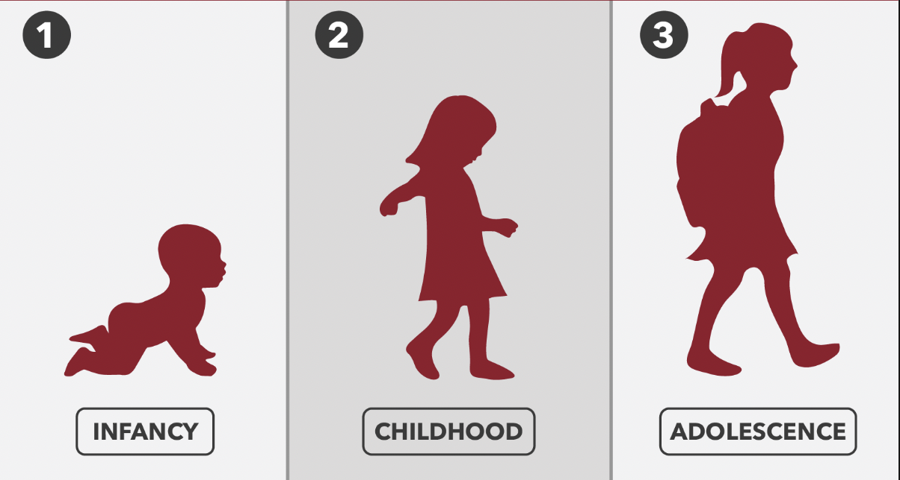
Developmental Psychology
Studies human mental and physical growth
from conception to death.
Child psychologists
Adolescent psychologists
Life-span psychologists

Slide 6

Physiological Psychology
Investigates the biological basis of human behavior.
1
neuropsychologists
2
psycho-biologists
3
behavioral geneticists

Slide 7

Experimental Psychology
Conducts research on basic
psychological processes, such as:
x
x
learning
cognition
x
x
memory
motivation
x
x
emotion
sensation
x
perception

Slide 8
1
One of the largest and most popular branches of psychology
Personality Psychology
2
Personality psychologists study the
differences among individuals.
3
They strive to understand how personality develops and influences the way we think and behave.

Slide 9
Clinical & Counseling Psychology
Clinical psychologists are interested primarily in the diagnosis, cause, and treatment of psychological disorders.
Counseling psychologists are concerned primarily with ‘normal’ problems of adjustments in life.

Slide 10

Social Psychology
Social psychologists study how people influence one another.
Social psychologists study how people influence one another.
How the role of society and its culture influence in the development of one’s personality.

Slide 11
Industrial & Organizational
Psychology
Psychology applied to the workplace.
I/O psychologists are interested in
Selecting and training personnel.
improving productivity and working conditions.
the impact of computerization and automation on workers

Slide 12
Health Psychology
This branch observes how
1
Behavior
Biology
Social context
2
3
Influence illness and health.

Slide 13

Forensic Psychology
This branch talks about
Law
Criminal investigation
Within criminal justice system

Slide 14
Military Psychology
This branch deals with psychological
problems arising in the:
Training of military personnel and war
Under extreme conditions (airplane, submarine)
Stress

Slide 15
Social PSYCHOLOGY
It concerned with analyzing jobs and selecting the correct person for the job.
Steps to select the person for any job
01
One of the largest and most popular
branches of psychology
02
Personality psychologists study the
differences among individuals.
03
They strive to understand how personality
develops and influences the way we think
and behave.
04
Deciding who will get the job based on
results of those assessments.

Slide 16
Forensic Psychology
Growth and development
Psychological protection
Recognition and reward
Protection of physical safety
Workload management
Management style
Reducing stress increases productivity
Customer Orientation
Engagement
Balance

Slide 17

POSITIVE WORK ENVIRONMENT BENEFITS
Happiness has a multiplying effect
Happiness inspires creativity
Happy employees are successful
employees
Happy employees are not afraid to make mistakes
Happy employees have the right attitude
People like to work with happy people
Reducing stress increases productivity
Happy employees support each other
Leaders lead by example

Slide 18
Thanks

