Slide 1
Machine Learning
4771 Instructor: Itsik Pe’er

Slide 2
Example quiz question
The perceptron loss function
induces a discontinuous, stair-like empirical risk function
is differentiable anywhere
is the number of misclassified datapoints
penalizes misclassified datapoints proportionally to |f(x;θ)|

Slide 3
Example quiz question
Convergence proof of online perceptron learning
Bounds the length of the current parameter vector from above
Bounds from above the projection of the current parameter vector on the optimal one
Relies on an optimal gap-tolerant classifier
Is part of the material for the quiz

Slide 4
Class 8 SVMs
Theoretical motivation
Formulation
Dual problem

Slide 5
True Risk Bound & Gaps
Wider gap (w.r.t. universe) means the function family is weaker

Slide 6
True Risk Bound & Gaps
Wider gap (w.r.t. universe) means the function family is weaker
Weakest family = widest gap
Can’t always classify (even chosen) 3
Can choose 2 that always classify

Slide 7
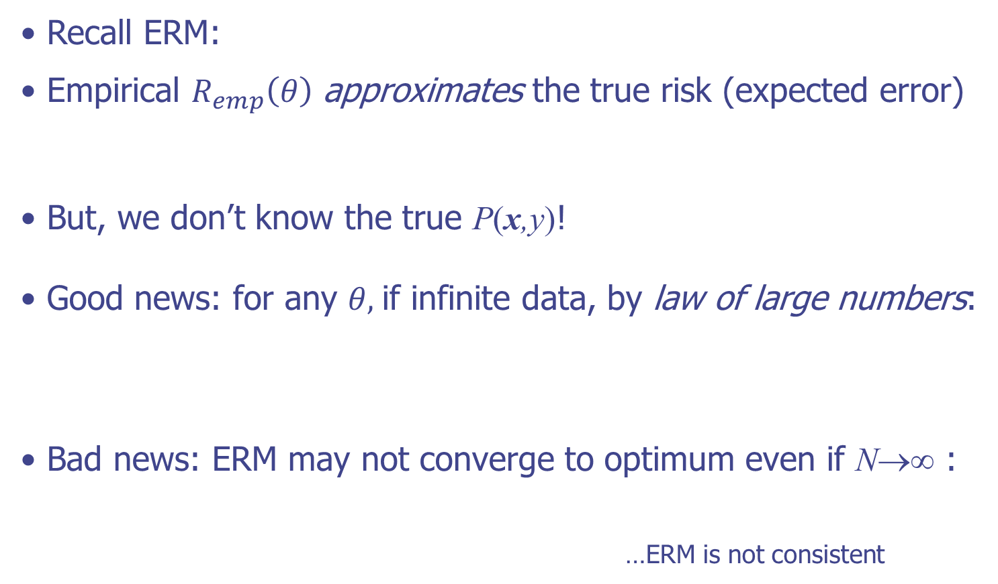



Empirical Risk Minimization
Recall ERM:
Empirical $R_{emp}\left(θ\right)$ approximates the true risk (expected error)
But, we don’t know the true P(x,y)!
Good news: for any $θ,$if infinite data, by law of large numbers:
Bad news: ERM may not converge to optimum even if N→∞ :
…ERM is not consistent
$$R_{emp}\left(θ\right)=\frac{1}{N}\sum_{i}^{N}{Loss\left(y_{i}, f\left(x_{i};θ\right)\right)}∈\left[0,1\right]$$
$$R\left(θ\right)=E_{P}\left\{Loss\left(y,x,θ\right)\right\}=\int_{X×Y}{P\left(x,y\right)Loss\left(y,x,θ\right)}dxdy∈\left[0,1\right]$$
$$\lim_{n→∞}{R_{emp}\left(θ\right)}=R\left(θ\right)$$
$$argmin_{θ}R_{emp}\left(θ\right)≠argmin_{θ}R\left(θ\right)$$
Notes:
ASK: Why is it in [0,1]?

Slide 8
Bounding the True Risk

Slide 9



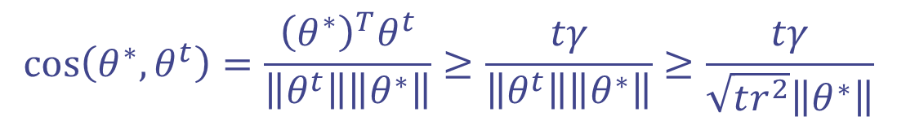
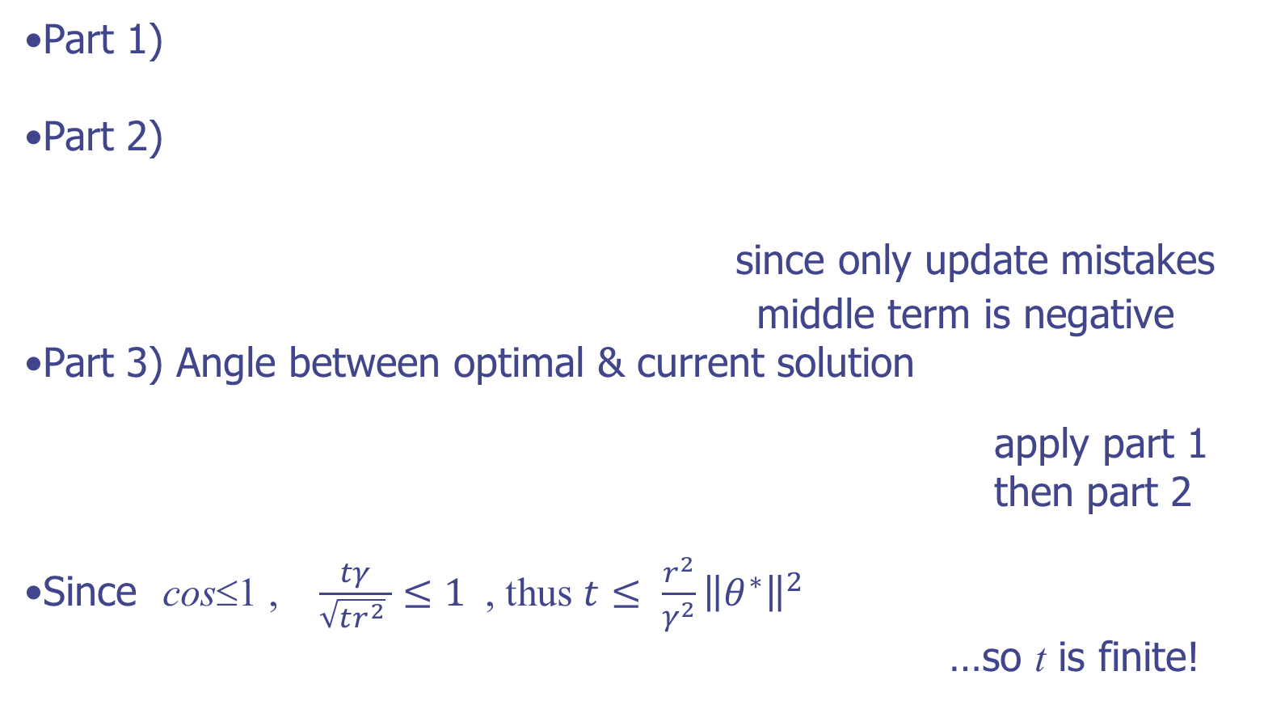
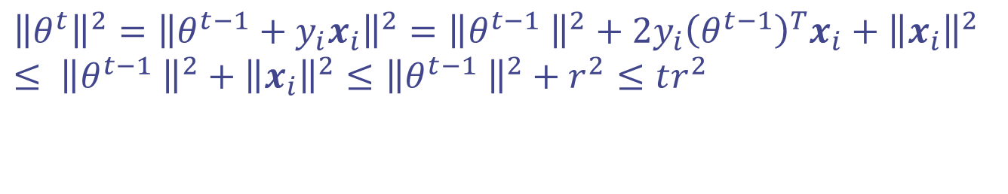
Bounding the True Risk
$$R_{emp}\left(\hat{θ}\right)≤R\left(\hat{θ}\right)$$
$$R_{emp}\left(θ\right)$$
ERM’s risk is not
guaranteed since
it may do better
on training than
on test!
$$R\left(θ\right)$$
$$θ^{∗}$$
$$\hat{θ}$$
$$θ$$

Slide 10


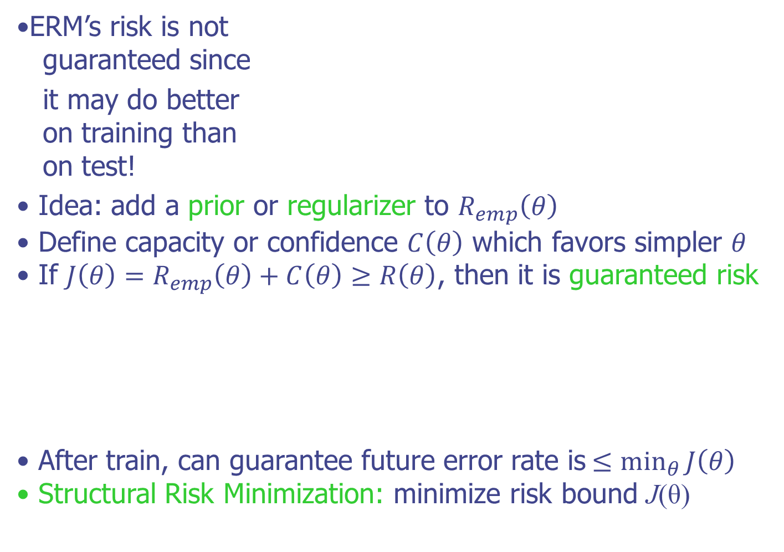





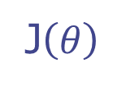



Bounding the True Risk
$$R_{emp}\left(\hat{θ}\right)≤R\left(\hat{θ}\right)$$
$$R_{emp}\left(θ\right)$$
ERM’s risk is not
guaranteed since
it may do better
on training than
on test!
Idea: add a prior or regularizer to $R_{emp}\left(θ\right)$
Define capacity or confidence $C\left(θ\right)$ which favors simpler $θ$
If ${J\left(θ\right)=R}_{emp}\left(θ\right)+C\left(θ\right)≥R\left(θ\right)$, then it is guaranteed risk
After train, can guarantee future error rate is$≤\min_{θ}{J\left(θ\right)}$
Structural Risk Minimization: minimize risk bound J(θ)
$$R\left(θ\right)$$
$$θ^{∗}$$
$$\hat{θ}$$
$$θ$$
J$\left(θ\right)$
$$R\left(θ\right)$$
$$θ^{∗}$$
$$\hat{θ}$$
$$θ$$

Slide 11
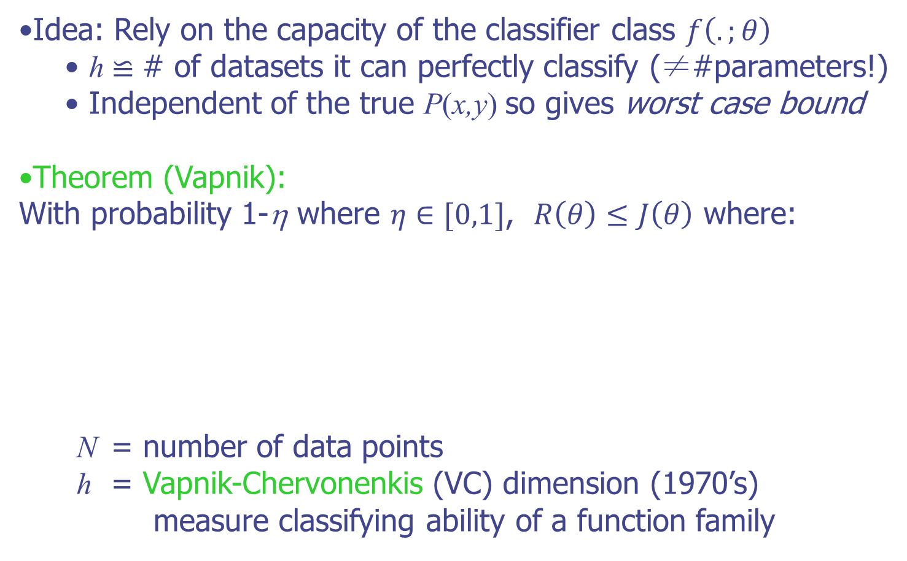
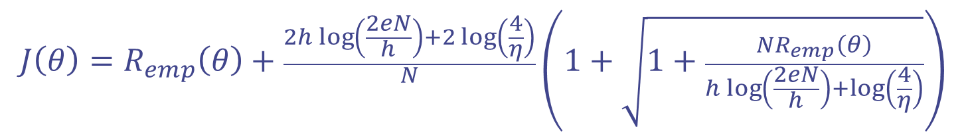
Bound the True Risk with VCD
Idea: Rely on the capacity of the classifier class $f\left(.;θ\right)$
h ≌ # of datasets it can perfectly classify (≠#parameters!)
Independent of the true P(x,y) so gives worst case bound
Theorem (Vapnik): With probability 1-η where $η∈[0,1]$, $R\left(θ\right)≤J\left(θ\right)$ where:
N = number of data points
h = Vapnik-Chervonenkis (VC) dimension (1970’s) measure classifying ability of a function family
$$J\left(θ\right)=R_{emp}\left(θ\right)+\frac{2h\log\left(\frac{2eN}{h}\right)+2\log\left(\frac{4}{η}\right)}{N}\left(1+\sqrt{1+\frac{NR_{emp}\left(θ\right)}{h\log\left(\frac{2eN}{h}\right)+\log\left(\frac{4}{η}\right)}}\right)$$
Notes:
ASK: is bound truly guaranteed?
ASK: what if we want eta to be 0 so that it is? C() term goes to infinity…

Slide 12
Support Vector Machines
Support vector machines are (in the simplest case)
linear classifiers that do structural risk minimization (SRM)
Directly maximize margin to reduce guaranteed risk J(θ)
Notes:
ASK: What would perceptron do? Any of the zero error solutions it would stop. Want better… SVM

Slide 13
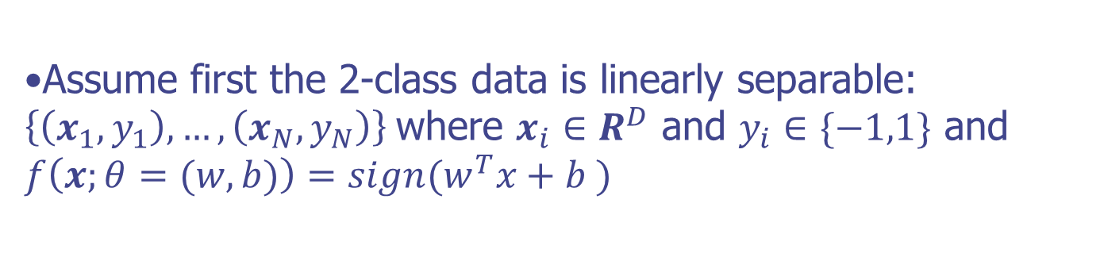
SVM Notation
Assume first the 2-class data is linearly separable: $\left\{\left(x_{1},y_{1}\right),…,\left(x_{N},y_{N}\right)\right\}$where $x_{i}∈R^{D}$ and $y_{i}∈\{−1,1\}$ and
$$f\left(x;θ=(w,b)\right)=sign(w^{T}x+b )$$
Notes:
ASK: What would perceptron do? Any of the zero error solutions it would stop. Want better… SVM

Slide 14
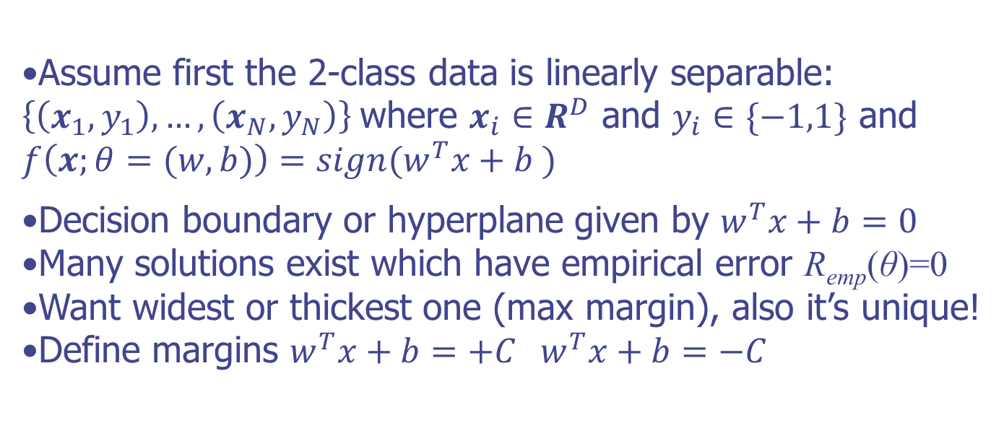
SVM Notation
Assume first the 2-class data is linearly separable: $\left\{\left(x_{1},y_{1}\right),…,\left(x_{N},y_{N}\right)\right\}$where $x_{i}∈R^{D}$ and $y_{i}∈\{−1,1\}$ and
$$f\left(x;θ=(w,b)\right)=sign(w^{T}x+b )$$
Decision boundary or hyperplane given by $w^{T}x+b=0$
Many solutions exist which have empirical error R_{emp}(θ)=0
Want widest or thickest one (max margin), also it’s unique!
Define margins $w^{T}x+b=+C$ $w^{T}x+b=−C$
Notes:
ASK: What would perceptron do? Any of the zero error solutions it would stop. Want better… SVM

Slide 15
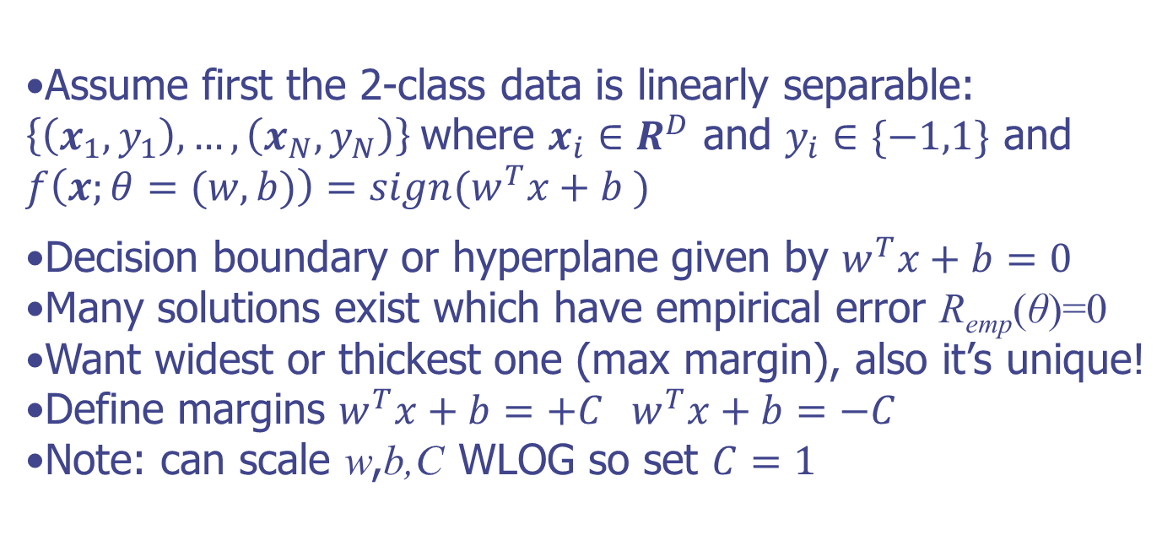
SVM Notation
Assume first the 2-class data is linearly separable: $\left\{\left(x_{1},y_{1}\right),…,\left(x_{N},y_{N}\right)\right\}$where $x_{i}∈R^{D}$ and $y_{i}∈\{−1,1\}$ and
$$f\left(x;θ=(w,b)\right)=sign(w^{T}x+b )$$
Decision boundary or hyperplane given by $w^{T}x+b=0$
Many solutions exist which have empirical error R_{emp}(θ)=0
Want widest or thickest one (max margin), also it’s unique!
Define margins $w^{T}x+b=+C$ $w^{T}x+b=−C$
Note: can scale w,b,C WLOG so set $C=1$
Notes:
ASK: What would perceptron do? Any of the zero error solutions it would stop. Want better… SVM

Slide 16
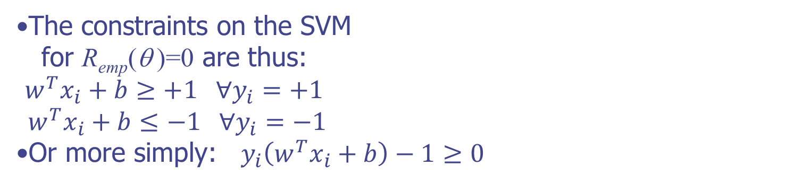
Support Vector Machines
The constraints on the SVM
for R_{emp}(θ )=0 are thus:
$w^{T}x_{i}+b≥+1 ∀y_{i}=+1$
$${ w}^{T}x_{i}+b≤−1 ∀y_{i}=−1$$
Or more simply:$y_{i}\left(w^{T}x_{i}+b\right)−1≥0$
Notes:
ASK: What is a quadratic program? Quadratic cost function with many linear constraints

Slide 17

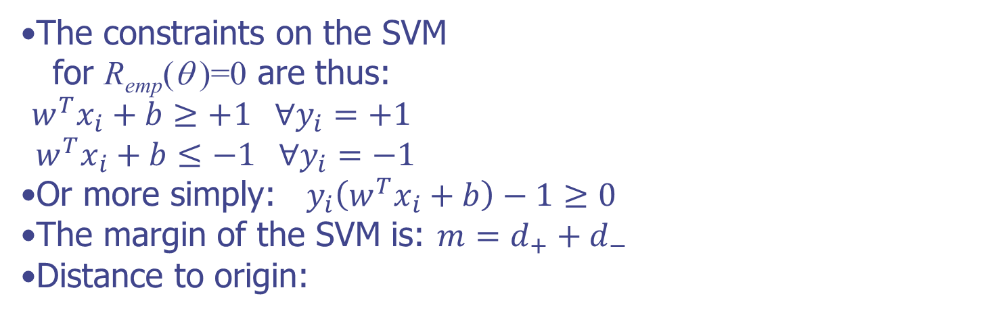
Support Vector Machines
The constraints on the SVM
for R_{emp}(θ )=0 are thus:
$w^{T}x_{i}+b≥+1 ∀y_{i}=+1$
$${ w}^{T}x_{i}+b≤−1 ∀y_{i}=−1$$
Or more simply:$y_{i}\left(w^{T}x_{i}+b\right)−1≥0$
The margin of the SVM is: $m=d_{+}+d_{−}$
Distance to origin:
$$H_{+}→w^{T}x+b=+1$$
$$H→w^{T}x+b=0$$
$$H_{−}→w^{T}x+b=−1$$
Notes:
ASK: What is a quadratic program? Quadratic cost function with many linear constraints

Slide 18
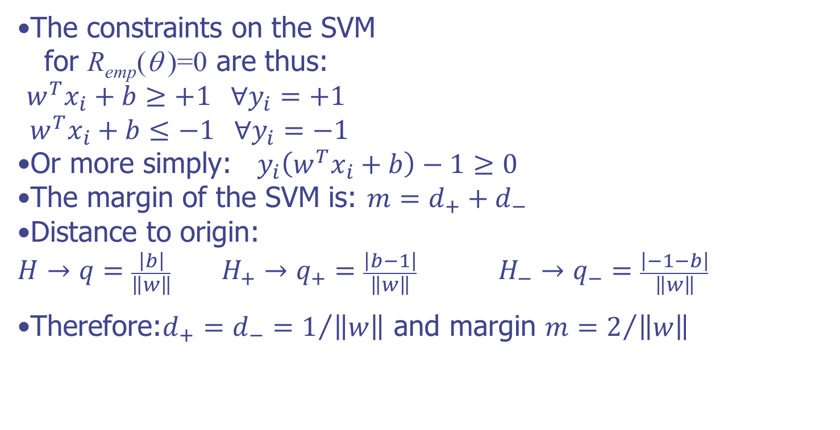
Support Vector Machines
The constraints on the SVM
for R_{emp}(θ )=0 are thus:
$w^{T}x_{i}+b≥+1 ∀y_{i}=+1$
$${ w}^{T}x_{i}+b≤−1 ∀y_{i}=−1$$
Or more simply:$y_{i}\left(w^{T}x_{i}+b\right)−1≥0$
The margin of the SVM is: $m=d_{+}+d_{−}$
Distance to origin:
$$H→q=\frac{\left|b\right|}{\left\|w\right\|} H_{+}→q_{+}=\frac{\left|b−1\right|}{\left\|w\right\|} H_{−}→q_{−}=\frac{\left|−1−b\right|}{\left\|w\right\|}$$
Therefore:$d_{+}=d_{−}=1/{\left\|w\right\|}$ and margin $m=2/{\left\|w\right\|}$
$$H_{+}→w^{T}x+b=+1$$
$$H→w^{T}x+b=0$$
$$H_{−}→w^{T}x+b=−1$$
Notes:
ASK: What is a quadratic program? Quadratic cost function with many linear constraints

Slide 19
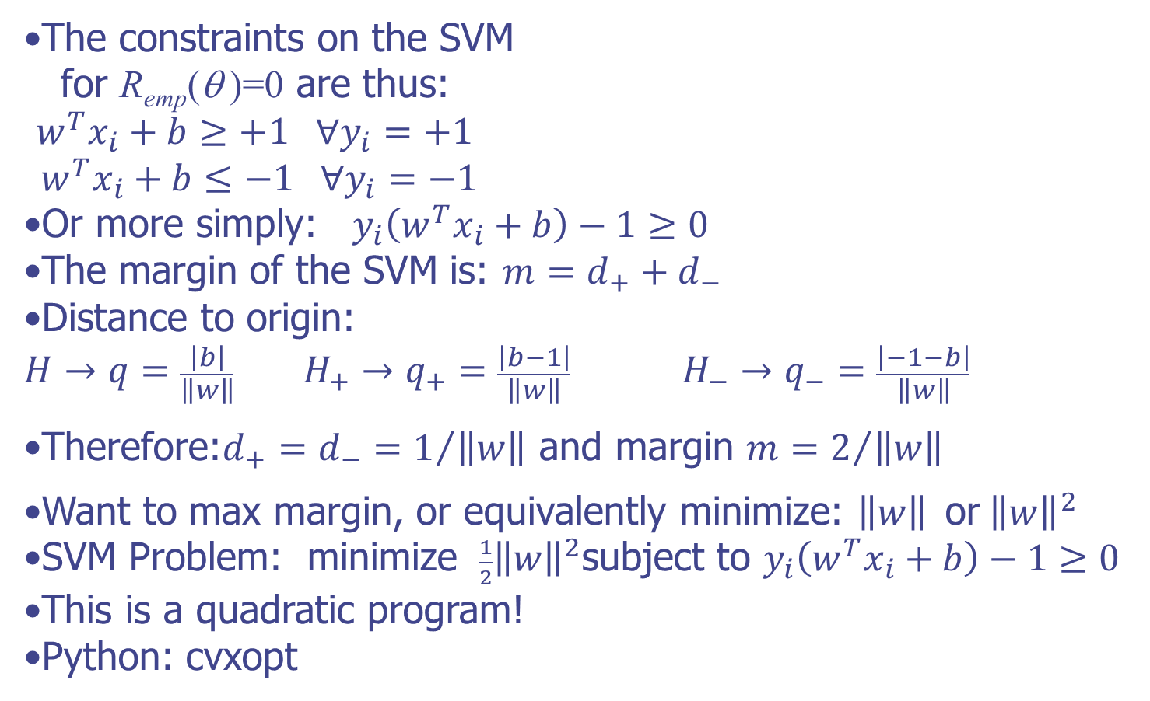
Support Vector Machines
The constraints on the SVM
for R_{emp}(θ )=0 are thus:
$w^{T}x_{i}+b≥+1 ∀y_{i}=+1$
$${ w}^{T}x_{i}+b≤−1 ∀y_{i}=−1$$
Or more simply:$y_{i}\left(w^{T}x_{i}+b\right)−1≥0$
The margin of the SVM is: $m=d_{+}+d_{−}$
Distance to origin:
$$H→q=\frac{\left|b\right|}{\left\|w\right\|} H_{+}→q_{+}=\frac{\left|b−1\right|}{\left\|w\right\|} H_{−}→q_{−}=\frac{\left|−1−b\right|}{\left\|w\right\|}$$
Therefore:$d_{+}=d_{−}=1/{\left\|w\right\|}$ and margin $m=2/{\left\|w\right\|}$
Want to max margin, or equivalently minimize: $\left\|w\right\|{ \text{or} \left\|w\right\|}^{2}$
SVM Problem: minimize ${ \frac{1}{2}\left\|w\right\|}^{2}$subject to $y_{i}\left(w^{T}x_{i}+b\right)−1≥0$
This is a quadratic program!
Python: cvxopt
$$H_{+}→w^{T}x+b=+1$$
$$H→w^{T}x+b=0$$
$$H_{−}→w^{T}x+b=−1$$
Notes:
ASK: What is a quadratic program? Quadratic cost function with many linear constraints

Slide 20
Note: Quadratic Programming
A hierarchy of optimization packages to use:
Linear Programming (LP)
<Quadratic Programming (QP)
<Quadratically Constrained Quadratic Programming
<Semidefinite Programming (SDP)
<Convex Programming (CP)
<Polynomial Time Algorithms (P)
LP
QP
QCQP
SDP
CP
P

Slide 21
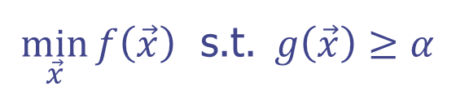
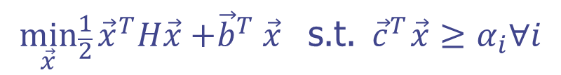
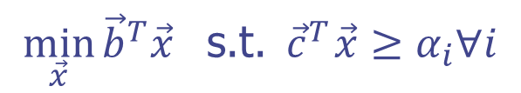
Note: Quadratic Programming
LP < QP < QCQP < SDP < Convex Programming
LP
QP
QCQP
SDP
CP
$$\min_{\vec{x}}{{\vec{b}}^{T}\vec{x}}{ \text{s}\text{.}\text{t}\text{.} \vec{c}}^{T}\vec{x}≥α_{i}∀i$$
$$\min_{\vec{x}}\frac{1}{2}{{\vec{x}}^{T}H\vec{x}{+\vec{b}}^{T}\vec{x}}{ \text{s}\text{.}\text{t}\text{.} \vec{c}}^{T}\vec{x}≥α_{i}∀i$$
$$\min_{\vec{x}}{f\left(\vec{x}\right) }\text{s}\text{.}\text{t}\text{.} g\left(\vec{x}\right)≥α$$

Slide 22
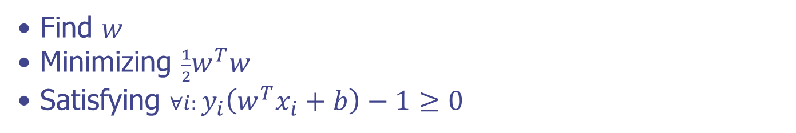
SVM Quadratic Program
Find $w$
Minimizing ${\frac{1}{2}w}^{T}w$
Satisfying ${∀i: y}_{i}\left(w^{T}x_{i}+b\right)−1≥0$

Slide 23
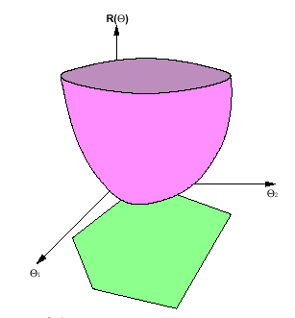
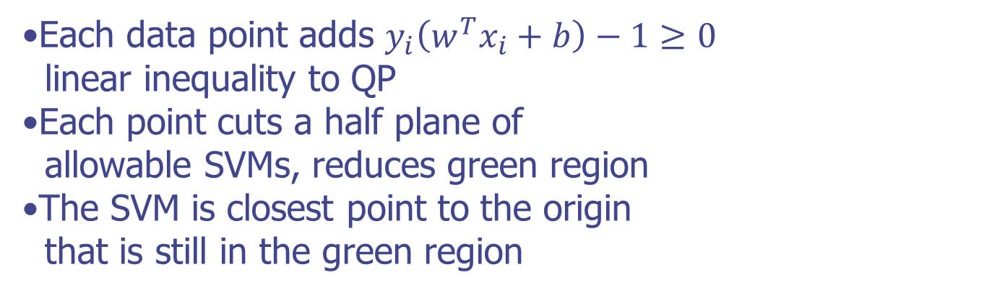
SVM Quadratic Program
Each data point adds $y_{i}\left(w^{T}x_{i}+b\right)−1≥0$
linear inequality to QP
Each point cuts a half plane of allowable SVMs, reduces green region
The SVM is closest point to the origin that is still in the green region

Slide 24

SVM Quadratic Program
Each data point adds $y_{i}\left(w^{T}x_{i}+b\right)−1≥0$
linear inequality to QP
Each point cuts a half plane of allowable SVMs, reduces green region
The SVM is closest point to the origin that is still in the green region
The preceptron algorithm just
puts us randomly in green region
QP runs in cubic polynomial time
There are D values in the w vector
Needs O(D³) run time

Slide 25
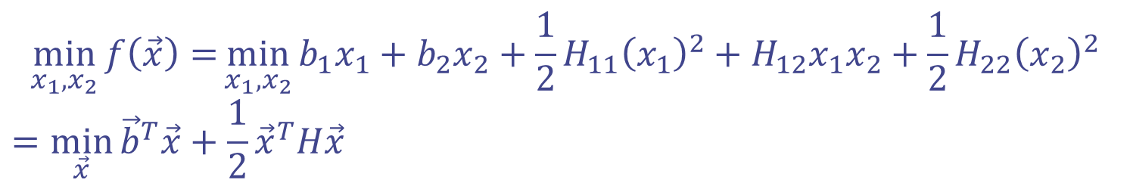
Note: Lagrange Multipliers
How to minimize a function subject to equality constraints?
Only walk on x₁=2x₂
$$\min_{x_{1},x_{2}}{f\left(\vec{x}\right)=}\min_{x_{1},x_{2}}{b_{1}x_{1}+b_{2}x_{2}+\frac{1}{2}H_{11}{\left(x_{1}\right)}^{2}+H_{12}x_{1}x_{2}+\frac{1}{2}H_{22}{\left(x_{2}\right)}^{2}}$$
$$=\min_{\vec{x}}{{\vec{b}}^{T}\vec{x}}+\frac{1}{2}{\vec{x}}^{T}H\vec{x}$$
Notes:
ASK: What would perceptron do? Any of the zero error solutions it would stop. Want better… SVM

Slide 26
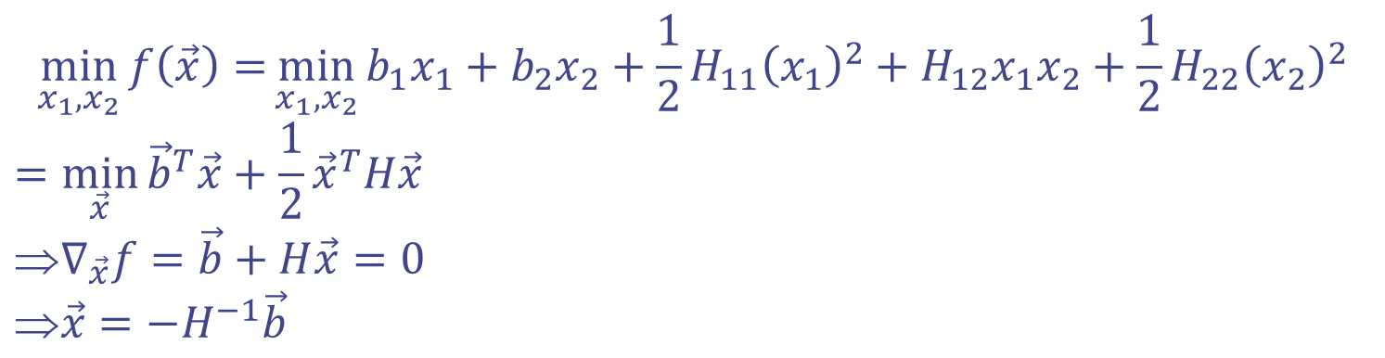
Note: Lagrange Multipliers
How to minimize a function subject to equality constraints?
Only walk on x₁=2x₂ or… x₁-2x₂=0 …
$$\min_{x_{1},x_{2}}{f\left(\vec{x}\right)=}\min_{x_{1},x_{2}}{b_{1}x_{1}+b_{2}x_{2}+\frac{1}{2}H_{11}{\left(x_{1}\right)}^{2}+H_{12}x_{1}x_{2}+\frac{1}{2}H_{22}{\left(x_{2}\right)}^{2}}$$
$$=\min_{\vec{x}}{{\vec{b}}^{T}\vec{x}}+\frac{1}{2}{\vec{x}}^{T}H\vec{x}$$
$$∇_{\vec{x}}f=\vec{b}+H\vec{x}=0$$
$$\vec{x}=−H^{−1}\vec{b}$$
Notes:
ASK: What would perceptron do? Any of the zero error solutions it would stop. Want better… SVM

Slide 27


Note: Lagrange Multipliers
How to minimize a function subject to equality constraints?
Only walk on x₁=2x₂ or… x₁-2x₂=0 …
Use Lagrange Multipliers…
λ blows up the minimization if we don’t satisfy the constraint:
$$\min_{x_{1},x_{2}}{\max_{λ}{f\left(\vec{x}\right)+λ(equality condition=0)}}$$
$$\min_{x_{1},x_{2}}{f\left(\vec{x}\right)=}\min_{x_{1},x_{2}}{b_{1}x_{1}+b_{2}x_{2}+\frac{1}{2}H_{11}{\left(x_{1}\right)}^{2}+H_{12}x_{1}x_{2}+\frac{1}{2}H_{22}{\left(x_{2}\right)}^{2}}$$
$$=\min_{\vec{x}}{{\vec{b}}^{T}\vec{x}}+\frac{1}{2}{\vec{x}}^{T}H\vec{x}$$
$$∇_{\vec{x}}f=\vec{b}+H\vec{x}=0$$
$$\vec{x}=−H^{−1}\vec{b}$$
Notes:
ASK: What would perceptron do? Any of the zero error solutions it would stop. Want better… SVM

Slide 28

Note: Lagrange Multipliers
How to minimize a function subject to equality constraints?
Only walk on x₁=2x₂ or… x₁-2x₂=0 …
Use Lagrange Multipliers…
λ blows up the minimization if we don’t satisfy the constraint:
$$\min_{x_{1},x_{2}}{\max_{λ}{f\left(\vec{x}\right)+λ(equality condition=0)}}$$
$$=\min_{x_{1},x_{2}}{b_{1}x_{1}+b_{2}x_{2}+\frac{H_{11}{\left(x_{1}\right)}^{2}}{2}+H_{12}x_{1}x_{2}+\frac{H_{22}{\left(x_{2}\right)}^{2}}{2}+λ(x_{1}−2x_{2})}$$
$$\min_{x_{1},x_{2}}{f\left(\vec{x}\right)=}\min_{x_{1},x_{2}}{b_{1}x_{1}+b_{2}x_{2}+\frac{1}{2}H_{11}{\left(x_{1}\right)}^{2}+H_{12}x_{1}x_{2}+\frac{1}{2}H_{22}{\left(x_{2}\right)}^{2}}$$
$$=\min_{\vec{x}}{{\vec{b}}^{T}\vec{x}}+\frac{1}{2}{\vec{x}}^{T}H\vec{x}$$
$$∇_{\vec{x}}f=\vec{b}+H\vec{x}=0$$
$$\vec{x}=−H^{−1}\vec{b}$$
Notes:
ASK: What would perceptron do? Any of the zero error solutions it would stop. Want better… SVM

Slide 29
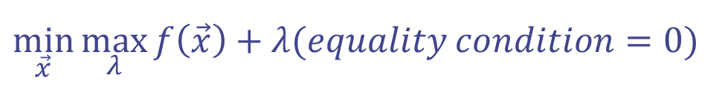
Note: Lagrange Multipliers
Minimization with equality constraint:
1) Add each constraint times an extra variable
(a Lagrange multiplier λ, like an adversary variable)
2) Take partials with respect to x and set to zero
3) Plug in solution into constraint to find lambda
$$\min_{\vec{x}}{\max_{λ}{f\left(\vec{x}\right)+λ(equality condition=0)}}$$
Notes:
ASK: What would perceptron do? Any of the zero error solutions it would stop. Want better… SVM

Slide 30
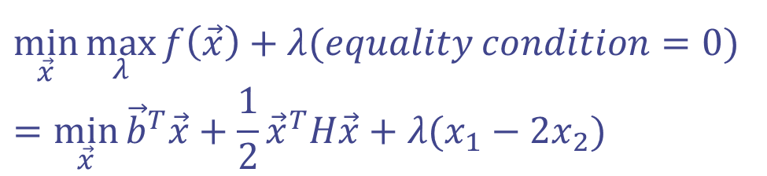
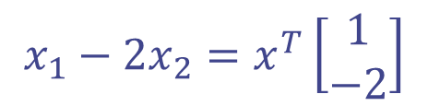
Note: Lagrange Multipliers
Minimization with equality constraint:
1) Add each constraint times an extra variable
(a Lagrange multiplier λ, like an adversary variable)
2) Take partials with respect to x and set to zero
3) Plug in solution into constraint to find lambda
$$\min_{\vec{x}}{\max_{λ}{f\left(\vec{x}\right)+λ(equality condition=0)}}$$
$$=\min_{\vec{x}}{{\vec{b}}^{T}\vec{x}}+\frac{1}{2}{\vec{x}}^{T}H\vec{x}+λ(x_{1}−2x_{2})$$
$$x_{1}−2x_{2}=x^{T}\left[\begin{matrix}1 \\ −2\end{matrix}\right]$$
Notes:
ASK: What would perceptron do? Any of the zero error solutions it would stop. Want better… SVM

Slide 31
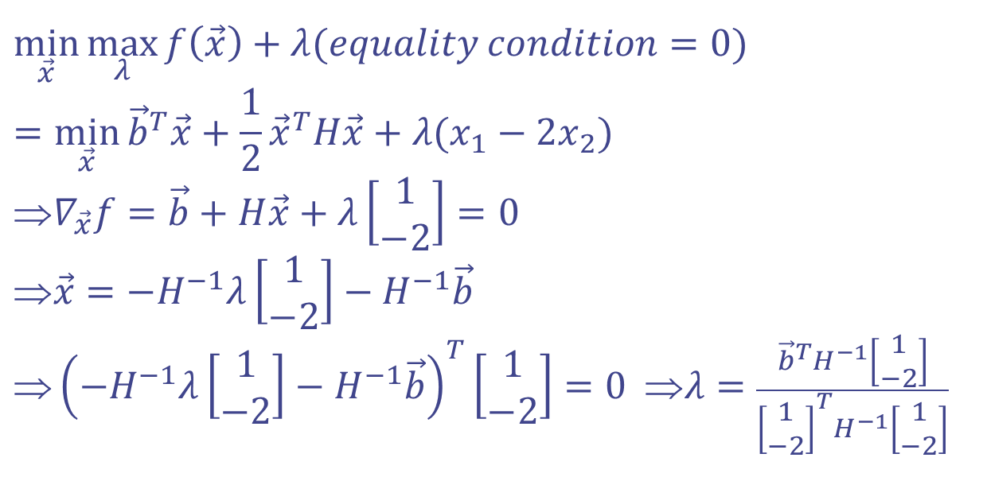
Note: Lagrange Multipliers
Minimization with equality constraint:
1) Add each constraint times an extra variable
(a Lagrange multiplier λ, like an adversary variable)
2) Take partials with respect to x and set to zero
3) Plug in solution into constraint to find lambda
$$\min_{\vec{x}}{\max_{λ}{f\left(\vec{x}\right)+λ(equality condition=0)}}$$
$$=\min_{\vec{x}}{{\vec{b}}^{T}\vec{x}}+\frac{1}{2}{\vec{x}}^{T}H\vec{x}+λ(x_{1}−2x_{2})$$
$$∇_{\vec{x}}f=\vec{b}+H\vec{x}+λ\left[\begin{matrix}1 \\ −2\end{matrix}\right]=0$$
$$\vec{x}=−H^{−1}λ\left[\begin{matrix}1 \\ −2\end{matrix}\right]−H^{−1}\vec{b}$$
$${\left(−H^{−1}λ\left[\begin{matrix}1 \\ −2\end{matrix}\right]−H^{−1}\vec{b}\right)}^{T}\left[\begin{matrix}1 \\ −2\end{matrix}\right]=0 ⇒λ=\frac{{\vec{b}}^{T}H^{−1}\left[\begin{matrix}1 \\ −2\end{matrix}\right]}{{\left[\begin{matrix}1 \\ −2\end{matrix}\right]}^{T}H^{−1}\left[\begin{matrix}1 \\ −2\end{matrix}\right]}$$
$$x_{1}−2x_{2}=x^{T}\left[\begin{matrix}1 \\ −2\end{matrix}\right]$$
Notes:
ASK: What would perceptron do? Any of the zero error solutions it would stop. Want better… SVM

Slide 32

SVM Quadratic Program
Each data point adds $y_{i}\left(w^{T}x_{i}+b\right)−1≥0$
linear inequality to QP
Each point cuts a half plane of allowable SVMs, reduces green region
The SVM is closest point to the origin that is still in the green region
The preceptron algorithm just
puts us randomly in green region
QP runs in cubic polynomial time
There are D values in the w vector
Needs O(D³) run time
But, there is a DUAL SVM in O(N³)!

Slide 33

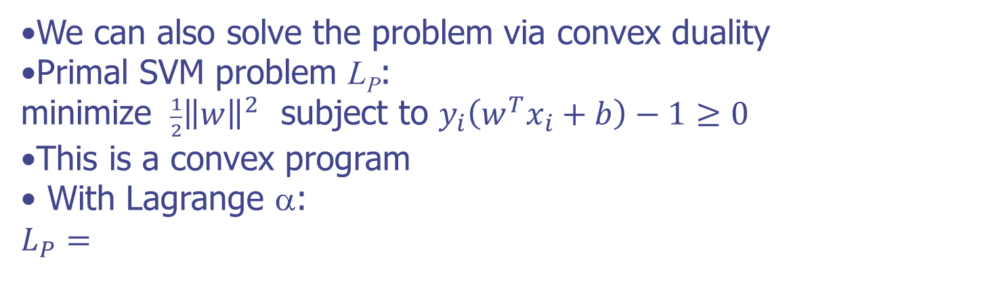
SVM in Dual Form
We can also solve the problem via convex duality
Primal SVM problem L_{P}: minimize ${ \frac{1}{2}\left\|w\right\|}^{2}$ subject to $y_{i}\left(w^{T}x_{i}+b\right)−1≥0$
This is a convex program
With Lagrange α:
$$L_{P}=$$
Notes:
ASK: What is a convex program? MORE general than convex function (I.e. e-family) and STILL UNIQUE!
ASK: To get LD, we note we have 1/2 w^2 and - w^2 from Lagrange, it just works out…
ASK: why positive alphas? Because INEQUALITIES,

Slide 34
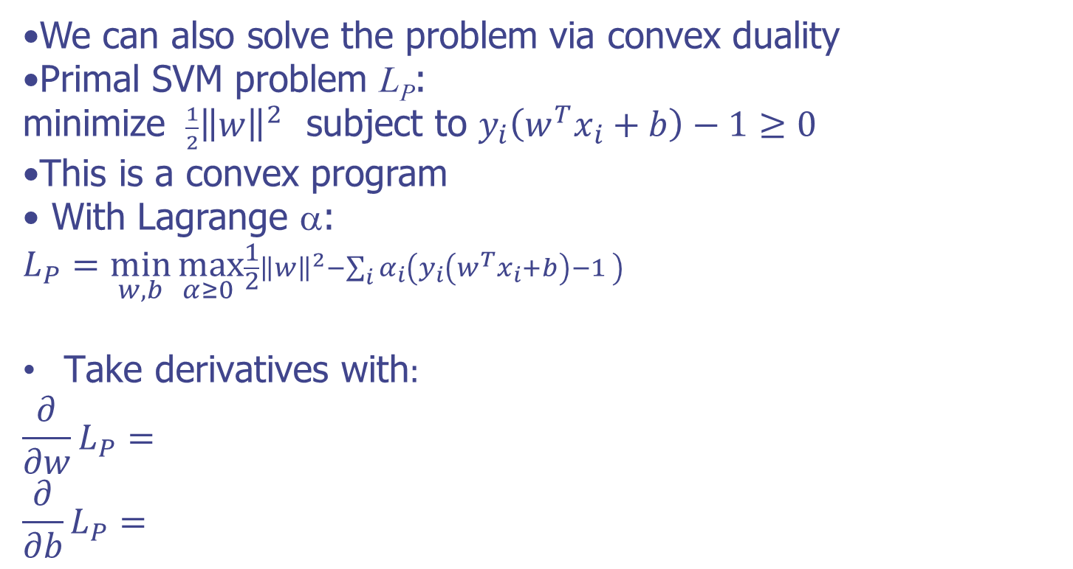
SVM in Dual Form
We can also solve the problem via convex duality
Primal SVM problem L_{P}: minimize ${ \frac{1}{2}\left\|w\right\|}^{2}$ subject to $y_{i}\left(w^{T}x_{i}+b\right)−1≥0$
This is a convex program
With Lagrange α:
$$L_{P}=\min_{w,b}{\max_{α≥0 }\frac{1}{2}{\left\|w\right\|}^{2}−\sum_{i}{α_{i}\left(y_{i}\left(w^{T}x_{i}+b\right)−1 \right)}}$$
$\text{T}\text{ak}\text{e} \text{derivatives} \text{with}:$
$$\frac{∂}{∂w}L_{P}=$$
$$\frac{∂}{∂b}L_{P}=$$
Notes:
ASK: What is a convex program? MORE general than convex function (I.e. e-family) and STILL UNIQUE!
ASK: To get LD, we note we have 1/2 w^2 and - w^2 from Lagrange, it just works out…
ASK: why positive alphas? Because INEQUALITIES,

Slide 35
SVM in Dual Form
We can also solve the problem via convex duality
Primal SVM problem L_{P}: minimize ${ \frac{1}{2}\left\|w\right\|}^{2}$ subject to $y_{i}\left(w^{T}x_{i}+b\right)−1≥0$
This is a convex program
With Lagrange α:
$$L_{P}=\min_{w,b}{\max_{α≥0 }\frac{1}{2}{\left\|w\right\|}^{2}−\sum_{i}{α_{i}\left(y_{i}\left(w^{T}x_{i}+b\right)−1 \right)}}$$
$\text{T}\text{ak}\text{e} \text{derivatives} \text{with}:$
$$\frac{∂}{∂w}L_{P}=w−\sum_{i}{α_{i}y_{i}x_{i}}=0 →w=\sum_{i}{α_{i}y_{i}x_{i}}$$
$$\frac{∂}{∂b}L_{P}=−\sum_{i}{α_{i}y_{i}}=0$$
Plug back in:
Notes:
ASK: What is a convex program? MORE general than convex function (I.e. e-family) and STILL UNIQUE!
ASK: To get LD, we note we have 1/2 w^2 and - w^2 from Lagrange, it just works out…
ASK: why positive alphas? Because INEQUALITIES,

Slide 36
SVM in Dual Form
We can also solve the problem via convex duality
Primal SVM problem L_{P}: minimize ${ \frac{1}{2}\left\|w\right\|}^{2}$ subject to $y_{i}\left(w^{T}x_{i}+b\right)−1≥0$
This is a convex program
Try taking derivatives with Lagrange α:
$$L_{P}=\min_{w,b}{\max_{α≥0 }\frac{1}{2}{\left\|w\right\|}^{2}−\sum_{i}{α_{i}\left(y_{i}\left(w^{T}x_{i}+b\right)−1 \right)}}$$
$$\frac{∂}{∂w}L_{P}=w−\sum_{i}{α_{i}y_{i}x_{i}}=0 →w=\sum_{i}{α_{i}y_{i}x_{i}}$$
$$\frac{∂}{∂b}L_{P}=−\sum_{i}{α_{i}y_{i}}=0$$
Plug back in, dual:
Notes:
ASK: What is a convex program? MORE general than convex function (I.e. e-family) and STILL UNIQUE!
ASK: To get LD, we note we have 1/2 w^2 and - w^2 from Lagrange, it just works out…
ASK: why positive alphas? Because INEQUALITIES,

Slide 37
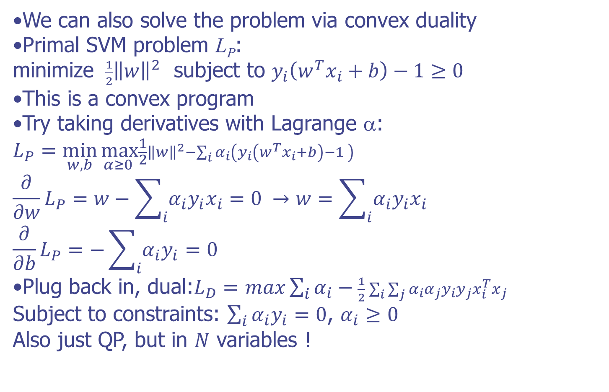
SVM in Dual Form
We can also solve the problem via convex duality
Primal SVM problem L_{P}: minimize ${ \frac{1}{2}\left\|w\right\|}^{2}$ subject to $y_{i}\left(w^{T}x_{i}+b\right)−1≥0$
This is a convex program
Try taking derivatives with Lagrange α:
$$L_{P}=\min_{w,b}{\max_{α≥0 }\frac{1}{2}{\left\|w\right\|}^{2}−\sum_{i}{α_{i}\left(y_{i}\left(w^{T}x_{i}+b\right)−1 \right)}}$$
$$\frac{∂}{∂w}L_{P}=w−\sum_{i}{α_{i}y_{i}x_{i}}=0 →w=\sum_{i}{α_{i}y_{i}x_{i}}$$
$$\frac{∂}{∂b}L_{P}=−\sum_{i}{α_{i}y_{i}}=0$$
Plug back in, dual:$L_{D}=$ $max\sum_{i}{α_{i}}−\frac{1}{2}\sum_{i}{\sum_{j}{α_{i}α_{j}y_{i}y_{j}x_{i}^{T}x_{j}}}$
Subject to constraints: $\sum_{i}{α_{i}y_{i}}=0$, $α_{i}≥0$
Also just QP, but in $N$ variables !
Notes:
ASK: What is a convex program? MORE general than convex function (I.e. e-family) and STILL UNIQUE!
ASK: To get LD, we note we have 1/2 w^2 and - w^2 from Lagrange, it just works out…
ASK: why positive alphas? Because INEQUALITIES,

Slide 38
SVM Dual Solution Properties
We have dual convex program: $L_{D}=$ $max\sum_{i}{α_{i}}−\frac{1}{2}\sum_{i}{\sum_{j}{α_{i}α_{j}y_{i}y_{j}x_{i}^{T}x_{j}}}$ subject to $\sum_{i}{α_{i}y_{i}}=0$, $α_{i}≥0$
Solve for N alphas (one per data point) instead of D w’s
Still convex (qp) so unique solution, gives alphas
Alphas can be used to get w: $w=\sum_{i}{α_{i}y_{i}x_{i}}$

Slide 39
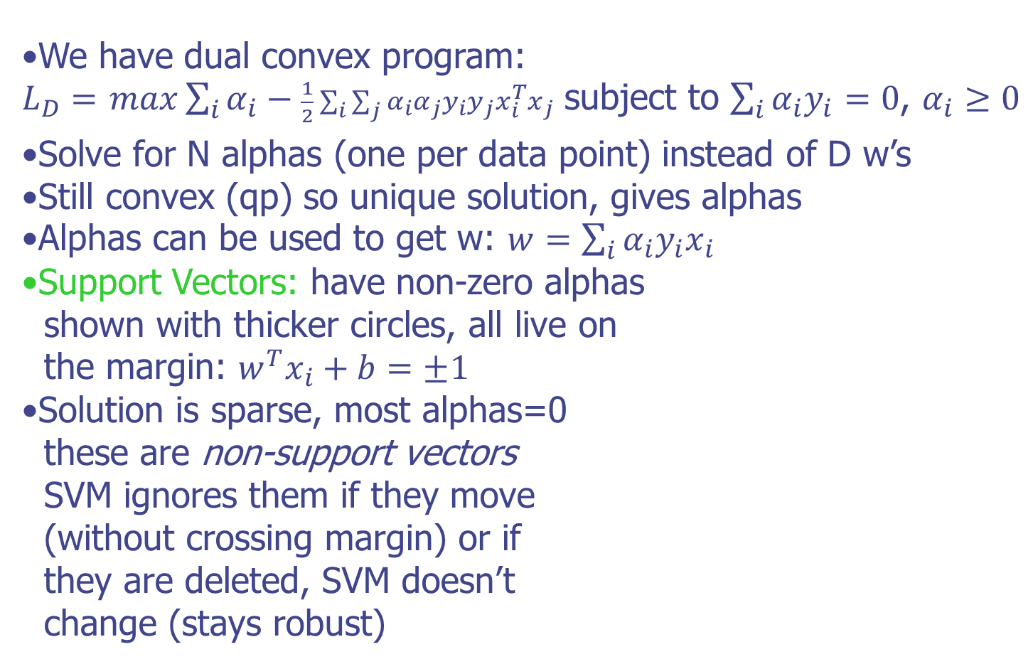
SVM Dual Solution Properties
We have dual convex program: $L_{D}=$ $max\sum_{i}{α_{i}}−\frac{1}{2}\sum_{i}{\sum_{j}{α_{i}α_{j}y_{i}y_{j}x_{i}^{T}x_{j}}}$ subject to $\sum_{i}{α_{i}y_{i}}=0$, $α_{i}≥0$
Solve for N alphas (one per data point) instead of D w’s
Still convex (qp) so unique solution, gives alphas
Alphas can be used to get w: $w=\sum_{i}{α_{i}y_{i}x_{i}}$
Support Vectors: have non-zero alphas
shown with thicker circles, all live on
the margin: $w^{T}x_{i}+b=±1$
Solution is sparse, most alphas=0
these are non-support vectors
SVM ignores them if they move
(without crossing margin) or if
they are deleted, SVM doesn’t
change (stays robust)

Slide 40
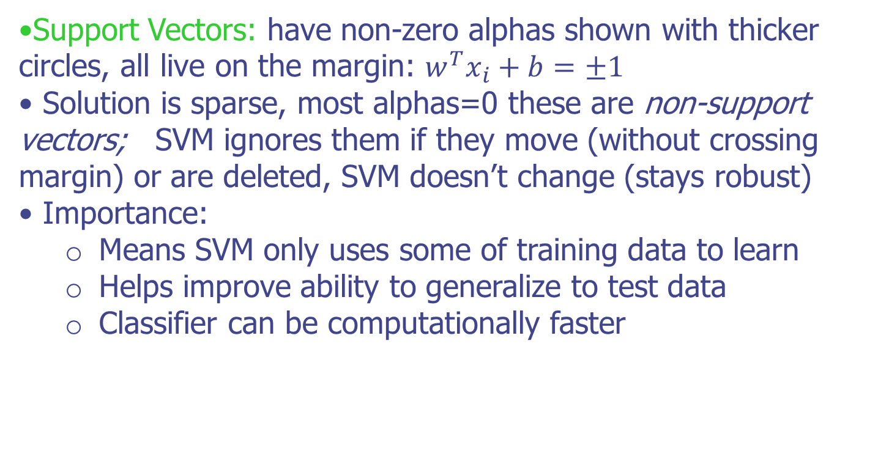
SVM Dual Solution Sparsity
Support Vectors: have non-zero alphas shown with thicker circles, all live on the margin: $w^{T}x_{i}+b=±1$
Solution is sparse, most alphas=0 these are non-support vectors; SVM ignores them if they move (without crossing margin) or are deleted, SVM doesn’t change (stays robust)
Importance:
Means SVM only uses some of training data to learn
Helps improve ability to generalize to test data
Classifier can be computationally faster

Slide 41
Summary
SVM maximizes gap
Solved by QP in #dimensions
Dual: QP in #datapoints
Leans on a few support vectors

