Slide 1
Advanced Topics in Sorting
ducnh-fit@mail.hut.edu.vn

Slide 2
Sorting applications
Sorting algorithms are essential in a broad variety of applications
Organize an MP3 library.
Display Google PageRank results.
List RSS news items in reverse chronological order.
Find the median.
Find the closest pair.
Binary search in a database.
Identify statistical outliers.
Find duplicates in a mailing list.
Data compression.
Computer graphics.
Computational biology.
Supply chain management.
Load balancing on a parallel computer.
. . .

Slide 3
Sorting algorithms
Many sorting algorithms to choose from
Internal sorts
Insertion sort, selection sort, bubblesort, shaker sort.
Quicksort, mergesort, heapsort, samplesort, shellsort.
Solitaire sort, red-black sort, splaysort, Dobosiewicz sort, psort, ...
External sorts
Poly-phase mergesort, cascade-merge, oscillating sort.
Radix sorts
Distribution, MSD, LSD.
3-way radix quicksort.
Parallel sorts
Bitonic sort, Batcher even-odd sort.
Smooth sort, cube sort, column sort.
GPUsort.

Slide 4
Which algorithm to use?
Applications have diverse attributes
Stable?
Multiple keys?
Deterministic?
Keys all distinct?
Multiple key types?
Linked list or arrays?
Large or small records?
Is your file randomly ordered?
Need guaranteed performance?
Cannot cover all combinations of attributes.

Slide 5
Case study 1
Problem
Sort a huge randomly-ordered file of small records.
Example
Process transaction records for a phone company.
Which sorting method to use?
Quicksort: YES, it's designed for this problem
Insertion sort: No, quadratic time for randomly-ordered files
Selection sort: No, always takes quadratic time

Slide 6
Case study 2
Problem
Sort a huge file that is already almost in order.
Example
Re-sort a huge database after a few changes.
Which sorting method to use?
Quicksort: probably no, insertion simpler and faster
Insertion sort: YES, linear time for most definitions of "in order"
Selection sort: No, always takes quadratic time

Slide 7
Case study 3
Problem: sort a file of huge records with tiny keys.
Ex: reorganizing your MP3 files.
Which sorting method to use?
Mergesort: probably no, selection sort simpler and faster
Insertion sort: no, too many exchanges
Selection sort: YES, linear time under reasonable assumptions
Ex: 5,000 records, each 2 million bytes with 100-byte keys.
Cost of comparisons: 100 x 50002 / 2 = 1.25 billion
Cost of exchanges: 2,000,000 x 5,000 = 10 trillion
Mergesort might be a factor of log (5000) slower.

Slide 8
Duplicate keys
Often, purpose of sort is to bring records with duplicate keys together.
Sort population by age.
Finding collinear points.
Remove duplicates from mailing list.
Sort job applicants by college attended.
Typical characteristics of such applications.
Huge file.
Small number of key values.
Mergesort with duplicate keys: always ~ N lg N compares
Quicksort with duplicate keys
algorithm goes quadratic unless partitioning stops on equal keys!
1990s Unix user found this problem in qsort()

Slide 9
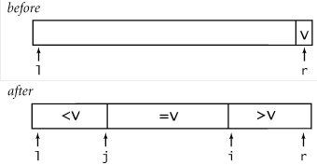
3-Way Partitioning
3-way partitioning. Partition elements into 3 parts:
Elements between i and j equal to partition element v.
No larger elements to left of i.
No smaller elements to right of j.

Slide 10
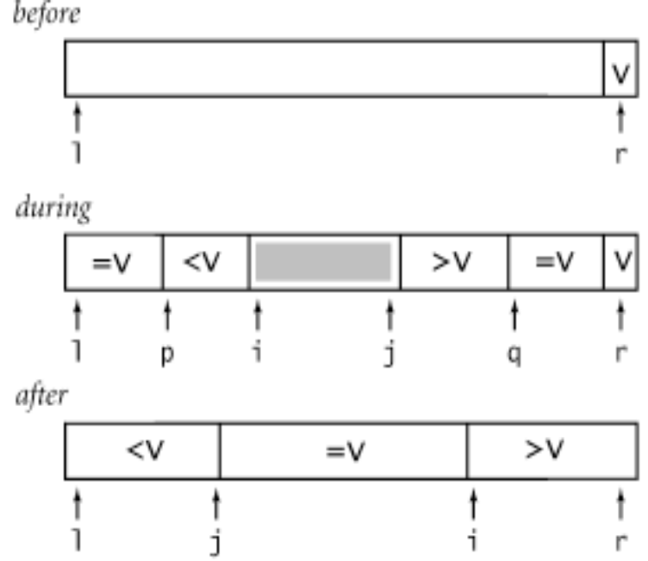
Implementation solution
3-way partitioning (Bentley-McIlroy): Partition elements into 4 parts:
no larger elements to left of i
no smaller elements to right of j
equal elements to left of p
equal elements to right of q
Afterwards, swap equal keys into center.

Slide 11
Code
void sort(int a[], int l, int r) {
if (r <= l) return;
int i = l-1, j = r;
int p = l-1, q = r;
while(1) {
while (a[++i] < a[r]));
while (a[r] < a[--j])) if (j == l) break;
if (i >= j) break;
exch(a, i, j);
if (a[i]==a[r]) exch(a, ++p, i);
if (a[j]==a[r]) exch(a, --q, j);
}
exch(a, i, r);
j = i - 1;
i = i + 1;
for (int k = l ; k <= p; k++) exch(a, k, j--);
for (int k = r-1; k >= q; k--) exch(a, k, i++);
sort(a, l, j);
sort(a, i, r);
}

Slide 12
Demo
demo-partition3.ppt

Slide 13
Quiz 1
Write two quick sort algorithms
  2-way partitioning
  3-way partitioning
Create two identical arrays of 10 millions randomized numbers having value from 1 to 10.
Compare the time for sorting the numbers using each algorithm

Slide 14
Instructions (1)
Write a function to create new data stored in a dynamic memory. The array’s size is passed as a parameter.
  int * createArray(int size);
Call rand() function to generate a random number in the range 0 to RAND_MAX
  #include <stdlib.h>
  i = rand();
Write a function to help duplicating data from an existing array.
  int * dumpArray(int *p, int size);

Slide 15
Instructions (2)
Call memcpy() function to copy data from an array to another array.
  memcpy(void* dest, void* src, size_t size);
Write 2 sorting algorithms in 2 functions:
  void sort2way(int a[], int l, int r);
  void sort3way(int a[], int l, int r);
Write a main() function where we can firstly verify the correctness of the sorting functions on a small data and then check their performance on a huge volume data.

Slide 16
Instructions (3)
#define SMALL_NUMBER 20
#define HUGE_NUMBER 10000000
main() {
int* a1, a2;
a1 = createArray(SMALL_NUMBER);
a2 = dumpArray(a1, SMALL_NUMBER);
sort2way(a1, 0, SMALL_NUMBER-1);
/* print data in a1 */
sort2way(a2, 0, SMALL_NUMBER-1);
/* print data in a2 */
free (a1);
free (a2);
a1 = createArray(HUGE_NUMBER);
a2 = dumpArray(a1, HUGE_NUMBER);
/* compare the time to execute sorting */
}

Slide 17
Instructions (4)
How to check the performance
#include <time.h>
#include <stdio.h>
time_t start,end;
volatile long unsigned t;
start = time(NULL);
/* your algorithm to check the performance */
end = time(NULL);
printf(“Run in %f seconds.\n", difftime(end, start));

Slide 18
Generalized sorting
In C we can use the qsort function for sorting
void qsort(
void *buf,
size_t num,
size_t size,
int (*compare)(void const *, void const *)
);
The qsort() function sorts buf (which contains num items, each of size size).
The compare function is used to compare the items in buf. compare should return negative if the first argument is less than the second, zero if they are equal, and positive if the first argument is greater than the second.

Slide 19
Example
int int_compare(void const* x, void const *y) {
int m, n;
m = *((int*)x);
n = *((int*)y);
if ( m == n ) return 0;
return m > n ? 1: -1;
}
void main()
{
int a[20], n;
/* input an array of numbers */
/* call qsort */
qsort(a, n, sizeof(int), int_compare);
}

Slide 20
Brief on function pointer
Declare a pointer to a function
  int (*pf) (int);
Declare a function
  int f(int);
Assign a function to a function pointer
  pf = &f;
Call a function via pointer
  ans = pf(5); // which are equivalent with ans = f(5)
In the qsort() function, compare is a function pointer to reference to a compare the items

Slide 21
Quiz 2
How to use qsort() to sort an array in ascendant or descendant order?
Rewrite the program in Quiz 1 to compare the performance of your algorithm with the one of qsort().
Let a file contain the data of a phone book (records of name and phone numbers). Write a program to read the phone book’s data and sort the records by name using qsort().

