Slide 1
Directed graphs
anhtt-fit@mail.hut.edu.vn

Slide 2
Terminology
Connected graph
  A graph is connected if and only if there exists a path between every pair of distinct vertices
Sub-graph
  A graph with the vertex and edge set being subsets of the original graph
Connected Components
  A connected component of a graph is a maximally connected subgraph of a graph
Cycle
  A path in a graph that starts and ends at the same vertex
Tree
  A graph G is a tree if and only if it is connected and acyclic
Directed Graph
  A graph whose the edges (arcs) are directional
Directed Acyclic Graph
  A directed graph with no directed cycles

Slide 3
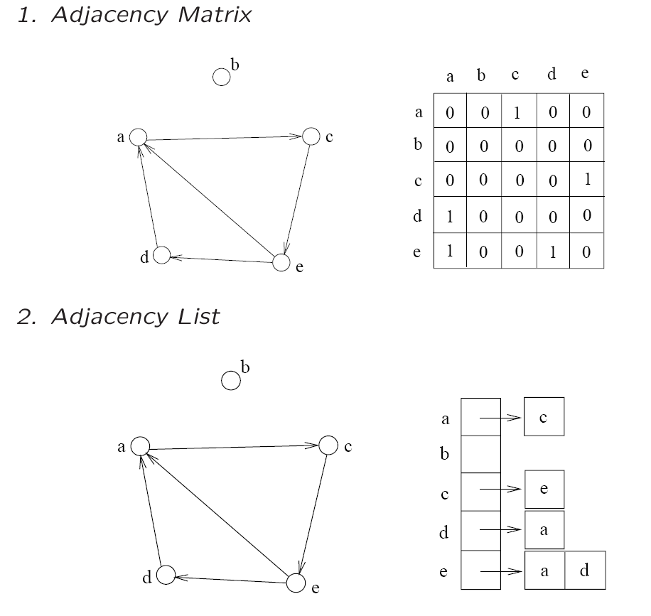
Directed Graphs
A directed graph can be represented by an adjacency matrix/list the same way as in undirected graph, except:
  An arc (u, v) only contributes to 1 entry in the adj. matrix or 1 node in the adj. list

Slide 4
Paths/Cycles
A directed graph can also contain paths and cycles
(“directed paths” and “directed cycles”)
  Graph on top has directed paths and directed cycle
  Graph on bottom has directed paths but NO directed cycle (acyclic)
b
a
c
b
a
c

Slide 5
Graph traversal
BFS and DFS can be used to traverse a directed graph, the same way as in undirected graph

Slide 6
DAG
DAG is directed graph without directed cycles
To check for cycles in a directed graph
  run DFS using an arbitrary vertex as the source. If the source can be visited twice, then there is a cycle in the graph.

Slide 7
A complete graph API
In the current graph API, only the edges are managed. Therefore we can not know how many vertices there are in the graph. Each vertex need also a name for identification.
Redefine the graph structure in order the vertices data are stored in a tree as the following
  typedef struct {
  JRB edges;
  JRB vertices;
  } Graph;

Slide 8
API (cont.)
  Graph createGraph();
  void addVertex(Graph graph, int id, char* name);
  char *getVertex(Graph graph, int id);
  void addEdge(Graph graph, int v1, int v2);
  int hasEdge(Graph graph, int v1, int v2);
  int indegree(Graph graph, int v, int* output);
  int outdegree(Graph graph, int v, int* output);
  int DAG(Graph graph);
  void dropGraph(Graph graph);

Slide 9
Quiz 1
Implement the directed graph API based on the given specification
Test your new API with the following example
  Graph g = createGraph();
  addVertex(g, 0, "V0");
  addVertex(g, 1, "V1");
  addVertex(g, 2, "V2");
  addVertex(g, 3, "V3");
  addEdge(g, 0, 1);
  addEdge(g, 1, 2);
  addEdge(g, 2, 0);
  addEdge(g, 1, 3);
  if (DAG(g)) printf("The graph is acycle\n");
  else printf("Have cycles in the graph\n");

Slide 10
Solution
directed_graph.c

Slide 11
Topological Sort
One can make use of the direction in the directed graph to represent a dependent relationship
  COMP104 is a pre-requisite of COMP171
  Breakfast has to be taken before lunch
A typical application is to schedule an order preserving the order-of-completion constraints following a topological sort algorithm
  We let each vertex represents a task to be executed. Tasks are inter-dependent that some tasks cannot start before another task finishes
  Given a directed acyclic graph, our goal is to output a linear order of the tasks so that the chronological constraints posed by the arcs are respected
  The linear order may not be unique

Slide 12
Topological Sort Algorithm
Build an “indegree table” of the DAG
Output a vertex v with zero indegree
For vertex v, the arc (v, w) is no longer useful since the task (vertex) w does not need to wait for v to finish anymore
  So after outputting the vertex v, we can remove v and all its outgoing arcs. The result graph is still a directed acyclic graph. So we can repeat from step 2 until no vertex is left

Slide 13
Demo
demo-topological.ppt

Slide 14
Pseudocode
Algorithm TSort(G)
Input: a directed acyclic graph G
Output: a topological ordering of vertices
Initialize Q to be an empty queue;
For each vertex v
do if indegree(v) = 0
then enqueue(Q,v);
While Q is non-empty
do v := dequeue(Q);
output v;
for each arc(v,w)
do indegree(w) = indegree(w)-1;
if indegree(w) = 0
then enqueue(w);

Slide 15
Quiz 2
Let a file describe the perquisites between classes as the following
    CLASS CS140
    PREREQ CS102
    CLASS CS160
    PREREQ CS102
    CLASS CS302
    PREREQ CS140
    CLASS CS311
    PREREQ MATH300
    PREREQ CS302
Use the last graph API to write a program to give a topological order of these classes

Slide 16
Hint
Create a new function in the for topological sort.
  void topologicalSort(Graph g, int* output, int* n);
Reuse the following example to test the function.
  Graph g = createGraph();
  addVertex(g, 0, "CS102"); addVertex(g, 1, "CS140");
  addVertex(g, 2, "CS160"); addVertex(g, 3, "CS302");
  addVertex(g, 4, "CS311"); addVertex(g, 5, "MATH300");
  addEdge(g, 0, 1); addEdge(g, 0, 2);
  addEdge(g, 1, 3); addEdge(g, 5, 4); addEdge(g, 3, 4);
  if (!DAG(g)) {
  printf(“Can not make topological sort\n");
  return 1; }
  topologicalSort(g, output, &n);
  printf(“The topological order:\n”);
  for (i=0; i<n; i++)
  printf(“%s\n”, getVertex(g, output[i]));

Slide 17
Solution
topological_sort.c

