Slide 1
State space search
anhtt-fit@mail.hut.edu.vn

Slide 2
State Space Search
Define problem in form of a state space
and use a search algorithm to find a solution
The problem space consists of:
  a state space which is a set of states representing the possible configurations of the world
  a set of operators which can change one state into another
The problem space can be viewed as a graph where the states are the nodes and the arcs represent the operators.

Slide 3
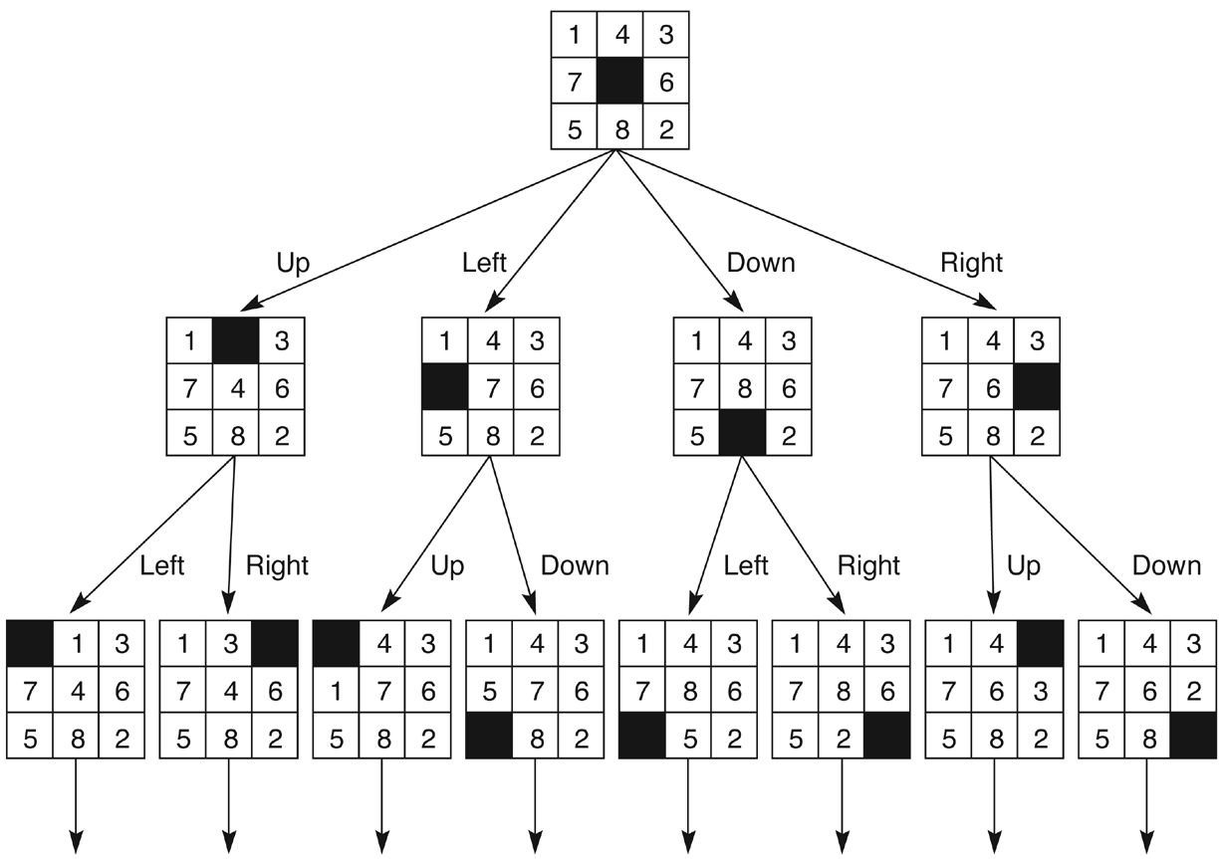
State space of the 8-puzzle

Slide 4
Size of search space: 8/16-puzzle
8-puzzle: 8! = 40,320 different states
16-puzzle: 16! =20,922,789,888,000 ≈ 10¹³ different states
Game works by moving tiles
Simplification: assume only blank tile is moved
Legal moves: blank up, down, left, right
Keep blank tile on board
State space consists of two disconnected subgraphs

Slide 5
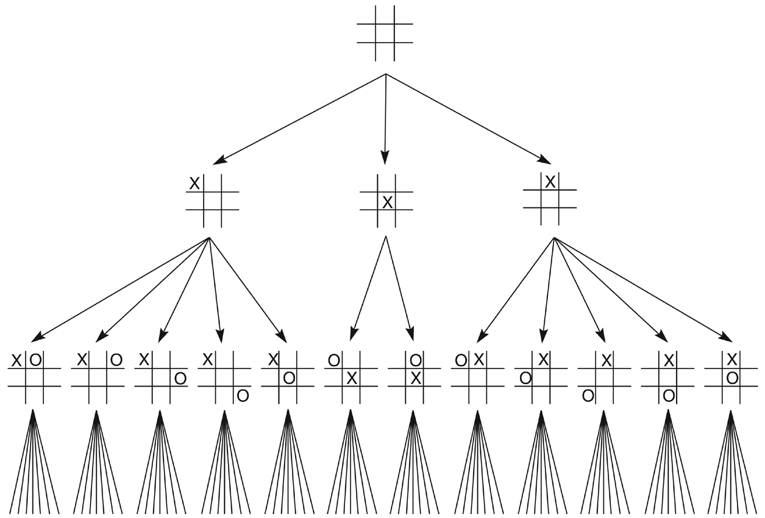
State space of tic-tac-toe

Slide 6
Size of search space: tic-tac-toe
Start is empty board
Goal is board with 3 Xs in a row, column or diagonal
Path from start to end gives a series of moves in a winning game
Vocabulary is (blank, X, O)
3⁹ = 19,683 ways to arrange (blank, X, O) in 9 spaces
No cycles possible: why?
Represented as DAG (directed acyclic graph)
9! = 362,880 different paths can be generated: why?

Slide 7
Search Strategies
Traverse the graph from an initial state to find a goal
Alternative search strategies:
  Depth-first: visit children before siblings (= alg. backtrack)
  Breadth-first: visit graph level-by-level
  Best-first: order unvisited nodes through heuristic, finding best candidate for next step

Slide 8
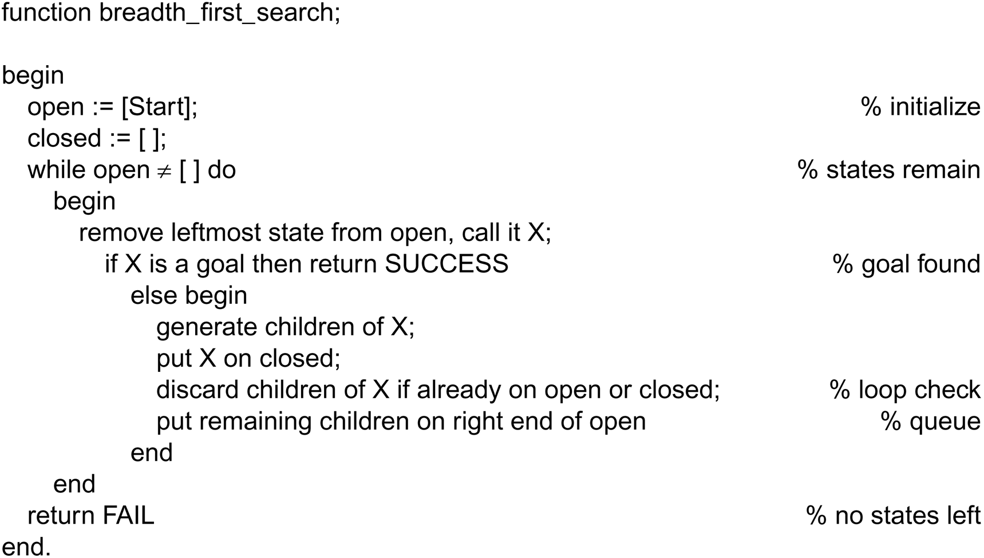
Breadth-First search

Slide 9
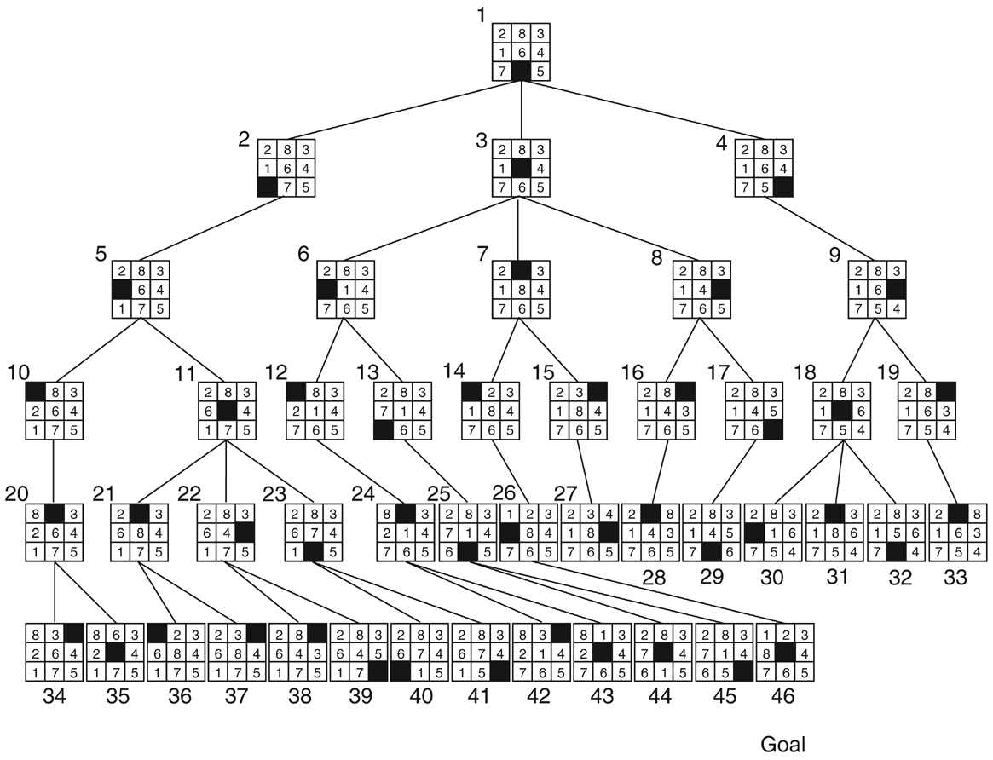
Breadth-first search of the 8-puzzle
Goal

Slide 10
Quiz 1
Write a program to print out solutions for the 8-puzzle game using the BFS algorithm.
Question to solve:
  How to represent a state of 8-puzzle game in memory?
  How to compare two states?
  How to generate sub-states from a state?
  How to store states in two collections (open and closed)?
  How to print a state in the screen?

Slide 11
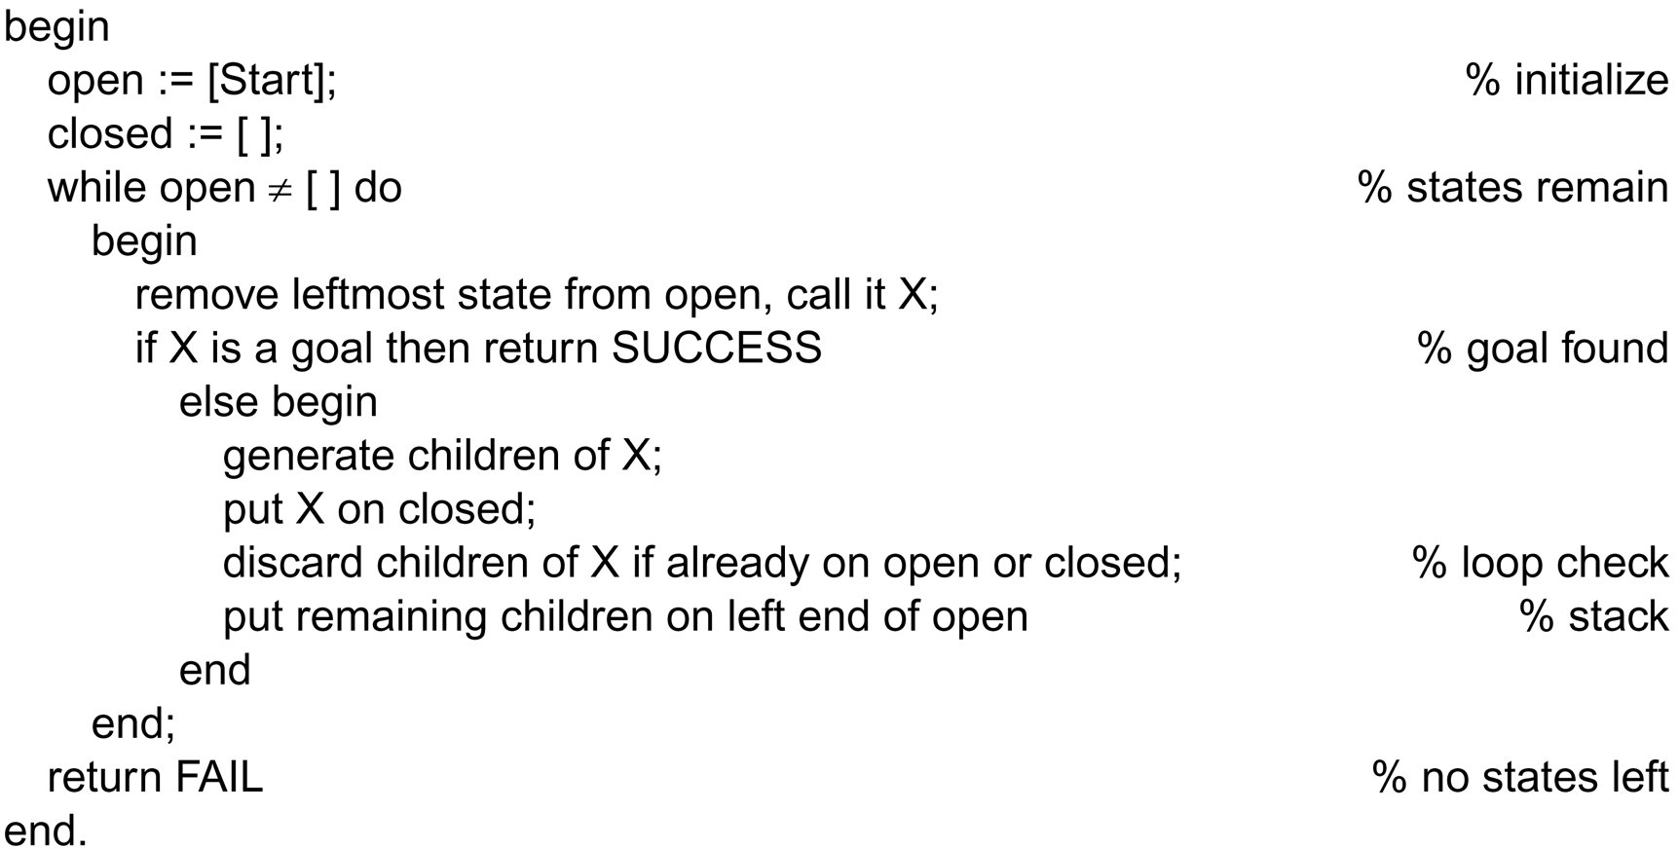
Depth first search

Slide 12
Depth-first vs. breadth-first
Breadth-first:
  always finds shortest path
  inefficient if branching factor B is very high
  memory requirements high
  exponential space for states required: B^{n}
Depth-first:
  does not always find shortest path
  efficient if solution path is known to be long
  but can get „lost“ in (infinitely) deep paths
  only memory for states of one path needed: B×n

Slide 13
Iterative Deepening
Compromise solution:
use depth-first search, but
with a maximum depth before going to next level
→ Depth-first Iterative Deepening

Slide 14
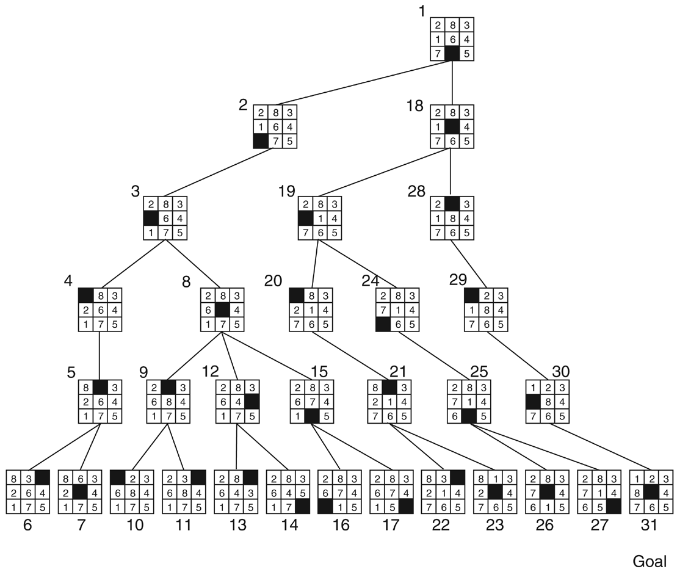
Depth-first search of the 8-puzzle
Depth-first search of the 8-puzzle with a depth bound of 5
Goal

Slide 15
Quiz 2
Rewrite the program in Quiz 1 using the DFS algorithm.
Compare the solution given by the two strategies.

