Slide 1
Unit 2.
The phases of a Compiler

Slide 2
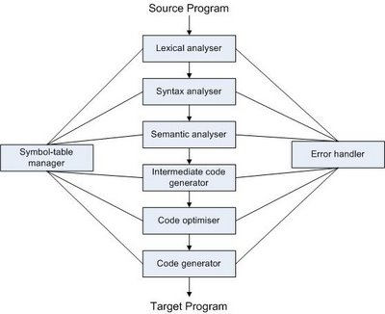
Phases of a compiler
Notes:
What is a compiler: A program that converts the source code written in a high level language to the target code written in machine language.
Compilation process is a sequnece of 6 processes.:…..
Output of a process is the input of the next process. Symbol table is used to keep information and error handler is used to inform errors

Slide 3
Phases of a compiler
Lexical Analysis
  Stream of characters making up the source program is read from left to right and grouped into tokens (sequences of characters having a collective meaning)
Syntax Analysis
  Group the tokens of the source program into grammatical phrases that are used by the compiler to synthesize output

Slide 4
Phases of a compiler
Semantic Analysis: Check the source program for semantic errors and gather type information for the subsequent code generation phase.
Intermediate Code Generation: Generate an intermediate representation as a program for an abstract machine.

Slide 5
Phases of a compiler
Code optimization : Improve the intermediate code so that faster running code will result
Code generation: Generation of target code, consisting normally of relocatable machine code or assembly code

Slide 6
The Grouping of phases
Compiler front and back ends:
  Front end: analysis (machine independent)
  Back end: synthesis (machine dependent)
Compiler passes:
  A collection of phases is done only once (single pass) or multiple times (multi pass)
    Single pass: usually requires everything to be defined before being used in source program
    Multi pass: compiler may have to keep entire program representation in memory

Slide 7
Phase 1:Lexical Analysis
Lexical analysis is the process of converting the stream of input characters into a stream of tokens that becomes the input to the next phase (parsing) while removing white spaces and comments
Meaningful tokens are called Lexemes
The program that perform lexical analysis is usually called scanner
Notes:
Lexeme

Slide 8
Example
In statement:
  position:= initial +rate *60
  position, initial, rate are identifiers
  := is assign operator
  + is addition operator
  * is multiplication operator
  60 is number
  The statement includes 7 lexemes, 5 tokens

Slide 9
phase 2: Parsing
The process of determining if a string of token can be generate by a grammar
Is executed by a parser

Slide 10
phase 2: Parsing
Output of a parser:
  Parse tree (if any)
  Error Message (otherwise)
If a parse tree is built succesfully, the program is grammatically correct
Notes:
The second phrase of compiler
Take the input from lexical analyzer in the form of token string
Analyze against syntax rules to find the errors or generate the parse tree

Slide 11
Syntax Rules of an assign statement
Any identifier is an Expression
Any number is an Expression
If E1 and E2 are Expressions then E1 *E2 and E1+E2 are Expressions
If id is an identifier and E is an Expression then an assignment statement has form id:=E
Notes:
Consider the description of the syntax rules of an assignment (explain rules)

Slide 12
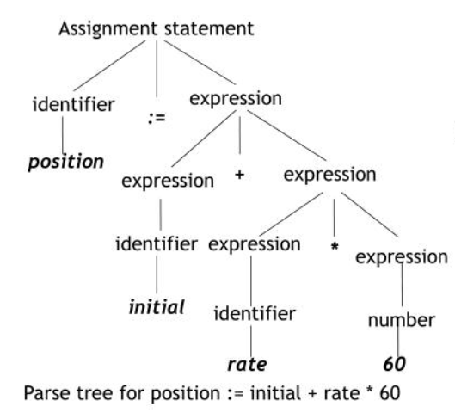
Parse tree
Notes:
By looking at the rules of previous slide, we can build a hierarchical structure, a tree.
By rule 1, we can draw the tree ….

Slide 13
Grammars,languages, BNF,syntax diagrams
The parser takes the token produced by scanner as input and generates a parse tree (or syntax tree). Token arrangements are checked against the grammar of the source language.
Notations for grammar:
  BNF (Backus-Naur Form) is is a meta language used to express grammars of programming languages
  Syntax Diagrams : A pictorial diagram showing the rules for forming an instruction in a programming language, and how the components of the statement are related. Syntax diagrams are like directed graphs.

Slide 14
BNF
BNF (and formal grammars) use 2 types of symbol
Terminals :
  Tokens of the language
  Never appear in the left side of any production
Nonterminals
  Intermediate symbol to express structures of a language
  Must be in a left side of at lease one production
  Enclose in <>
Start symbol
  Nonterminal of the first level
  Appear at the root of parse tree

Slide 15
Grammars,languages, BNF,syntax diagrams
Start symbol :
  Nonterminal of the first level
  Appear at the root of parse tree

Slide 16
Parsing: Concept and Techniques
Continuously apply grammatical rules until a string of terminal is generated.
If the parser convert first symbol into the input string, it is syntactically correct
Otherwise, string is not syntactically correct

Slide 17
Parsing: Concept and techniques
The most important thing of a compiler: grammar
Grammar includes all structures of a program
Not includes any other rule

Slide 18
Parsing: Concept and Techniques
Grammar must be unambiguous
If grammar is ambiguous, more than one parse tree can be created

Slide 19
phase 3: Semantic Analysis
Certain check are performed to ensure that the components of a program fit together meaningfully
To generate code, source program must be syntactically and semantically correct

Slide 20


Slide 21
phase 4: Intermediate code generation
Source program is transferred to an equivalent program in intermediate code by intermediate code generator
Intermediate code is close to the target code, which makes it suitable for register and memory allocation, instruction set selection, etc.
It is good for machine-dependent optimizations.

Slide 22
Advantages of Intermediate Code
  Easy to translate into object code.
  Code optimizer can be applied before code generation
  Decrease time cost

Slide 23
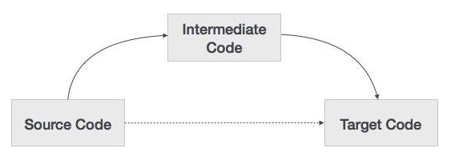
phase 5: Code Generator
Input: Intermediate code of source program
Output: Object program
  Assembly code
  Virtual machine code

Slide 24
Problems
Input
Output
Object machine
  Set of instruction
  Register allocation

Slide 25
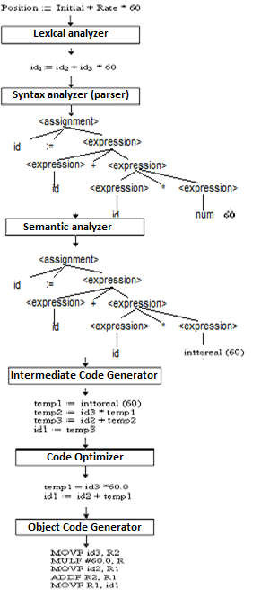
Translation of a statement

Slide 26
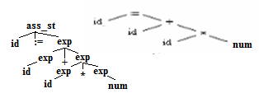



Details of the phases of a Compiler
phase | Output | Sample
Programmer (source code producer) | Source string | Position:= inition * rate + 60
Scanner (performs lexical analyzer) | Token string | position’, ‘:=’, ‘inition’, ‘+’, ‘60’, And symbol table with identifier
Parser (performs syntax analysis based on the grammar of the programming language) | Parse tree or abstract syntax tree
Semantic analyzer (type checking, etc) | Annotated parse tree or abstract syntax tree | Convert integer (60) to real
Intermediate code generator | Three-address code
Optimizer | Three-address code
Code generator | Assembly code
Notes:
Parse tree show the concrete syntax (how tokens are grouped together)
the tree initially constructed by the parser
Abstract tree show the semantically significant structure
the tree returned by the parser and manipulated by type checker
The structure of trees
Parse tree:
nodes: nonterminals (= syntactic categories)
leaves: terminals (= tokens)
Abstract tree:
nodes: constructor functions
leaves: atoms (= zero-place constructor functions)
The definition and construction of trees
Parse trees are defined by context-free grammars
Exp ::= Exp "+" Exp ; Exp ::= "2" ; Exp ::= "3" ;
Abstract trees are defined by constructor type signatures
plus : (Exp, Exp) -> Exp 2 : Exp 3 : Exp
From concrete to abstract syntax
1. Give a name (= label) to each rule:
Exp ::= Exp "+" Exp ==> plus. Exp ::= Exp "+" Exp
2. Ignore terminals (= tokens, in quotes):
plus .Exp ::= Exp "+" Exp ==> plus. Exp ::= Exp Exp
3. Treat label as constructor name, LHS (left-hand-side) as value type, RHS as argument types:
plus. Exp ::= Exp Exp ==> plus : (Exp, Exp) -> Exp

