Slide 1
Predicting App Ratings
Group 11
Dao Ngoc Thanh - 20163693
Nguyen Duc Dung - 20160674
Vu Thanh Tung - 20164571
Tran Bich Ngoc - 20167313
Tran Duc Phung - 20166589

Slide 2
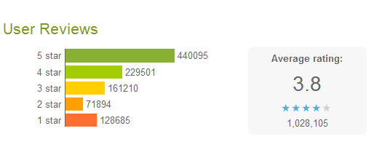
1.Problem
Find the overall rating of a mobile app -> recommended & trusted by users that find the app while browsing the app store.
Help developers to be able to predict the success of their app, then infer more appropriate orientation

Slide 3
2.Investigation
The approaches and techniques used to conduct predictive analysis:
Regression techniques : focus on establishing a mathematical equation as a model to represent the interactions between the different variables
Linear regression model
Discrete choice models
Classification and regression models
Machine learning techniques : emulate human cognition and learn from training examples to predict future events
Neural networks
k-nearest neigbours
Naïve Bayes, ...

Slide 4
3.Dataset and Tools
Google Play Store App
- Dataset has 12 features and one target variable (the rating) and about 10.8k entries
- For file , the dataset provides insights about each app: App name, Category, Rating, No. Reviews, Size, No. Download, Price, Genres...
Tools: pandas, numpy, seaborn, matplotlib, scikit-learn

Slide 5
4. Methods and Analysis
Data Processing (Data Exploring, Data Cleaning, Plotting)
Categorical Data Encoding
All data should be ready for model because some machine learning algorithms do not support categorical values -> Convert categorical variables to numerical variables
Building Machine Learning Model (Decision Tree, Random Forest)
Feature Selection
Select features in data that contribute most to the prediction variable or output in which the target aims for
Reduce Overfitting
Improve Accuracy
Reduce training time

Slide 6
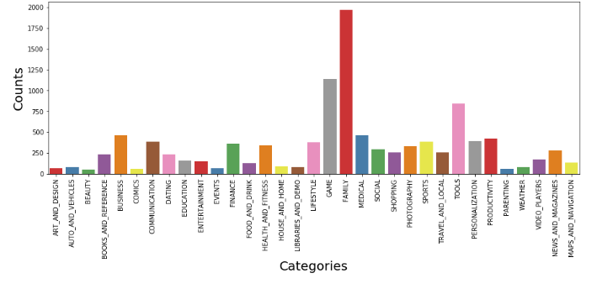
Data analysis
Count of application according to Category

Slide 7
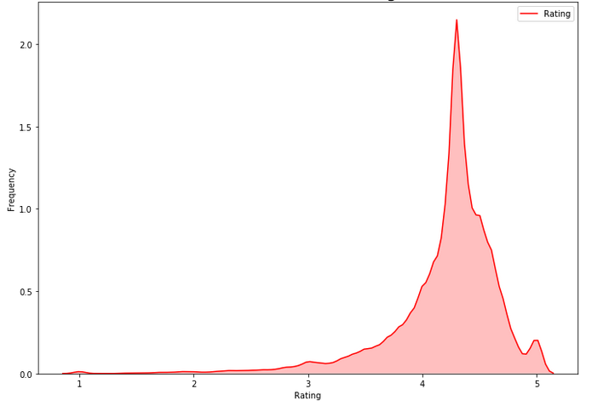
Data analysis
Rating distribution

Slide 8
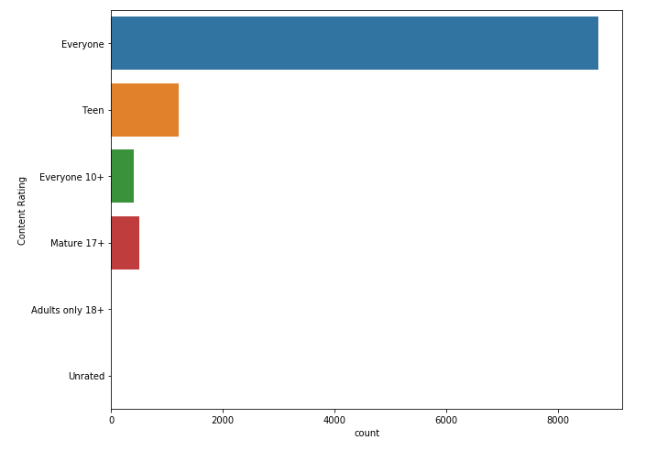
Data analysis
Content Distribution

Slide 9
Categorical Data Encoding
One Hot Encoding
map each category to a vector that contains 1 and 0 denoting the presence or absence of the feature
Label Encoding
assign a value from 1 through N (here N is the number of category for the feature)

Slide 10
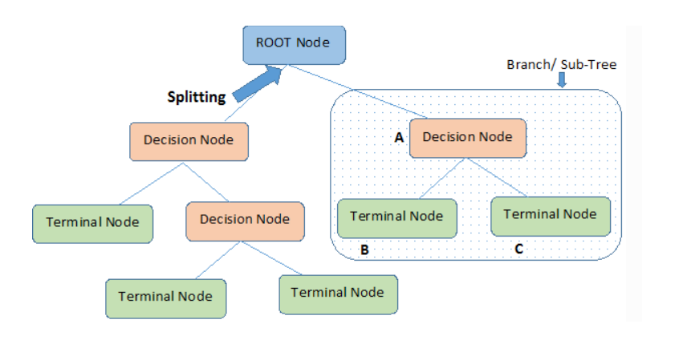
Building Machine Learning Model
Decision Tree Regression using
scikit-learn
Observes features of an object and trains a model in the structure of a tree to predict data in the future
Why Decision Tree?
Easy to Understand, Interpret, Visualize
Less data preparation required
Can capture Nonlinear relationships
Data type is not a constraint

Slide 11
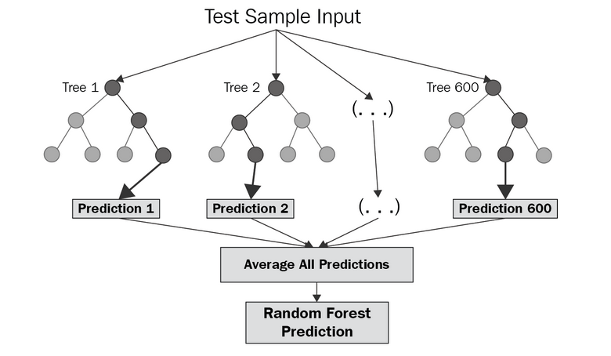
Building Machine Learning Model
Random Forest Regression Model
Decision trees carry a big risk of overfitting -> random forest : combining many decision trees into one model
The trees in random forests are run in parallel
-> outputting mean prediction (regression) of the individual trees

Slide 12
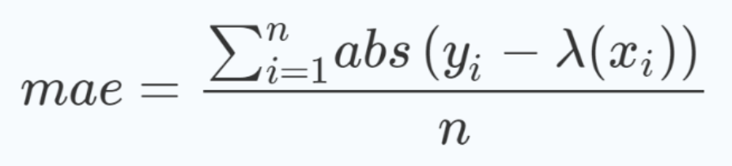
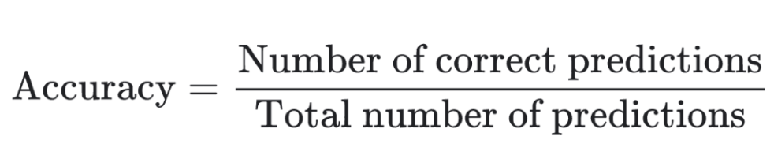
Evaluation
MAE (Mean Absolute Error)
Accuracy

Slide 13
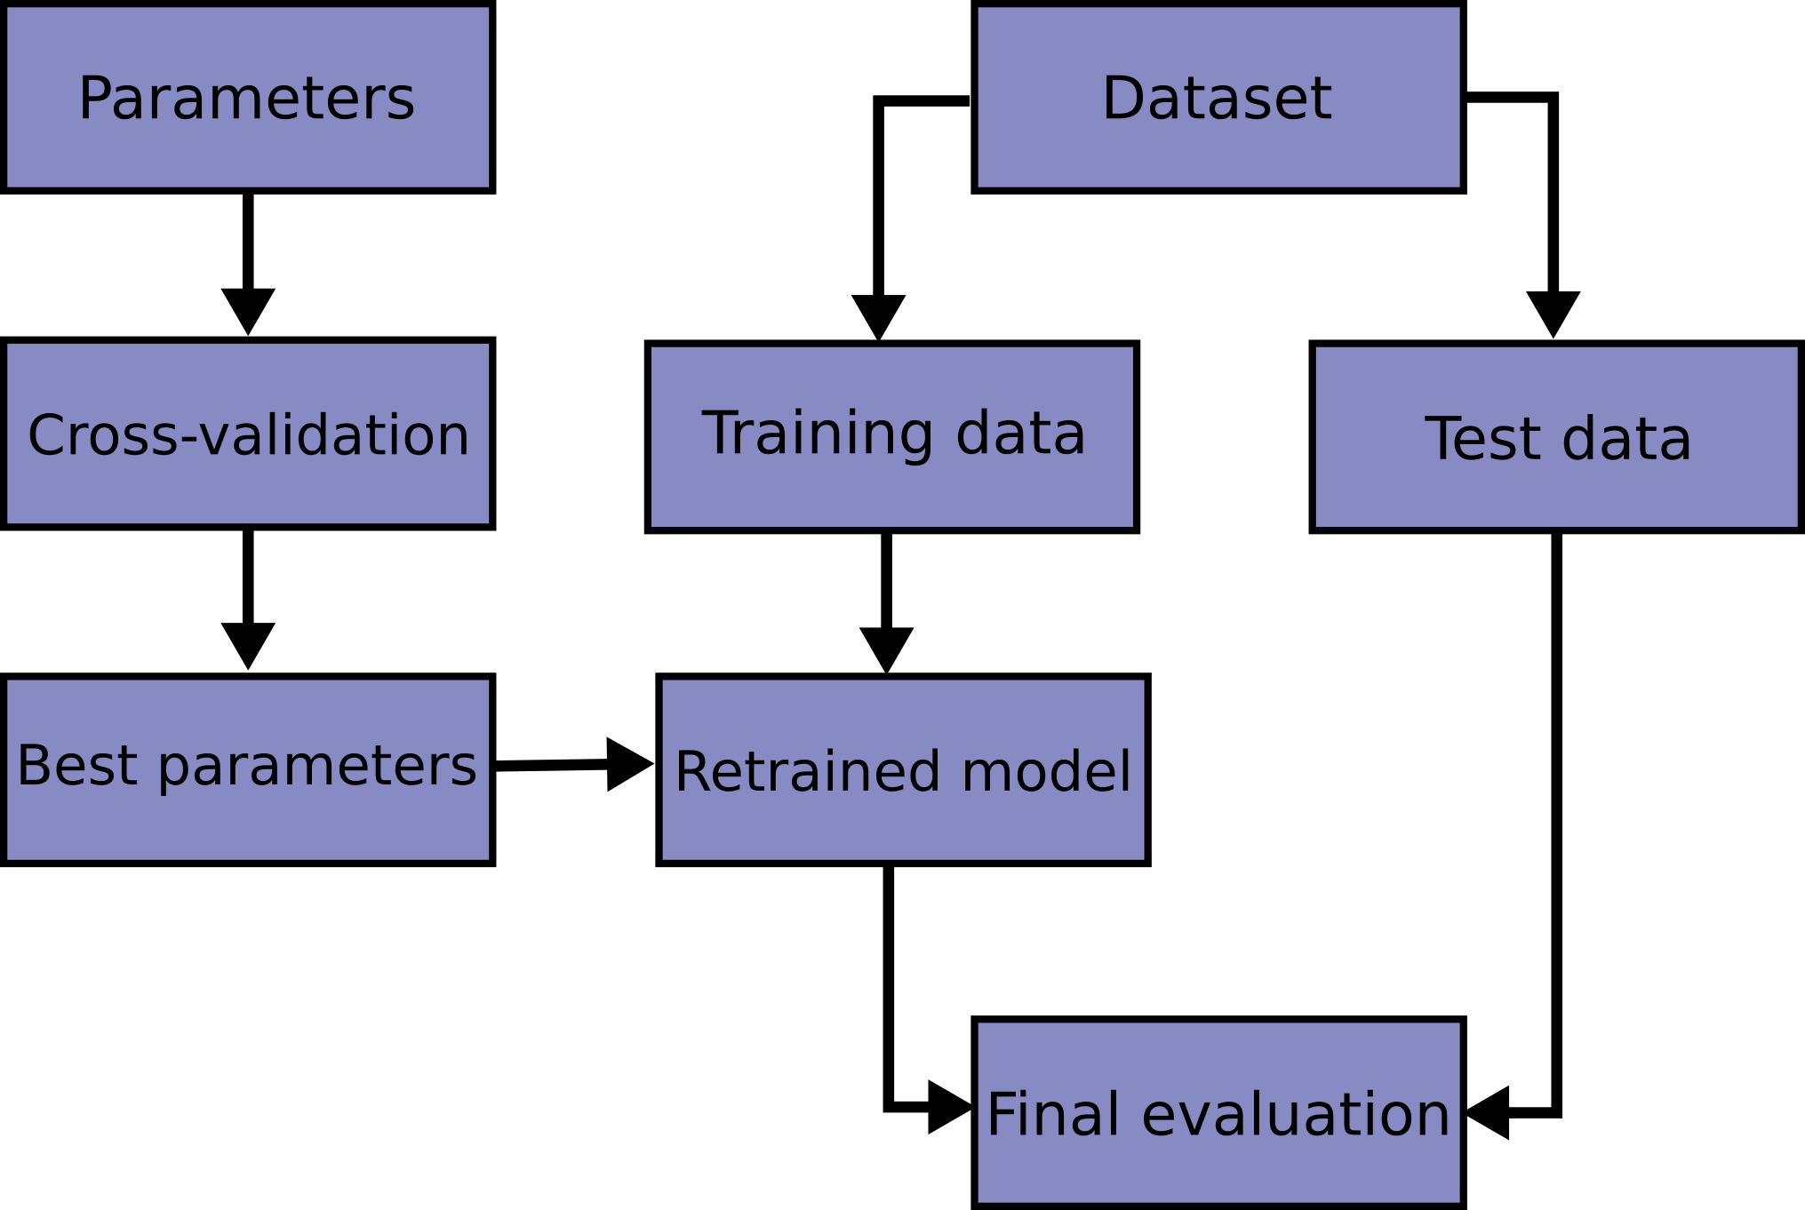

Evaluation
Cross-validation
For choosing the best parameters

Slide 14
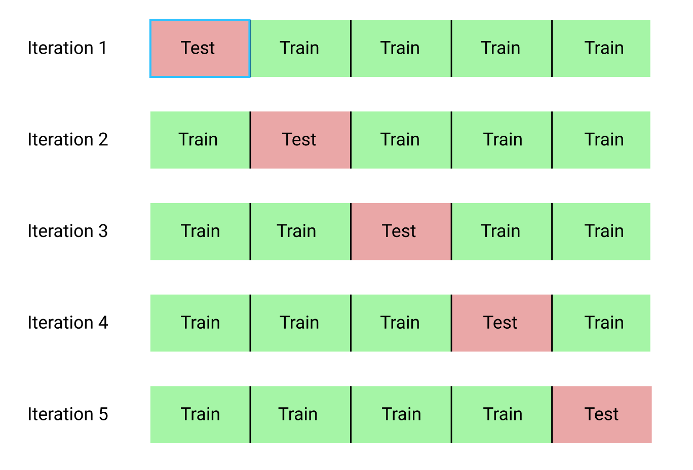
Evaluation
Cross-validation
For evaluating the model

Slide 15
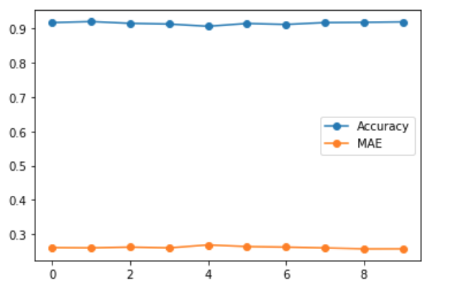
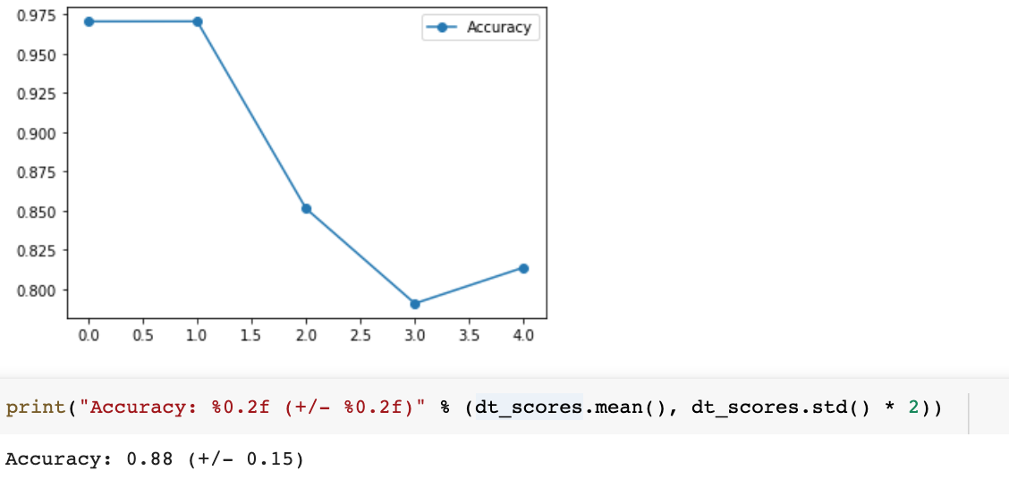
Evaluation result
Decision tree

Slide 16
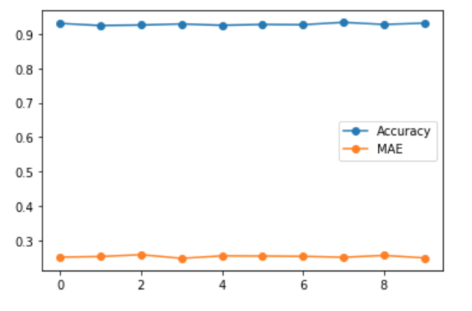
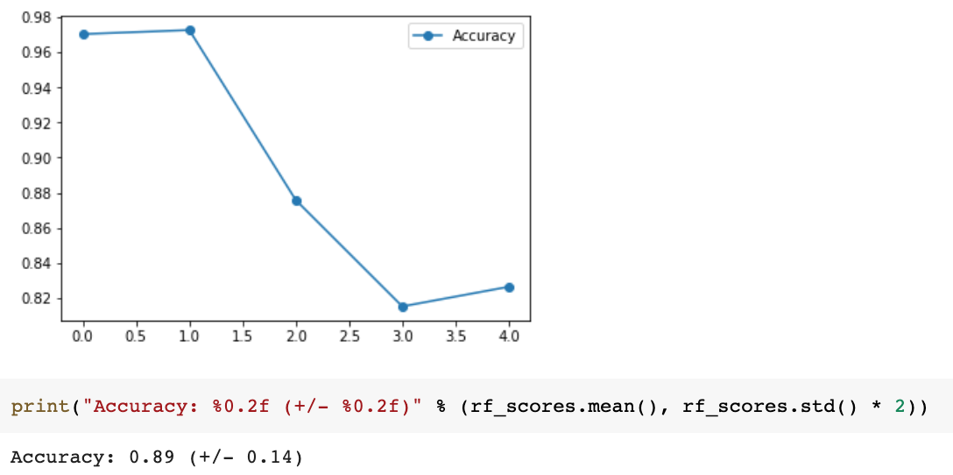
Evaluation result
Random forest

Slide 17
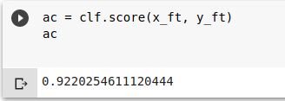
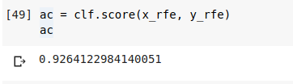
Feature selection
Filter methods : filter and take only the subset of the relevant features, not incorporating a specific machine learning algorithm but fast and less prone to overfitting
Wrapper : feed the features to the selected Machine Learning algorithm and based on the model performance you add/remove the features

Slide 18
Reference
https://www.kaggle.com/lava18/google-play-store-apps/data
https://en.wikipedia.org/wiki/Predictive_analytics
https://towardsdatascience.com/feature-selection-with-pandas-e3690ad8504b

