Slide 1
Introduction to PostgreSQL

Slide 2
Outline
Database environments
Comparing PostgreSQL
Installing PostgreSQL on Windows
The PostgreSQL Files and Programs

Slide 3
1. Database environments

Slide 4
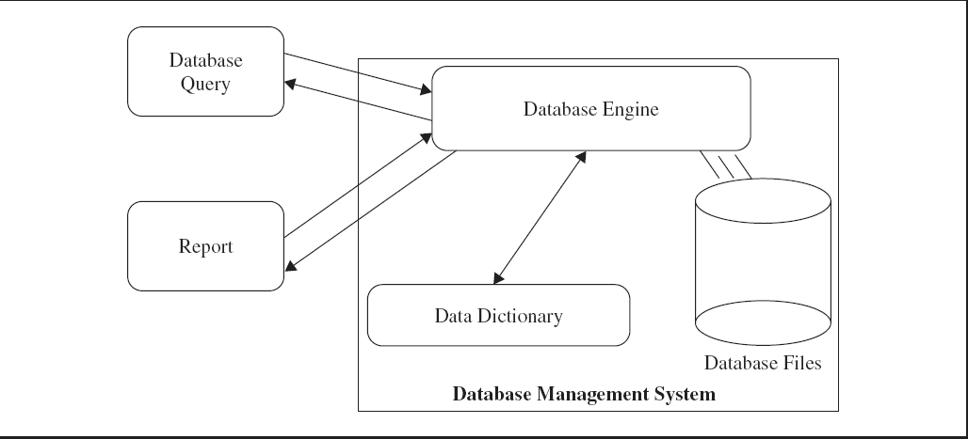
A Simple Database engine

Slide 5
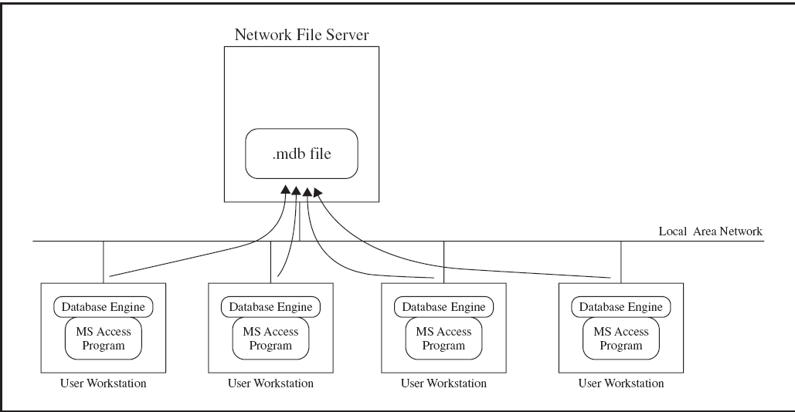
A shared Microsoft Access environment

Slide 6
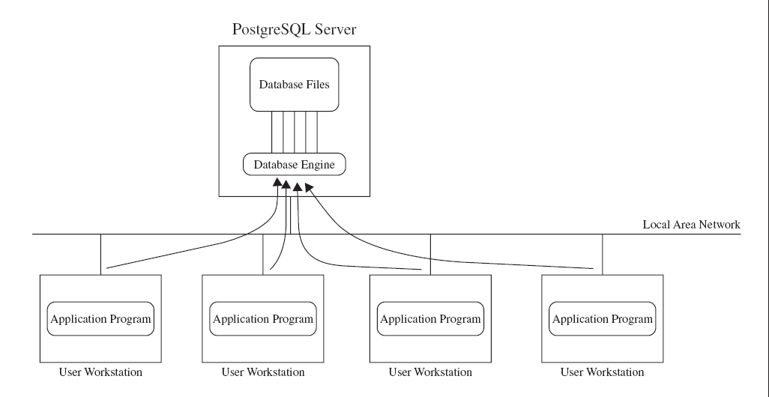
A multiuser PostgreSQL environment

Slide 7
2. Comparing PostgreSQL

Slide 8
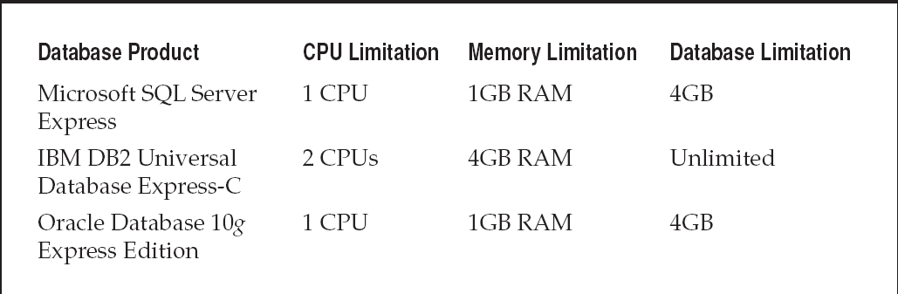
PostgreSQL Versus Commercial DBMS Products
Free Commercial Database Limitations
PostGreSQL:
- free open source
No limitations: CPU, Memory, Database
Notes:
CPU limitation ?

Slide 9
3. Installing PostgreSQL on Windows

Slide 10
Download
http://www.postgresql.org/download/windows
http://www.enterprisedb.com/products-services-training/pgdownload#windows
(Lastest version 9.6)
The graphical installer for PostgreSQL includes
the PostgreSQL server
pgAdmin III: a graphical tool for managing and developing your databases
and StackBuilder: a package manager that can be used to download and install additional PostgreSQL applications and drivers

Slide 11
Install and test
Install
Stop/start server (run as administrator)
Connect to server from pgAdminIII

Slide 12
Notes: Uninstall postgreSQL
Uninstall
Remove data directory
C:\Program Files\PostgreSQL

Slide 13
4. Install PostgreSQL on Ubuntu
Notes:
https://www.postgresql.org/download/linux/ubuntu/
https://help.ubuntu.com/community/PostgreSQL
http://suite.opengeo.org/docs/latest/dataadmin/pgGettingStarted/firstconnect.html

Slide 14
Install
Postgresql APT Repository:
Create the file /etc/apt/sources.list.d/pgdg.list and add a line for the repository:
deb http://apt.postgresql.org/pub/repos/apt/ YOUR_UBUNTU_VERSION_HERE-pgdg main
YOUR_UBUNTU_VERSION_HERE: trusty (ubuntu 14.04), xenial (ubuntu 16.04), bionic (ubuntu 18.04)
Import the repository signing key, and update the package lists:
wget -quiet -O - https://www.postgresql.org/media/keys/ACCC4CF8.asc | sudo apt-key add -
sudo apt-get update
Notes:
YOUR_UBUNTU_VERSION_HERE
deb http://apt.postgresql.org/pub/repos/apt/ trusty-pgdg main
deb http://apt.postgresql.org/pub/repos/apt/ xenial-pgdg main
deb http://apt.postgresql.org/pub/repos/apt/ bionic-pgdg main
The repository contains many different packages including third party addons. The most common and important packages are (substitute the version number as required):
postgresql-client-10 client libraries and client binaries
postgresql-10 core database server
postgresql-contrib-9.x additional supplied modules (part of the postgresql-xx package in version 10 and later)
libpq-dev libraries and headers for C language frontend development
postgresql-server-dev-10 libraries and headers for C language backend development
pgadmin4 pgAdmin 4 graphical administration utility

Slide 15
Install
Install PostgreSQL on Ubuntu, use the apt-get command:
sudo apt-get install postgresql-10
(Installed packages: postgresql-10, postgresql-client-10, postgresql-client-common, postgresql-common, sysstat , …)
If pgadmin4 (a graphical administration utility) is not installed, use the apt-get command:
sudo apt-get install pgadmin4
Notes:
YOUR_UBUNTU_VERSION_HERE
deb http://apt.postgresql.org/pub/repos/apt/ trusty-pgdg main
deb http://apt.postgresql.org/pub/repos/apt/ xenial-pgdg main
deb http://apt.postgresql.org/pub/repos/apt/ bionic-pgdg main
The repository contains many different packages including third party addons. The most common and important packages are (substitute the version number as required):
postgresql-client-10 client libraries and client binaries
postgresql-10 core database server
postgresql-contrib-9.x additional supplied modules (part of the postgresql-xx package in version 10 and later)
libpq-dev libraries and headers for C language frontend development
postgresql-server-dev-10 libraries and headers for C language backend development
pgadmin4 pgAdmin 4 graphical administration utility

Slide 16
Client installation
If you only wish to connect to an external PostgreSQL server, install only the PostgreSQL client package:
Client installation
sudo apt-get install postgresql-client
Connect to the server:
psql -h server.domain.org database user
Example: psql -h 192.168.100.5 postgres postgres

Slide 17
Basic Server Setup
Set the password of the PostgreSQL user (role) called "postgres"
Connect as a role with the same name as the local user (i.e. postgres) to the database "postgres"
sudo -u postgres psql postgres
Set a password for the "postgres" database role:
\password postgres and then give your password when prompted
Exit the psql prompt: \q
Create the first database
sudo -u postgres createdb mydb

Slide 18
Basic Server Setup
Allowing local connections
By default, local connections are not allowed for the postgres user
As a super user, open /etc/postgresql/9.6/main/pg_hba.conf (Ubuntu) in a text editor:
sudo gedit /etc/postgresql/9.6/main/pg_hba.conf
Scroll down to the line that describes local socket connections like this:
local all postgres peer
local all all peer
Change the "peer" method to "md5"
To allow connections using pgAdmin, find the line that describes local loopback connections over IPv6:
host all all ::1/128 ident
Change the "ident" method to "md5"
Save and close the file
Notes:
The file pg_hba.conf governs the basic constraints underlying connection to PostgreSQL. By default, these settings are very conservative. Specifically, local connections are not allowed for the postgres user.
Đổi : local all postgres peer
Thành: local all postgres md5

Slide 19
Basic Server Setup
Restart postgresql : sudo service postgresql restart
To test your connection using psql: psql -U postgres -W
To test your connection using pgAdmin, connect to the database at localhost:5432 using the user name postgres and the password supplied
Notes:
The file pg_hba.conf governs the basic constraints underlying connection to PostgreSQL. By default, these settings are very conservative. Specifically, local connections are not allowed for the postgres user.
Đổi : local all postgres peer
Thành: local all postgres md5

Slide 20
Stop/start/reload PostgreSQL server – on Ubuntu
sudo service postgresql {start|stop|restart|reload|force-reload|status}
Notes:
https://dba.stackexchange.com/questions/156717/command-not-found-pg-ctl-on-ubuntu
Có thể sử dụng pg_ctl
/usr/lib/postgresql/10/bin/pg_ctl –D /var/lib/postgresql/10/main –l logfile start

Slide 21
Create superuser
Create a database superuser, same name as login name:
sudo -u postgres createuser --superuser $USER
sudo -u postgres psql
postgres=# \password $USER
Notes:
https://dba.stackexchange.com/questions/156717/command-not-found-pg-ctl-on-ubuntu
Create a new database:
sudo -u postgres createdb database_name

Slide 22
5. The PostgreSQL Files and Programs

Slide 23
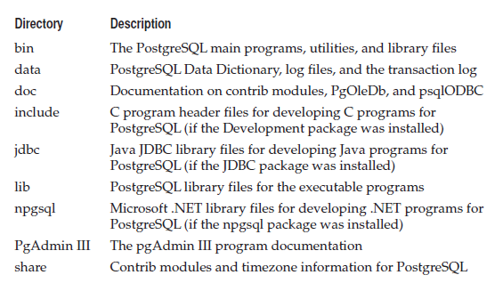
PostgreSQL Files – on Windows
Default: C:\Program Files\PostgreSQL\9.x

Slide 24
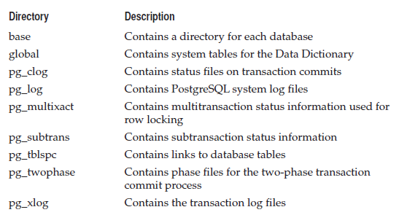
Database cluster Directory
Default: C:\Program Files\PostgreSQL\9.x\data
Notes:
Base: Chua du lieu cho DB (1 thu muc, 1 DB). Neu nhu tablespace cua DB la default

Slide 25
PostgreSQL Files - on Ubuntu
Configuration files:
/etc/postgresql/9.x/main/
Data directory:
/var/lib/postgresql/9.x/main/
Log files:
/var/log/postgres/
Notes:
Configuration files:
/etc/postgresql/9.x/main/
Data directory:
/var/lib/postgresql/9.x/main/
Log files:
/var/log/postgres/
(can use this command : ps auxw|grep postgres|grep -- -D )
https://www.vultr.com/docs/how-to-backup-and-restore-postgresql-databases-on-ubuntu-16-04

Slide 26
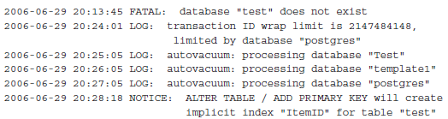
pg_log directory for Administrators
Each started time, a new log file: postgresl-year-month-day-time.log
Each row: a timestamp + the event

Slide 27
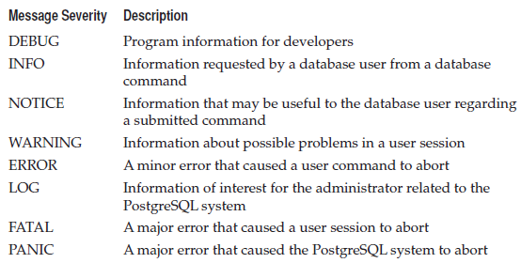
PostgreSQL Log Message Levels

Slide 28
Configuration Files
How PostgreSQL behaves is controlled by three separate configuration files
postgresql.conf (C:\Program Files\PostgreSQL\9.4\data)
pg_hba.conf
pg_ident.conf
Text files:
can be changed at any time
will not take effect until either the system is restarted or reloaded
Each entry in the configuration files is on a separate line
#: comment

Slide 29
Changing configuration files
Use text editor: notepad++, gedit, …
Default values = standard values
If a configuration line is commented out, PostgreSQL uses the default value for that entry
Changing the default value = removing the comment symbol from the line, reloading or restarting system
Reverting to the default value for an entry = puting the comment symbol back, stopping and restarting the PostgreSQL system (NOT reloading)

Slide 30
The postgresql.conf File
Format: featurename = value
Example: port = 5432
The main configuration file
File Locations Section
Connections and Authentication Section
Resource Usage Section
Write Ahead Log Section
Query Tuning Section
Error Reporting and Logging Section
Runtime Statistics Section
Autovacuum Parameters Section
Client Connection Defaults Section
Lock Management Section
Version/Platform Compatibility Section
Customized Options Section
Notes:
The Write Ahead Log (WAL) feature allows PostgreSQL to submit transactions to the transaction log before they are processed in the database. This provides for a more stable environment where all transactions are recoverable in case of a database crash. The transaction log is guaranteed to contain the transactions performed on the database data, even if the database crashes before a transaction is committed to the database.
The Runtime Statistics section allows you to configure PostgreSQL to log database performance statistics. These features allow you to view internal PostgreSQL statistics.
In a DBMS, deleted records are not really removed from the database at the time you execute a delete command. Instead, deleted records are just marked for deletion and kept in the database. This feature enables you to restore any deleted records if you (or your customers) change your mind. The downside to this feature is that deleted records take up space in the database. Depending on the amount of updates and deletes performed on data, over time this extra space can add up and have a negative impact on database performance. To accommodate this problem, PostgreSQL allows you to remove database records marked for deletion. This process is called vacuuming.

Slide 31
The pg_hba.conf File
Configure:
Which network hosts are allowed to connect to PostgreSQL
Which PostgreSQL usernames can be used to connect from the network
What authentication method users must use to log into the system
Which PostgreSQL databases an authenticated client can connect to
Format: connection-type database user network-address login-method [options ]
Example: host all all 127.0.0.1/32 md5
Notes:
http://www.postgresql.org/docs/9.4/static/auth-pg-hba-conf.html
Ex: host all all 192.168.0.0/27 md5
(tu 192.168.0.1 den 192.168.0.254)
connection-type.
􀁘 local Uses a local Unix-domain style socket on the system
􀁒 host Uses a plain or SSL-encrypted TCP/IP socket
􀁒 hostssl Uses an SSL-encrypted TCP/IP socket
􀁗 hostnossl Uses a plain TCP/IP socket

Slide 32
The pg_hba.conf File
Format: connection-type database user network-address login-method [options ]
Examples:
host all all 127.0.0.1/32 md5 : allows any client on the localhost to connect as any user to any database using md5 authentication
host all postgres 192.168.1.0/24 md5 : allows the postgres user account to connect any database from the local 192.168.1.0 subnetwork (192.168.1.0 to 192.168.1.255)
Notes:
Ex: host all all 192.168.0.0/24 md5
(tu 192.168.0.0 den 192.168.0.255)
connection-type.
􀁘 local Uses a local Unix-domain style socket on the system
􀁒 host Uses a plain or SSL-encrypted TCP/IP socket
􀁒 hostssl Uses an SSL-encrypted TCP/IP socket
􀁗 hostnossl Uses a plain TCP/IP socket
Login method:
-- trust : no password requiered
-- reject: authentication method specifically prohibits clients matching the record
from accessing the PostgreSQL system. This is often used for temporarily restricting access
to the system for a specific user or host
-- ident: authentication method uses the client userid from the client’s host system. (see pg_ident.conf)
-- password: send password in plain text through the connection
-- md5: sends a md5-encrypted version of password through the connection
-- crypt: sends a crypt-encrypted version of password through the connection

Slide 33
The pg_ident.conf File
Provides a method for you to map remote client user accounts to PostgreSQL user accounts
Format: map-name ident-name PostgreSQL-user-account
Example:
host all all 192.168.0.10/32 ident map=testhost: All users from the host 192.168.0.10 will have access to all PostgreSQL databases. User accounts from this host are mapped to PostgreSQL user accounts using the testhost ident mapping.
testhost rich richard
testhost mike michael
testhost dan daniel
Notes:
http://www.postgresql.org/docs/9.4/static/auth-username-maps.html
All users from the host 192.168.0.10 will have access to all PostgreSQL databases. User accounts from this host are mapped to PostgreSQL user accounts using the testhost ident mapping.
When the user rich connects from the host 192.168.0.10, he is automatically mapped to the richard PostgreSQL user account on the system. The same process happens for users mike and dan. If any user other than rich, mike, or dan attempts to connect from this host, they will be denied access to the PostgreSQL system.

Slide 34
Programs
Most Unix administrators live and die by simple command-line programs : psql
Windows administrators will want to use the graphical tools available in the pgAdmin application. pgAdmin is also available on Ubuntu.

Slide 35
PostgreSQL Server Commands – on Windows
Location: C:\Program Files\PostgreSQL\9.x\bin
postgres: the PostgreSQL database server
can be used to query, but not easy → psql
The utility command pg_ctl can be used to start and shut down the postgres server safely and comfortably
Notes:
https://dba.stackexchange.com/questions/156717/command-not-found-pg-ctl-on-ubuntu

Slide 36
PostgreSQL Server Commands – on Windows
pg_ctl: control the PostgreSQL system (stop, start, or reload the configuration files, kill a specified process)
using the -D commandline option
Example: C:\>pg_ctl stop -D "c:\ProgramFiles\PostgreSQL\9.4\data”
Document:
file:///C:/Program%20Files/PostgreSQL/9.4/doc/postgresql/html/app-pg-ctl.html
http://www.postgresql.org/docs/9.4/static/app-pg-ctl.html
Notes:
Chi khi start = lenh thi moi stop duoc bang lenh
C:\>pg_ctl status -D "c:\ProgramFiles\PostgreSQL\9.4\data“
C:\>pg_ctl start -D "c:\ProgramFiles\PostgreSQL\9.4\data“
C:\>pg_ctl restart -D "c:\ProgramFiles\PostgreSQL\9.4\data“
C:\>pg_ctl stop -D "c:\ProgramFiles\PostgreSQL\9.4\data“
C:\>pg_ctl reload -D "c:\ProgramFiles\PostgreSQL\9.4\data“

Slide 37
Stop/start/reload PostgreSQL server – on Ubuntu
Easy way:
sudo service postgresql {start|stop|restart|reload|force-reload|status}
Can use pg_ctl
/usr/lib/postgresql/10/bin/pg_ctl –D /var/lib/postgresql/10/main –l logfile start
Notes:
https://dba.stackexchange.com/questions/156717/command-not-found-pg-ctl-on-ubuntu
Có thể sử dụng pg_ctl
/usr/lib/postgresql/10/bin/pg_ctl –D /var/lib/postgresql/10/main –l logfile start

Slide 38
PostgreSQL Client Applications
psql: a command-line interface to the PostgreSQL system
pg_config: see the current configuration values used to compile and install the PostgreSQL package
pg_dump: dump (or back up) the contents of a database on the PostgreSQL system to a file
Script: SQL files
Archived: compressed binary files (using pg_restore to restore)

Slide 39
PostgreSQL Client Applications
pg_dumpall: similar to the pg_dump program, except it dumps all of the databases to a file
pg_restore
pgAdmin III / pgAdmin IV: a fancy graphical interface for administering a PostgreSQL system
Open Source: www.pgadmin.org

