Slide 1
Communication Plan: What it is
& Why it’s important?

Slide 2
Outline
What’s Communication Plan?
Why it’s important?
How to create a Communication Plan?

Slide 3
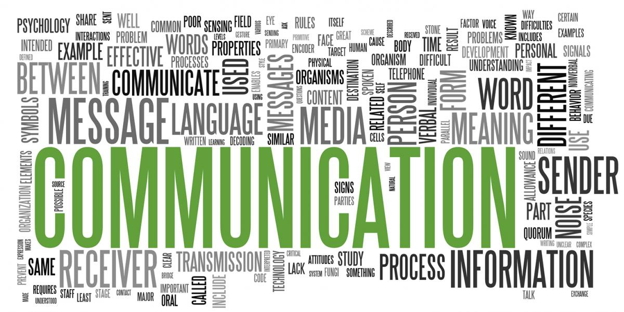
What’s Communication Plan?
A project communication plan is a simple tool that enables you to communicate effectively on a project with your client, team, and other stakeholders. It sets clear guidelines for how information will be shared, as well as who’s responsible for and needs to be looped in on each project communication.

Slide 4



Simple Definition
Reaching the right AUDIENCE ...
... With the right MESSAGE ...
... at the right TIME.

Slide 5
Why it’s important?
A project management communication plan will help you:
Keep your project on track.
Increases stakeholders’ visibility into the project and its status.
Provides the opportunity for stakeholders to give feedback.
Increases productivity during meeting.

Slide 6
How to create a Communication Plan?
Define your communication goals and requirements
Who needs to be communicated to?
What needs to be communicated to them?
When should this be communicated?
Where should it be communicated?
Why is communicating this to them essential to the project’s success?
How is this going to be communicated?

Slide 7
How to create a Communication Plan?
Gather stakeholder information and communication preferences
How urgent is the information?
Does the project require specific technology solutions?
Think about the structure of your team and their specific communications needs.

Slide 8
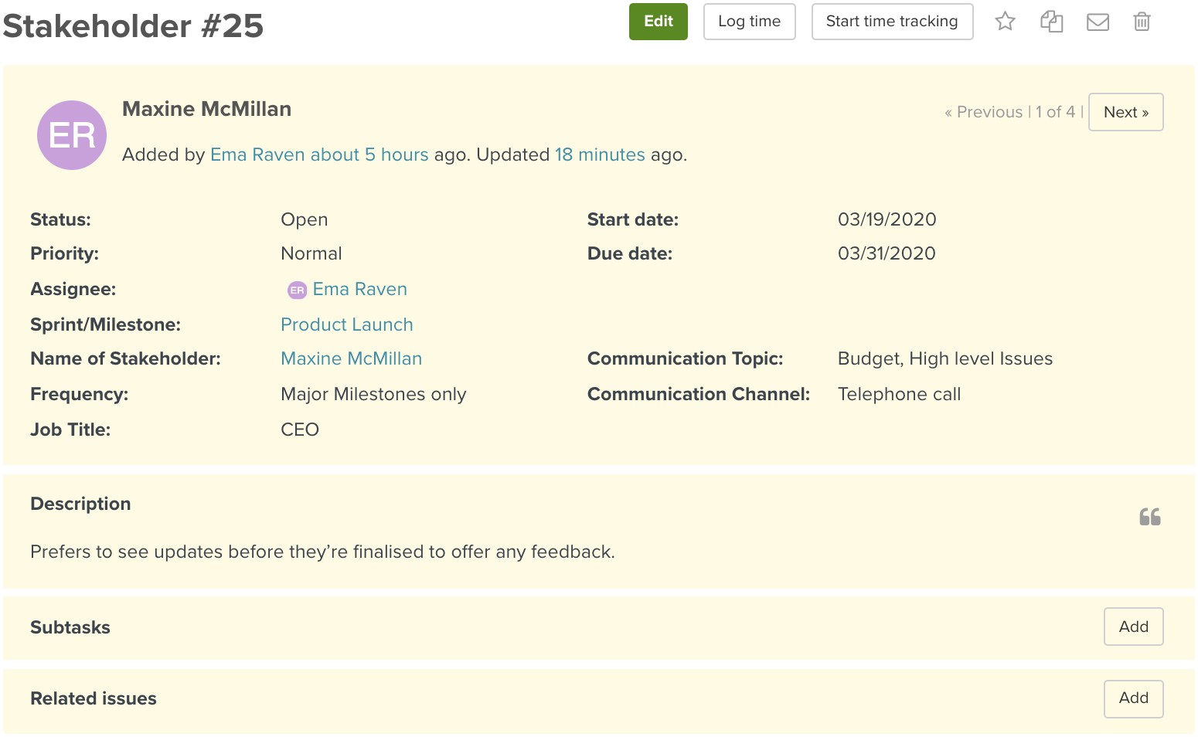

Slide 9
How to create a Communication Plan?
Set your regular communication types and schedules
Here are some regular communication types that might work for various aspects of your project:
Weekly email reports
Major milestone meetings
Daily emails
Annual reports

Slide 10
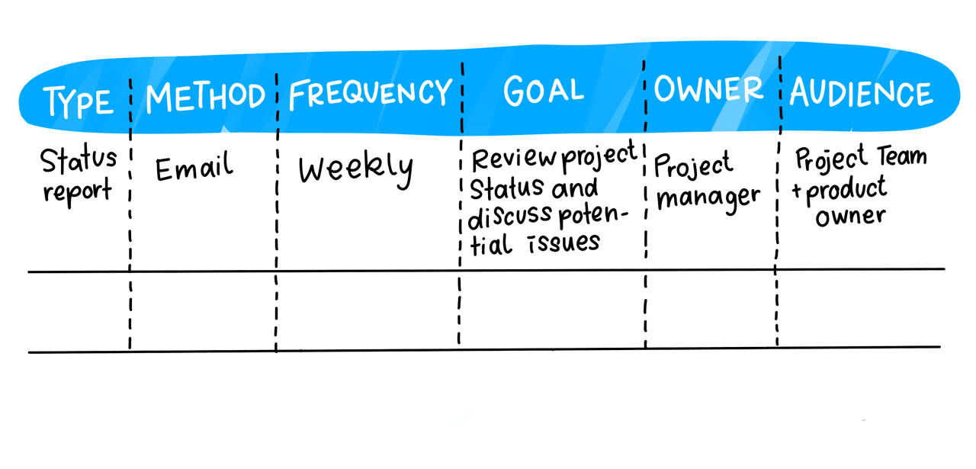

Slide 11


