Slide 1
IoT Foundations, Design, and Application
Xiaohang Wang (王小航)
baikeina@163.com

Slide 2
Outline
What is IoT
Application scenarios
Challenges
Scope of this course

Slide 3
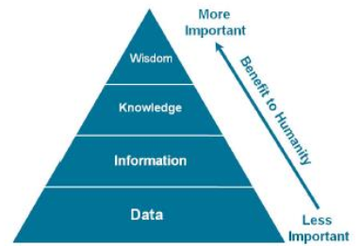
What is IoT
“Things having identities and virtual personalities operating in smart spaces using intelligent interfaces to connect and communicate within social, environmental, and user contexts”. -------IoT in 2020

Slide 4
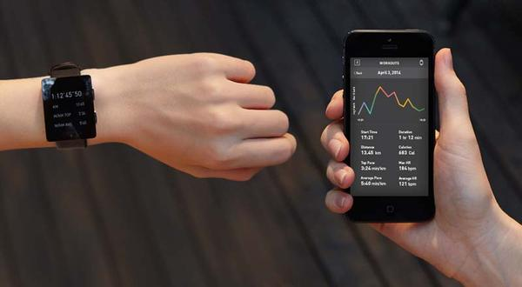
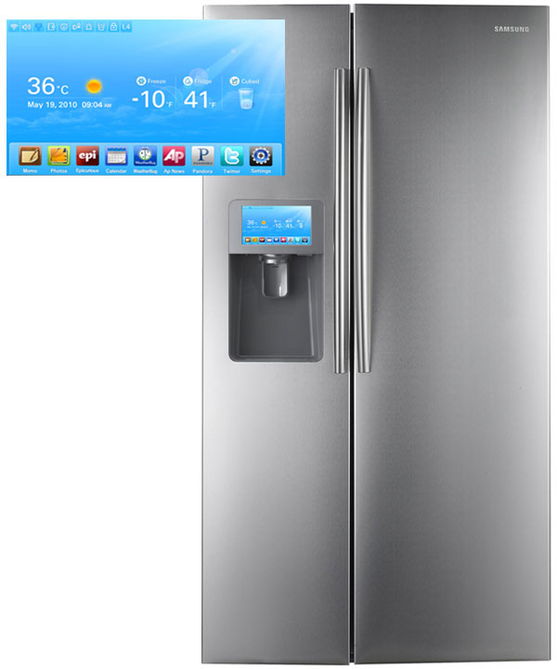
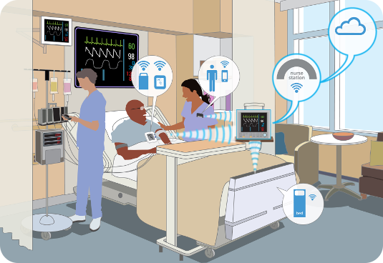
What is IoT
Smart Appliances
Wearable Tech
Healthcare

Slide 5

What is IoT
The market
As of 2013, 9.1 billion IoT units
Expected to grow to 28.1 billion IoT devices by 2020
Revenue growth from $1.9 trillion in 2013 to $7.1 trillion in 2020

Slide 6
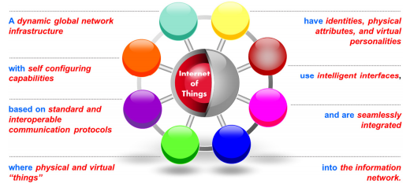
What is IoT

Slide 7
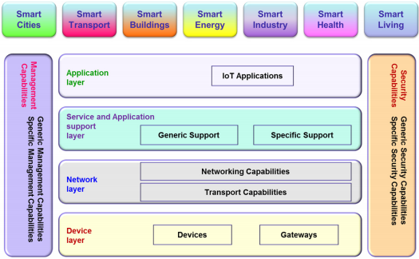

Slide 8
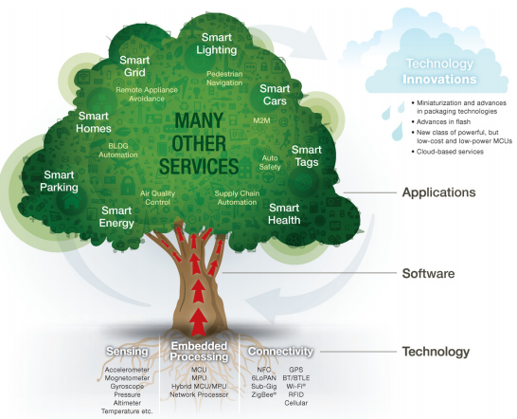
What is IoT

Slide 9
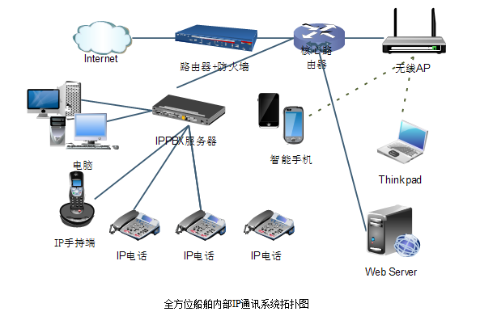
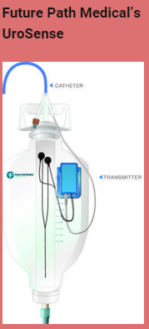
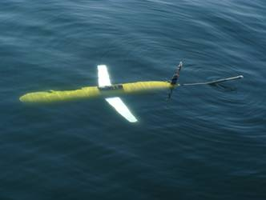
Application scenarios
Everywhere and everyday
Smart food/water monitoring, leakage
Smart health
Fall detection and monitor for aging people, sports care

Slide 10
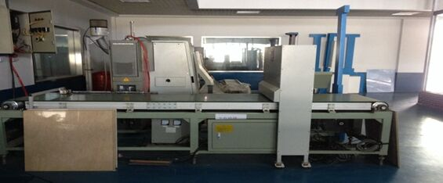
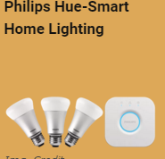
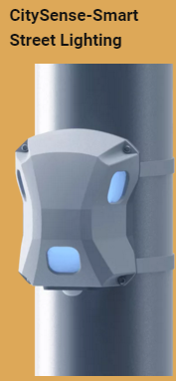
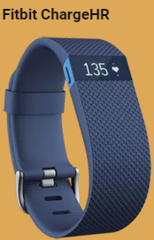
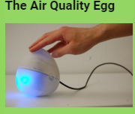
Application scenarios
Smart living
Smart environment
Smart manufacturing
Smart transportation/city/tourism

Slide 11
Challenges
Multiple design constraints
Performance
Computation speed, communication latency, etc.
Energy
Energy harvesting, ultra-low power
Cost
$$$
Security
Attack, trust, privacy
Reliability
Failure

Slide 12
Scope of this course
Application specification
Representation of distributed program
Application mapping
Energy and power management
Network topology, synchronization, flow control, and routing algorithms
Security and attacks
Application design

Slide 13
Scope of this course
New applications (algorithms)
Application design
Depends on areas, machine learning, social networks, etc.
System design
Parallel programming, system architecture, network interconnection, security, etc.
Essence of IoT
Distributed systems and programming

