Slide 1
Application representation in IoT systems
Xiaohang Wang
baikeina@163.com

Slide 2
Outline
Application specification
Task graph representation
How to get a task graph from a program ?
Computation
Communication
Profiling

Slide 3
Programming and configuring IoT getting started
Application specification
Specification
Functions
Timing
Scale
Objectives: performance, energy, cost, etc.

Slide 4
Task graph representation
Start from a sequential algorithm or source code
Partition the codes into code segments which can run in parallel
Partition the data into data segments
Envelop the code segments into threads
Allocate data segments to threads
Communication and synchronization
Task graph !

Slide 5
// thread 1
int input[10];
void producer()
{
int product[10] ;
extern int input[];
static int coefficient[10] = {...};
static int i ;
for (i = 0; i <10;i++)
product[i] = input[i] * coefficient[i]
SEND (product, 2); // the destination ID is 2
SIGNAL (2); // tell thread 2 the transmission is done
}
// thread 2
void consumer ()
{
WAIT (1);// wait for the transmission done of thread 1
extern int product[];
static int i;
int sum = 0;
RECEIVE (product,1)// the source ID is 1
for (i = 0; i <10;i++)
sum += product[i];
}
Producer
Execution time
product
Consumer

Slide 6
Task graph representation
A thread/task
Communication
Input data
Output data
How to calculate the communication volume?
Manually, compiler, Valgrind
Computation
Function
Execution time
aHow to calculate the communication volume?
Mnually, compiler, Valgrind

Slide 7
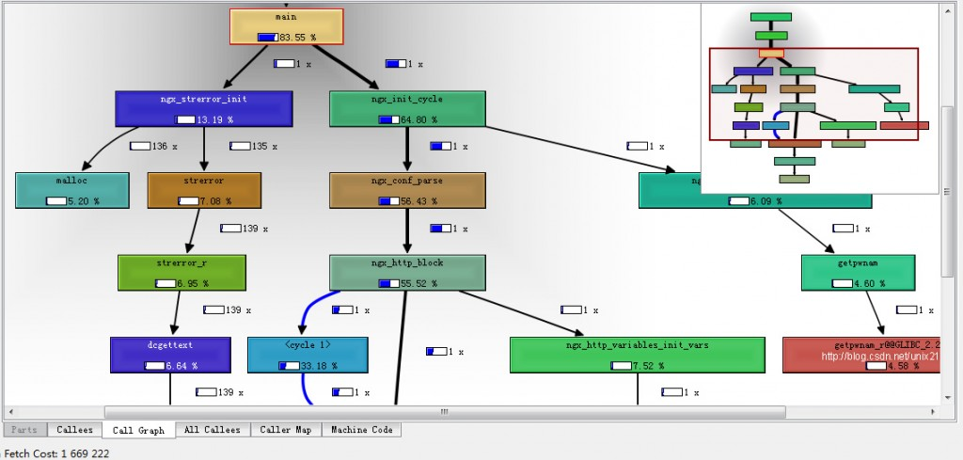
Task graph representation
Task execution time profiling
Valgrind, gprof

Slide 8
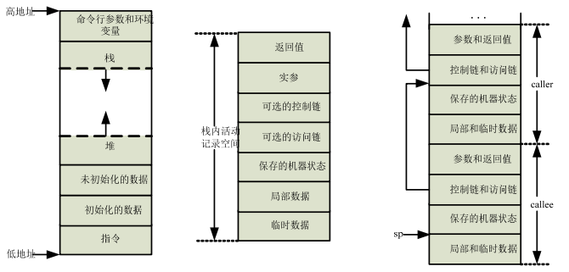
Task graph representation
Communication volume: data volume between two functions

Slide 9
Synchronization

Slide 10
Parallelism
Task parallelism
Data parallelism
Pipeline parallelism

Slide 11
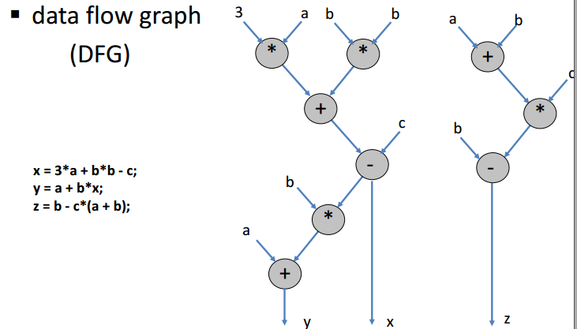
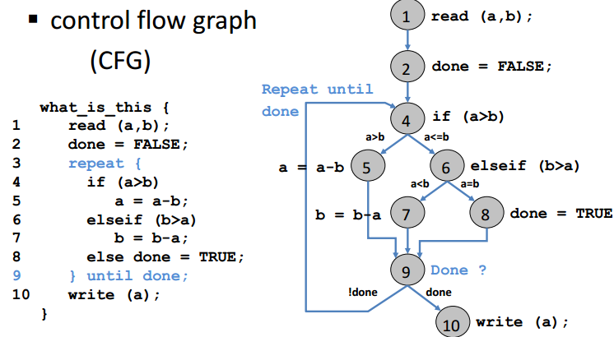
Other task graph models

Slide 12
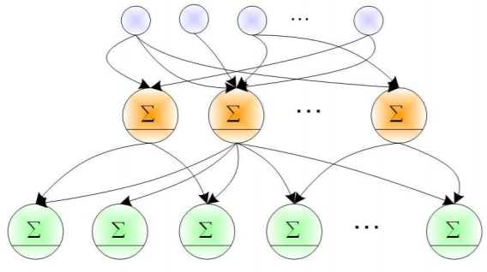
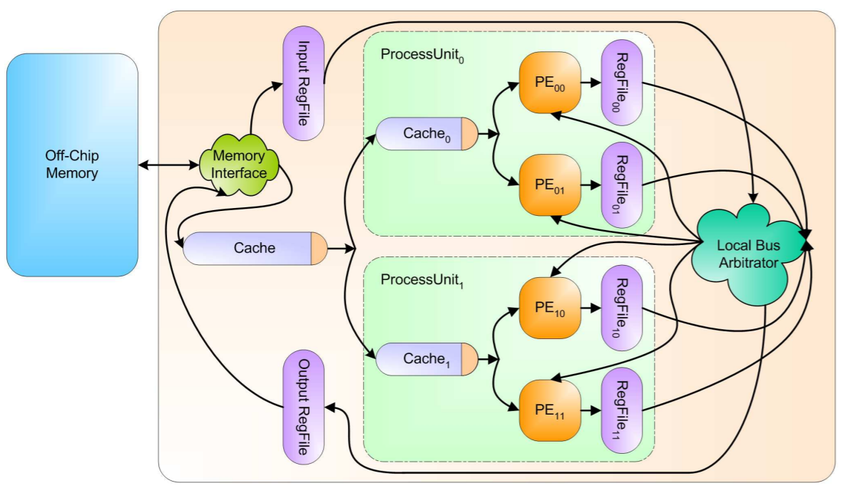
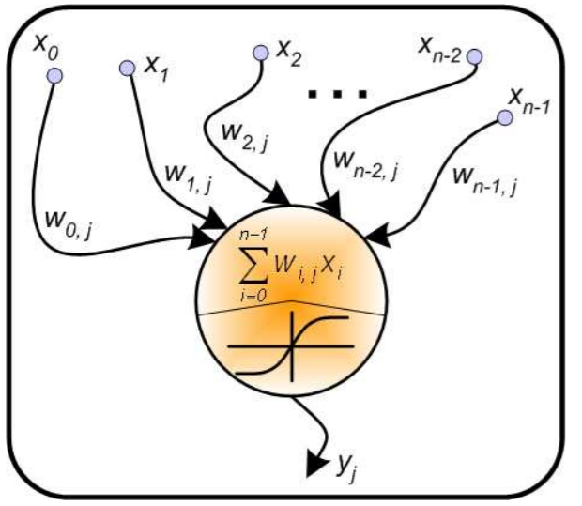
Other task graph models
Dataflow graph for deep learning

Slide 13
Other task graph models

Slide 14
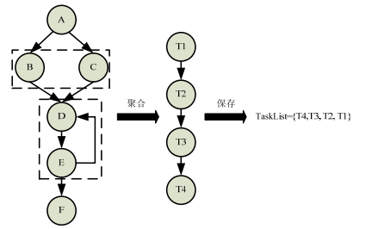
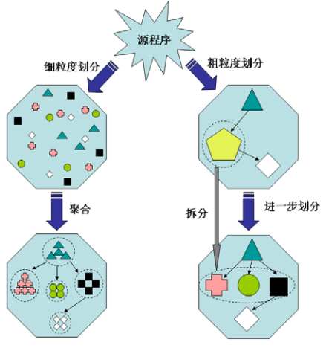
Operations on task graph
Aggregation

Slide 15
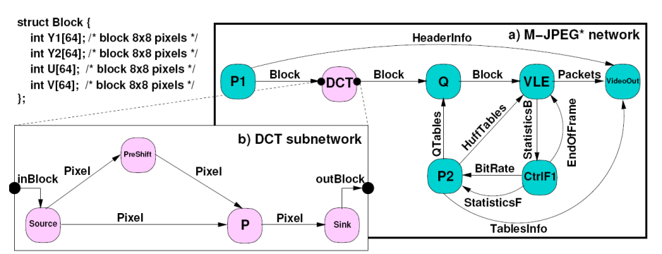
Operations on task graph
Hierarchical design

Slide 16
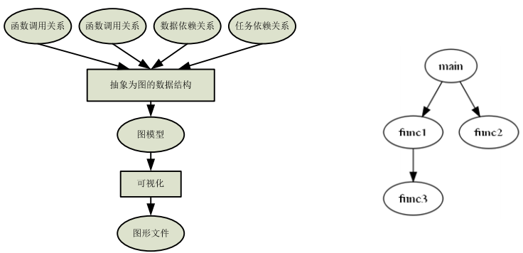
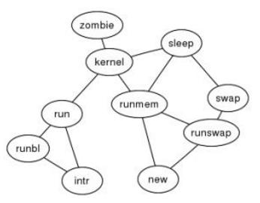
Visualization of task graph
Graphviz

Slide 17
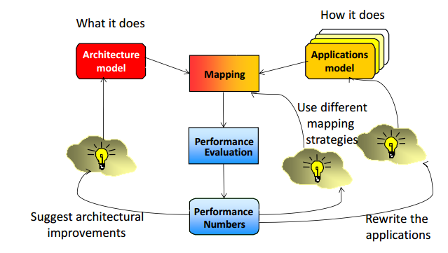
Mapping and scheduling

Slide 18
Tool chain

Slide 21
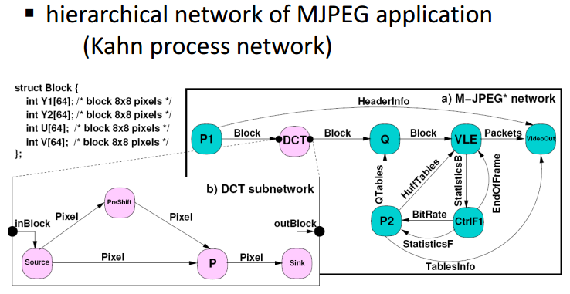

Slide 22
Mapping transforms behavior into structure and execution ▪ Synthesis tasks o allocation: select components o binding: assign functions to components o scheduling: determine execution order o ... finally, synthesis results into implementation

Slide 23
Task graph

Slide 26
... using an underlying model of computation ▪ some examples (see also next slides) o task graphs: data flow graph, control flow graph o process networks: Kahn process network, synchronous data-flow o state machine representations: SpecCharts, StateCharts [not covered in this course] ▪ for mapping, very often only the process network structure and its (abstract) properties are relevant (abstraction from detailed functionality)

Slide 27
