Slide 1
Application mapping and scheduling
Xiaohang Wang

Slide 2
Outline
Overview
Objectives and constraints
Mapping algorithms
Schedule algorithms

Slide 3
Overview
Mapping
Given a task graph G1(V, E) and an architecture G2(T, L), find a function M
M(v) = t
Scheduling
For each task, determine its start time

Slide 4
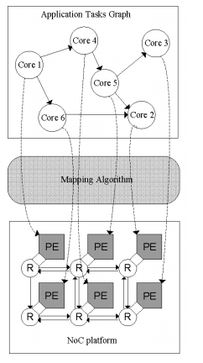
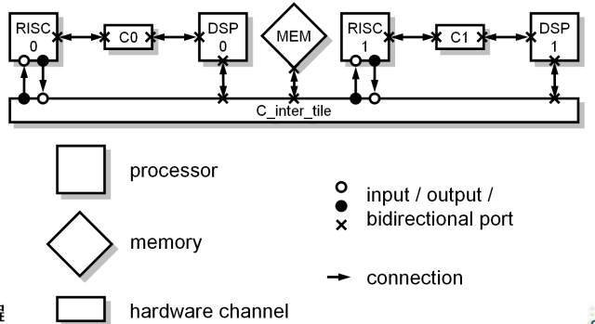
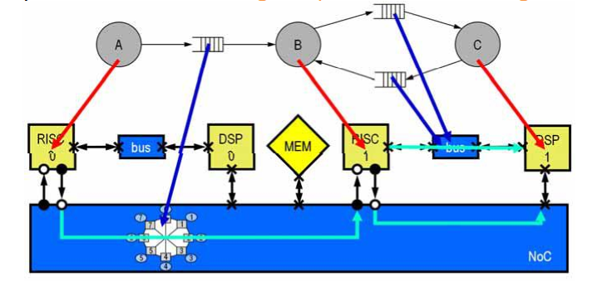
Overview

Slide 5
Objectives and constraints
Energy, power
Execution time
Communication latency
Reliability
Temperature
…

Slide 6
Mapping algorithm
1
2
Complexity:
a
b
1
a
b
3
4
2
c
d
…
c
d
3
3
1
a
b
4
1
4
c
d

Slide 7
Mapping algorithm
To reduce complexity
Heuristic
Branch and bound
Linear/ integer programming
Randomized optimization
Genetic algorithm, simulated annealing, etc.

Slide 9
The Galaxy Linear Programming Model
Decisions variables:
X₁ = Weekly production level of Space Rays (in dozens)
X₂ = Weekly production level of Zappers (in dozens).
Objective Function:
Weekly profit, to be maximized

Slide 10
The Galaxy Linear Programming Model
Max 8X₁ + 5X₂ (Weekly profit)
subject to
2X₁ + 1X₂ ≤ 1000 (Plastic)
3X₁ + 4X₂ ≤ 2400 (Production Time)
X₁ + X₂ ≤ 700 (Total production)
X₁ - X₂ ≤ 350 (Mix)
X_{j}> = 0, j = 1,2 (Nonnegativity)

Slide 11
2.3 The Graphical Analysis of Linear Programming
The set of all points that satisfy all the constraints of the model is called
a
FEASIBLE REGION

Slide 12
Using a graphical presentation
we can represent all the constraints,
the objective function, and the three
types of feasible points.

Slide 13
Graphical Analysis – the Feasible Region
The non-negativity constraints
X₂
X₁

Slide 14
Graphical Analysis – the Feasible Region
X₂
1000
The Plastic constraint
2X₁+X₂ ≤ 1000
700
Total production constraint:
X₁+X₂ ≤ 700 (redundant)
500
Infeasible
Production Time
3X₁+4X₂ ≤ 2400
Feasible
X₁
500
700

Slide 15
Graphical Analysis – the Feasible Region
X₂
1000
The Plastic constraint
2X₁+X₂ ≤ 1000
700
Total production constraint:
X₁+X₂ ≤ 700 (redundant)
500
Infeasible
Production mix constraint:
X₁-X2 ≤ 350
Production Time
3X₁+4X2≤ 2400
Feasible
500
700
X₁
Interior points.
Boundary points.
Extreme points.
There are three types of feasible points

Slide 16
Solving Graphically for an Optimal Solution

Slide 17
The search for an optimal solution
X₂
Start at some arbitrary profit, say profit = $2,000...
1000
Then increase the profit, if possible...
...and continue until it becomes infeasible
700
Profit =$4360
500
X₁
500

Slide 18
Summary of the optimal solution
Space Rays = 320 dozen
Zappers = 360 dozen
Profit = $4360
This solution utilizes all the plastic and all the production hours.
Total production is only 680 (not 700).
Space Rays production exceeds Zappers production by only 40 dozens.

Slide 19
Extreme points and optimal solutions
If a linear programming problem has an optimal solution, an extreme point is optimal.

Slide 20
Multiple optimal solutions
For multiple optimal solutions to exist, the objective function must be parallel to one of the constraints
Any weighted average of optimal solutions is also an optimal solution.

Slide 21
Genetic algorithms
Holland’s original GA is now known as the simple genetic algorithm (SGA)
Other GAs use different:
Representations
Mutations
Crossovers
Selection mechanisms

Slide 22
SGA technical summary tableau
Representation | Binary strings
Recombination | N-point or uniform
Mutation | Bitwise bit-flipping with fixed probability
Parent selection | Fitness-Proportionate
Survivor selection | All children replace parents
Speciality | Emphasis on crossover

Slide 23
Representation
Phenotype space
Genotype space = {0,1}^{L}
Encoding
(representation)
10010001
10010010
010001001
011101001
Decoding
(inverse representation)

Slide 24
SGA reproduction cycle
Select parents for the mating pool
(size of mating pool = population size)
Shuffle the mating pool
For each consecutive pair apply crossover with probability p_{c} , otherwise copy parents
For each offspring apply mutation (bit-flip with probability p_{m} independently for each bit)
Replace the whole population with the resulting offspring

Slide 25
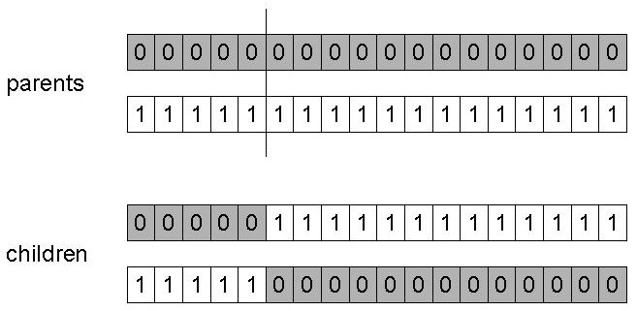
SGA operators: 1-point crossover
Choose a random point on the two parents
Split parents at this crossover point
Create children by exchanging tails
P_{c} typically in range (0.6, 0.9)

Slide 26
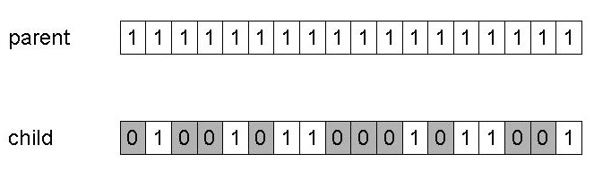
SGA operators: mutation
Alter each gene independently with a probability p_{m}
p_{m} is called the mutation rate
Typically between 1/pop_size and 1/ chromosome_length

Slide 27
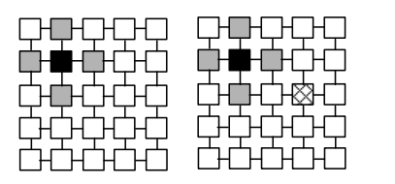
Mapping algorithm
Heuristic
If-else rules
Iteration based
Sort the tasks
Map the tasks one by one
Map the neighbor tasks

Slide 28
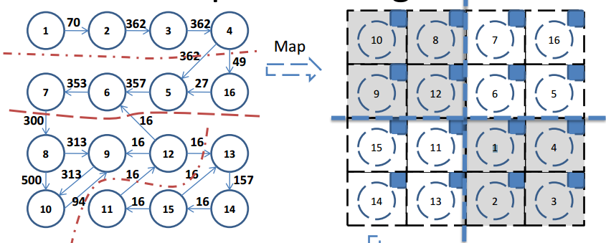
Mapping algorithm
Heuristic
Partition based
Partition both the task graph and network recursively
Chaco

Slide 29


Mapping algorithm
Linear programming
X i,j : binary value, 1 if task i is mapped to cpu j; 0 otherwise
Or,
Ai = <the ID of the cpu>
Objective: MD(j,k): Manhattan distance of CPUs j and k
LP Solve, Matlab, etc.
$$\sum_{i}{X_{i,j}}=1$$
$$\sum_{j}{X_{i,j}}=1$$

Slide 30
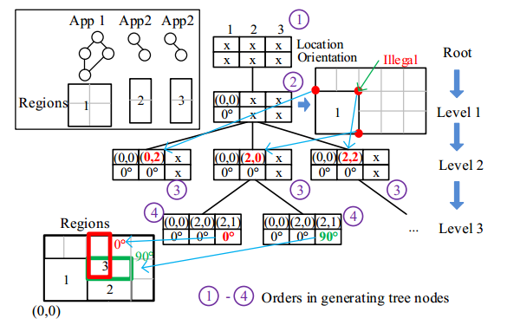
Mapping algorithm
Branch and bound
New branches and cut

Slide 31
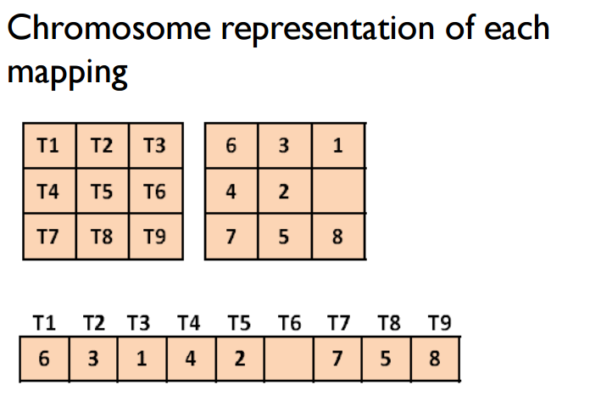
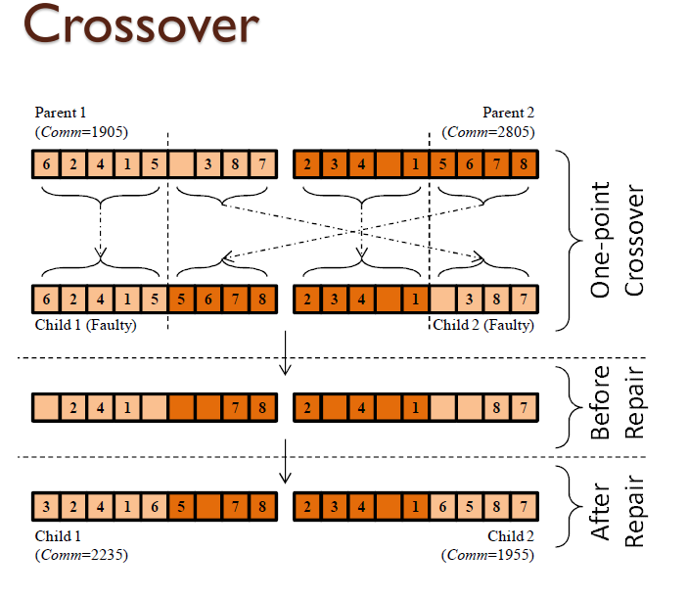
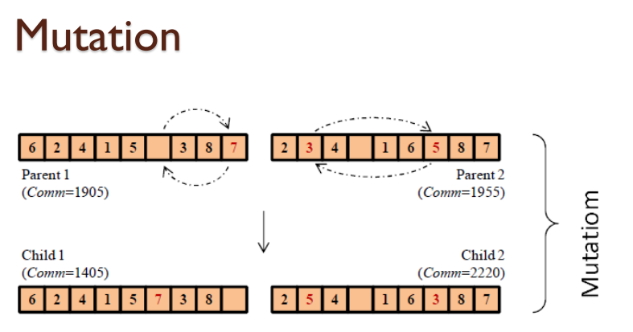
Mapping algorithm
Genetic algorithm

Slide 32
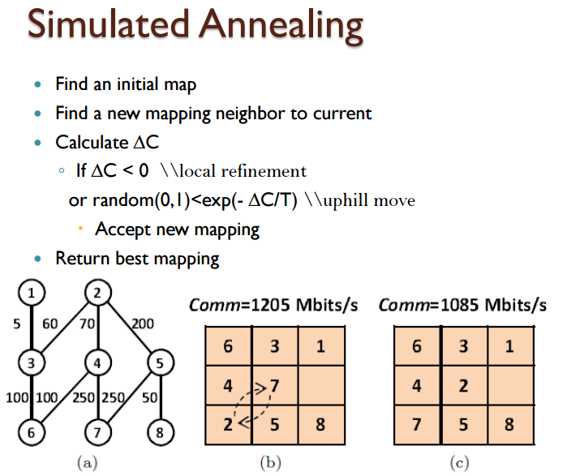
Mapping algorithm

Slide 33
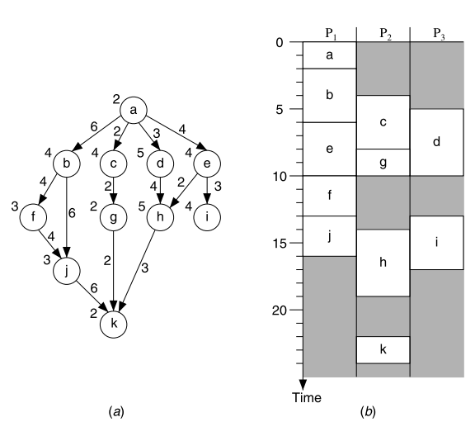
Schedule algorithm

Slide 34
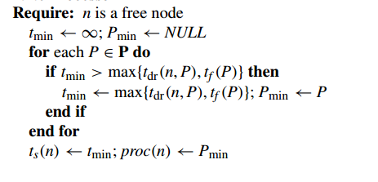
Schedule algorithm
Start time minimization

Slide 35
Load Balancing: List Scheduling
A
B
C
D
E
F
G
H
I
J
Machine 1
Machine 2
Machine 3
0
Time
Notes:
actually new elements with weights W-t+1 and t+1 works

Slide 36
Load Balancing: List Scheduling
B
C
D
E
F
G
H
I
J
Machine 1
A
Machine 2
Machine 3
0
Time
Notes:
actually new elements with weights W-t+1 and t+1 works

Slide 37
Load Balancing: List Scheduling
C
D
E
F
G
H
I
J
Machine 1
A
Machine 2
B
Machine 3
0
Time
Notes:
actually new elements with weights W-t+1 and t+1 works

Slide 38
Load Balancing: List Scheduling
D
E
F
G
H
I
J
Machine 1
A
Machine 2
B
Machine 3
C
0
Time
Notes:
actually new elements with weights W-t+1 and t+1 works

Slide 39
Load Balancing: List Scheduling
E
F
G
H
I
J
Machine 1
A
Machine 2
B
D
Machine 3
C
0
Time
Notes:
actually new elements with weights W-t+1 and t+1 works

Slide 40
Load Balancing: List Scheduling
F
G
H
I
J
Machine 1
A
E
Machine 2
B
D
Machine 3
C
0
Time
Notes:
actually new elements with weights W-t+1 and t+1 works

Slide 41
Load Balancing: List Scheduling
G
H
I
J
Machine 1
A
E
Machine 2
B
D
Machine 3
C
F
0
Time
Notes:
actually new elements with weights W-t+1 and t+1 works

Slide 42
Load Balancing: List Scheduling
H
I
J
Machine 1
A
E
Machine 2
B
D
G
Machine 3
C
F
0
Time
Notes:
actually new elements with weights W-t+1 and t+1 works

Slide 43
Load Balancing: List Scheduling
I
J
Machine 1
A
E
H
Machine 2
B
D
G
Machine 3
C
F
0
Time
Notes:
actually new elements with weights W-t+1 and t+1 works

Slide 44
Load Balancing: List Scheduling
J
Machine 1
A
E
H
I
Machine 2
B
D
G
G
Machine 3
C
F
0
Time
Notes:
actually new elements with weights W-t+1 and t+1 works

Slide 45
Load Balancing: List Scheduling
Machine 1
A
E
H
I
Machine 2
B
D
G
Machine 3
C
F
J
0
Time
Notes:
actually new elements with weights W-t+1 and t+1 works

Slide 46
Load Balancing: List Scheduling
Machine 1
D
E
H
C
B
Machine 2
A
G
I
Machine 3
F
J
0
Optimal Schedule
Machine 1
A
E
H
I
Machine 2
B
D
G
Machine 3
C
F
J
0
List schedule
Notes:
actually new elements with weights W-t+1 and t+1 works

Slide 47
Schedule algorithm
Variants
End time minimization
Schedulability

