Slide 1
Energy and power management techniques
Xiaohang Wang

Slide 2
Outline
Introduction
Techniques
Optimization

Slide 3
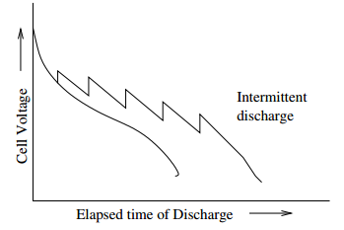
Introduction
What is energy/power management ?
Control the energy/power consumption of the system or components
Why we need it ?
Battery lifetime
Thermal constraint

Slide 4
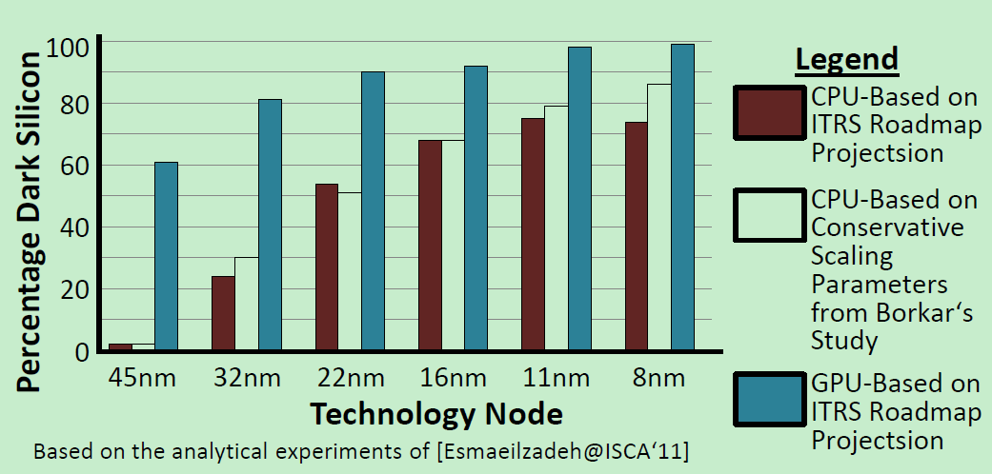
Introduction
Thermal constraint
Dark silicon
More than 50% of the chip area will be dark.
Dark silicon trends for different technology nodes

Slide 5
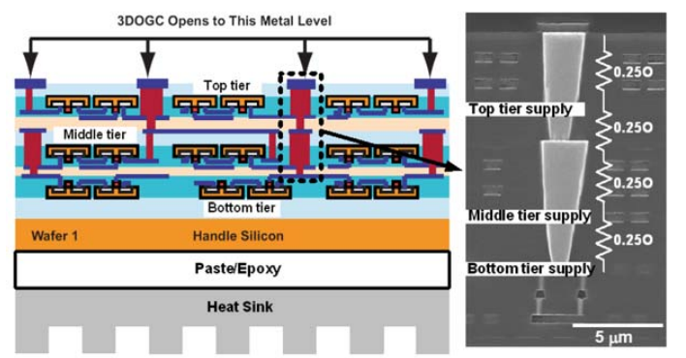
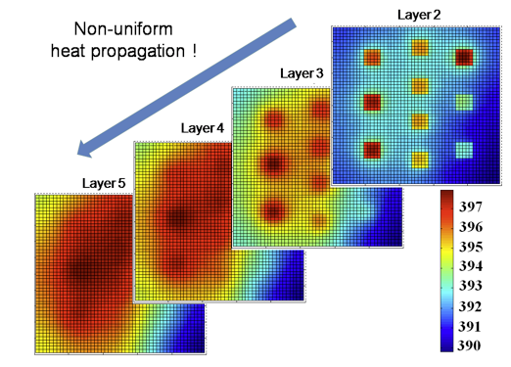
Introduction
Thermal constraint
3D system

Slide 6
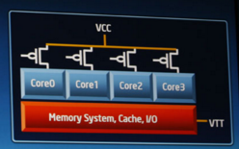
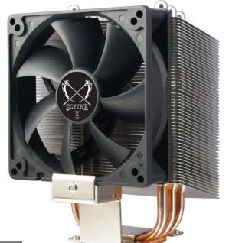
Techniques
Voltage/frequency scaling
Power gating
Fan speed control

Slide 7
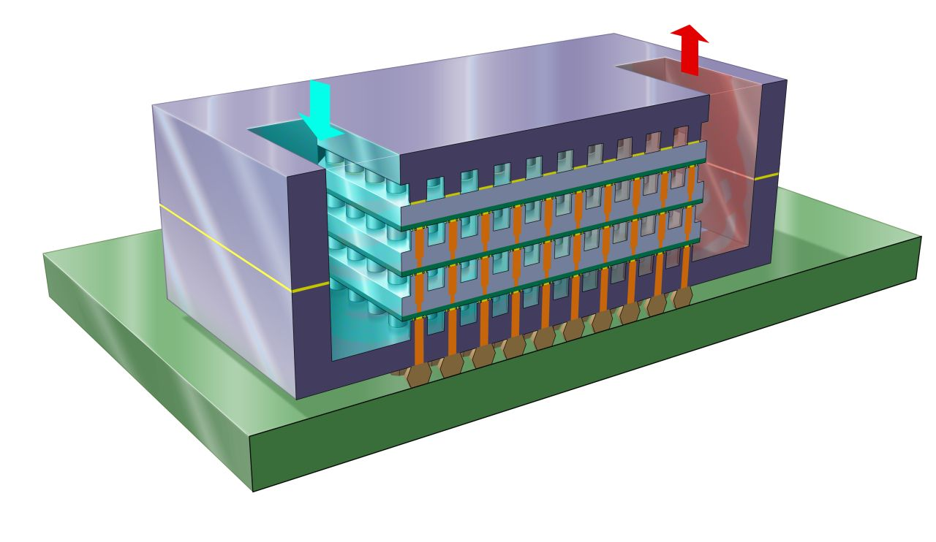
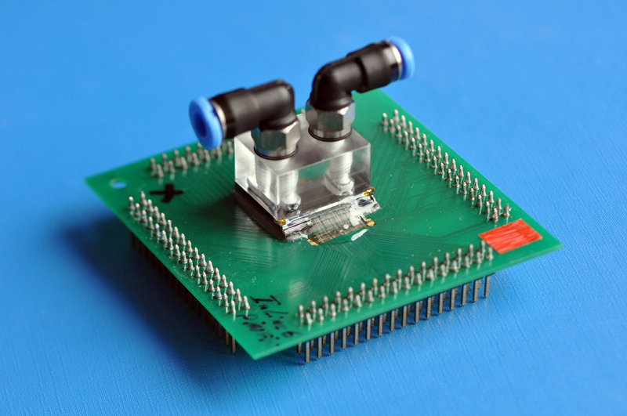
Techniques
Liquid cooling

Slide 8
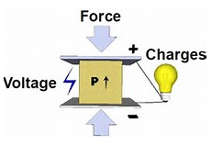
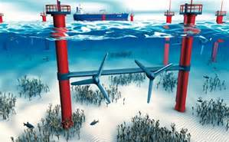
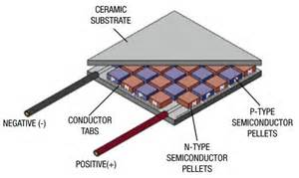
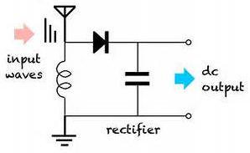
Techniques
Energy harvesting
Piezo
Solar
Wind
Ocean energy
Thermo-electric generator
RF

Slide 9


Optimization
Models
Performance model
Exec time
+ r L
IPC
Network latency
Make span

Slide 10

Optimization
Power model
Dynamic
Frequency and voltage
Static
Temperature and area

Slide 11

Optimization
Problem definition

Slide 12
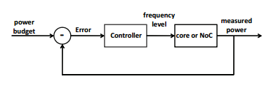

Optimization
Algorithm
Heuristic
Dynamic programming
ILP
Control PID

Slide 13
Optimization
Thermal-aware task mapping scheduling
Communication: close to each other
Computation: V/F level of cores
3D: close to the heat sink

Slide 14
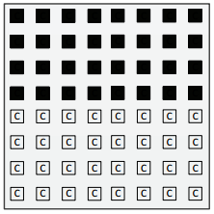
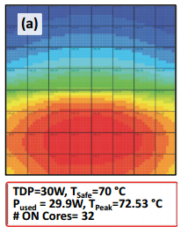
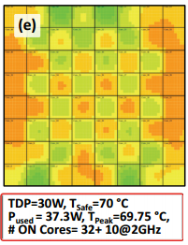
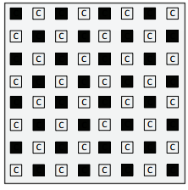
Optimization
Thermal-aware task mapping scheduling
Balance the power consumption of each vertical stack in 3D
Dark silicon patterning

Slide 15
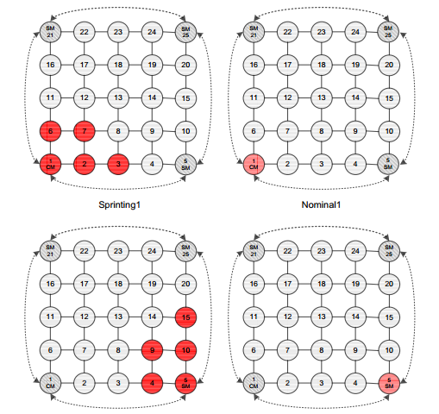
Optimization
Thermal-aware task mapping scheduling
Heat and run
Sprinting

