Slide 1
Interconnection Networks: Topology and Routing

Slide 2
Topology Overview
Definition: determines arrangement of channels and nodes in network
Analogous to road map
Often first step in network design
Routing and flow control build on properties of topology

Slide 3
Abstract Metrics
Use metrics to evaluate performance and cost of topology
Also influenced by routing/flow control
At this stage
Assume ideal routing (perfect load balancing)
Assume ideal flow control (no idle cycles on any channel)
Switch Degree: number of links at a node
Proxy for estimating cost
Higher degree requires more links and port counts at each router

Slide 4
Latency
Time for packet to traverse network
Start: head arrives at input port
End: tail departs output port
Latency = Head latency + serialization latency
Serialization latency: time for packet with Length L to cross channel with bandwidth b (L/b)
Hop Count: the number of links traversed between source and destination
Proxy for network latency
Per hop latency with zero load

Slide 5
Impact of Topology on Latency
Impacts average minimum hop count
Impact average distance between routers
Bandwidth

Slide 6
Throughput
Data rate (bits/sec) that the network accepts per input port
Max throughput occurs when one channel saturates
Network cannot accept any more traffic
Channel Load
Amount of traffic through channel c if each input node injects 1 packet in the network

Slide 7
Maximum channel load
Channel with largest fraction of traffic
Max throughput for network occurs when channel saturates
Bottleneck channel

Slide 8
Bisection Bandwidth
Cuts partition all the nodes into two disjoint sets
Bandwidth of a cut
Bisection
A cut which divides all nodes into nearly half
Channel bisection → min. channel count over all bisections
Bisection bandwidth →min. bandwidth over all bisections
With uniform traffic
½ of traffic cross bisection

Slide 9
Throughput Example
0
1
2
3
4
5
6
7
Bisection = 4 (2 in each direction)
With uniform random traffic
3 sends 1/8 of its traffic to 4,5,6
3 sends 1/16 of its traffic to 7 (2 possible shortest paths)
2 sends 1/8 of its traffic to 4,5
Etc
Channel load = 1

Slide 10
Path Diversity
Multiple minimum length paths between source and destination pair
Fault tolerance
Better load balancing in network
Routing algorithm should be able to exploit path diversity
We’ll see shortly
Butterfly has no path diversity
Torus can exploit path diversity

Slide 11
Path Diversity (2)
Edge disjoint paths: no links in common
Node disjoint paths: no nodes in common except source and destination
If j = minimum number of edge/node disjoint paths between any source-destination pair
Network can tolerate j link/node failures

Slide 12
Symmetry
Vertex symmetric:
An automorphism exists that maps any node a onto another node b
Topology same from point of view of all nodes
Edge symmetric:
An automorphism exists that maps any channel a onto another channel b

Slide 13
Direct & Indirect Networks
Direct: Every switch also network end point
Ex: Torus
Indirect: Not all switches are end points
Ex: Butterfly

Slide 14
Torus (1)
K-ary n-cube: k^{n} network nodes
n-dimensional grid with k nodes in each dimension
3-ary 2-cube
3-ary 2-mesh
2,3,4-ary 3-mesh

Slide 15

Torus (2)
Topologies in Torus Family
Ring k-ary 1-cube
Hypercubes 2-ary n-cube
Edge Symmetric
Good for load balancing
Removing wrap-around links for mesh loses edge symmetry
More traffic concentrated on center channels
Good path diversity
Exploit locality for near-neighbor traffic

Slide 16
Implementation
Folding
Equalize path lengths
Reduces max link length
Increases length of other links
0
1
2
3
3
2
0
1

Slide 17
Concentration
Don’t need 1:1 ratio of network nodes and cores/memory
Ex: 4 cores concentrated to 1 router

Slide 18
Butterfly
K-ary n-fly: k^{n} network nodes
Example: 2-ary 3-fly
Routing from 000 to 010
Dest address used to directly route packet
Bit n used to select output port at stage n
0
1
0
0
0
00
10
20
1
1
2
2
01
11
21
3
3
4
4
02
12
22
5
5
6
6
03
13
23
7
7

Slide 19
Flattened Butterfly
Proposed by Kim et al (ISCA 2007)
Adapted for on-chip (MICRO 2007)
Advantages
Max distance between nodes = 2 hops
Lower latency and improved throughput compared to mesh
Disadvantages
Requires higher port count on switches (than mesh, torus)
Long global wires
Need non-minimal routing to balance load

Slide 20
Flattened Butterfly
Path diversity through non-minimal routes

Slide 21
Clos Network
rxr input switch
nxm input switch
mxn output switch
rxr input switch
nxm input switch
mxn output switch
rxr input switch
nxm input switch
mxn output switch
rxr input switch
nxm input switch
mxn output switch
rxr input switch

Slide 22
Clos Network
3-stage indirect network
Characterized by triple (m, n, r)
M: # of middle stage switches
N: # of input/output ports on input/output switches
R: # of input/output switching
Hop Count = 4

Slide 23
Folded Clos (Fat Tree)
Bandwidth remains constant at each level
Regular Tree: Bandwidth decreases closer to root

Slide 24
Fat Tree (2)
Provides path diversity

Slide 25
Common On-Chip Topologies
Torus family: mesh, concentrated mesh, ring
Extending to 3D stacked architectures
Favored for low port count switches
Butterfly family: Flattened butterfly

Slide 26
Topology Summary
First network design decision
Critical impact on network latency and throughput
Hop count provides first order approximation of message latency
Bottleneck channels determine saturation throughput

Slide 27
Routing Overview
Discussion of topologies assumed ideal routing
Practically though routing algorithms are not ideal
Discuss various classes of routing algorithms
Deterministic, Oblivious, Adaptive
Various implementation issues
Deadlock

Slide 28
Routing Basics
Once topology is fixed
Routing algorithm determines path(s) from source to destination

Slide 29
Routing Algorithm Attributes
Number of destinations
Unicast, Multicast, Broadcast?
Adaptivity
Oblivious or Adaptive? Local or Global knowledge?
Implementation
Source or node routing?
Table or circuit?

Slide 30
Oblivious
Routing decisions are made without regard to network state
Keeps algorithms simple
Unable to adapt
Deterministic algorithms are a subset of oblivious

Slide 31
Deterministic
All messages from Src to Dest will traverse the same path
Common example: Dimension Order Routing (DOR)
Message traverses network dimension by dimension
Aka XY routing
Cons:
Eliminates any path diversity provided by topology
Poor load balancing
Pros:
Simple and inexpensive to implement
Deadlock free

Slide 32
Valiant’s Routing Algorithm
To route from s to d, randomly choose intermediate node d’
Route from s to d’ and from d’ to d.
Randomizes any traffic pattern
All patterns appear to be uniform random
Balances network load
Non-minimal
d’
d
s

Slide 33
Minimal Oblivious
Valiant’s: Load balancing comes at expense of significant hop count increase
Destroys locality
Minimal Oblivious: achieve some load balancing, but use shortest paths
d’ must lie within minimum quadrant
6 options for d’
Only 3 different paths
d
s

Slide 34
Adaptive
Uses network state to make routing decisions
Buffer occupancies often used
Couple with flow control mechanism
Local information readily available
Global information more costly to obtain
Network state can change rapidly
Use of local information can lead to non-optimal choices
Can be minimal or non-minimal

Slide 35
Minimal Adaptive Routing
d
s
Local info can result in sub-optimal choices

Slide 36
Non-minimal adaptive
Fully adaptive
Not restricted to take shortest path
Example: FBfly
Misrouting: directing packet along non-productive channel
Priority given to productive output
Some algorithms forbid U-turns
Livelock potential: traversing network without ever reaching destination
Mechanism to guarantee forward progress
Limit number of misroutings

Slide 37
Non-minimal routing example
d
d
s
s
Longer path with potentially lower latency
Livelock: continue routing in cycle

Slide 38
Routing Deadlock
A
B
D
C
Without routing restrictions, a resource cycle can occur
Leads to deadlock

Slide 39
Turn Model Routing
West first
North last
Negative first
Some adaptivity by removing 2 of 8 turns
Remains deadlock free (like DOR)

Slide 40
Turn Model Routing Deadlock
Not a valid turn elimination
Resource cycle results

Slide 41
Routing Implementation
Source tables
Entire route specified at source
Avoids per-hop routing latency
Unable to adapt to network conditions
Can specify multiple routes per destination
Node tables
Store only next routes at each node
Smaller tables than source routing
Adds per-hop routing latency
Can adapt to network conditions
Specify multiple possible outputs per destination

Slide 42
Implementation
Combinational circuits can be used
Simple (e.g. DOR): low router overhead
Specific to one topology and one routing algorithm
Limits fault tolerance
Tables can be updated to reflect new configuration, network faults, etc

Slide 43
Circuit Based
sx
x
sy
y
=0
=0
Productive Direction Vector
exit
+x
-x
+y
-y
Queue lengths
Route selection
Selected Direction Vector
exit
+x
-x
+y
-y

Slide 44
Routing Summary
Latency paramount concern
Minimal routing most common for NoC
Non-minimal can avoid congestion and deliver low latency
To date: research favors DOR for simplicity and deadlock freedom
On-chip networks often lightly loaded
Only covered unicast routing
Recent work on extending on-chip routing to support multicast

Slide 45
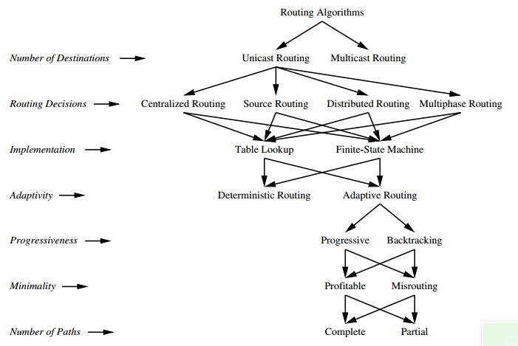

Slide 46
Multicast
Why multicast ?
Classification
Path-based
Tree-based

Slide 47
Unicast
Src

Slide 48
Unicast
Src

Slide 49
Unicast
Src

Slide 50
Unicast
Src

Slide 51
Unicast
Src

Slide 52
Unicast
Src

Slide 53
Multicast
Src

Slide 54
Multicast
Src

Slide 55
Multicast
Src

Slide 56
Multicast
Src

Slide 57
Multicast
Src

Slide 58
Multicast
Src

Slide 59
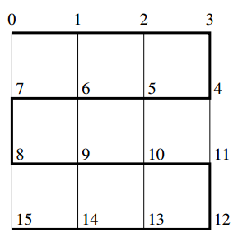
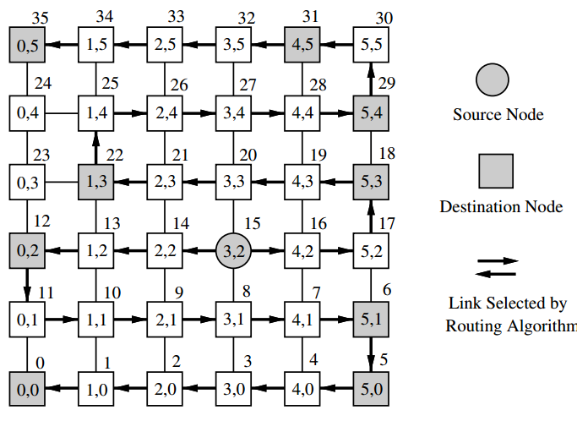
Multicast
Path based
Hamiltonian path

Slide 60
Multicast
Tree based
Replicate
Source
Destination
0
1
2
3
0
1
2
3
4
5
6
7
4
5
6
7
8
9
10
11
8
9
10
11
12
13
14
15
12
13
14
15

Slide 61
Bibliography
Topology
William J. Dally and C. L Seitz. The torus routing chip. Journal of Distributed Computing, 1(3):187–196, 1986.
Charles Leiserson. Fat-trees: Universal networks for hardware efficient supercomputing. IEEE Transactions on Computers, 34(10), October 1985.
Boris Grot, Joel Hestness, Stephen W. Keckler, and OnurMutlu. Express cube topologies for on-chip networks. In Proceedings of the International Symposium on High Performance Computer Architecture, February 2009.
Flattened butterﬂy topology for on-chip networks. In Proceedings of the 40th International Symposium on Microarchitecture, December 2007.
J. Balfour and W. Dally. Design tradeoﬀs for tiled cmp on-chip networks. In Proceedings of the International Conference on Supercomputing, 2006.
Routing
L. G. Valiant and G. J. Brebner. Universal schemes for parallel communication. In Proceedings of the 13th Annual ACM Symposium on Theory of Computing, pages 263–277, 1981.
D. Seo, A. Ali, W.-T. Lim, N. Raﬁque, and M. Thottenhodi. Near-optimal worst- case throughput routing in two dimensional mesh networks. In Proceedings of the 32nd Annual International Symposium on Computer Architecture, June.
Christopher J. Glass and Lionel M. Ni. The turn model for adaptive routing. In Proceedings of the International Symposium on Computer Architecture, 1992.
P. Gratz, B. Grot, and S. W. Keckler, “Regional congestion awareness for load balance in networks-on-chip,” in Proceedings of the 14th IEEE International Symposium on High-Performance Computer Architecture, February 2008.
N. EnrightJerger, L.-S. Peh, and M. H. Lipasti, “Virtual circuit tree multi- casting: A case for on-chip hardware multicast support,” in Proceedings of the International Symposium on Computer Architecture (ISCA-35), Beijing, China, June 2008.

