Slide 1
Baseball and Luck

Slide 2
WINS RUNS BASES
1st Order
2nd Order

Slide 3
Sequences
HR O 1B O 1B O
1
1B 1B HR O O O
3

Slide 4
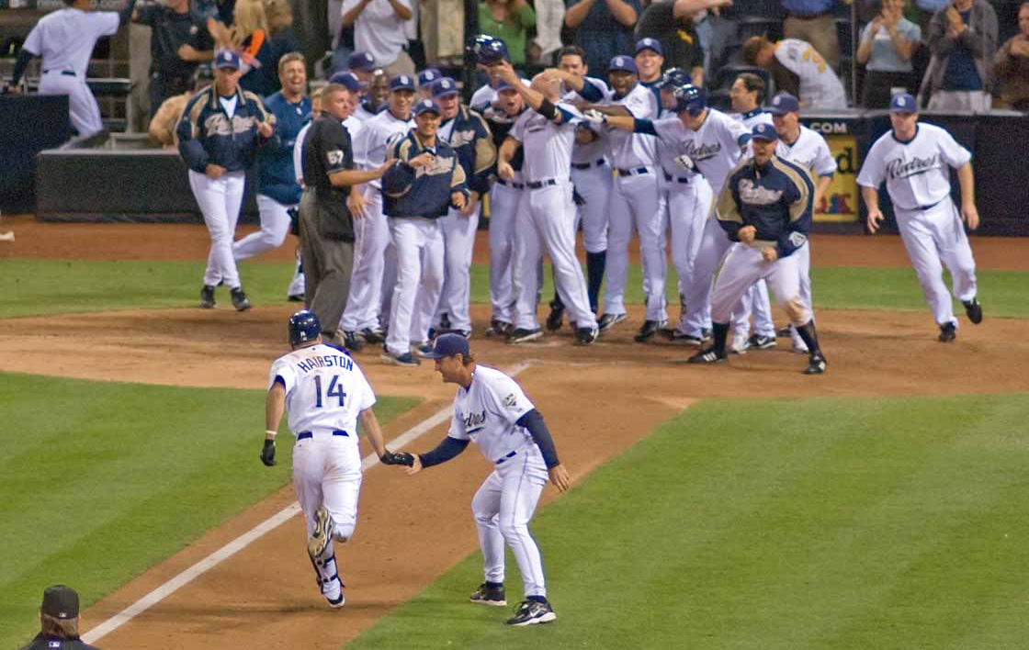

Slide 5
?
Notes:
How many bases does it take to earn a run?
How many bases does it take to give up a run?

Slide 6
TB⁺_{off}
= 1B + 2B*2 + 3B*3 + HR*4 + HBP + BB + SB – CS
TB⁺_{def}
= 1B + 2B*2 + 3B*3 + HR*4 + HBP + BB + SB – CS + ROE
TB⁺ / Runs = Efficiency

Slide 7
Show graphs/results

Slide 8
Efficiency _{projected} = R² * β + (1 - R²) * α
p-value < 0.001
Runs _{projected} = (162/G – 1) * TB⁺/Eff_{proj}

Slide 9
W% =
Pythagorean Expectation
(RS)^{e}
(RS)^{e} + (RA)^{e}
e = ( ) ^{.287}
RS + RA
G

Slide 10
W = W_{i} + (162 – G) * W%
Regression to the Mean

Slide 11
Show predicted playoffs

