Slide 1
Baseball and Luck
Notes:
Don’t talk about predictive power until the end: “…And here’s the best part!”
Also, remember to mention ruby with CSVs and D3

Slide 2
WINS RUNS BASES
1st Order
2nd Order

Slide 3
Sequences
HR O 1B O 1B O
1
1B 1B HR O O O
3

Slide 4
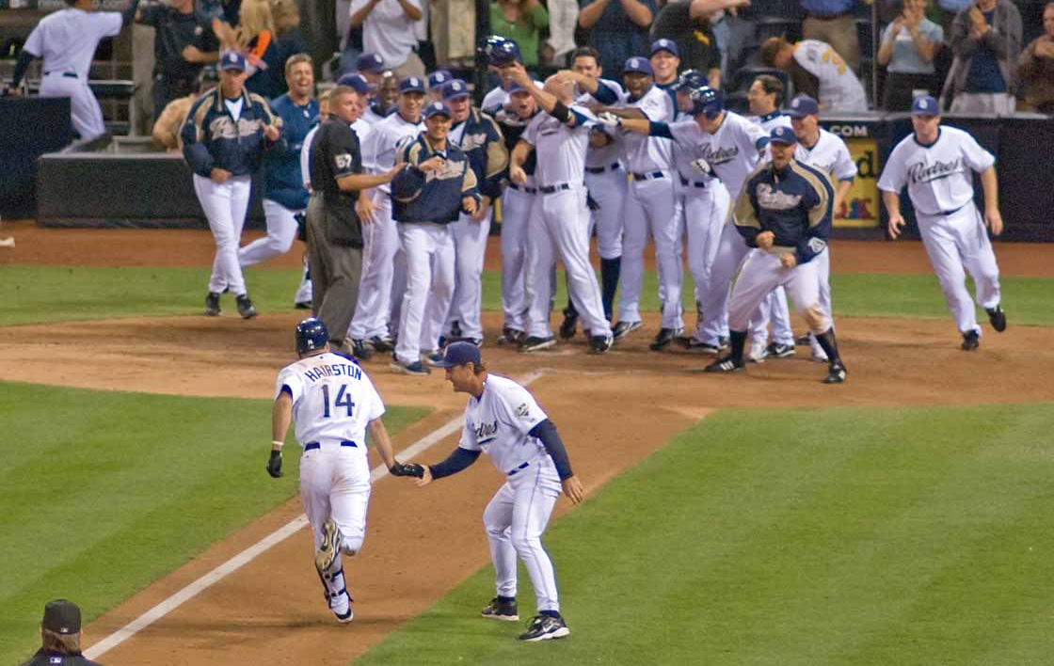

Slide 5
?
Notes:
How many bases does it take to earn a run?
How many bases does it take to give up a run?

Slide 6
TB⁺_{off}
= 1B + 2B*2 + 3B*3 + HR*4 + HBP + BB + SB – CS
TB⁺_{def}
= 1B + 2B*2 + 3B*3 + HR*4 + HBP + BB + SB – CS + ROE
Notes:
Skip over this….

Slide 7
TB⁺
=
Efficiency
Runs
Notes:
What is a TB⁺, and what is a Run.
What is Efficiency.

Slide 8
Show graphs/results

Slide 9
Efficiency _{projected} = R² * β + (1 - R²) * α
p-value < 0.001
Runs _{projected} = (162/G – 1) * TB⁺/Eff_{proj}

Slide 10
W% =
Pythagorean Expectation
(RS)^{e}
(RS)^{e} + (RA)^{e}
e = ( ) ^{.287}
RS + RA
G

Slide 11
W = W_{i} + (162 – G) * W%
Regression to the Mean

Slide 12
Predictions
WSN gets home field advantage
LAD wins division
SFG falls to wild card
STL ties ATL for 2nd wild card
BAL and MIL win divisions, but play .500 henceforth
NYY is sub-.500 henceforth
TB is above-.500 henceforth
CHC improves, but still is sub-.500

