Slide 1


Slide 2
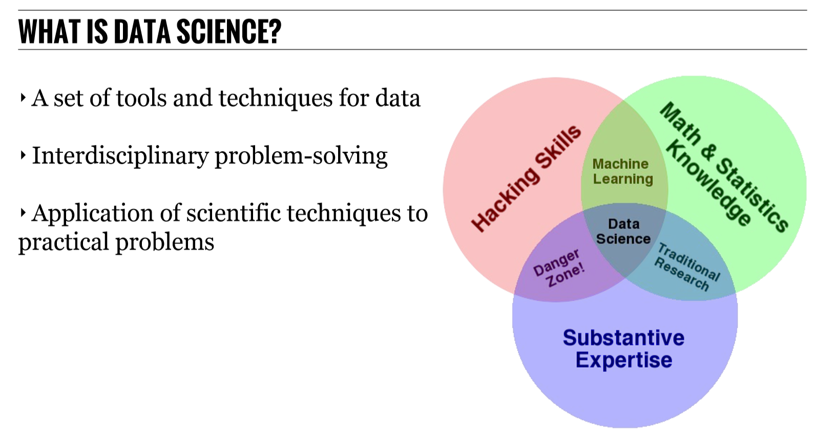

Slide 3
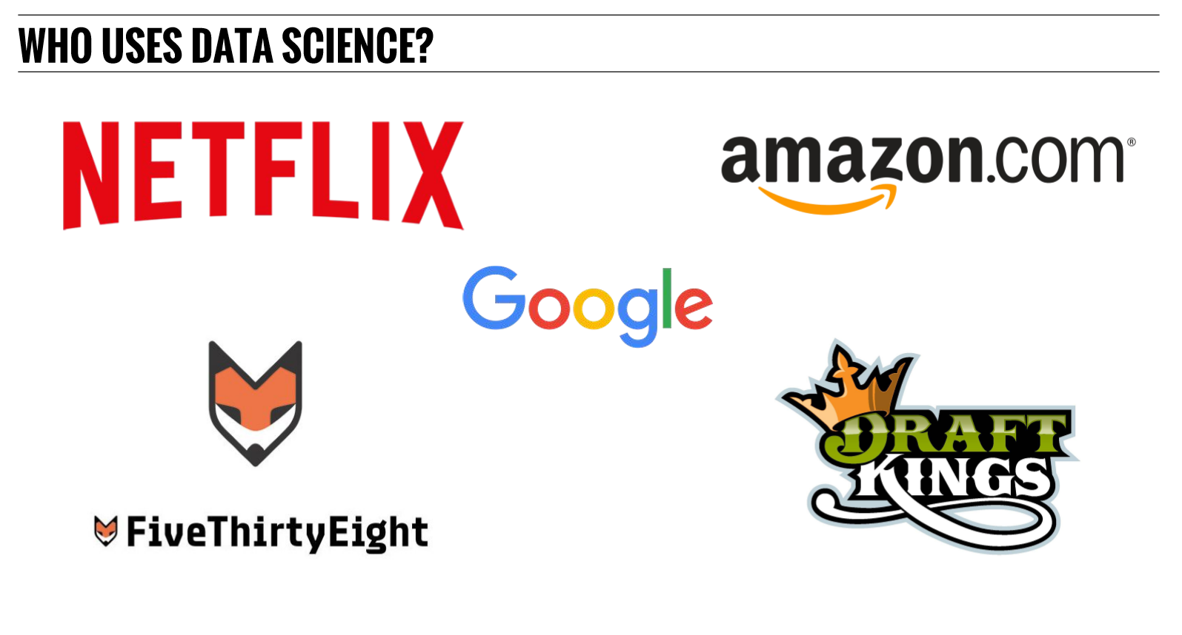

Slide 4


Slide 5
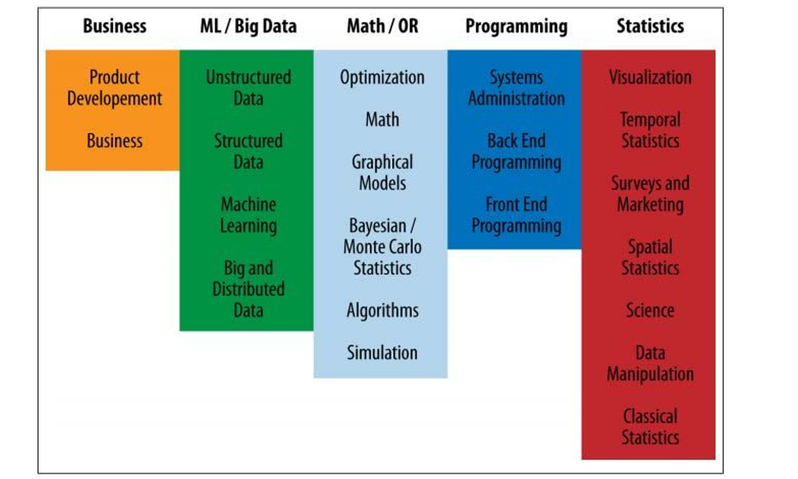

Slide 6
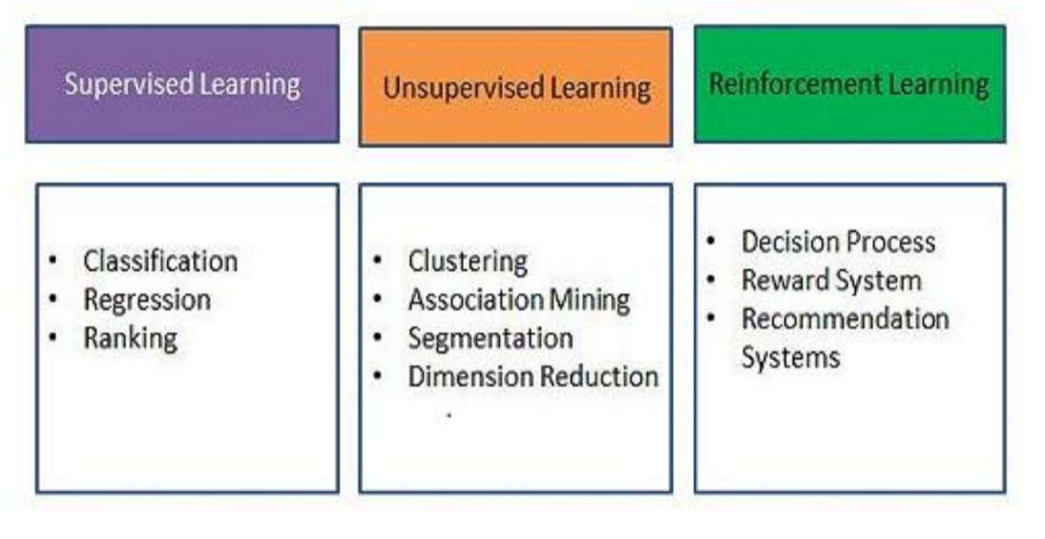

Slide 7
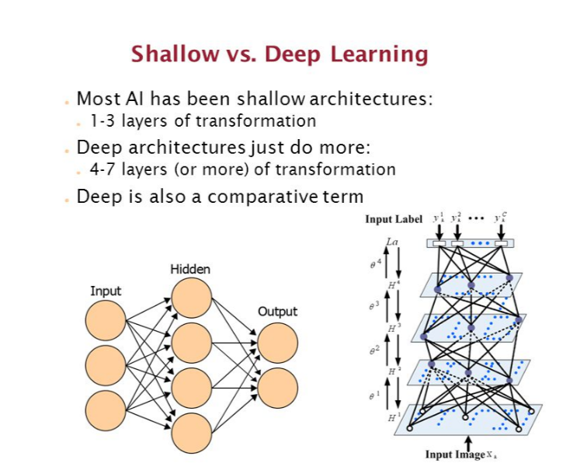

Slide 8
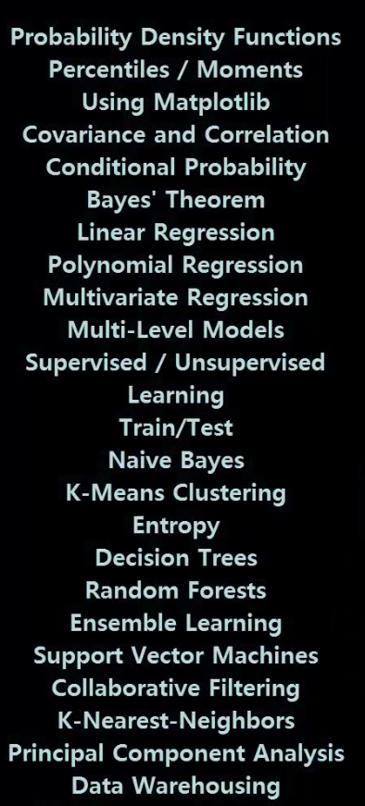
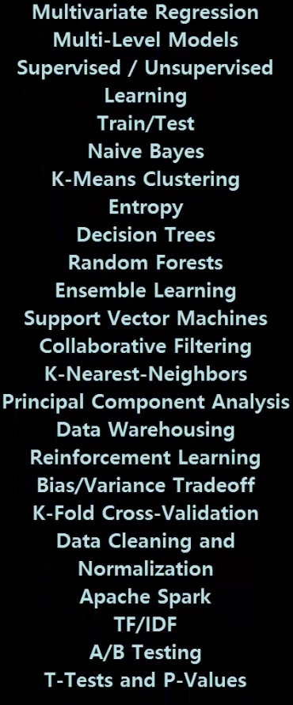
ML Techniques

Slide 9
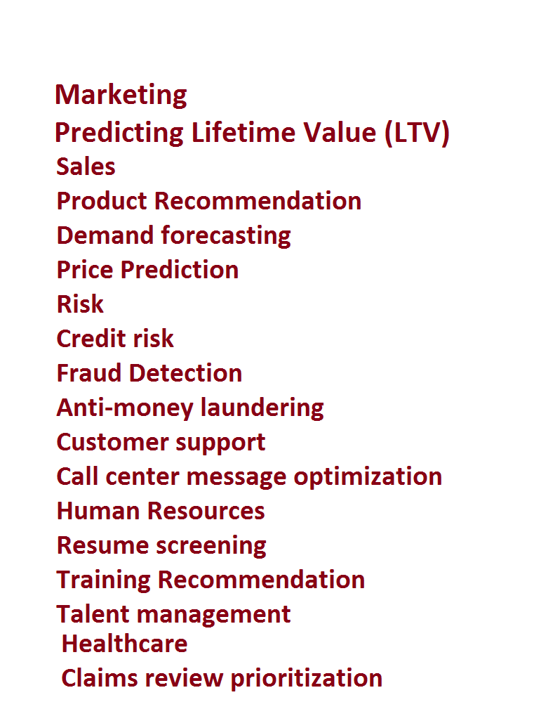
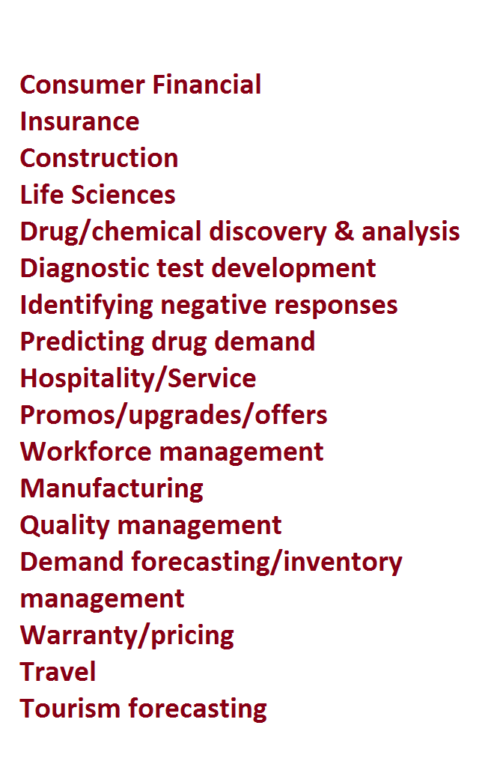
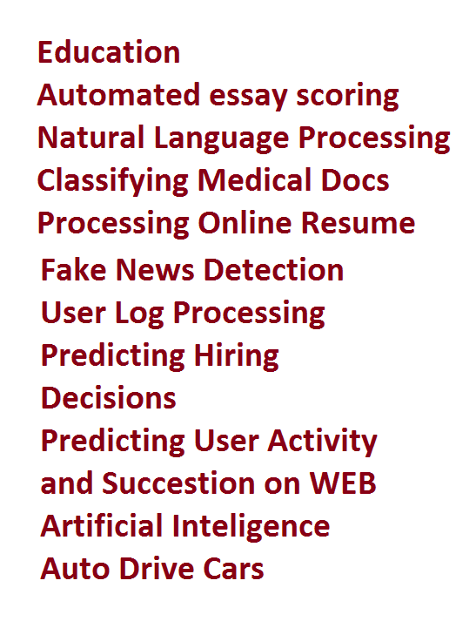
USECASES
USECASES

Slide 10

EXAMPLE1 – Predicting Online Activity

Slide 11
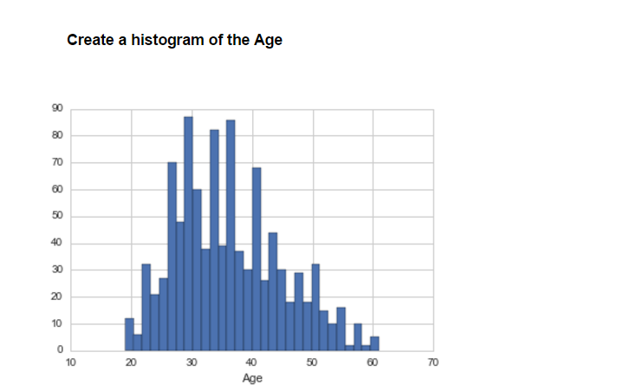

Slide 13
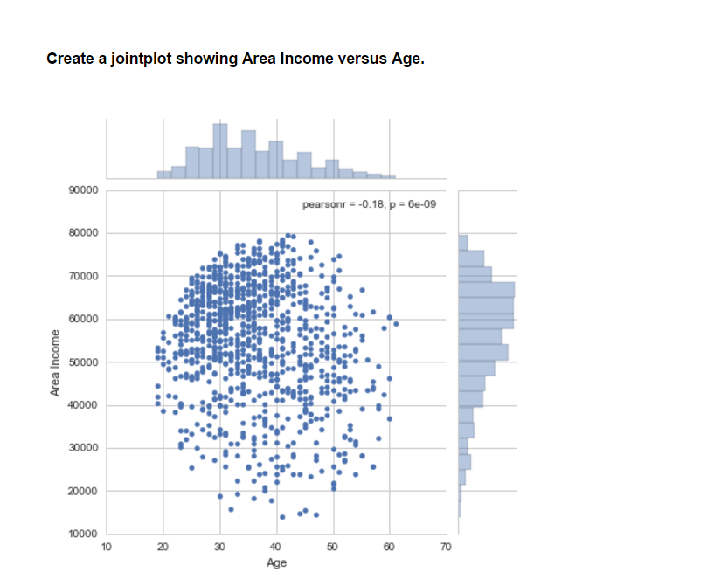

Slide 14
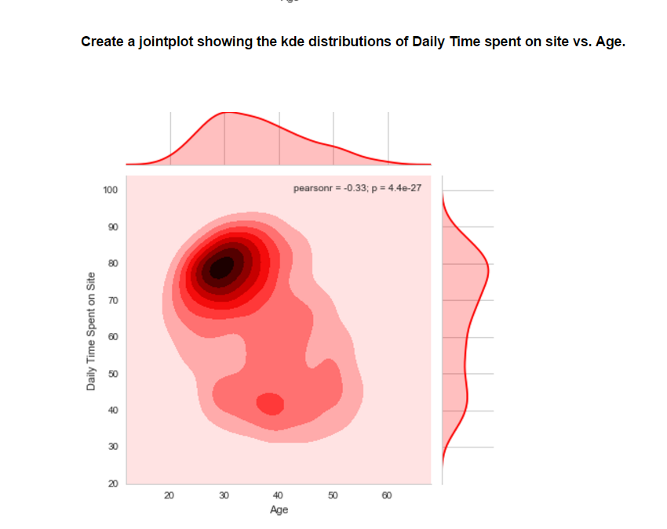

Slide 15
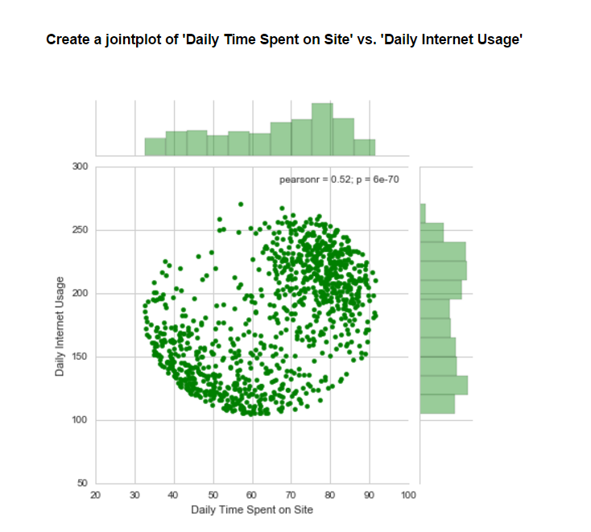

Slide 16
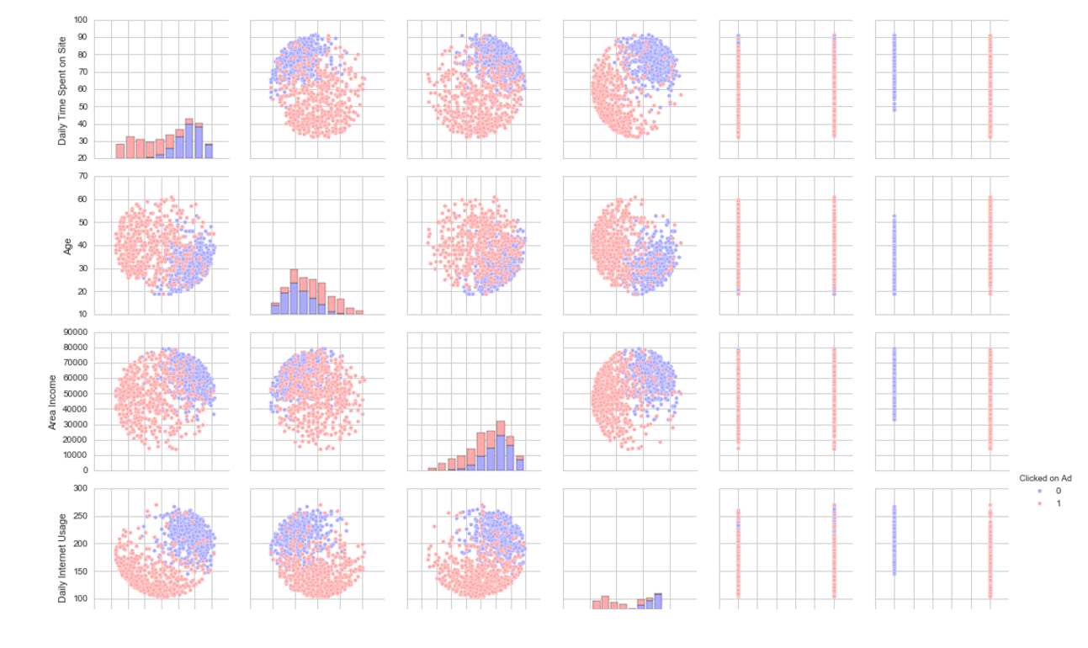
All Features Pair Plot

Slide 17
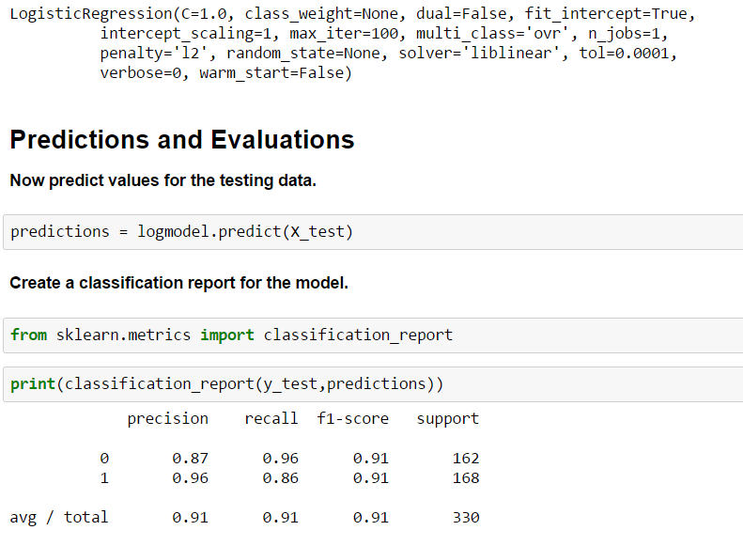
Logistic Regression
Now it's time to do a train test split, and train our model!

Slide 18
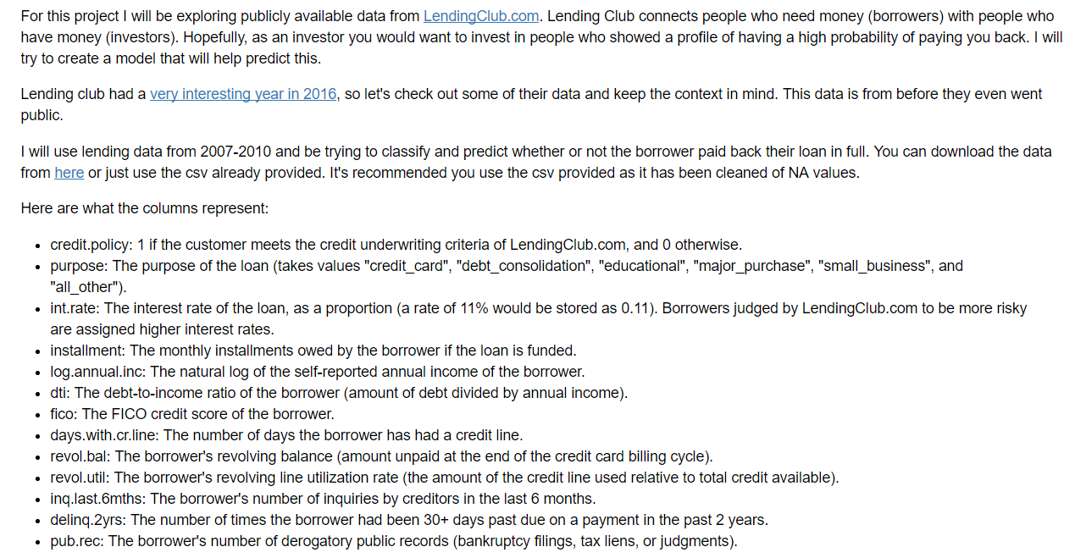
EXAMPLE2 – Predict borrower pay back full loan

Slide 19
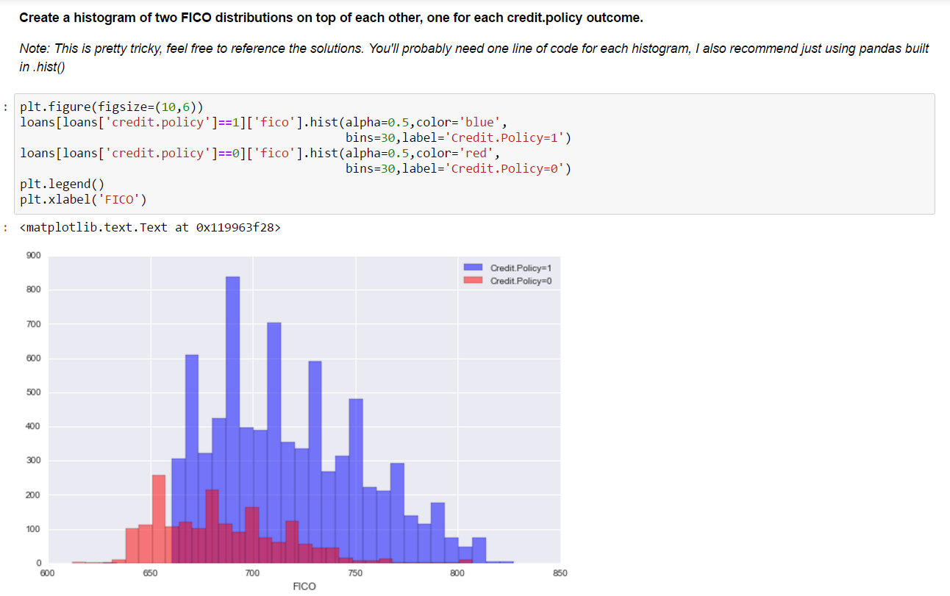
Exploratory Data Analysis

Slide 20
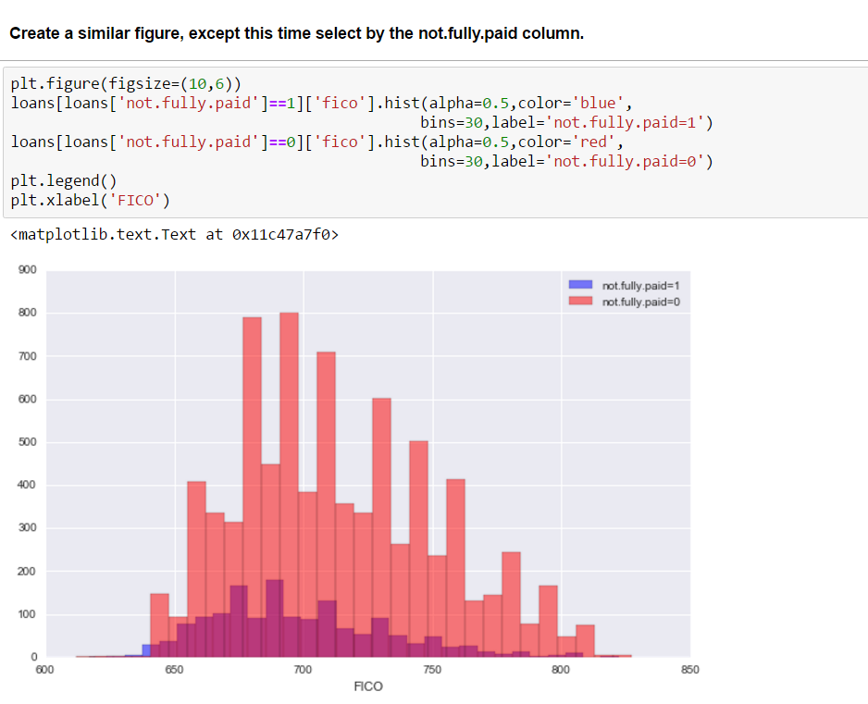

Slide 21
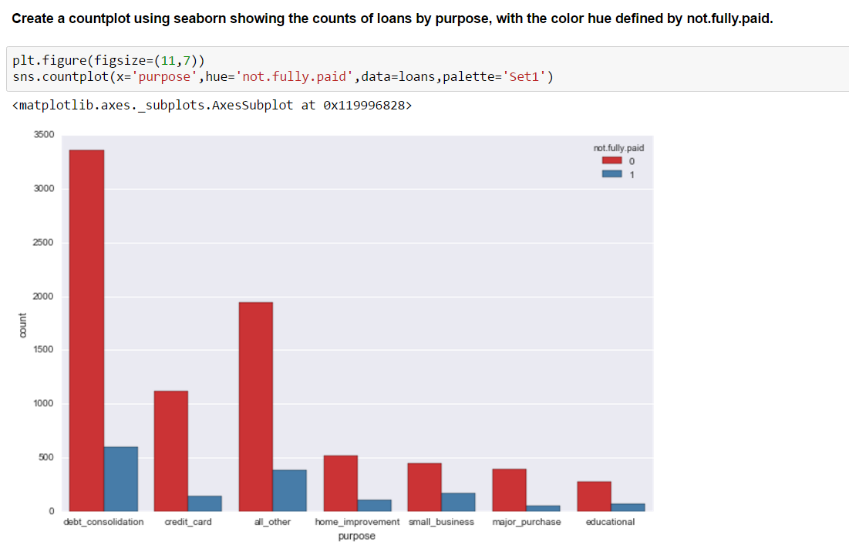

Slide 22
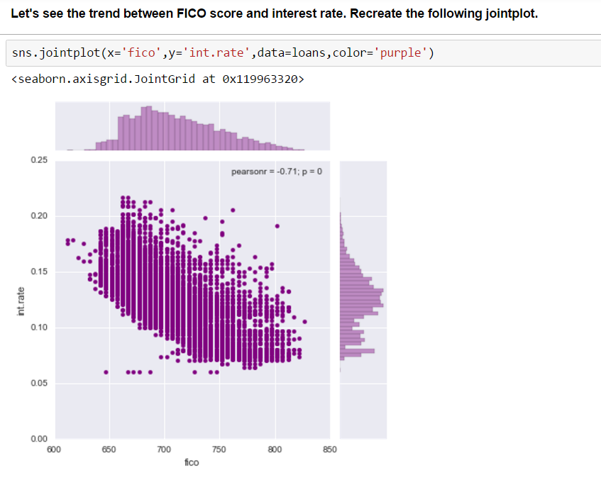

Slide 23
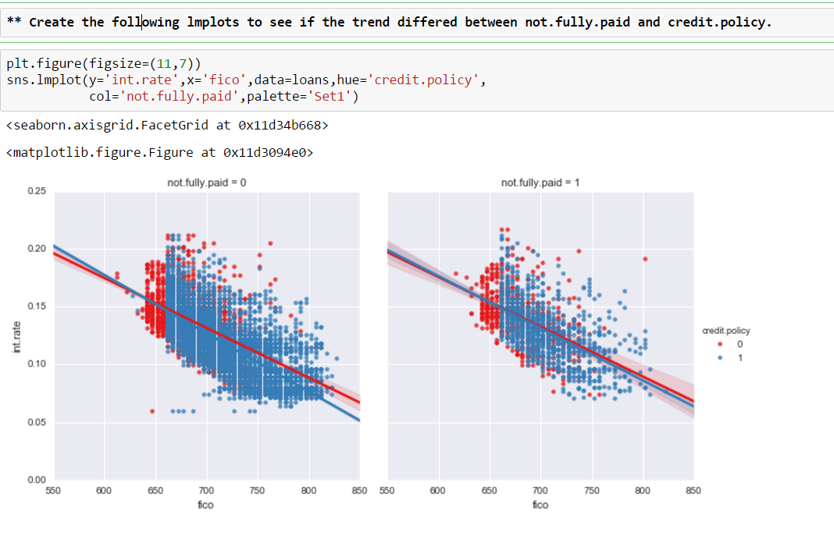

Slide 24
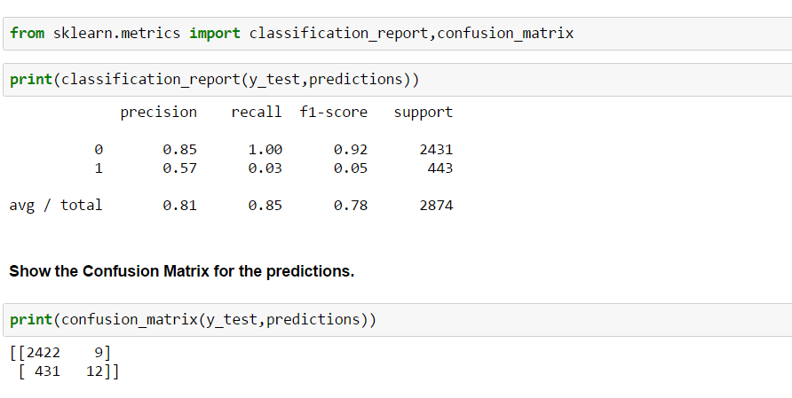
Predictions and Evaluation of Decision Tree

Slide 25
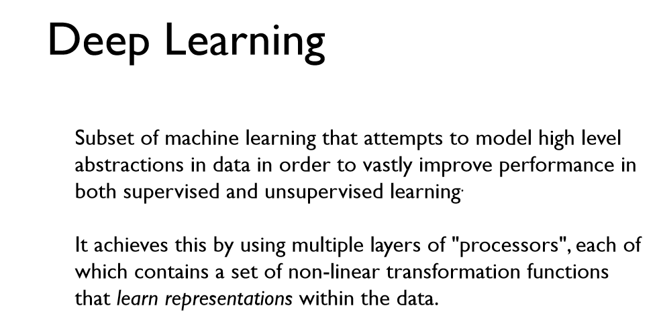

ARTIFICIAL NEURAL NETWORK

Slide 26
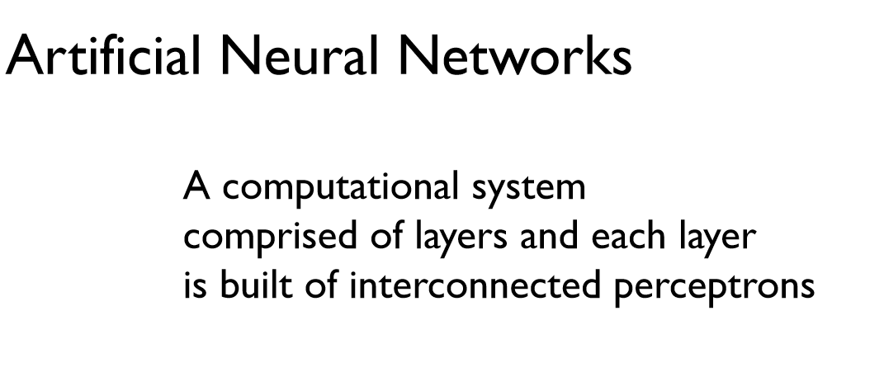


Slide 27
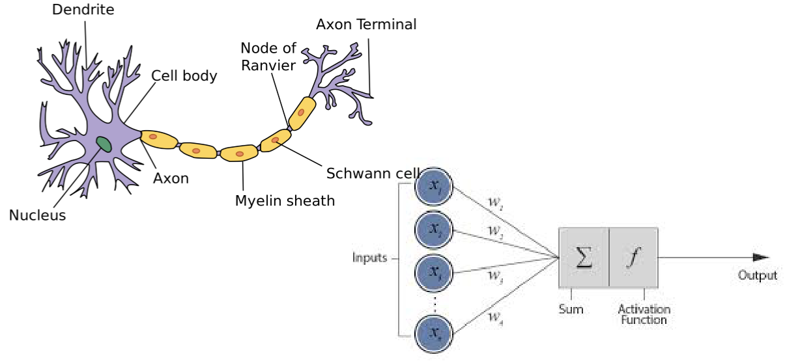

Slide 28
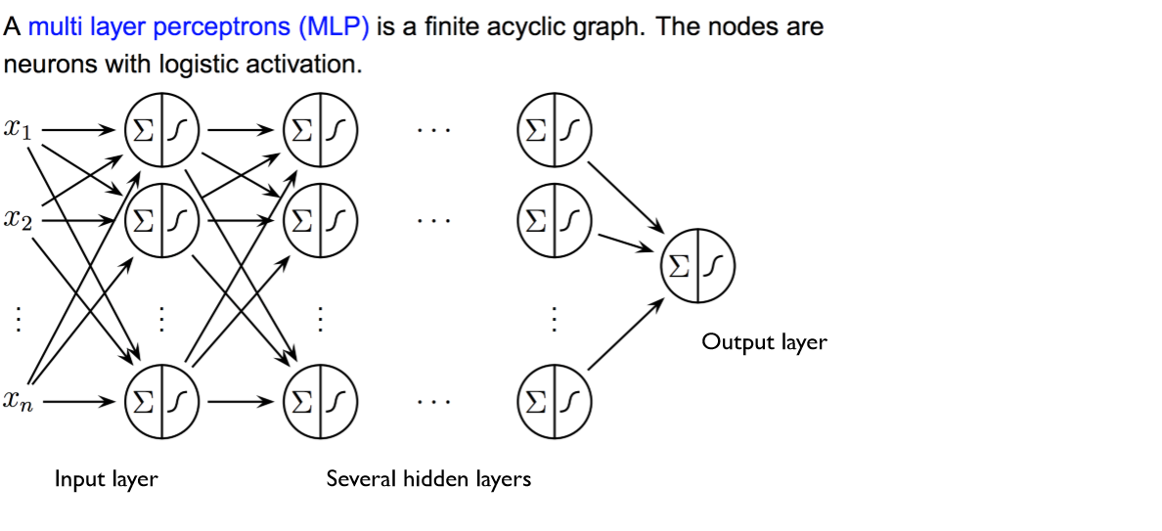

Slide 29
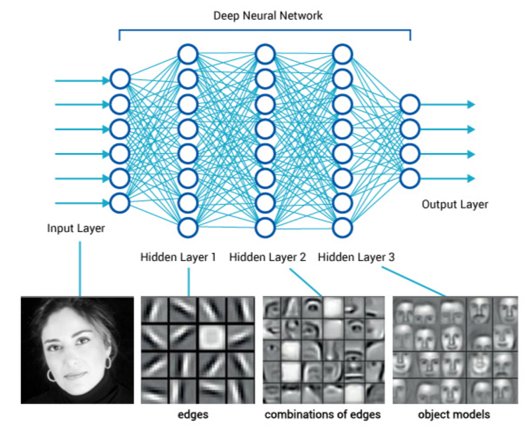

Slide 30
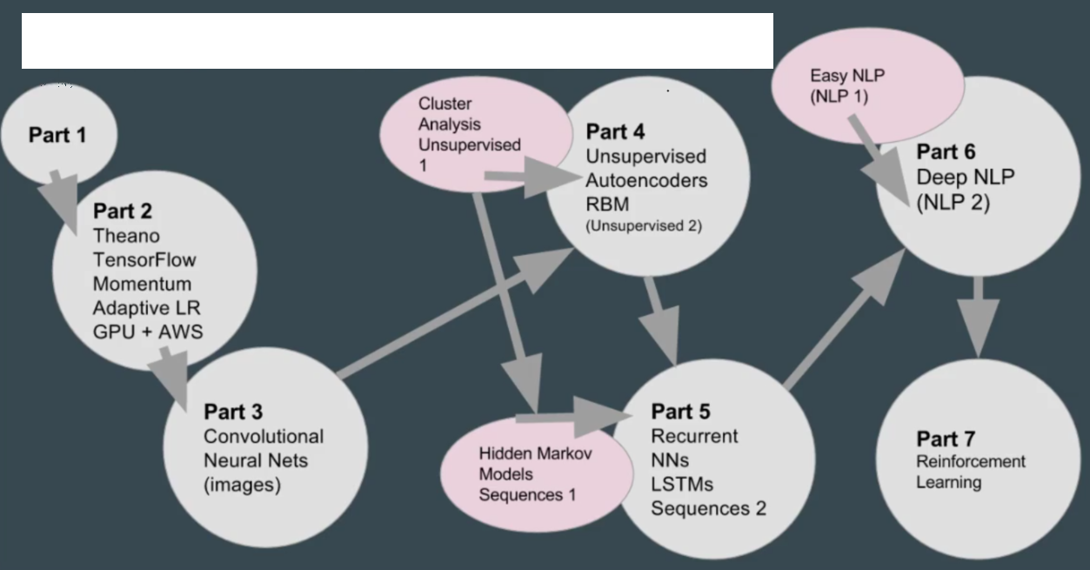
Deep Learning Application

Slide 31
Audit Data Analytic Project

Slide 32
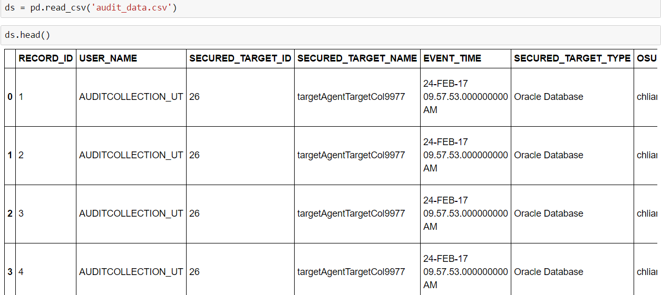

Slide 33
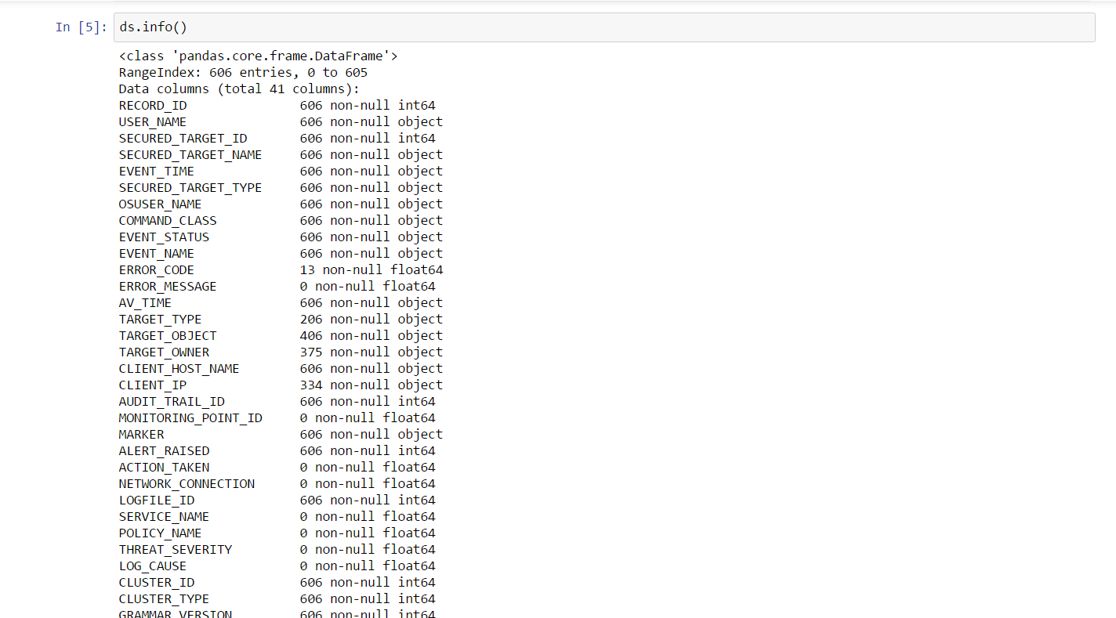
Features Information

Slide 34
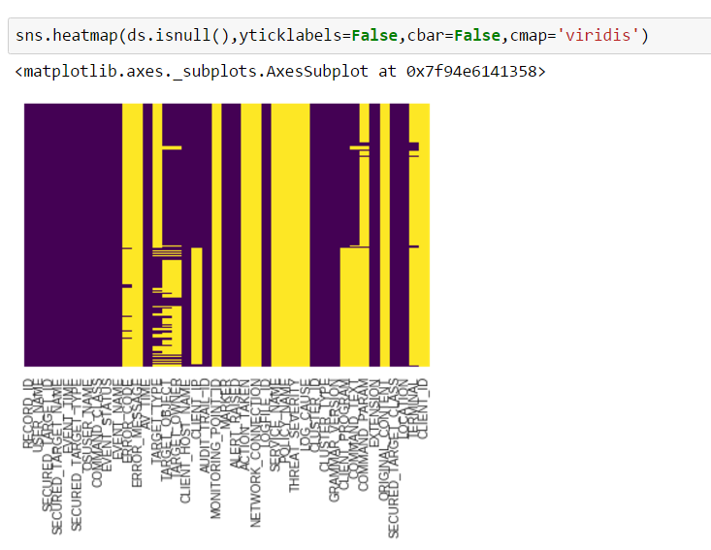
Visualize Null Values

Slide 35
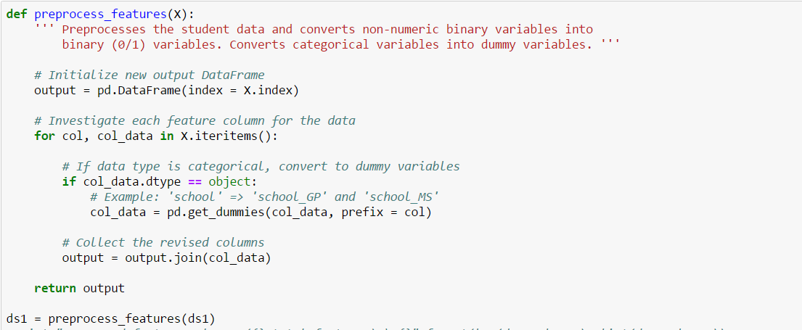
Data process and Dummy Variables

Slide 36
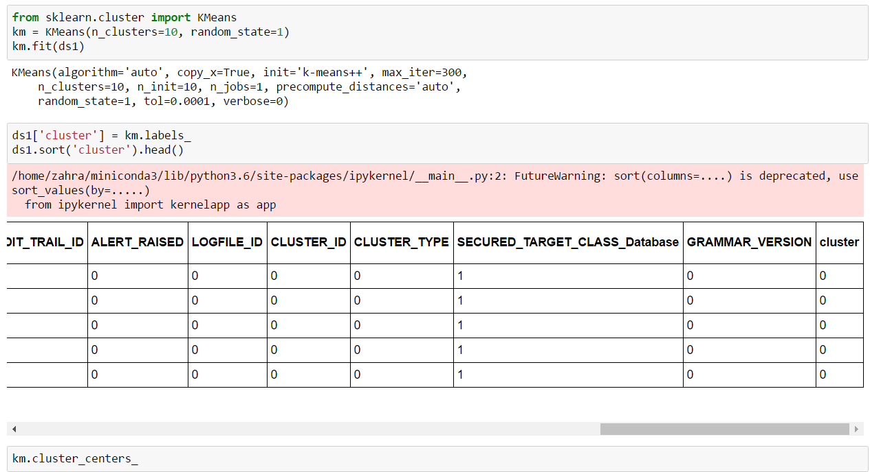
Unsupervised K-Mean Classification

Slide 37
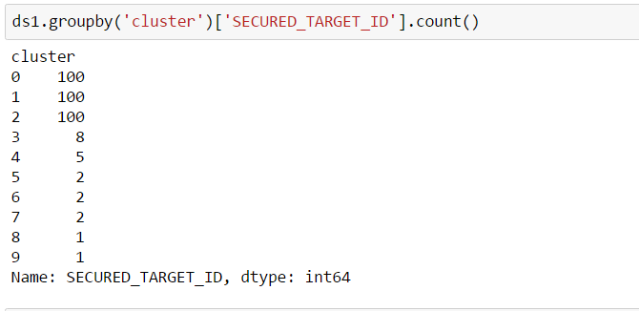
Number of Transactions per Cluster

Slide 38
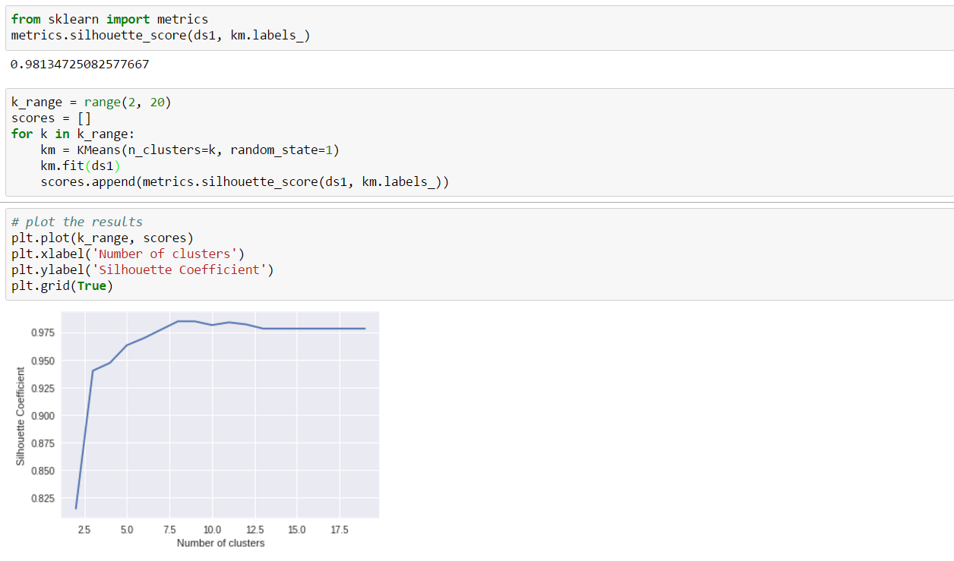
Silhouette Score

Slide 39
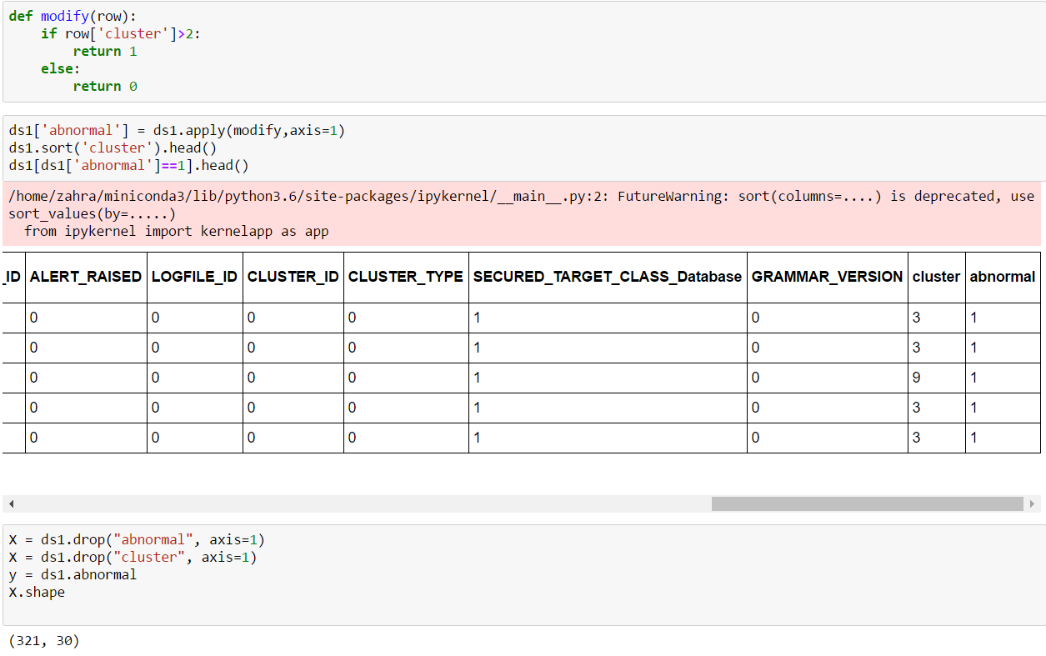
Add a Target Label for Abnormality

Slide 40
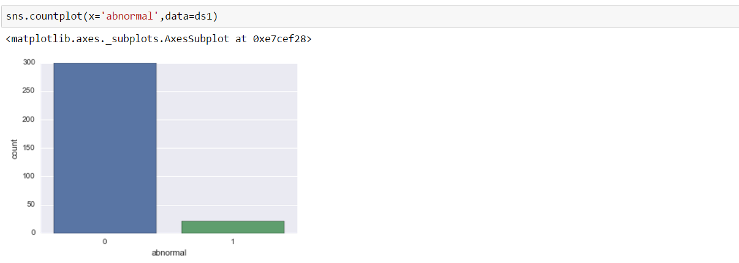
Visualize Abnormality

Slide 41
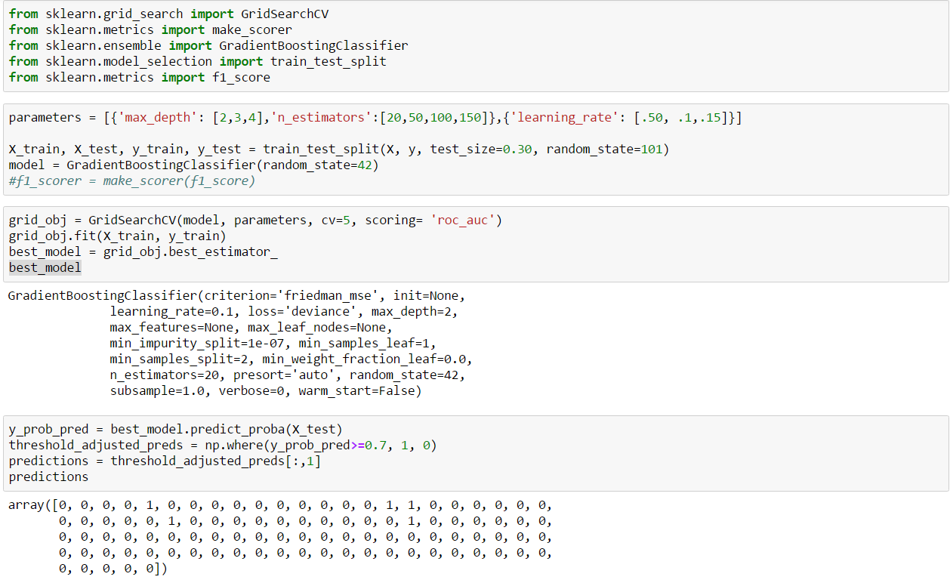
Grid Search + Gradient Boosting

Slide 42

Classification Report + Confusion Matrix

Slide 43
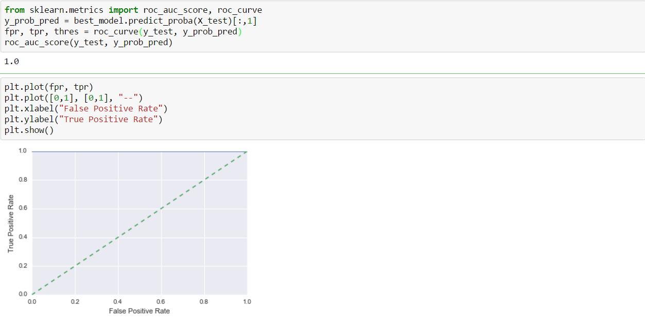
Roc curve

Slide 44
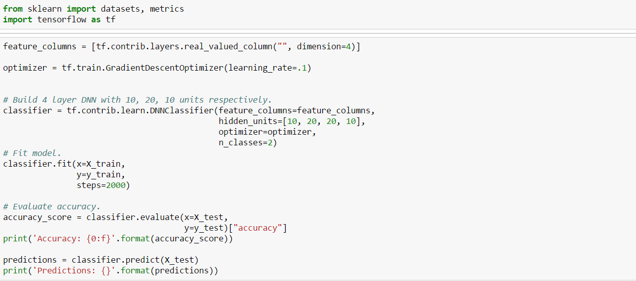
Tensor Flow Deep Classification

Slide 45
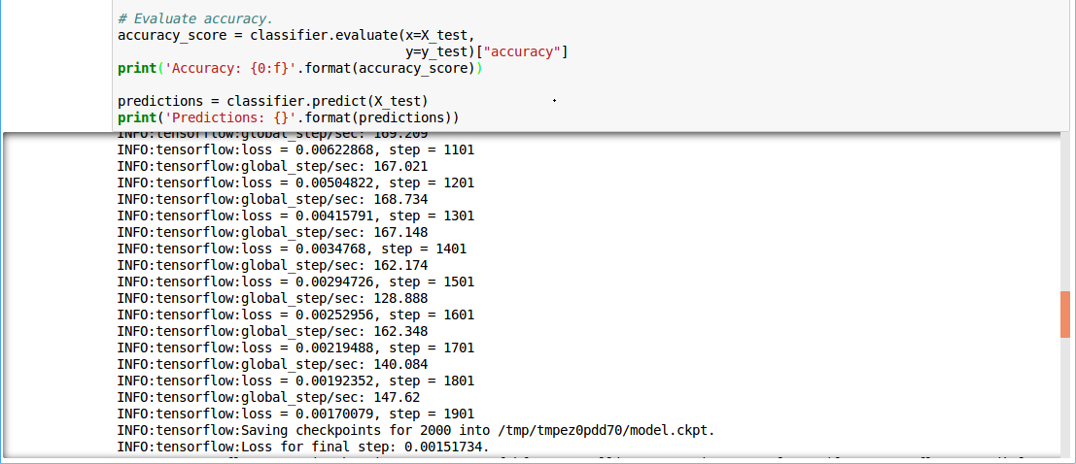
Steps + Loss

Slide 46
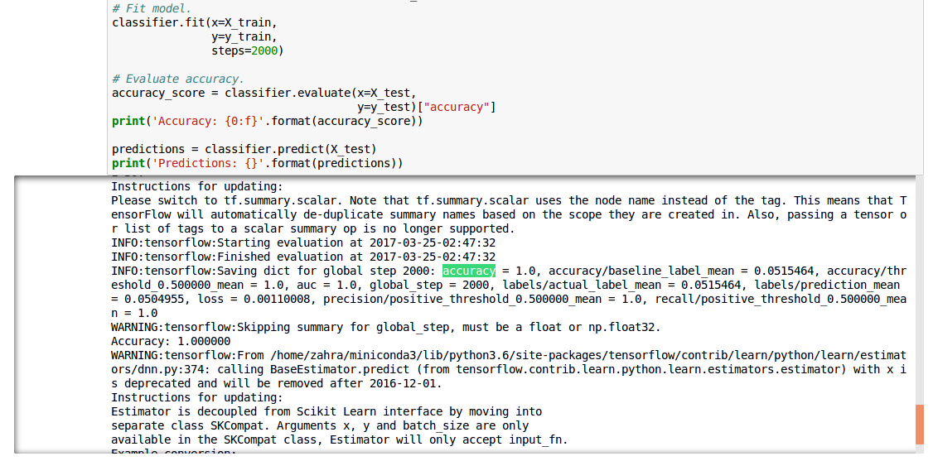
Accuracy

Slide 47
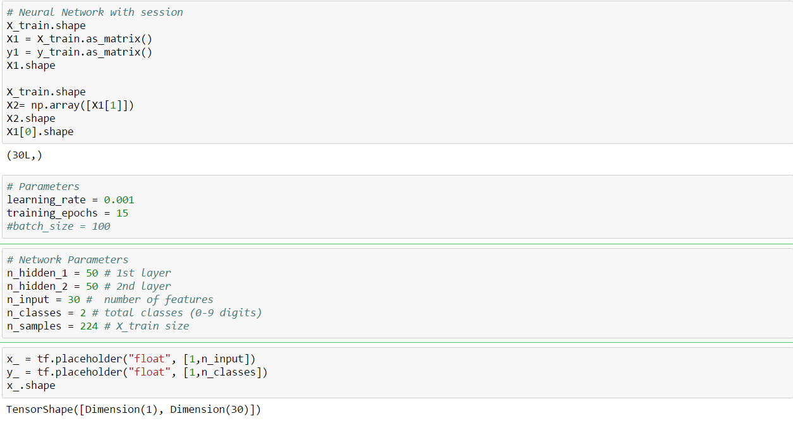
Neural Network with Tensor flow Session

Slide 48
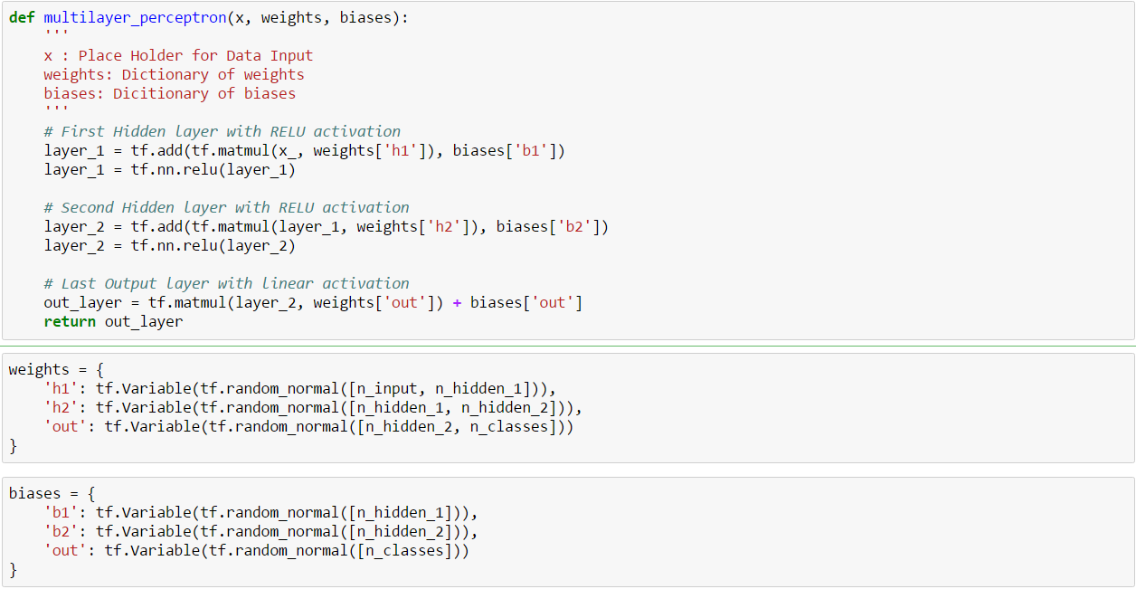
Multi-Layer Perceptron

Slide 49
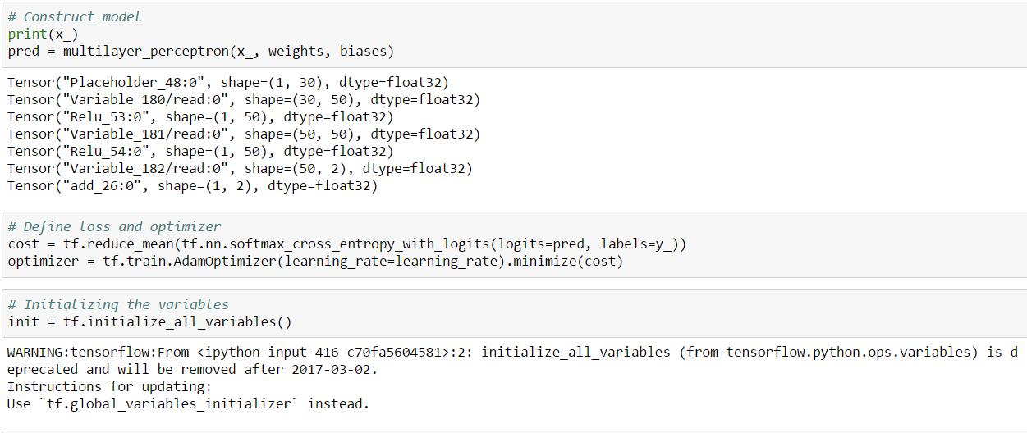
Model + Cost + Optimizer

Slide 50
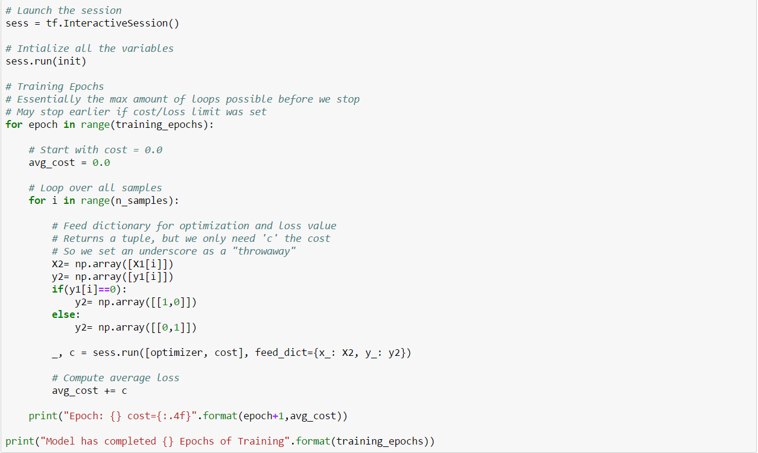
Launch Interactive Session

Slide 51
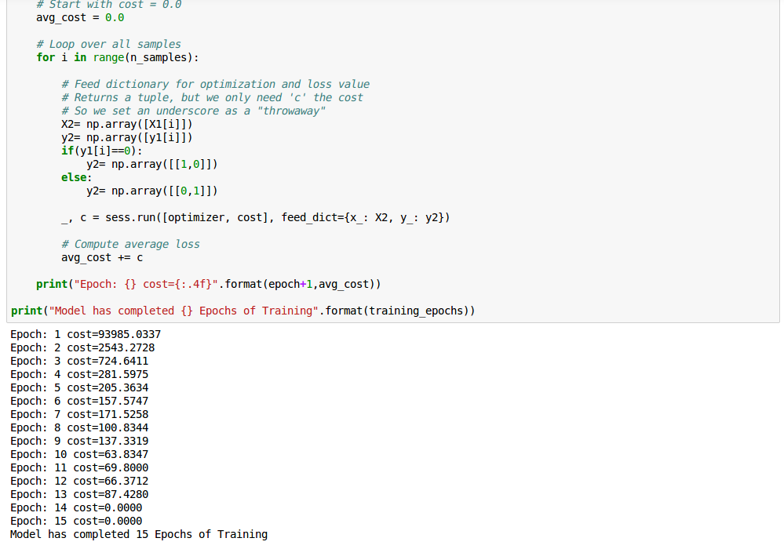
Average Loss per Training Epochs

Slide 52
Q & A

