Slide 1

上课前，请大家准备好:
1. 蓝色听课手册
2. 笔记本
3. 黑笔和红笔
● 重难考点过关
●一词多义专练

Slide 2
第9课时 Units 9—10 (八上)
初三英语备课组

Slide 3
Unit 9 Can you come to my birthday party?
话题作文
1.Can/Could you …?
2.Would you like to …?
3.Do you want to…?
Make an invitation
(发出邀请)
·prepare for an exam
·go to the doctor
·help my parents meet my friend
·have the flu...
1.Yes, I’d love to. / I’d like to .
2.Yes, it’s very kind/nice of you.
3.That sounds great.
4.That sounds like fun.
5.I’m happy/glad to….
Accept an invitation (接受邀请)
●一词多义专练
1.I’d like/love to,but I'm going to...
2.I’m sorry I can’t. I have to…
3.I’m afraid I can’t.I must...
4.I’m afraid not.I might have to...
5.Sorry, I’m not free/available.I...
reasons
Refuse an invitation (拒绝邀请)

Slide 4
Unit 10 If you go to the party, you'll have a good time!
If 引导的条件状语从句，如果...就会...
主将、主祈、主情，从现
1.如果明天不下雨，我们就去野餐。
If it doesn’t rain tomorrow, we will have a picnic.(主将从现)
● 重难考点过关
●一词多义专练
2.如果你想取得进步，认真听课。
If you want to make progress, listen to the teacher carefully. (主祈从现)
3.如果你不放弃，没有什么能阻止你。
Unless you give up, nothing can stop you. (主情从现)
引导词：if, unless(if not)
如果不，除非

Slide 5
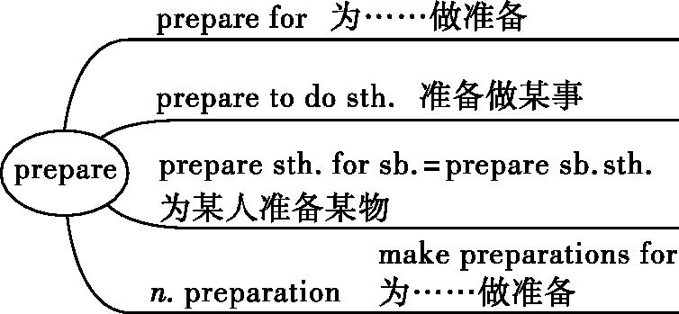
1
prepare v. 使做好准备;把……准备好
be/get ready for
be/get ready to
prepared adj.有准备的，准备好的
be\get well-prepared for sth.
be\get prepared to do sth.

Slide 6
1
prepare v. 使做好准备;把……准备好
to cook
（1）I was preparing （cook） dinner when my son arrived home yesterday.
（2）I was preparing my math exam in my study last night when you called.
（3）I have made ____________ （prepare） for the coming test. And I am sure I will do a good job.
for
preparations

Slide 7
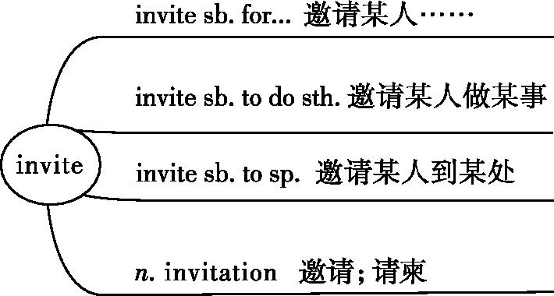
2
invite v. 邀请
be invited to do… 某人被邀请做……
不定式
介词

Slide 8
（1）—Susan’s birthday is coming. Among those
（invitation） are some of my friends’.
—I guess you’ve got one.
（2）Lily invited me Sanya with her this summer holiday.
（3）I （invite） as a special guest to attend the exhibition.
invitations
to
was invited
（4）琳达邀请我们所有人明天去钓鱼。
_______________________________________
Linda invited all of us to go fishing tomorrow.

Slide 9
（1）look after ：take care of,意为“照料;照顾”。
look after well = take good care of,意为“好好照顾”。
（2）look的其他相关短语:
look at... 看…… look up 查阅（词典）
look for寻找 look out 当心
look around 环顾 look through 浏览
look over检查 look out of... 朝……的外面看
look up to 敬仰 look down on 轻视
look into 调查 look forward to 盼望;期待
3
look after 照顾;照料
care for 喜欢，照顾

Slide 10
3
look after 照顾;照料
（1）Before you choose a book, you'd better look
the first few pages to know whether it is too easy or too difficult for you.
（2）青少年应该学习如何照顾自己。
through
Teenagers should learn how to look after themselves.

Slide 11
（3）Katy's family, friends and fans look up to her as an example of someone who has overcome her difficulties and achieved her dreams.
凯蒂的家人、朋友和粉丝都很敬佩她，把她视为克服困难、实现梦想的榜样。

Slide 12
4
receive/accept
词条 | 意义及用法
receive | 意为“收到”,强调客观上接到或收到,但主观上不一定接受
accept | 意为“接受”,指主观上接受

Slide 13
4
receive/accept
（1）My friend Paul received an expensive model car
his brother as a Christmas present.
（2）I didn't mean to trouble Curry yesterday. It was pouring with rain so I （accept） his offer of a lift.
from
receive sth from sb 从某人那里收到某物
accepted
下着瓢泼大雨
mean to do 想要、意图做
（3）Before stamps appeared, people didn't pay for the letters they sent, but for the letters they _________（receive）.
received

Slide 14
5
advice/suggestion
词条 | 分类 | 一条建议 | 动词
advice | 不可数名词 | a piece of advice | advise
suggestion | 可数名词 | a suggestion | suggest
我们的老师给了我们多么有用的建议啊！_______________________________________
What useful advice our teacher gave us!

Slide 15
[注意] （1）advise的常见用法:
advise sb. on/about sth. 关于某事给某人提出建议/忠告
advise sb. （not） to do sth. 建议/劝告某人（不要）做某事
（2）advice的常用短语:
ask sb. for advice 向某人征求意见
give sb. advice on/about sth. 就某事向某人提建议
take/follow one’s advice 听取某人的建议

Slide 16
[注意]
（1）sb suggest doing
I suggest staying at home.
（2）sb suggest that sb (should) do…(虚拟语气)
They suggest that he (should) stay at home.

Slide 17
5
advice/suggestion
（1）Our teacher often advises us （develop）the habit of taking notes while reading.
（2）My teacher gave me much advice how to study English well when I had some trouble.
（3）The doctor suggested （drink）as much water as possible.
to develop
养成……的习惯
on/about
drinking
suggestion
（4）If you're looking for some birthday gifts, here is my （suggest）.
（5）Jenny took her （father） advice and made up her mind to develop a good living habit.
father's
决心做……

Slide 18

Homework
完成今天对应的课时训练
Thanks for listening ！

Slide 19
6
hear from/hear of
词条 | 用法 | 例句
hear from | hear from sb. 收到某人的来信 | I hear from him once a week. 我每星期收到一次他的来信。
hear of | hear of sb./sth.=hear about sb./sth. 听说某人/某事 | I heard of the Palace Museum first when I was five.当我五岁的时候,第一次听说故宫。

Slide 20
6
hear from/hear of
（1）I （hear） from my sister yesterday. She told me she was fine.
（2）We are all sorry to hear the flood disaster in our city in June.
（3）Drop us a line. It's always great to hear from you.
heard
of
给我们写封信吧,能收到你的信总是让人很高兴。

