Slide 1
HI7700/4 Training
μITRON Specification RTOS
μITRON is an acronym of "Micro ITRON".
ITRON is an acronym of "Industrial TRON”.
TRON is an acronym of “The Real time Operating system Nucleus”.
HEW is an acronym of “High-performance Embedded Workshop”.
RTOS is an acronym of “Real Time Operating System”.

Slide 2
Contents
1. Overview (Anh)
1.1 μITRON?
1.2 Line-up of Renesas μITRON OSs
1.3 HI7700/4 Related Products
1.4 HI7700/4 specifications
2. HI7700/4 Kernel
2.1 Advantage to use RTOS (Anh)
2.2 Service Call (Anh)
2.3 Object, ID Number (Anh)
2.4 Task Scheduling (Anh)
2.5 Task Management (Anh)
2.6 Task Synchronization, Communication (Tien)
2.7 Exclusive Control (Tien)
2.8 Memory Pool (Tien)
2.9 Interrupt (Tien)
2.10 Time Management (Tien)
3. Start-up
3.1 Start-up Sequence
3.2 Initialize Section
3.3 Initialize Standard Library
4. System-Down
5. Configuration/Build
6. Installation
6.1 How to Install HI7700/4
6.2 How to Install Debugging Extension
6.3 HI7700/4 Directory Structure
7. Appendix
7.1 Service Call List
7.2 Related URL

Slide 3
1. Overview

Slide 4

1.1 μITRON?
μITRON is the name of Realtime-Multitasking OS kernel specification.
The specification can be downloaded from TRON Association WEB site.
=
μITRON
μITRON is used most in Japan. But each μITRON is NOT same.
Company A’s
μITRON OS
≠
Company B’s
μITRON OS

Slide 5
1.2 Line-up of Renesas μITRON OSs
μITRON3.0
μITRON4.0
μITRON4.0/PX
SH-4, SH-4A
HI7750/4
HI7300/PX *
SH4AL-DSP,
SH-3, SH3-DSP
HI7700/4
SH-1,SH-2,
SH-2A, SH2A-FPU
HI7000/4
HI7000/4 series
M32R
M3T-MR32R/4
M32C/80, 90
M3T-MR308/4
M16C/80, 70
M16C/60, 30,
Tiny, 20, 10
M3T-MR30
M3T-MR30/4
H8SX
HI1000/4
H8S
HI2000/3
Only for SH-4A and SH4AL-DSP
http://sg.renesas.com/products/tools/os_middleware/u_itron/index.jsp : for detail.

Slide 6
1.3 HI7700/4 Related Products
1. HI7700/4
Real-time, Multi-tasking OS Kernel ( μITRON specification)
GUI Configurator
Sample programs
HI7000/4 series User’s Manual
2. Debugging Extension (OS aware debugger)
This is add-in software for HEW.
The debugging extension can be download from our WEB site.
(Free of charge)
http://www.renesas.com/products/tools/os_middleware/os_aware_debugging/dx/index.jsp
Functions:
Display kernel objects (tasks, etc.) status to HEW window
Service call from HEW window
Display service call history (service call trace) to HEW window

Slide 7
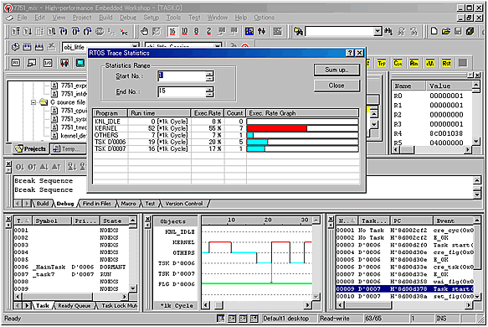
Debugging Extension Window Image
Execution rate
Service call trace
Tasks status

Slide 8
1.4 HI7700/4 specifications
Target CPU : SH-3, SH3-DSP, SH4AL-DSP (http://www.renesas.com/support/training_and_workshops)
(2) Conforming specification : μITRON4.0 Specification
(3) Max. number of objects : 1023(Except cyclic handler and alarm handler)
14 (Cyclic handler)
15 (Alarm handler)
(4) Max. task’s priority : 255
(5) Number of Service calls : 157
(6) Performance : 1.25 μs
[SH4AL-DSP@216MHz, SDRAM+Cache, few cache-miss]
(Time takes for a target task to be executed after the wup_tsk is called.)
(7) Support dynamic object creation (cre_yyy)
(8) Supported objects :
Task
Semaphore
Event flag
Data queue
Mailbox
Mutex
Message buffer
Fixed-size memory pool
Variable-size memory pool
Cyclic handler
Alarm handler
Overrun handler
(9) Latest version : V.2.04 Release 00
http://www.renesas.com/products/tools/os_middleware/u_itron/hi7700_4/downloads.jsp : for more info.
Notes:
5.5-44kB

Slide 9
Example of uITRON OS in DTV System
User application
Common I/F
EMF
ISDB-T
middle
ISDB-TB
Fullseg middle
ISDB-TB
Oneseg middle
DVB-T
middle
CMMB
middle
DCM
H.264, MPEG2. Decoder
AAC, aacPlus, AC3, MP3, DRA Decoder
Qg2
graphics
Select by local area
Renesas
development
Frame work
OS µITRON
Driver
DMAC
TSIF
ICB
DU
SPUF
DMAC
TLC
MEM
DSP0
DSP1
SRU
SIM
MSTIF0
EMUX
VDP1
2D-
DMAC
VSP1
SSI
MSTIF1
VPC
DISP
R-CarH1 Peripheral modules

Slide 10
2. HI7700/4 Kernel

Slide 11
Preface
HI series OS supports only “OS Kernel”.
The user should prepare the following functions.
- Device Driver
- File System
- Middleware
In general, the user buys them from Renesas or other vendors.
In this section, you learns HI7700/4 Kernel.

Slide 12
2.1 Advantage to use RTOS
Because the independence of software improves by the task division, the
following effects can be expected.
- Software Portability
- Software Reusability
- Software Maintainability
- Team-programing
- Effective use of time of CPU
When it is necessary to do something in polling (e.x. I/O), other processing (task) can be executed without actually doing polling.

Slide 13
2.2 Service Call (System Call)
The application can do various requests to OS by using service call.
The service call API is defined as C-function.
ercd = act_tsk(1); // Activate task with task ID=1
Naming rule
Most service calls are the forms named xxx_yyy.
xxx : Shortening type of verb that shows kind of operation
cre : create, act : activate, snd : send, etc.
yyy : Target object
tsk : task, mbx : mailbox, etc.
xxx_yyy and ixxx_yyy
xxx_yyy is only for the call from task-context.
ixxx_yyy is only for the call from non-task context. ‘i’ means “interrupt”.
Ex.) act_tsk and iact_tsk
Note, sns_yyy can be called from all context.
In this documents, only “xxx_yyy” is described. Description of “ixxx_yyy” is omitted.

Slide 14
2.3 Kernel Object, ID Number
The object is distinguished by ID number.
The ID number space is independent each kind of the object.
To use object, you must register object to the kernel.
In the μ ITRON, this operation is called “Create”.
The object is created by “cre_yyy” service call. The ID number must be specified at “cre_yyy”.
If you do NOT want to decide ID number, you should use “acre_yyy”. In this case, kernel assigns ID number.
The object is also created by configurator.
‘a’ means “Assign ID Automatically”

Slide 15
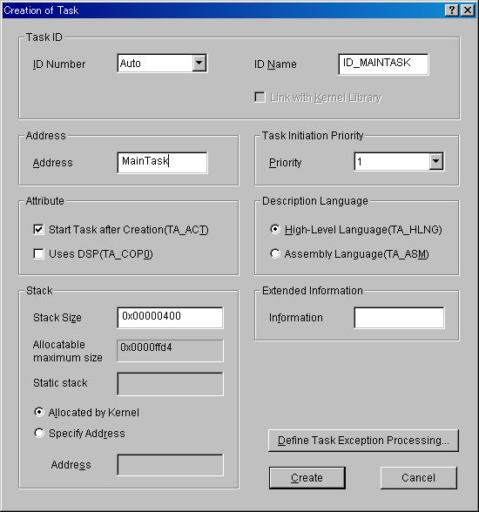
ID name header file
The ID name can be specified when you create an object by using the configurator.
The configurator generates ID name header file.
“kernel_id.h” or “kernel_id_sys.h”
#define ID_MAINTASK 1
:

Slide 16
2.4 Task Scheduling
Event-driven
The kernel re-schedules tasks only when an event is occurred.
Event : Service call, Timer interrupt
In other words, a certain task keeps executing as long as the event is not occurred.
# μITRON is NOT TSS(Time sharing system)!
Priority-based
Each task has “task priority”.
The kernel selects the task with the highest priority in the system at task scheduling.
When two or more tasks with the highest priority exist, the kernel select the task that entered the READY state earliest. (FCFS)
Smaller priority value is higher priority.
Non-task context (Interrupt context)
When non-task context is executed, any tasks is not executed.
The interrupt handler is executed as Non-task context.

Slide 17
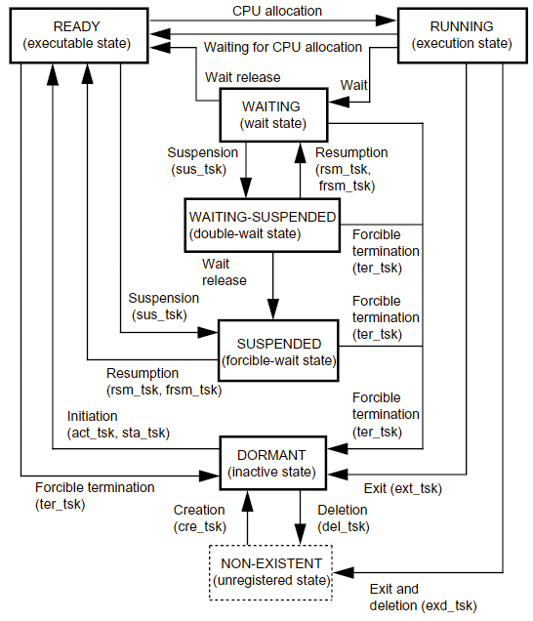
Task States
NON-EXISTENT State: A task has not been registered in the kernel and has been in a virtual state.
DORMANT State: A task has been registered in the kernel but has not yet been initiated, or has already been terminated.
READY (executable) State: An executable task is in the queue is waiting for CPU resource allocation because another higher priority task is currently running.
RUNNING State: The task is currently running. The kernel puts the READY task with the highest priority in the RUNNING state.
WAITING State: A task issues a service call such as tslp_tsk to put itself to sleep when it can no longer continue execution. The task is released (awakened) from the WAITING (sleep) state when the service call wup_tsk is issued, and it then makes the transition to the READY state.
SUSPENDED State: A task has been suspended by another task by sus_tsk.
WAITING-SUSPENDED State: This state is a combination of the WAITING state and SUSPENDED state.
READY
(executable state)
RUNNING
(execute state)

Slide 18
Example of task scheduling
wai_flg()
Wait until setting eventflag
ext_tsk()
Exit this task
Task-A
(priority = 1)
Task-B
slp_tsk()
(priority = 2)
Task-C
(priority = 3)
act_tsk(B)
Activate Task-B
set_flg()
Set eventflag
wup_tsk(B)
Wake-up Task-B
RUNNING
READY
WAITING
TIME
Event

Slide 19
Context Switch
When the kernel switches task, the kernel saves CPU registers of the old task to the memory, and after that the kernel restores CPU registers of new task from the memory.
Memory
CPU Registers
R0
R1
R0
1. Save
Area for saving CPU registers for Task-A
R1
PC
PC
R0
2. Restore
R1
Area for saving CPU registers for Task-B
PC

Slide 20
2.5 Task Management
Parameters at task creation
The packet which includes following parameters are passed to kernel.
tskatr Task attribute (( TA_HLNG||TA_ASM ) | [ TA_ACT ] | [ TA_COP1 ])
TA_ACT： After task creation, the task becomes RUNNING state.
TA_COP1： Use FPU (SH2A-FPU)
TA_HLNG : C-language
TA_ASM : Assembly language
Note, the kernel It does not distinguish TA_HLNG from TA_ASM.
TA_HLNG is recommended.
exinf Extended information
task Start address
itskpri Initial task priority
stksz Stack size
stk Stack address (see next page)

Slide 21
Kind of Task’s Stack
Dynamic Stack
  1) When task is created, the kernel allocates the task’s stack from system area. The area size for dynamic stack allocation is specified by configurator (CFG_TSKSTKSZ).
  2) (CFG_STSTKID + 1) ≤ Task ID ≤ CFG_MAXTSKID
  (CFG_MAXTSKID : specified by configurator)
  If you don’t use dynamic stack, make CFG_MAXTSKID as CFG_STSTKID.
  3) You must specify 0 as the "stk", that is specified at creation.
User-prepared Stack
  You must specify the address as the "stk", that is specified at creation.
Static Stack (Out of ITRON spec.)
Static stack can be shared between multiple tasks to reduce RAM footprint. At the same time, only one task among the tasks which shares the stack can become other than DORMANT state. (Other tasks cannot be changed from DORMANT state.)
  1) The area is secured statically.
  2) 1 ≤ Task ID ≤ CFG_STSTKID (CFG_STSTKID : specified by configurator)
  If you don’t use static stack, specify 0 as CFG_STSTKID.
Usually, "Dynamic stack" or "User-prepared stack" is recommended to be used.
Note, kernel does not initialize task stack contents.

Slide 22
How to create
For task using dynamic stack or user-prepared stack
  cre_tsk service call
  acre_tsk service call (Assign Task ID Automatically)
  By using configurator
For task using static stack
  vscr_tsk service call
  By using configurator
How to activate
Specify TA_ACT attribute at creation
Non-Existent --> READY
act_tsk, iact_tsk service call
DORMANT --> READY, activation request is queued.
sta_tsk, ista_tsk service call (see next page)
DORMANT --> READY

Slide 23
Example of task code
#include “kernel.h” // [MUST] HI7700/4 header file
#include “kernel_id_sys.h” // [If necessary] ID name header file. Generated by configurator
#include “kernel_id.h” // [If necessary] ID name header file. Generated by configurator
#pragma noregsave(MainTask) // [If necessary] The task entry function does not need
// to guarantee register contents.
void MainTask(VP_INT exinf)
{
while(1) {
// Main processing
}
// ext_tsk(); // Not needed if there is no possibility of breaking out of the infinite loop
}
The parameter “exinf” :
Activation method
exinf
Specify TA_ACT attribute at creation
act_tsk service call
sta_tsk service call
Extended information (exinf) which is specified at creation
Start code which is specified by sta_tsk

Slide 24
2.6 Task Synchronization, Communication
2.6.1 Basic Task Synchronization Algorithm
External event
Interrupt handler
or another task
Task
Notify event
（using service call）
Wait event
（using service call）
processing
END

Slide 25
2.6.2 Sleep and Wake-up
For waiting event :
- slp_tsk(void) : Wait until waking-up
- tslp_tsk(tmout) : Wait until waking-up.
When tmout[msec] has passed, calling task is released from WAITING
and error "E_TMOUT" is returned.
This is called “Time-out function”. ‘t’ means “time-out”.
txxx_yyy = xxx_yyy + “Time-out function”
For notifying event :
- wup_tsk(tskid) : Wake-up task
The wup_tsk must be specified target task ID.
That is, independence of waiting-side and notifying side is not excellent.

Slide 26
2.6.3 Eventflag : Synchronization with multiple events
The eventflag is one of kernel object, and is independent from task.
The eventflag has 32-bits pattern. Task can wait the bits condition (AND/OR).
When WAITING is released, the eventflag pattern at the time is transferred to the task. And when you create a eventflag, you can specify TA_CLR attribute. When TA_CLR is specified, the eventflag pattern cleared to 0 at WAITING is released.
For waiting event :
- wai_flg, twai_flg: Wait until required bits are set
- pol_flg : Confirm whether required bits are set or not. (Polling)
If bits have been set, this API returns E_OK.
If bits have not been set, this API returns error(E_TMOUT).
Note, this API never enter WAITING.
For notifying event :
- set_flg : Set specified bits
Others :
- clr_flg : Clear specified bits
- ref_flg : Refer to eventflag status
Create/Dele :
- cre_flg : Create eventflag with specified ID
- acre_flg : Create eventflag. The ID is assigned by kernel.
- del_flg : Delete eventflag

Slide 27


Wait_flag/AND: release condition requires all bits in Wait flag pattern to be set
Wait_flag/OR: release condition only requires at least one bit in Wait flag pattern to be set
Please refer “mition-400e.pdf” page 143 for more information
Example
Interrupt handler
iset_flg
(00000001)
Task
Requested event from
the remote controller
wai_flg/OR
Waiting data(00000011)
00000010
flgptn？
Interrupt handler
Requested event from
the main unit key
00000001
iset_flg
(00000010)
Interrupt handler
Processing from
the remote control
Interrupt handler
processing
from the main unit key
Note: The above event flag is 8-bit to make the description easier.

Slide 28
2.6.4 Task Waiting Queue
The eventflag and other objects have task waiting queue.
Task waiting queue can be managed by FIFO-order or priority-order.
You can select FIFO-order or priority-order by “attribute”, that is specified at creation.
TA_TFIFO : FIFO-order
TA_TPRI : Task priority-order

Slide 29
2.6.5 Mailbox: No-Copy Message communication
The mailbox is one of kernel object, and is independent from task.
Application can send/receive message which is generated in the shared memory. The mailbox transfers message pointer. Message contents does not copied. (Fast!)
Generally, message should be generated the memory block which is get from memory-pool.
You can specify priority to each message. In this case, TA_MFIFO attribute should be specified as the mailbox attribute at creation.

Slide 30
2.6.5 Mailbox: No-Copy Message communication (cnt)
For sending message :
- snd_mbx : Send message
For receiving message :
- use rcv_mbx, trcv_mbx and prcv_mbx to receive message from the mailbox.
+ rcv_mbx: Wait until a message in mailbox is available to receive
+ trcv_mbx: Receive a message from the mailbox with time-out.
If the time-out has passed without avaible message, E_TMOUT will be returned.
When: tmout = TMO_POL: it acts as prcv_mbx
tmout = TMO_FEVR: it acts as rcv_mbx
+ prcv_mbx: If no message is available in the mailbox, E_TMOUT will be returned immediately.
Others :
- ref_mbx : Refer to mailbox status
Create/Dele :
- cre_mbx : Create mailbox with specified ID
- acre_mbx : Create mailbox. The ID is assigned by kernel.
- del_mbx : Delete mailbox

Slide 31


Example
Task-A
Task-C
get_mpf
Get message area
Mailbox
Generate message contents
rcv_mbx
snd_mbx
A
A
process
Task-B
B
rel_mpf
Release message area
get_mpf
Get message area
A
Generate message contents
B
B
snd_mbx

Slide 32
Message Structure
(1) Message without priority
(2) Message with priority
T_MSG
T_MSG_PRI
T_MSG
Application
message data
(Arbitrary structure)
Application
message data
(Arbitrary structure)
typedef struct {
VP msghead;
} T_MSG;
The kernel uses this area to manage messages. Application must clear this area before snd_mbx.
typedef struct {
T_MSG msgque;
PRI msgpri; // Message priority
} T_MSG_PRI;
Generally, user should define message structure as follows.
struct UserMsg {
T_MSG osarea; // or T_MSG_PRI
UB user_data[16]; // Application message data
};

Slide 33
Sample code
typedef struct {
T_MSG osarea;
UB userdata[8];
} USERMSG;
// ***** Sample of sender *****
void Task1(VP_INT exinf)
{
USERMSG *pk_msg;
get_mpf(ID_MPF1, (VP *)&pk_msg); // get message area
… Create message
pk_msg->osarea.msghead = (VP)0; // set 0 to T_MSG
. snd_mbx(ID_MBX1, (T_MSG *)pk_msg); // send message
…
}
// ***** Sample of receiver *****
void Task2(VP_INT exinf)
{
USERMSG *pk_msg;
rcv_mbx(ID_MBX1, (T_MSG **)&pk_msg); // receive message
…process
rel_mpf(ID_MPF1, (VP)pk_msg): // release memory block
…
}

Slide 34
2.6.6 Data Queue: 1-word(32bits) FIFO buffer
The data queue is one of kernel object, and is independent from task.
Application can send/receive word data (32bits). The data queue has FIFO buffer. The FIFO buffer size (number of data) is specified at creation.
For sending data :
- snd_dtq, tsnd_dtq : Send data. If data queue is full, wait until
another task receives data from data queue
Note, task waiting queue for sending is always managed by FIFO.
- psnd_dtq : Polling
- fsnd_dtq : Send URGENT data. If data queue is full, the kernel
deletes the oldest data in the data queue and send data.
For receiving data :
- rcv_dtq, trcv_dtq: Wait until data is sent to the data queue
- prcv_dtq : Polling
Others :
- ref_dtq : Refer to data queue status
Create/Dele :
- cre_dtq : Create data queue with specified ID
- acre_dtq : Create data queue. The ID is assigned by kernel.
- del_dtq : Delete data queue

Slide 35
Example
Data queue
Task-A
Task-C
Generate data
Data-A
(Empty)
rcv_dtq
snd_dtq
Data-B
…
Data-A
(Empty)
Task-B
Data-B
process
Data-A
Generate data
Data-B
snd_dtq
4 bytes

Slide 36
2.6.7 Message Buffer : FIFO buffer
The message buffer is one of kernel object, and is independent from task.
Application can send/receive arbitrary size message. The message buffer has FIFO buffer. The FIFO buffer size is specified at creation.
Note, the message is copied, so the performance is not good.
The max. size of the message that can be sent is specified at creation. The receiver must prepare the memory space with the max. size.
For sending message :
- snd_mbf, tsnd_mbf : Send message. If message buffer is full, wait until
another task receives message from message buffer
Note, task waiting queue for sending is always managed by FIFO.
- psnd_mbf : Polling
For receiving message (receive a message to specified address) :
- rcv_mbf, trcv_mbf: Wait until message is sent to the message buffer
- prcv_mbf : Polling
Others :
- ref_mbf : Refer to message buffer status
Create/Dele :
- cre_mbf : Create message buffer with specified ID
- acre_mbf : Create message buffer . The ID is assigned by kernel.
- del_mbf : Delete message buffer

Slide 37
Example
Message Buffer
Task-A
Copy to message buffer
Task-C
Generate Message
Message-A
Copy to Task-C's memory space
(Empty)
rcv_mbf
snd_mbf
Message-B
MessageA
Message-B
Task-B
process
Generate Message
Message-A
Copy to Task-C's memory space
Message-B
Copy to message buffer
snd_mbf

Slide 38
2.7 Exclusive Control
2.7.1 Semaphore
The semaphore is one of kernel object, and is independent from task.
The semaphore has “Semaphore counter”.This counter means number of resources. The initial value is specified at creation.
User should relate actual resource to semaphore. Application must get semaphore before using resource, and must release semaphore after using resource.
For getting semaphore :
- wai_sem, twai_sem : Decrement semaphore counter. If the counter
has been 0, wait until semaphore is released.
- pol_sem : Polling
For releasing semaphore :
- sig_sem: Increment semaphore counter
Others :
- ref_sem : Refer to semaphore status
Create/Dele :
- cre_sem : Create semaphore with specified ID
- acre_sem : Create semaphore. The ID is assigned by kernel.
- del_sem : Delete semaphore

Slide 39
Task() {
wai_sem(ID_SEM_A);
…
… // In this block, other tasks cannot access the resource
… // related on the semaphore ID_SEM_A.
…
sig_sem(ID_SEM_A);
}

Slide 40
Semaphore counts
１
０
０
１
Release semaphore
-> Task-B get semaphore
Get semaphore and continue executing
wai_sem
sig_sem
Task-A
wai_sem
sig_sem
Task-B
RUNNING
Request semaphore, but cannot get and enter to WAITING
Release semaphore
READY
Exclusive section
WAITING

Slide 41
Priority inversion problem
The higher priority task might be blocked by lower priority task
Time until Task-A acquires semaphore depends on the execution time of Task-B that has not acquired semaphore and has higher priority than Task-C that has acquired semaphore.
Acquire semaphore
wai_sem
->WAITING
TASK-A
Priority=HIGH
slp_tsk->WAITING
TASK-B
Priority=MID
TASK-C
Priority=LOW
wai_sem
Scheduling by some factors
Scheduling by some factors
sig_sem
：Semaphore is acquired.

Slide 42
2.7.2 Mutex : Avoid Priority inversion
The mutex is one of kernel object, and is independent from task.
The feature of mutex is,
- Binary semaphore
- Priority ceiling protocol
When task locks mutex (acquires resource), the priority is ceiled to the
“ceiling priority”. The ceiling priority is specified at creation.
For locking mutex :
- loc_mtx, tloc_mtx : Lock mutex. If another task has already locked,
wait until mutex is unlocked.
- ploc_mtx : Polling
For unlocking mutex :
- unl_mtx : Unlock mutex
Others :
- ref_mtx : Refer to mutex status
Create/Dele :
- cre_mtx : Create mutex with specified ID
- acre_mtx : Create mutex. The ID is assigned by kernel.
- del_mtx : Delete mutex

Slide 43
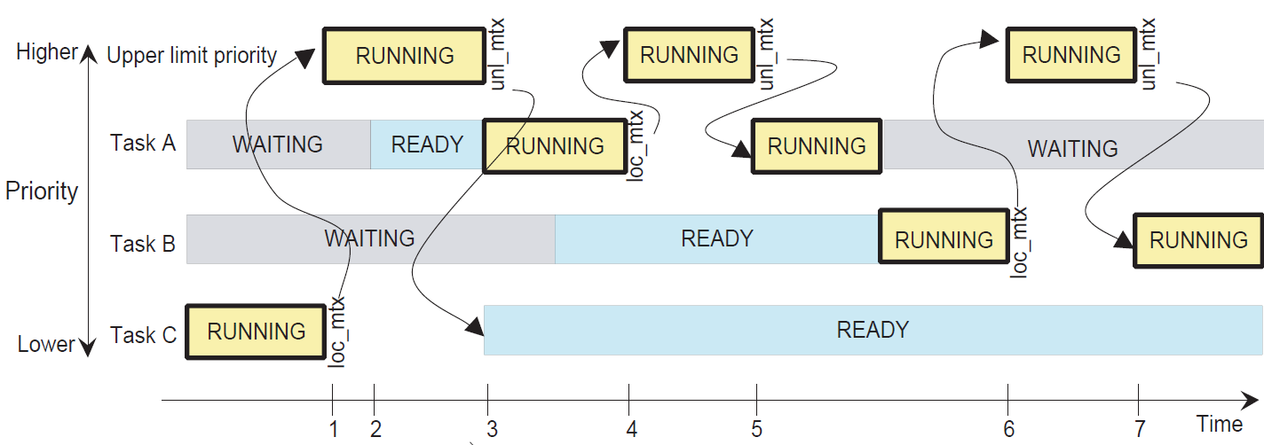
Ceiling priority

Slide 44
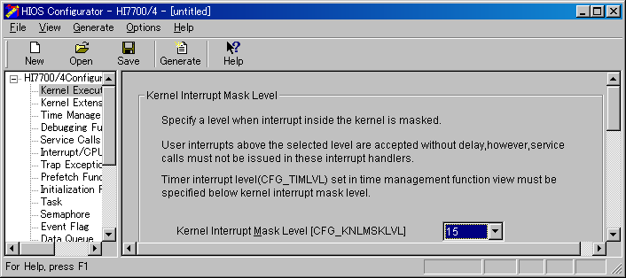
2.7.3 Other Methods
Disable Dispatch (Exclusion with other tasks)
Other tasks cannot execute during "Dispatch-Disable State".
・dis_dsp：Disable dispatch
・ena_dsp：Enable dispatch
CPU-Lock (Exclusion with other tasks and interrupt handlers)
Other tasks cannot execute during "CPU-Locked State".
And SR.IMASK bits are set to "Kernel interrupt mask level". Interrupts with the level equal to or lower than "Kernel interrupt mask level" are masked.
"Kernel interrupt mask level" is specified by configurator.
・loc_cpu：Enter to CPU-Locked state
・unl_cpu：Cancel CPU-Locked state

Slide 45
2.8 Memory Pool
The memory pool supports dynamic memory allocation.
The kernel supports 2-type memory pools.
- Fixed-size memory pool
- Variable-size memory pool
Both memory pools are one of kernel object, and are independent from task.
Each memory pool area allocation
1. The kernel allocates memory pool area dynamically at creation.
Area sizes for dynamic memory pool allocation are specified by configurator. (Similar to CFG_TSKSTKSZ)
CFG_MPFSZ : For fixed-size memory pools
CFG_MPLSZ : For variable-size memory pools
2. Use user-prepared area
The area address must be specified at creation.
Note, kernel does not initialize pool area contents.

Slide 46
2.8.1 Fixed-size Memory Pool
The acquisition size is fixation of each memory pool.
The block size and number of blocks are specified at creation.
For getting memory :
- get_mpf, tget_mpf : Get fixed-size memory block. If there is no free
block in the pool, wait until memory block is released.
- pget_mpf : Polling
For releasing memory :
- rel_mpf : Release memory block
Others :
- ref_mpf : Refer to fixed-size memory pool status
Create/Dele :
- cre_mpf : Create fixed-size memory pool with specified ID
- acre_mpf : Create fixed-size memory pool .
The ID is assigned by kernel.
- del_mpf : Delete fixed-size memory pool

Slide 47
2.8.2 Variable-size Memory Pool
Application can get arbitrary size memory block.
The pool size are specified at creation.
The performance of variable-size memory pool is lower than fixed-size memory pool.
For getting memory :
- get_mpl, tget_mpl : Get requied size memory block. If there is no
free memory in the pool, wait until memory block is released.
- pget_mpl : Polling
For releasing memory :
- rel_mpl : Release memory block
Others :
- ref_mpl : Refer to variable-size memory pool status
Create/Dele :
- cre_mpl : Create variable-size memory pool with specified ID
- acre_mpl : Create variable-size memory pool .
The ID is assigned by kernel.
- del_mpl : Delete variable-size memory pool

Slide 48
Caution of configuration for variable-size memory pool
(V.2.01R00 or later)
CFG_NEWMPL is strongly recommended to be checked.
When CFG_NEWMPL is checked,
1. Performance is improved.
2. Fragmentation problem is reduced.
And the newly supported VTA_UNFRAGMENT attribute further reduces fragmentation. Although specifying the VTA_UNFRAGMENT attribute generally helps in reducing fragmentation, the degree of fragmentation depends on how the memory pools are used.

Slide 49
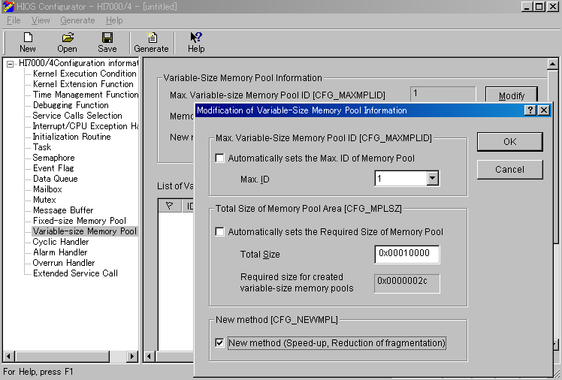

Slide 50
2.9 Interrupt
2.9.1 SH-3, SH3-DSP, SH-4, SH4AL-DSP, SH-4A Architecture
When CPU accepts an interruption, CPU does,
Set the “Interrupt event code” to INTEVT register
Note : SH-3, SH3-DSP … INTEVT2 register
SH-4, SH4AL-DSP, SH-4A … INTEVT register
(2) PC(Program counter register) → SPC(Saved PC register)
SR(CPU Status register) →SSR(Saved SR register)
(3) PC = VBR(Vector base register) + 0x600
SR.MD=1, SR.BL=1, SR.RB=1
BL : Interruption is blocked
RB : Register Bank
MD : Privilege mode(1)/User mode (0)

Slide 51
2.9.2 Kernel Specification
An interrupt handler can be defined for each “Interrupt event code” by configurator or def_inh service call.
An interrupt handler executes in “Non-task context”. Only “ixxx_yyy” service call can be used in the “Non-task context”.
No task executes during “Non-task context” is executing.
In the kernel critical section, interrupts whose level is lower than or equal to "Kernel interrupt mask level" (CFG_KNLMSKLVL) are masked. CFG_KNLMSKLVL is specified in the configurator.
The handler with a level that is higher than CFG_KNLMSKLVL MUST NOT use service call.
The VBR register is initialized by kernel.

Slide 52
2.9.3 Behavior
Application don’t have to read INTEVT register.
Programs
VBR
0x600
Kernel
Interrupt handler
Interrupt handler
Interrrupt!
Interrupt handler
Set SR for the handler, and call the handler corresponding to Interrupt event code
Return to interrupted task
If a task was interrupted, kernel re-schedules task
The process of this heavy line is executed in SR.BL=1.
The SR value is specified by user at the handler definition. (see next page)
Switched to another task

Slide 53
Parameters at handler definition
The packet which includes following parameters are passed to kernel at definition (def_inh service call).
inhatr Interrupt handler attribute ( TA_HLNG||TA_ASM )
TA_HLNG : C-language
TA_ASM : Assembly language
Note, the kernel I does not distinguish TA_HLNG from TA_ASM.
TA_HLNG is recommended.
inthdr Handler start address
inhsr Initial SR value at staring the handler execution
- MD(bit-30) : Must be 1
In the HI7700/4 system, All programs executes in MD=1.
- RB(bit-29) : Must be 0
Register Bank1 is reserved by kernel.
- BL(bit-28) and IMASK(bit-7…4) : See next page
- DSP/CL(bit-12) (only for SH-3 and SH3-DSP) :
If you use "Cache lock function" of the microcomputer, you must specify 1 as
DSP/CL bit.
For details, refer to SHxxxx Hardware Manual and HI7000/4 series User's Manual.

Slide 54
BL (bit-30) and IMASK (bit-7…4)
1. The interrupt handler must have it not reenter.
To achieve this, following conditions must be satisfied.
(1) IMASK >= The interrupt level
Or
(2) BL = 1
2. Multiple Interrupts
To permit multiple interrupts, following conditions must be satisfied.
(1) IMASK >= The interrupt level
And
(2) BL = 0
To prohibits multiple interrupts, following conditions must be satisfied.
(1) BL = 1

Slide 55
Example of interrupt handler code
Interrupt handler can be described as normal C-function,
The kernel (VBR+0x600) saves scratched registers, and after that, call the handler.
#include “kernel.h” // [MUST] HI7700/4 header file
#include “kernel_id_sys.h” // [If necessary] ID name header file. Generated by configurator
#include “kernel_id.h” // [If necessary] ID name header file. Generated by configurator
void InteruptHandler(void)
{
// Interruption processing (clear the interrupt flag, etc.)
// iwup_tsk(1); // Notify event to a task
}

Slide 56
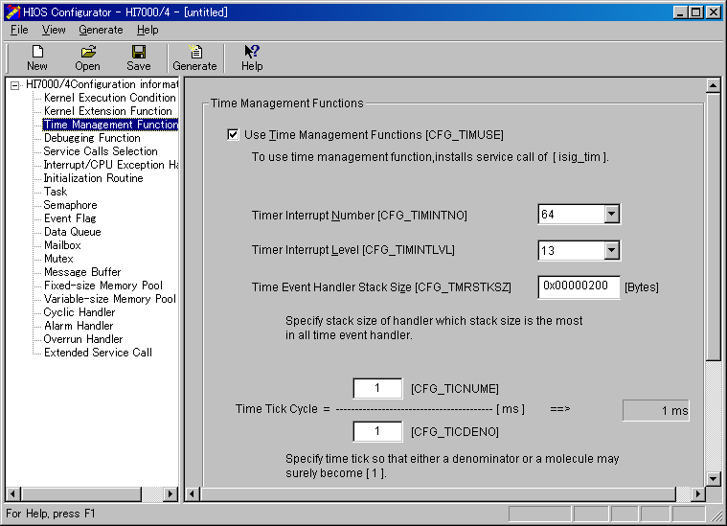
2.10 Time management
The unit time of service call parameter is 1 msec.
Timer tick (interrupt) cycle time can be specified in configurator.

Slide 57
2.10.1 Timer Driver
The timer driver must be created by user.
The HI7700/4 provides sample timer driver for some SHxxxx microcomputer.
Programs
(Interrupt handler)
VBR
Kernel timer
process
Timer driver
Interrupt routine
0x600
Kernel
Timer
Interrrupt!
Clear interrupt flag
Interrupt handler
Call handlers
- Cyclic handler
- Alarm handler
- Overrun handler
Interrupt handler
Handler
If a task was interrupted, kernel re-schedules task
Timeout tasks
Switched to another task
Same as slide-51

Slide 58
2.10.2 Cyclic Handler
The cyclic handler is one of kernel object, and is independent from task.
The cyclic handler executes in “Non-task context”.
The cyclic time is specified at creation.
cre_cyc, acre_cyc : Create cyclic handler
del_cyc : Delete cyclic handler
sta_cyc : Start cyclic handler
stp_cyc : Stop cyclic handler
ref_cyc : Refer to cyclic handler status
2.10.3 Alarm Handler
The alarm handler is one of kernel object, and is independent from task.
The alarm handler executes in “Non-task context”.
The alarm handler is called when specified time has been passed from sta_alm.
cre_alm, acre_alm : Create alarm handler
del_alm : Delete alarm handler
sta_alm : Start alarm handler
stp_alm : Stop alarm handler
ref_alm : Refer to alarm handler status

Slide 59
3. Start-up

Slide 60
3.1 Start-up Sequence
CPU Reset
Created by user. Function name is not fixed.
OS service call except vsta_knl must not be called.
Initialize hardware
Initialize cache
etc.
Address H'A0000000
(Phisical adress=0)
hi_cpuasm (ASM)
JMP instruction
hi_cpuini()
Call vsta_knl()
Kernel
-Initialize kernel
-Initialize VBR
-Initialize Timer
Initialization
routine
Initialization
routine
Initialization
routine
Multi-tasking environment
User can use "Initialization routine". This is registered by using configurator.

Slide 61
3.2 Initialize Section
Section should be initialized at start-up.
3.2.1 Kind of Initialization
Clear BSS section
If you want to reduce start-up time, you can omit this.
In this case, initial value of this section is undefined.
(2) Copy from ROM to RAM
i) The initialized data section must be allocate to ROM, and copy from
ROM to RAM at start-up.
ii) When you want to allocate specific program/data to RAM for
performance, you should do same way as i).
To copy from ROM to RAM, it is required to set some command to Linker.
(see next page)

Slide 62
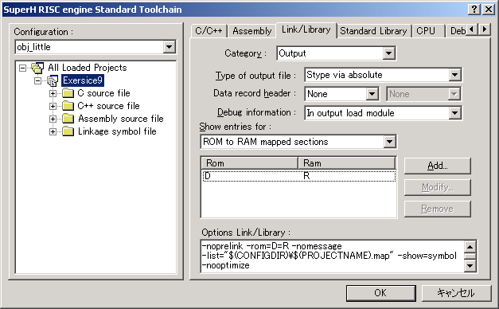
3.2.2 Linker setting for copying ROM->RAM
(1) Generate R section to locate in RAM
Address Space
0
ROM
D
Linker generates R section which size is same as D section. The symbol address is allocated in R section.
RAM
R
(2) Allocate R section to RAM address.
0xFFFFFFFF

Slide 63
3.2.3 _INITSCT() : Function to initialize section
The _INITSCT() is provided by standard library.
The _INITSCT() initializes the section according to the content of a special following sections. The user should prepare this. Note, HEW can generate this example (dbsct.c).
#pragma section $DSEC // Section name = "C$DSEC". This is the information for copying ROM->RAM.
static const struct {
_UBYTE *rom_s; /* Start address of the initialized data section in ROM */
_UBYTE *rom_e; /* End address of the initialized data section in ROM */
_UBYTE *ram_s; /* Start address of the initialized data section in RAM */
} DTBL[] = {
{ __sectop("D"), __secend("D"), __sectop("R") }
};
#pragma section $BSEC // Section name = "C$BSEC". This is the information for initializing BSS section.
static const struct {
_UBYTE *b_s; /* Start address of non-initialized data section */
_UBYTE *b_e; /* End address of non-initialized data section */
} BTBL[] = {
{ __sectop("B"), __secend("B") }
};

Slide 64
3.2.4 When the section should be initialized?
You should initialize at either the following.
(1) Before calling vsta_knl
(2) Initialization routine
(1)
CPU Reset
hi_cpuasm (ASM)
JMP instruction
(2)
hi_cpuini()
Call vsta_knl()
Kernel
-Initialize kernel
-Initialize VBR
-Initialize Timer
Initialization
routine
Initialization
routine
Initialization
routine
User can use "Initialization routine". This is registered by using configurator.
Multi-tasking environment

Slide 65
3.3 Initialize Standard Library
The standard library, including Run-time routines, is generated by Standard Library Generator.
The Exercise8 is an example of the reference of initializing standard library.
3.3.1 Content of initialization
(1) Call _INIT_IOLIB()
This function is generated by HEW project generator. (lowsrc.c)
(2) Initialize errno when you use errno
(3) Call srand() when you use rand().
(4) Initialize _s1ptr = NULL when you use strtok().
_s1ptr is defined in standard library.

Slide 66
3.3.2 Low-level routines
Low-level routines must be implemented by user when you use standard I/O library functions or memory management library functions. For details, refer to section 9.2.2 of the compiler manual.
Note, HEW can generates these sample code at project generation.
(1) open()
(2) close()
(3) read()
(4) write()
(5) lseek()
(6) sbrk()
(7) sbrk__X()
(8) sbrk__Y()
Open file
Close file
Read from file
Write to file
Definition of file read/write position
Memory area allocation
X-memory area allocation
Y-memory area allocation

Slide 67
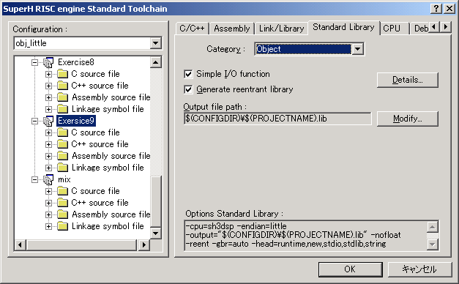
3.3.3 Reentrant Library
You can generate standard library as reentrant.
In this case, you must implements following low-level routines.
Note, HEW CANNOT generate these sample code.
(9) errno_addr()
(10) wait_sem()
(11) signal_sem()
Return errno address for current context
Get semaphore
Release semaphore

Slide 68
It should be prepared by the user.
Applications
printf()
fprintf()
fopen()
…
Standard library
open()
sbrk()
wait_sem()
…
Low-level routines
Device
OS (Kernel)

Slide 69
3.3.4 When the standard library should be initialized?
1. When you use reentrant library
You should initialize at "Initialization routine", because the low-level routines such as wait_sem() should use OS service calls.
2. When you don't use reentrant library
You should initialize at either the following.
(1) Before calling vsta_knl
(2) Initialization routine

Slide 70
4. System-Down

Slide 71
When following events occur, the system down routine is called.
Undefined interruption/CPU-exception occurs
Task exit service call (ext_tsk or exd_tsk) is called from Non-task context.
The object which is created by configurator cannot be created at start-up (vsta_knl).
Application calls vsys_dwn().
Some error information is passed to the system-down routine.
(see next page)
System-down routine prototype:
void _kernel_sysdwn(W type, ER ercd, VW inf1, VW inf2);
Function name is fixed.
The breakpoint is recommended to be set here at debugging.

Slide 72
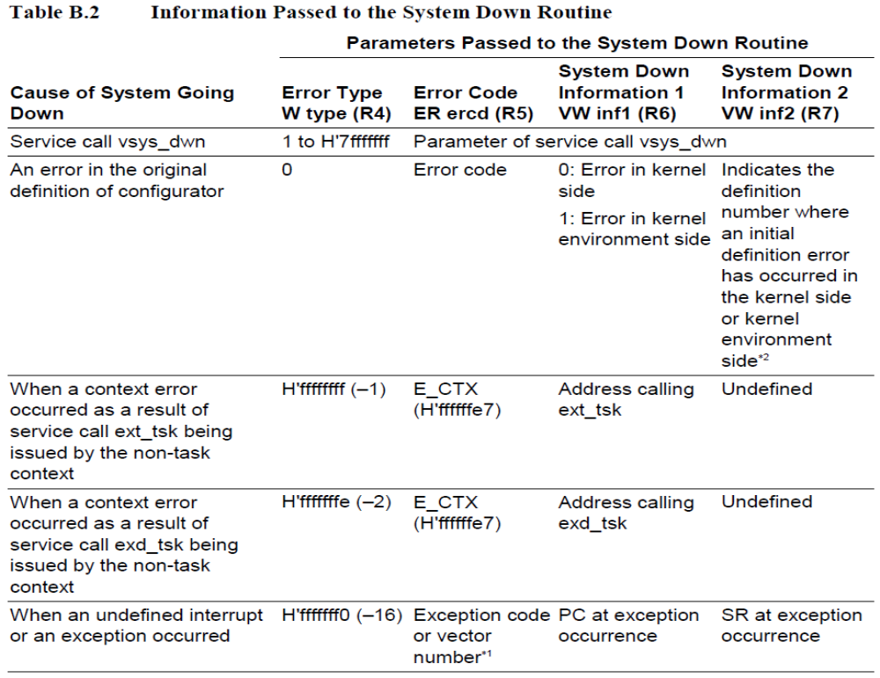

Slide 73
5. Configuration/Build

Slide 74
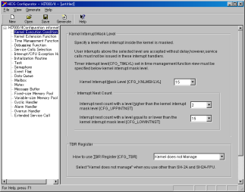
Configuration/Build Flow
Configurator
Yellow : Provided by HI7000/4
HCF file
Generate
ID name header
Configuration files(C/ASM)
Include
Include
Include
kernel_def.c, kernel_cfg.c
Application source files(C/ASM)
Kernel library
User, standard libraries
Compiler/Assembler/Linker (HEW build environment)
HI7000/4 provides sample HEW workspace.
Load module

Slide 75
Configurator
Select kernel functions (service calls) required your system
--> Reduce ROM foot-print
2. Define number of objects required your system
--> Reduce RAM foot-print
3. Define various area size required your system
- Dynamic stack
- Memory pool
- etc.
4. Create/define objects
--> User don’t have to describe object creation code.

Slide 76
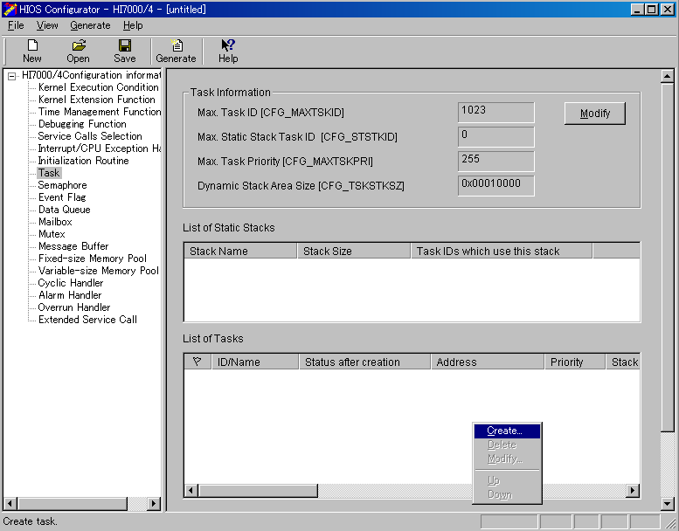
Configurator window image

Slide 77
How to make/construct Workspace for ITRON system
(1) The HI7700/4 provides sample workspace. (see slide-86)
You can use it as template.
(2) Some workspaces will be used for the exercise tomorrow.
This workspace contains more sample code than the above (1).
You can use it as template.

Slide 78
6. Installation

Slide 79
6.1 How to Install HI7700/4
Run “setup.exe” in the HI7000/4 CD-ROM root directory.
HI7700/4 setup requires administrator privileges to run.
Setup generates User Registration form.
Please do the user registration by e-mail.
Note, please install to “C:\hi7700”.
The practice is assumption installed in this place.

Slide 80
6.2 How to Install Debugging Extension
Please install HEW (included in Compiler package or E10A-USB software) beforehand.
1. Download from Renesas WEB site
http://www.renesas.com/products/tools/ide/ide_hew/downloads.jsp
Note, the above URL does not include manual. Please download manual from,
http://documentation.renesas.com/eng/products/tool/rej10b0029_de_s.pdf
2. Run downloaded file
Setup will start.
Note, HEW should be installed before installing debugging extension.

Slide 81
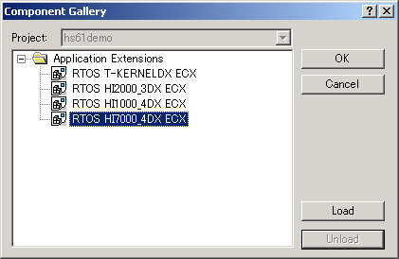
3. HEW Project setting for Debugging Extension
Select [Project->Component…] to open following dialog-box.
Select “RTOS HI7000_4DX_ECX” and press [Load] button.
And then, press [OK] button.
This icon will be changed after “Load”.

Slide 82
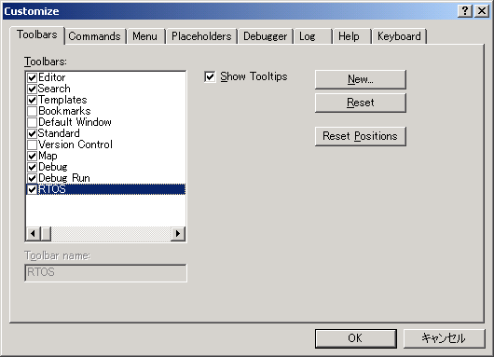

4. How to Display Toolbar for Debugging Extension
Select [Setting->Customize…]
Debugging Extension Toolbar
Each button is colored to yellow.

Slide 83
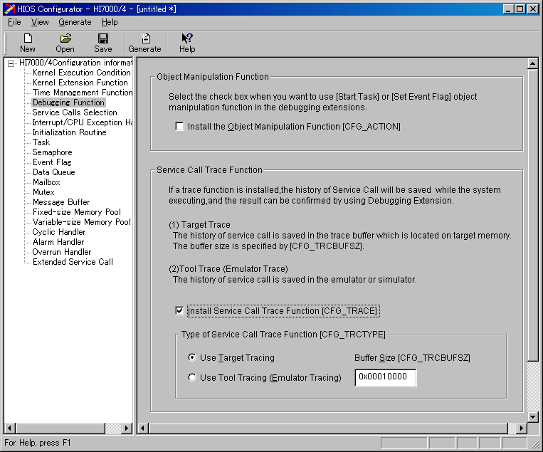
5. To use Service call Trace Function
The kernel can acquire the history of service call.
The debugging Extension displays the history by graphical and text format.
The history is acquired to target RAM or E-seriec emulator(E200F and a part of E10A-USB with AUD). Note, SH7727 E10A-USE with AUD is not supported.
Check this to use trace function.
When using trace, kernel performance worsens.
Acquire to target RAM
Acquire to emulator
Target RAM size for trace

Slide 84
6. Limitation of Debugging Extension
When one or more following sections are copied from ROM to RAM at start-up, nothing might be displayed in the Debugging Extension window.
- C_hisysmt section
- C_hibase section
Workaround
Download program(*.abs)
Set break-point to the _kernel_tmrini() (OS timer driver) or any tasks.
Reset Go, then program stops at the break-point
Download same program(*.abs)

Slide 85
6.3 HI7700/4 Directory Structure
<Install Dir.>
User registration form
kernel
hihead
Header files for application
hilib
Kernel library
hisys
Kernel configuration system files
samples
sh????
Sample programs and HEW workspace
for SHnnnn microcomputer (see next page)
shnnnn
config
english
English version configurator
japanese
Japanese version configurator
(When using Japanese Windows(R))
manuals
english
English manuals
japanese
Japanese manuals
(When using Japanese Windows(R))

Slide 86
shnnnn
Sample HEW workspace (Workspace directory)
def
“def” project
Generate load module including kernel code
For advanced
user
cfg
“cfg” project
Generate load module including kernel data
mix
“mix” project
Generate load module including over-all
src
Sample files
HCF file
Timer driver
Tutorial task
CPU reset routine

Slide 87
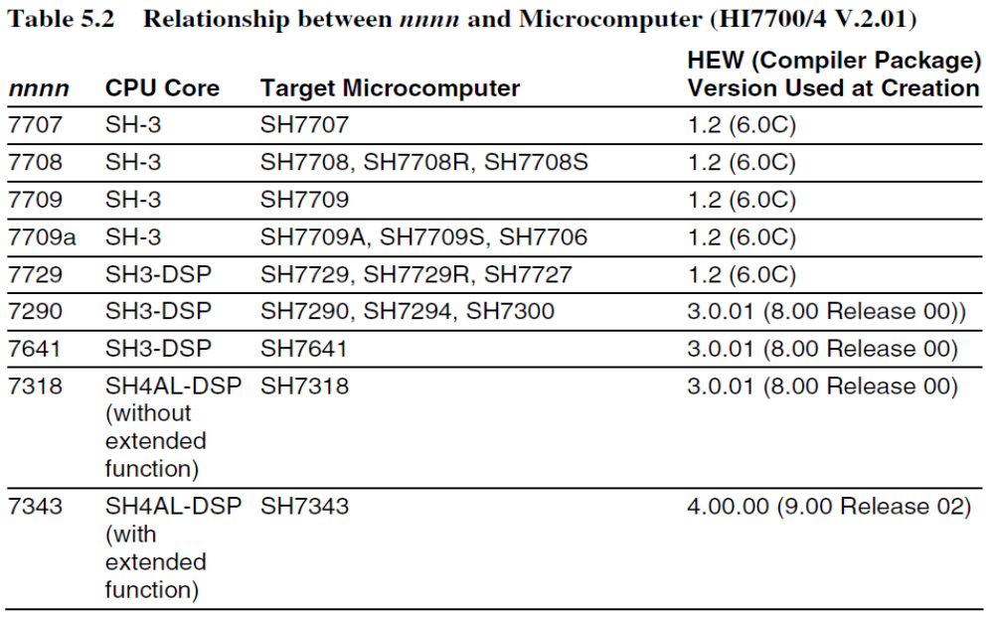
Very old HEW version!

Slide 88
7. Appendix

Slide 89
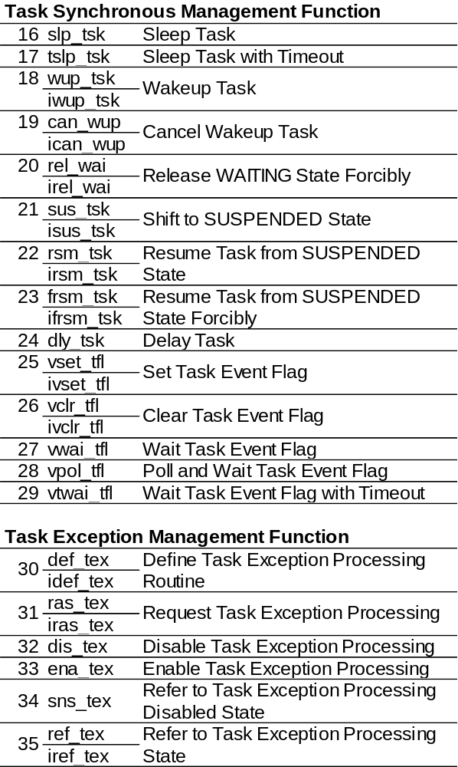
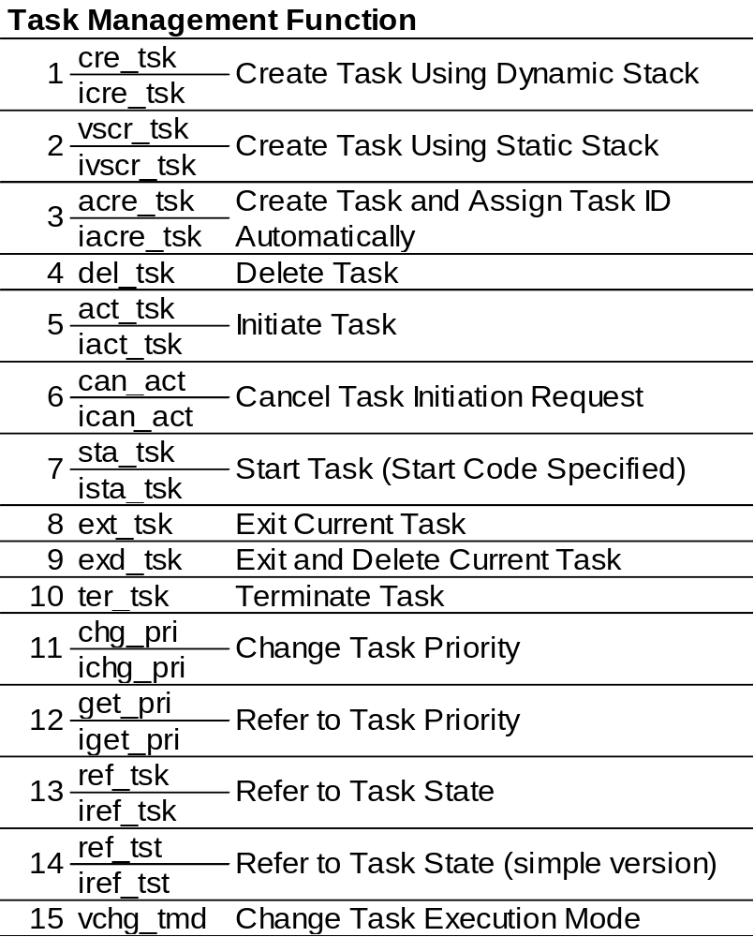
7.1 Service Call List

Slide 90
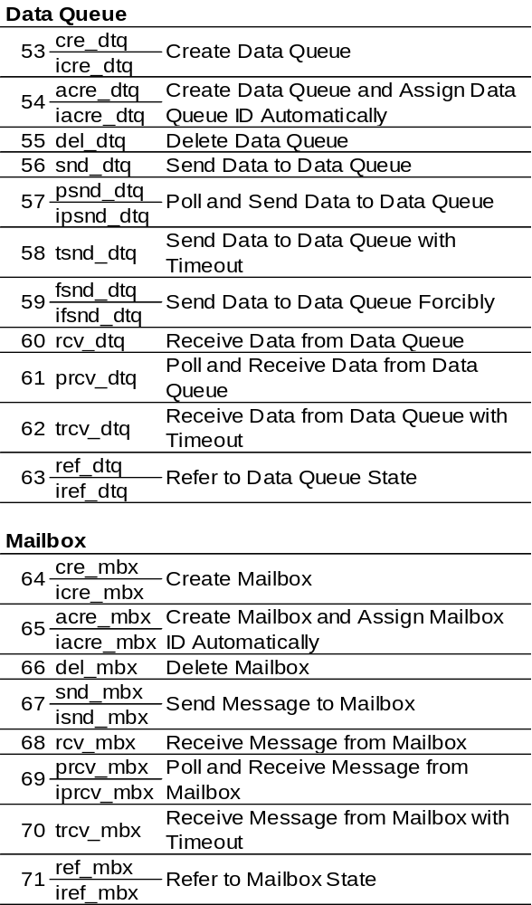
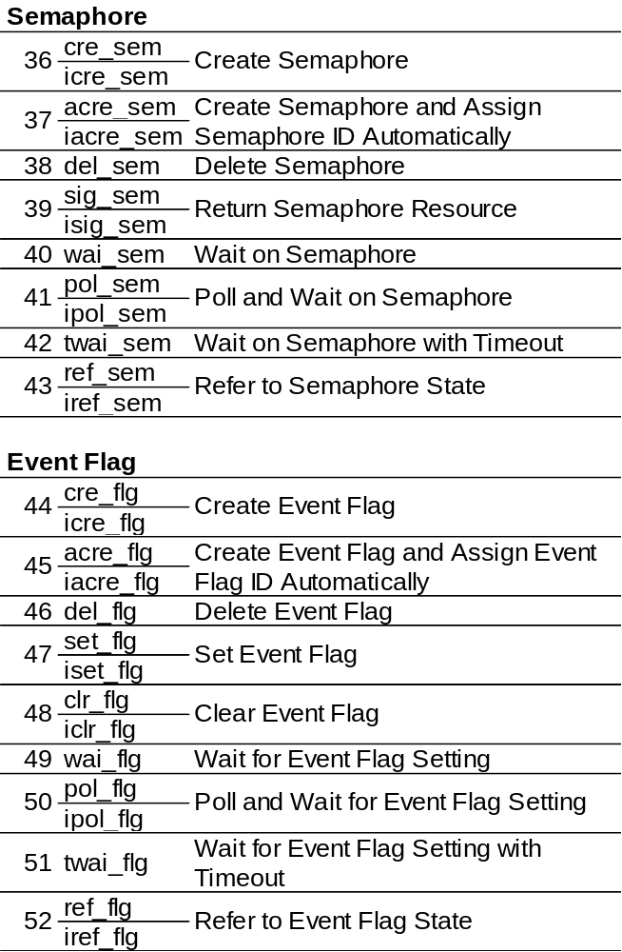

Slide 91
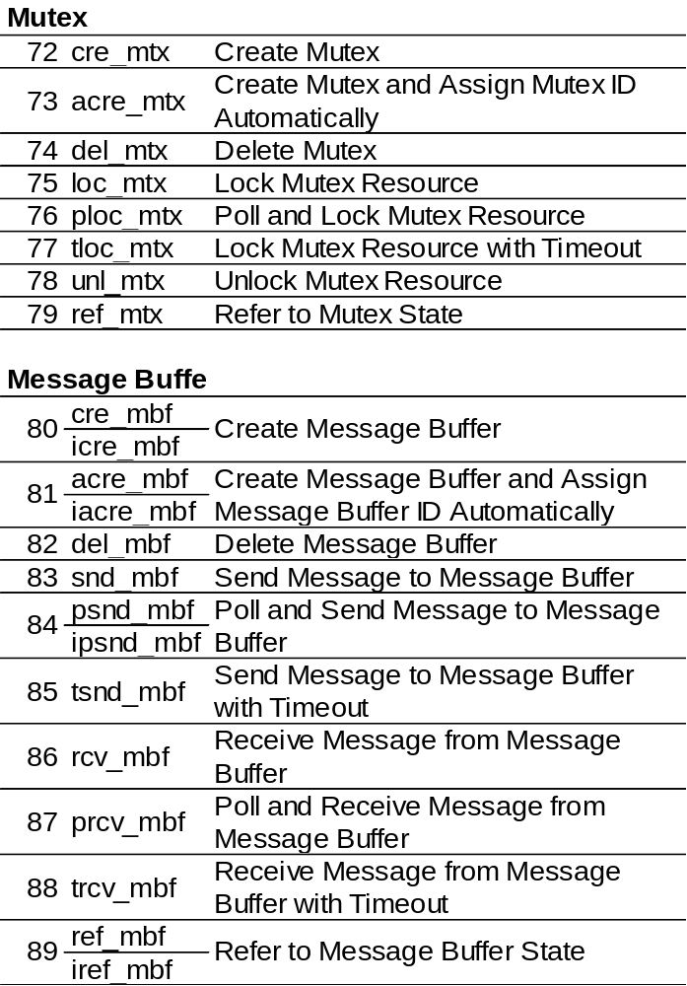
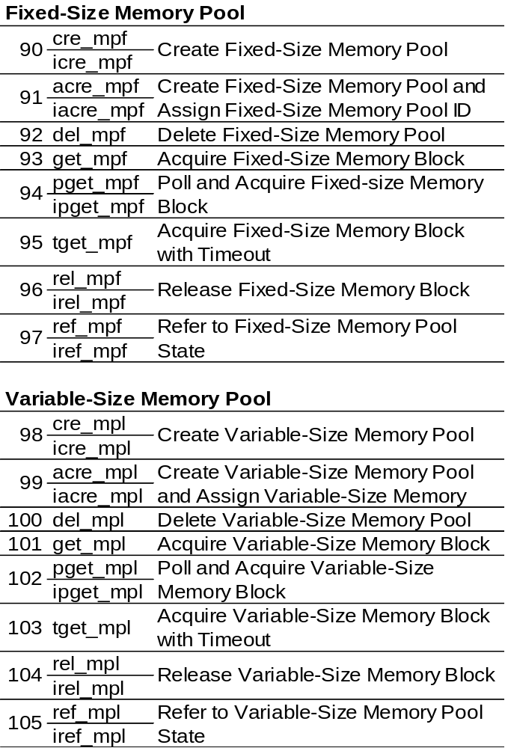

Slide 92
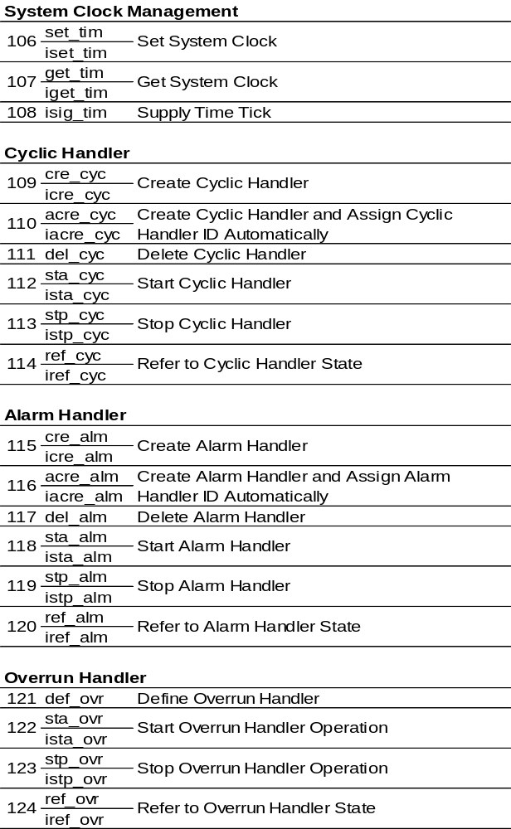
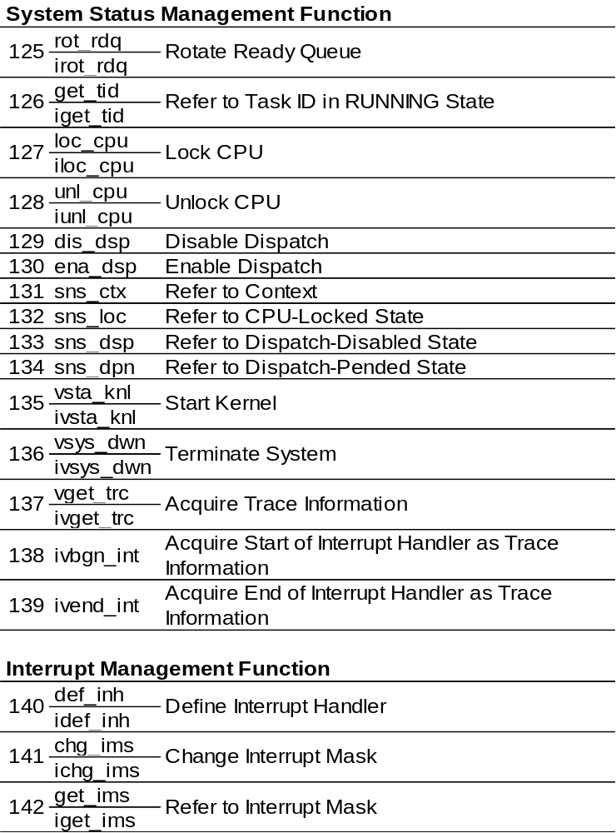

Slide 93
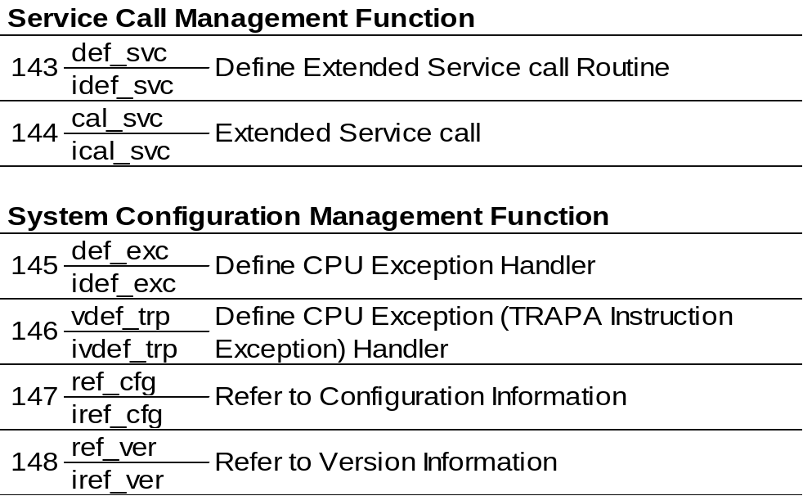

Slide 94
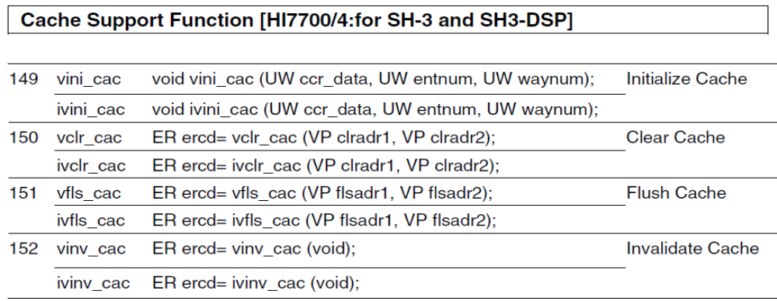
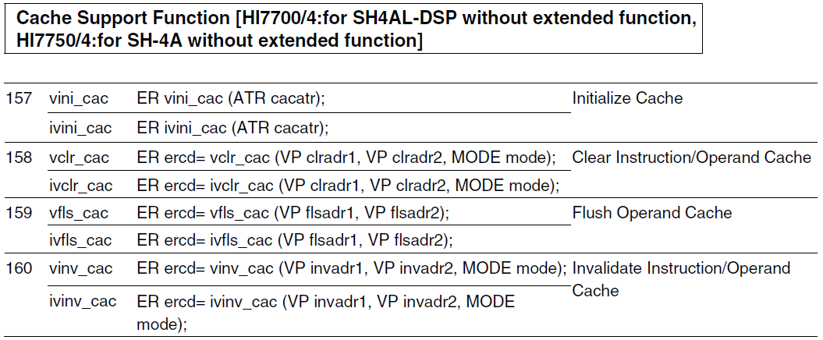
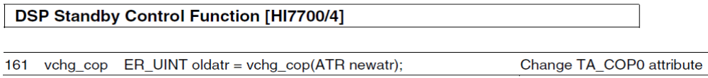

Slide 95
7.2 Related URL
Renesas
http://www.renesas.com/
Software and Tools (HEW, Compiler, E10A, HI7700/4)
http://www.renesas.com/en/tools
TRON Association
http://www.assoc.tron.org/
ITRON Project Archive
http://www.ertl.jp/ITRON/home-e.html

Slide 96
Thank you for your attention.

