Slide 1
BOOTCAMPUTERSHOP
A Computer Shop in a Bootcamp Located in Gredu, Panabo City.

Slide 2
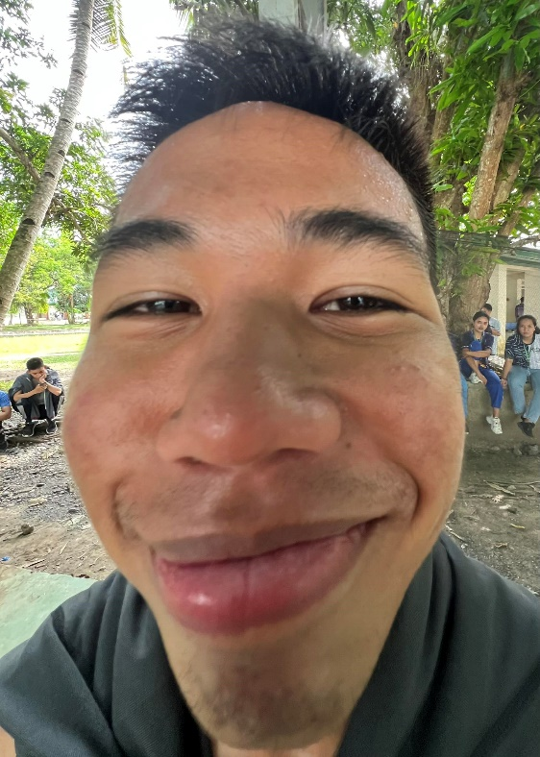
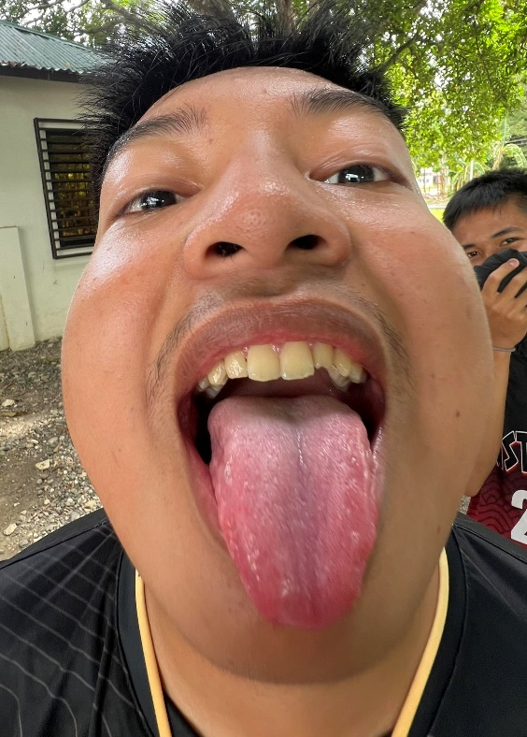
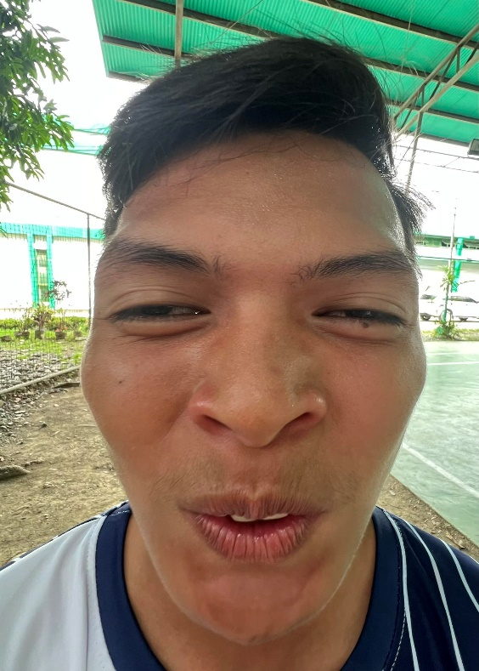
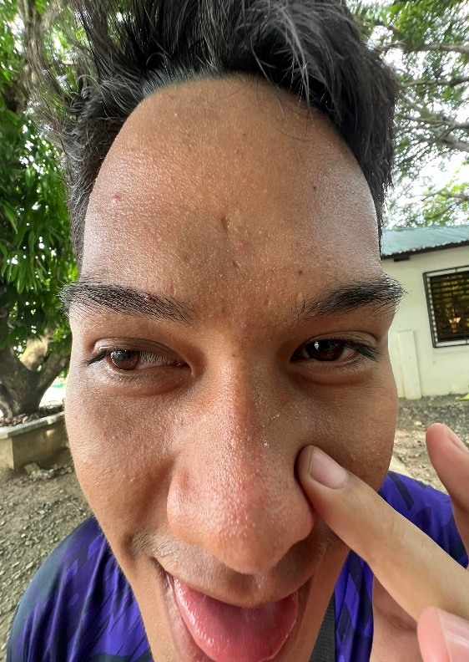
ADMINS/MEMBERS OF THE GROUP
Juntilla, Zyrou V.
Orga, Cyrelle Khen D.
Villarente, Gian
Pantonial, John Kenneth R.

Slide 3
OBJECTIVES
To establish a server for an internet cafe business.
The developers aim to develop a computer shop server for internet cafe business to any parts of Panabo City.
Specifically the project aims to:
1. Ask the user to register an account and input their details:
A. Full Name
B. Password
C. Amount
2. Let the user to log in the registered account.
3. Display the details and time remaining of the user in the admin page.
4. Let the admin Update/Edit/Delete an account.

Slide 4
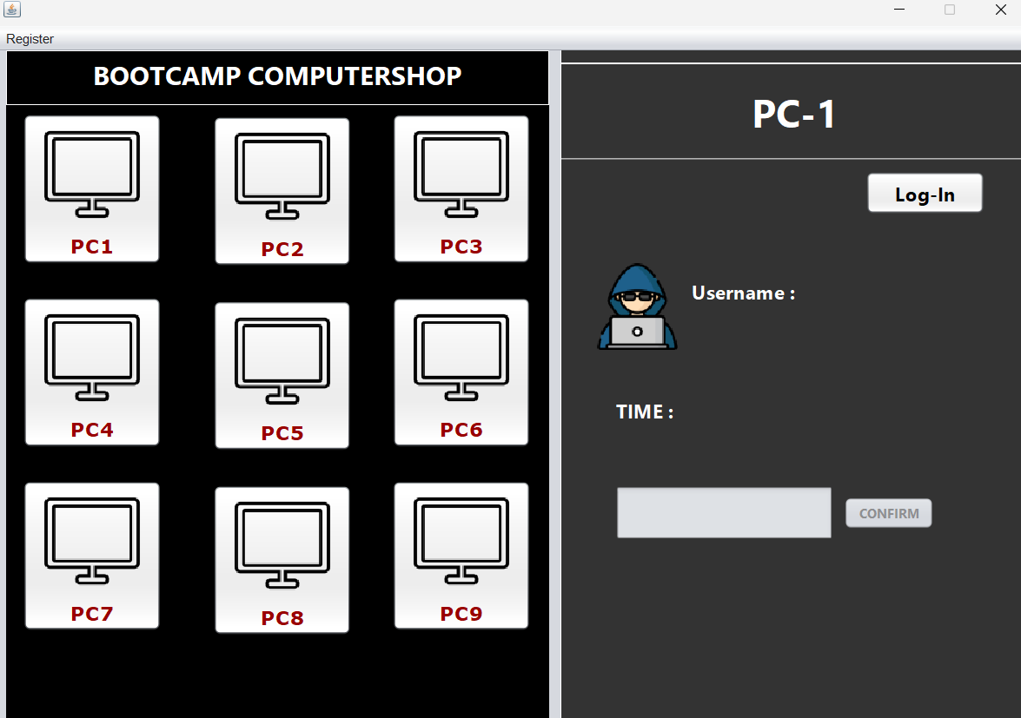
FLOW OF OUR SYSTEM
Adding/Register a user/customer
Log in of the registered user
Update the time of the user
Edit/Update the info of the user
Delete a user

Slide 5
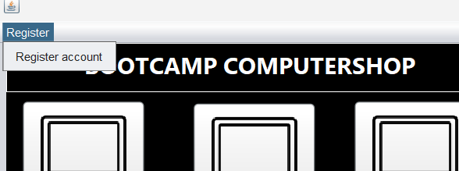
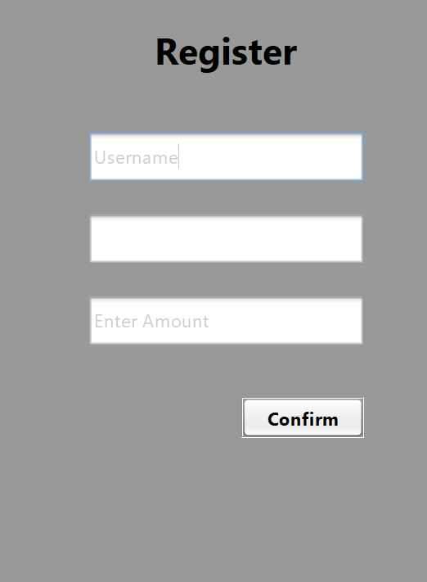
FLOW OF OUR SYSTEM
Adding/Register a user/customer

Slide 6
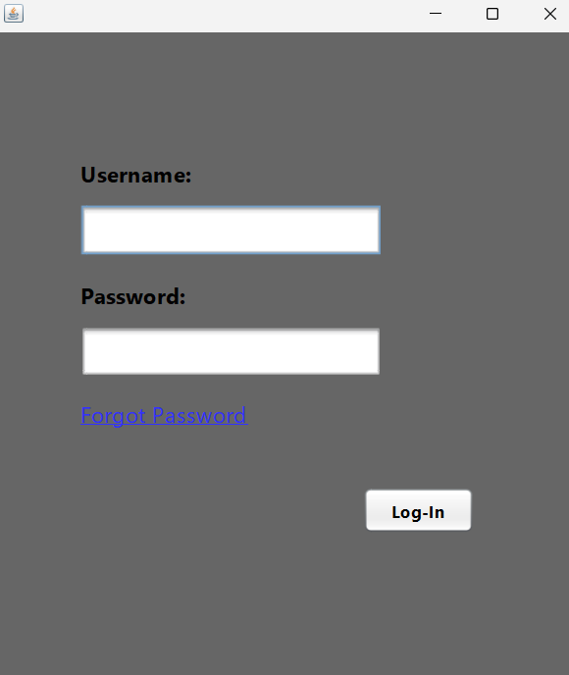
FLOW OF OUR SYSTEM
Adding/Register a user/customer
Log in of the registered user

Slide 7
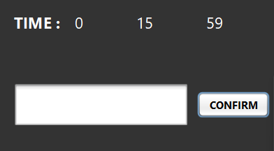
FLOW OF OUR SYSTEM
Adding/Register a user/customer
Log in of the registered user
Update the time of the user

Slide 8
FLOW OF OUR SYSTEM
Adding/Register a user/customer
Log in of the registered user
Update the time of the user
Edit/Update the info of the user
Delete a user

