Slide 1
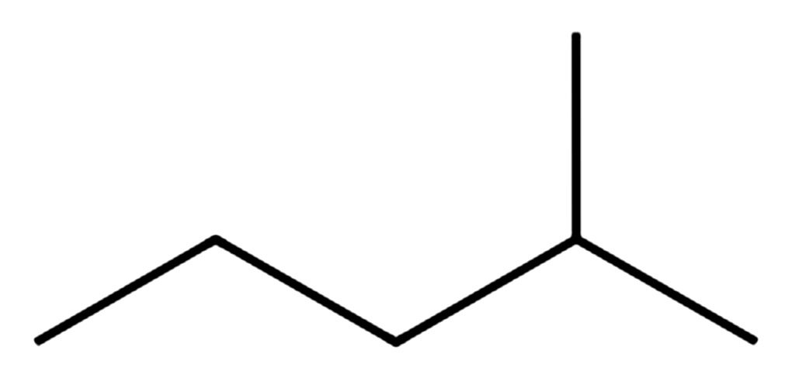
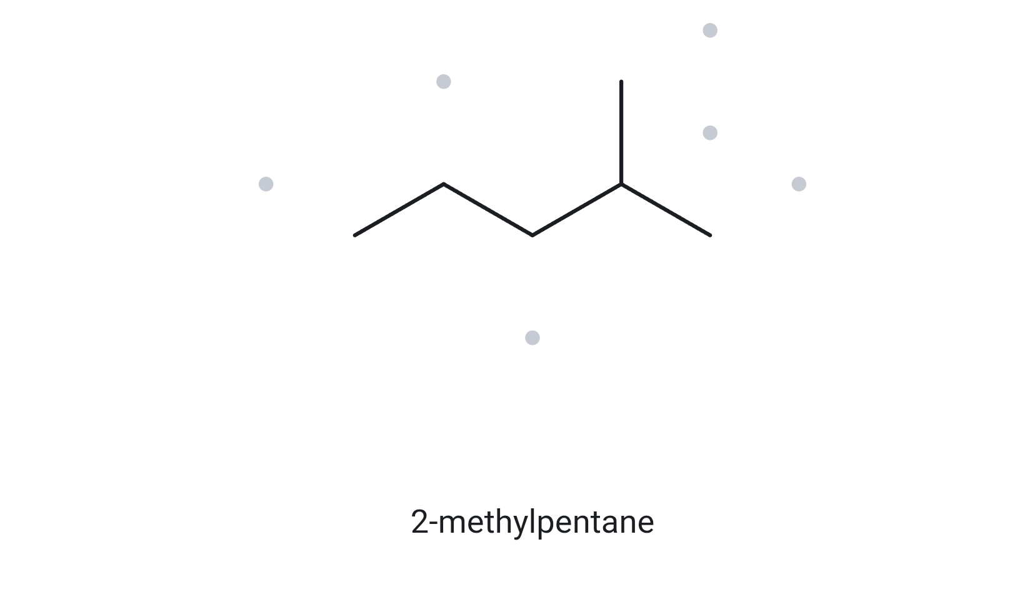
A01
Find the longest chain; number from the end nearer the branch
MOLECULAR FORMULA
FOUNDATION
C₆H₁₄
Branched C6 alkane in light naphtha and gasoline blends
6 C · open chain → C_{n}H_{2n+2}
1 NUMBERED PARENT
2 NAMING TRAIL
Parent: longest chain = 5 C → pentane. Two equal 5-C paths exist (ending at the right-hand carbon or at the upward carbon); they give the same name.
Numbering: left → right puts the methyl on C4; right → left puts it on C2. First point of difference: 2 < 4, so number from the right.
Substituents: methyl on C2 → 2-methyl.
4
2
5
3
1
3 MY NAME
4 THE ALKANE CHECK
2-methylpentane
Returned name:
2-methylpentane
Verdict: ✓ match
✓ longest chain/ring confirmed ✓ lowest locants ✓ alphabetical order ✓ punctuation ✓ formula counted

Slide 2
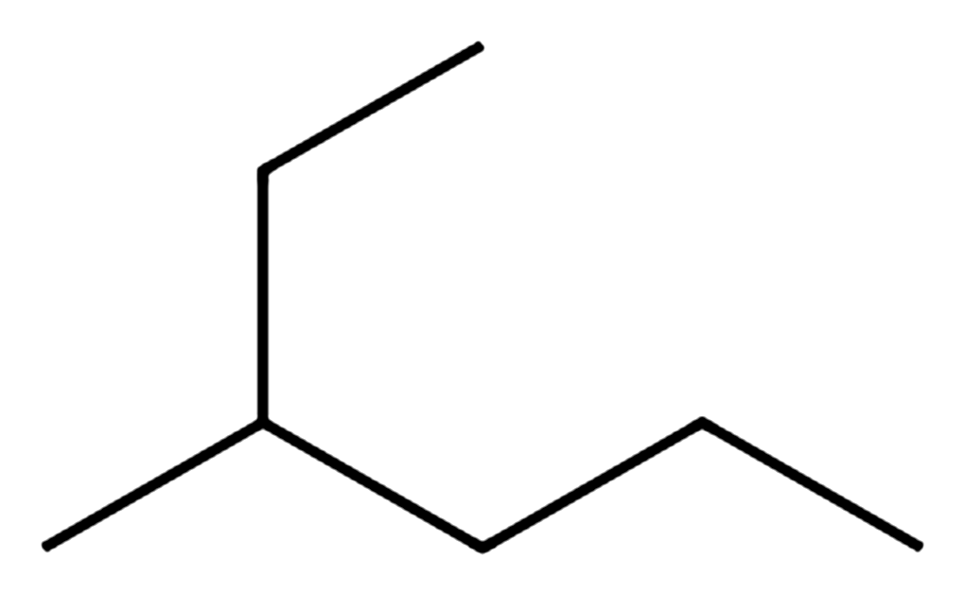
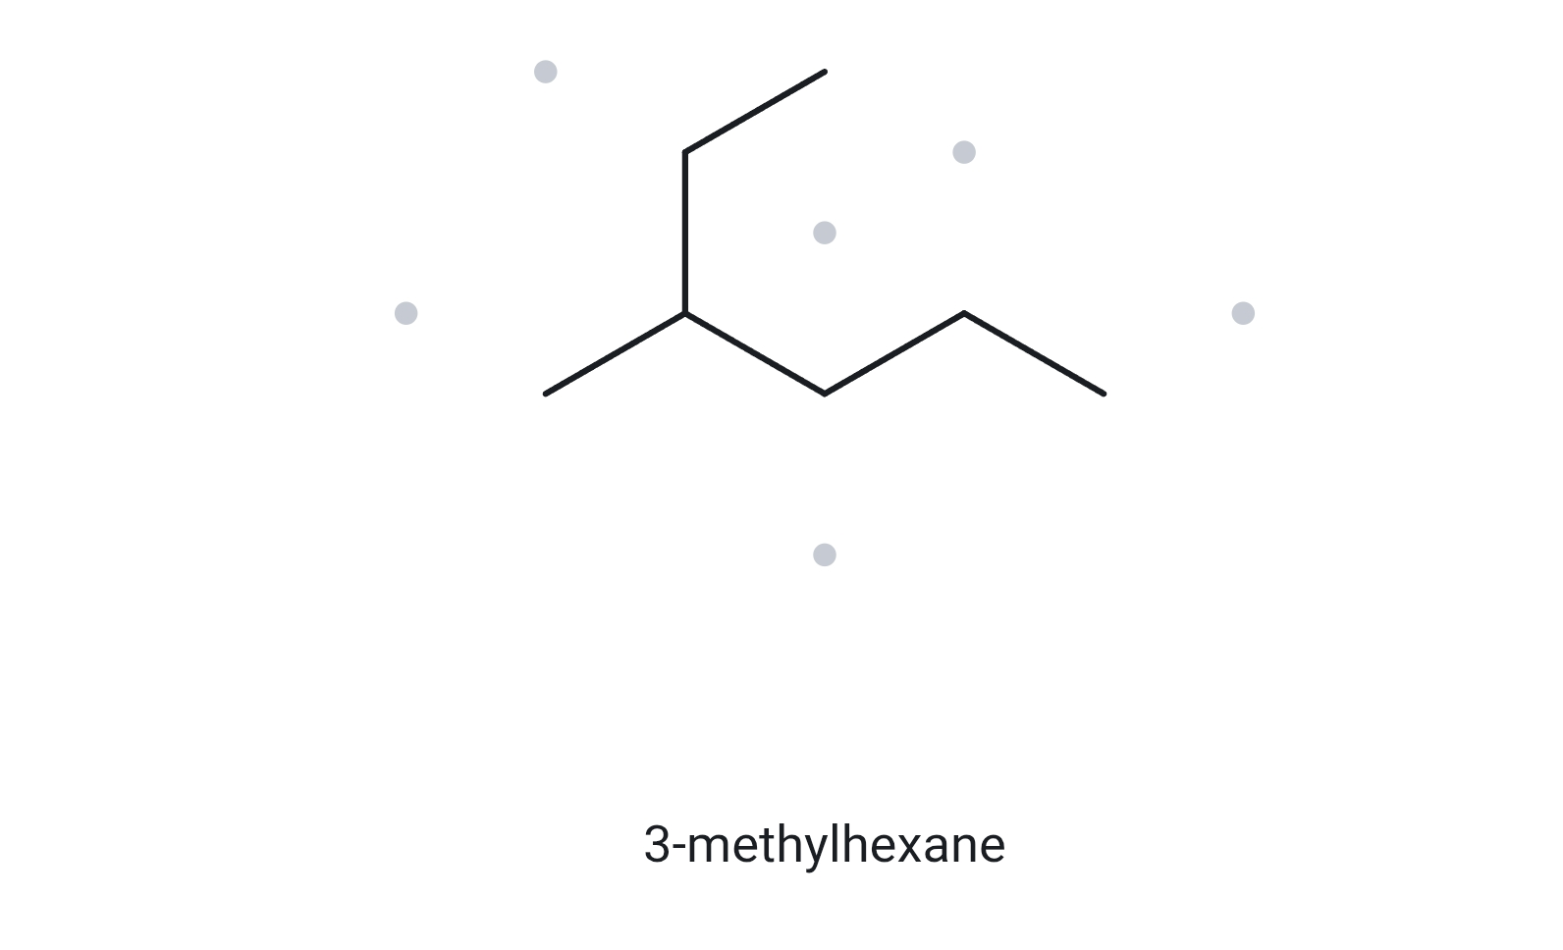
A02
The longest chain is not drawn in a straight line
MOLECULAR FORMULA
FOUNDATION
C₇H₁₆
C7 gasoline-range isomer; isomer structure shifts octane number
7 C · open chain → C_{n}H_{2n+2}
1 NUMBERED PARENT
2 NAMING TRAIL
1
Parent: longest chain = 6 C → hexane. It bends up through the ethyl group; the horizontal zigzag is only 5 C.
Numbering: from the top end the methyl sits on C3; from the right-hand end it sits on C4. First point of difference: 3 < 4, so number from the top end.
Substituents: methyl on C3 → 3-methyl.
2
3
5
4
6
3 MY NAME
4 THE ALKANE CHECK
3-methylhexane
Returned name:
3-methylhexane
Verdict: ✓ match
✓ longest chain/ring confirmed ✓ lowest locants ✓ alphabetical order ✓ punctuation ✓ formula counted

Slide 3
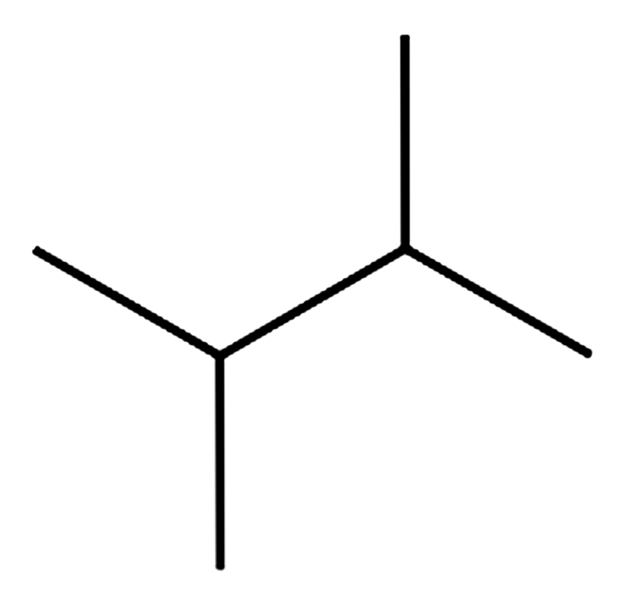
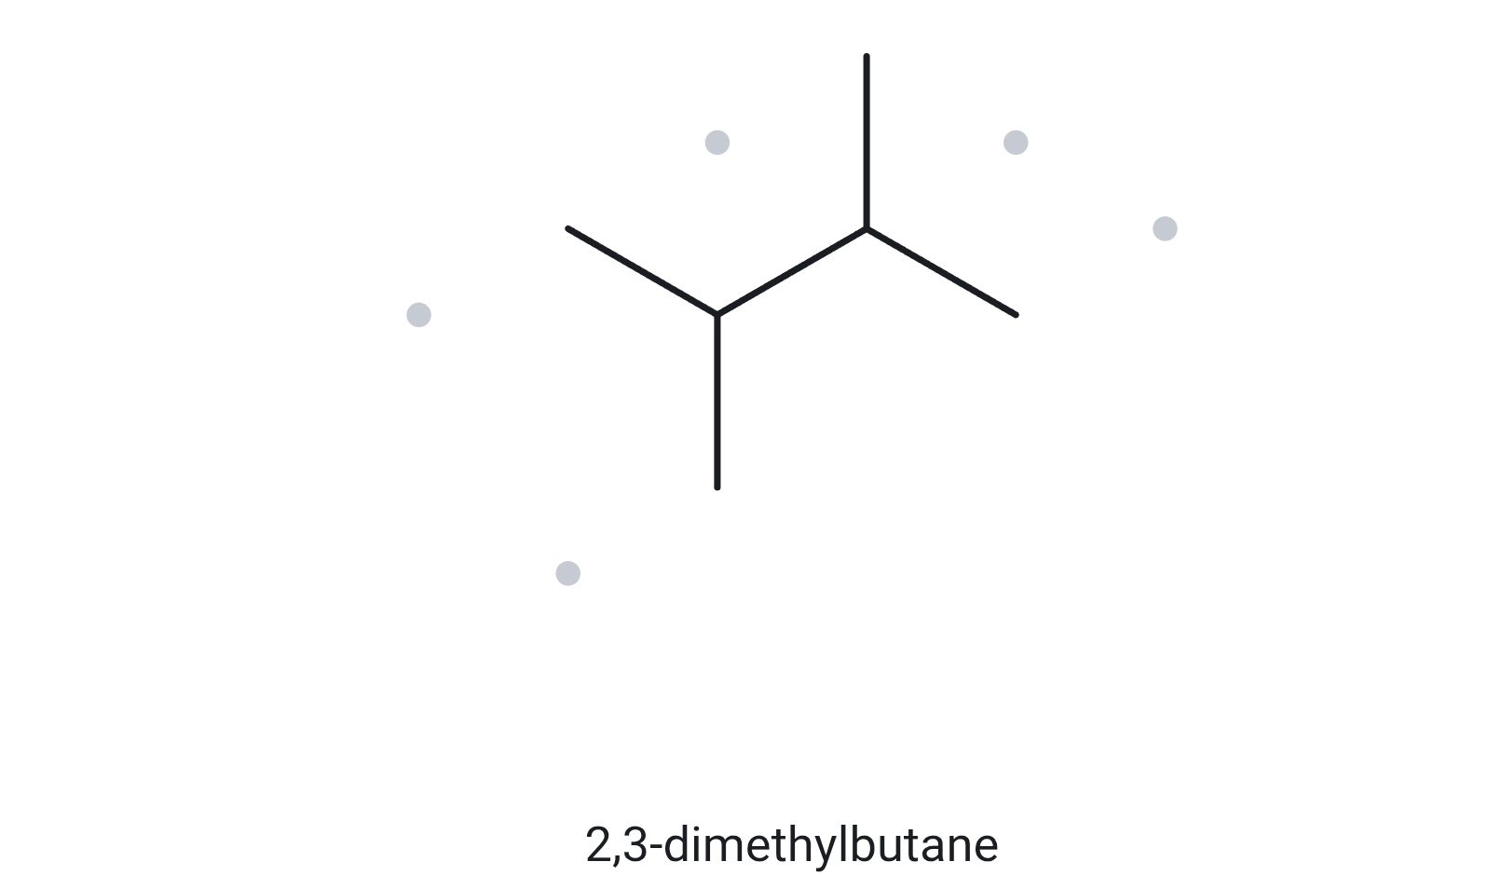
A03
Two identical substituents: di- prefix, commas and hyphens
MOLECULAR FORMULA
FOUNDATION
C₆H₁₄
Highly branched C6 valued in isomerate (high-octane) streams
6 C · open chain → C_{n}H_{2n+2}
1 NUMBERED PARENT
2 NAMING TRAIL
Parent: longest chain = 4 C → butane. Four equal 4-C paths exist (each uses one methyl from each branched carbon); all give the same name.
Numbering: left → right puts methyls on C2 and C3; right → left also gives C2 and C3. The locant sets 2,3 are identical, so there is no choice to make.
Substituents: two identical methyls, on C2 and C3 → 2,3-dimethyl (di- for two).
1
3
2
4
3 MY NAME
4 THE ALKANE CHECK
2,3-dimethylbutane
Returned name:
2,3-dimethylbutane
Verdict: ✓ match
✓ longest chain/ring confirmed ✓ lowest locants ✓ alphabetical order ✓ punctuation ✓ formula counted

Slide 4
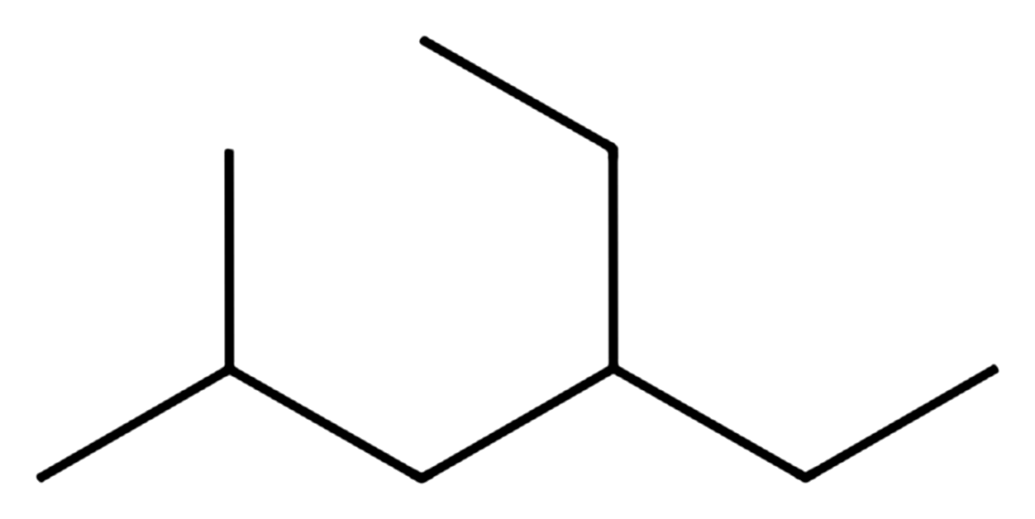
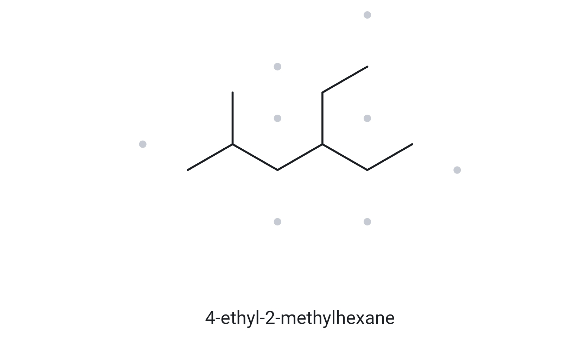
A04
Alphabetical order, not locant order, decides which substituent is cited first
MOLECULAR FORMULA
DEVELOPING
C₉H₂₀
Branched C9 paraffin in the gasoline/kerosene boiling range
9 C · open chain → C_{n}H_{2n+2}
1 NUMBERED PARENT
2 NAMING TRAIL
Parent: longest chain = 6 C → hexane. Four equal 6-C paths exist; each leaves one methyl and one ethyl as substituents, so all give the same name.
Numbering: left → right: methyl on C2, ethyl on C4 = 2,4; right → left: ethyl on C3, methyl on C5 = 3,5. First point of difference: 2 < 3, so number from the left.
Substituents: cited alphabetically: ethyl (C4) before methyl (C2), because e comes before m, even though 2 < 4 → 4-ethyl-2-methyl.
2
4
6
1
3
5
3 MY NAME
4 THE ALKANE CHECK
4-ethyl-2-methylhexane
Returned name:
4-ethyl-2-methylhexane
Verdict: ✓ match
✓ longest chain/ring confirmed ✓ lowest locants ✓ alphabetical order ✓ punctuation ✓ formula counted

Slide 5
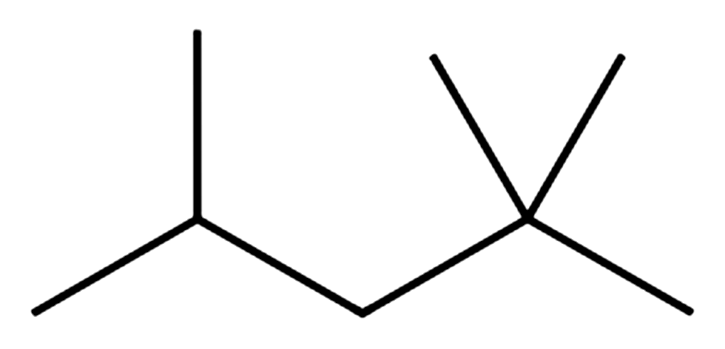
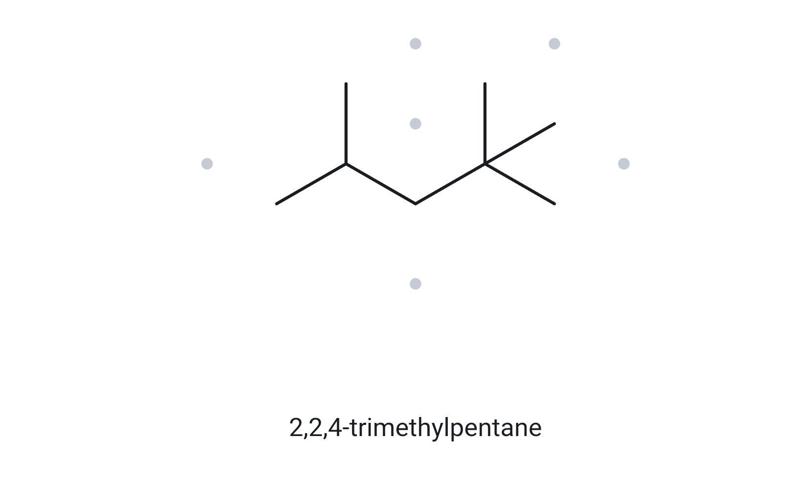
A05
Repeated locants and the first point of difference
MOLECULAR FORMULA
DEVELOPING
C₈H₁₈
Reference compound for the gasoline octane-rating scale
8 C · open chain → C_{n}H_{2n+2}
1 NUMBERED PARENT
2 NAMING TRAIL
Parent: longest chain = 5 C → pentane. Six equal 5-C paths exist (two possible left ends × three equivalent methyls on the quaternary carbon); all give the same name.
Numbering: left → right: methyls on C2, C4, C4 = 2,4,4; right → left: methyls on C2, C2, C4 = 2,2,4. First point of difference (second term): 2 < 4, so number from the right.
Substituents: three identical methyls, on C2, C2 and C4 → 2,2,4-trimethyl (tri- for three; the repeated locant is written twice).
4
2
5
3
1
3 MY NAME
4 THE ALKANE CHECK
2,2,4-trimethylpentane
Returned name:
2,2,4-trimethylpentane
Verdict: ✓ match
✓ longest chain/ring confirmed ✓ lowest locants ✓ alphabetical order ✓ punctuation ✓ formula counted

Slide 6
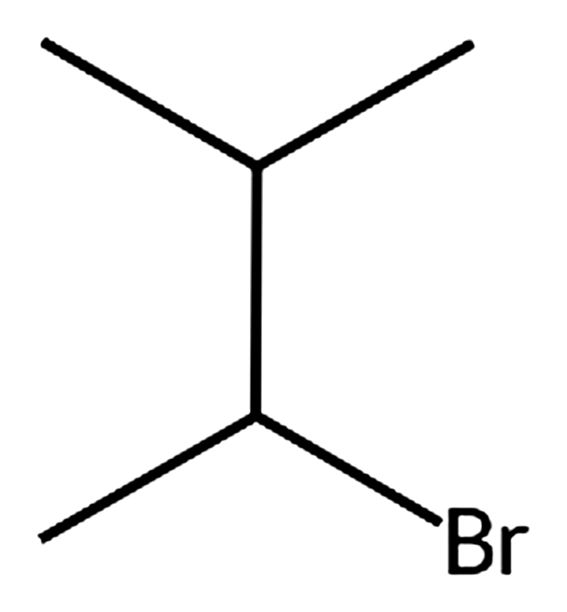
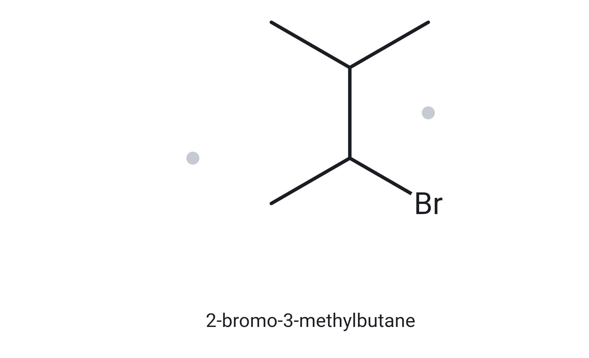
A06
Halogen as a prefix; tie in locants broken alphabetically
MOLECULAR FORMULA
DEVELOPING
C₅H₁₁Br
Alkyl halides are standard intermediates for substitution and elimination steps
5 C · open chain C₅H₁₂; Br replaces 1 H
1 NUMBERED PARENT
2 NAMING TRAIL
4
Parent: longest chain = 4 C → butane. Two equal 4-C paths exist (the two methyls on the upper carbon are interchangeable).
Numbering: from the lower-left CH3: bromo on C2, methyl on C3 = 2,3; from the upper-right CH3: methyl on C2, bromo on C3 = 2,3. The sets tie, so alphabetical order decides: bromo (b) is cited before methyl (m) and takes the lower locant → number from the lower-left end.
Substituents: bromo on C2, methyl on C3 → 2-bromo-3-methyl.
3
2
1
3 MY NAME
4 THE ALKANE CHECK
2-bromo-3-methylbutane
Returned name:
2-bromo-3-methylbutane
Verdict: ✓ match
✓ longest chain/ring confirmed ✓ lowest locants ✓ alphabetical order ✓ punctuation ✓ formula counted

Slide 7
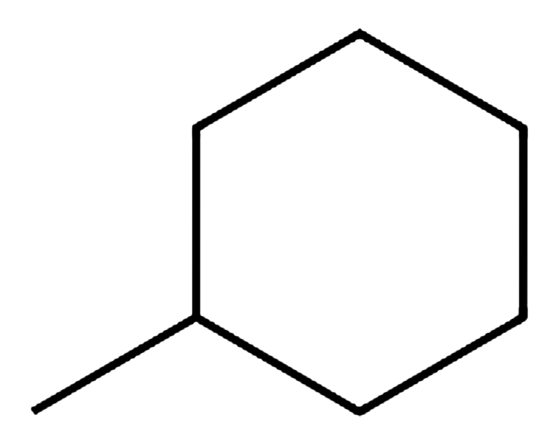
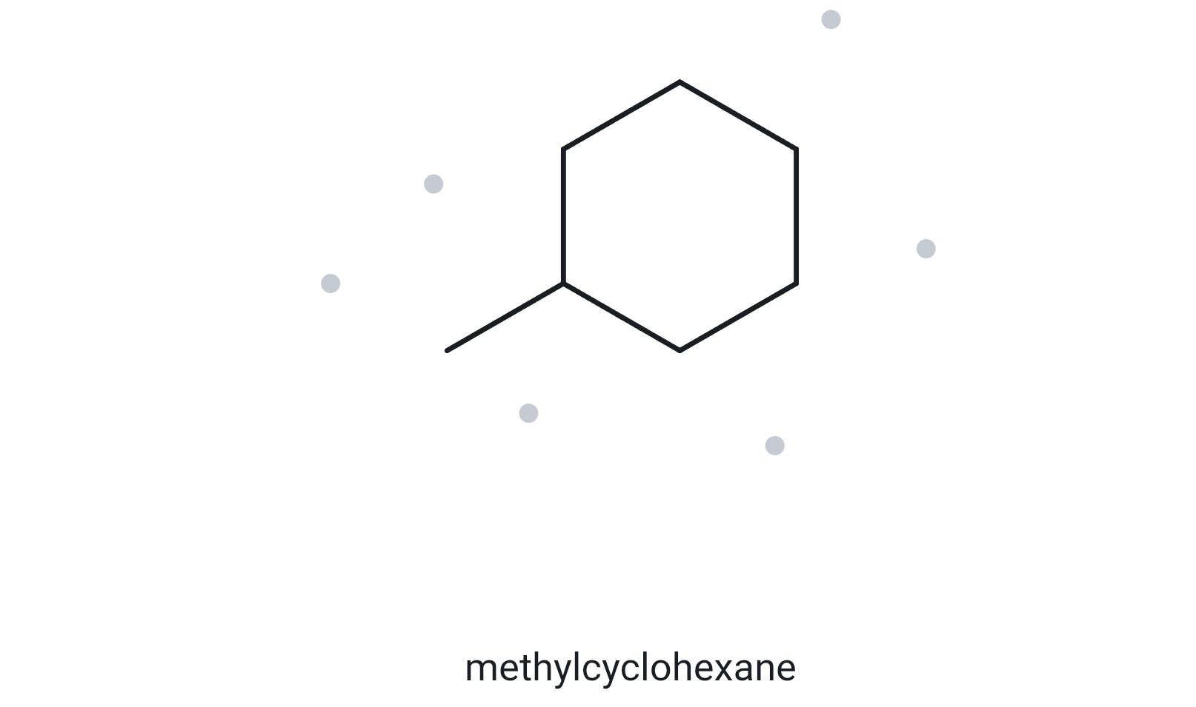
A07
Ring as parent; when is a locant unnecessary?
MOLECULAR FORMULA
DEVELOPING
C₇H₁₄
Solvent and hydrogen-carrier liquid (reversibly dehydrogenated to toluene)
7 C · one ring → C_{n}H_{2n}
1 NUMBERED PARENT
2 NAMING TRAIL
5
Parent: a ring is present, so the ring (6 C) is the parent → cyclohexane. The methyl is a one-carbon substituent.
Numbering: start at the ring carbon that carries the methyl (C1). Either direction round the ring gives the same single locant 1, so there is nothing to compare.
Substituents: methyl → methylcyclohexane. A lone substituent on a ring needs no locant (not 1-methyl).
6
4
1
3
2
3 MY NAME
4 THE ALKANE CHECK
methylcyclohexane
Returned name:
methylcyclohexane
Verdict: ✓ match
✓ longest chain/ring confirmed ✓ lowest locants ✓ alphabetical order ✓ punctuation ✓ formula counted

Slide 8
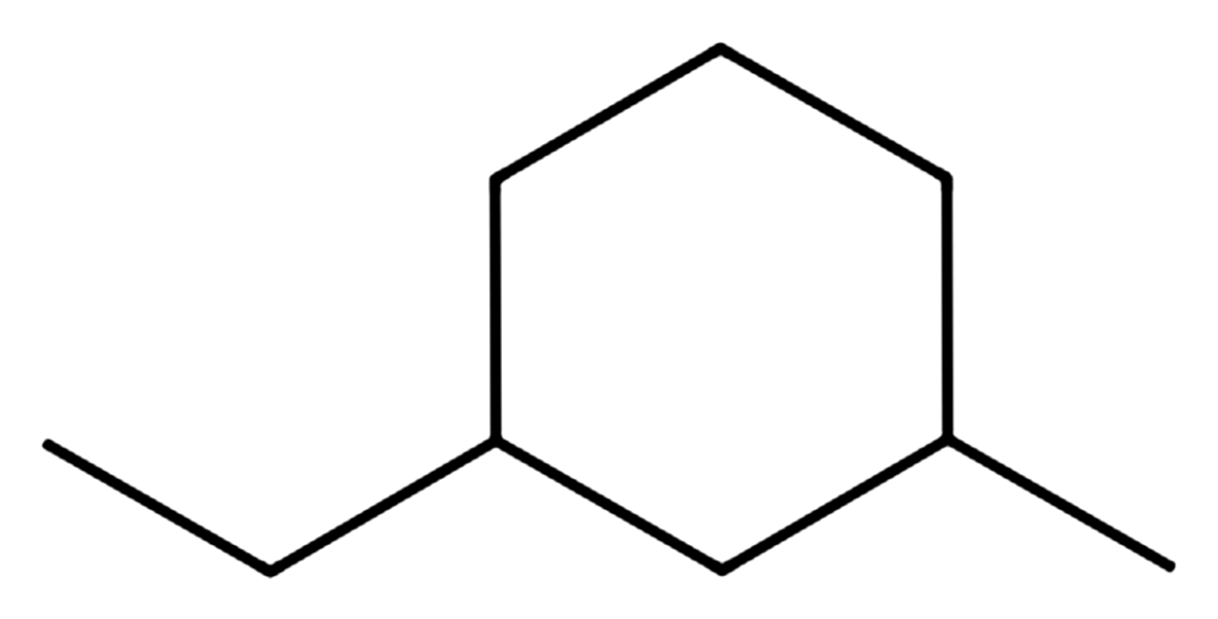
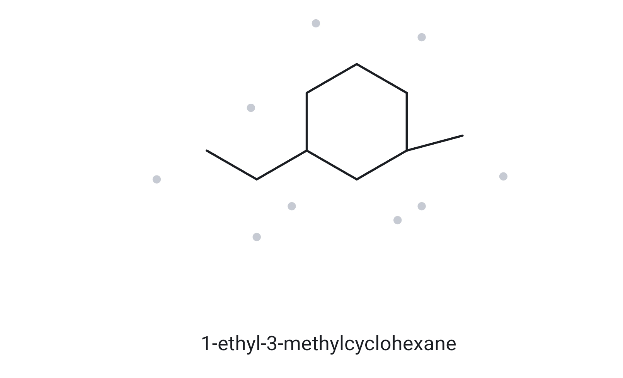
A08
Ring numbering with two substituents; alphabetical tie-break on a ring
MOLECULAR FORMULA
CHALLENGE
C₉H₁₈
Alkylcyclohexanes (naphthenes) are a major hydrocarbon class in crude oil and reformer feed
9 C · one ring → C_{n}H_{2n}
1 NUMBERED PARENT
2 NAMING TRAIL
5
Parent: a ring is present, so the ring (6 C) is the parent → cyclohexane. Ethyl (2 C) and methyl (1 C) are substituents.
Numbering: the substituted carbons are separated by one ring carbon (the bottom one). The short way round gives 1,3 from either substituent; the long way gives 1,5. The two 1,3 options tie, so alphabetical order decides: ethyl (e) is cited first and takes C1.
Substituents: ethyl on C1, methyl on C3 → 1-ethyl-3-methyl.
6
4
1
3
2
3 MY NAME
4 THE ALKANE CHECK
1-ethyl-3-methylcyclohexane
Returned name:
1-ethyl-3-methycyclohexane
Verdict: ✓ match
✓ longest chain/ring confirmed ✓ lowest locants ✓ alphabetical order ✓ punctuation ✓ formula counted

Slide 9
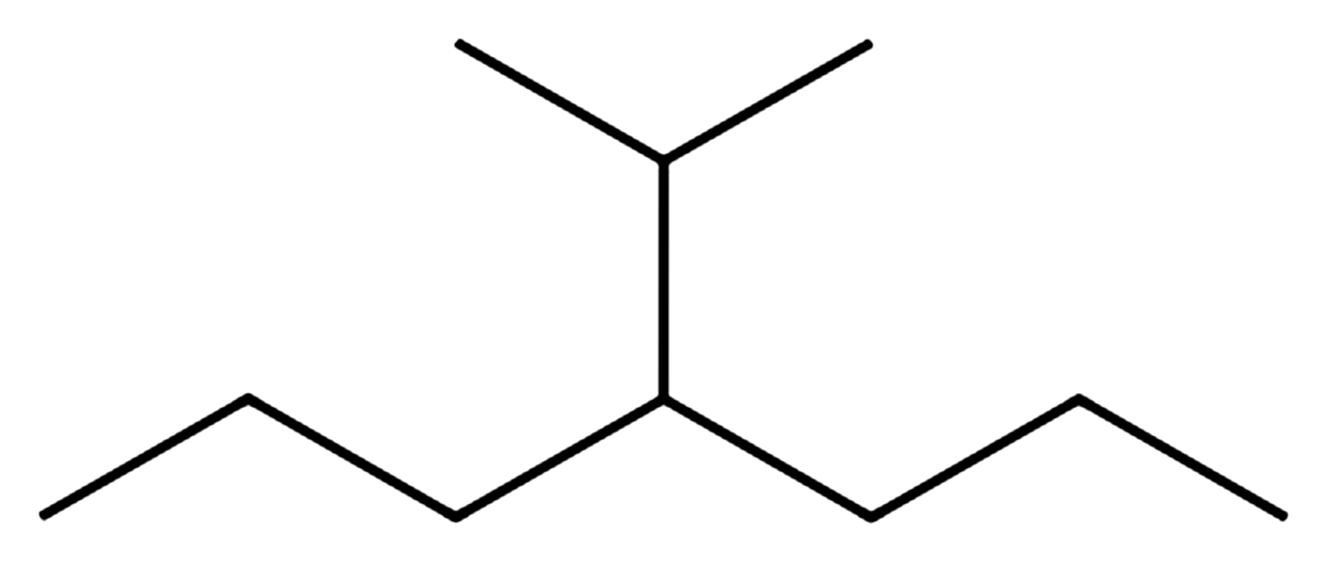
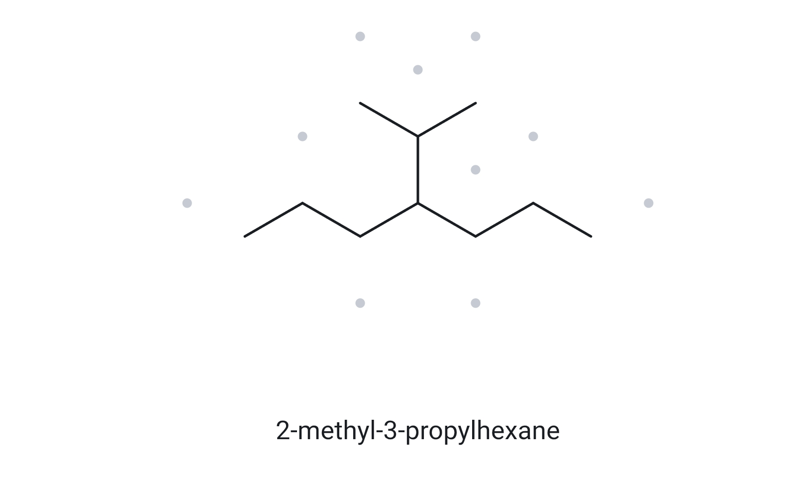
A09
A branched substituent; the longest-chain rule still decides the parent
MOLECULAR FORMULA
CHALLENGE
C₁₀H₂₂
Branched C10 paraffin in the kerosene/jet-fuel range
10 C · open chain → C_{n}H_{2n+2}
1 NUMBERED PARENT
2 NAMING TRAIL
Parent: longest chain = 7 C → heptane (the horizontal zigzag). A path through the branch reaches only 6 C (CH₃–CH–C4–C5–C6–C7), so the branch is a substituent, not the parent.
Numbering: both ends put the branch on C4 (4 either way), so there is no choice to make.
Substituents: isopropyl on C4 → 4-isopropyl. Accepted equivalents: (1-methylethyl) and propan-2-yl (Appendix B.3).
2
4
6
1
3
5
7
3 MY NAME
4 THE ALKANE CHECK
4-isopropylheptane
Returned name:
2-methyl-3-propylhexane
Verdict: ✗ mismatch
If ✗ or a different form: correct name + rule
[ 2-methyl-3-propylhexane → ✗: longest chain = 7 C → heptane ]
✓ longest chain/ring confirmed ✓ lowest locants ✓ alphabetical order ✓ punctuation ✓ formula counted

Slide 10
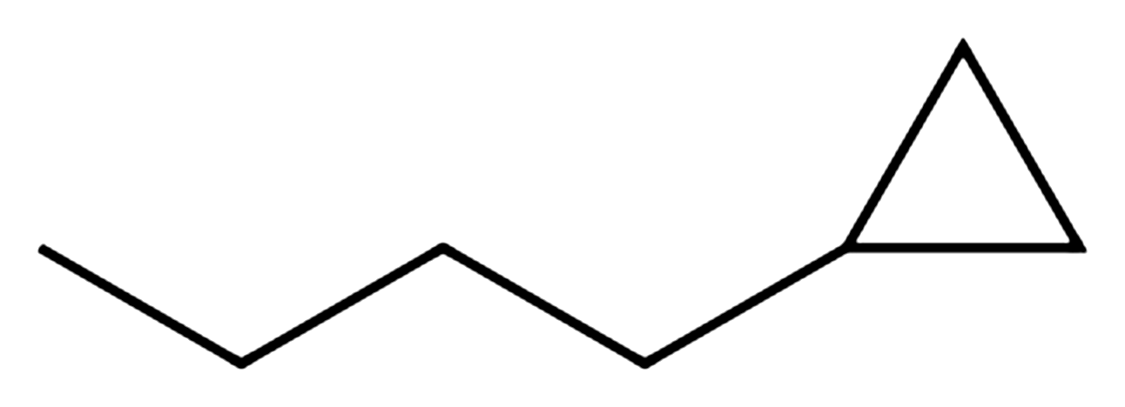
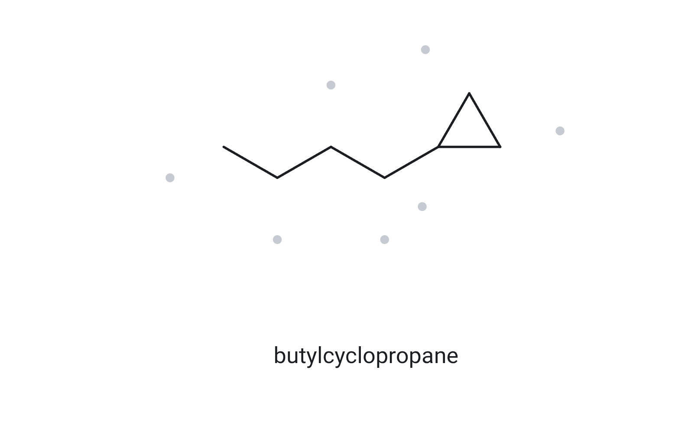
A10
A ring and a chain in one molecule: which is the parent?
MOLECULAR FORMULA
CHALLENGE
C₇H₁₄
Cyclopropyl rings are common building blocks in drugs (e.g., ciprofloxacin)
7 C · one ring → C_{n}H_{2n}
1 NUMBERED PARENT
2 NAMING TRAIL
Parent: a ring is present, so the ring (3 C) is the parent → cyclopropane, even though the attached chain (4 C) is longer. This activity follows the 2013 rule: ring = parent.
Numbering: C1 is the ring carbon that carries the chain. Both directions round the ring give the same single locant 1.
Substituents: an unbranched 4-carbon chain → butyl → butylcyclopropane (a lone ring substituent needs no locant; not 1-cyclopropylbutane).
2
1
3
3 MY NAME
4 THE ALKANE CHECK
butylcyclopropane
Returned name:
butylcyclopropane
Verdict: ✓ match
If ✗ or a different form: correct name + rule
[ 1-cyclopropylbutane → ✗: the ring is the parent in this activity ]
✓ longest chain/ring confirmed ✓ lowest locants ✓ alphabetical order ✓ punctuation ✓ formula counted

Slide 11
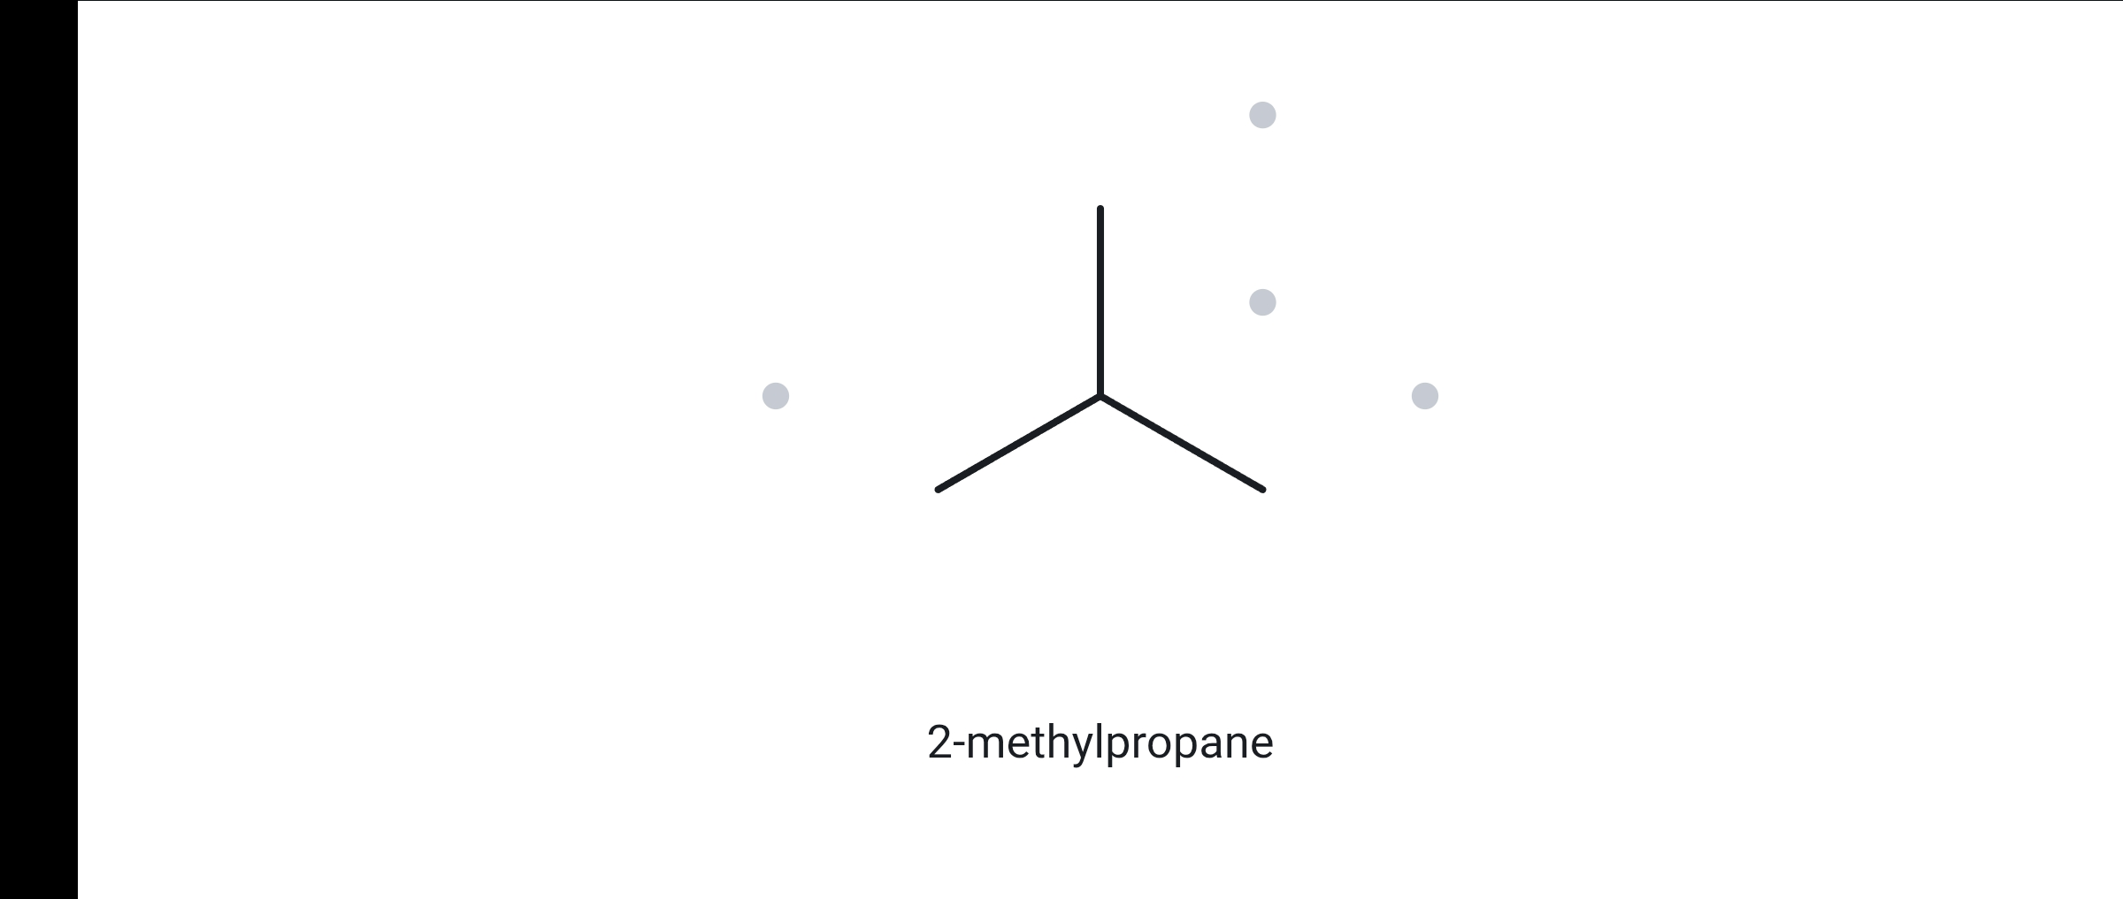
B01
GIVEN NAME
Shortest parent with one branch
FOUNDATION
2-methylpropane
Isobutane: LPG component and refrigerant R-600a
1 NAME DECODED
2 BOND-LINE STRUCTURE (THE ALKANE)
Parent: propane → a 3-carbon chain.
Substituents: methyl on C2.
Expected formula: 3 + 1 = 4 C; open chain → C₄H₁₀.
3 FORMULA CHECK
4 BACK-CHECK
Counted from the drawing: C₄H₁₀
Returned name:
2-methylpropane
Carbon types: 3 CH₃ + 1 CH → 3(3) + 1 = 10 H
Verdict:
✓ same as the given name
Open chain: C_{n}H_{2n+2}, n = 4 → C₄H₁₀ ✓
✓ parent length matches ✓ substituent positions match ✓ formula agrees ✓ back-check recorded

Slide 12
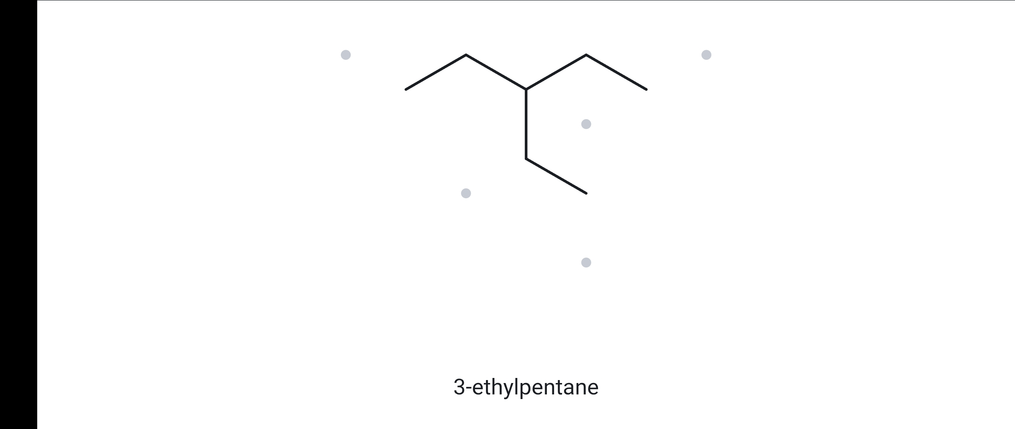
B02
GIVEN NAME
Ethyl branch on the middle carbon
FOUNDATION
3-ethylpentane
C7 isomer of heptane; gasoline range
1 NAME DECODED
2 BOND-LINE STRUCTURE (THE ALKANE)
Parent: pentane → a 5-carbon chain.
Substituents: ethyl on C3 (the middle carbon).
Expected formula: 5 + 2 = 7 C; open chain → C₇H₁₆.
3 FORMULA CHECK
4 BACK-CHECK
Counted from the drawing: C₇H₁₆
Returned name:
3-ethylpentane
Carbon types: 3 CH₃ + 3 CH₂ + 1 CH → 9 + 6 + 1 = 16 H
Verdict:
✓ same as the given name
Open chain: C_{n}H_{2n+2}, n = 7 → C₇H₁₆ ✓
✓ parent length matches ✓ substituent positions match ✓ formula agrees ✓ back-check recorded

Slide 13
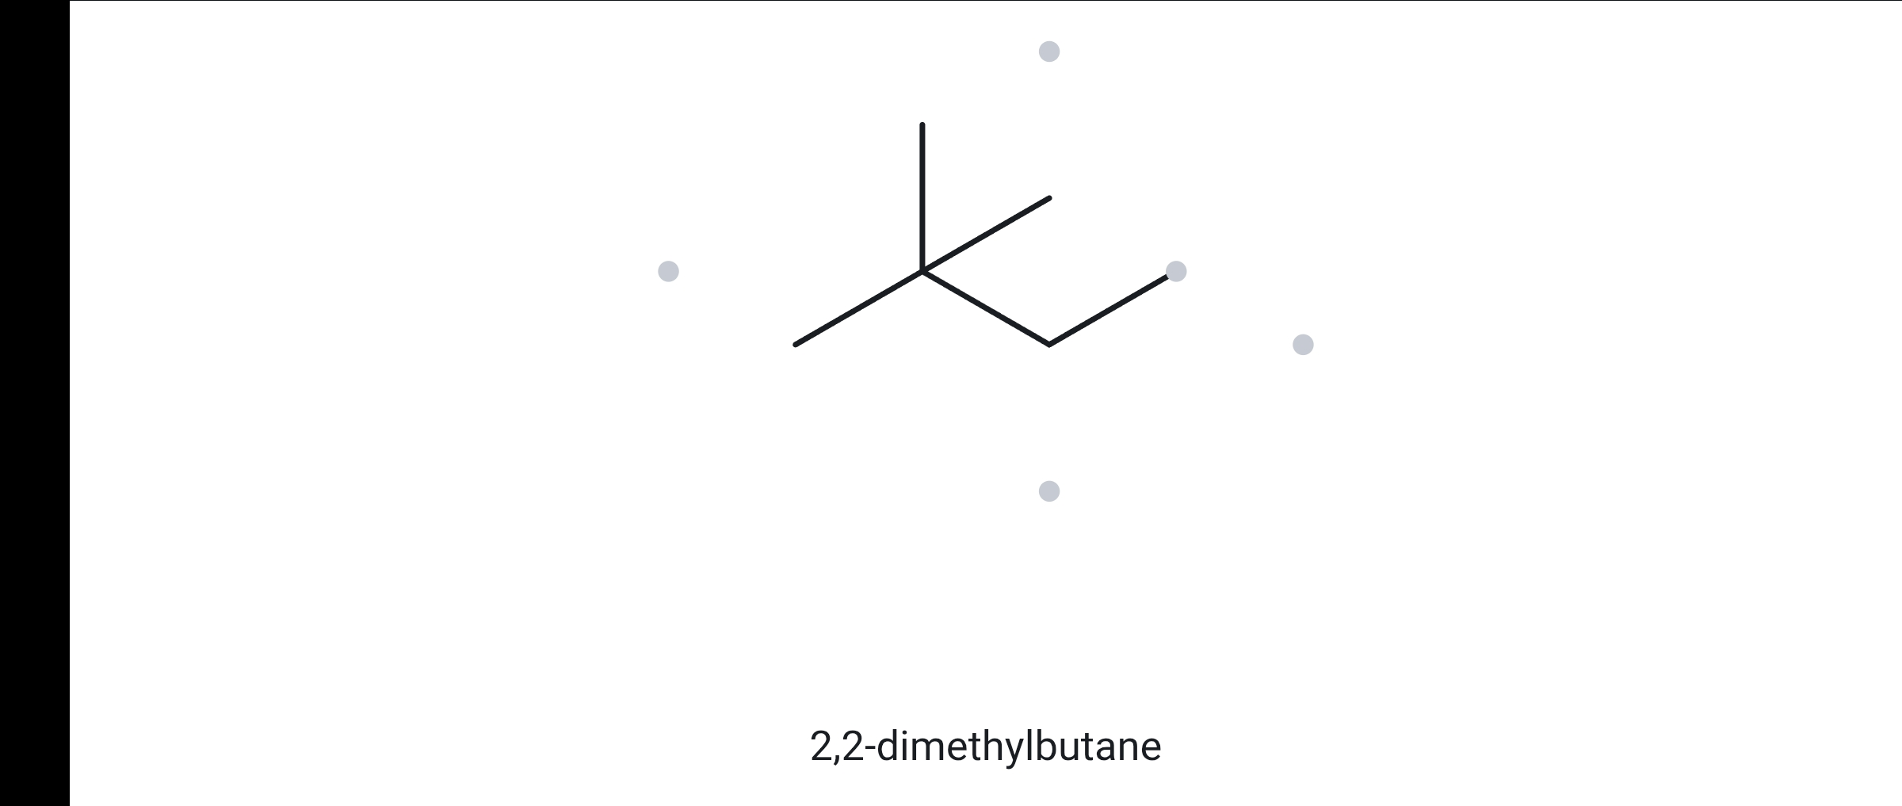
B03
GIVEN NAME
Two substituents on the same carbon
FOUNDATION
2,2-dimethylbutane
Neohexane: high-octane gasoline blending component
1 NAME DECODED
2 BOND-LINE STRUCTURE (THE ALKANE)
Parent: butane → a 4-carbon chain.
Substituents: two methyls, both on C2 (2,2-dimethyl).
Expected formula: 4 + 2 = 6 C; open chain → C₆H₁₄.
3 FORMULA CHECK
4 BACK-CHECK
Counted from the drawing: C₆H₁₄
Returned name:
2,2-dimethylbutane
Carbon types: 4 CH₃ + 1 CH₂ + 1 C → 12 + 2 + 0 = 14 H
Verdict:
✓ same as the given name
Open chain: C_{n}H_{2n+2}, n = 6 → C₆H₁₄ ✓
✓ parent length matches ✓ substituent positions match ✓ formula agrees ✓ back-check recorded

Slide 14
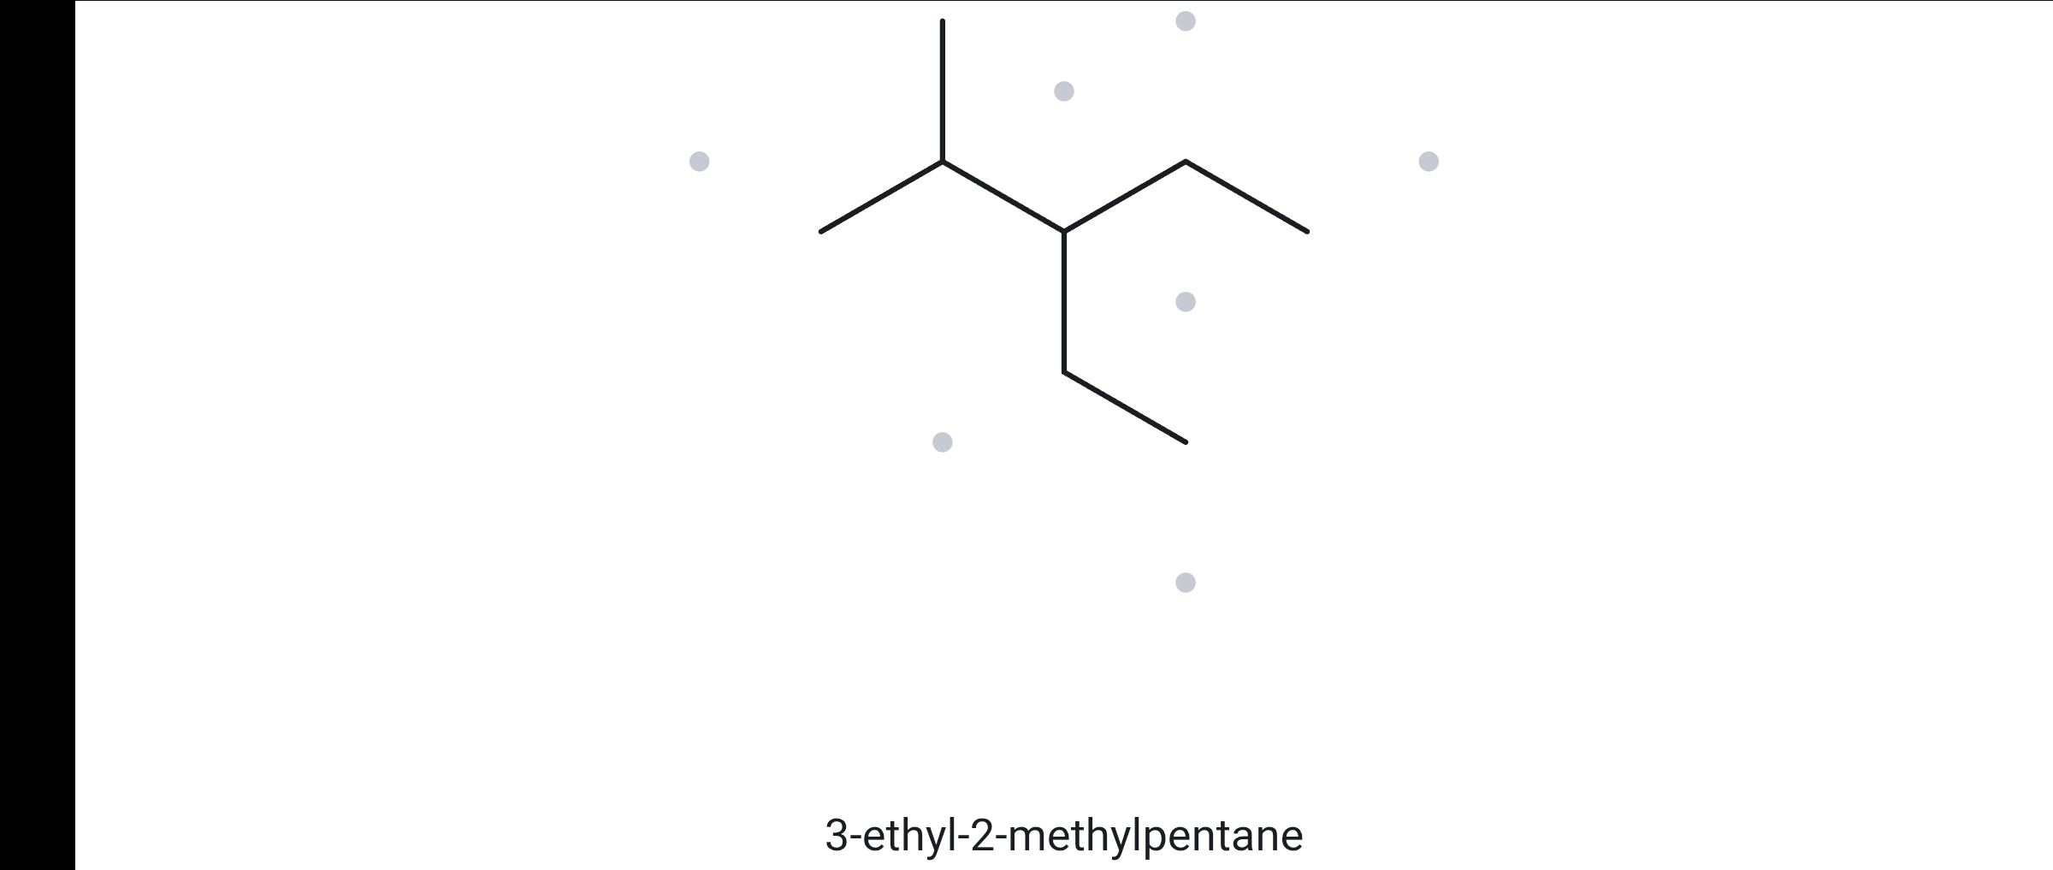
B04
GIVEN NAME
Two different substituents on neighbouring carbons
DEVELOPING
3-ethyl-2-methylpentane
C8 isomer of octane
1 NAME DECODED
2 BOND-LINE STRUCTURE (THE ALKANE)
Parent: pentane → a 5-carbon chain.
Substituents: methyl on C2; ethyl on C3 (cited alphabetically: ethyl, then methyl).
Expected formula: 5 + 1 + 2 = 8 C; open chain → C₈H₁₈.
3 FORMULA CHECK
4 BACK-CHECK
Counted from the drawing: C₈H₁₈
Returned name:
3-ethyl-2-methylpentane
Carbon types: 4 CH₃ + 2 CH₂ + 2 CH → 12 + 4 + 2 = 18 H
Verdict:
✓ same as the given name
Open chain: C_{n}H_{2n+2}, n = 8 → C₈H₁₈ ✓
✓ parent length matches ✓ substituent positions match ✓ formula agrees ✓ back-check recorded

Slide 15
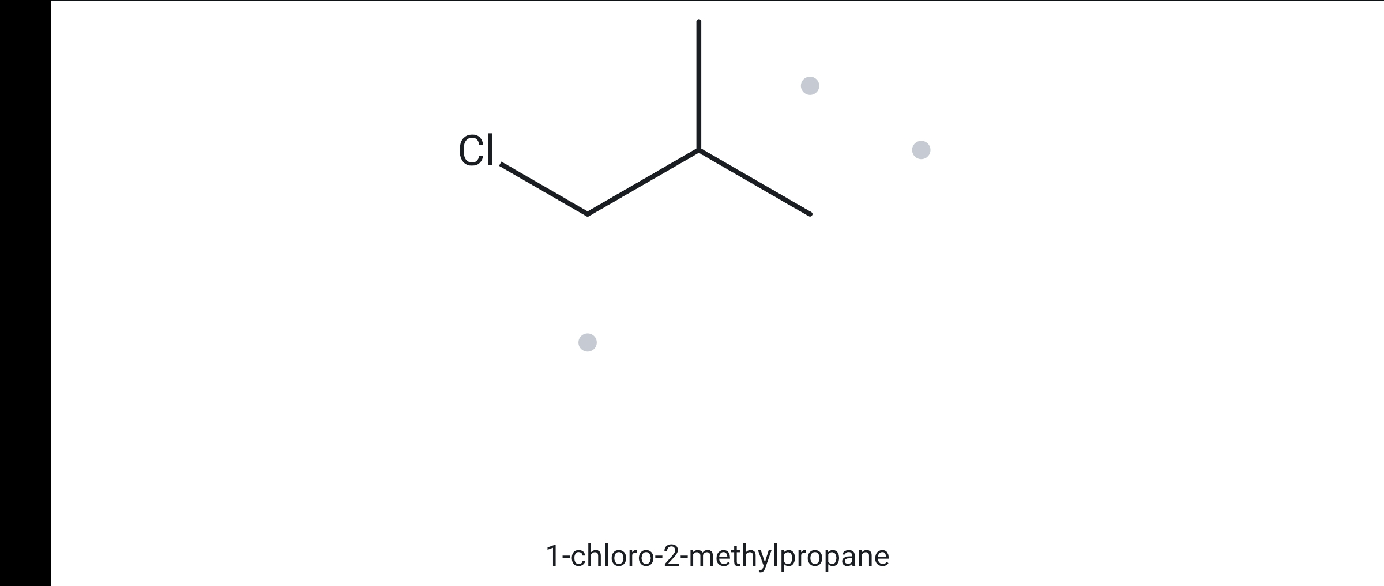
B05
GIVEN NAME
Halogen on a terminal carbon
DEVELOPING
1-chloro-2-methylpropane
Isobutyl chloride: alkylating agent and intermediate
1 NAME DECODED
2 BOND-LINE STRUCTURE (THE ALKANE)
Parent: propane → a 3-carbon chain.
Substituents: chloro on C1; methyl on C2.
Expected formula: 3 + 1 = 4 C; open chain C₄H₁₀; Cl replaces one H → C₄H₉Cl.
3 FORMULA CHECK
4 BACK-CHECK
Counted from the drawing: C₄H₉Cl
Returned name:
1-chloro-2-methylpropane
Carbon types: 2 CH₃ + 1 CH₂ + 1 CH → 6 + 2 + 1 = 9 H, plus 1 Cl
Verdict:
✓ same as the given name
Open chain: C_{n}H_{2n+2}, n = 4 → C₄H₁₀; Cl replaces one H → C₄H₉Cl ✓
✓ parent length matches ✓ substituent positions match ✓ formula agrees ✓ back-check recorded

Slide 16
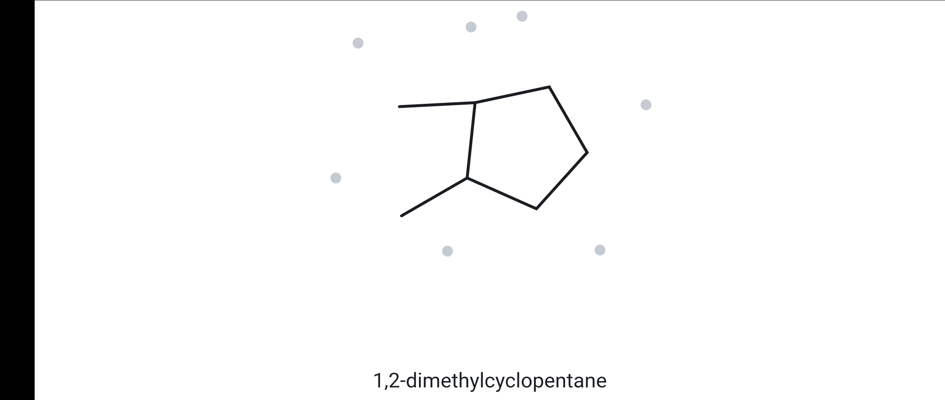
B06
GIVEN NAME
Adjacent substituents on a five-membered ring
DEVELOPING
1,2-dimethylcyclopentane
Naphthene found in petroleum naphtha
1 NAME DECODED
2 BOND-LINE STRUCTURE (THE ALKANE)
Parent: cyclopentane → a 5-carbon ring.
Substituents: methyl on C1 and methyl on C2 (adjacent ring carbons).
Expected formula: 5 + 2 = 7 C; one ring → C₇H₁₄.
3 FORMULA CHECK
4 BACK-CHECK
Counted from the drawing: C₇H₁₄
Returned name:
1,2-dimethylcyclopentane
Carbon types: 2 CH₃ + 3 CH₂ + 2 CH → 6 + 6 + 2 = 14 H
Verdict:
✓ same as the given name
One ring: C_{n}H_{2n}, n = 7 → C₇H₁₄ ✓
✓ parent length matches ✓ substituent positions match ✓ formula agrees ✓ back-check recorded

Slide 17
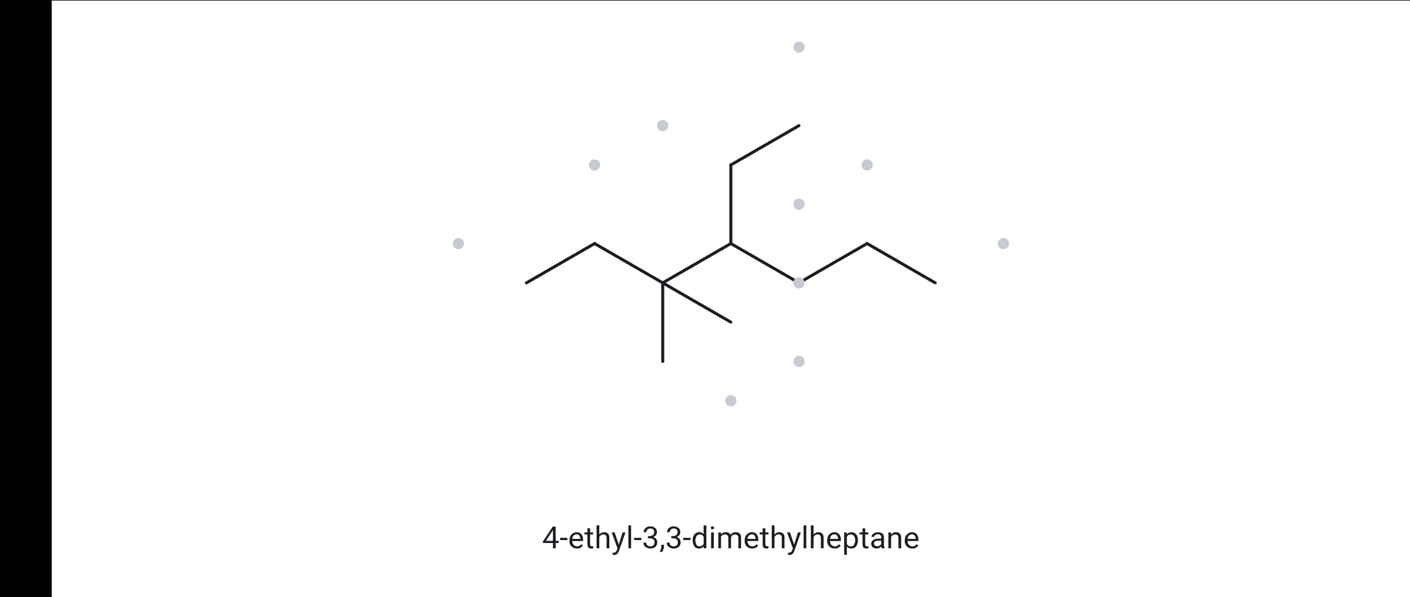
B07
GIVEN NAME
Three substituents on a seven-carbon parent
DEVELOPING
4-ethyl-3,3-dimethylheptane
Branched C11 paraffin in the kerosene range
1 NAME DECODED
2 BOND-LINE STRUCTURE (THE ALKANE)
Parent: heptane → a 7-carbon chain.
Substituents: two methyls on C3 (3,3-dimethyl); ethyl on C4.
Expected formula: 7 + 2 + 2 = 11 C; open chain → C₁₁H₂₄.
3 FORMULA CHECK
4 BACK-CHECK
Counted from the drawing: C₁₁H₂₄
Returned name:
4-ethyl-3,3-dimethylheptane
Carbon types: 5 CH₃ + 4 CH₂ + 1 CH + 1 C → 15 + 8 + 1 + 0 = 24 H
Verdict:
✓ same as the given name
Open chain: C_{n}H_{2n+2}, n = 11 → C₁₁H₂₄ ✓
✓ parent length matches ✓ substituent positions match ✓ formula agrees ✓ back-check recorded

Slide 18
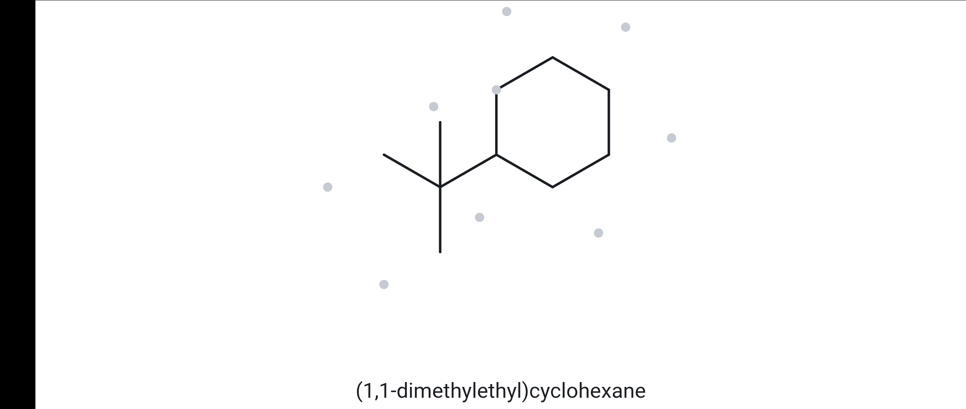
B08
GIVEN NAME
A common substituent name: draw it, then compare with the tool’s systematic name
CHALLENGE
tert-butylcyclohexane
The bulky tert-butyl group anchors cyclohexane conformations (a later topic)
1 NAME DECODED
2 BOND-LINE STRUCTURE (THE ALKANE)
Parent: cyclohexane → a 6-carbon ring.
Substituents: tert-butyl, –C(CH₃)₃ (4 C), on C1; a lone ring substituent needs no locant. Equivalent forms: (1,1-dimethylethyl), 2-methylpropan-2-yl.
Expected formula: 6 + 4 = 10 C; one ring → C₁₀H₂₀.
3 FORMULA CHECK
4 BACK-CHECK
Counted from the drawing: C₁₀H₂₀
Returned name:
If it differs from the given name, explain why:
(1,1-dimethylethyl)cyclohexane
[ (1,1-dimethylethyl)cyclohexane: same compound, since tert-butyl = (1,1-dimethylethyl) ]
Carbon types: 3 CH₃ + 5 CH₂ + 1 CH + 1 C → 9 + 10 + 1 + 0 = 20 H
Verdict:
✗ differs
One ring: C_{n}H_{2n}, n = 10 → C₁₀H₂₀ ✓
✓ parent length matches ✓ substituent positions match ✓ formula agrees ✓ back-check recorded

Slide 19
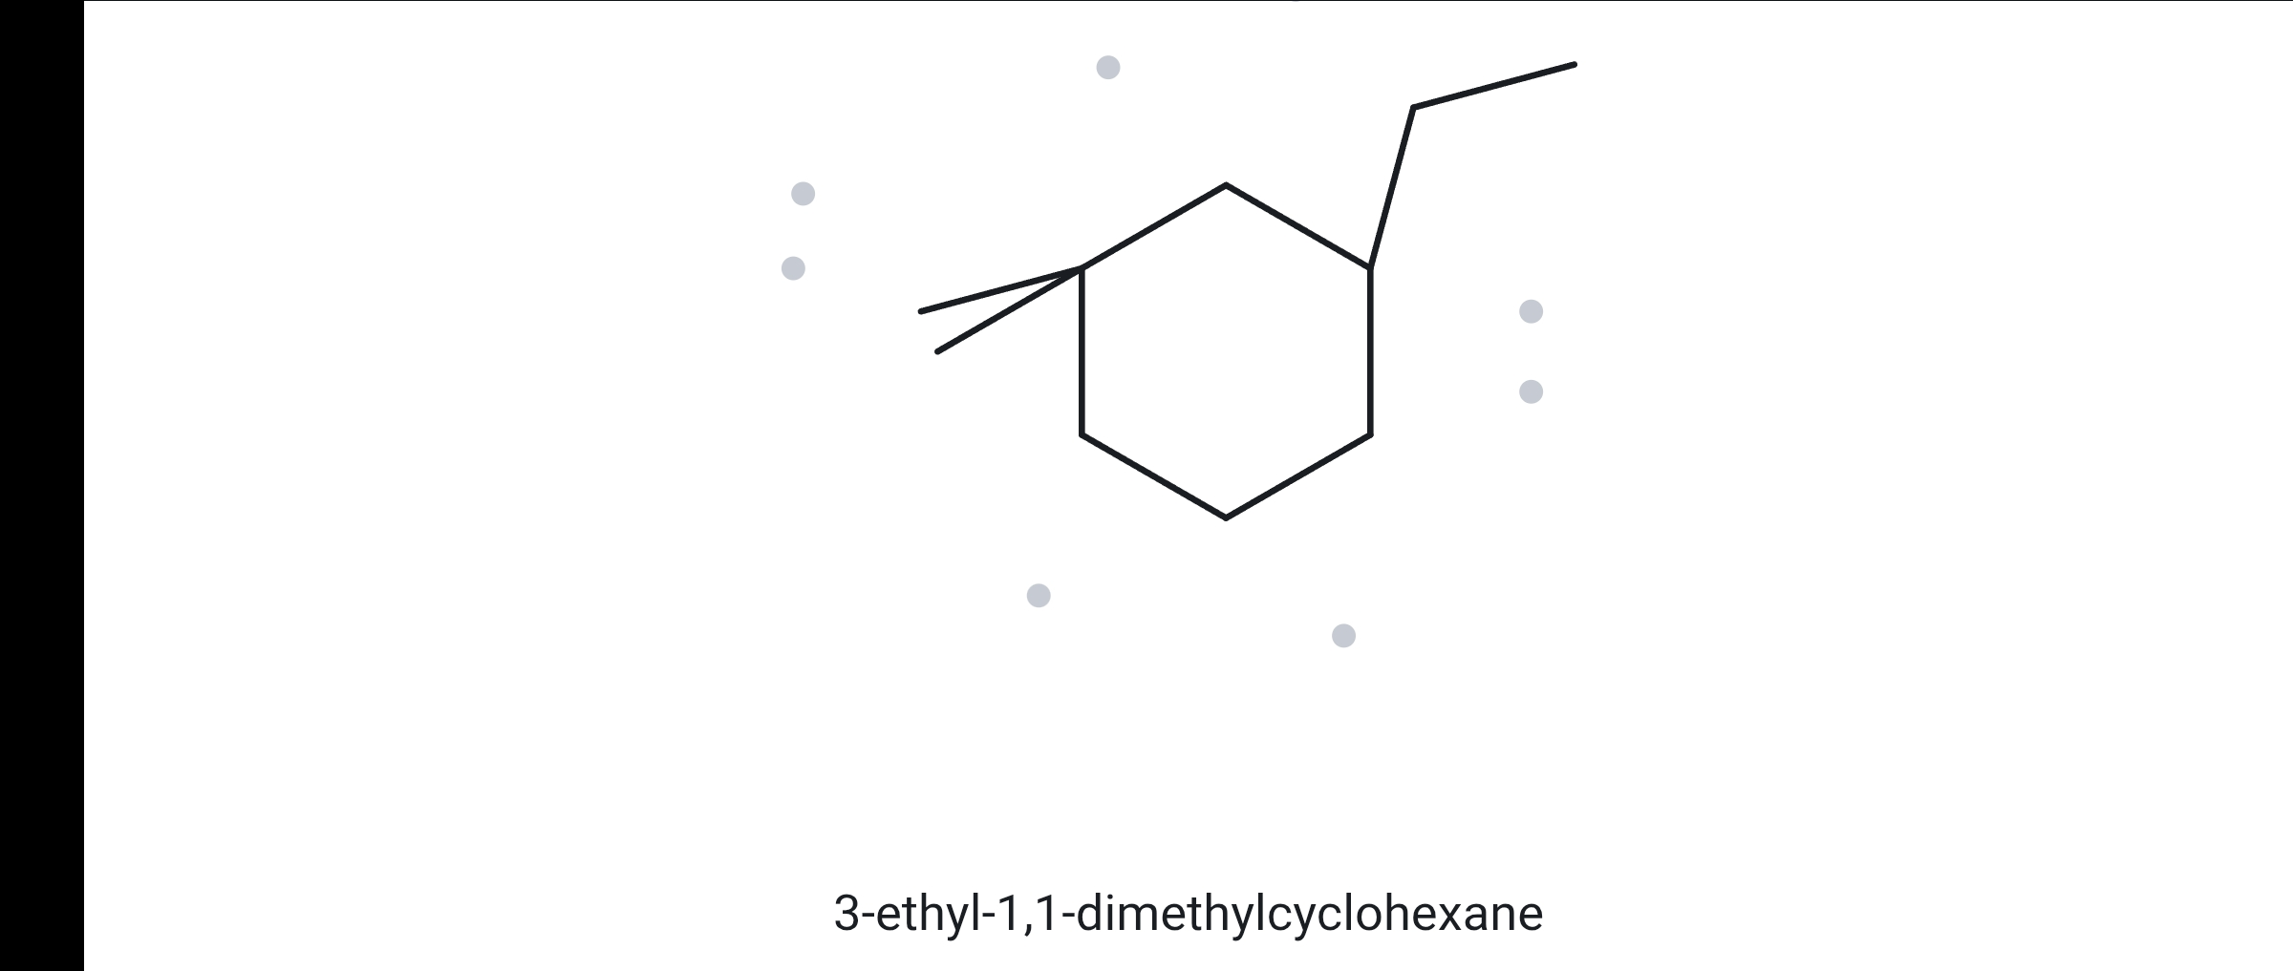
B09
GIVEN NAME
Ring numbering with a doubly substituted carbon
CHALLENGE
3-ethyl-1,1-dimethylcyclohexane
Alkylcyclohexane of the kind found in jet and diesel fuel
1 NAME DECODED
2 BOND-LINE STRUCTURE (THE ALKANE)
Parent: cyclohexane → a 6-carbon ring.
Substituents: two methyls on C1 (1,1-dimethyl); ethyl on C3.
Expected formula: 6 + 2 + 2 = 10 C; one ring → C₁₀H₂₀.
3 FORMULA CHECK
4 BACK-CHECK
Counted from the drawing: C₁₀H₂₀
Returned name:
3-ethyl-1,1-dimethylcyclohexane
Carbon types: 3 CH₃ + 5 CH₂ + 1 CH + 1 C → 9 + 10 + 1 + 0 = 20 H
Verdict:
✓ same as the given name
One ring: C_{n}H_{2n}, n = 10 → C₁₀H₂₀ ✓
✓ parent length matches ✓ substituent positions match ✓ formula agrees ✓ back-check recorded

Slide 20
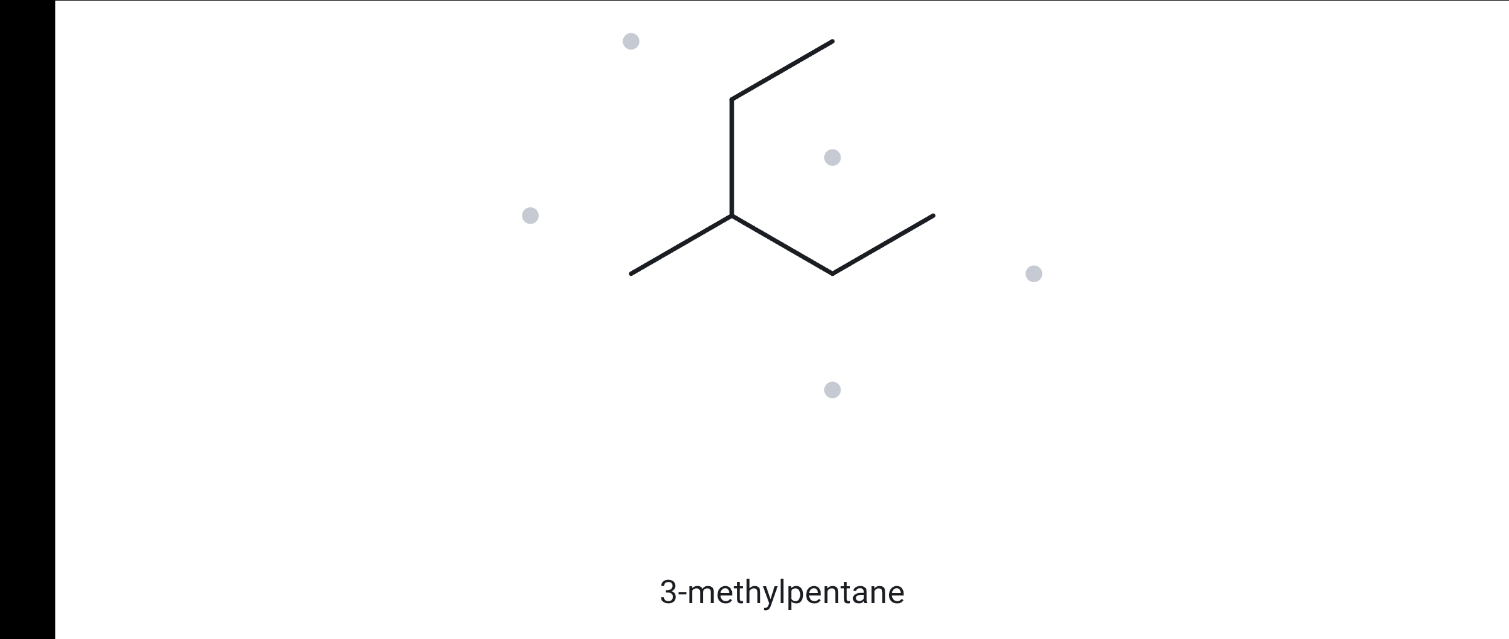
B10
GIVEN NAME
This name breaks a rule: draw exactly what it says, then find the correct name
CHALLENGE
2-ethylbutane
Naming errors on labels and safety data sheets cause real mix‑ups
DELIBERATELY INCORRECT NAME
1 NAME DECODED
2 BOND-LINE STRUCTURE (THE ALKANE)
Parent: butane → a 4-carbon chain (as written).
Substituents: ethyl on C2 (as written).
Expected formula: 4 + 2 = 6 C; open chain → C₆H₁₄.
3 FORMULA CHECK
4 BACK-CHECK
Counted from the drawing: C₆H₁₄
Returned name:
Correct name: 3-methylpentane
Rule broken: the parent must be the longest continuous chain. As written, C4–C3–C2–CH2–CH3 runs through the ethyl group: 5 C → pentane, not butane. The old C1 becomes a methyl on C3.
Same molecule, C₆H₁₄.
3-methylpentane
Carbon types: 3 CH₃ + 2 CH₂ + 1 CH → 9 + 4 + 1 = 14 H
Verdict:
✗ differs
Open chain: C_{n}H_{2n+2}, n = 6 → C₆H₁₄ ✓
✓ parent length matches ✓ substituent positions match ✓ formula agrees ✓ back-check recorded

