Slide 1
News Popularity Prediction
——— Who will hit the headlines next !
Yue Zhuang
Brown University
Oct 22, 2019
Github : https://github.com/zysophia/News Rank Prediction

Slide 2
Introduction
Problem description:
Predict the popularity of a certain piece of news and find the news which will hit the headlines in the next 20 minutes.
Why important:
An improvement on the existing recommendation system
Supervised learning:
Regression
Data source: UCI
https://archive.ics.uci.edu/ml/datasets/News+Popularity+in+Multiple+Social+Media+Platforms

Slide 3
Data Preprocessing I
Raw data:
news_final.csv fb_Economy.csv fb_Obama.csv fb_Microsoft.csv fb_Palestine.csv
(2015.11 ~ 2016.7)
Merge DataFrames:
Before merging: Missing values (In fb_*.csv & NOT In news_final.csv)
Missing rate: 0.3% & MCAR test 1.0 -> Drop
Calculate:
Popularity V.S. Popularity_Diff
Topic Popularity by Time (20 min)
Merge calculation:
Index: IDLink
Columns: Topic, Period, Sentiment, History popularity info, Topic popularity info, Popularity

Slide 4
Data Preprocessing II
One Hot Encoder:
Topic
Scaler:
MinMax Scaler: Period, History popularity info, Topic popularity info
Before Scale:
Deal with some extremely large values
Log (x+1) for popularity related columns
Final DataFrame:
Index: Index
Columns (40):
Topic(4), Period(1), Sentiment(2), History popularity info(2), Topic popularity info(30)
Target variable: Popularity
Size: 121049 * 40

Slide 5
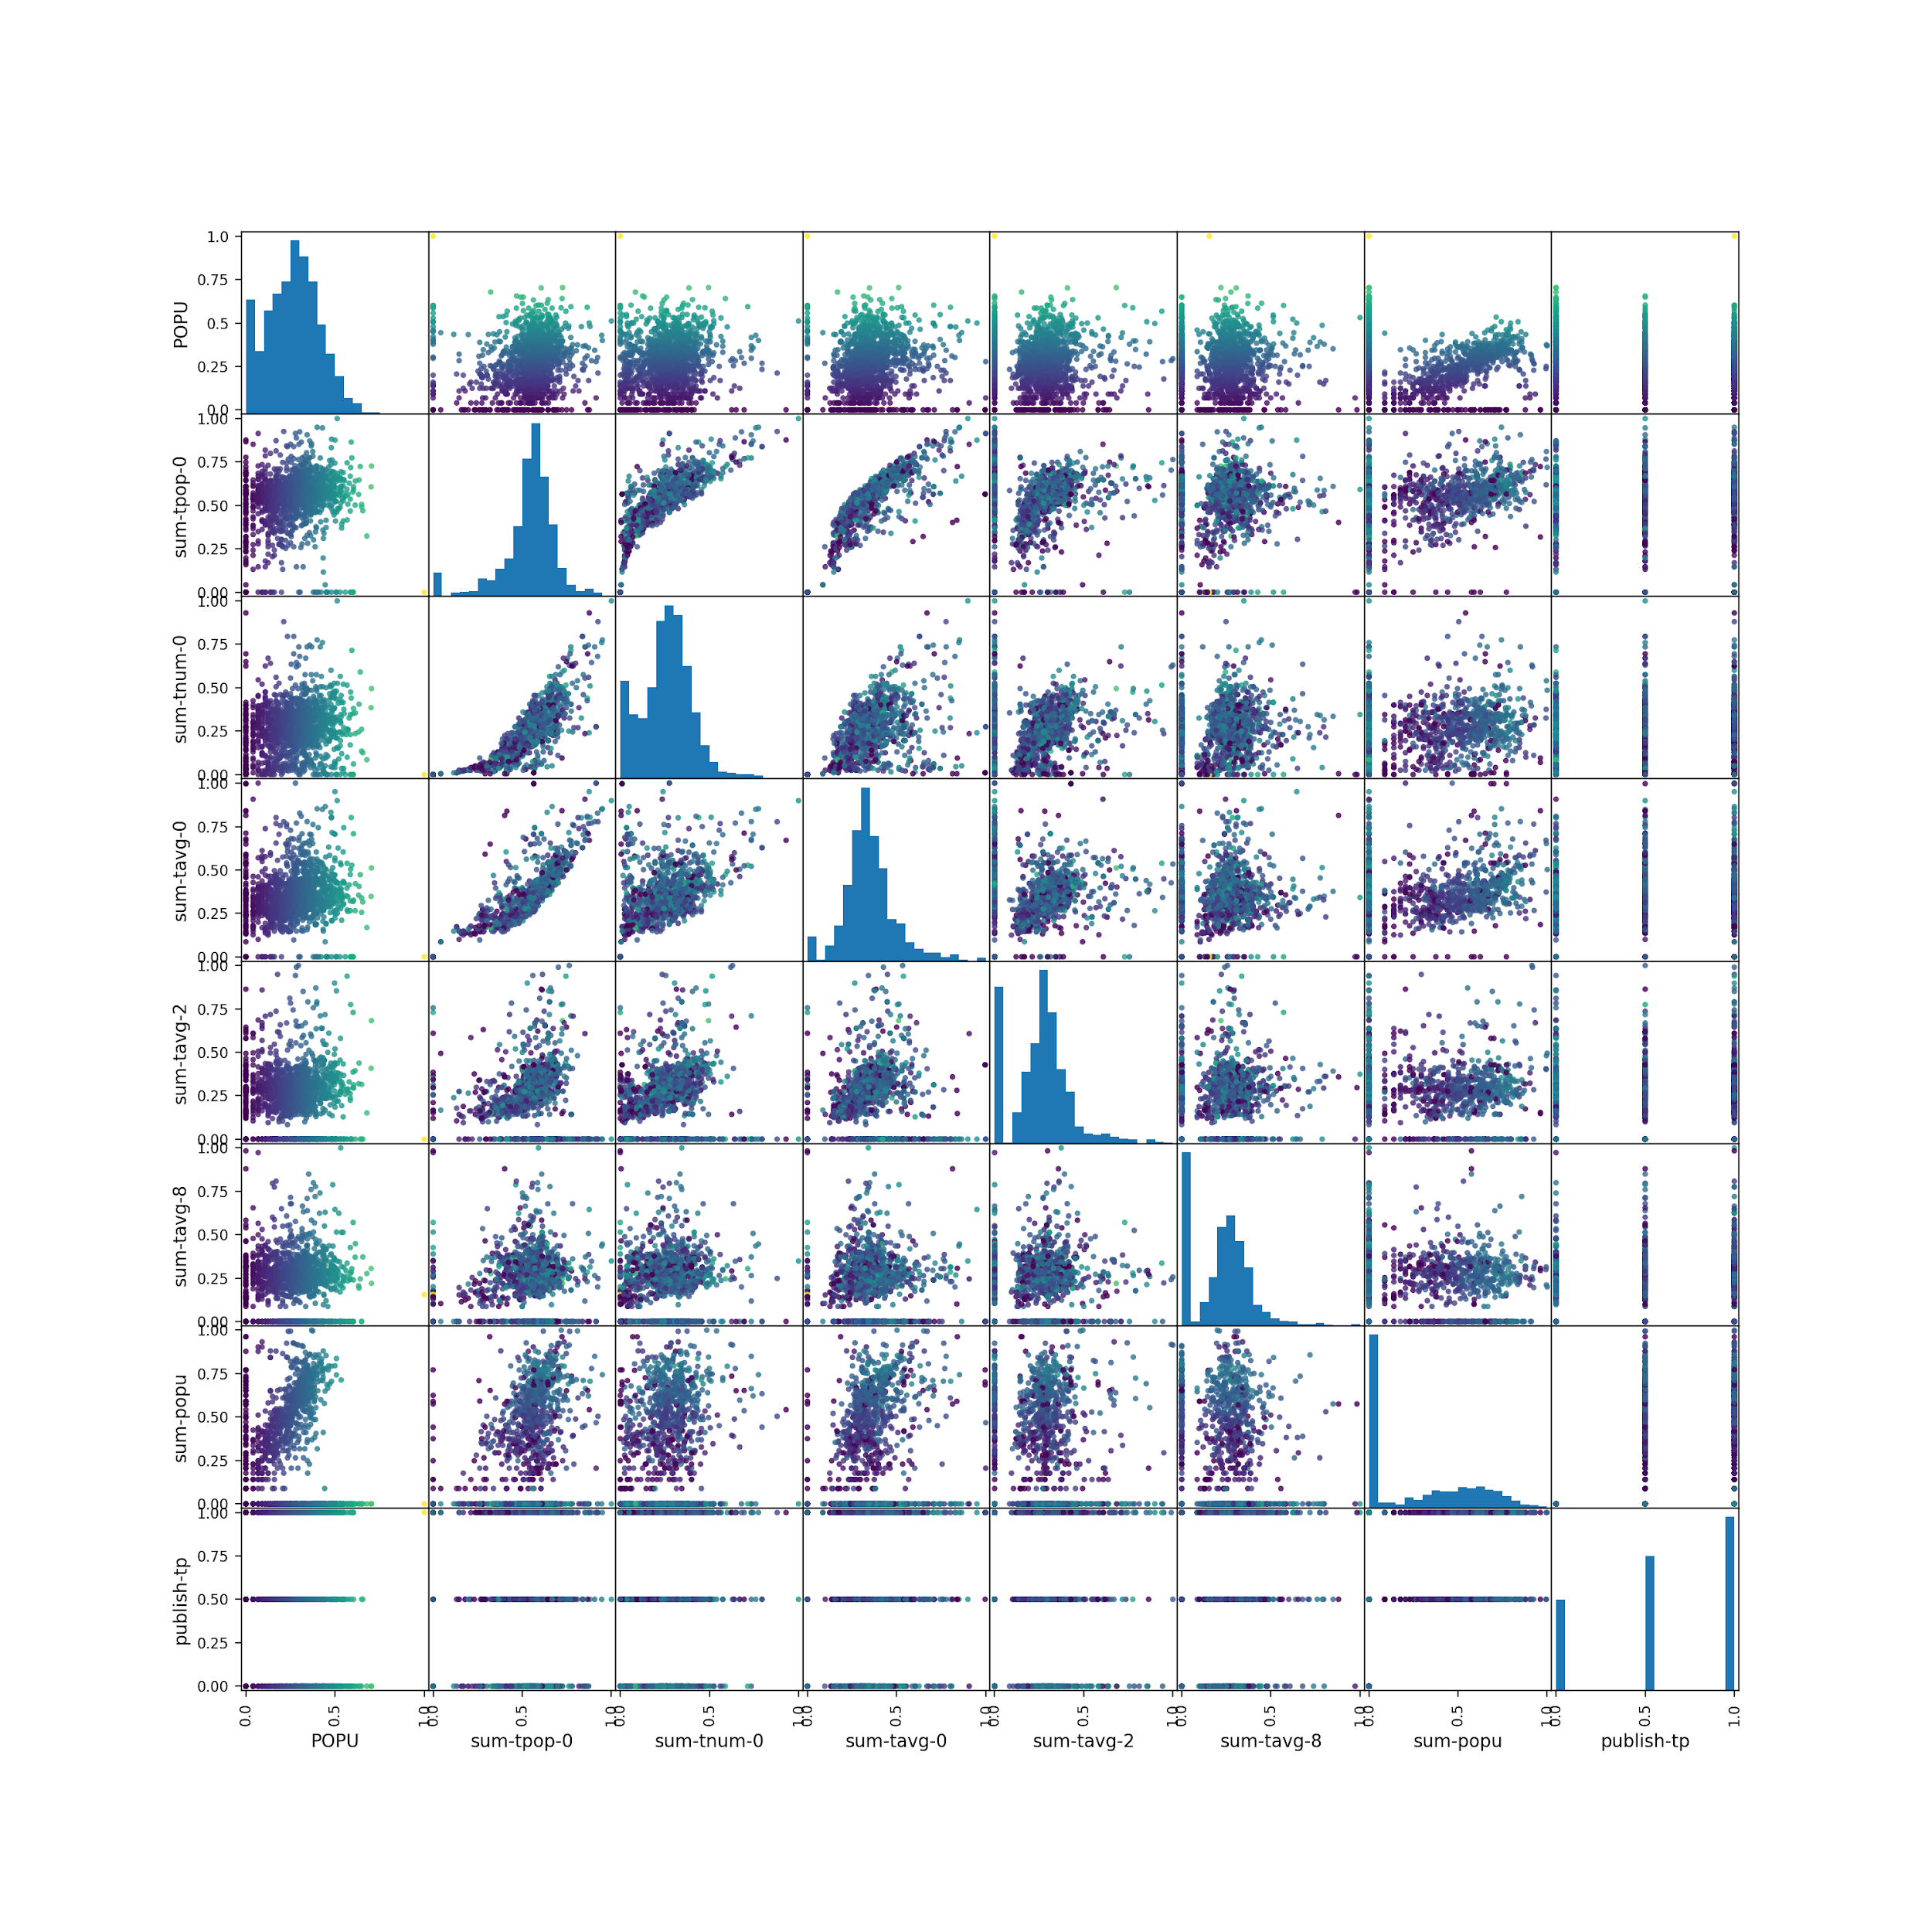
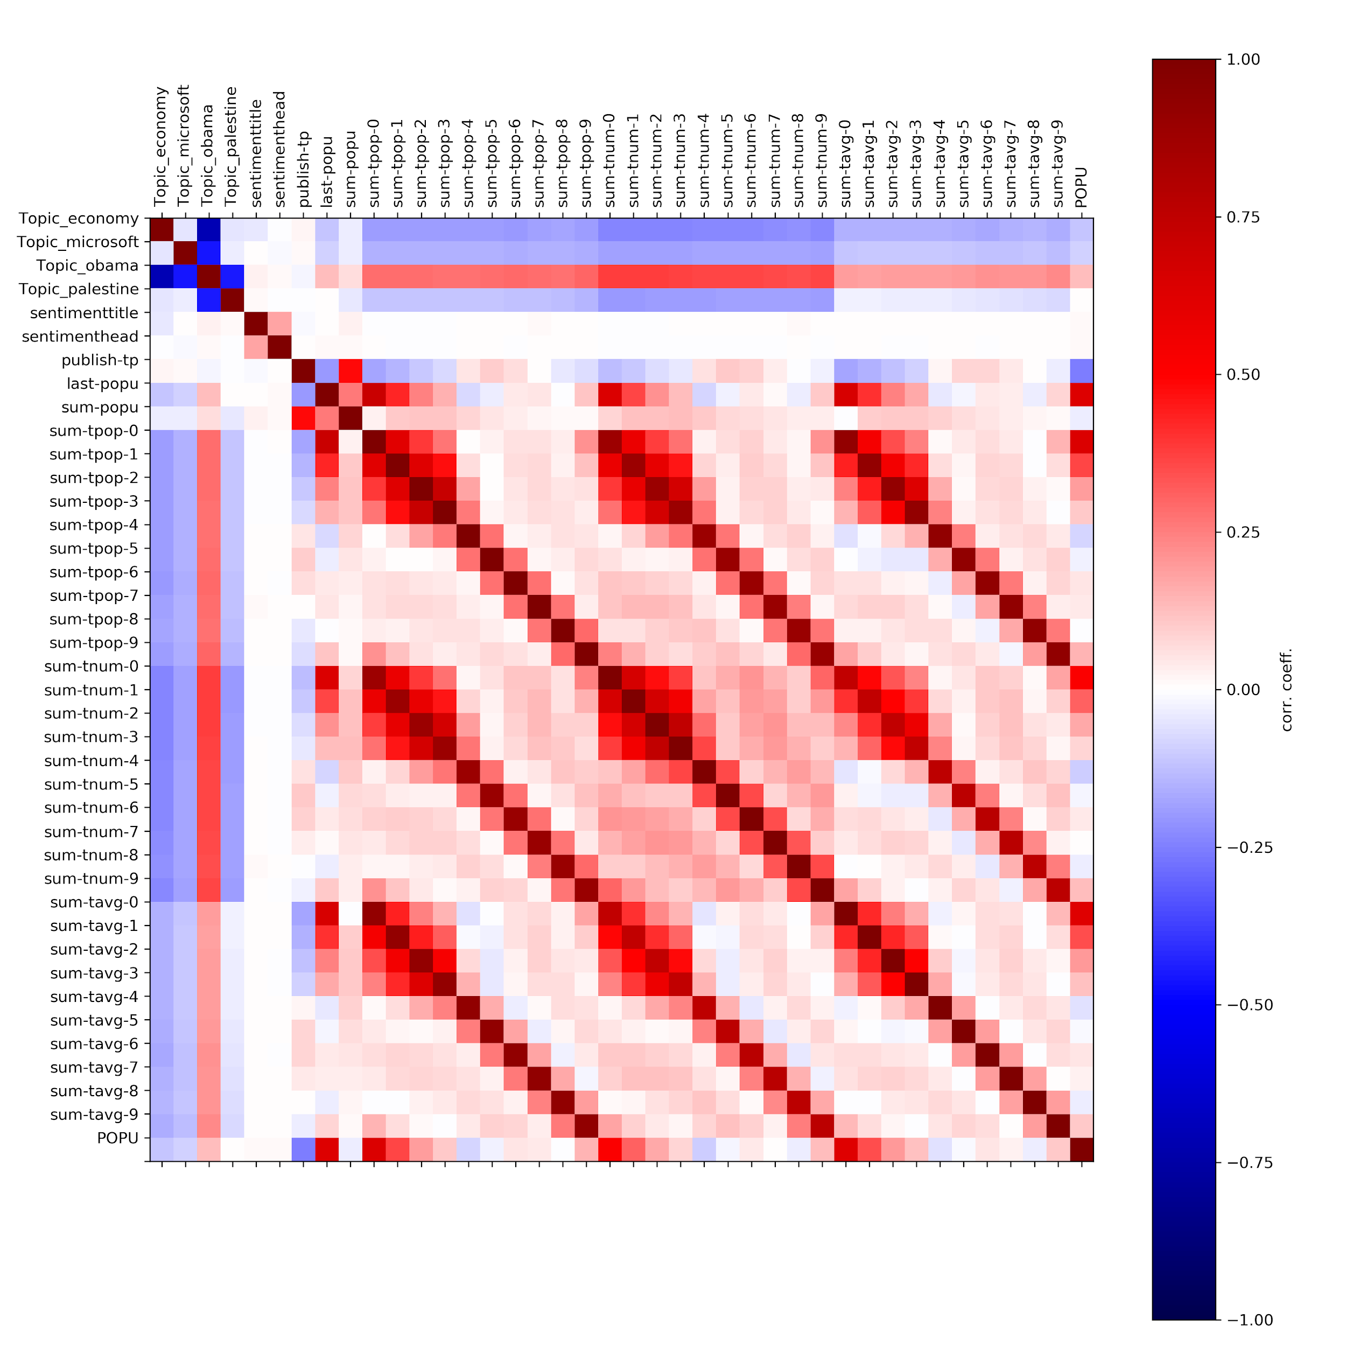
EDA

Slide 6
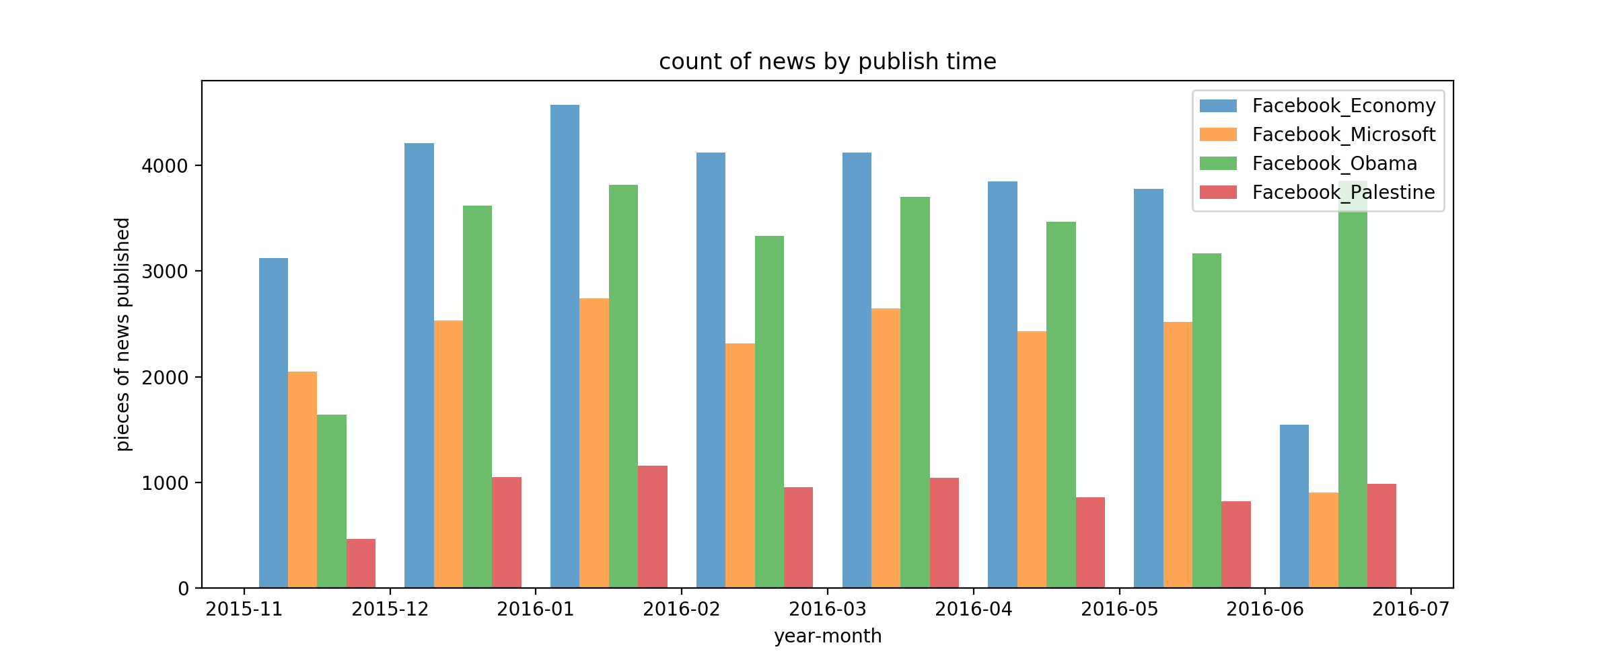
Do we have balanced data ?

Slide 7
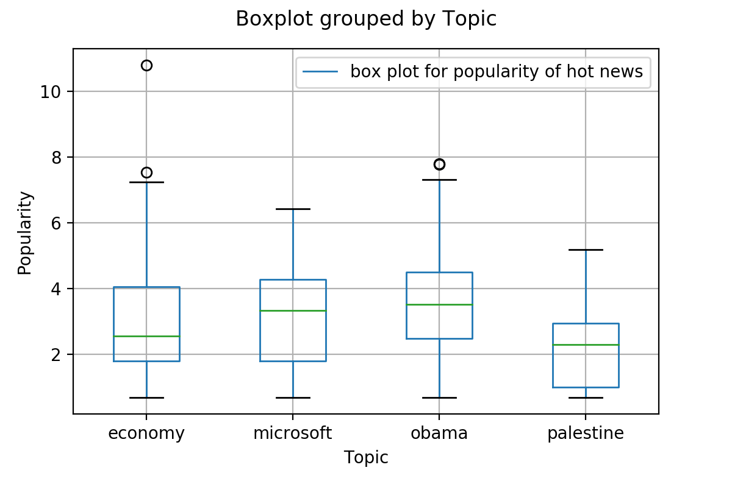
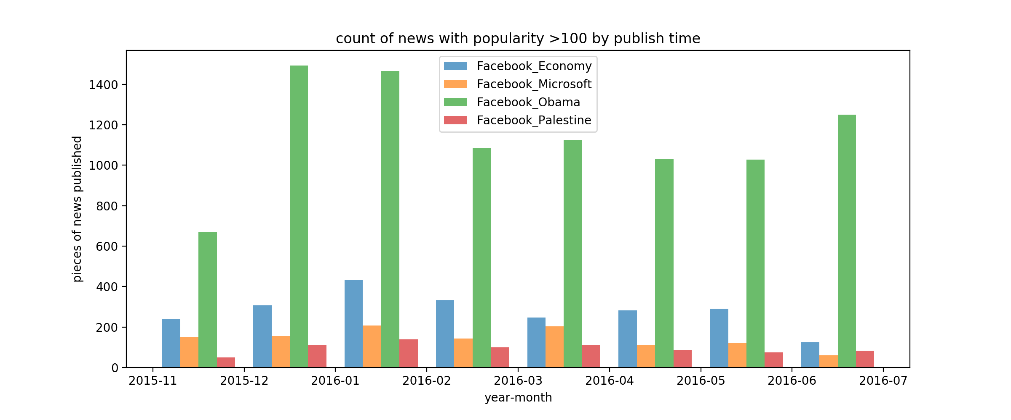
Focus On the Most Popular News
Why
2016 Obama Year
Keep In Mind:
Unbalanced Dataset
Popularity related to topics

Slide 8
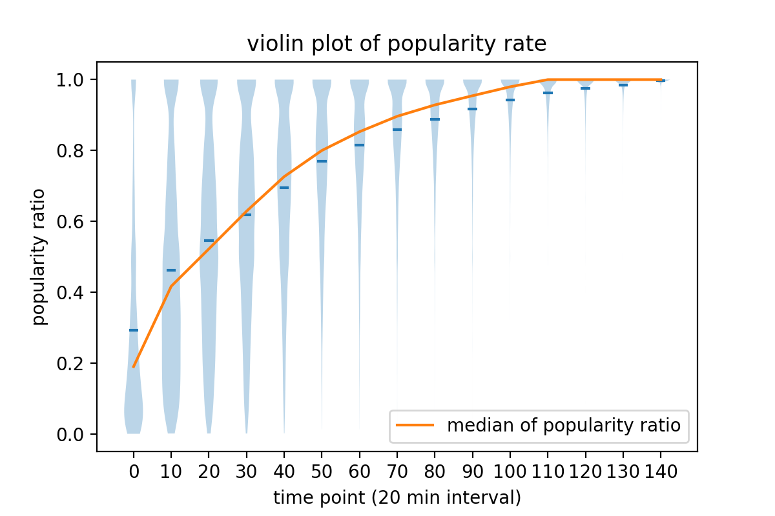
Popularity Trend
Reaches an average 30% of its total popularity in the first 20 minutes after publishment

Slide 9
Does the trend differ by Topics ?

Slide 10
Does the trend differ by Topics ?
Yes

Slide 11
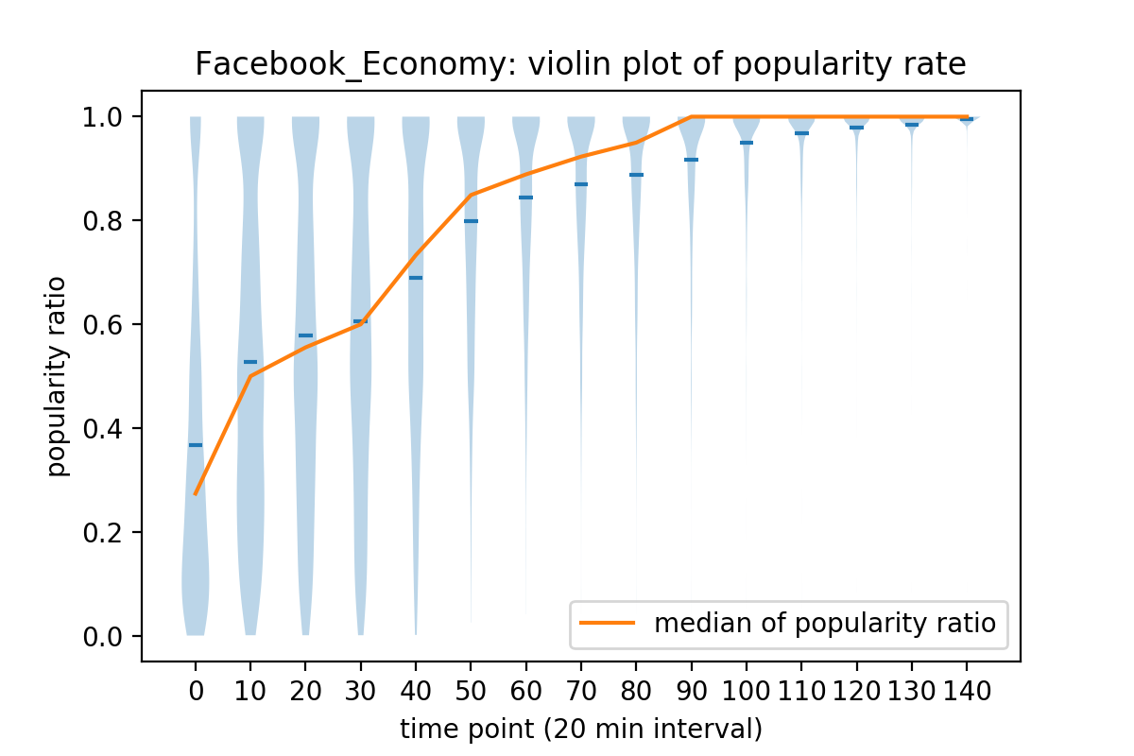
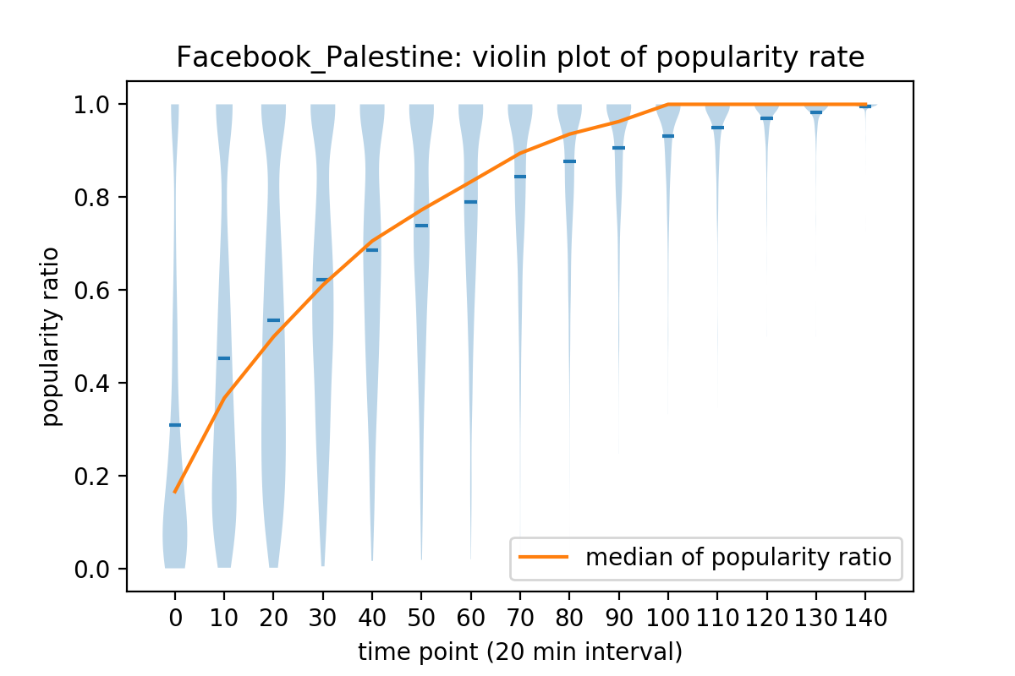
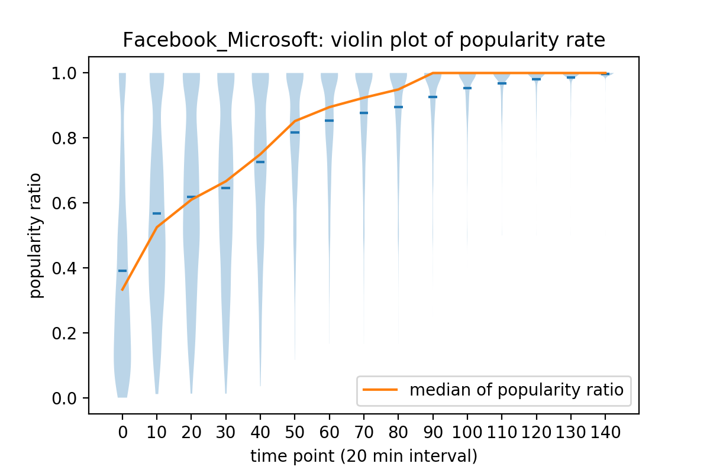
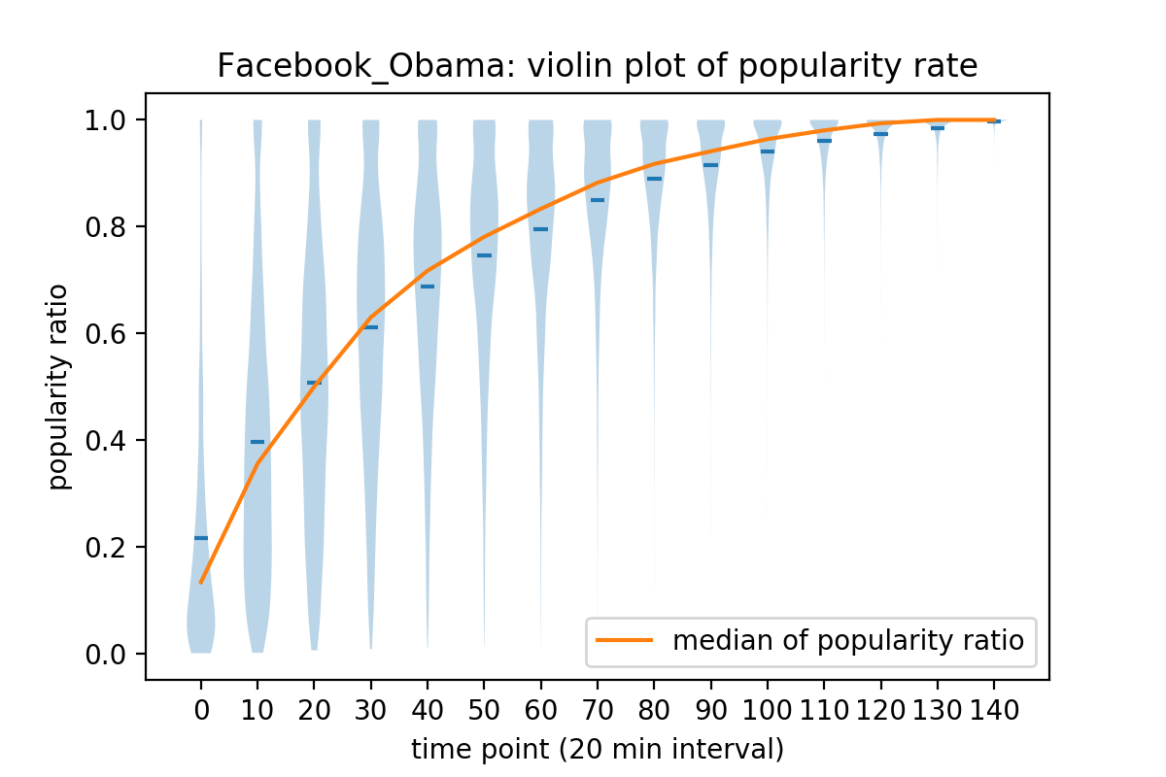
Smooth
Bimodal
Bimodal
Smooth

Slide 12
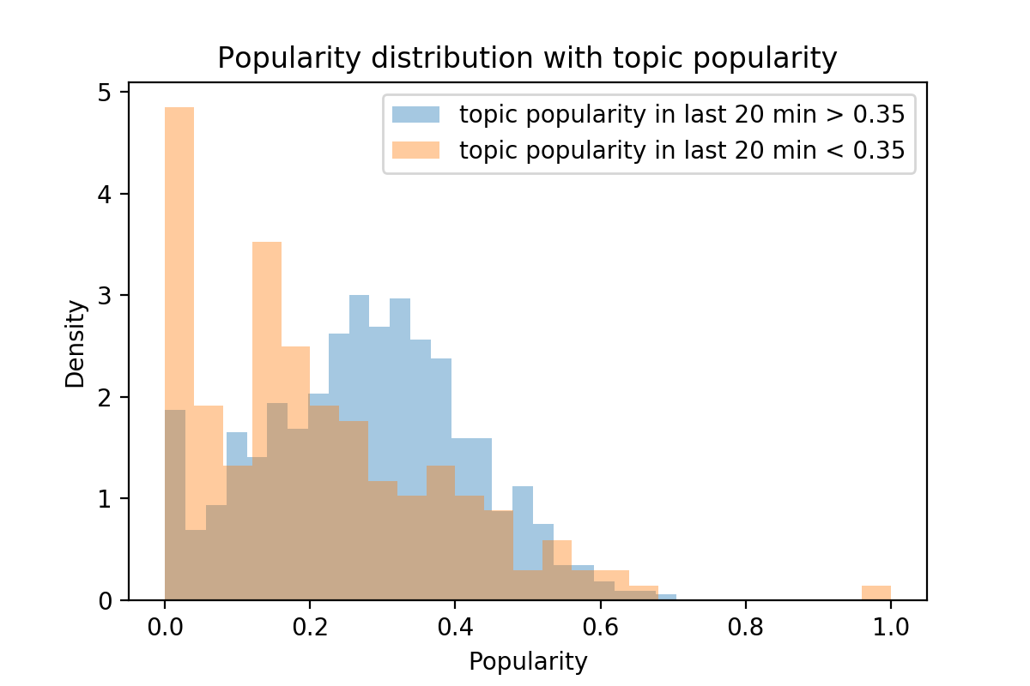
News Popularity V.S. Topic Popularity

Slide 13
News Popularity V.S. Topic Popularity
When topic is not popular, the news is likely to be unpopular.
Most Popular news appears
where topic is not popular

Slide 14
Guess Why
Guess 1
News popularity is positively related to Topic popularity
Guess 2
Imperfect recommendation system
The news has not yet been exposed to users when the topic is not hot enough

Slide 15
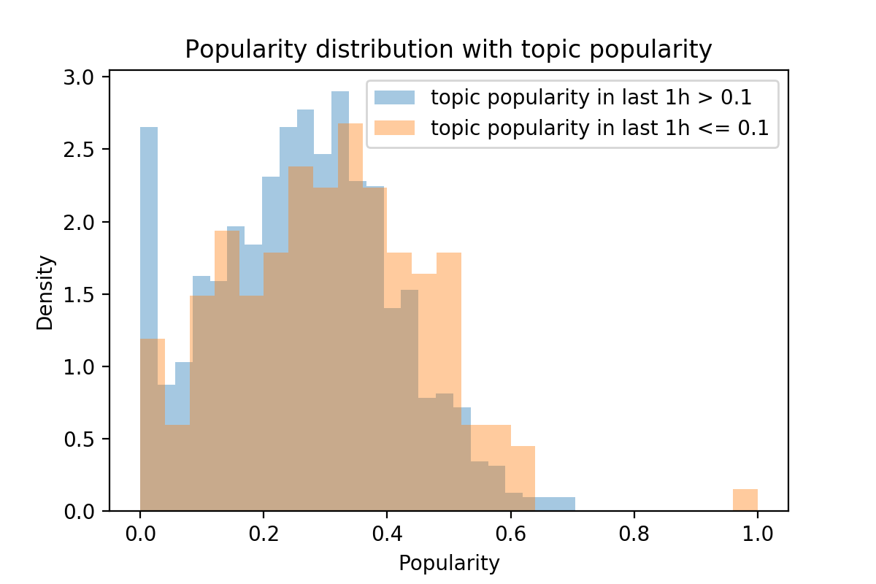
News Popularity V.S. Topic Popularity
Goes Down
Keeps High

Slide 16
Insights
Insight 1
News popularity is not positively related to Topic popularity
Insight 2
News need to be New!
A piece of news is more likely to stand out and gain popularity if the corresponding topic is not hot yet!

Slide 17
Reference
Multi Source Social Feedback of Online News Feeds
Author: Nuno Moniz, Luis Torgo
Date: Jan 2018
The Utility Problem of Web Content Popularity Prediction
Author: Nuno Moniz, Luis Torgo
Date: May 2018

Slide 18
Questions

