Slide 1
Task02
28.09.2015, Schmocker, Noser, Tschanz, Zysset, Iseli, Schmied

Slide 2
SE Process
Plangetrieben |  | Agil
Vorteile | Nachteile | Vorteile | Nachteile
Klare Struktur von Anfang an Ende | Schwierig alle Probleme vorherzusehen | Einfacher auf sich ändernde Anforderungen einzugehen | Basteleffekt
Projekt hat einen klaren Endpunkt | Flexibilität für Anpassungen ist nicht vorhanden | Permanenter Kundenkontakt – Feedback Möglichkeit | Kein klares Ende in Sicht
Begrenztes Budget | Schwierig wenn es keine Routine Software ist. | Möglichkeit frühzeitig auf Probleme einzugehen | Im Detail verfangen
 | Kunde muss wissen was er will | Kleines Team = bessere Kommunikation möglich
Notes:
Health Visitor = Gesundheitsbeauftragte (Staat, Bund, etc.)
Health Service Manager = Verantwortlicher Finanzen, tägl. Abläufe Spital*

Slide 3
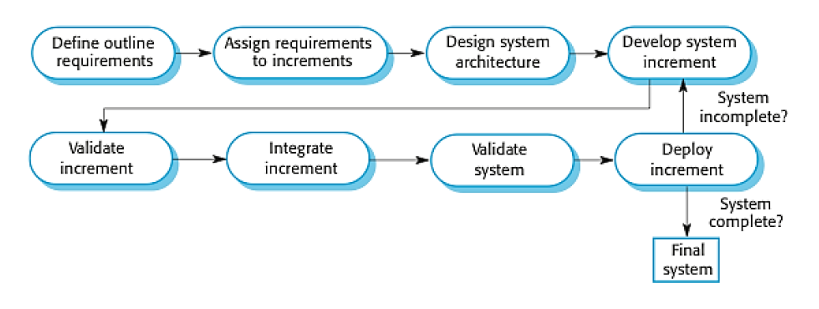
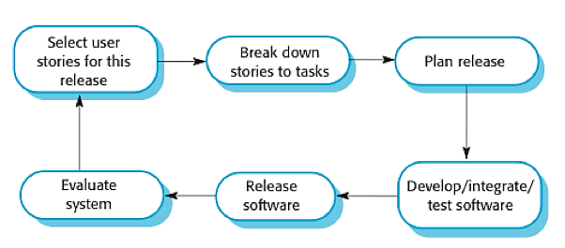
SE Process
Based on our evaluation we decided to make a combination of plandriven and agile
Incremental Delivery and Extreme Programming

Slide 4
Process Model
Activity | Goal | Tasks | Potential Output
Specification | Description of the product in general and we choose the most important use cases to implement | Describe what is the vision of the project and which are the most important use cases for the beginning | A part of the specification
Developement (with minimal testing) | Implement the defined use cases | Implement the defined use cases | First version of the product
Feedback/Validation | Check the implementation | Talk with the customer | Feedack
Test | First implementation is working without errors | Make testcases and test the product | First (next) version of the product which is working ( Fixed errors)
Final version | A good product which is working without errors | Go on production | Release: Final product

Slide 5
Relation among outputs of different activities
A part of the specification
We need the specification to produce the first version
First version of the product
We need to present the first version to get a feedback
Feedback
Release: First (next) version of the product which is working ( Fixed errors)
We need the feedback to fix the errors and to add missing demands or delete not needed demands
……
We need to repeat the whole process until we get our final working version
Final Product

Slide 6
Involvement of stakeholders
The customer gets involved with the development team to give the required information
Users and management are a part of the customer ( they interact with each other)
The development team is responsible to arrange new meetings
users
management
customer
development team

Slide 7
Thank‘s for listening!

