Slide 1
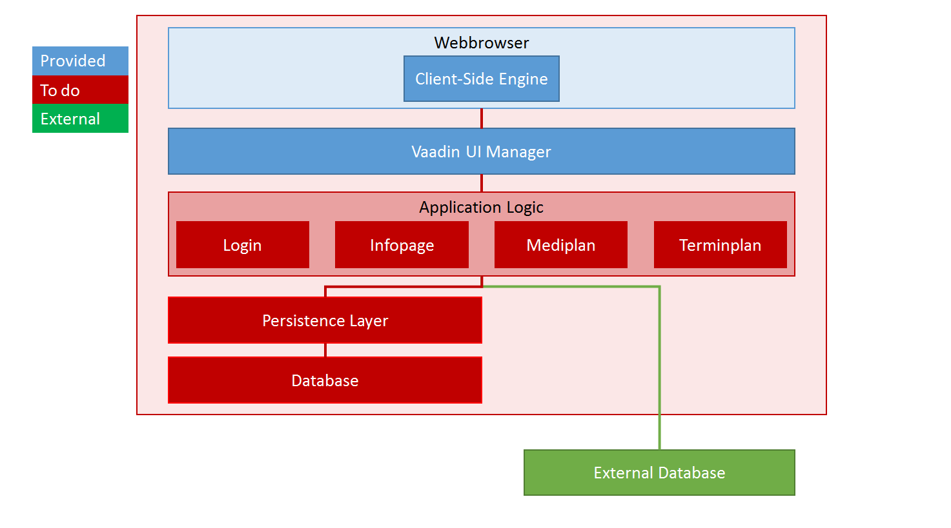

Slide 2
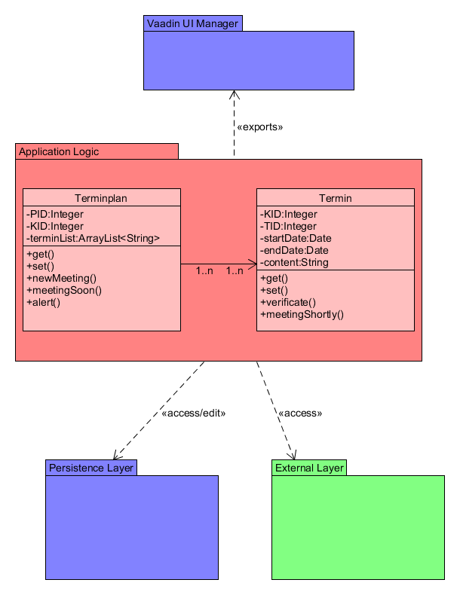

Slide 3
Scrum Version 1
Name | GitHub Alias
Mauro Tschanz | tschm2
Maurice Zysset | zyssm4
Kaspar Schmocker | schmk3
Rea Iseli | iselr1
Philippe Noser | nosep2
ID | Story Name | Description | Priority | Effort Plan Original | Effort Plan Updated | Effort Actual | Status
1 | Create Infopage | The User enters all relevant Data about himself and his disease | high | 20 |  | 0h | waiting
2 | new Appointment | The User makes a new Appointment with the doctor | high | 70 |  | 0h | waiting
3 | Enter a new drug | The user can enter the name and dosage he has to take, afterwards he has a overview of all drugs he has to take a day | medium | 50 |  | 0h | waiting
 |  |  | Total | 120

Slide 4
Scrum Version 1
ID | Sprint | Name | Description | Components | Owner | Reviewer | Priority | Effort Plan Original | Effort Plan Updated | Effort Actual | Status
1.1 | 1 | Package Structure | Create Packages and structures |  | nosep2 | zyssm4 | high | 1 |  |  | waiting
1.2 | 1 | Infopage GUI | Create the GUI | UI | zyssm4 | tschm2 | high | 6 |  |  | waiting
1.3 | 1 | Infopage Interface | Create the Interfaces of the Classes | interface | tschm2 | schmk3 | high | 3 |  |  | waiting
1.4 | 1 | Infopage Logic | Create the logic of the infopage | controller | schmk3 | iselr1 | high | 6 |  |  | waiting
1.5 | 1 | Test Infopage | Create a test case & Testing | Test | iselr1 | zyssm4 | medium | 4 |  |  | waiting
1.6 | 1 | login gui | create the gui | UI | nosep2 | tschm2/iselr1 | low | 4 |  |  | waiting
1.7 | 1 | login | implementation with data from txt-File & Testing | Login | tschm2/iselr1 | nosep2 | low | 6 |  |  | waiting
 |  |  |  |  |  |  | total | 30

