Slide 1

Large Language Models are Few-Shot Clinical Information Extractors
Samuel Räber, Luca Sichi
07. 05. 2024

Slide 2
Background
Clinical information extraction
Ambiguous jargon
Non standard phrase structure
Restrictively licensed data sets
Thus most off-the-shelf NLP tools perform poorly.
Task specific domain knowledge is used to overcome these issues.
This paper:
Introduces 3 new annotated datasets
Shows GPT-3 performs well in clinical NLP
Introduces guided prompt design and resolvers

Slide 3
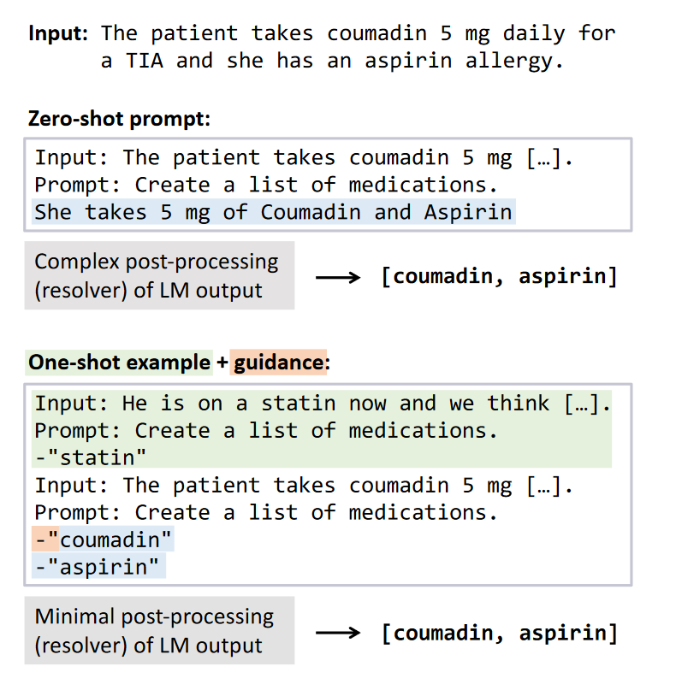
Methods
Query acces to a LLM
Hand crafted prompt templates using 5 validation examples per task
A resolver is used to map from LLM output space to a label space
LOC means the lines of code in the resolver and is used for some results

Slide 4
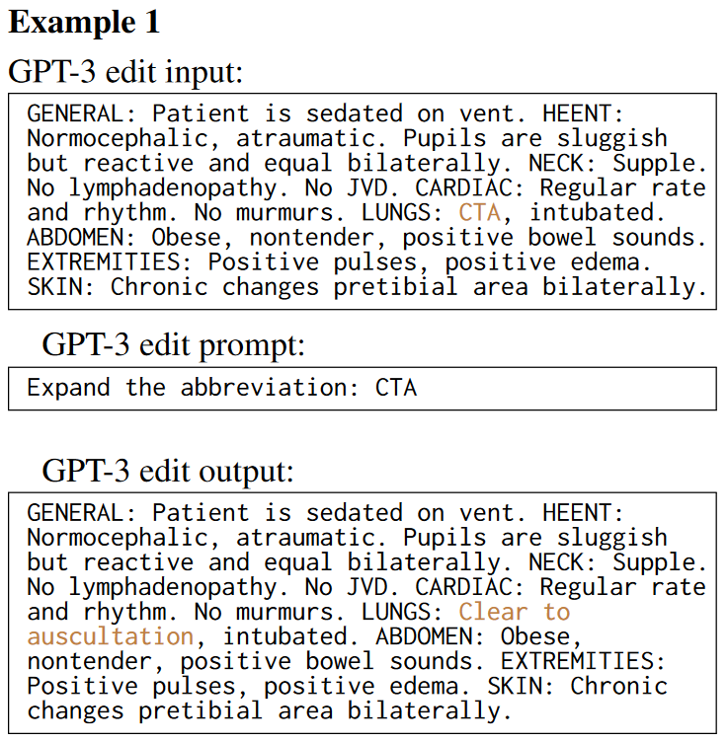
Clinical Sense Disambiguation
Expand abbreviations to corresponding word
Eg. patient,physical therapy, prothrombin time, or posterior tibial
CASI Dataset: 500 text examples for 75 acronyms
Filtered to 18164 examples and 41 acronyms
MIMIC Dataset: generated from unlabeled text by replacing expansions with acronyms
8912 examples over same 41 acronyms
Prompting and Resolver:
Resolver needed (right atria -> right atrium)
Model Distilation
Data privacy and model size
LLM and Resolver as labeler instead of classifier
Finetuned PubMedBERT
Notes:
-CASI = Clinical Acronym Sense Inventory
-MIMIC a de-identified publicly available database of chest radiographs with free-text reports
-In the resolver, we choose the answer choice with the highest contiguous character overlap with the LLM generated output
-Destilation: use outputs of casi system as weak supervision to train finetuned model

Slide 5
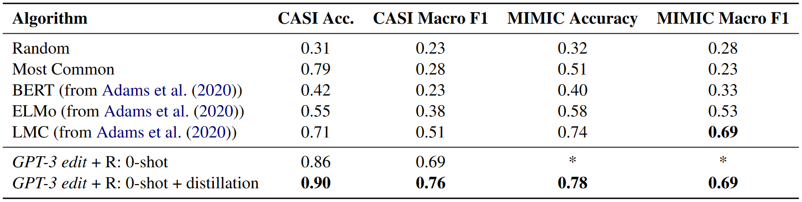
Clinical Sense Disambiguation Results
Compare to:
Other zero shot methods
Random guessing
Most probable expansion
Metrics Used: Accuracy and macro F1 score

Slide 6
Biomedical Evidence Extraction
Aid the adoption of Evidence Based Medicine with automated approaches for parsing clinical abstracts
Identify the distinct arms of a clinical trial (intervention/control)
Evaluated on 187 test abstracts and 20 manually annotated test abstracts
Single prompt with InstructGPT

Slide 7
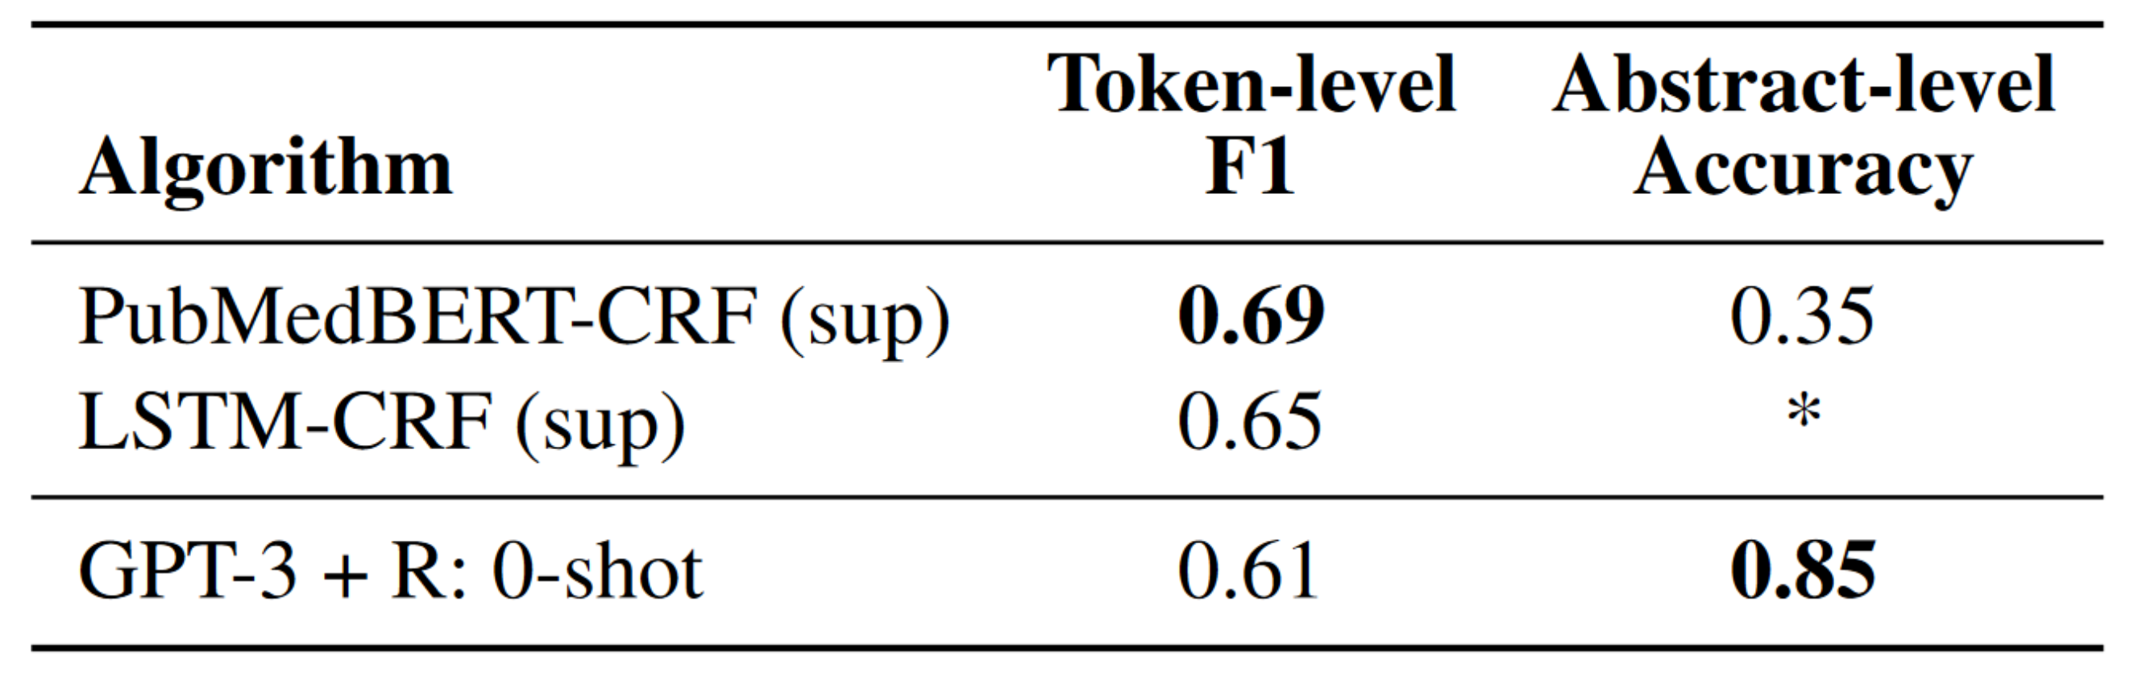
Biomedical Evidence Extraction Results
Biomedical Evidence Extraction compared to two supervised baselines which were trained on 4800 abstracts

Slide 8
Coreference Resolution
grouping noun phrases that refer to the same underlying entity
Dataset includes 105 manually annotated coreference pairs
5 used for prompt design and 100 to evaluate
Experiments done with 0-shot prompts and 1-shot prompts
For 1-shot prompts 2 different experiments were made with correct/incorrect answers

Slide 9
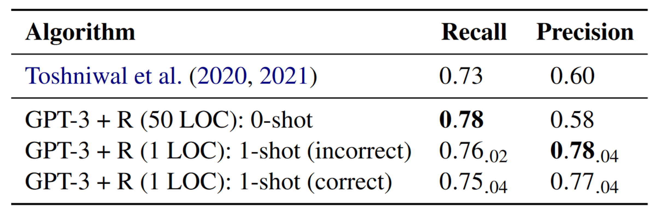
Coreference Resolution Results

Slide 10
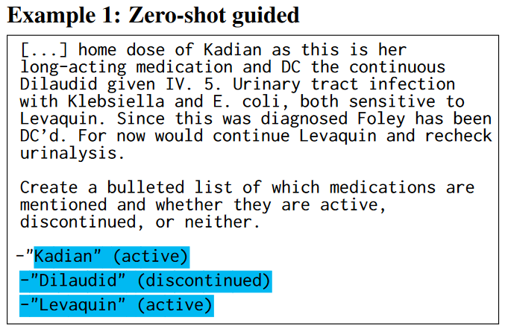
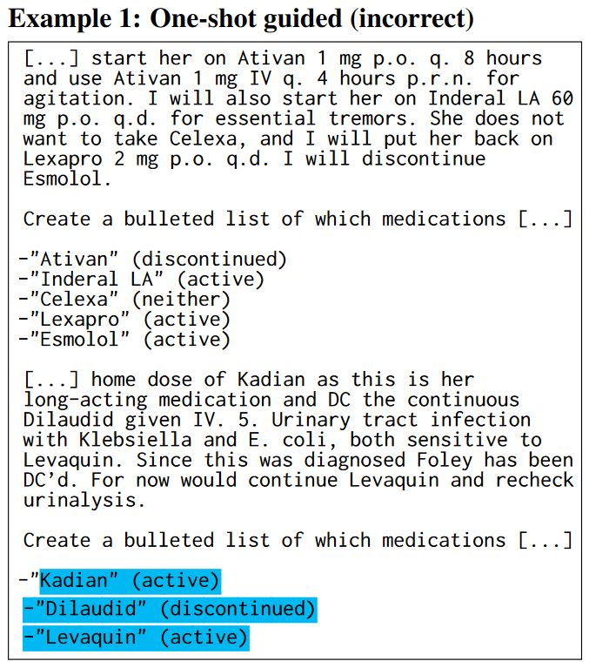
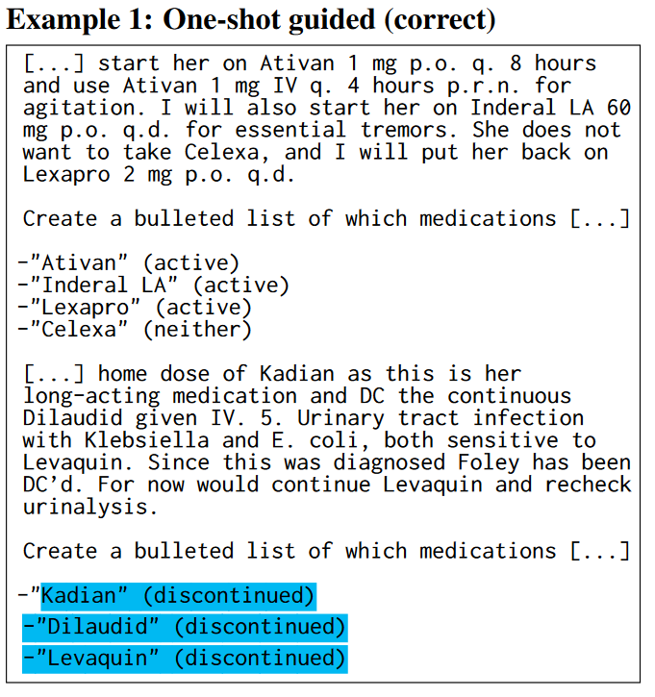
Medication Status Extraction
Extract List of medication and status labels
Dataset: modified CASI
Prompting and Resolver: InstructGPT
Notes:
-Labels: active, discontinued, neither
-105 randomly selected snippets manually annotated
-Augment status labels so all are present, or correct

Slide 11
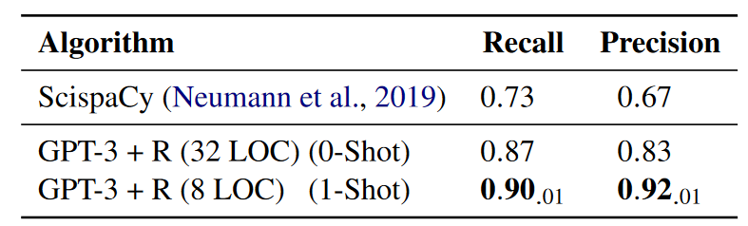
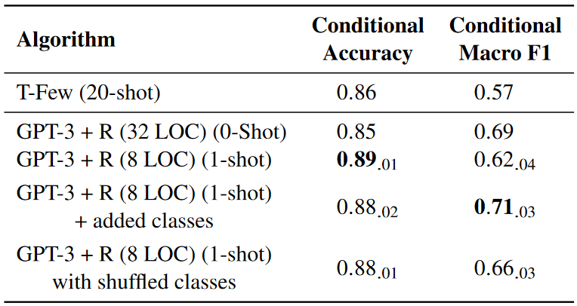
Medication Status Extraction Results
Comparison
Medication extraction: Rule based (ScispaCy)
Status label: T-few (Few shot LLM)
Notes:
-Status labels focused on the examples where gpt found the same medications
-We find that if the rarer Neither class wasn’t demonstrated in the 1-shot example, it was unlikely to be output, depressing the F1 score; including all classes in the 1-shot prompt appears more important than necessarily having the correct labels.

Slide 12
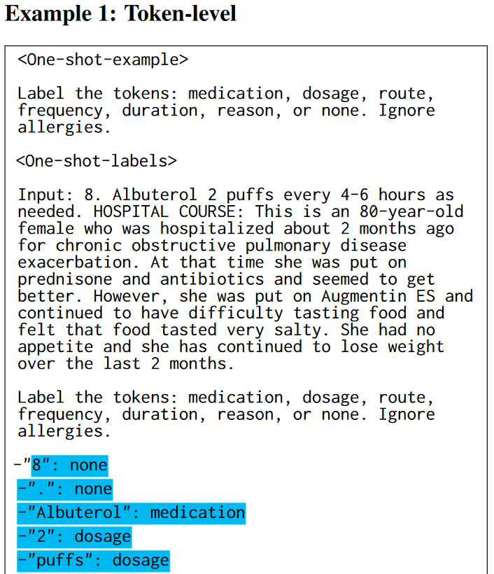
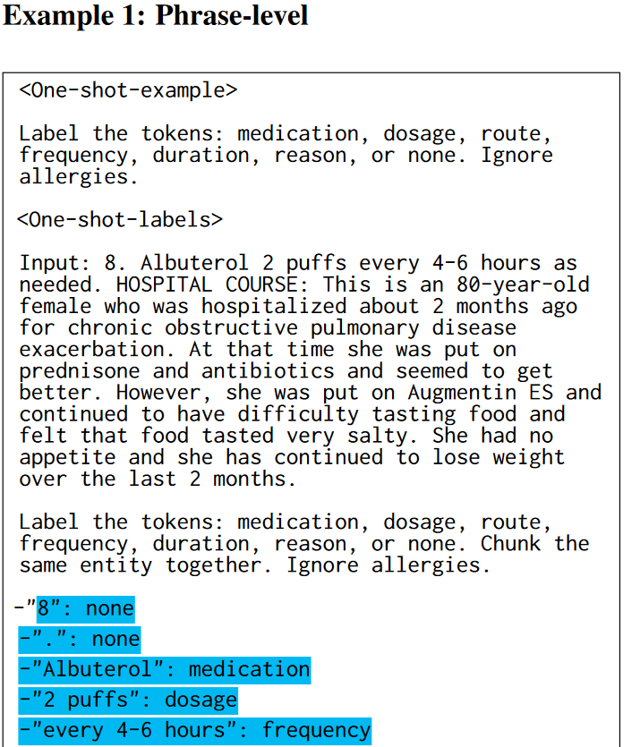
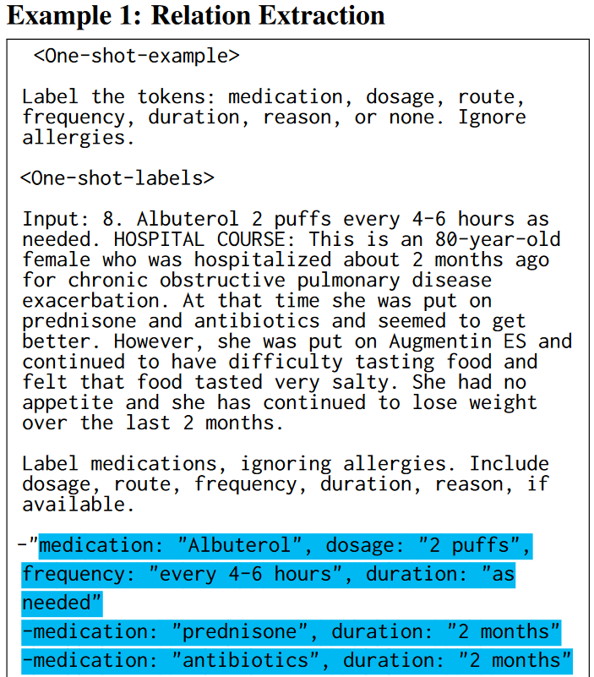
Medication Attribute Extraction
Extract list of medication and corresponding metrics (dosage, routes, frequency, reason, duration)
Dataset labeled by annotators (105 samples)
Different framing for task: Token-level, Phrase-level and end-to-end relation
Prompting and Resolver: InstructGPT, different for each framing

Slide 13
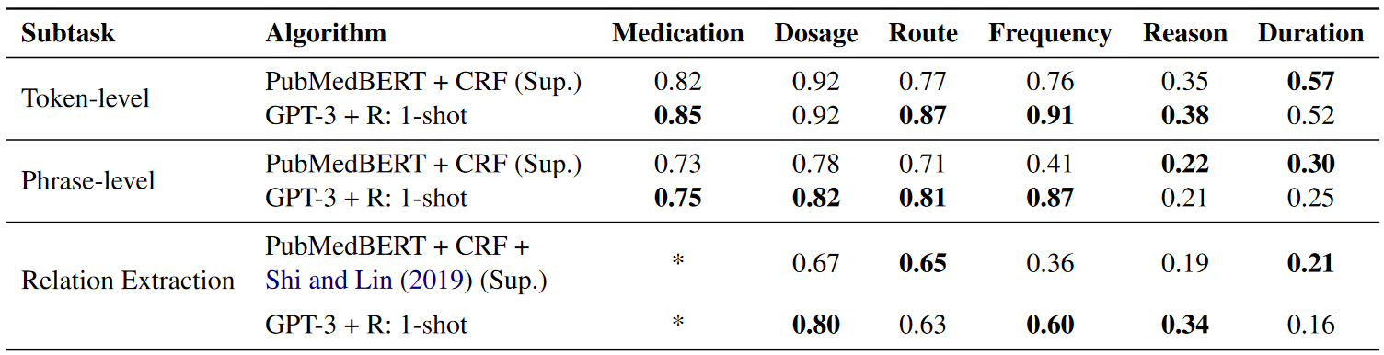
Medication Attribute Extraction Results
Comparison:
Token and Phrase: PubMedBERT topped with CRF layer
End to end: token level baseline, specific metric
Notes:
-CRF layer: conditional random field layer
-Specific metric: simple BERT-based models for relation extraction and semantic role labeling

