Slide 1
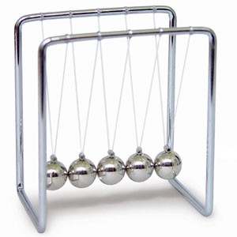

Newton’s cradle
by Aldearaban group
Cadenas Quijano, Patricia
Cotrina Fernández, Manuel
García Tomillo, Javier
Hijarrubia Bernal, Luis

Slide 2
Introduction
Newton’s Cradle
Law of conservation of energy
Law of momentum
OpenGL over Java (JOGL)
Different modes
Movement
Appearance
Number of balls
Camera movement and ball dragging

Slide 3
Architecture
JavaForm with a GLJPANEL
Object oriented
1 Class for each issue
All the conditional sentences in mode change
Display Method as simple as possible

Slide 4
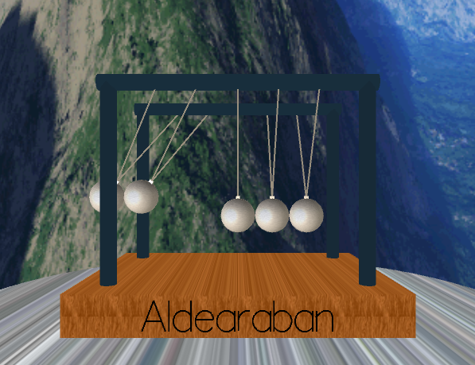
Movement
Simulated by angle calculations
Two movement modes
Linear
Cuadratic
Friction
Speed

Slide 5
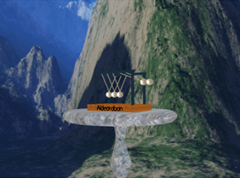
User interaction
Camera movement by keys
Characteristics by menu
Ball dragging with mouse
Change number of balls
Help window provided

Slide 6
The world
Skybox
Huge cube with textures
Choosable by user in menu
Limits the scene
OBJ
External file (.OBJ)
Cradle and table

Slide 7
Materials and Textures
Every object has a material
Only ball material can be changed
Textures
Cradle and table
Skybox
Balls (some modes)

Slide 8
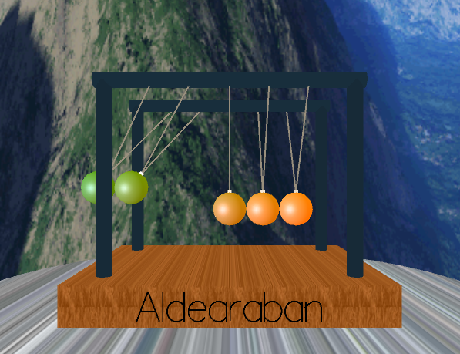
Features
Transparency
Material light emission
Moving sun
Shaders
Vibration
Colorize

Slide 9
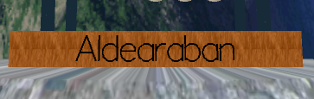
Other features
Sound
Different for each mode
Text
Rendered with GLUT

Slide 10
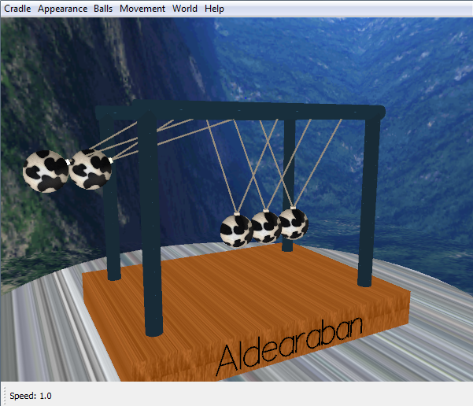
Demo!

Slide 11
Conclusions
Acquired the knowledge required
Takes advantage of the different capabilities usually used in an interactive multimedia system
Exploiting JOGL capabilities almost to the limit

Slide 12
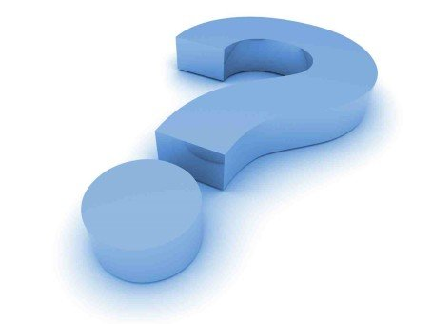
Questions?

