Slide 1
Decision tree & random forest in Real Forest (Kaggle.com)
Zhixian(Jason) Yu
COMP790-134

Slide 2
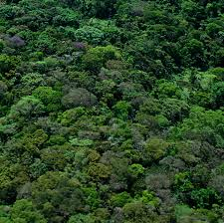
Problem
Forest cover type prediction

Slide 3
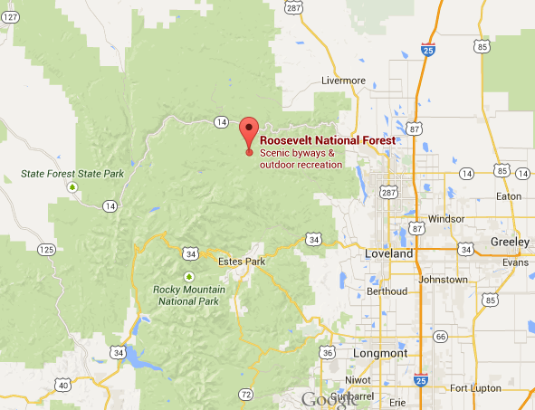
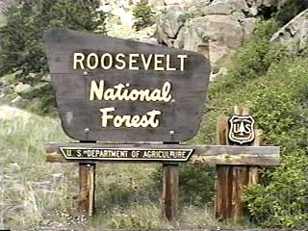
Forest data

Slide 4
Forest types – response
1 - Spruce/Fir 2 - Lodgepole Pine 3 - Ponderosa Pine 4 - Cottonwood/Willow 5 - Aspen 6 - Douglas-fir 7 - Krummholz

Slide 5
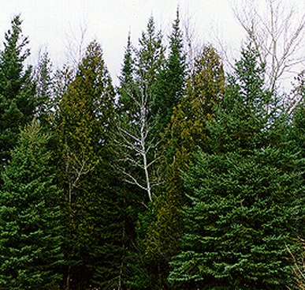
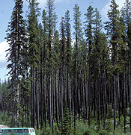
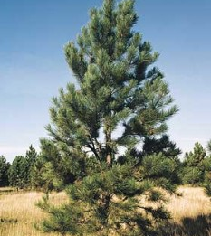
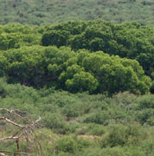
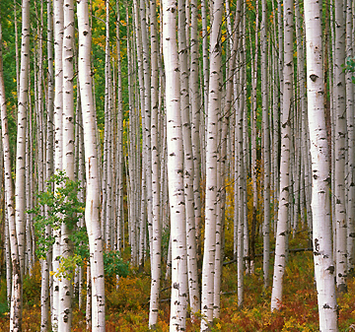
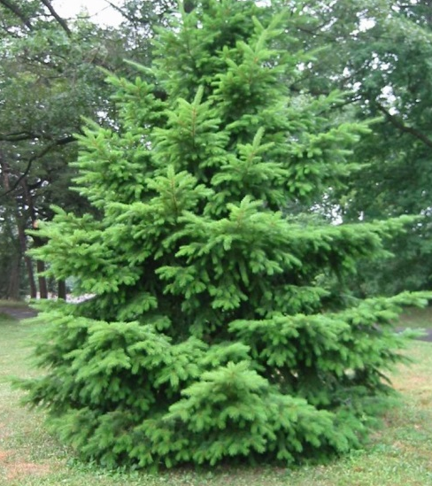
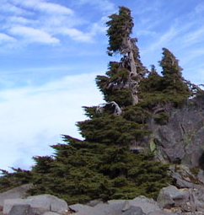
1
2
3
4
5
6
7

Slide 6
Data
15,120 data items
54 features

Slide 7
Features
54 features
9 groups:
Elevation
Aspect (0-North; 90-East, 180-South, 270-West)
Slope
Distance_To_Hydrology: Horizontal/Vertical
Horizontal_Distance_To_Roadways
Hillshade: 9am 12pm 3pm
Horizontal_Distance_To_Fire_Points
Wildness_area: 4 wild areas (binary)
Soil_type: 40 soil types (binary)

Slide 8
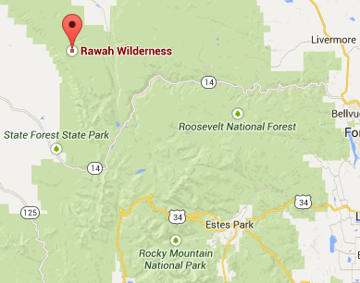
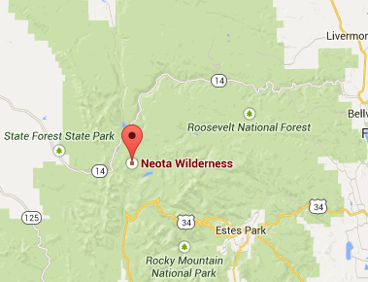
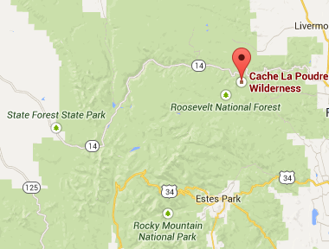
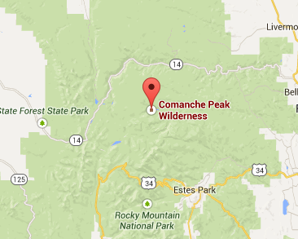
Wildness_area: binary 0/1

Slide 9
Sample data #1 – cover type 5 (Aspen)
Id | Elevation | Aspect | Slope | Horizontal_Distance_To_Hydrology | Vertical_Distance_To_Hydrology | Horizontal_Distance_To_Roadways | Hillshade_9am | Hillshade_Noon | Hillshade_3pm | Horizontal_Distance_To_Fire_Points
1 | 2596 | 51 | 3 | 258 | 0 | 510 | 221 | 232 | 148 | 6279
Wilderness_Area1 | Wilderness_Area2 | Wilderness_Area3 | Wilderness_Area4
1 | 0 | 0 | 0
Soil_Type27 | Soil_Type28 | Soil_Type29 | Soil_Type30 | Soil_Type31
0 | 0 | 1 | 0 | 0

Slide 10
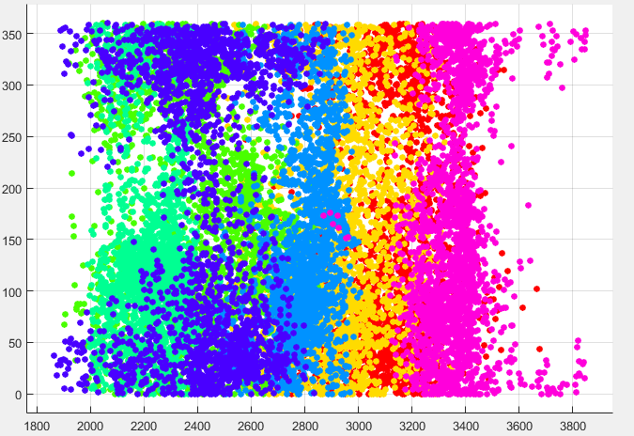
Aspect
Elevation

Slide 11
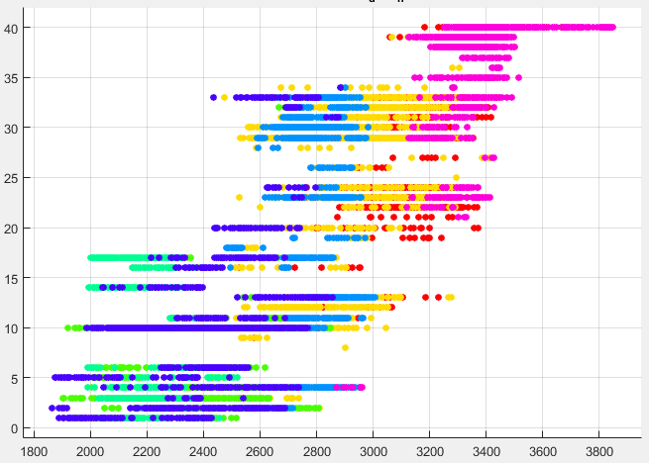
Soil Type
Elevation

Slide 12

Decision Tree

Slide 13
Decision tree: fitctree()
Cross-validation error = 0.2110

Slide 14
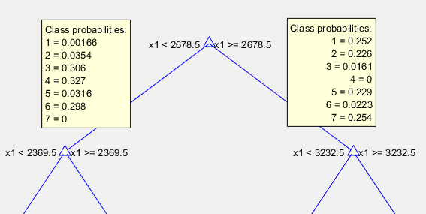
Elevation is the best classifier

Slide 15
Feature Importance
Elevation
Horizontal_Distance_To_Roadways
Horizontal_Distance_To_Fire_Points
Soil Type
Aspect

Slide 16
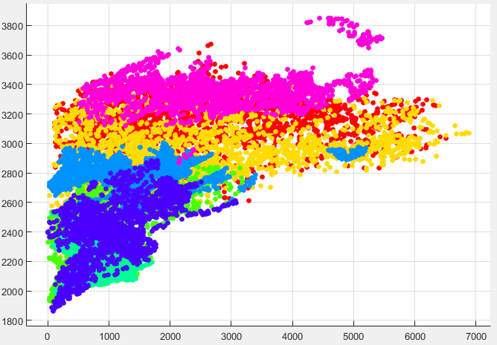
Elevation
Horizontal_Distance_To_Fire_Points

Slide 17
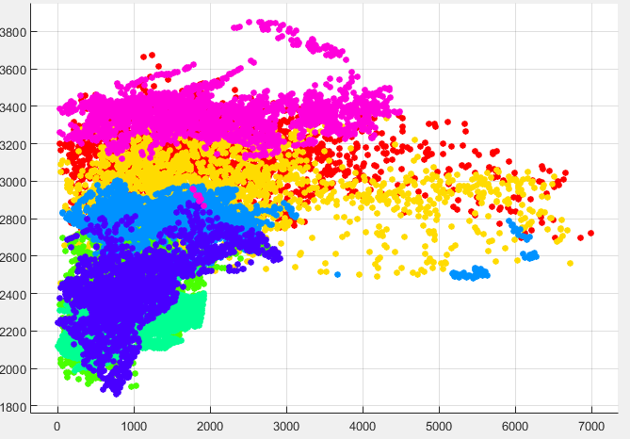
Elevation
Horizontal_Distance_To_Roadways

Slide 18
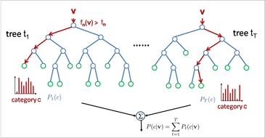
Random Forest

Slide 19
Random Forest vs. Decision Tree

Slide 20
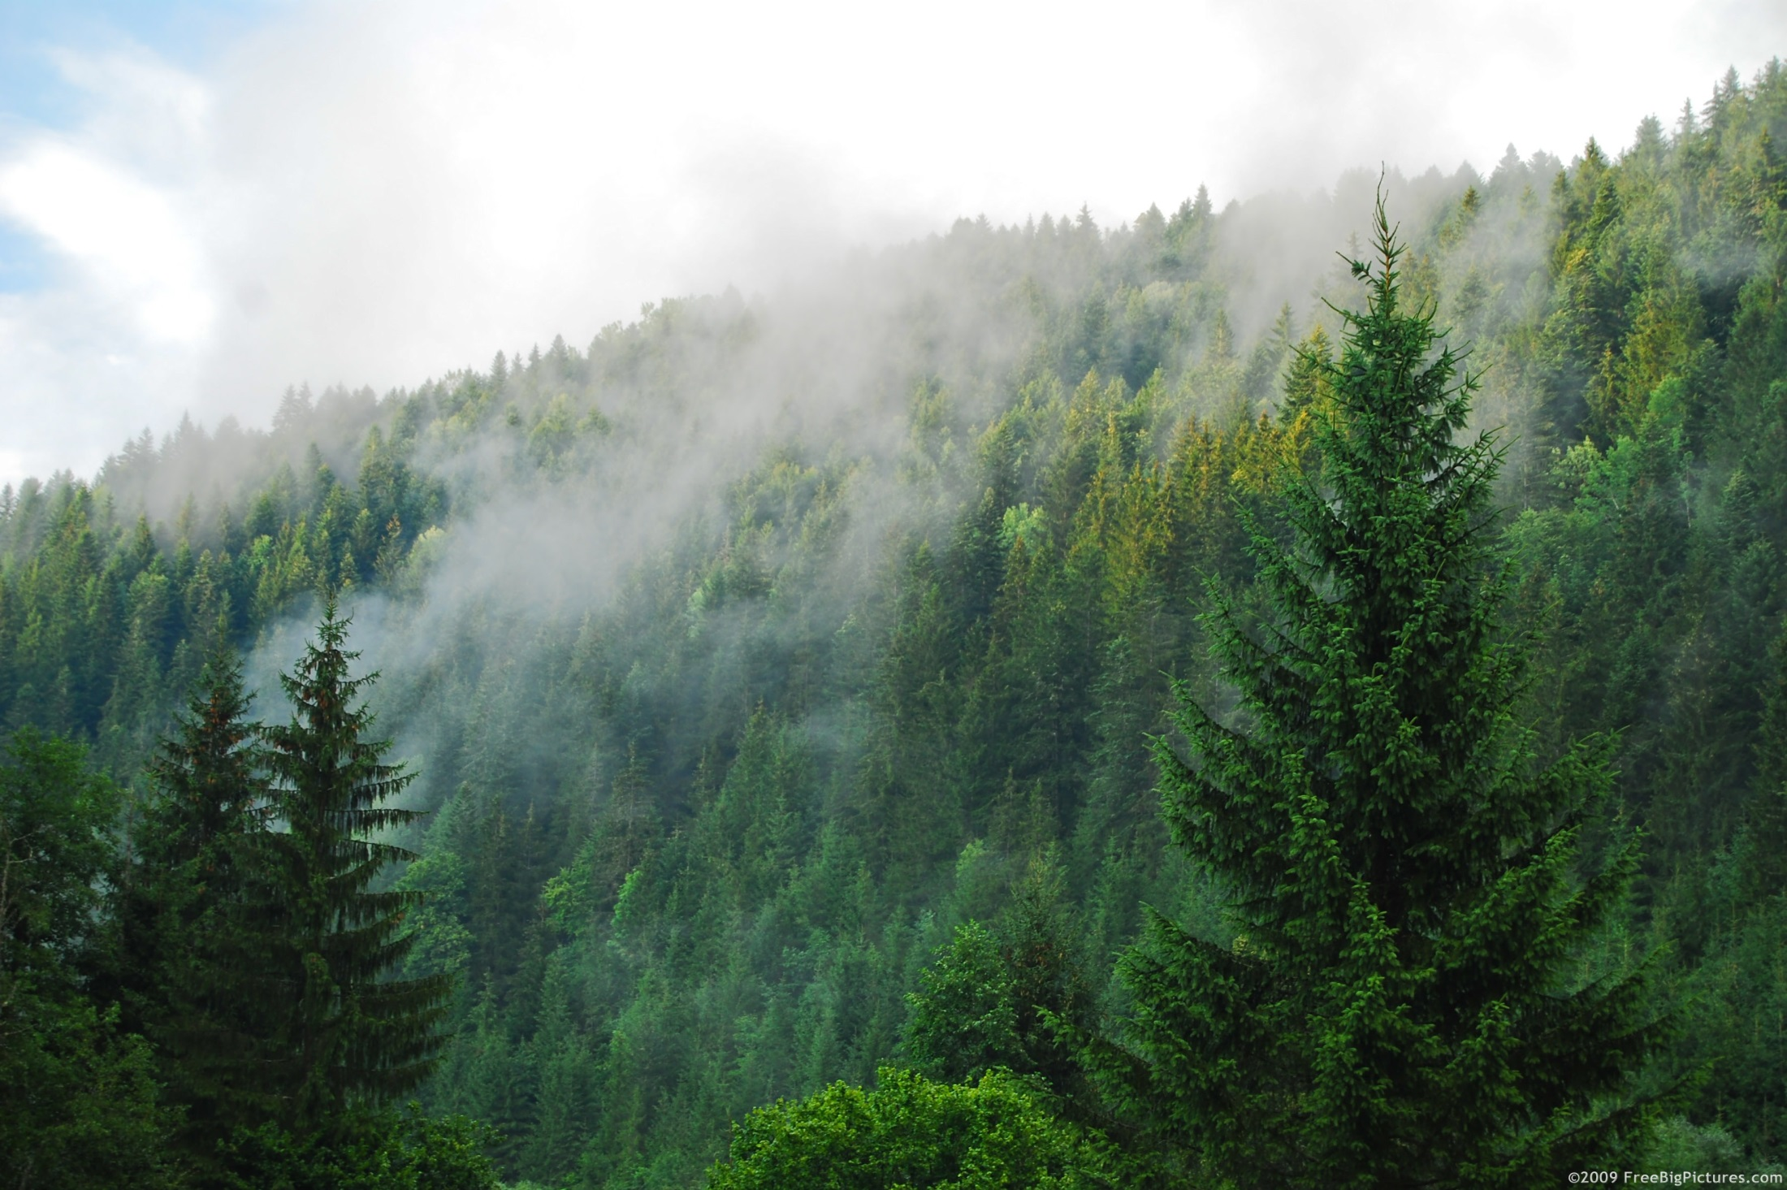
Thank you

