Slide 1

Presenter
Security Attacks on Kubernetes Pods
Presenter: Yue Zhang
Date: 1/28/2025

Slide 2
Agenda
01
Introduction to Kubernetes
02
Motivation
03
04
Current Findings
Research Questions

Slide 3
PART 01
Introduction to Kubernetes

Slide 4
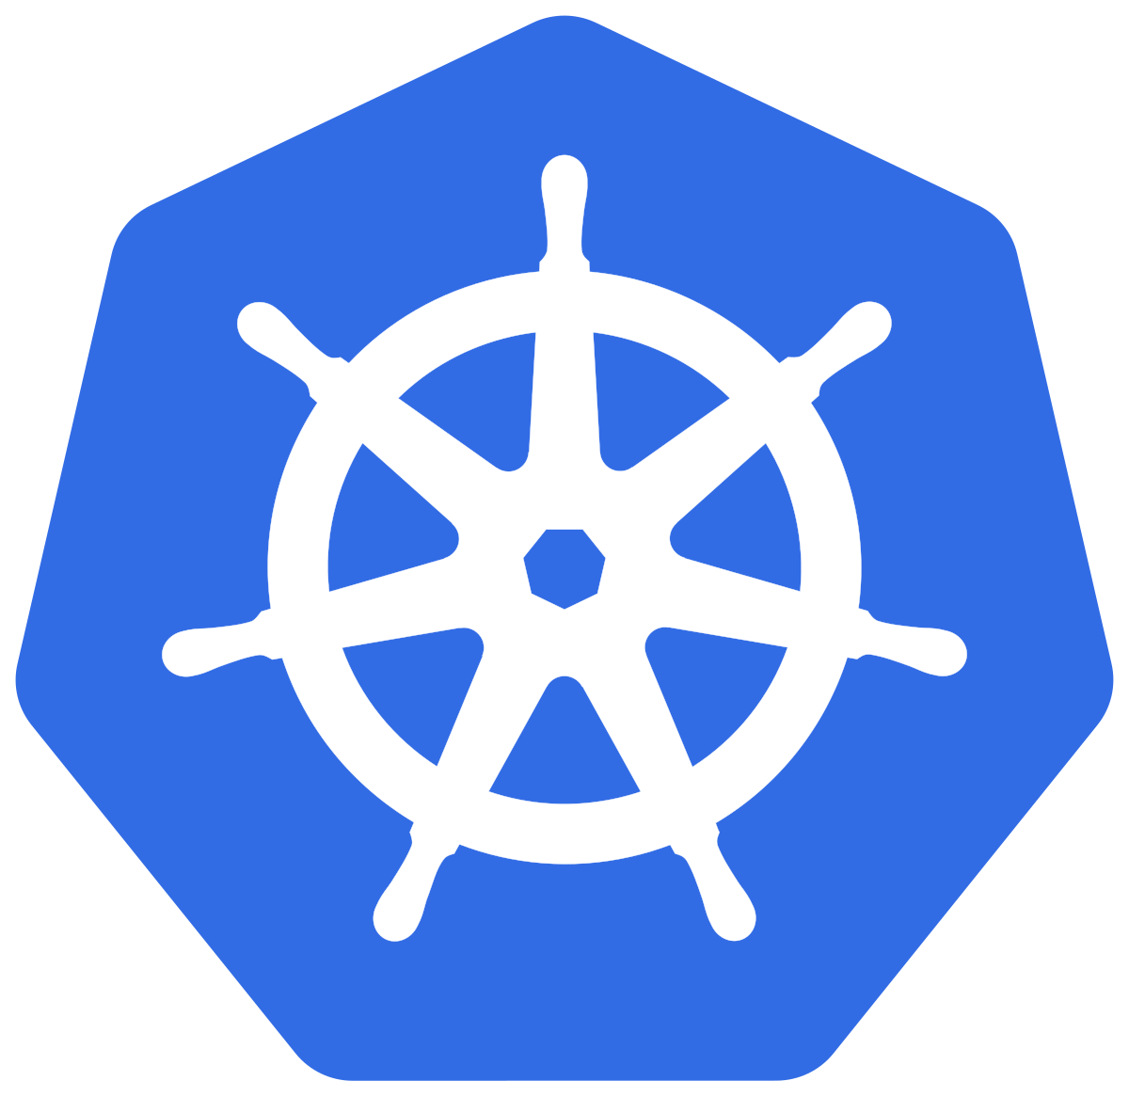

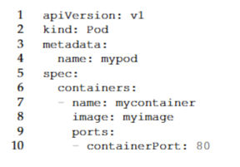


Introduction to Kubernetes
Control Plane
Kubernetes Node 1
Controller
API Server
Pod 1
Pod 2
Pod 3
Scheduler
etcd
Developer
YAML Scripts
Notes:
Kubernetes is an open-source container orchestration platform designed to manage the deployment, scaling, and operation of containerized applications across clusters of servers. It simplifies handling distributed systems by automating tasks like load balancing, resource allocation, and self-healing.
Configurations for pods and other K8s entities are specified using configuration scripts that are typically written in the YAML format.
Pods: The smallest and most fundamental deployment unit, consisting of one or more containers.
API server: stores configurations in a database called `etcd'. With the provided configurations, the API server decides which pods can host the given containers.
A controller and scheduler: are automated agents that control the state of the K8s to identify a suitable node for a pod.

Slide 5
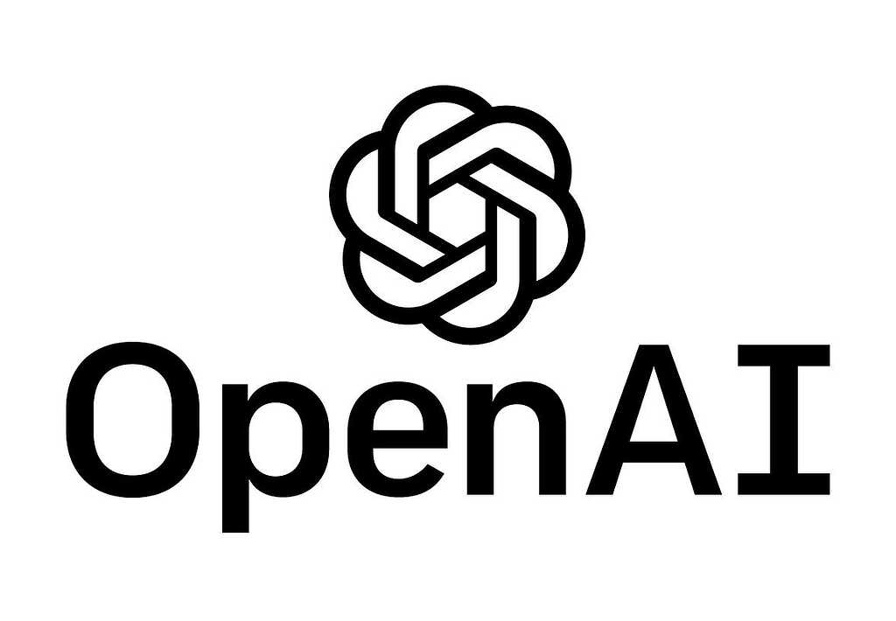

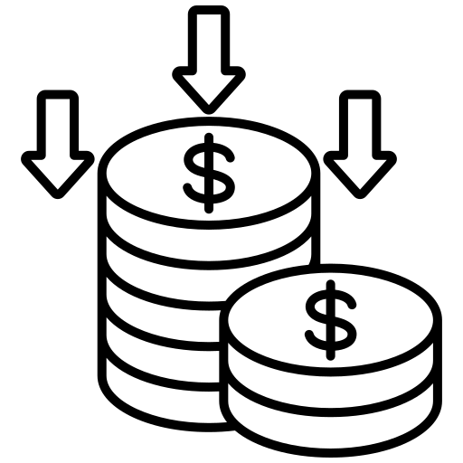
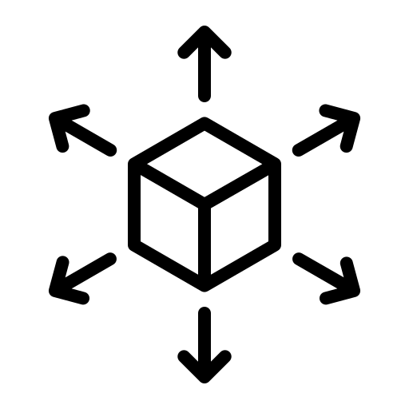
Introduction to Kubernetes
A couple of Months
More than 2,500 servers
Two to Three Days
Rapid Deployment
Cost Efficiency
Scalability & Resilience
Notes:
Rapid Deployment: Organizations like Capital One and OpenAI have seen significant improvements in deployment efficiency, with OpenAI reported that \kubs\ enabled a reduction of deployment time from ``a couple of months'' to ``two or three days'.
Cost Efficiency: Enables organizations to manage thousands of servers cost-effectively, OpenAI uses Kubernetes to manage containers that run on more than 2,500 servers.
Scalability and Resilience: Built-in features like autoscaling and failover ensure high availability and optimal performance.

Slide 6
PART 02
Motivation

Slide 7
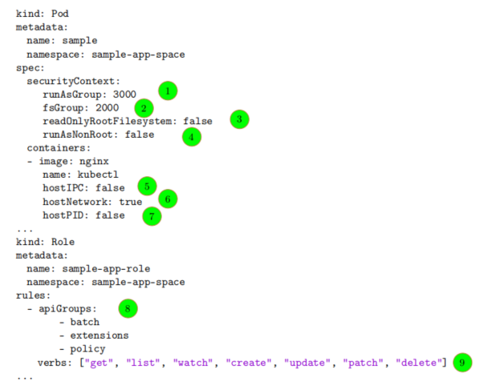
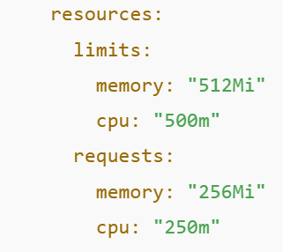
Motivation
10
Resource Limits
11
Permissions
Networking Policies
YAML scripts define pod’s behavior.
Access Controls
Notes:
Misconfigured YAML scripts have facilitated security attacks like cryptojacking, where attackers exploited Kubernetes clusters to mine cryptocurrency, costing companies thousands of dollars.
For example, the Telnet attack on Kubernetes led to significant financial losses.

Slide 8
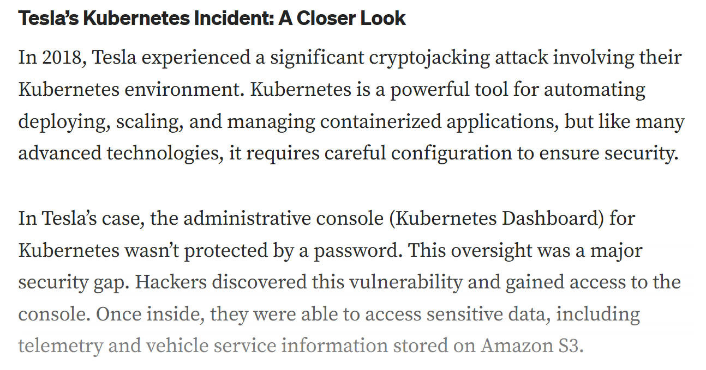
Motivation
Notes:
Tesla’s Kubernetes cluster was breached in 2018 due to an unsecured Kubernetes administrative console.
Attackers exploited this misconfiguration to deploy cryptomining software.
The breach led to significant financial losses and tarnished Tesla’s reputation for security.

Slide 9
Motivation
Challenges with Pod Security:
Complexity of Configurations: Kubernetes pods have numerous parameters, the combinatorial complexity makes manual inspection infeasible.
a Kubernetes pod includes parameters like runAsNonRoot: false and hostNetwork: true. These configurations, if combined with missing network policies and insecure access controls, can enable an attacker to escalate privileges and access sensitive data.
High Risk of Exploitation: Even a single vulnerable configuration can enable attackers to escalate privileges, access secrets, or disrupt services.

Slide 10
PART 03
Research Questions

Slide 11
Research Questions
How many exploit scenarios can be constructed by combining identified vulnerable configurations?
How many configurations parameters are involved in each exploit?
How frequently do identified configuration parameters used in real-world YAML scripts?
Notes:
The systematic identification of vulnerable parameter combinations can help practitioners secure Kubernetes deployments.
By understanding and mitigating these vulnerabilities, organizations can prevent costly security breaches, maintain user trust, and safeguard sensitive data.

Slide 12
PART 04
Current Findings

Slide 13
Current Findings
10 Security Attacks Identified:
Container escape to the host system.
Docker in docker exploitation.
Gain Env info with hardcoded secret.
Dos of CPU/Memory
RBAC least privileges
hostPID - Access to host processes
7. hostIPC - DoS for admin manage containers
8. hostNetwork - Sniff network traffic
9. privileged - Access to sensitive directories
10. Pod to pod attack

Slide 14
Thanks

Slide 15
Backup

Slide 16
Introduction to Kubernetes
Notes:
Despite the above-mentioned benefits, Kubernetes-based software deployment infrastructure can be susceptible to security attacks. For example, a Kubernetes-related configuration parameter facilitated a security attack called cryptojacking. Cryptojacking is the attack of using a computing resource to stealthily mine cryptocurrency without the user’s awareness [37]. As part of this attack, malicious users gained access to the containers managed with Kubernetes, and used those containers to mine cryptocurruencies

