Slide 1

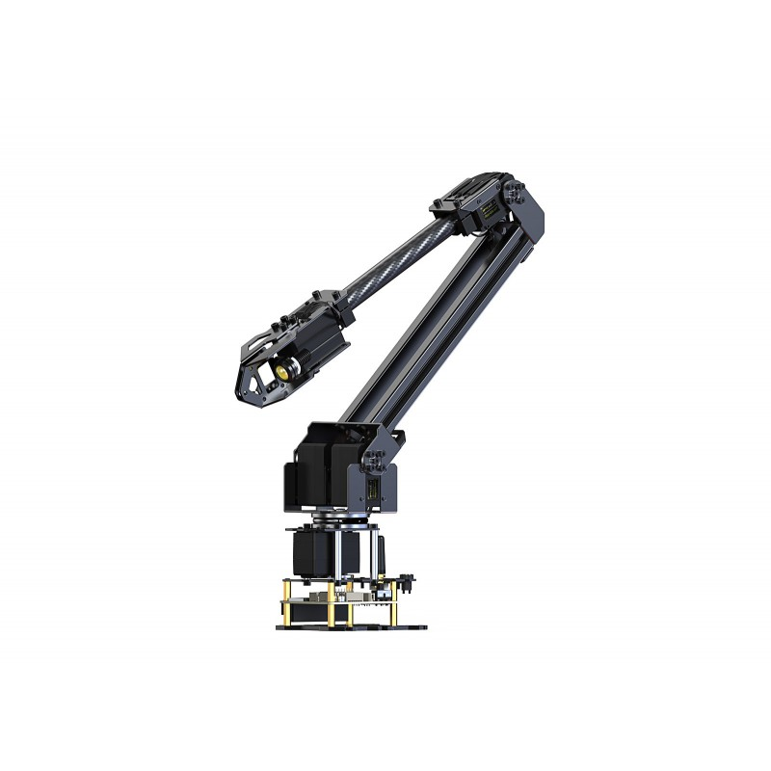
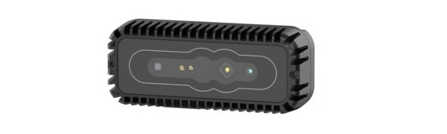
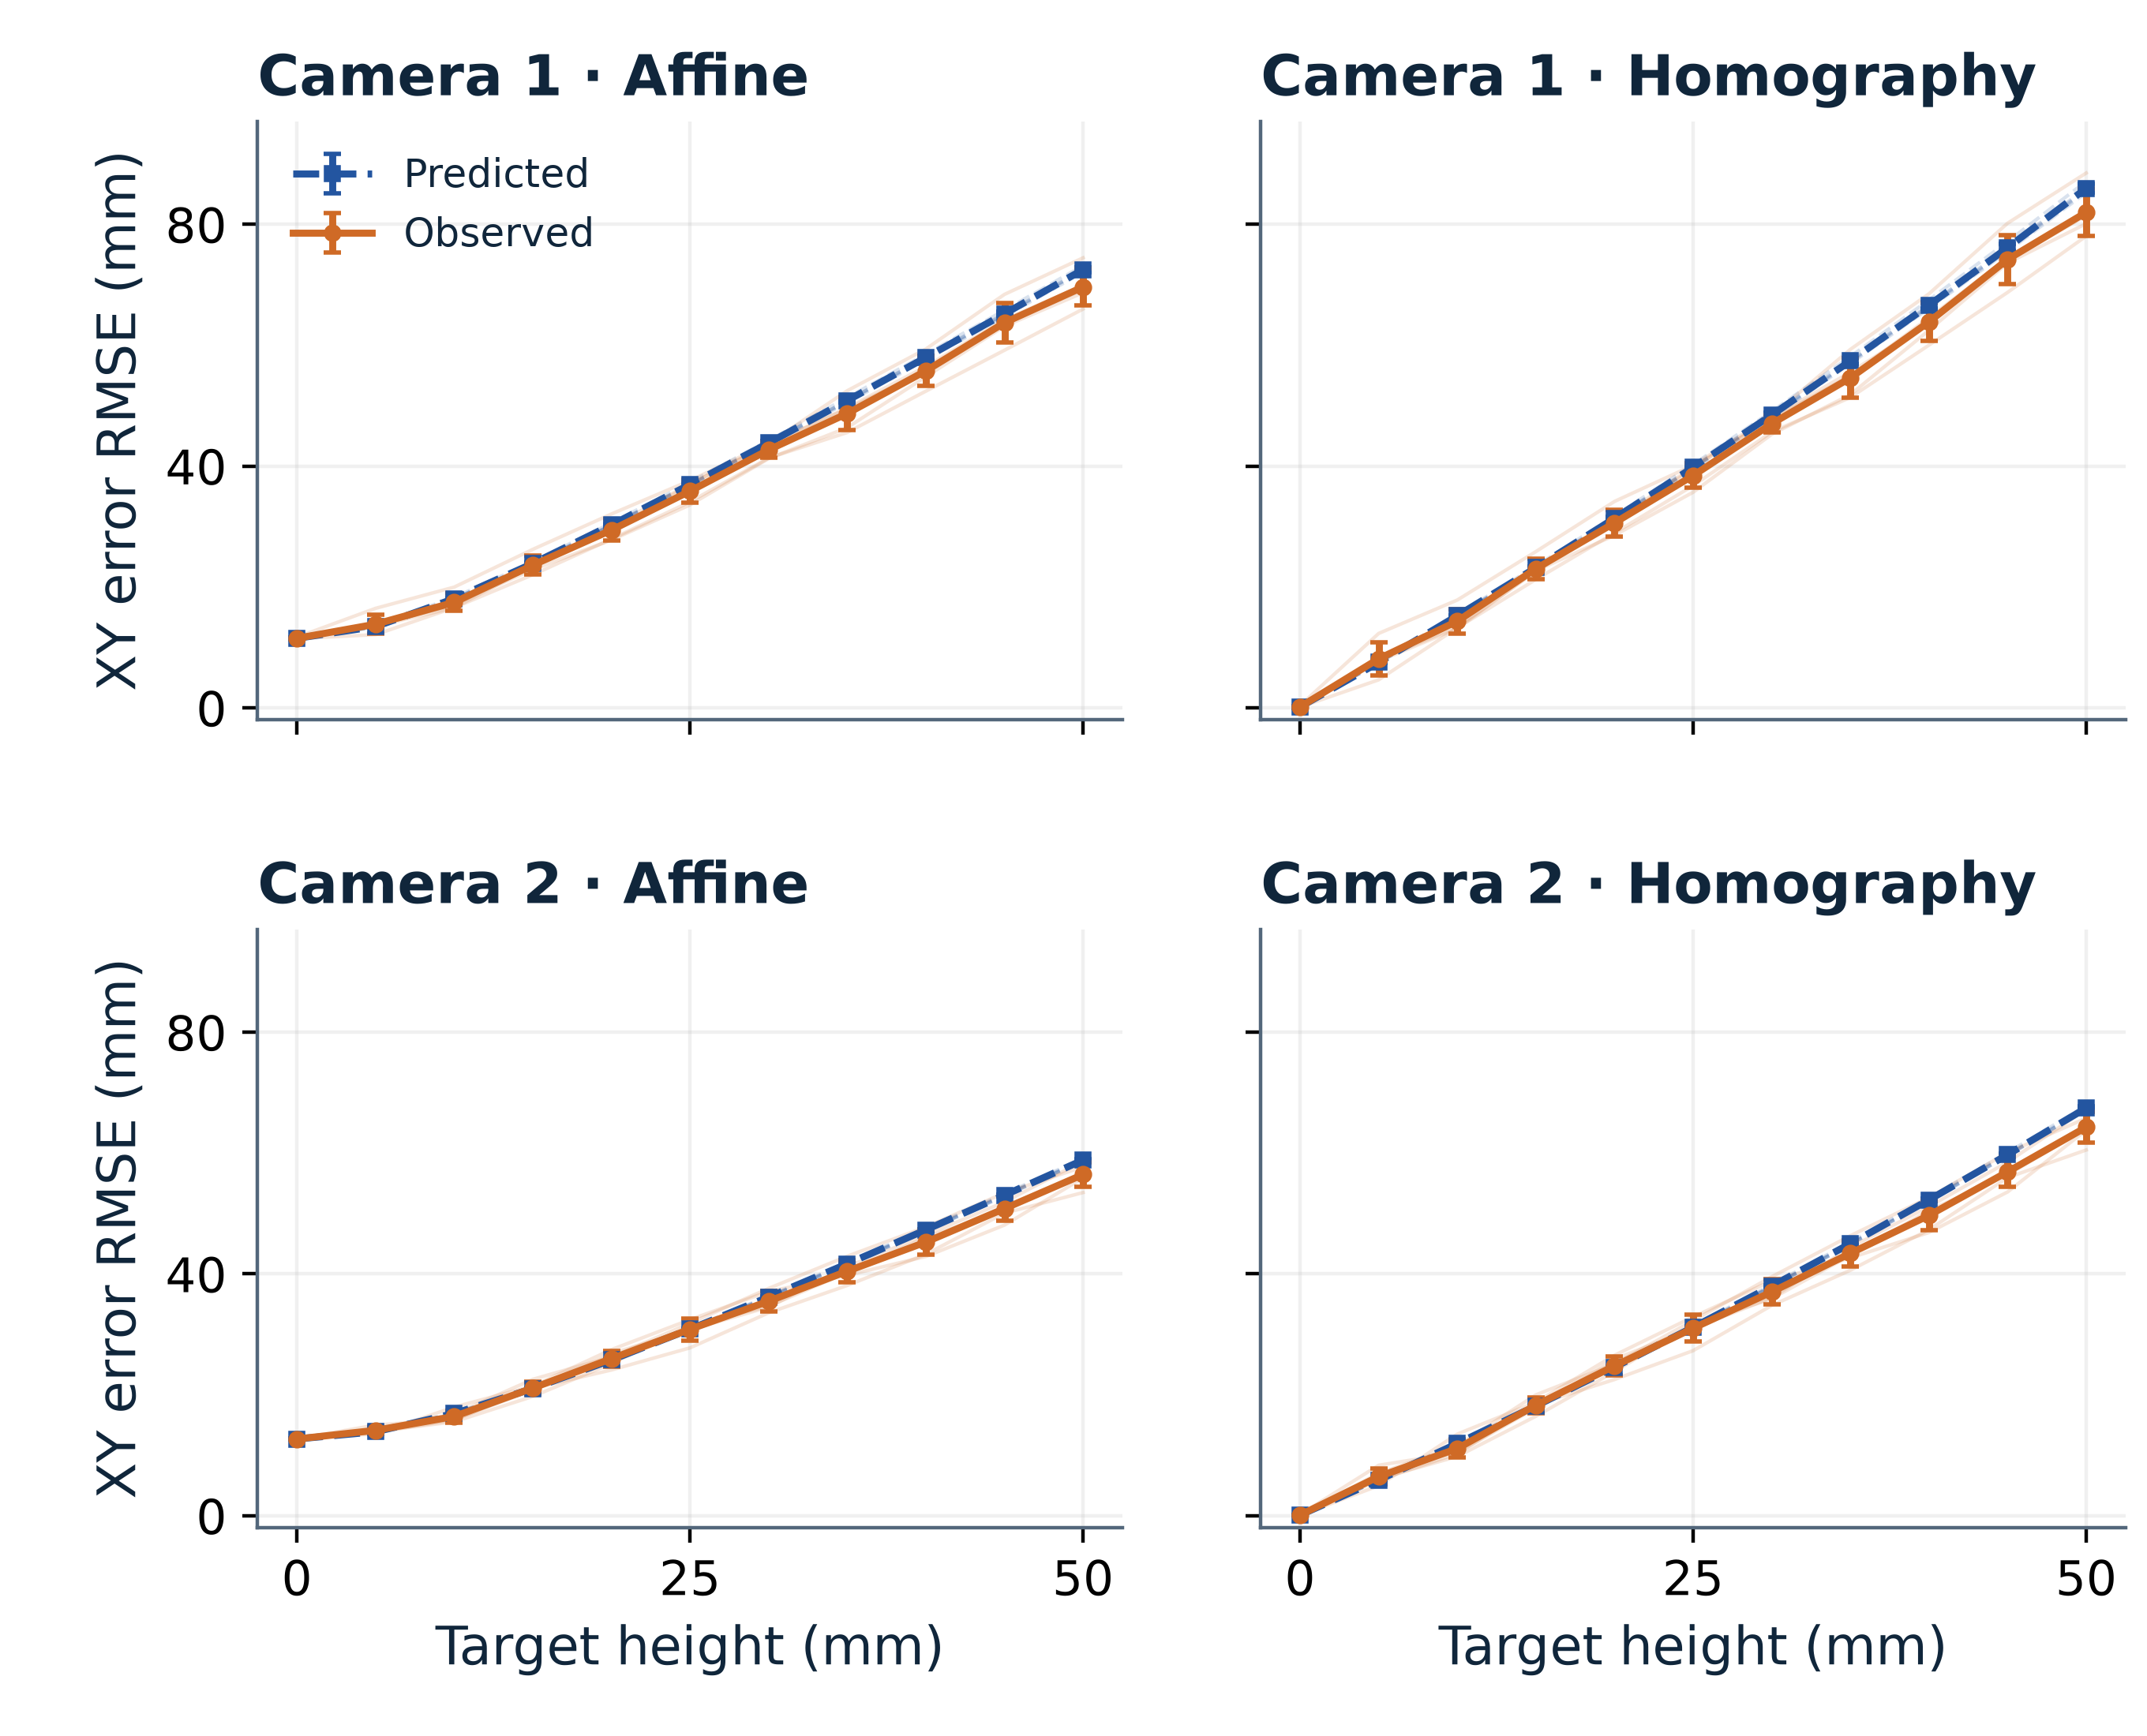
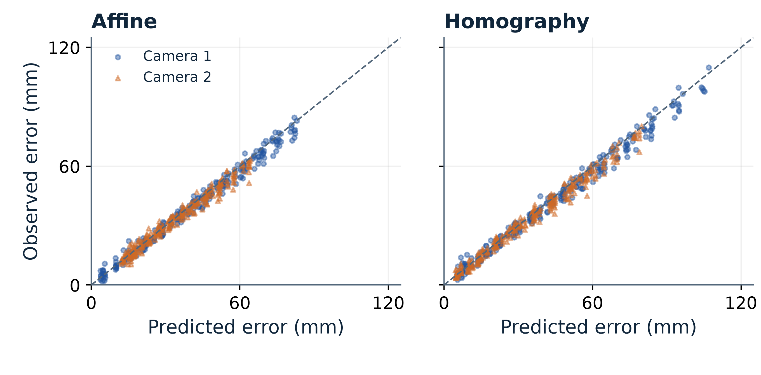
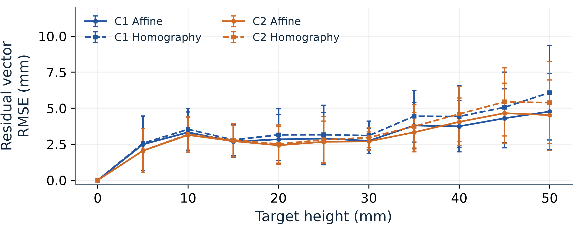
Department: [Electrical and Electronic Engineering]
VALIDATION SETUP & ROBOT CONTEXT
WHEN IS 3D WORTH IT?
Task-Conditioned Adequacy of Planar Localisation
for Vision-Guided Manipulation
OUR CONTRIBUTION We combine analytically predicted off-plane error with a separate real-system error bound to determine whether planar localisation meets a specified task tolerance.
RoArm M2
Berxel iHawk 100Q
Robot context only
E2 physical validation
2 × RGB-D + marker board
1. INTRODUCTION
3. RESULTS
3. RESULTS CONTINUED
When is 2D localisation good enough?
3.1 Analytical geometric error — E2 cameras
3.4 STAR-loc external validation summary
Planar localisation is simple and efficient. Off-plane targets introduce systematic XY positioning errors. [1, 2]
iHawk 1
iHawk 2
12,473 repeated observations
55 AprilTags; 8 held-out sequences
0.981
0.998
Can we predict these errors, and when do they require 3D-aware localisation for a task guarantee?
Spearman magnitude
correlation
Median direction
cosine
━ TL
━ TR
━ BL
━ BR
━ C
Independent observations support the structural projective-error mechanism [A, §7.3; 3]. Supporting evidence only: no absolute-accuracy or task-boundary validation.
Aim: predict, validate and assess task sufficiency.
Figure 2. Analytical prediction using reconstructed E2 camera geometry.
Each marker: mean of 5 rebuilds; board-frame XY and height (mm).
C_{z}: iHawk 1, 356.13–359.22; iHawk 2, 349.46–351.10 mm.
Figure 1 Off-plane localisation
3.2 Blind experimental validation
4. DISCUSSION
Camera centre C
3A Blind Geometric Prediction vs Observation
When is 3D actually required?
01
e_{P} = e_{geom} + r_{P}
r_{P} covers all error beyond geometry, including baseline.
C_{z}
P = (X, Y, h)
02
‖r_{P}‖ ≤ S_{P}
S_{P}: declared upper bound on remaining XY error.
03
E_{P} = ‖e_{P}‖ ≤ E_{geom} + S_{P}
h
E_{P}: total error magnitude; ‖·‖: Euclidean norm.
04
E_{geom} + S_{P} ≤ τ
τ: allowable task XY error (mm); planar use is certified.
Z = 0
Q
P′
05
E_{geom} + S_{P} > τ
XY error
Planar guarantee unavailable; actual failure is not implied.
Q: true lateral target projection. P′: planar estimate. Z: vertical coordinate; Z = 0: calibration plane. The viewing ray passes through C, P and P′.
06
S_{3D} ≤ τ
S_{3D}: declared 3D bound; with row 5 → 3D-only guarantee.
e_{pred,E2} = e_{fit,0} + δ_{M}(h) (vector sum)
e_{fit,0}: Z = 0 fit error; δ_{M}: frozen-mapper increment.
Mean ± SD: 5 rebuilds; faint lines: individual rebuilds.
Height-curve r = 0.9942–0.9951 (h > 0); no h > 0 fitting.
Figure 6 Task-Conditioned Adequacy
2. METHODOLOGY
E2 Camera Geometry with Illustrative
Error-Bound Scenarios
2.1 Analytical geometric model
3B Point-Level Prediction Agreement
E2 geometry: median-C_{z} rebuild 20260808_162715.
τ = 10, S_{P} = 2, S_{3D} = 5 mm: hypothetical scenarios.
Not experimentally certified; S_{P} is not an E2 error bound.
ΔX = h(X − C_{x}) / (C_{z} − h)
Teal: both certified Gold: only 3D certified
X-direction bias: planar estimate minus true X.
iHawk 1 · C_{z} = 359.05 mm
iHawk 2 · C_{z} = 351.04 mm
ΔY = h(Y − C_{y}) / (C_{z} − h)
800
ρ (mm)
800
ρ (mm)
Y-direction bias: planar estimate minus true Y.
ρ = √[(X − C_{x})² + (Y − C_{y})²]
Lateral camera–target distance in the XY plane.
A
B
E_{geom} = |h|ρ / |C_{z} − h|
400
400
Magnitude of the geometry-induced XY error.
C = (C_{x}, C_{y}, C_{z}): camera centre (XY, height).
P = (X, Y, h): target; X, Y are work-plane coordinates.
h: target height; C_{z}: camera height above Z = 0.
5–50 mm; 250 points per camera/model; n = 5 rebuilds.
Magnitude r = 0.9869–0.9942; median direction cosine
= 0.9983–0.9992. Correlation is not absolute accuracy.
All lengths: mm; |·|: absolute value; √: square root.
Board-relative h; fixed rotation; robot Z unverified.
0
0
2.2 Blind physical validation
3.3 Geometry-Unexplained Residual Analysis
0
25
50
0
25
50
E2: two RGB-D cameras + calibrated marker board.
5 rebuilds; 5 locations; h = 0:5:50 mm.
Z = 0 fitting; no off-plane fitting or grasp-success test.
Target height h (mm)
Target height h (mm)
Boundary: hρ/(C_{z} − h) + S_{P} = τ; 0 ≤ h < C_{z}.
iHawk 1; E2 centre marker (X, Y) = (0, 0) mm
Calibrate
at Z = 0
›
Predict
geometry
›
Measure
off-plane
›
Compare
errors
A h = 5 mm; ρ = 516.47 mm
E_{geom} = 7.29 mm
Planar bound: 9.29 mm < τ
BOTH GUARANTEED
B h = 20 mm; ρ = 516.47 mm
E_{geom} = 30.47 mm
Planar bound: 32.47 mm > τ
3D ONLY GUARANTEED
2.3 Task-based bounded-error analysis
e_{P} = e_{geom} + r_{P}
“Not guaranteed” does not mean actual failure.
Camera geometry is E2-derived; task tolerance and
error bounds are illustrative, not certified.
e_{P}: total XY; r_{P} includes baseline mapping error.
r_{E2} = e_{obs} − e_{pred,E2} (not task remainder r_{P}).
Residual RMSE: 3.61–4.36 mm; SD bars: 5 rebuilds.
Remaining error requires a separate bound; RMSE ≠ S_{P}.
‖r_{P}‖ ≤ S_{P}
S_{P}: separately declared bound; not residual RMSE.
5. CONCLUSIONS
Geometry matters
Blind prediction validated
Real-system errors remain
Task tolerance determines adequacy
E_{geom} = |h|ρ / |C_{z} − h|
0.9942–0.9951
3.61–4.36 mm
E_{geom} + S_{P} ≤ τ
Height alone cannot determine localisation adequacy.
Predictions capture the dominant experimental error trends.
Geometry alone does not fully explain total localisation error.
Planar localisation can remain sufficient under the declared error bound.
3D IS NOT ALWAYS NECESSARY, EVEN WHEN 2D IS GEOMETRICALLY IMPERFECT.
[1] J. Carlson, “Flatland Revisited: The Effects of Non-Planar Floors on Large-Scale Warehouse Deployment of Autonomous Mobile Robots,” ICRA Robots in the Wild Workshop, 2025.
[2] J. Carlson & A. Kolling, “Selective Placement of Visual Fiducials for Localization Tasks,” ICRA Robot Execution Failures and Failure Management Strategies Workshop, 2023.
[3] F. Dümbgen et al., “STAR-loc: Dataset for STereo And Range-based localization,” arXiv:2309.05518, 2023. [A] Research drafts. E2 frozen package: final-SEP, commit 9a2844f.
Team members / student ID: [YUNKAI CHOU 20717037 / Xianying Zhou 20720172]
Supervisor: [C.F. Kwong]
Notes:
V11: E2 frozen commit 9a2844fdda424ac25071d27147b04760e1c338a4. C=-R_CB^T t_CB, board coordinates in mm. Figure 2: pure geometry per marker, arithmetic mean of predictions across five rebuilds, not error from averaged geometry. Figure 6: actual rebuild 20260808_162715, which is median Cz for BOTH cameras: C1=(-282.668323,-432.252314,359.053549), C2=(-389.576469,-20.859123,351.044845). All S_P=2, S_3D=5, tau=10 mm are hypothetical and do not bound E2 residuals. Centre marker (0,0) C1 rho516.472114; A h5 E7.293701 bound9.293701 both; B h20 E30.465519 bound32.465519 only3D. Full E2 prediction includes baseline fit error; r_E2 is not the pure-geometry task remainder. E2 marker-board scans do not establish robot grasp success. Bibliography checked against Carlson workshop PDFs and Amazon Science, and arXiv2309.05518; Liu citation identifies the real SLP dataset paper but is omitted in favour of closer problem-level literature. Full provenance and parameter table are in the V11 revision report.

