Slide 1





Quilt: Resource-aware Merging of Serverless Workflows
Yuxuan Zhang and Sebastian Angel
University of Pennsylvania

Slide 2









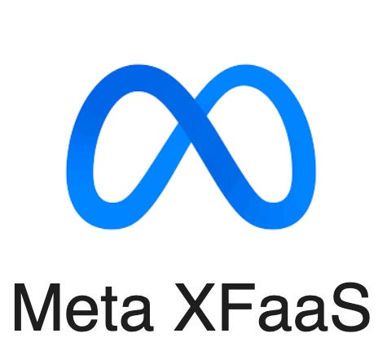
Serverless deployment
identifier
Fission
Serverless platforms
Developer writes & uploads code

Slide 3

Serverless invocation
API Gateway
HTTP Request (identifier + input)
Controller / Scheduler
Worker
Worker
HTTP Response
Clients
Container
Function
Serverless platform (simplified)

Slide 4
Serverless workflows
fn3
fn1
fn2
fn4
fn5
fn6
Invocations can be synchronous or asynchronous (so callees execute in parallel)

Slide 5
Invocation with workflows
API Gateway
HTTP Request (fn1 + input)
Controller / Scheduler
HTTP Request (fn2 + input)
Worker
Worker
Clients
Container
Container
fn1
fn2
Serverless platform (simplified)

Slide 6
The problem: high invocation overhead
Sources of overhead
Networking and queueing delay
Cold starts
I/O serialization and deserialization
Median latency of warm no-op function on Lambda ≈10.4 ms*
Big effect on workflows with many short-running functions
*Nightcore: efficient and scalable serverless computing for latency-sensitive, interactive microservices.
Zhipeng Jia and Emmett Witchel. ASPLOS 2021.

Slide 7
Quilt reduces invocation overhead
100,000X
~10 ms
~100 ns
Existing platforms
with Quilt
(assuming warm functions)
Main technique: merging functions in the background
Notes:
3 mins

Slide 8
In the rest of this talk
Answers to three key questions
Where to merge? How to merge? What to merge?
Evaluation results on Fission serverless platform
Summary, limitations, and future plans

Slide 9
In the rest of this talk
Answers to three key questions
Where to merge? How to merge? What to merge?
Evaluation results on Fission serverless platform
Summary, limitations, and future plans

Slide 10
Where to merge functions?
Worker
Worker
Worker
Container
Container
Container
Container
fn1
fn2
fn1
fn2
fn1 + fn2
Collocate in the same worker
Collocate in container
Collocate in process
Quilt takes this approach
No modifications
Compiled languages
Multi-language support
Examples:
Nightcore [ASPLOS 2021]
SONIC [ATC 2021]
Example:
Meta’s XFaaS [SOSP 2023]
Examples:
Faasm [ATC 2020]
Faastlane [ATC 2021]
Wisefuse [POMACS 2022]
Fusionize [IC2E 2022]

Slide 11
In the rest of this talk
Answers to three key questions
Where to merge? How to merge? What to merge?
Evaluation results on Fission serverless platform
Limitations and future plans

Slide 12
How to merge functions?
fn1
Observation 1: we are not dealing with functions that take arbitrary inputs and produce arbitrary outputs
Rust
fn2
Serverless functions implement REST APIs:
Input and output usually JSON string or HTTP request
C++
fn3
Fission, OpenWhisk, OpenFaaS use JSON strings
Swift

Slide 13
How to merge functions?
fn1
Observation 2: languages that need to interact with the OS already have ways to create and parse “C strings”
OS ABI for syscalls like open, creat, execve, stat, …
Rust
fn2
C++
fn3
Takeway: Can automatically instrument code to translate JSON strings to and from C strings
Swift

Slide 14
Quilt compiles functions to LLVM IR
fn1
LLVM pass that converts
RPC into function calls
Rust
LLVM IR
LLVM IR
fn2
Debloating + llc
C++
.obj File
fn3
lld
Swift
merged binary

Slide 15
In the rest of this talk
Answers to three key questions
Where to merge? How to merge? What to merge?
Evaluation results on Fission serverless platform
Summary, limitations, and future plans

Slide 16
Can we just merge all functions?
fn3
fn1
fn2
fn4
fn5
fn6
assume asynchronous (parallel) invocations

Slide 17
Can we just merge all functions?
Merged function needs a larger container (more RAM and vCPUs)
fn3
Max memory
needed
fn4
fn1
fn6
fn2
fn5
Execution time (assuming enough vCPUs)

Slide 18
Providers set constraints on container sizes
AWS: 128 MB -- 10 GB RAM (1 MB increments)
0.07 – 5.71 vCPU (proportional to memory)
Azure: 512 MB, 2048 MB , and 4096 MB
(Flex plan) vCPU proportional to memory Google: 128 MB – 32 GB RAM (128 MB increments)
1 – 8 vCPU (independent of memory in Gen2)
Main point: Limits + restrictions makes scheduling easier and reduces fragmentation

Slide 19
Can we just merge all functions?
Depends on how many resources the merged workflow uses, how often functions call each other, and platform restrictions

Slide 20
Quilt’s merge decision algorithm
Profiles functions to determine memory, vCPU usage, and call frequency to understand which functions make sense to merge
Introduces a graph clustering problem that captures which sets of functions should be merged
Formulates goal and constraints as an ILP
fn2
fn5
Suppose call is infrequent

Slide 21
Quilt will do something like:
fn3
fn1
fn2
fn4
fn5
fn6

Slide 22
In the rest of this talk
Answers to three key questions
Where to merge? How to merge? What to merge?
Evaluation results on Fission serverless platform
Summary, limitations, and future plans

Slide 23
Evaluation
When is Quilt helpful and what are the benefits?
What are the costs of merging?
Profiling
Graph clustering
Compiling, Merging, Linking
What happens when profiling is wrong?

Slide 24
Evaluation
When is Quilt helpful and what are the benefits?
What are the costs of merging?
Profiling
Graph clustering
Compiling, Merging, Linking
What happens when profiling is wrong?

Slide 25
Quilt deployment
Fission serverless platform
3 worker machines: each has 128-cores, 2TB RAM
Runtime server: API Gateway + Scheduler + Profiler
Storage server: Tempo, InfluxDB, KeyDB, memcached
Container size: 128 MB RAM and 2 vCPU
Max deployment size: 192 containers
Workflows: All applications from DeathStarBench

Slide 26
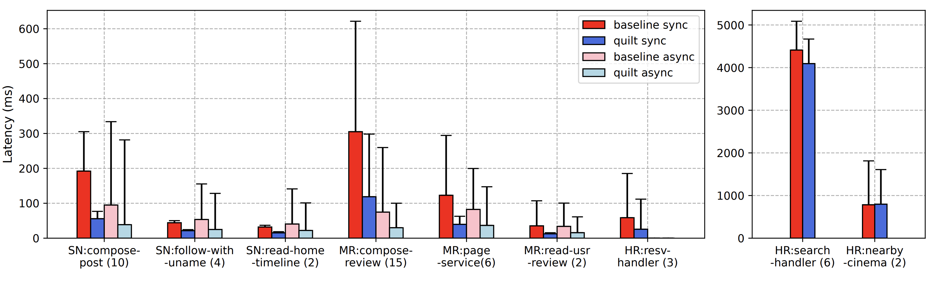
Results of Quilt on DeathStarBench
Workflows with short-running functions
Median and 99-^{th} percentile latency
(lower is better)

Slide 27
Results of Quilt on DeathStarBench
Workflows with short-running functions
Median latency reduction: 46%–71%
Tail latency reduction: 16%–85%
Median and 99-^{th} percentile latency
(lower is better)

Slide 28
Results of Quilt on DeathStarBench
Workflows with short-running functions
Workflows with long-running functions
Median latency reduction: 46%–71%
Tail latency reduction: 16%–85%
Median and 99-^{th} percentile latency
(lower is better)

Slide 29
Results of Quilt on DeathStarBench
Workflows with short-running functions
Workflows with long-running functions
Takeaway: Quilt is effective for workflows with many small functions
Median and 99-^{th} percentile latency
(lower is better)

Slide 30
Evaluation
When is Quilt helpful and what are the benefits?
What are the costs of merging?
Profiling
Graph clustering
Compiling, Merging, Linking
What happens when profiling is wrong?
Cheap (<0.5 ms of extra latency)
Cheap (200 ms for graphs up to 200 functions)
Very expensive (10s or 100s of seconds)

Slide 31
Evaluation
When is Quilt helpful and what are the benefits?
What are the costs of merging?
Profiling
Graph clustering
Compiling, Merging, Linking
What happens when profiling is wrong?
Cheap (<0.5 ms of extra latency)
Cheap (200 ms for graphs up to 200 functions)
Very expensive (10s or 100s of seconds)
Partial benefit.
Quilt also handles data-dependent and large fan-out.

Slide 32
In the rest of this talk
Answers to three key questions
Where to merge? How to merge? What to merge?
Evaluation results on Fission serverless platform
Summary, limitations, and future plans

Slide 33
Summary
Quilt is a serverless optimizer
Reduces invocation latency by optimally merging functions into process
Does not require changes to serverless platforms or functions
We tested Rust, C, C++, Go, Swift and OpenFaaS, OpenWhisk, Fission
Functions are not merged by default (opt in)
Quilt relies on LLVM and compilation is expensive
We are currently building a version on Junction [NSDI 2024]
Quilt is open source: https://github.com/eniac/quilt

