Slide 1
带响铃提醒功能的简易备忘录
2014级软件工程一班
201402505124
周亚新

Slide 2
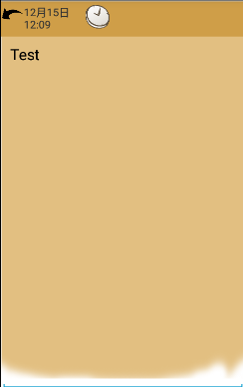
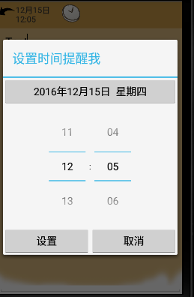
效果图如下：
+编辑备忘录
+设置时间

Slide 3

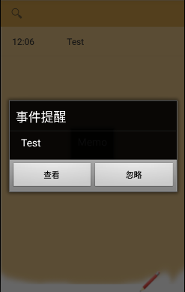
+设置完成后的效果 +事件提醒

Slide 4
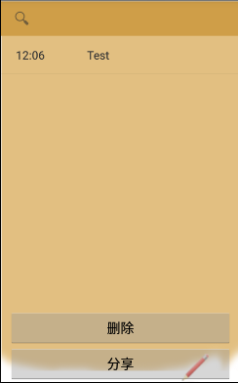
+事件的删除或分享

Slide 5
主要代码：
设置日期
new DatePickerDialog(getContext(), new OnDateSetListener(){ @Override public void onDateSet(DatePicker view, int year, int monthOfYear, int dayOfMonth) { //设置日期 calendar.set(year, monthOfYear, dayOfMonth); date = Utils.toDateString(calendar); dateSetButton.setText(date); }}, calendar.get(Calendar.YEAR), calendar.get(Calendar.MONTH),calendar.get(Calendar.DAY_OF_MONTH)).show(); } }); positiveButton.setOnClickListener(new View.OnClickListener() { @Override public void onClick(View v) { calendar.set(Calendar.HOUR_OF_DAY, timePicker.getCurrentHour()); calendar.set(Calendar.MINUTE, timePicker.getCurrentMinute()); alerttime = calendar.getTimeInMillis()+""; timeSetDialog.cancel(); } });

Slide 6
+广播闹铃
private void alertSet(){ Intent intent = new Intent("android.intent.action.ALARMRECEIVER"); //提示弹出框 /*Intent intent=new Intent(EditActivity.this,AlarmReceiver.class);*/ intent.putExtra("datetime", datetime); intent.putExtra("content", content); intent.putExtra("alerttime",alerttime); PendingIntent pendingIntent = PendingIntent.getBroadcast(EditActivity.this, 0, intent, 0);// 第二个参数为区别不同闹铃的唯一标识 AlarmManager alarmManager = (AlarmManager)getSystemService(ALARM_SERVICE); //设置闹钟 alarmManager.set(AlarmManager.RTC_WAKEUP,calendar.getTimeInMillis(), pendingIntent); //setRepeating()这里第二个参数不能设置成现在时间，否则闹钟会设置完就开启 alarmManager.setRepeating(AlarmManager.RTC_WAKEUP, calendar.getTimeInMillis(),(24 * 60 * 60 * 1000), pendingIntent); }

Slide 7
+广播接收BroadcastReceiver （并在xml中注册）
public class AlarmReceiver extends BroadcastReceiver { //广播接收 @Override public void onReceive(Context context, Intent intent) { Toast.makeText(context, "你设置的闹铃时间到了", Toast.LENGTH_LONG).show(); intent.setClass(context, AlertDialogActivity.class); intent.addFlags(Intent.FLAG_ACTIVITY_NEW_TASK); //必须增加，否则报错 context.startActivity(intent);
<receiver android:name=".alert.AlarmReceiver"> <intent-filter> <action android:name="android.intent.action.ALARMRECEIVER" android:process=":remote" /> </intent-filter> </receiver>

Slide 8
+锁屏仍启动
protected void onCreate(Bundle savedInstanceState) { super.onCreate(savedInstanceState); //需要在AndroidManifest里面设置权限，唤醒屏幕 PowerManager pm = (PowerManager)getSystemService(Context.POWER_SERVICE); mWakelock = pm.newWakeLock(PowerManager.ACQUIRE_CAUSES_WAKEUP |PowerManager.FULL_WAKE_LOCK, "AlertDialog"); mWakelock.acquire(); //屏幕解锁，需要设置权限 KeyguardManager keyguardManager = (KeyguardManager)getSystemService(KEYGUARD_SERVICE); KeyguardLock keyguardLock = keyguardManager.newKeyguardLock("AlertDialog"); keyguardLock.disableKeyguard();//系统自带的锁屏

Slide 9
+数据库及SQL语句
public class DatabaseHelper extends SQLiteOpenHelper{
public void onCreate(SQLiteDatabase db) { //使用execSQL函数执行SQL语句 db.execSQL("create table user(datetime varchar(30),content varchar(100),alerttime varchar(30))"); }

Slide 10
public static DatabaseHelper createDBHelper(Context context) { DatabaseHelper dbHelper = new DatabaseHelper(context, DATABASE_NAME); return dbHelper; } public void insert(DatabaseHelper dbHelper, UserInfo user) { ContentValues values = new ContentValues(); values.put("datetime", user.getDatetime()); values.put("content", user.getContent()); values.put("alerttime", user.getAlerttime()); SQLiteDatabase db = dbHelper.getWritableDatabase(); //调用insert方法，就可以将数据插入到数据库当中 db.insert("user", null, values); db.close(); } //更新操作就相当于执行SQL语句当中的update语句 public void update(DatabaseHelper dbHelper) { SQLiteDatabase db = dbHelper.getWritableDatabase(); ContentValues values = new ContentValues(); values.put("content", "zhou"); db.update("user", values, "id=?", new String[]{"1"}); db.close(); } public void delete(DatabaseHelper dbHelper, String datetime) { SQLiteDatabase db = dbHelper.getReadableDatabase(); // 删除表的所有数据 // 从表中删除指定的一条数据 db.execSQL("DELETE FROM " + "user" + " WHERE datetime=" + datetime); db.close(); } }

