Slide 1
A Sensory Layer for AI Agent
2026/6/15
詹詠翔

Slide 2
Outline
Motivation
Agent Sense
Demo
Architecture
Hearing
Seeing
Agent Integration
Future Work

Slide 3
From YouTube Insight to Notes
Scenario:
You are watching a YouTube talk and want to keep one segment
Workflow:
Paste the URL into Claude Code
Wait for the transcribe MCP to return the full transcript
Tell the agent which segment to save and where to store it
The bottleneck:
The agent does not share the user’s context

Slide 4
Agent Need Senses
Agents run on our computers, but they do not know what we see or hear
We watch videos, listen to talks, and point at important moments
The agent only receives the text and images we explicitly provide
Goal:
Let the agent hear what we hear
Let the agent see what we point at
Let the agent understand what is happening before we explain it

Slide 5
Agent Sense: A Sensory Layer for AI Agent
Agent Sense gives agent access to the context I already have
Hearing:
Turns system audio into live captions
Seeing:
Provides a focus selector triggered by cursor shaking
Supports UI element selection and screen region capture

Slide 6
Outline
Motivation
Agent Sense
Demo
Architecture
Hearing
Seeing
Agent Integration
Future Work

Slide 7
Outline
Motivation
Agent Sense
Demo
Architecture
Hearing
Seeing
Agent Integration
Future Work

Slide 8
Agent Sense Architecture
Hearing
zh-TW ASR
Transcript Store
System Audio Stream
Language Router
Transcript
Post-Processor
en-US ASR
Seeing
Apple Accessibility API
UI Element Selection
Visual Context
(text / image)
Agent
(Codex)
Screen Region Selection
Agent Init Prompt (context paths and usage rules)
ASR: Automatic Speech Recognition

Slide 9
Outline
Motivation
Agent Sense
Demo
Architecture
Hearing
Seeing
Agent Integration
Future Work

Slide 10
Hearing Pipeline
System Audio Stream:
Captures system audio in real time
ASR:
Transcribe speech to text on device with Apple SpeechTranscriber
Run zh-TW and en-US recognizers in parallel on the same audio
Language Router:
Selects the active language using confidence scores
Transcript Post-Processor:
Fixes punctuation and recognition errors with a small model (gpt-5.4-nano)
Uses deterministic code for paragraph breaks
ASR: Automatic Speech Recognition

Slide 11
Apple SpeechTranscriber
Provides on-device speech recognition on macOS
Runs in a system process outside the application
Executes on the Apple Neural Engine
Returns recognized words with confidence scores and timestamps

Slide 12

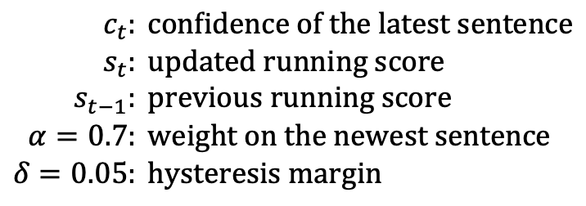

Language Router
ASR Output:
zh-TW and en-US recognizers transcribe the same audio in parallel
Each recognized word includes a confidence score
Language Selection:
Average word confidences into one score per sentence
Tracks each language with an exponential moving average (EMA)
Switches language only when the confidence gap passes a margin (hysteresis)
$$\begin{aligned}c_{t}&: \text{confidence} \text{of} \text{the} \text{latest} \text{sentence} \\ s_{t}&: \text{updated} \text{running} \text{score} \\ s_{t−1}&: \text{previous} \text{running} \text{score} \\ α=0.7&: \text{weight} \text{on} \text{the} \text{newest} \text{sentence} \\ δ=0.05&: \text{hysteresis} \text{margin}\end{aligned}$$
$$EMA: s_{t}=α⋅c_{t}+\left(1−α\right) s_{t−1}, α=0.7$$
$${hysteresis: s}_{\text{cand}}>s_{\text{active}}+δ, δ=0.05$$

Slide 13
Transcript Post-Processor
Post-processing steps:
Cleanup: a small model (gpt-5.4-nano) fixes punctuation and recognition errors
Structure: deterministic code handles paragraph breaks
Translation: foreign-language passages are translated into Chinese
Estimated cost per 10-minute video:
Cleanup: about $0.01
Structure: $0, handled by local deterministic code
Translation: about $0.01, only for foreign-language segments

Slide 14
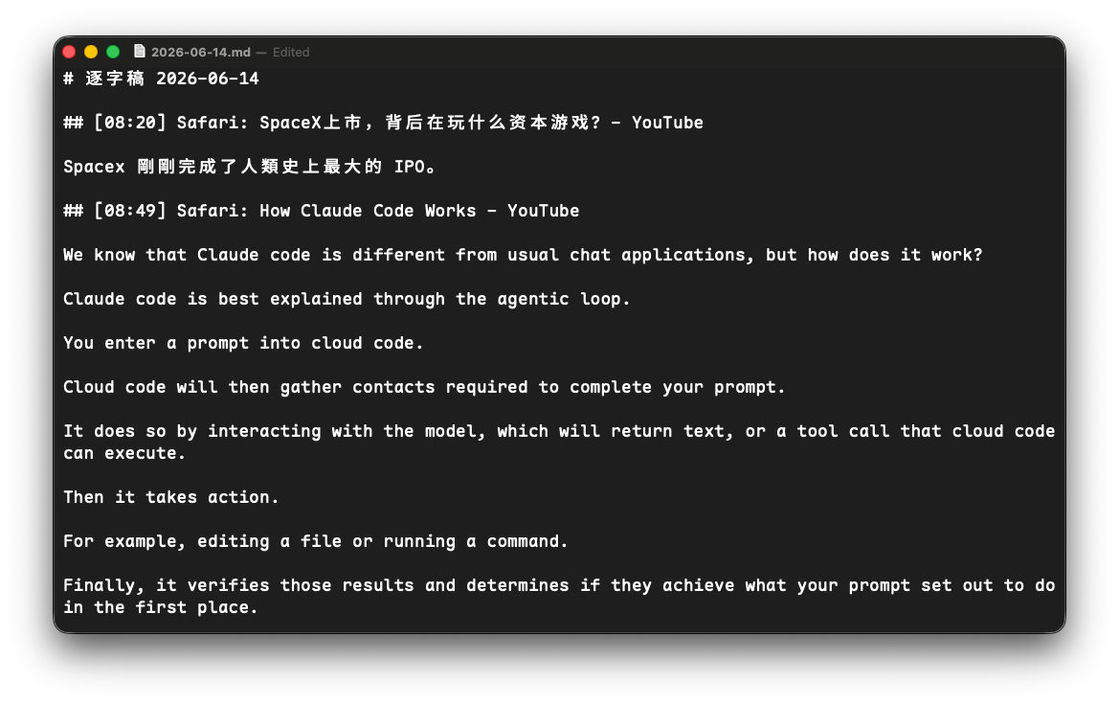
Transcript Store
Structure
One Markdown file per day: ~/.agent/transcripts/YYYY-MM-DD.md
Each segment starts with [HH:mm], application name, and window title
New segments are appended after cleanup without rewriting existing entries

Slide 15
Outline
Motivation
Agent Sense
Demo
Architecture
Hearing
Seeing
Agent Integration
Future Work

Slide 16
Apple Accessibility API
What Apple Accessibility provides:
Provides the structure of macOS UI
Provides UI metadata such as role, title, value, and bounds
Supports assistive technologies such as VoiceOver
How Agent Sense uses it:
Finds the UI element under the cursor
Uses bounds to locate the element on screen
Uses titles, labels, and values to understand the element

Slide 17
Outline
Motivation
Agent Sense
Demo
Architecture
Hearing
Seeing
Agent Integration
Future Work

Slide 18
Workspace as Context Storage
Codex inside the ~/.agent workspace:
Agent Sense writes transcripts, notes, and captures into ~/.agent
Codex reads these files with its built-in file tools
AGENTS.md provides workspace instructions:
Describes where transcripts and captures are stored
Tells Codex how to search past context
Each user request includes recent context:
Selected text and screenshots are attached to the prompt

Slide 19
Outline
Motivation
Agent Sense
Demo
Architecture
Hearing Pipeline
Seeing Pipeline
Agent Integration
Future Work

Slide 20
Future Work
Local model:
Current transcript cleanup relies on cloud models
Next step: move cleanup and language processing to a local model
Goal: keep the full sensing pipeline on device
Multi-speaker Support:
Current transcripts do not distinguish between speakers
Next step: add speaker diarization to separate speaker turns
Goal: label multi-speaker audio as Speaker A, B, C, etc.

Slide 21
Q & A

