Slide 1
Introduction to Processor Architecture (EC2.204)
Lecture 2 – instruction set architecture
Deepak Gangadharan
Computer Systems Group (CSG), IIIT Hyderabad
Slide Contents: Based on materials from text books and other public sources

Slide 2
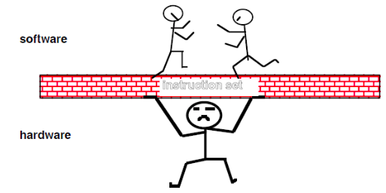
ISA: Hardware – Software Interface

Slide 3
Programming Languages and Abstractions
A Programming Language provides
Data Abstractions
int, float, bool etc. data types.
Mechanism for hierarchical composition of new Data Abstractions
Structures, arrays, Unions etc.
Data Processing Abstractions
Arithmetic and Boolean Operations, String Operations etc.
Control Abstractions – while, if, for constructs etc.
Key Idea: We should be able
to realize these abstractions
through the ISA of a given processor!

Slide 4
ISA Design Philosophy
Two ISA design philosophies
RISC – Reduced Instruction Set Computer
CISC – Complex Instruction Set Computer

Slide 5
RISC versus CISC
RISC | CISC
Each instruction does one simple task. | Each instruction can do multiple tasks.
Amount of work done in each instruction is roughly the same. | Amount of work done in each instruction could have huge variance.
Fixed Length instruction format. | Variable length instruction format.
Load-Store Architecture. Instruction operands should always reside in registers. | Instruction Operands can reside in memory also.
Large bank of general purpose registers. | Many special purpose registers.
Simple Addressing Modes. | Can have complex addressing modes.
Few Data Types (typically integer and float) | Could provide support for more data types like Strings.
Berkeley RISC , Stanford MIPS, ARM, HP’s PA-RISC | Intel x86 line of processors

Slide 6
RISC or CISC – Which way should we go?
RISC | CISC
Simple, fast (pipelined) and power efficient hardware implementations. | Complex hardware, not so power efficient, hard to come up with pipelined implementations.
Not so good for an Assemble Language Programmer when compared with CISC ISAs. | Good for an Assemble Language Programmer.
Good for compiler writer. | Compiler writer has to work hard to use the underlying CISC ISA features.
Less code density | Good code density

Slide 7
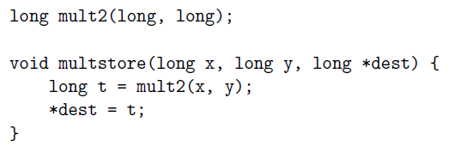

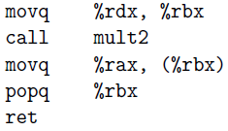
Assembly Language Example

Slide 8
Assembly/Machine Code View
CPU
Memory
Registers
Addresses
Data
Code
Data
Stack
PC
Condition
Codes
Instructions
Programmer-Visible State
PC: Program counter
Address of next instruction
Called “RIP” (x86-64)
Register file
Heavily used program data
Condition codes
Store status information about most recent arithmetic or logical operation
Used for conditional branching
Memory
Byte addressable array
Code and user data
Stack to support procedures

Slide 9
8-bit, 16-bit, 32-bit, 64-bit ISAs
A processor supporting a 32-bit ISA
Registers are 32 bits in length
32-bit ALU
Data bus width between processor and main memory 32 bits
Address space size 2^32 bytes [4 GB]
A 64-bit processor may support a 32-bit ISA also for compatibility reasons [but don’t expect performance gains]

Slide 10
Intel x86 Processors
Dominate laptop/desktop/server market
Evolutionary design
Backwards compatible up until 8086, introduced in 1978
Added more features as time goes on
Complex instruction set computer (CISC)
Many different instructions with many different formats
Hard to match performance of Reduced Instruction Set Computers (RISC)
But, Intel has done just that!
In terms of speed. Less so for low power.

Slide 11
Intel x86 Evolution: Milestones
Name Date Transistors MHz
8086 1978 29K 5-10
First 16-bit Intel processor. Basis for IBM PC & DOS
1MB address space
386 1985 275K 16-33
First 32 bit Intel processor , referred to as IA32
Added “flat addressing”, capable of running Unix
Pentium 4E 2004 125M 2800-3800
First 64-bit Intel x86 processor, referred to as x86-64
Core 2 2006 291M 1060-3500
First multi-core Intel processor
Core i7 2008 731M 1700-3900
Four cores

Slide 12
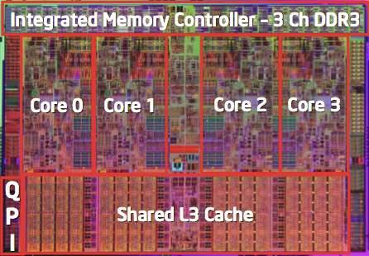
Intel x86 Processors, cont.
Machine Evolution
386 1985 0.3M
Pentium 1993 3.1M
Pentium/MMX 1997 4.5M
PentiumPro 1995 6.5M
Pentium III 1999 8.2M
Pentium 4 2001 42M
Core 2 Duo 2006 291M
Core i7 2008 731M
Added Features
Instructions to support multimedia operations
Instructions to enable more efficient conditional operations
Transition from 32 bits to 64 bits
More cores

Slide 13
Assembly/Machine Code View
CPU
Memory
Registers
Addresses
Data
Code
Data
Stack
PC
Condition
Codes
Instructions
Programmer-Visible State
PC: Program counter
Address of next instruction
Called “RIP” (x86-64)
Register file
Heavily used program data
Condition codes
Store status information about most recent arithmetic or logical operation
Used for conditional branching
Memory
Byte addressable array
Code and user data
Stack to support procedures

Slide 14
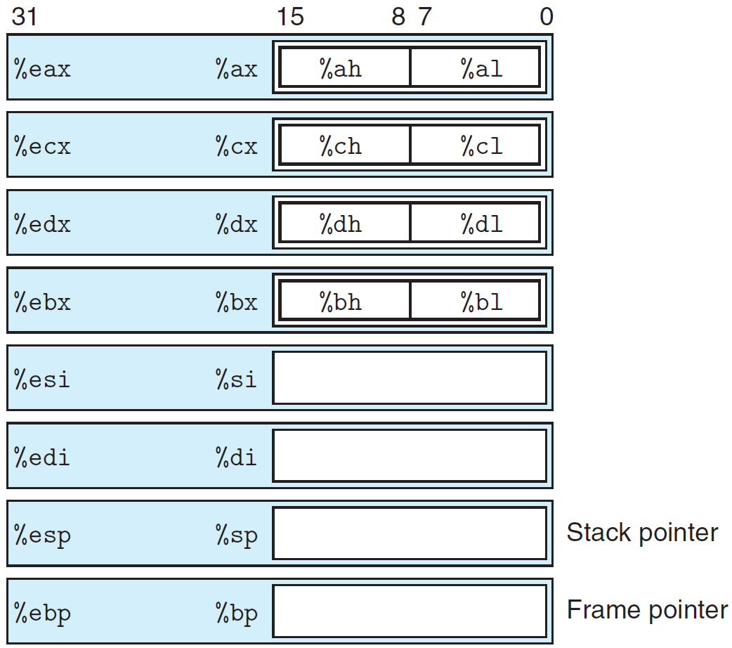
Accessing Information: IA32 Integer Registers
Used to store integer/pointers
First six registers can be considered general purpose registers, except some instructions that uses specific registers as source and/or destination.
Last two registers, contain pointers to important places in the program stack
The low-order 2 bytes of the first four registers can be independently read or written by the byte operation instructions.
Similarly, the low-order 16 bits of each register can be read or written by word operation instructions.

Slide 15
Accessing Information: x86-64 Integer Registers
16 registers to store integer/pointers
First six registers can be considered general purpose registers, except some instructions that uses specific registers as source and/or destination.
Next two registers, contain pointers to important places in the program stack
The low-order 2 bytes of the first four registers can be independently read or written by the byte operation instructions.
Similarly, the low-order 16 bits of each register can be read or written by word operation instructions.

Slide 16
General Purpose Registers
Accumulator register (ax). Used in arithmetic operations
Counter register (cx). Used in shift/rotate instructions and loops.
Data register (dx). Used in arithmetic operations and I/O operations.
Base register (bx). Used as a pointer to data
Stack Pointer register (sp). Pointer to the top of the stack.
Stack Base Pointer register (bp). Used to point to the base of the stack.
Source Index register (si). Used as a pointer to a source in stream operations.
Destination Index register (di). Used as a pointer to a destination in stream operations.
Source: Wikipedia

Slide 17
Data Transfer Instructions

Slide 18
movq Operand Combinations
Source
Dest
Src,Dest
C Analog
Reg
movq $0x4,%rax
temp = 0x4;
Imm
Mem
movq $-147,(%rax)
*p = -147;
Reg
movq %rax,%rdx
temp2 = temp1;
movq
Reg
Mem
movq %rax,(%rdx)
*p = temp;
Mem
Reg
movq (%rax),%rdx
temp = *p;
Cannot do memory-memory transfer with a single instruction

Slide 19
Simple Memory Addressing Modes
Normal (R) Mem[Reg[R]]
Register R specifies memory address
movq (%rcx),%rax
Displacement D(R) Mem[Reg[R]+D]
Register R specifies start of memory region
Constant displacement D specifies offset movq 8(%rbp),%rdx

Slide 20
Example of Simple Addressing Modes
void swap
(long *xp, long *yp)
{
long t0 = *xp;
long t1 = *yp;
*xp = t1;
*yp = t0;
}
swap:
movq (%rdi), %rax
movq (%rsi), %rdx
movq %rdx, (%rdi)
movq %rax, (%rsi)
ret

Slide 21
Understanding Swap()
Memory
void swap
(long *xp, long *yp)
{
long t0 = *xp;
long t1 = *yp;
*xp = t1;
*yp = t0;
}
Registers
%rdi
%rsi
%rax
%rdx
Register Value
%rdi xp
%rsi yp
%rax t0
%rdx t1
swap:
movq (%rdi), %rax # t0 = *xp
movq (%rsi), %rdx # t1 = *yp
movq %rdx, (%rdi) # *xp = t1
movq %rax, (%rsi) # *yp = t0
ret

Slide 22
Understanding Swap()
Memory
Registers
Address
123
0x120
%rdi
0x120
0x118
%rsi
0x100
0x110
%rax
0x108
%rdx
456
0x100
swap:
movq (%rdi), %rax # t0 = *xp
movq (%rsi), %rdx # t1 = *yp
movq %rdx, (%rdi) # *xp = t1
movq %rax, (%rsi) # *yp = t0
ret

Slide 23
Understanding Swap()
Memory
Registers
Address
123
0x120
%rdi
0x120
0x118
%rsi
0x100
0x110
%rax
123
0x108
%rdx
456
0x100
swap:
movq (%rdi), %rax # t0 = *xp
movq (%rsi), %rdx # t1 = *yp
movq %rdx, (%rdi) # *xp = t1
movq %rax, (%rsi) # *yp = t0
ret

Slide 24
Understanding Swap()
Memory
Registers
Address
123
0x120
%rdi
0x120
0x118
%rsi
0x100
0x110
%rax
123
0x108
%rdx
456
456
0x100
swap:
movq (%rdi), %rax # t0 = *xp
movq (%rsi), %rdx # t1 = *yp
movq %rdx, (%rdi) # *xp = t1
movq %rax, (%rsi) # *yp = t0
ret

Slide 25
Understanding Swap()
Memory
Registers
Address
456
0x120
%rdi
0x120
0x118
%rsi
0x100
0x110
%rax
123
0x108
%rdx
456
456
0x100
swap:
movq (%rdi), %rax # t0 = *xp
movq (%rsi), %rdx # t1 = *yp
movq %rdx, (%rdi) # *xp = t1
movq %rax, (%rsi) # *yp = t0
ret

Slide 26
Understanding Swap()
Memory
Registers
Address
456
0x120
%rdi
0x120
0x118
%rsi
0x100
0x110
%rax
123
0x108
%rdx
456
123
0x100
swap:
movq (%rdi), %rax # t0 = *xp
movq (%rsi), %rdx # t1 = *yp
movq %rdx, (%rdi) # *xp = t1
movq %rax, (%rsi) # *yp = t0
ret

Slide 27
Simple Memory Addressing Modes
Normal (R) Mem[Reg[R]]
Register R specifies memory address
Aha! Pointer dereferencing in C movq (%rcx),%rax
Displacement D(R) Mem[Reg[R]+D]
Register R specifies start of memory region
Constant displacement D specifies offset movq 8(%rbp),%rdx

Slide 28
Complete Memory Addressing Modes
Most General Form
D(Rb,Ri,S) Mem[Reg[Rb]+S*Reg[Ri]+ D]
D: Constant “displacement” 1, 2, or 4 bytes
Rb: Base register: Any of 16 integer registers
Ri: Index register: Any, except for %rsp
S: Scale: 1, 2, 4, or 8 (why these numbers?)
Special Cases
(Rb,Ri) Mem[Reg[Rb]+Reg[Ri]]
D(Rb,Ri) Mem[Reg[Rb]+Reg[Ri]+D]
(Rb,Ri,S) Mem[Reg[Rb]+S*Reg[Ri]]

Slide 29
Address Computation Examples
Carnegie Mellon
%rdx | 0xf000
%rcx | 0x0100
Expression | Address Computation | Address
0x8(%rdx)
(%rdx,%rcx)
(%rdx,%rcx,4)
0x80(,%rdx,2)
Expression | Address Computation | Address
0x8(%rdx) | 0xf000 + 0x8 | 0xf008
(%rdx,%rcx) | 0xf000 + 0x100 | 0xf100
(%rdx,%rcx,4) | 0xf000 + 4*0x100 | 0xf400
0x80(,%rdx,2) | 2*0xf000 + 0x80 | 0x1e080
Notes:
0xf000 + 0x8 = 0xf008
0xf000 + 0x0100 = 0xf100
0xf000 + 4*0x0100 = 0xf400
2*0xf000 + 0x80 = 0x1d080

Slide 30
Data Transfer Instructions

Slide 31
Example
Dereferencing a pointer → Copying the pointer into a register and using the register in a memory reference
Local variables are often stored in registers rather than memory locations → Faster access

Slide 32
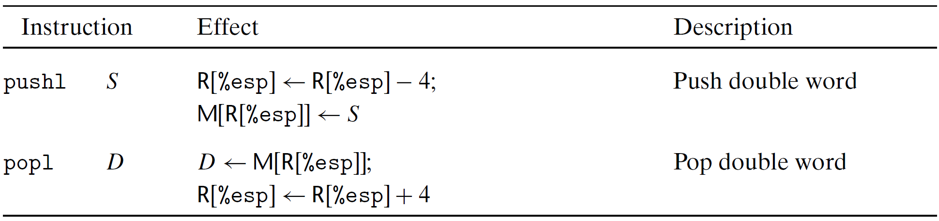
Push and Pop

Slide 33
Push and Pop
subl $4,%esp
movl %eax,(%esp)

Slide 34
Arithmetic and Logic Operations

Slide 35
Address Computation Instruction
Carnegie Mellon
leaq Src, Dst
Src is address mode expression
Set Dst to address denoted by expression
Uses
Computing addresses without a memory reference
E.g., translation of p = &x[i];
Computing arithmetic expressions of the form x + k*y
k = 1, 2, 4, or 8
Compilers can use it for compact arithmetic operations
Example
Converted to ASM by compiler:
long m12(long x)
{
return x*12;
}
leaq (%rdi,%rdi,2), %rax # t <- x+x*2
salq $2, %rax # return t<<2

Slide 36
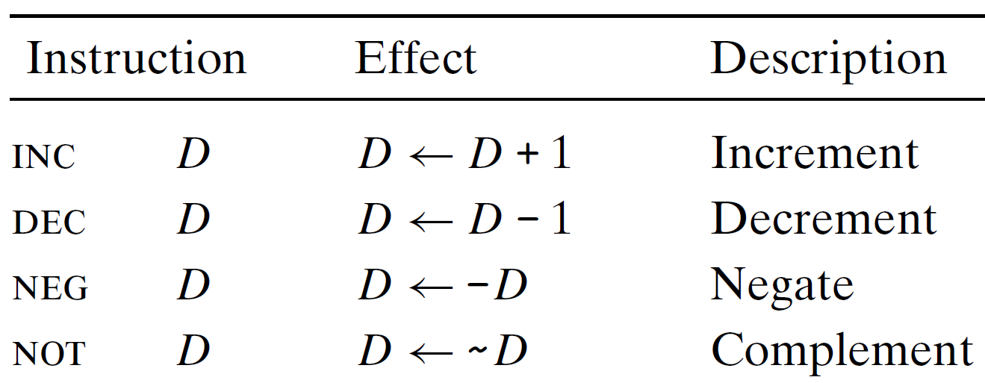
Unary Operations
The single operand can either be a register or a memory location
Example: incl (%esp) → Increments the 4 byte element on top of the stack

Slide 37
Some Arithmetic Operations
Carnegie Mellon
Two Operand Instructions:
Format Computation
addq Src,Dest Dest = Dest + Src
subq Src,Dest Dest = Dest − Src
imulq Src,Dest Dest = Dest * Src
salq Src,Dest Dest = Dest << Src Also called shlq
sarq Src,Dest Dest = Dest >> Src Arithmetic
shrq Src,Dest Dest = Dest >> Src Logical
xorq Src,Dest Dest = Dest ^ Src
andq Src,Dest Dest = Dest & Src
orq Src,Dest Dest = Dest | Src
Watch out for argument order!
No distinction between signed and unsigned int (why?)

Slide 38
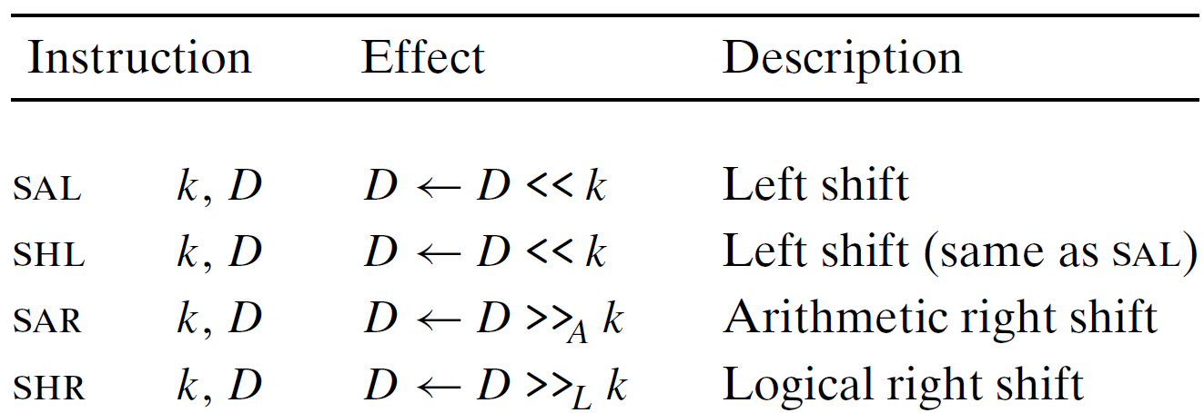
Shift Operations

Slide 39
Arithmetic Expression Example
Carnegie Mellon
arith:
leaq (%rdi,%rsi), %rax
addq %rdx, %rax
leaq (%rsi,%rsi,2), %rdx
salq $4, %rdx
leaq 4(%rdi,%rdx), %rcx
imulq %rcx, %rax
ret
long arith
(long x, long y, long z)
{
long t1 = x+y;
long t2 = z+t1;
long t3 = x+4;
long t4 = y * 48;
long t5 = t3 + t4;
long rval = t2 * t5;
return rval;
}
Interesting Instructions
leaq: address computation
salq: shift
imulq: multiplication
But, only used once

Slide 40
Understanding Arithmetic Expression Example
Carnegie Mellon
arith:
leaq (%rdi,%rsi), %rax # t1
addq %rdx, %rax # t2
leaq (%rsi,%rsi,2), %rdx
salq $4, %rdx # t4
leaq 4(%rdi,%rdx), %rcx # t5
imulq %rcx, %rax # rval
ret
long arith
(long x, long y, long z)
{
long t1 = x+y;
long t2 = z+t1;
long t3 = x+4;
long t4 = y * 48;
long t5 = t3 + t4;
long rval = t2 * t5;
return rval;
}
Register | Use(s)
%rdi | Argument x
%rsi | Argument y
%rdx | Argument z
%rax | t1, t2, rval
%rdx | t4
%rcx | t5

Slide 41
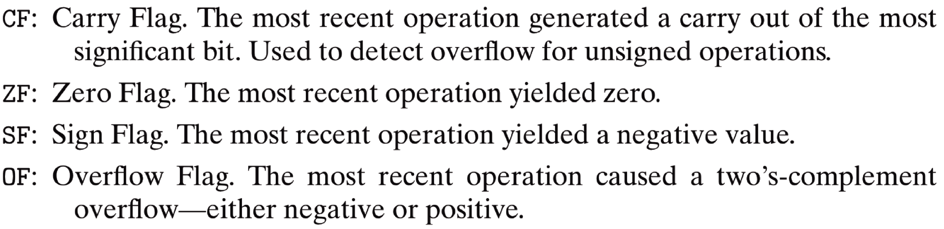
Condition Codes
CPU maintains a set of single-bit condition code registers describing attributes of the most recent arithmetic or logical operation.
These registers (listed below) can then be tested to perform conditional branches.

Slide 42
Condition Codes
t = a + b

Slide 43
Condition Codes
All unary and binary arithmetic & logical operations (except leaq) set the single bit condition codes.
For logical operations, the carry and overflow flags are set to zero.
Fore shift operations, the carry flag is set to the last bit shifted out, while the overflow flag is set to zero.
INC and DEC instruction set the overflow and zero flags but leave the carry flag unchanged.

Slide 44
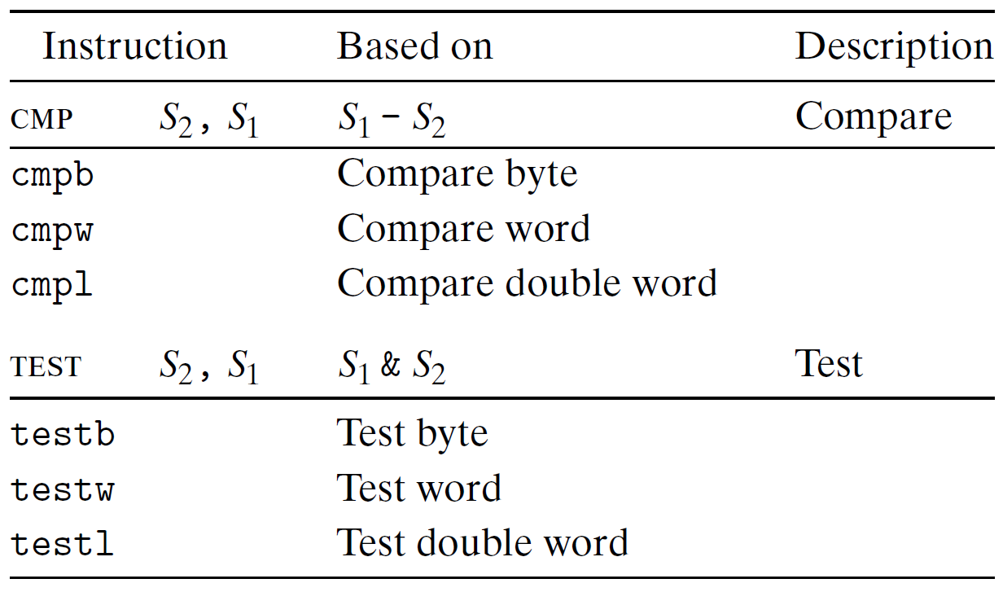
Condition Codes
Two instruction classes (CMP and TEST) set the condition codes.
CMP behave similar to SUB without altering the destination register.
TEST behave similar to AND without altering the destination register.

Slide 45
Condition Codes
Three common ways to use the condition codes
Set a single byte to 0 or 1 depending on some combination of condition codes (SET instructions)
Conditionally jump to some other part of the program (Jump instructions)
Conditionally move data (CMOVE instructions)

Slide 46
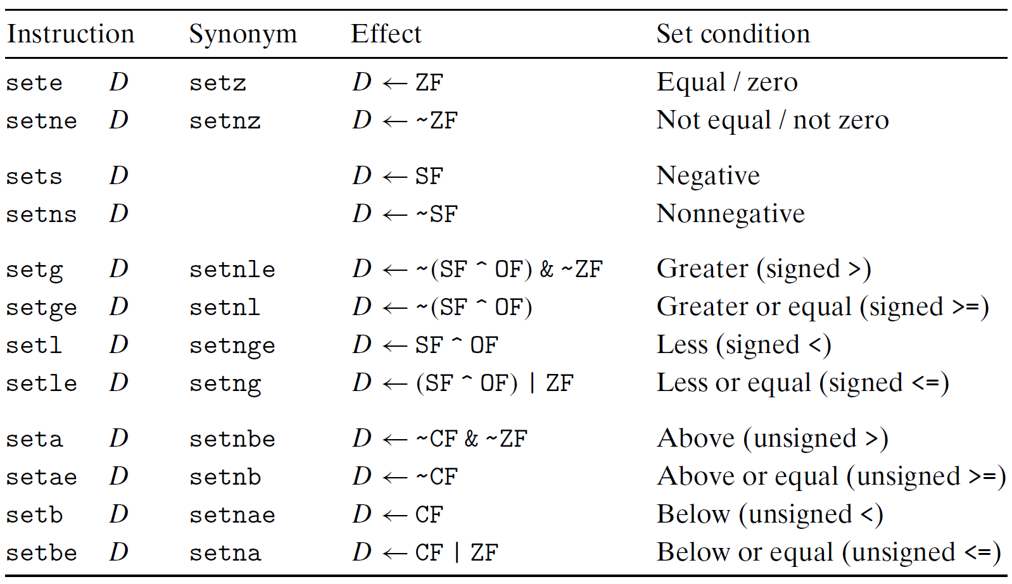
Accessing the Condition Codes
Instruction suffixes refer to combination of condition codes and not the operand types.
Operand D refers to a single byte register or single byte memory location.

Slide 47
Condition Codes

Slide 48
JUMP Instruction
A JUMP instruction can cause the execution to switch to a completely new position in the program
Generally a label used in assembly code to indicate the jump destination
Addresses of jump targets determined during object code generation

Slide 49
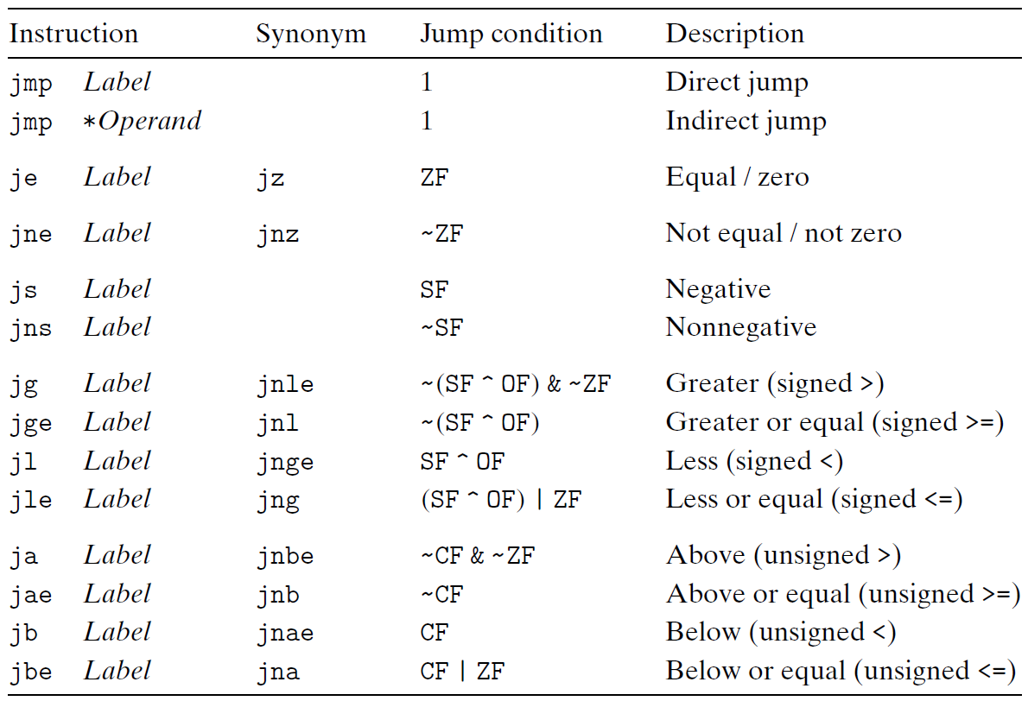
JUMP Instructions and Condition Codes

Slide 50
JUMP Instruction Encoding
Two common encodings used are
PC relative: Encodes the difference between the address of target instruction and address of instruction immediately following the jump
Absolute address
Why relative to address of instruction immediately following jump?
Assembly code
Disassembled code
+

Slide 51
JUMP Instruction Encoding
Disassembled version after linking
Advantages:
Instructions can be compactly encoded (requiring just 2 bytes)
Object code can be shifted to different positions in memory without alteration

Slide 52
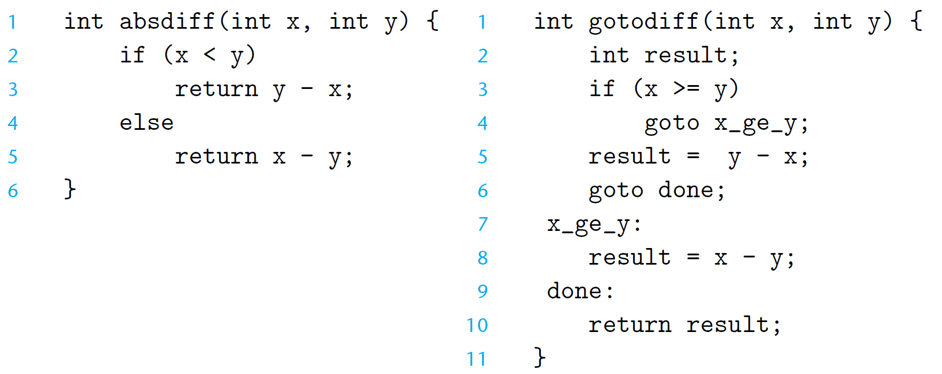
Implementing Conditional Branches with Conditional Control

Slide 53
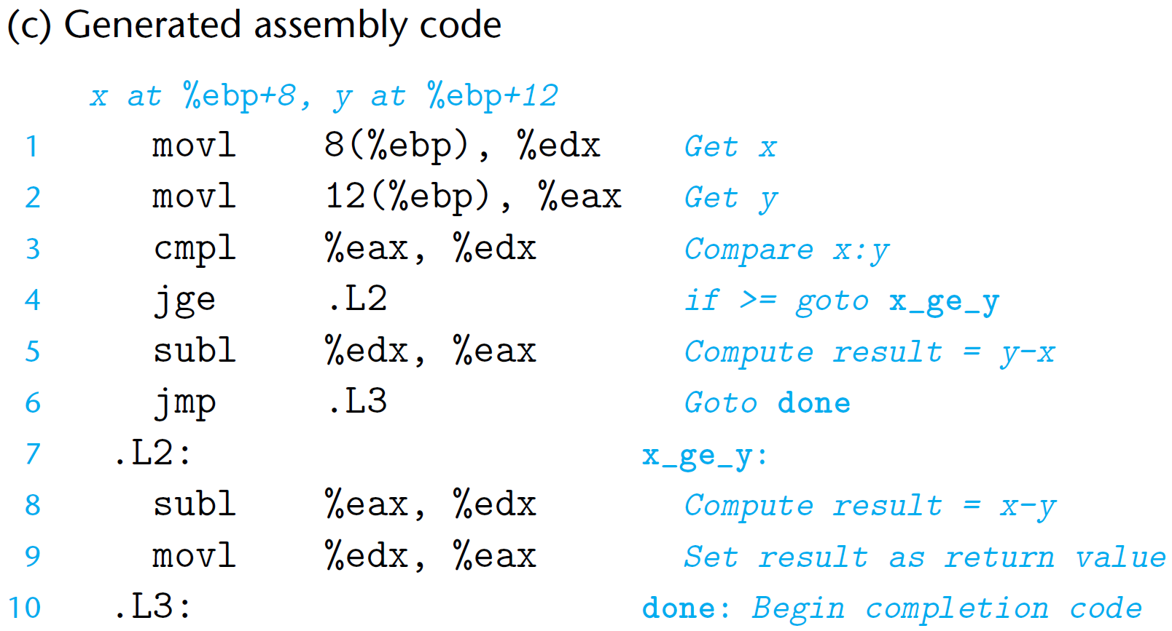
Implementing Conditional Branches with Conditional Control

Slide 54
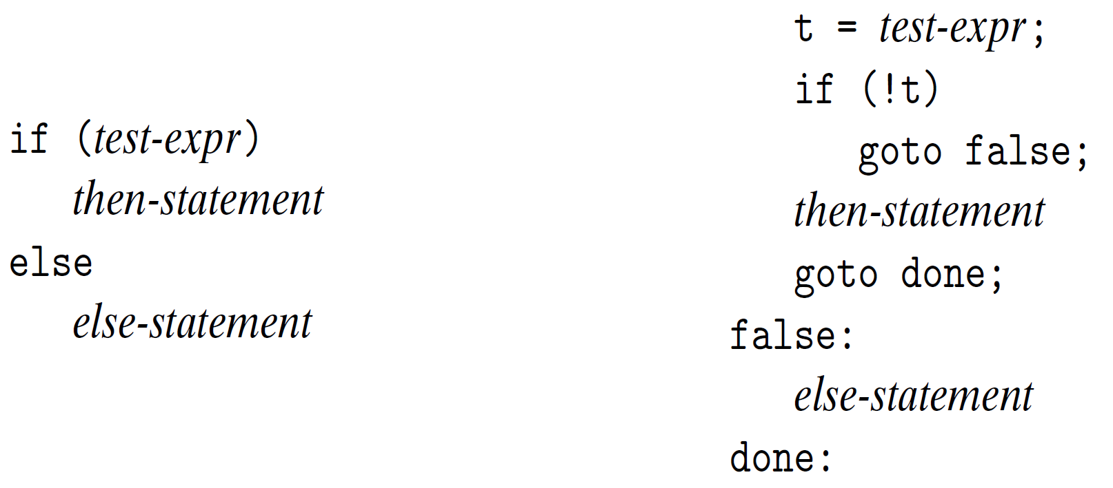
Implementing Conditional Branches with Conditional Control

Slide 55
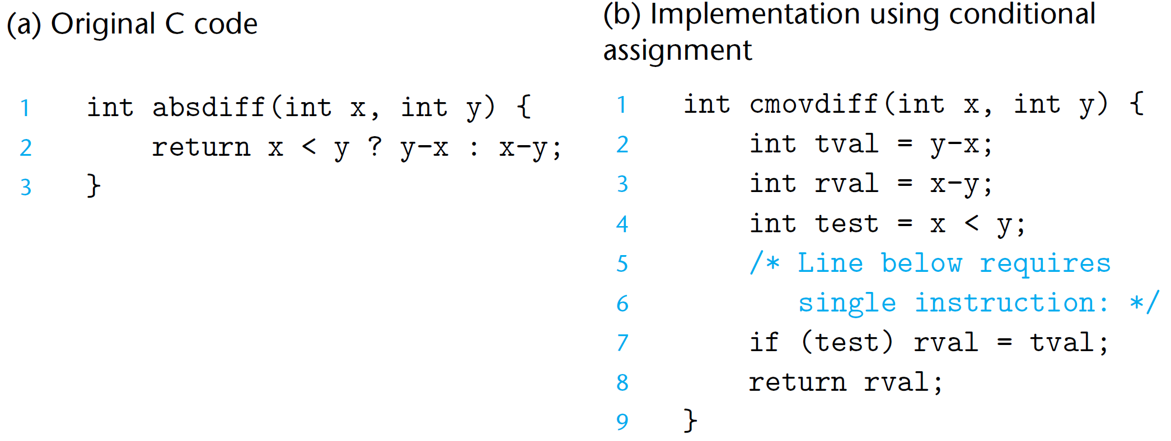
Conditional Branches with Conditional Move

Slide 56
Conditional Branches with Conditional Move

Slide 57
Conditional Branches with Conditional Move

Slide 58
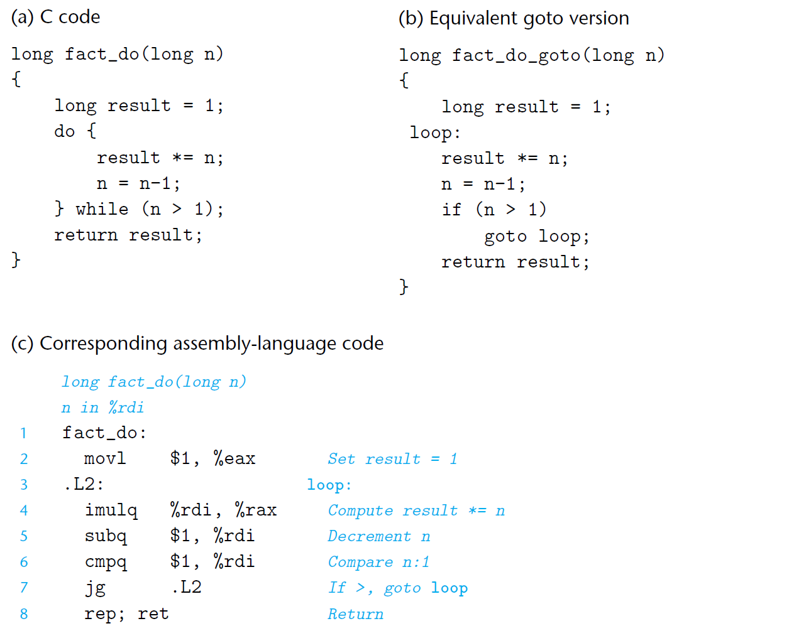
Conditional Branches: Do-While Loop

Slide 59
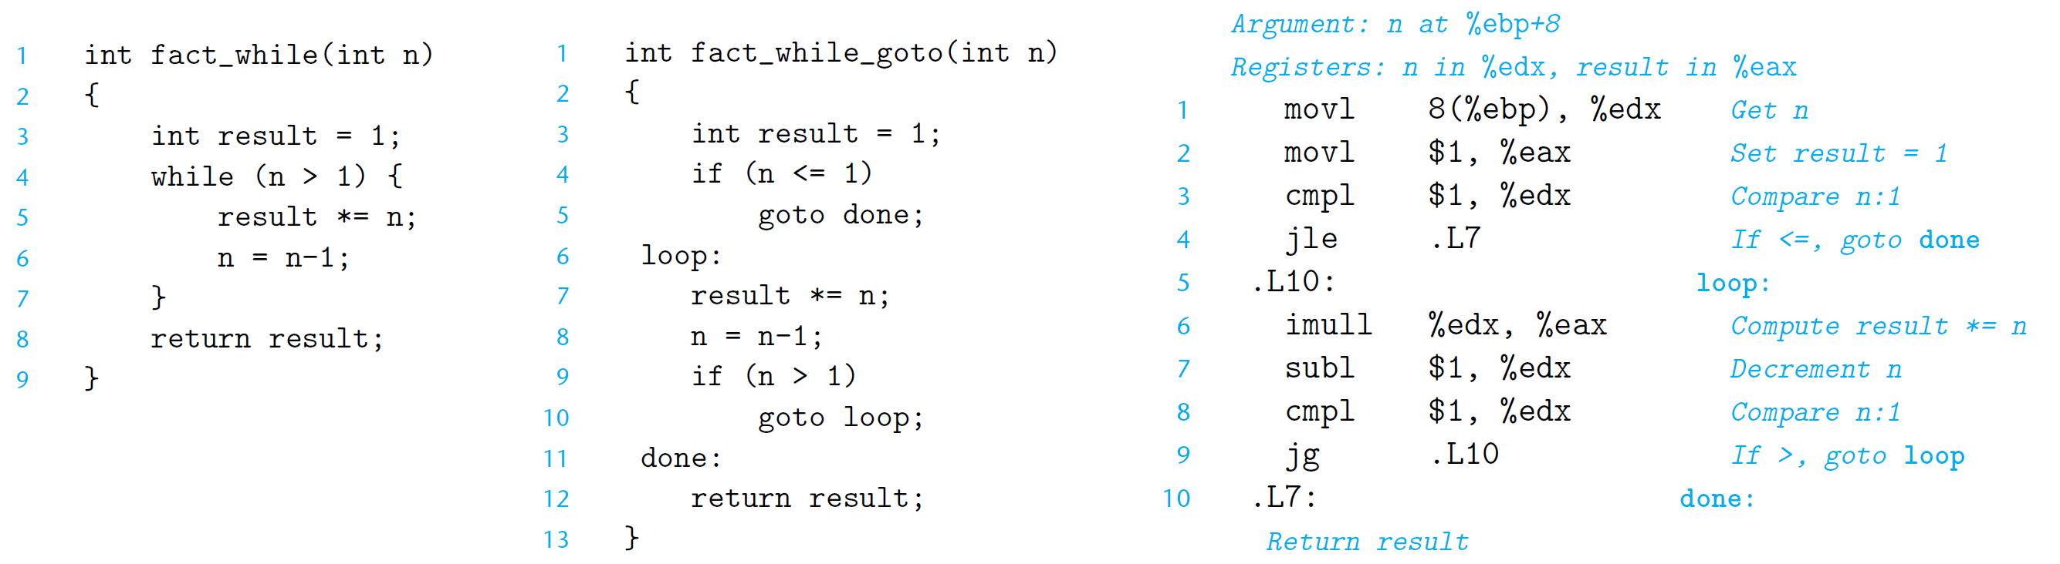
Conditional Branches: While Loop

Slide 60
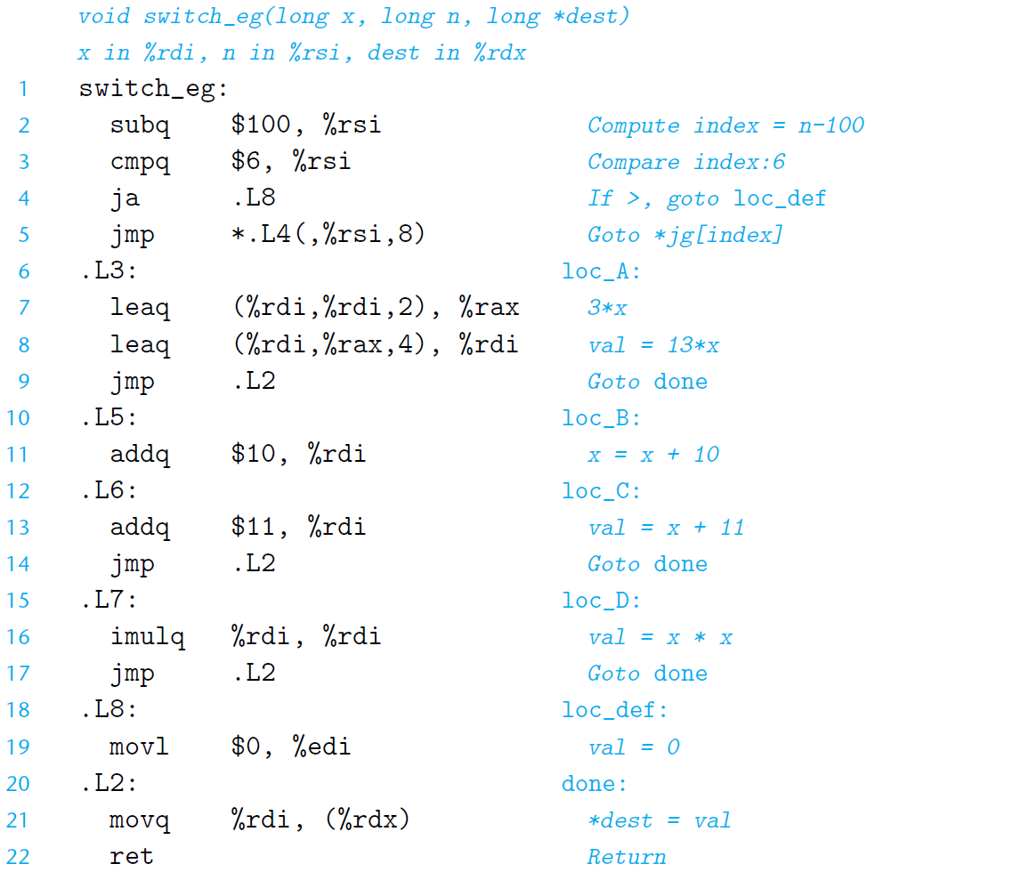
Conditional Branches: Switch Statement

Slide 61
Y86-64 Processor State
RF: Program registers
CC: Condition codes
Stat: Program status
%rax
%rsp
%r8
%r12
%rcx
%rbp
%r9
%r13
ZF
SF
OF
DMEM: Memory
%rdx
%rsi
%r10
%r14
PC
%rbx
%rdi
%r11
Program Registers
15 registers (omit %r15). Each 64 bits
Condition Codes
Single-bit flags set by arithmetic or logical instructions
ZF: Zero SF:Negative OF: Overflow
Program Counter
Indicates address of next instruction
Program Status
Indicates either normal operation or some error condition
Memory
Byte-addressable storage array
Words stored in little-endian byte order

Slide 62
Y86-64 Instructions
Subset of x86-64 instruction set
includes only 8-byte integer operations
fewer addressing modes (second index register and scaling not supported)
No transfer of immediate data to memory
smaller set of operations

Slide 63
Y86-64 Instruction Set #1
Byte
0
1
2
3
4
5
6
7
8
9
halt
0
0
nop
1
0
cmovXX rA, rB
2
fn
rA
rB
irmovq V, rB
3
0
F
rB
V
rmmovq rA, D(rB)
4
0
rA
rB
D
mrmovq D(rB), rA
5
0
rA
rB
D
The register order in encoding here is correct - Verified
OPq rA, rB
6
fn
rA
rB
jXX Dest
7
fn
Dest
call Dest
8
0
Dest
ret
9
0
pushq rA
A
0
rA
F
popq rA
B
0
rA
F
The register order in encoding here is correct - Verified

Slide 64
Y86-64 Instructions
Format
1–10 bytes of information read from memory
Can determine instruction length from first byte
Not as many instruction types, and simpler encoding than with x86-64
Each accesses and modifies some part(s) of the program state

Slide 65
Y86-64 Instruction Set #2
rrmovq
2
0
Byte
0
1
2
3
4
5
6
7
8
9
cmovle
halt
0
0
2
1
cmovl
nop
1
0
2
2
cmove
cmovXX rA, rB
2
fn
rA
rB
2
3
cmovne
irmovq V, rB
3
0
F
rB
2
4
V
cmovge
rmmovq rA, D(rB)
4
0
rA
rB
2
5
D
cmovg
mrmovq D(rB), rA
5
0
rA
rB
2
6
D
OPq rA, rB
6
fn
rA
rB
jXX Dest
7
fn
Dest
call Dest
8
0
Dest
ret
9
0
pushq rA
A
0
rA
F
popq rA
B
0
rA
F

Slide 66
Y86-64 Instruction Set #3
Byte
0
1
2
3
4
5
6
7
8
9
halt
0
0
nop
1
0
cmovXX rA, rB
2
fn
rA
rB
irmovq V, rB
3
0
F
rB
V
rmmovq rA, D(rB)
4
0
rA
rB
D
addq
6
0
mrmovq D(rB), rA
5
0
rA
rB
D
subq
6
1
OPq rA, rB
6
fn
rA
rB
andq
6
2
jXX Dest
7
fn
Dest
xorq
6
3
call Dest
8
0
Dest
ret
9
0
pushq rA
A
0
rA
F
popq rA
B
0
rA
F

Slide 67
Y86-64 Instruction Set #4
6
7
8
jmp
9
Byte
0
1
2
3
4
5
7
0
halt
0
0
jle
7
1
nop
1
0
jl
7
2
cmovXX rA, rB
2
fn
rA
rB
je
7
3
irmovq V, rB
3
0
F
rB
V
jne
7
4
rmmovq rA, D(rB)
4
0
rA
rB
D
jge
7
5
mrmovq D(rB), rA
5
0
rA
rB
D
jg
7
6
OPq rA, rB
6
fn
rA
rB
jXX Dest
7
fn
Dest
call Dest
8
0
Dest
ret
9
0
pushq rA
A
0
rA
F
popq rA
B
0
rA
F

Slide 68
Encoding Registers
Each register has 4-bit ID
Same encoding as in x86-64
Register ID 15 (0xF) indicates “no register”
Will use this in our hardware design in multiple places
%rax
0
%r8
8
%rcx
1
%r9
9
%rdx
2
%r10
A
%rbx
3
%r11
B
%rsp
4
%r12
C
%rbp
5
%r13
D
%rsi
6
%r14
E
%rdi
7
No Register
F

Slide 69
Instruction Example
Addition Instruction
Add value in register rA to that in register rB
Store result in register rB
Note that Y86-64 only allows addition to be applied to register data
Set condition codes based on result
e.g., addq %rax,%rsi Encoding: 60 06
Two-byte encoding
First indicates instruction type
Second gives source and destination registers
Generic Form
Encoded Representation
addq rA, rB
6
0
rA
rB

Slide 70
Arithmetic and Logical Operations
Instruction Code
Function Code
Refer to generically as “OPq”
Encodings differ only by “function code”
Low-order 4 bytes in first instruction word
Set condition codes as side effect
Add
addq rA, rB
6
0
rA
rB
Subtract (rA from rB)
subq rA, rB
6
1
rA
rB
And
andq rA, rB
6
2
rA
rB
Exclusive-Or
xorq rA, rB
6
3
rA
rB

Slide 71
Move Operations
rrmovq rA, rB
2
0
Register ➔ Register
irmovq V, rB
3
0
F
rB
V
Immediate ➔ Register
rmmovq rA, D(rB)
4
0
rA
rB
D
Register ➔ Memory
mrmovq D(rB), rA
5
0
rA
rB
D
Memory ➔ Register
Like the x86-64 movq instruction
Simpler format for memory addresses
Give different names to keep them distinct

Slide 72
Move Instruction Examples
X86-64
Y86-64
movq $0xabcd, %rdx
irmovq $0xabcd, %rdx
Encoding:
30 82 cd ab 00 00 00 00 00 00
movq %rsp, %rbx
rrmovq %rsp, %rbx
Encoding:
20 43
movq -12(%rbp),%rcx
mrmovq -12(%rbp),%rcx
Encoding:
50 15 f4 ff ff ff ff ff ff ff
movq %rsi,0x41c(%rsp)
rmmovq %rsi,0x41c(%rsp)
Encoding:
40 64 1c 04 00 00 00 00 00 00

Slide 73
Conditional Move Instructions
Move Unconditionally
Refer to generically as “cmovXX”
Encodings differ only by “function code”
Based on values of condition codes
Variants of rrmovq instruction
(Conditionally) copy value from source to destination register
rrmovq rA, rB
2
0
rA
rB
Move When Less or Equal
cmovle rA, rB
2
1
rA
rB
Move When Less
cmovl rA, rB
2
2
rA
rB
Move When Equal
cmove rA, rB
2
3
rA
rB
Move When Not Equal
cmovne rA, rB
2
4
rA
rB
Move When Greater or Equal
cmovge rA, rB
2
5
rA
rB
Move When Greater
cmovg rA, rB
2
6
rA
rB

Slide 74
Jump Instructions
Jump (Conditionally)
jXX Dest
7
fn
Dest
Refer to generically as “jXX”
Encodings differ only by “function code” fn
Based on values of condition codes
Same as x86-64 counterparts
Encode full destination address
Unlike PC-relative addressing seen in x86-64

Slide 75
Jump Instructions
Jump Unconditionally
jmp Dest
7
0
Dest
Jump When Less or Equal
jle Dest
7
1
Dest
Jump When Less
jl Dest
7
2
Dest
Jump When Equal
je Dest
7
3
Dest
Jump When Not Equal
jne Dest
7
4
Dest
Jump When Greater or Equal
jge Dest
7
5
Dest
Jump When Greater
jg Dest
7
6
Dest

Slide 76
Y86-64 Program Stack
Stack “Bottom”
Region of memory holding program data
Used in Y86-64 (and x86-64) for supporting procedure calls
Stack top indicated by %rsp
Address of top stack element
Stack grows toward lower addresses
Top element is at highest address in the stack
When pushing, must first decrement stack pointer
After popping, increment stack pointer
•
•
•
Increasing
Addresses
%rsp
Stack “Top”

Slide 77
Stack Operations
pushq rA
A
0
rA
F
Decrement %rsp by 8
Store word from rA to memory at %rsp
Like x86-64
Read word from memory at %rsp
Save in rA
Increment %rsp by 8
Like x86-64
popq rA
B
0
rA
F

Slide 78
Subroutine Call and Return
call Dest
8
0
Dest
Push address of next instruction onto stack
Start executing instructions at Dest
Like x86-64
Pop value from stack
Use as address for next instruction
Like x86-64
ret
9
0

Slide 79
Miscellaneous Instructions
nop
1
0
Don’t do anything
Stop executing instructions
x86-64 has comparable instruction, but can’t execute it in user mode
We will use it to stop the simulator
Encoding ensures that program hitting memory initialized to zero will halt
halt
0
0

Slide 80
Status Conditions
Mnemonic | Code
AOK | 1
Normal operation
Halt instruction encountered
Bad address (either instruction or data) encountered
Invalid instruction encountered
Desired Behavior
If AOK, keep going
Otherwise, stop program execution
Mnemonic | Code
HLT | 2
Mnemonic | Code
ADR | 3
Mnemonic | Code
INS | 4

Slide 81
Y86-64 program

Slide 82
Summary
Y86-64 Instruction Set Architecture
Similar state and instructions as x86-64
Simpler encodings
Somewhere between CISC and RISC
How Important is ISA Design?
Less now than before
With enough hardware, can make almost anything go fast

Slide 83
Thank You!

