Slide 1
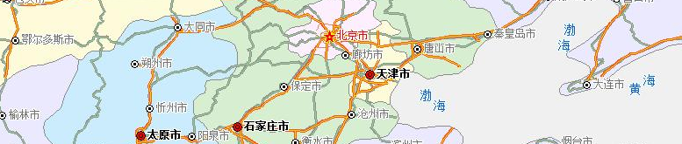
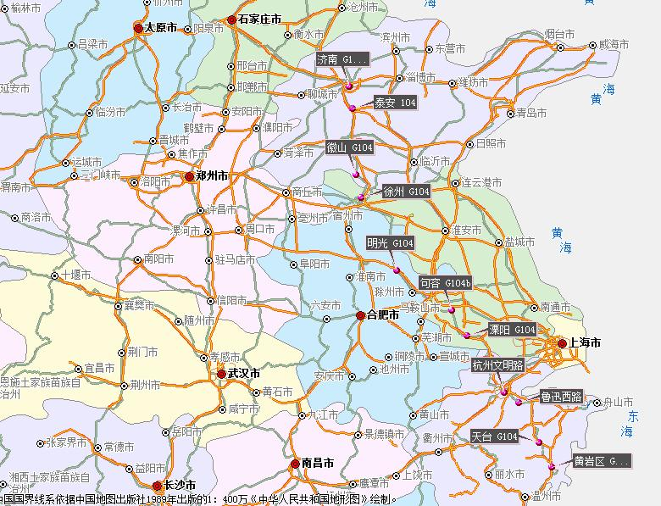
Beijing
INTRODUCTION
Tianjin
Jinan
11days
1800km
Nanking
~40 cities and towns of 5 provinces
Hangzhou
Wenzhou
Notes:
It happened in the last winter holiday. It begins in Beijing and terminates in Wenzhou which is my hometown. It took me 11days to cover the whole 1800 km passing through about 40 cities and towns of 5 provinces

Slide 2
Beijing
Tianjin
Jinan
Nanking
Hangzhou
Wenzhou
Notes:
It happened in the last winter holiday. It begins in Beijing and terminates in Wenzhou which is my hometown. It took me 11days to cover the whole 1800 km passing through about 40 cities and towns of 5 provinces

