Slide 1
Predicting Facebook Post Comment Volume
Ravi Sinha
Yiyang (Ian) Zeng
Fall 2018

Slide 2

Problem + Approach
Predict number of comments for a Facebook Page post
Data (54 columns) included:
Day of week posted
Likes on the page
Number of Shares
Was post promoted
Approach: Linear Regression

Slide 3
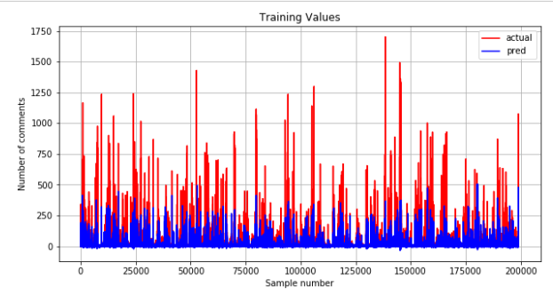
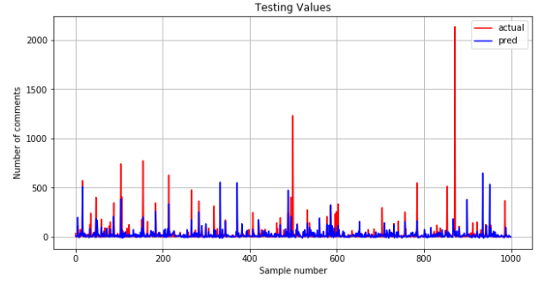
Results
Large amounts of training (given from dataset):
Trained on ~200,000 training samples
Tested on 1,000 samples
RSS_train = 0.68
RSS_test = 0.89
Under estimate mostly

Slide 4
Conclusions + Improvements
Predictability of Facebook comment volume more complex than we thought
Other determining factors:
Actual context of the post (not necessarily just a broad category)
Most posts from pages do not get many comments (many unfrequented pages)
Choose a different dataset with specific post information
Use a more complex analysis method (SVM or Neural Networks)

