Slide 1
Introduction to Machine Learning
Homework 2 Announcement
Presenter: TA Jui-Che (Ben)
Lastest update: 2023/10/30 10:00
Notes:
1
Good afternoon, everyone. I'm Ben. Today I’m going to announce homework 2.
In this course, each homework assignment is a crucial component of your academic score. Please don't hesitate to raise your hand if you have any questions during this announcememt.

Slide 2
Homework 2
Deadline: 23:59, Nov. 14th (Tue), 2023
Coding (50%): Implement linear classification methods by only using numpy.
Part 1: Logistic Regression
Part 2: Fisher’s Linear Discriminant
Submit your python file (.py).
Answer the questions (by screenshots) in the report (.pdf).
Handwritten Questions (50%): Answer questions about linear classification methods.
Answer the questions (handwritten, typed, digital, etc.) in the report.
Notes:
You will have two full weeks to complete this assignment, as the deadline is set for November 14th.
This assignment consists of two section:
The first section is Coding: In this section, you'll implement linear classification methods only using NumPy. The first one will be logistic regression and the second one will be Fisher’s Linear Discriminant. You should submit your code and answer some associated questions in the report.
The second section is Hand-Written Questions: In this section, you'll answer theoretical questions about linear classification methods. You can choose your preferred method for responses, whether handwritten, typed, or digital, as long as your answers are clear and readable."

Slide 3
Links
Questions: Link
Sample code: Link
Dataset: Link
Report template: Link (same as HW1)
Notes:
Here are some links about this assignment, and these links are on E3 system too.

Slide 4
Environment
Python version: 3.8 or newer
Tips
We recommend that you use virtual environments when implementing your homework assignments.
Here are some popular virtual environment management tools:
Conda
Miniconda
virtualenv
Notes:
The following slide covers the topic of the environment. Please use Python 3.8 or a newer versions. We strongly encourage the use of virtual environments when working on your homework assignments. Below are some popular tools for managing virtual environments:

Slide 5
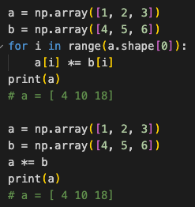
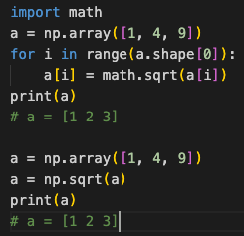
Numpy
Build-in array operations.
Numpy Tutorial: Link
Notes:
As previously mentioned, you will be implementing linear classification methods using only NumPy. NumPy is a powerful Python library that supports a wide range of array operations. We recommend that you have a basic understanding of NumPy before getting started. For instance, when performing element-wise multiplication, avoid writing code like this and instead utilize NumPy's multiplication function. Similarly, if you need to calculate element-wise square roots, there's no need to use the math library; simply use NumPy's numpy.sqrt() function.

Slide 6
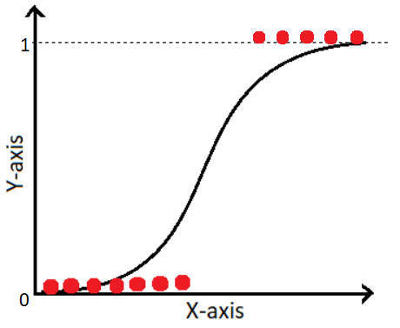
Logistic Regression
Find the best value of the weights and the intercept of a logistic model
Notes:
The first part is about Logistic Regression
In the course, you learned about logistic regression, which is the process of finding the optimal values for the weights and the intercept of a logistic model to predict the probability of an event.

Slide 7
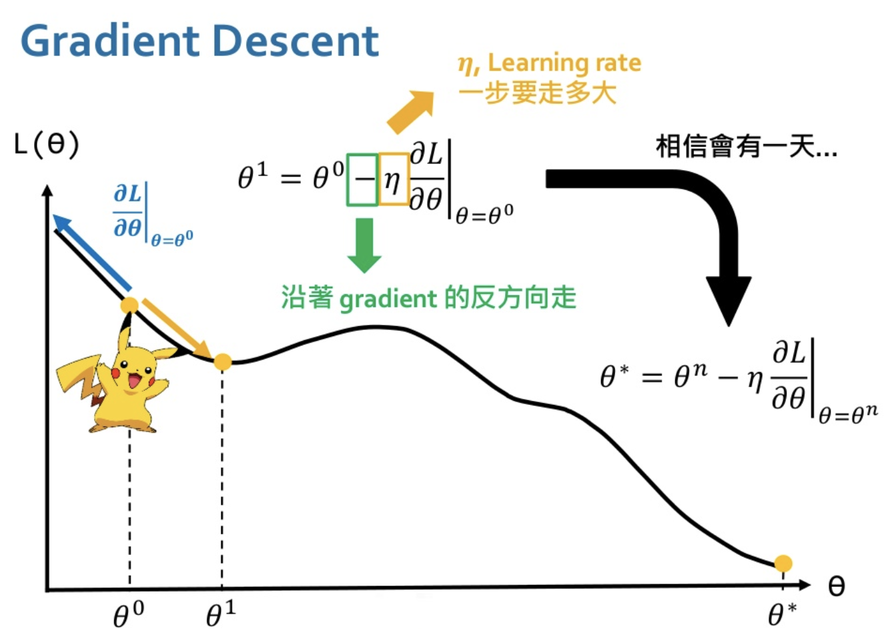
Logistic Regression
Gradient Descent
Notes:
And we can also use gradient descent to solve logistic regression just like you did in HW1.

Slide 8
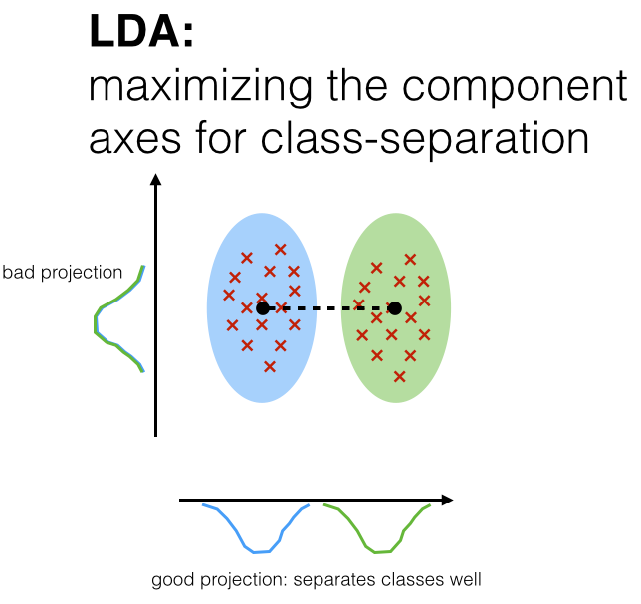
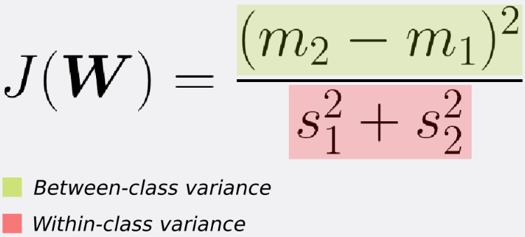
Fisher’s Linear Discriminant
FLD seeks the projection w that gives a large distance between the projected data means while giving a small variance within each class.
https://sebastianraschka.com/Articles/2014_python_lda.html, https://sthalles.github.io/fisher-linear-discriminant/
Notes:
The second part is Fisher’s Linear Discriminant.
In the course, you learned about Fisher’s Linear Discriminant, which seeks the projection w that gives a large distance between the projected data means while giving a small variance within each class.

Slide 9
Dataset
Heart Attack Dataset
Features
age
sex
cp: chest pain type (4 values)
fbs: fasting blood sugar > 120 mg/dl
thalach: maximum heart rate achieved
thal: 0 = normal; 1 = fixed defect; 2 = reversable defect
Target
target (0 = no heart attack, 1 = heart attack)
Notes:
You are going to implement the two linear classification methods on this dataset – Heart Attack Dataset.
Each data represent a patient
And these are the feature.
You are going to predict whether the patient has heart attack or not. So it is a simple binary classification problem.

Slide 10
Logistic Regression
Requirements:
Use Gradient Descent to update your model
Use CE (Cross-Entropy) as your loss function.
Criteria:
(0%) Show the hyperparameters (learning rate and iteration) that you used.
(5%) Show your weights and intercept of your model.
(10%) Show the accuracy score of your model on the testing set.
Notes:
For logistic regression, you have to use Gradient Descent to update your model and use cross-entropy loss as your loss function.
You have to show the hyperparameters you used, the weights and intercept of your model, and the accuracy score of your model.

Slide 11
Fisher’s Linear Discriminant
Requirements:
Implement FLD to reduce the dimension of the data from 2-dimensional to 1-dimensional.
Criteria:
(0%) Show the mean vectors m_{i} (i=0, 1) of each class of the training set.
(5%) Show the within-class scatter matrix S_{W} of the training set.
(5%) Show the between-class scatter matrix S_{B} of the training set.
(5%) Show the Fisher’s linear discriminant w of the training set.
(10%) Obtain predictions for the testing set by measuring the distance between the projected value of the testing data and the projected means of the training data for the two classes. Show the accuracy score on the testing set.
Notes:
For logistic Fisher’s Linear Discriminant, Implement FLD to reduce the dimension of the data from 2-dimensional to 1-dimensional.
You have to show the mean vectors of the two classes, the within-class scatter matrix SW, the between-class scatter matrix SB and finally the Fisher’s linear discriminant w.
After that, you have to obtain the predictions for the testing data by measuring the distance between the projected value of the testing data and the projected means of the training data for the two classes. Finally, you have to show the accuracy score of your model.

Slide 12
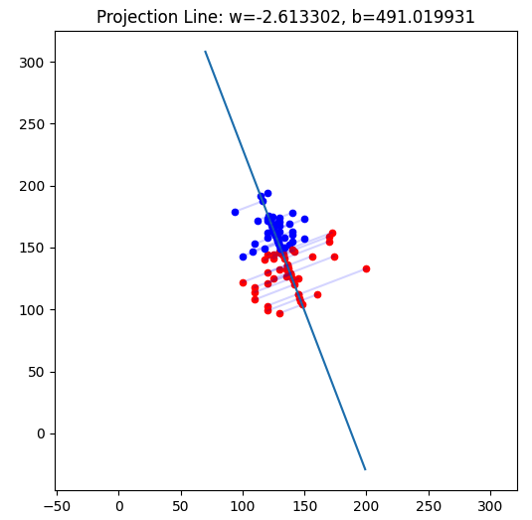
Fisher’s Linear Discriminant
Criteria:
(10%) Plot the projection line.
Plot the projection line trained on the training set and show the slope and intercept on the title.
Obtain the prediction of the testing set, plot and colorize them based on the prediction.
Project all testing data points on your projection line.
Notes:
And you are asked to draw a plot like this one:
Plot the projection line trained on the training set and show the slope and intercept on the title.
Obtain the prediction of the testing set, plot and colorize them based on the prediction.
Project all testing data points on your projection line.

Slide 13
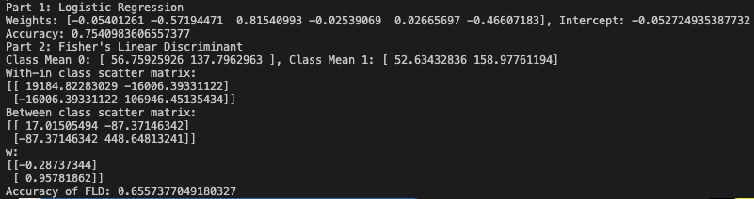
Code Output
Do not modify the main function architecture.
Your code output will look like this:
Notes:
We have already finished the main function, do not modify it and your code output will look like this.

Slide 14
Report
Please follow the same report template format just like HW1.
Link
Notes:
About the report, please follow the report template format.

Slide 15

Submission
Compress your code and report into a .zip file and submit it on E3.
<STUDENT ID>_HW2.zip
<STUDENT ID>_HW2.py
<STUDENT ID>_HW2.pdf (do not submit .doc, .docx or others format)
Notes:
About submission, you have to Compress your code and report into a .zip file and submit it on E3. You should name your files correctly.

Slide 16

Late policy
We will deduct a late penalty of 20 points per additional late day.
For example, If you get 90 points but delay for two days, your will get only 50 points!
Notes:
The final section is about our late policy. Please be aware that for each additional late day beyond the due date, a late penalty of 20 points will be deducted. For instance, if you earned 90 points but submitted your work two days late, your final score will be reduced to 50 points. Please submit your assignment on time.

Slide 17

Have Fun!

