Slide 1
Lecture 4
Ngrams Smoothing
CSCE 771
Natural Language Processing
Topics
  Python
  NLTK
  N – grams
  Smoothing
Readings:
  Chapter 4 – Jurafsky and Martin
January 23, 2013

Slide 2
Last Time
  Slides from Lecture 1 30-
    Regular expressions in Python, (grep, vi, emacs, word)?
    Eliza
  Morphology
Today
  Smoothing N-gram models
  Laplace (plus 1)
  Good Turing Discounting
  Katz Backoff
  Neisser-Ney

Slide 3
Problem
Let’s assume we’re using N-grams
How can we assign a probability to a sequence where one of the component n-grams has a value of zero
Assume all the words are known and have been seen
  Go to a lower order n-gram
  Back off from bigrams to unigrams
  Replace the zero with something else

Slide 4
Smoothing
Smoothing - reevaluating some of the zero and low probability N-grams and assigning them non-zero values
Add-One (Laplace)
Make the zero counts 1., really start counting at 1
Rationale: They’re just events you haven’t seen yet. If you had seen them, chances are you would only have seen them once… so make the count equal to 1.

Slide 5
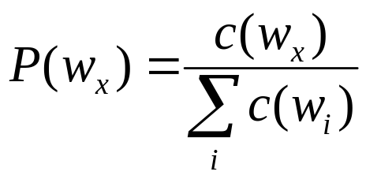
Add-One Smoothing
Terminology
N – Number of total words
V – vocabulary size == number of distinct words
Maximum Likelihood estimate

Slide 6
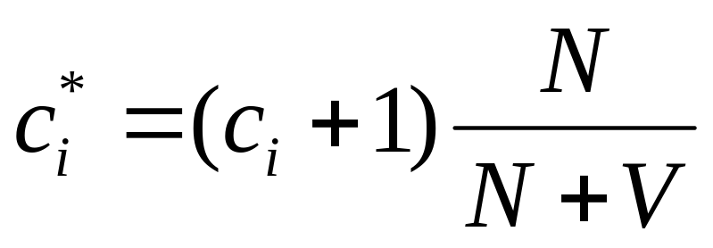
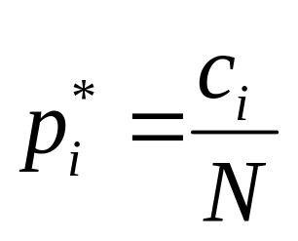
Adjusted counts “C*”
Terminology
N – Number of total words
V – vocabulary size == number of distinct words
Adjusted count C*
Adjusted probabilities

Slide 7
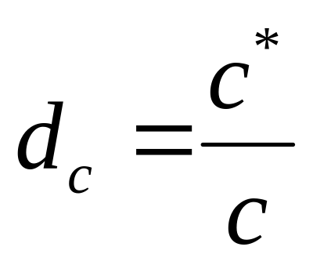
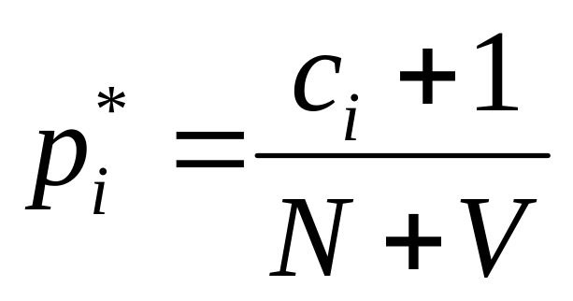
Discounting View
Discounting – lowering some of the larger non-zero counts to get the “probability” to assign to the zero entries
d_{c} – the discounted counts
The discounted probabilities can then be directly calculated

Slide 8
Original BERP Counts (fig 4.1)
Berkeley Restaurant Project data
V = 1616

Slide 9
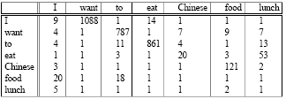
Figure 4.5 Add one counts (Laplace)
Counts
Probabilities

Slide 10
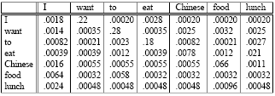
Figure 6.6 Add one counts & prob.
Counts
Probabilities

Slide 11
Add-One Smoothed bigram counts
Think about the occurrence of an unseen item (

Slide 12
Good-Turing Discounting
Singleton - an word that occurs only once
Good-Turing: Estimate probability of word that occur zero times with the probability of a singleton
Generalize words to bigrams, trigrams … events

Slide 13
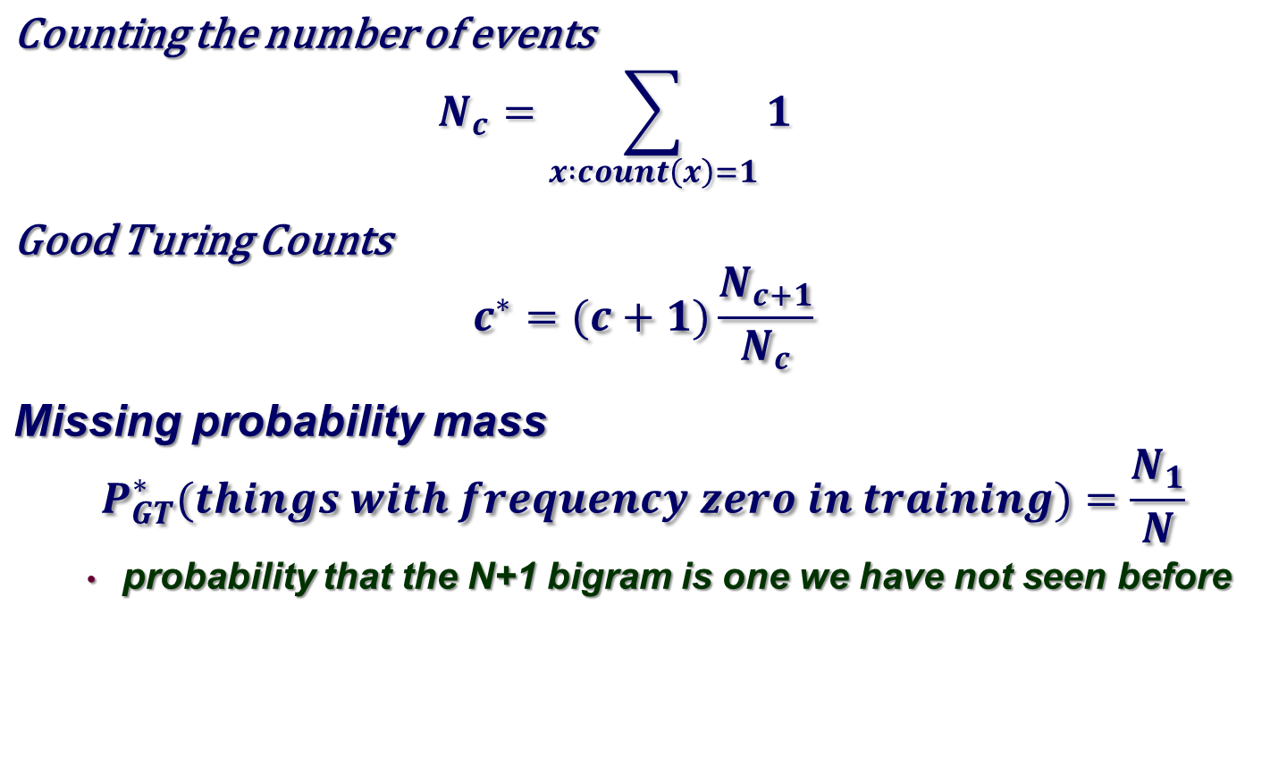
Calculating Good-Turing

Slide 14
Witten-Bell
Think about the occurrence of an unseen item (word, bigram, etc) as an event.
The probability of such an event can be measured in a corpus by just looking at how often it happens.
Just take the single word case first.
Assume a corpus of N tokens and T types.
How many times was an as yet unseen type encountered?

Slide 15
Witten Bell
First compute the probability of an unseen event
Then distribute that probability mass equally among the as yet unseen events
  That should strike you as odd for a number of reasons
  In the case of words…
  In the case of bigrams

Slide 16
Witten-Bell
In the case of bigrams, not all conditioning events are equally promiscuous
  P(x|the) vs
  P(x|going)
So distribute the mass assigned to the zero count bigrams according to their promiscuity

Slide 17
Witten-Bell
Finally, renormalize the whole table so that you still have a valid probability

Slide 18
Original BERP Counts;
Now the Add 1 counts

Slide 19
Witten-Bell Smoothed and Reconstituted

Slide 20
Add-One Smoothed BERP
Reconstituted

