Slide 1
Final Project
-
Web Crawler
Yizhe Zhao

Slide 2
Content
Introduction
Classes and functions
Demo
Conclusion

Slide 3
Introduction - What Is Web Crawler?
A Web crawler, sometimes called a spider or spiderbot and often shortened to crawler, is an Internet bot that systematically browses the World Wide Web, typically for the purpose of Web indexing (web spidering).

Slide 4

Introduction - The Goal Of The Final Project
Collect useful information from a specific website

Slide 5
Class - general
Libraries used: os
Functions:
create_project_dir: create a directory for a project
create_data_files: Create queue and crawled files
wirte_file: write data to a new file
append_to_file: Add data onto an existing file
delete_file_contents: delete contents of a file
file_to_set: convert each line of the file to set items
set_to_file: Iterate through a set, each item will be a new line in the file

Slide 6
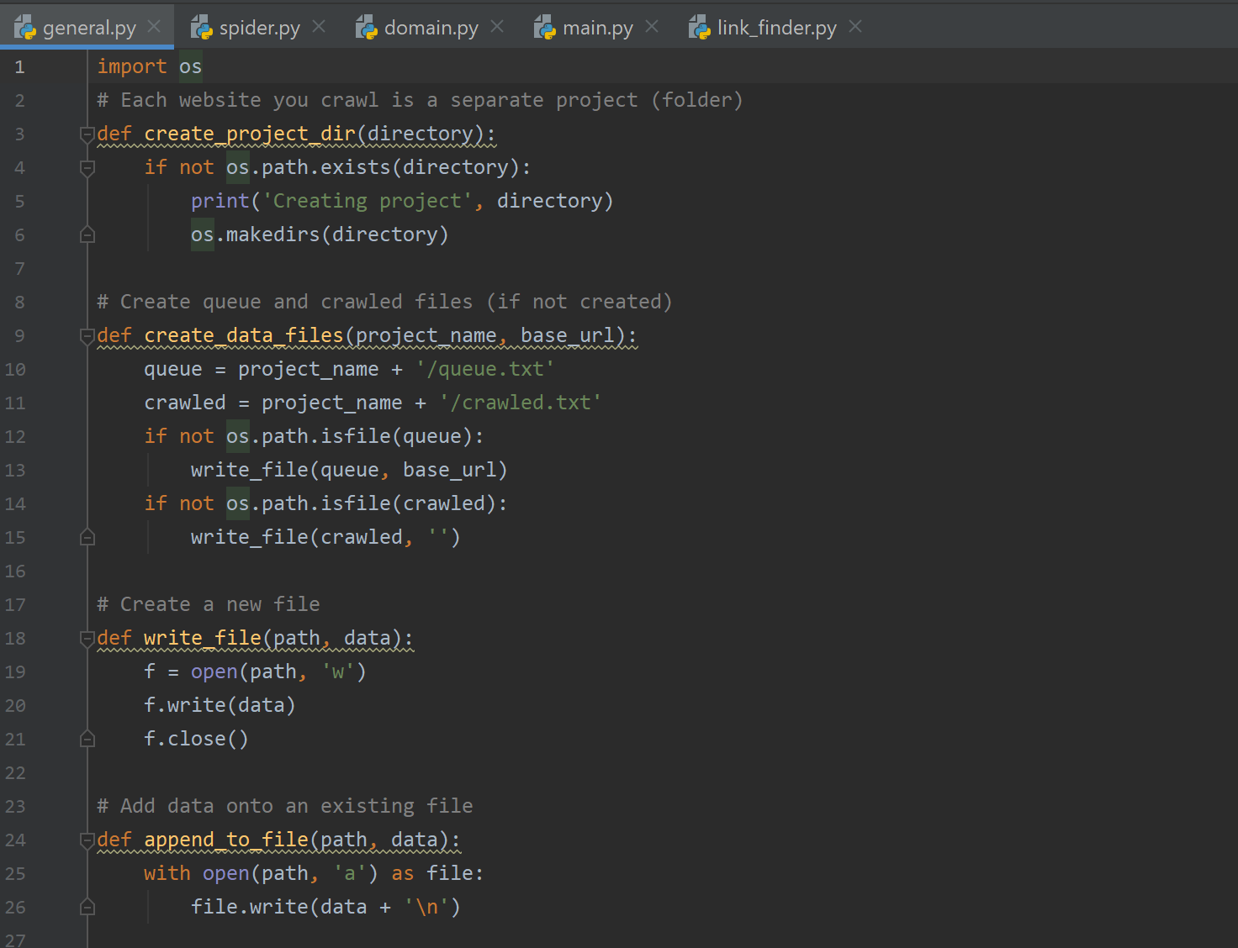
Class - general - example

Slide 7
Class - link_finder
Libraries used: parse from urllib
Functions:
constructor: Inherit functions from “HTMLPareser”, set some basic values
handle_starttag: handle the start of a tag
page_links: return links in the set
error: pass if met an error

Slide 8
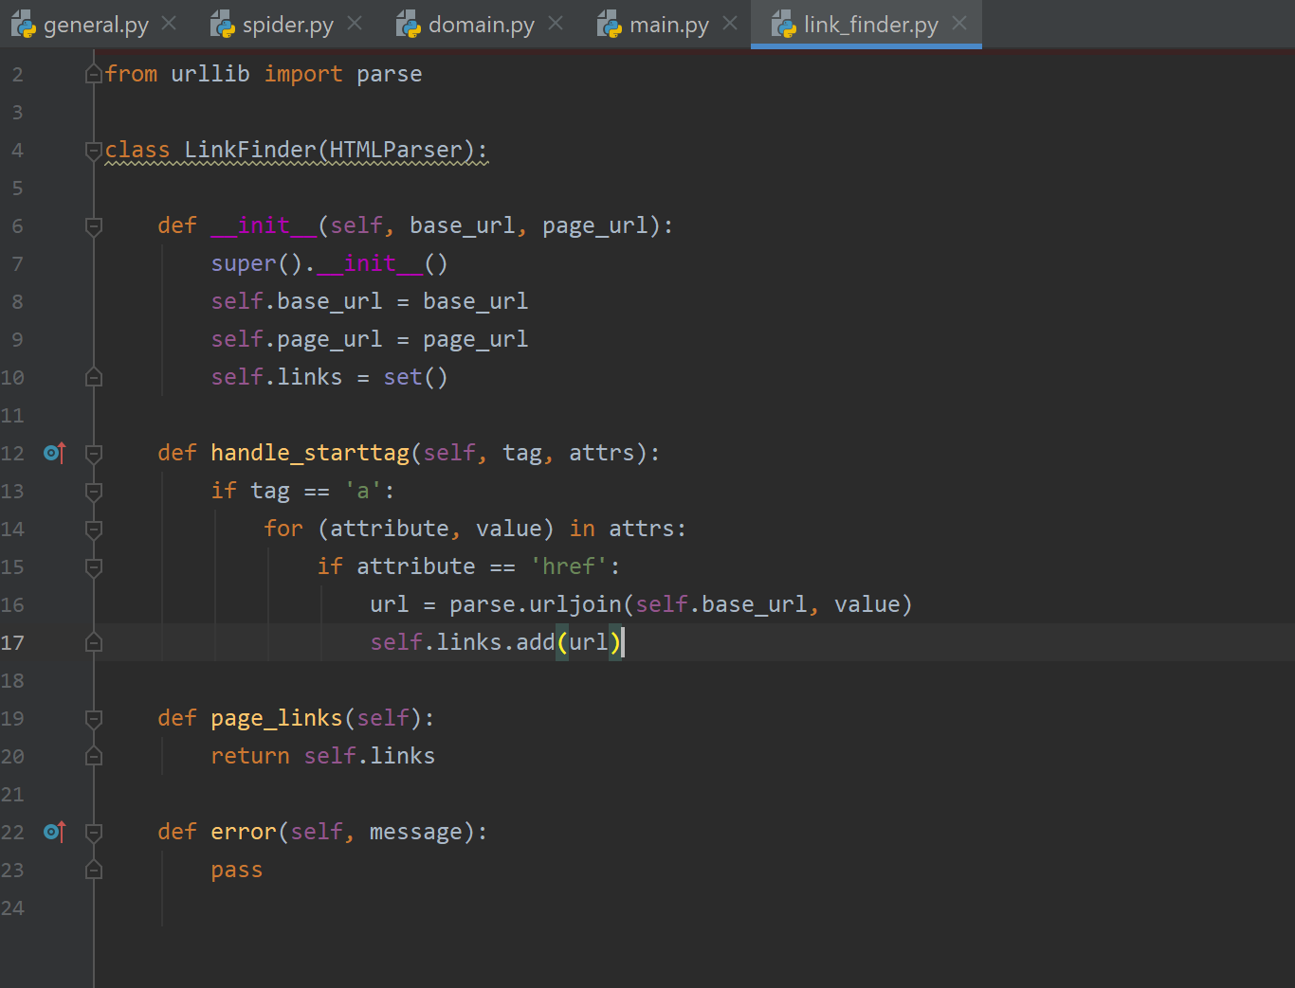
Class - link_finder - example

Slide 9
Class - domain
Libraries used: urlparse from urllib.parse
Functions:
get_domain_name: get domain name of a link and return top level domain and second level domain
get_sub_domain_name: helper function for the function, “get_domain_name”

Slide 10
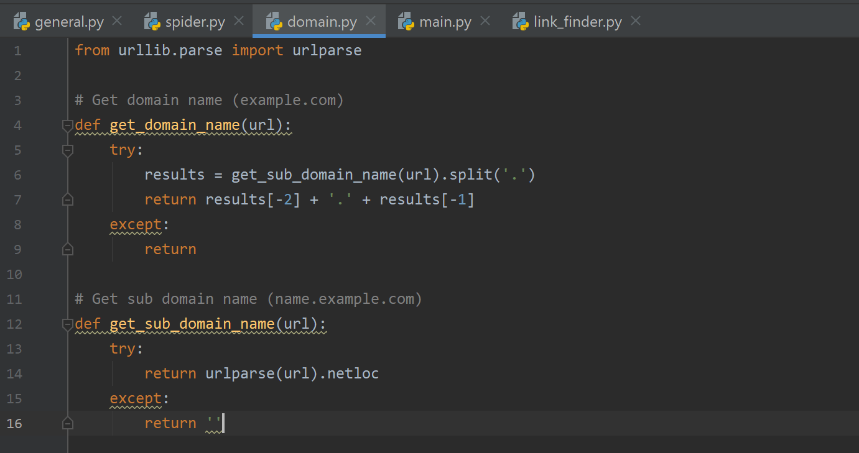
Class - domain - example

Slide 11
Class - Spider
Libraries used: urllib.request from urlopen, general, link_finder and domain
Private data types:
Project_name (str)
Base_url (str)
Domain_name (str)
Queue_file (str)
Crawled_file (str)
Queue (set)
Crawled (set)

Slide 12
Class - Spider
Functions:
constructor: initialize the class, ‘Spider’
boot: deploy files needed for crawling a website
crawl_page: crawling, filling queue and updating user display and files
gather_links: converts raw response data into readable information and checks for proper html formatting
add _links_to_queue: if find a new link, add it to queue
update_files: Update queue file and crawled file

Slide 13
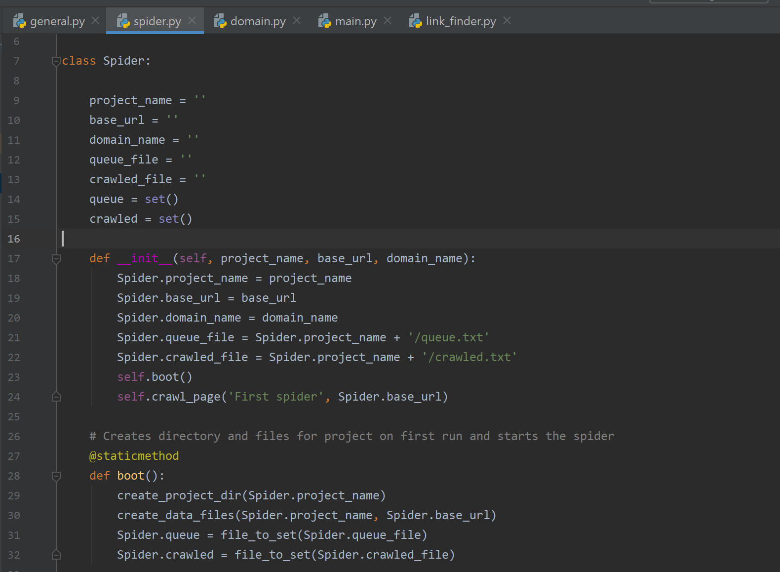
Class - spider - example

Slide 14
Class - main
Libraries used: threading, queue, general, link_finder, spider, and domain
Data types:
Project_name (str)
Homepage (str)
Domain_name (str)
Queue_file (str)
Number_of_threads (int)
Thread_queue (queue)
Spider (spider)

Slide 15
Class - main
Functions:
create_spiders(): create a spider for each thread, start multiply crawling
work(): target of each spider, make spiders crawl pages
create_jobs(): create jobs for spider
crawl(): the trigger of crawling

Slide 16
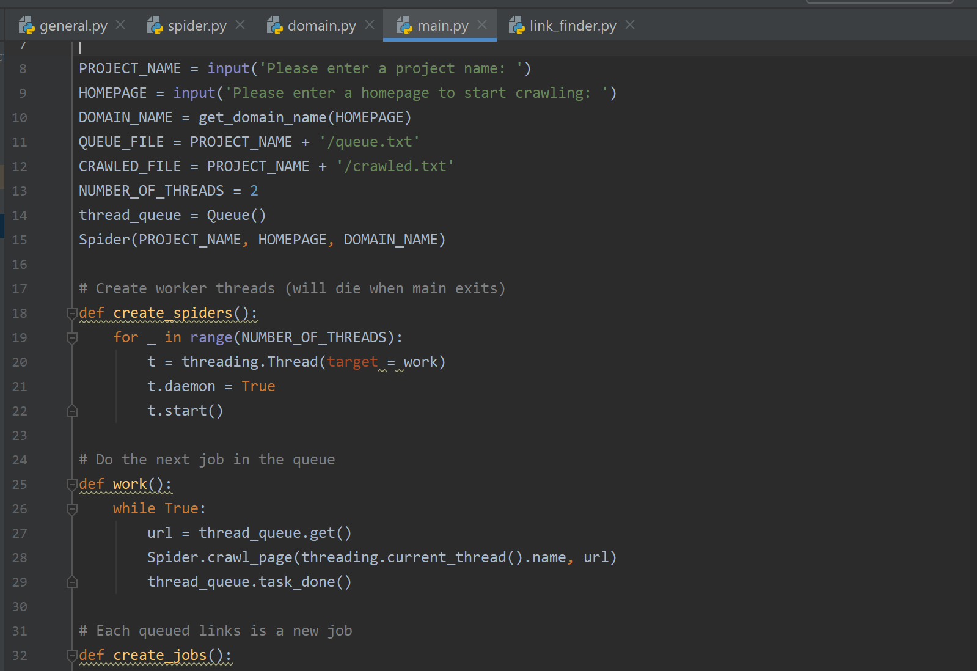
Class - main - example

Slide 17
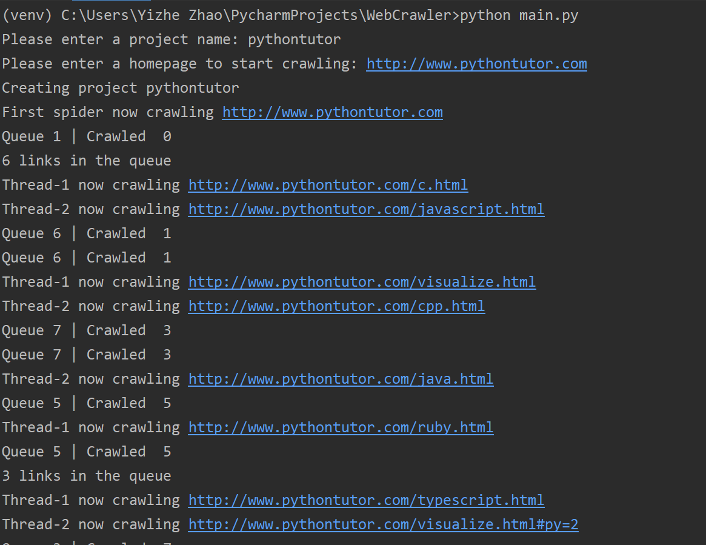
Demo 1
Project name: pythontutor; Homepage: http://www.pythontutor.com

Slide 18
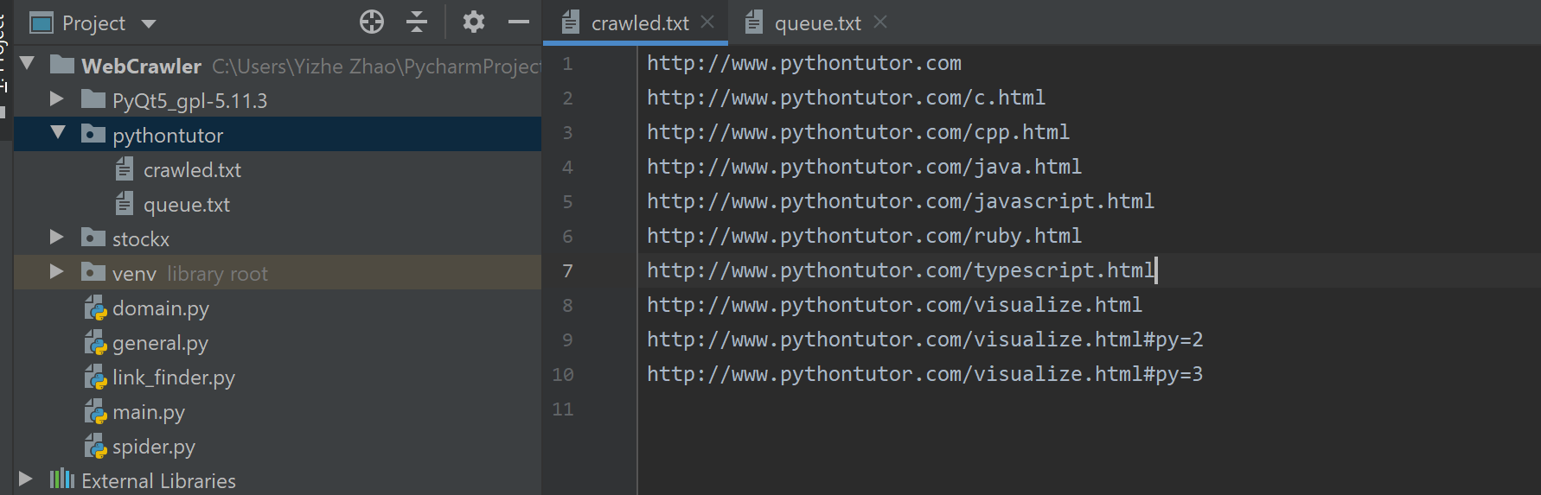
Demo 1

Slide 19
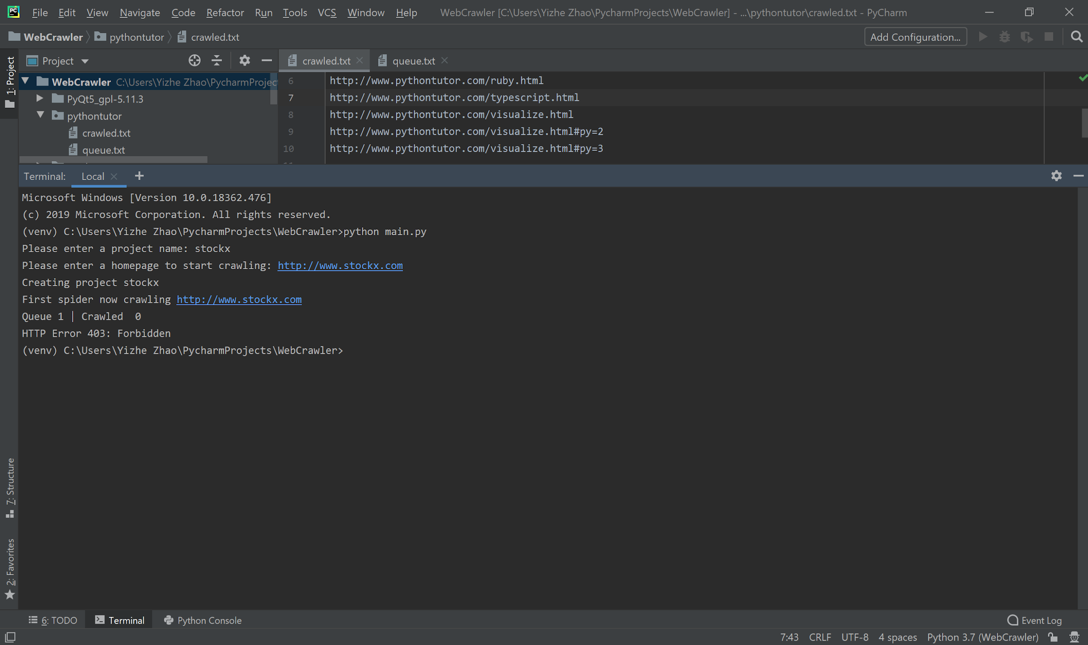
Demo - 2
Project name: stockx; Homepage: http://www.stockx.com

Slide 20
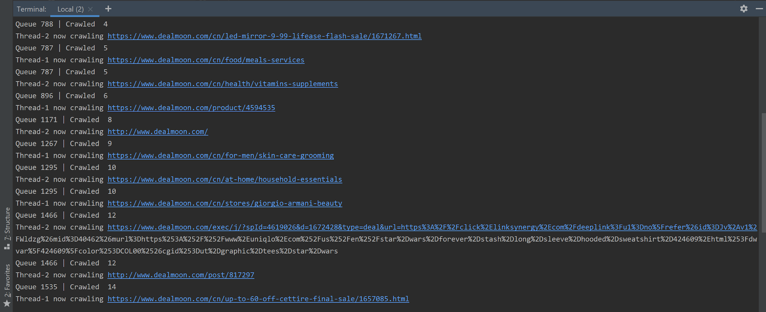
Demo - 3
Project name: dealmoon; Homepage: http://dealmoon.com

Slide 21
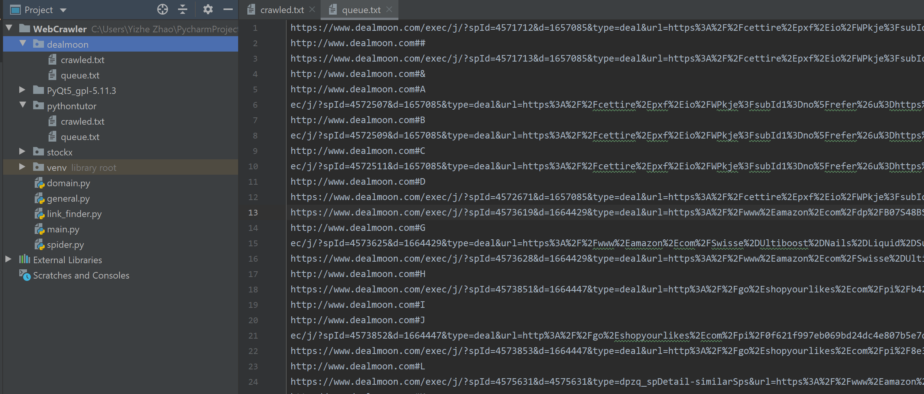
Demo - 3

Slide 22
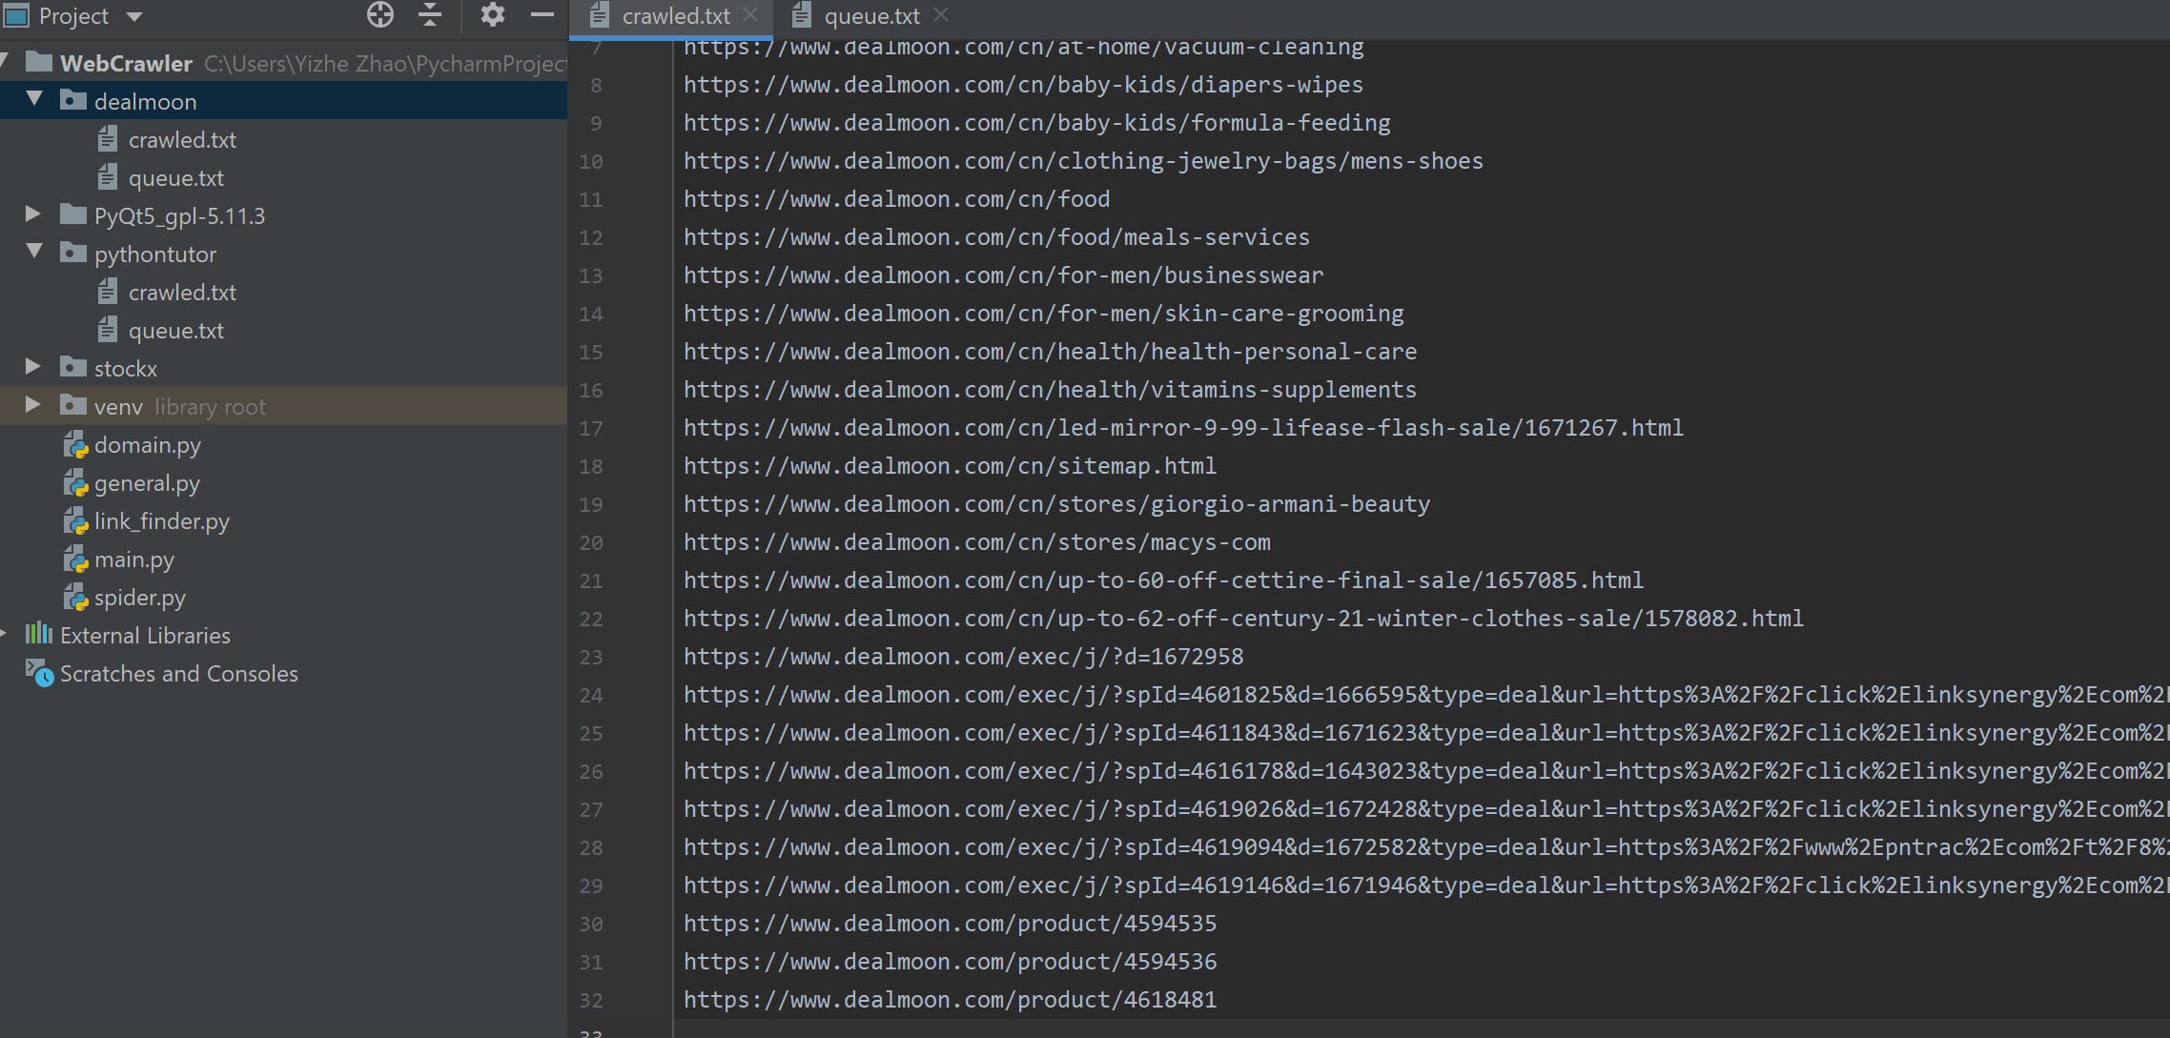
Demo - 3

Slide 23
Conclusion
“Make it work, make it right, make it fast.” – Kent Beck

Slide 24
Thanks for taking your time

