Slide 1
Spike-in Project
Carol Zhou

Slide 2
Table of contents
Introduction
Methods
Results
R Function

Slide 3
Introduction

Slide 4
RNA Spike-in
An RNA transcript of known sequence.
It was first used to calibrate variations in RNA hybridization assays.
Now it is also adapted to be used in sequencing.
It is a quality control.
Each sample is assigned and added a specific spike-in.
If the highest-read spike-in matches the assigned spike-in, the sample is prepared and sequenced correctly.

Slide 5
Questions
01
02
What is the lower cutoff for the number of spike-in reads?
Are there any spike-in aliquots with low concentrations?
What is the upper cutoff for the read difference between spike-ins with the highest read and the second highest read?
Is there any cross-contamination of spike-ins in a batch?

Slide 6
Methods
1606 COVID-19 (n = 1295), Dengue (n = 173), and BWH (n = 138) samples
Read per million (RPM) = highest spike-in reads / total reads * 1000000
Second-highest to highest spike-in-read ratio (SHR) = second-highest spike-in reads / highest spike-in reads
Range: 0-1
The spike-in confirmation status was re-calculated
All analyses were done in R.

Slide 7
Results Finding a lower cutoff for the RPM values

Slide 8
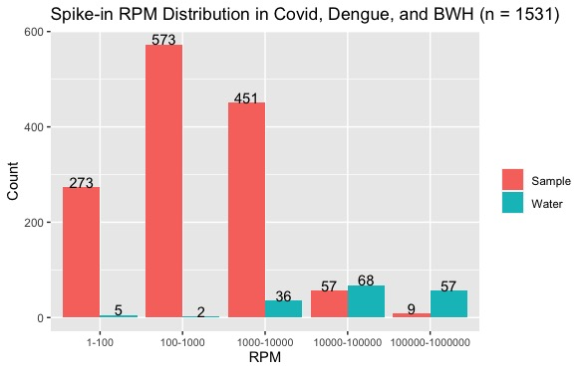
Samples (n = 1363) vs Water (n = 168) RPM

Slide 9
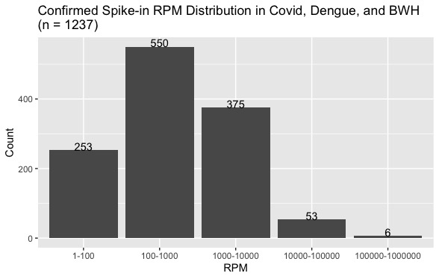
RPM Distribution
RPM Range | Percentage
1-100 | 20.45%
100-1000 | 44.46%
1000-10000 | 30.32%
10000-100000 | 4.28%
100000-1000000 | 0.49%
74.78%

Slide 10
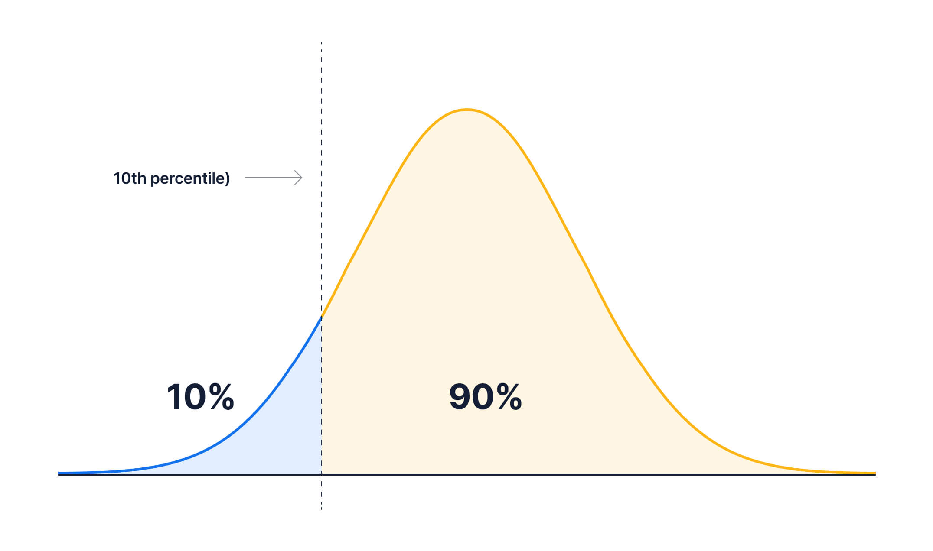
RPM Distribution
RPM Range | Percentage
1-100 | 20.54%
100-1000 | 44.42%
1000-10000 | 30.4%
10000-100000 | 4.24%
100000-1000000 | 0.41%
Percentile | RPM
20 | 94.28
15 | 61.85
10 | 32.56
5 | 12.41
3 | 7.24

Slide 11
Spike-ins with 1-100 RPM
Assigned Spike-ins | Low RPM Count | Total Count | Percentage
ERCC-00023 | 24 | 27 | 88.89%
ERCC-00077 | 16 | 20 | 80.00%
ERCC-00054 | 18 | 23 | 78.26%
ERCC-00067 | 12 | 24 | 50.00%

Slide 12
Results Finding an upper cutoff for the SHR values

Slide 13
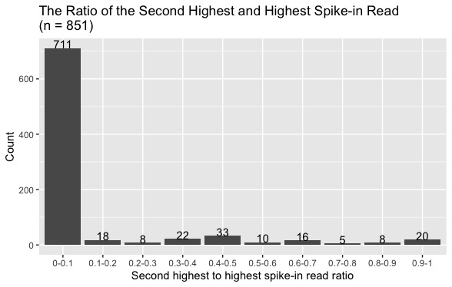
SHR Distribution
SHR Range | Count | Percentage
0-0.1 | 711 | 83.55%
≥ 0.1 | 140 | 16.45%
Percentile | SHR
80 | 0.05
85 | 0.16
90 | 0.43
95 | 0.63
97 | 0. 84

Slide 14
Spike-ins with > 0.43 SHR
Sequenced Date | Virus | Count | Total Count | Percentage
2022-12-01 | Dengue | 15 | 18 | 83.33%
2023-02-13 | Dengue | 12 | 15 | 80.00%
2023-02-02 | Dengue | 13 | 21 | 61.90%
2022-12-08 | Dengue | 11 | 18 | 61.11%

Slide 15
Summary
The lower cutoff for spike-in RPM
12.41 – 100
12.41 is the lowest cutoff
The upper cutoff for spike-in SHR
0.16 – 0.43
0.43 is the highest cutoff

Slide 16
R Function

Slide 17
confirm_spikein3.0.1
Description
A function used for calculating whether the expected spike-ins are confirmed and other spike-ins detected and their reads.
Usage
confirm_spikein3.0.1(spikein_dnanexus, spikein_ssss, spikein_sampleid)
Arguments
spikein_dnanexus | A count_summary.tsv file downloaded from DNAnexus
spikein_ssss | A csv file that contains information for the corresponding samples from SSSSS on Teams
spikein_sampleid | A csv file that contains only sample IDs for the corresponding samples from SSSSS on Teams

Slide 18
Instruction
General → Current lab members folders → Carol → Spike-in Project → R

Slide 19
Citation
https://en.wikipedia.org/wiki/RNA_spike-in#
https://www.thermofisher.com/order/catalog/product/4456740
Slidesgo.com

