Slide 1

Tutorial of Stigmata
Haruaki Tamada, Ph.D.
http://stigmata.sourceforge.jp/tutorial.pdf
Software Engineering Lab.,
Graduate School of Information and Science,
Nara Institute of Science and Technology

Slide 2
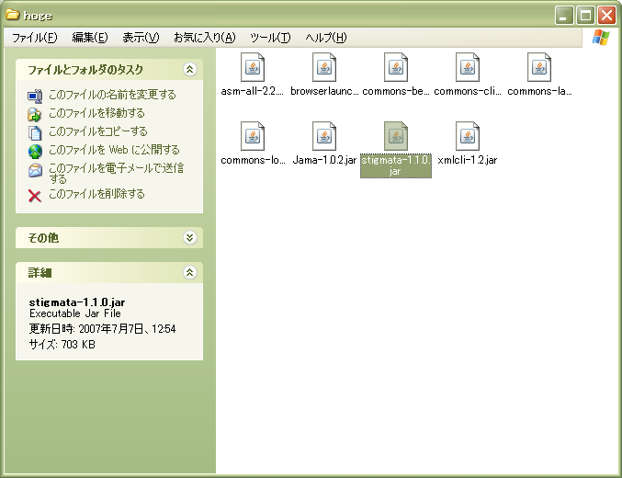
Launching Stigmata
Double Click, then launch stigmata

Slide 3
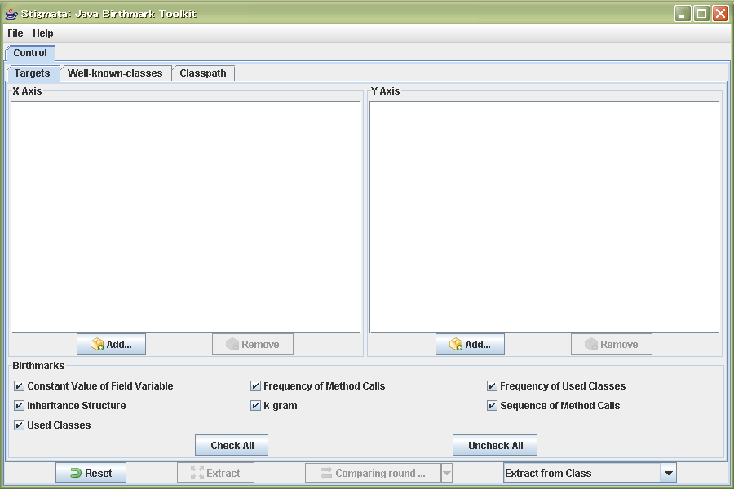
Screenshot

Slide 4
Choose target
Press this button, then file opening dialog is shown

Slide 5
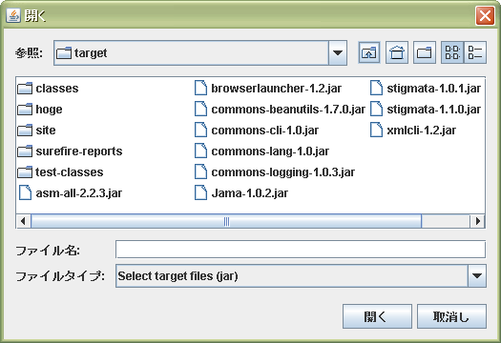
Choose target jar file
Select Jar file, and press open button

Slide 6
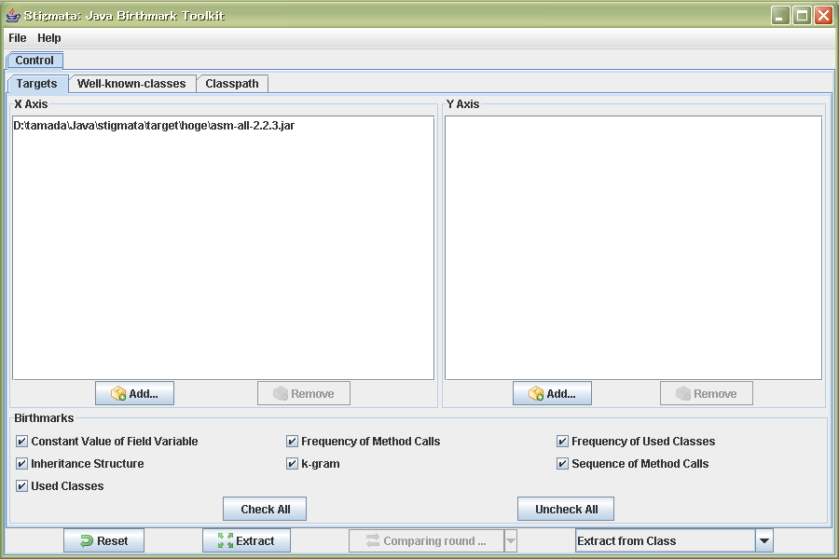
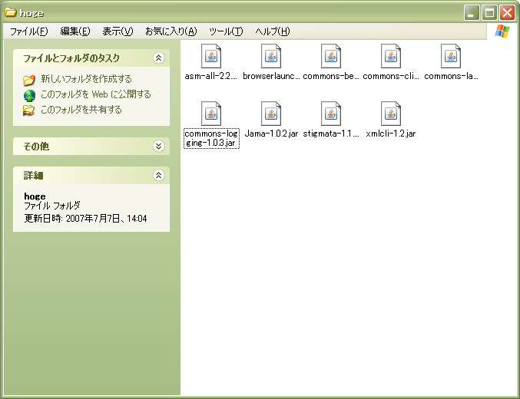
Other choice method (D&D)
Drag jar file and drop it into target list component, then the jar file was chosen as target.

Slide 7
Select extracted birthmarks
Select extracted birthmarks

Slide 8
Select extraction unit
Select extraction unit. Default is extracting from each class file. Other unit is extracting from package, and jar file (product)

Slide 9
Extract birthmarks from targets
Press ``extract’’ button, then extracting birthmarks from targets.

Slide 10
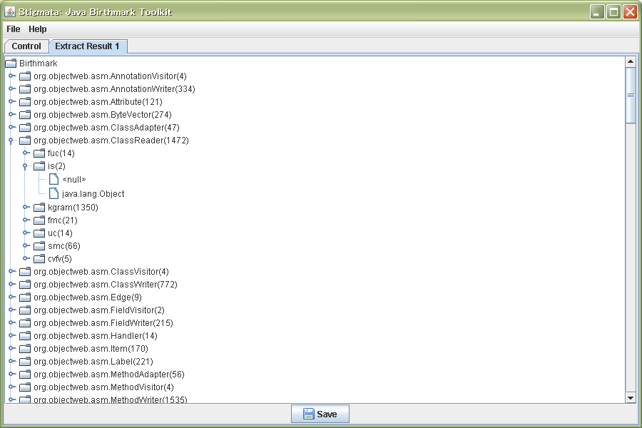
Extract birthmarks from targets
The list of extracted birthmarks in new tab.

Slide 11
Back to ``control’’ pane
Click this tab, then go back to ``control’’ pane.

Slide 12
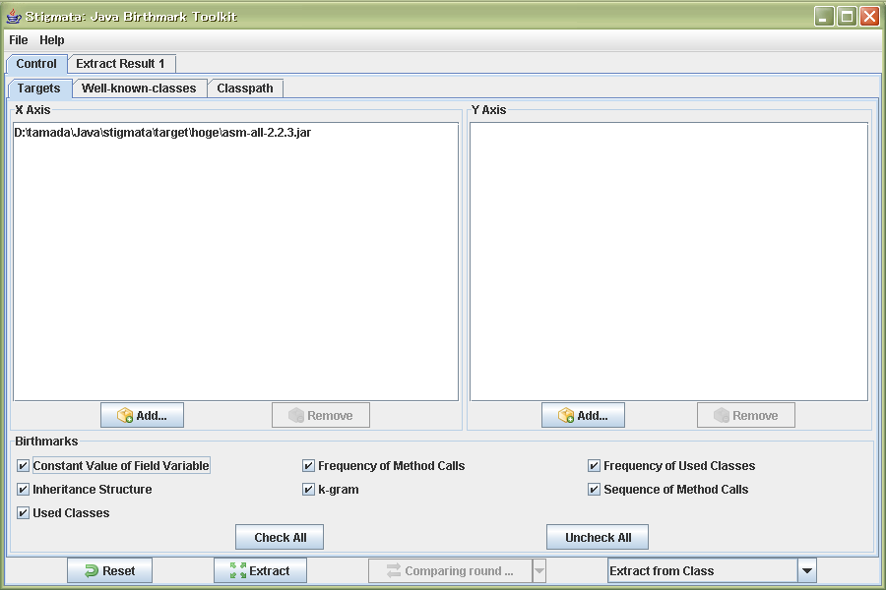
Add target file into Y axis
Press this button and choose target file.

Slide 13
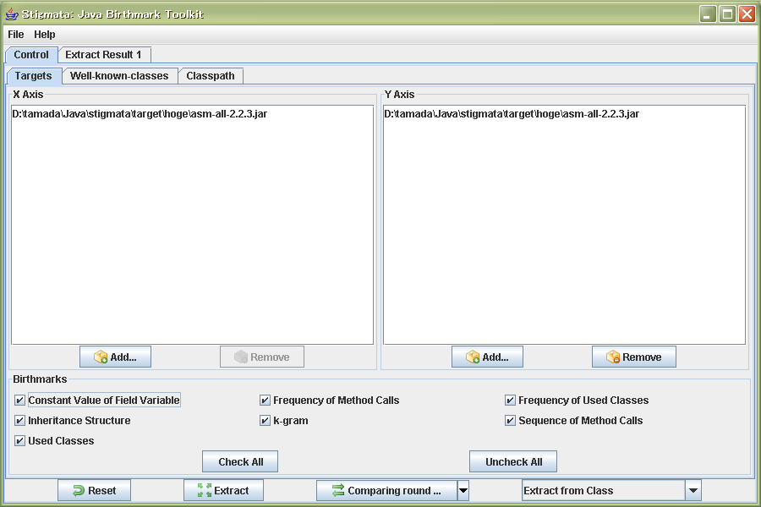
Extract birthmarks from targets
Press ``comparing round robin’’ button, then extracting birthmarks from targets.

Slide 14
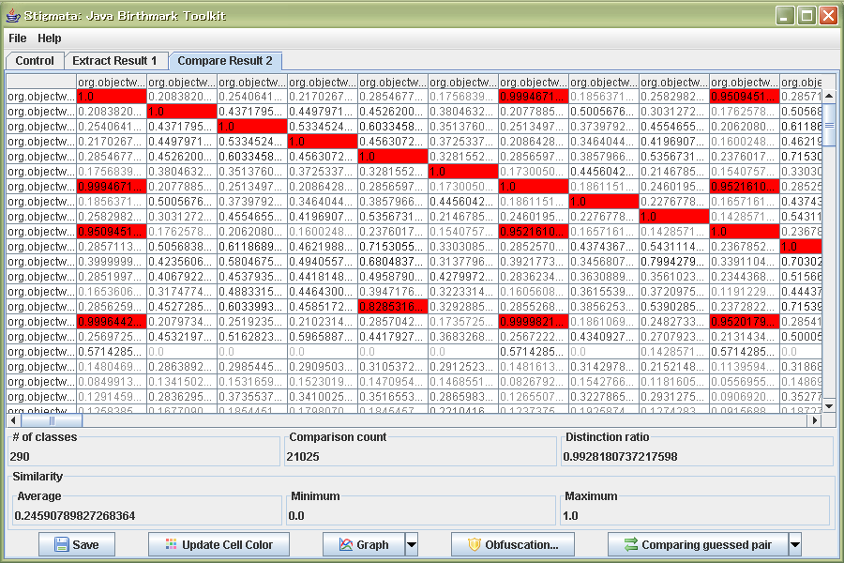
Comparison result of birthmarks
(Round robin comparison)

Slide 15
Comparison result of birthmarks
(Round robin comparison)
Click ``Save’’ button, then file save dialog is shown. You can save those result as csv and xml format.

Slide 16
Extract birthmarks from targets
Double clicking some cell, then opening new tab to show details of comparison pair.

Slide 17
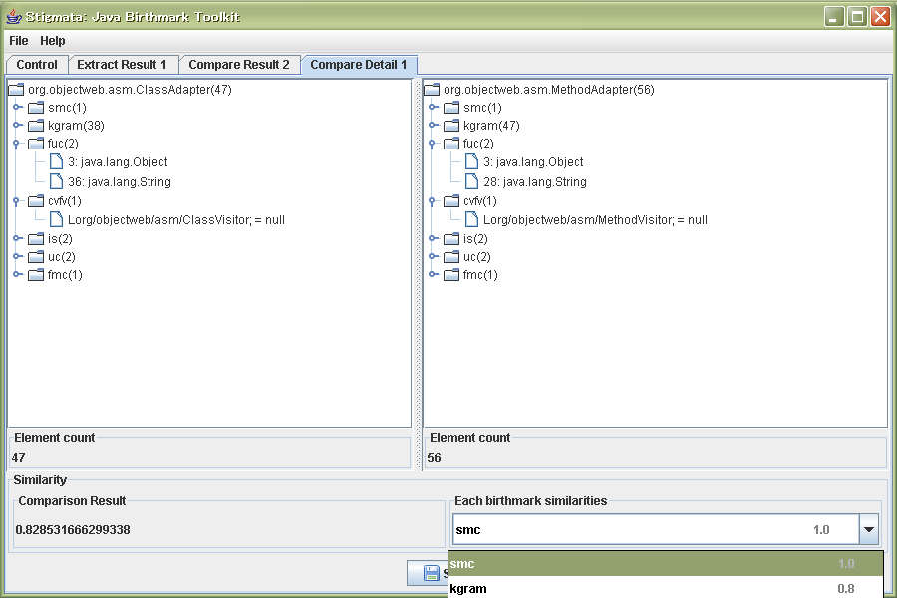
The result of comparison pair

Slide 18
Showing similarity distribution graph
Press ``Graph’’ button, then similarity distribution graph is shown in new tab.

Slide 19
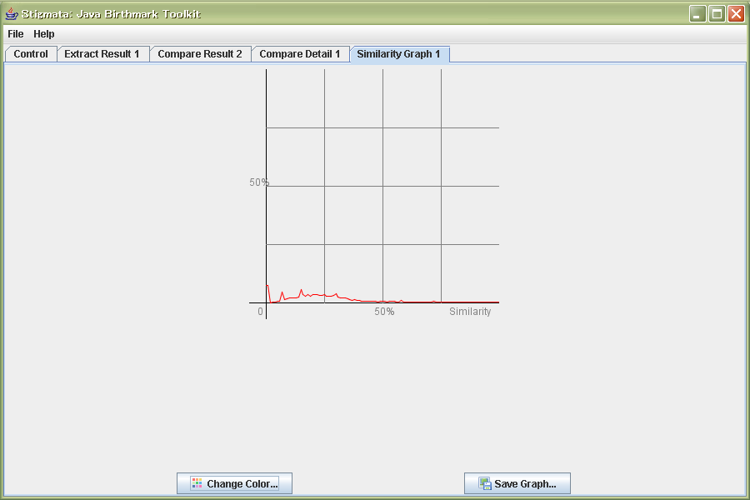
Similarity distribution graph

Slide 20
Showing mapping of classes
Press arrow button besides of ``Graph’’ button and popup menu is shown, select ``Distance Mapping’’ menu, then distance mapping is shown in new tab.

Slide 21
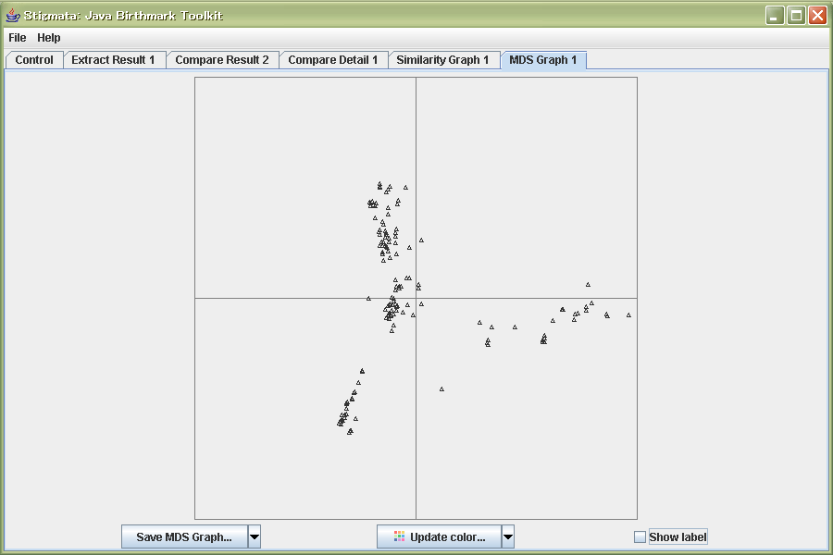
Distance mapping graph

Slide 22
Showing mapping of classes
Press ``Comparing guessed pair’’ button, showing the result of comparing birthmarks by same name pair from X and Y axis.

Slide 23
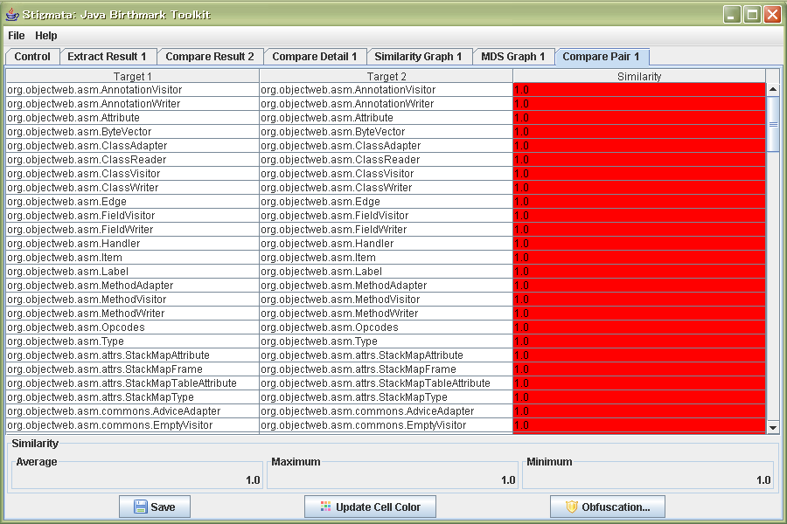
Showing mapping of classes

