Slide 1
THE IMPACT OF THE COVID-19 PANDEMIC ON AMAZON.COM
ZEYNEP ZİLAN YILDIRIM

Slide 2

The closure of people to their homes for precautionary purposes has caused a change in shopping habits.
People are becoming more active in online shopping, which is already growing steadily.

Slide 3

Actually, not much is presented differently. Amazon was founded by Jeff Bezos on July 5, 1994 in Washington. The company first emerged as an online marketplace for books, but over time it has expanded to sell electronic gadgets, video games, clothing, furniture, food, toys, and jewelry. In 2015, it surpassed Walmart as the most valuable retailer in the United States in terms of market value.

Slide 4

Why did people choose AMAZON.COM?

Slide 5
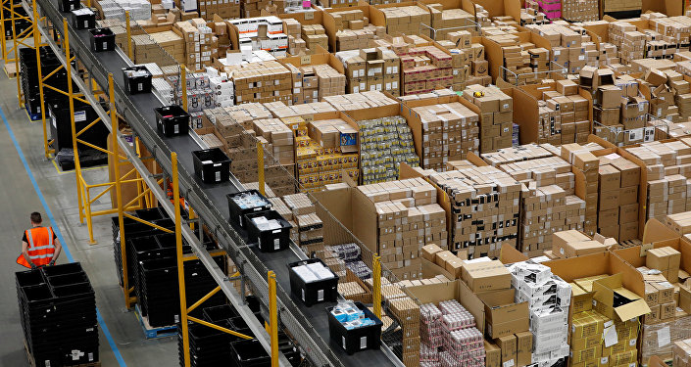
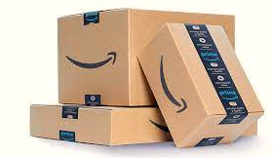

Slide 6
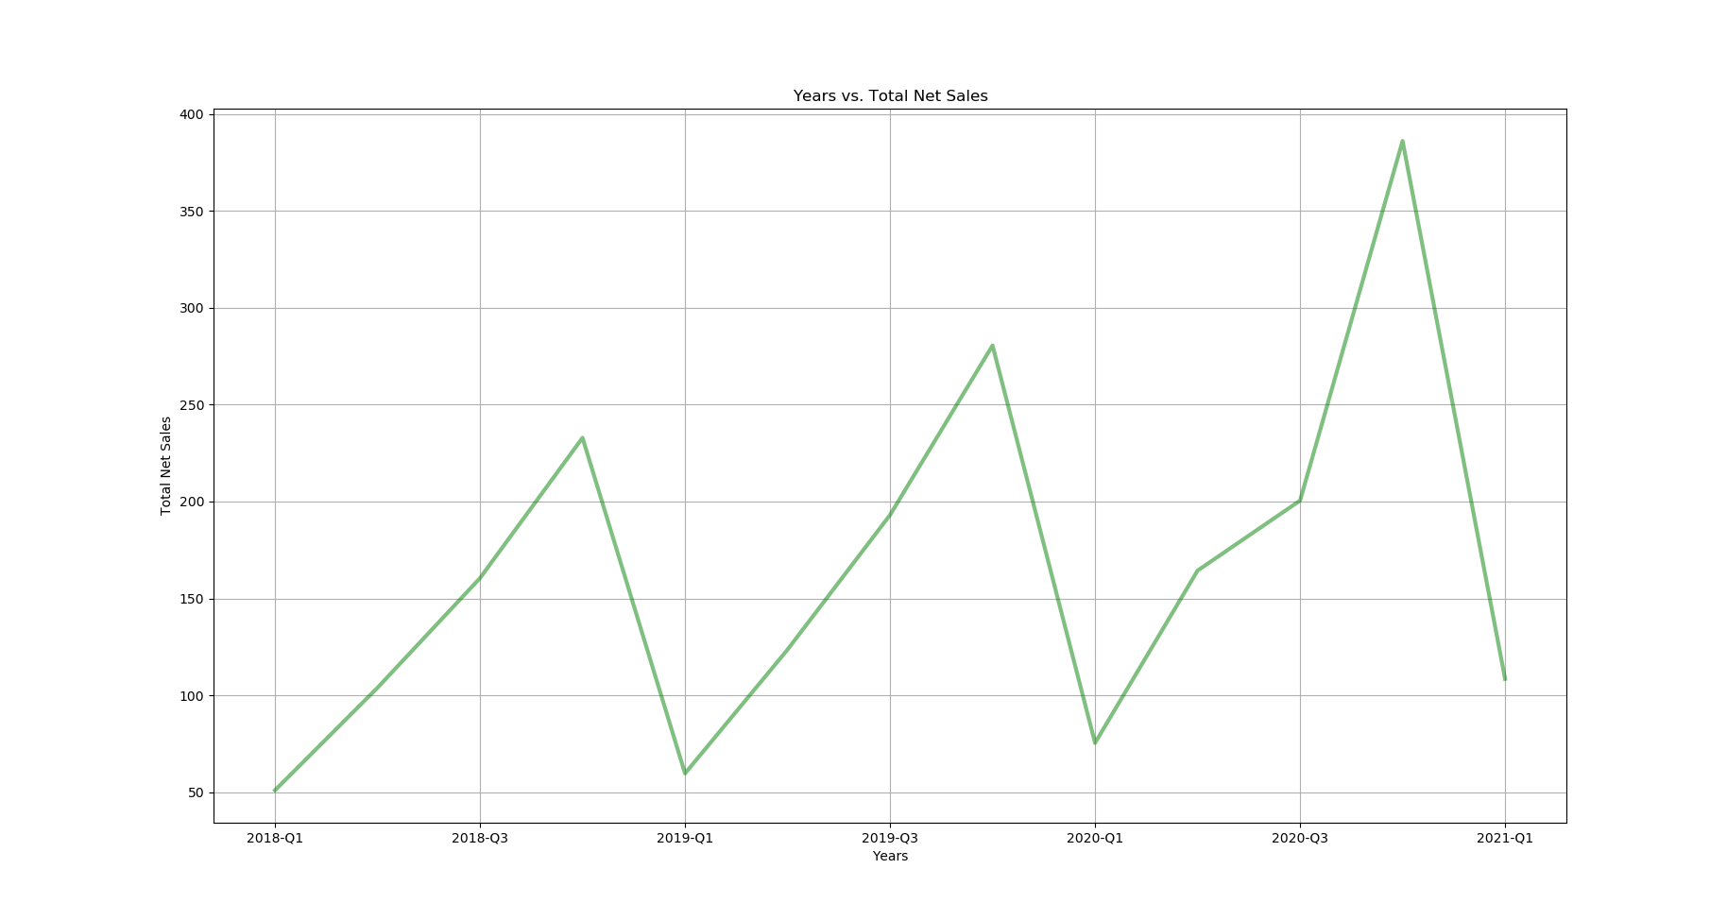
Total net sales growth between 2019 and 2021 is 34,8%

Slide 7
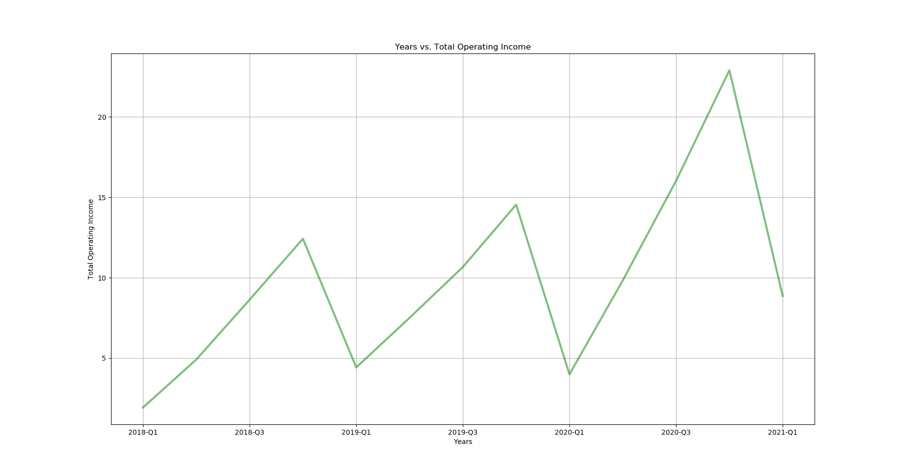
Total operating income growth between 2018 and 2021 is 21,75%

Slide 8
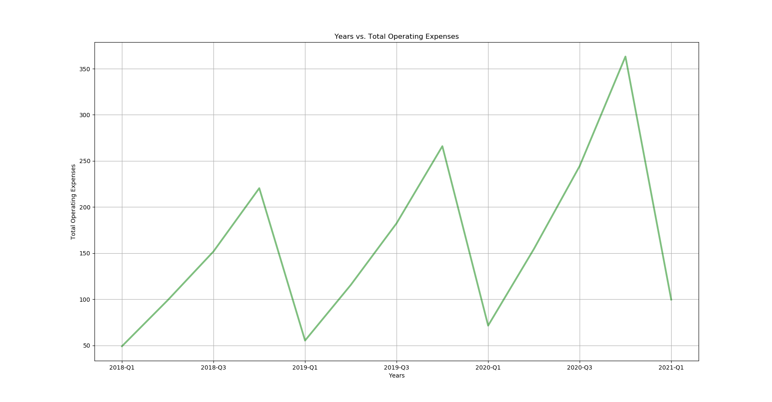
Total operating expenses growth between 2018 and 2021 is 26,5%

Slide 9
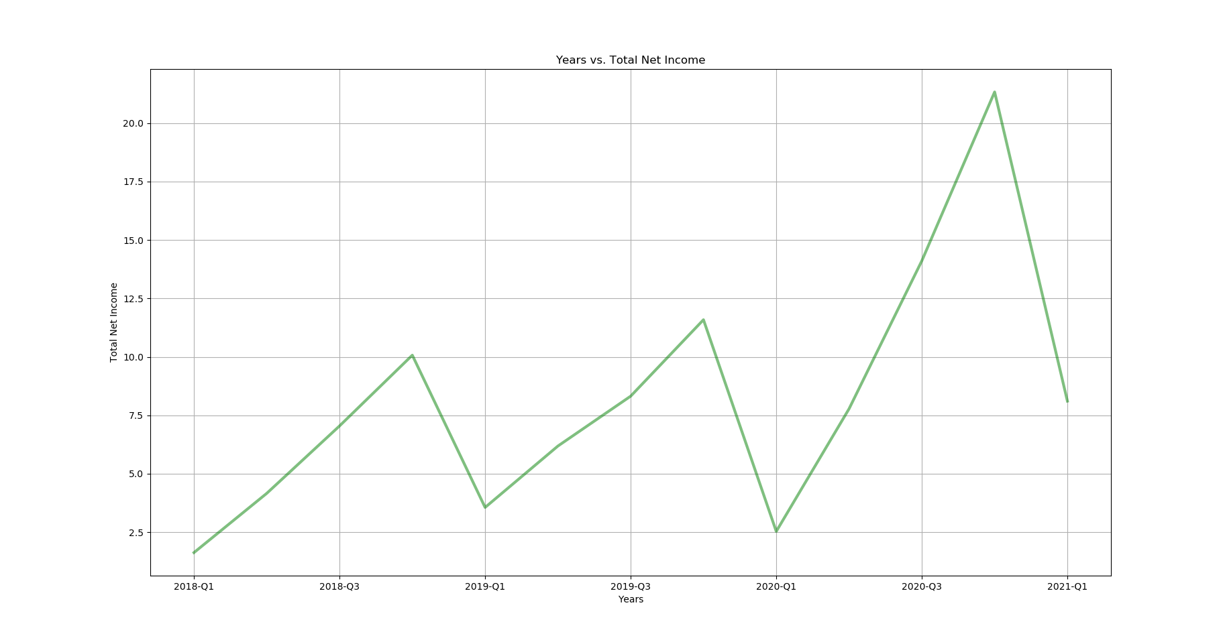
Total net income growth between 2018 and 2021 is 70,7%

Slide 10
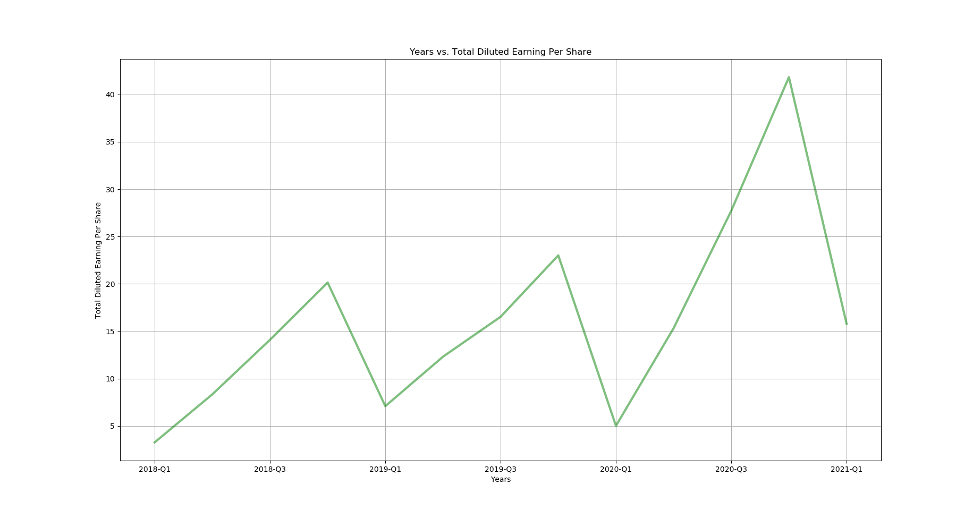
Total diluted earning per share growth between 2018 and 2021 is 69,02%

