Slide 1

Frito Lay Employee Attrition and Data Analysis

Slide 2
Steven Williams - CEO Hugh Johnston- CFO
Audience
Data Analysis Report Prepared By
Zach Zaiken, Data Scientist @ DDSAnalytics
Documentation:
Link to Github: https://github.com/zz415/SMU_DDS_6306_CaseStudy2
Link to Knit File: https://zz415.github.io/SMU_DDS_6306_CaseStudy2/11.21.20_CaseStudy2.html
Link to Youtube:

Slide 3
Outline & Key Findings
Primary Factors of Attrition:
- JobRole
- MonthlyIncome
- Overtime
Naïve-Bayes Attrition Classification & Prediction Model
Job Role Employee Wellness Trends and Inferences
Monthly Income Regression & Prediction Model

Slide 4

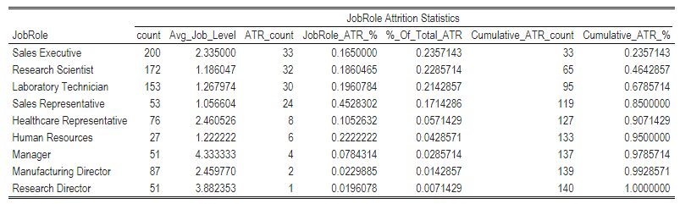
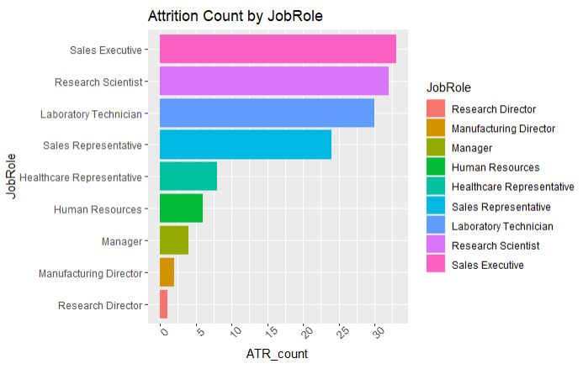
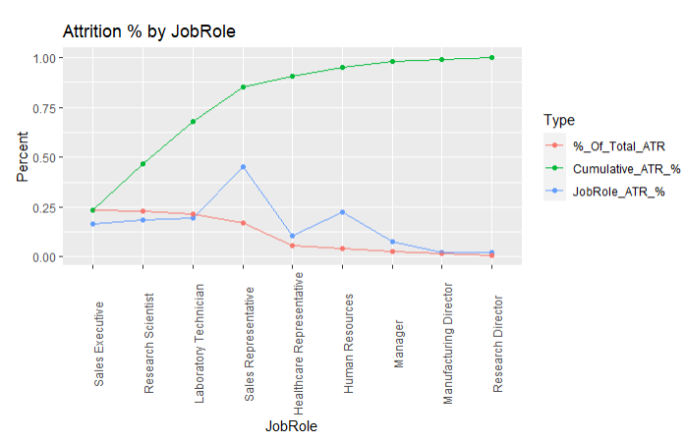
Primary Factors of Attrition: JobRole
Data Inferences
Attrition is heavily tied to 4 job roles within the company:
Sales Executive
Research Scientist
Laboratory Technician
Sales Representative
Account for 85% of the total attrition among employees
Have the highest job specific Attrition Rates of listed Job roles (exception: HR)
Based on the average Job level, there is correlation these are lower position or entry level jobs, which may also tie into attrition motivations

Slide 5
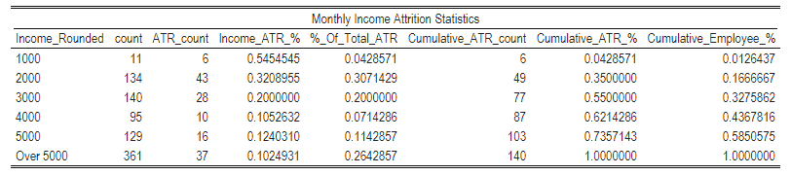
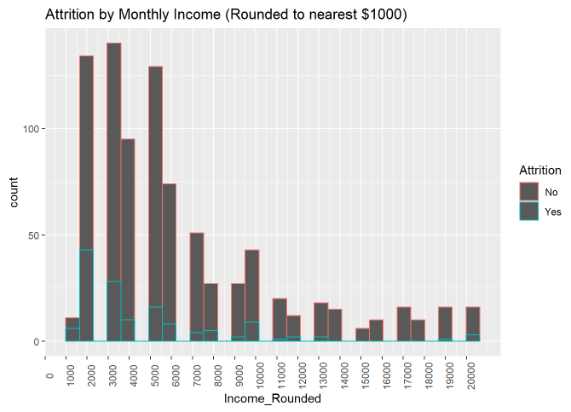
Primary Factors of Attrition: Monthly Income
Data Inferences
Attrition is greatly skewed to employees with lower Monthly Income
Incomes <= $5000 account for 73% of the total attrition among employees despite only being 58% of the total employee count
Very high attrition level in Incomes rounded to 1K, 2K & 3K (54%,32%,20%) vs the attrition rate of employees making over 5K (10%)

Slide 6


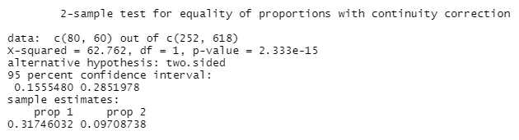
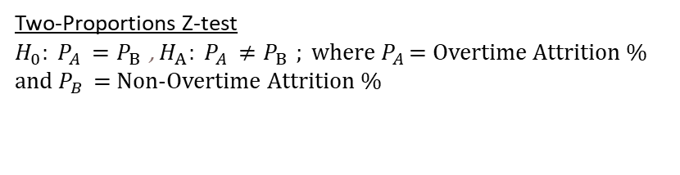
Primary Factors of Attrition: OverTime
Data Inferences
Attrition for Overtime workers is 3-fold that of Non-Overtime employees (31% vs 9%)
Overtime workers account for 57% of all employee attrition but account for only 28% of the employee count
2 Sample test for equality of proportions confirms with statistical significance (p-value < .0001) that the attrition % of Overtime vs Non- Overtime employees are not equal (95% confidence interval [15.5% - 28.5%])
Two-Proportions Z-test
$H_{0}: P_{A }=P_{B }$, $H_{A}: P_{A }≠P_{B }; w$here $P_{A }$= Overtime Attrition % and $P_{B }$ = Non-Overtime Attrition %

Slide 7
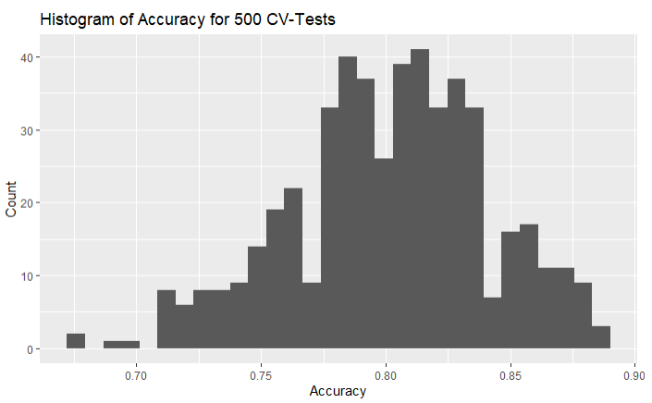

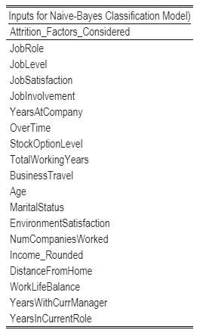
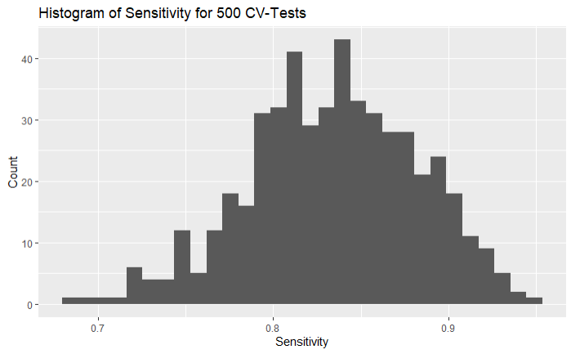
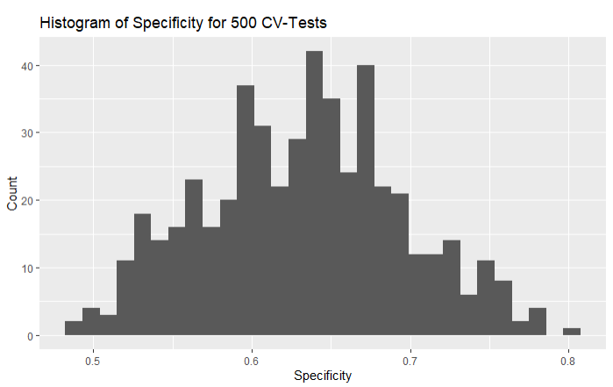
Naïve-Bayes Attrition Classification
Data Inferences
Although JobRole, Monthly Income & Overtime play a key role in Attrition, there are many more factors to consider.
The following model uses Naïve Bayes and calculates the Attrition classification based on the conditional probabilities of 18 different variables
500 iterations of 70/30 Test & Train sets were done to assess effectiveness of the classification model. The average accuracy, Sensitivity and Specificity of the model are 80%, 83% and 63% respectively.

Slide 8

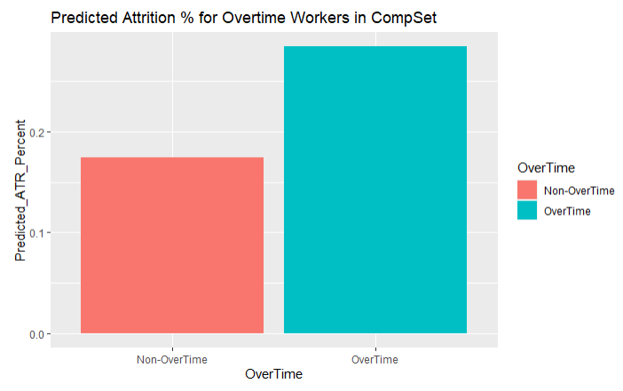
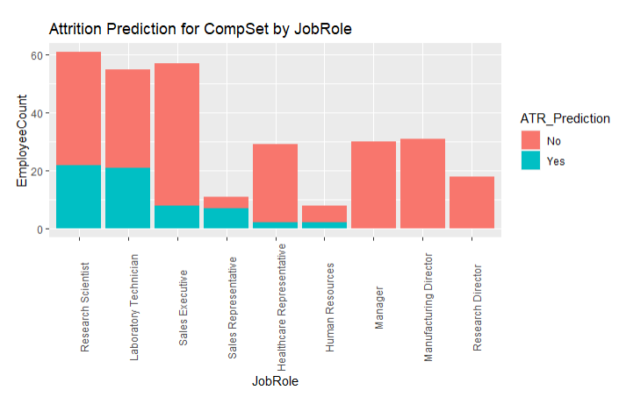
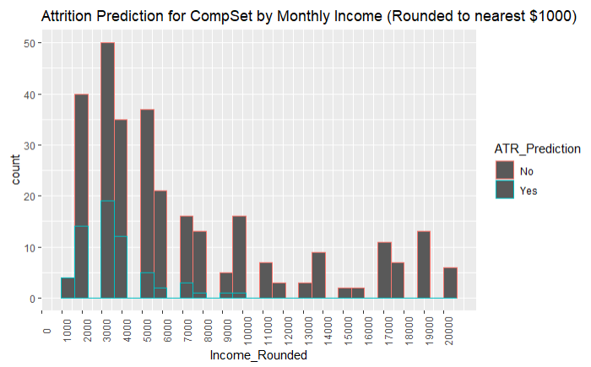
Naïve-Bayes Prediction Model
Data Inferences
Naïve-Bayes Prediction Model on CompSet yields 20% expected attrition (vs. 16% from the original data set)
3 Primary factors of Attrition show consistent results with that of the original data set:
High attrition counts and % in 4 identified JobRoles
High attrition associated to employees making less than $5000 per month
High attrition % in employees that work Ovetime

Slide 9
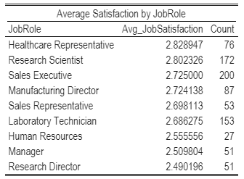
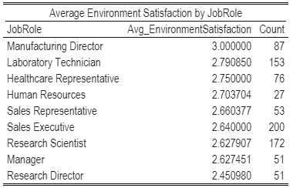
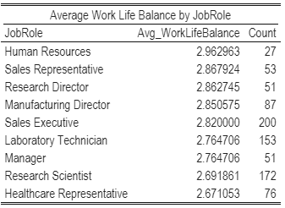
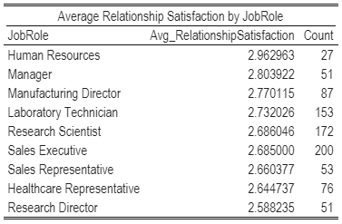
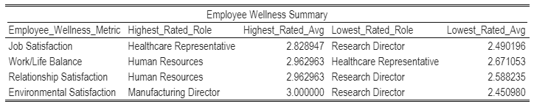
Employee Wellness Statistics by JobRole
Data Inferences
Average Statistics by JobRole of key employee wellness measures including: Job Satisfaction, Work Life Balance, Relationship Satisfaction and Environment Satisfaction
Human Resources ranks at the top in 50% , while Research Director the lowest rated in 75% of major categories
Can these trends be inferred to a larger population of employees and JobRoles?

Slide 10
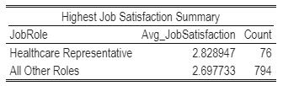


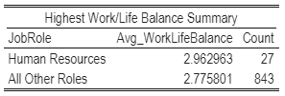

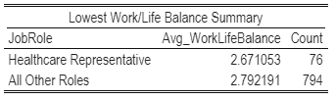
Employee Wellness Summary & Significance Testing by JobRole
Data Inferences
T-test were conducted to test the statistical significance of the highest & lowest rated job role from each wellness metric vs all other job roles
Highest and Lowest Rate Job roles for Job Satisfaction and Work/Life balance were found to be statistically insignificant (P-value > .05)

Slide 11

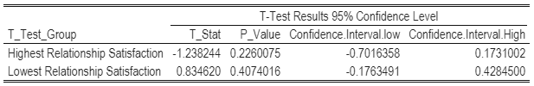



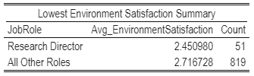
Employee Wellness Summary & Significance Testing by JobRole (cont.)
Data Inferences
T-test were conducted to test the statistical significance of the highest & lowest rated job role from each wellness metric vs all other job roles
Environment Satisfaction of Manufacturing Director was revealed to be statistically significant (p-value = .004)

Slide 12
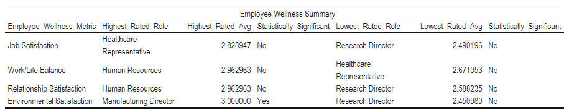
Employee Wellness Summary & Significance Testing by JobRole (cont.)
Data Inferences
T-test were conducted to test the statistical significance of the highest & lowest rated job role from each wellness metric vs all other job roles
Only Environment Satisfaction of Manufacturing Director was revealed to be statistically significant (p-value = .004)
Other than this once case, it is statistically inconclusive to apply or assume the employee wellness trends from this sample to a larger population of employees.
All Job roles (except for Environmental Satisfaction of Manufacturing Directors) could have the same average across all wellness metrics

Slide 13
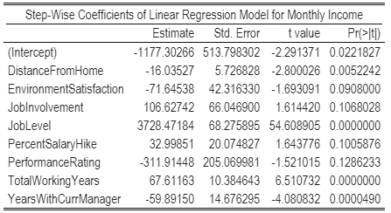

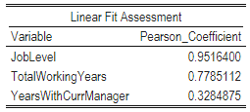
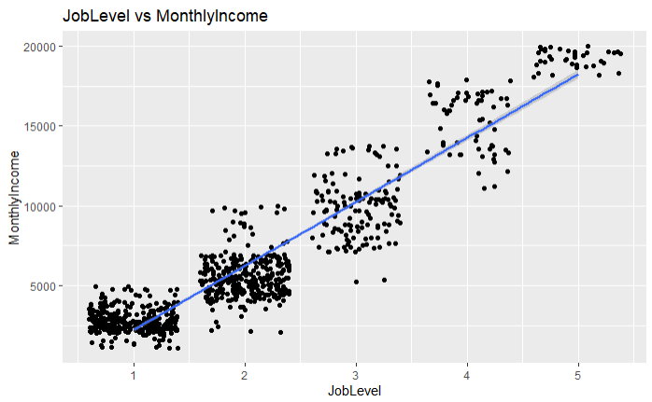
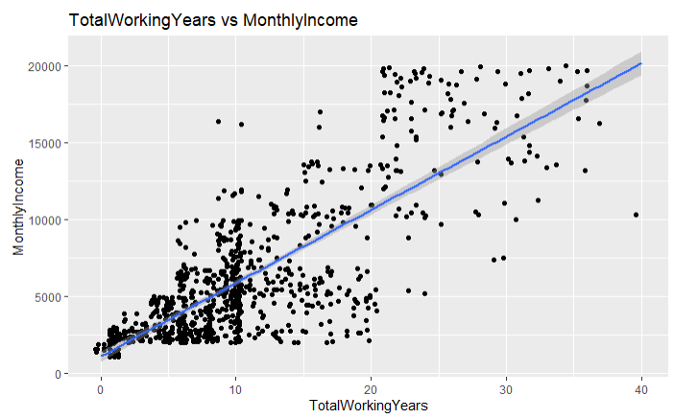
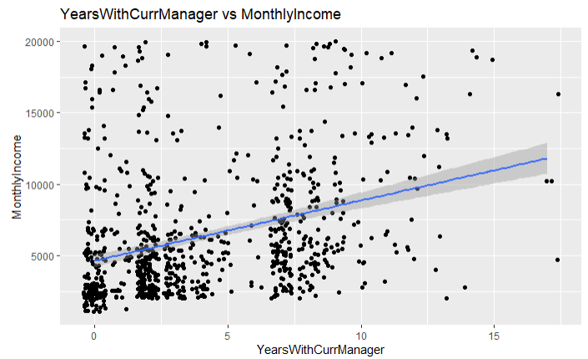
Monthly Income Regression & Prediction Model
Data Inferences
Similar to Attrition, there are many variables that contribute to determining Monthly Income, there are at least 27 different continuous variables that could play a part in Monthly Income determination
A step-wise selection process was done to ensure only the most statistically significant coefficients that yielded the highest Adjusted R squared and lowest root mean squared error were included in the model
The step-wise selection method yields 8 coefficients that will be used to predict monthly income. When running the model on the whole data set the Adjusted R^2 and RMSE are .91 and 1362.277 respectively
The model shows Joblevel, TotalWorkingYears and YearswithCurrentManager as 3 of the most influential variables. Pearson correlation coefficients support linear assosciations

Slide 14
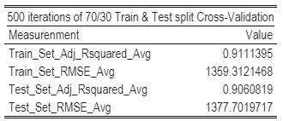
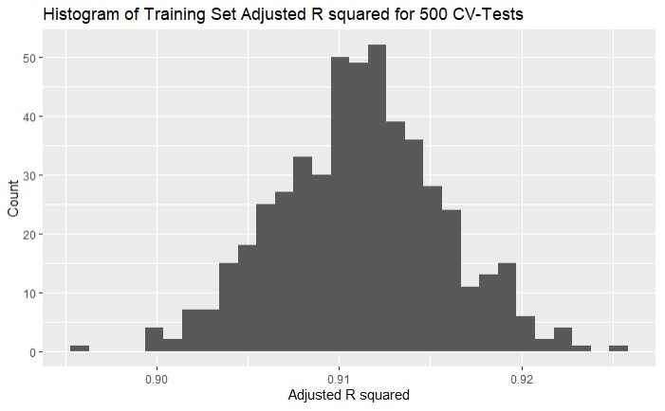
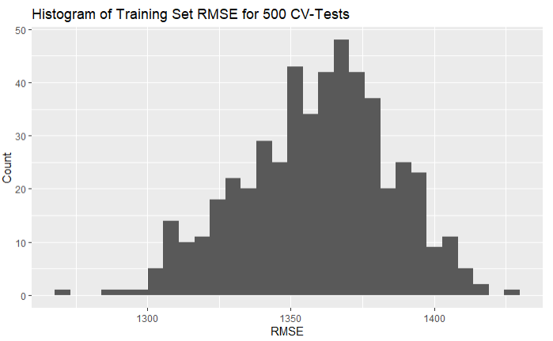
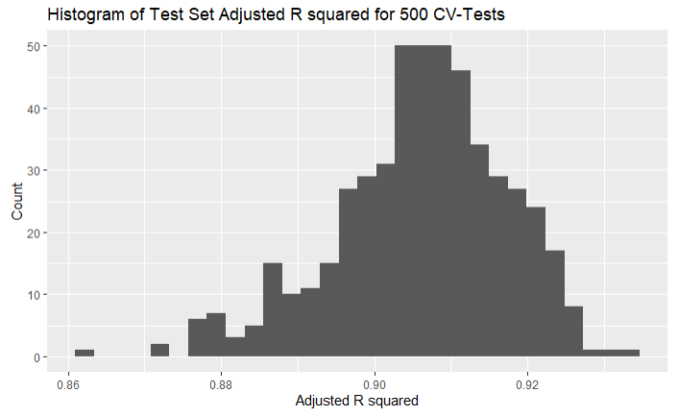
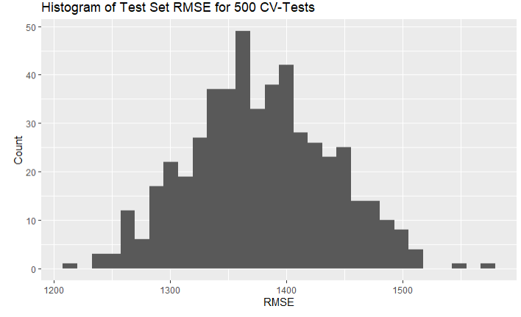
Monthly Income Regression & Prediction Model (Cross Validation)
Data Inferences
500 iterations of 70/30 train and tests sets yield very comparable numbers for adjusted R squared value and RMSE
Both the training and test set avg adj. R^2 and RMSE are very similar to that of the step-wise model using the full data set
Histograms show the normal distribution and consistency of measurements across the 500 iterations of test/train for adj. R^2 and RMSE

Slide 15
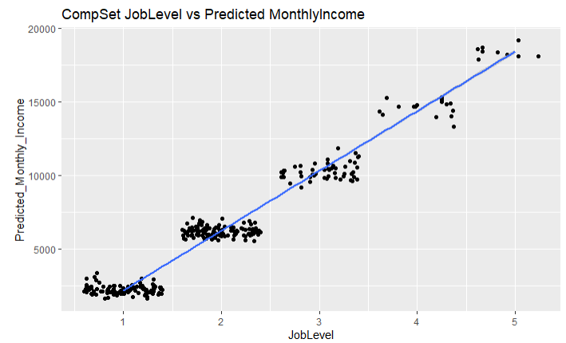
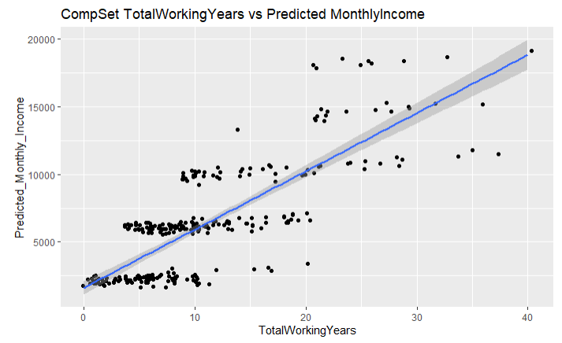
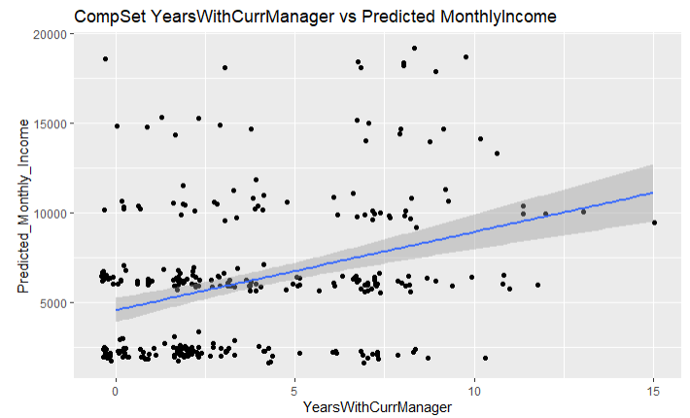
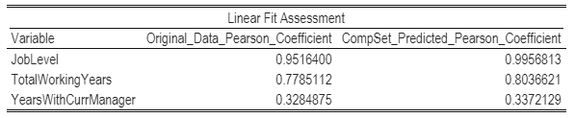
Monthly Income Regression & Prediction Model (Prediction)
Data Inferences
Step-wise Model used to predict Monthly Income for Compset (300 entries)
Scatterplots show similar linear trending for JobRole, TotalWorkingYears and YearsWithCurrentManager as original data
Pearsons linear coefficient between original data and predicted CompSet data very similar
As such this provides confidence into the accuracy of the model

