Slide 1
Smaller Is Not Always Faster
CSE 6359 · Advanced Topics in Systems & Architecture
LLM Quantization on an RTX 5090: Memory vs. Speed vs. Quality
Sijia Zhong · Zheng Zheng · Haofei Sun
Final Project · Fall 2026
Notes:
We studied what quantization really buys you when serving an LLM: memory, speed and quality, measured end to end on one RTX 5090 with two inference stacks.

Slide 2



What We Measured
2 backends × 8 configurations × 3 model sizes — every number measured on one GPU
Platform
Eight configurations
NVIDIA RTX 5090 (Blackwell, sm_120)
32 GB GDDR7 · 170 SMs · 575 W
Measured: 1.52 TB/s DRAM, 218 TFLOP/s BF16, 645 TFLOP/s FP8
Software: PyTorch 2.13, Transformers 5.19, bitsandbytes 0.50, vLLM 0.32
Models: Qwen2.5-3B / 7B / 14B-Instruct
Hugging Face (eager) + bitsandbytes, quantized at load
BF16
INT8 LLM.int8()
NF4 4-bit
vLLM (CUDA graphs) + fused kernels, official checkpoints
BF16
FP8 W8A8
INT8 GPTQ W8A16
INT4 AWQ / GPTQ W4A16
Workloads and metrics
Controlled sweep: batch 1–256 × prompt 128–2048 tokens, exactly 128 output tokens
Real workload: 300 ShareGPT requests (fixed seed), 1–64 concurrent clients
Quality: WikiText-2 perplexity, GSM8K (all 1,319 questions)
Metrics: peak memory, TTFT, TPOT, tokens/s, energy (J/token); 1 warm-up + 3 repeats
Notes:
Hardware, the eight configurations, the workloads and how we time things.

Slide 3
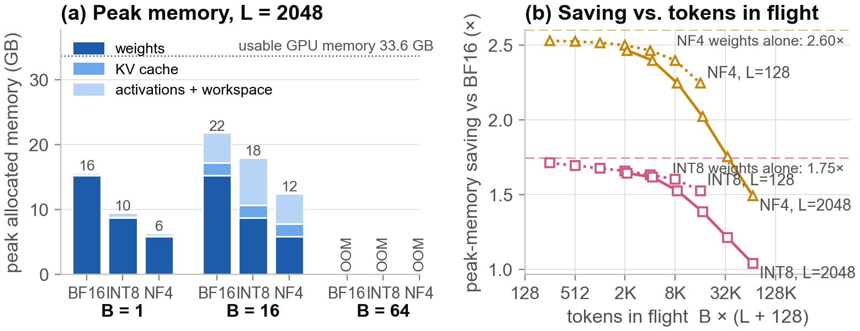
Q1 — Memory: Smaller, but Not 4× Smaller
Only the linear layers shrink; embeddings, LM head, KV cache and activations do not
2.60×
NF4 weight saving on Qwen2.5-7B
nominal 4× — LM head + embeddings stay 16-bit
1.49×
NF4 end-to-end saving at B=32, L=2048
KV cache and activations are not quantized
1.88×
more KV-cache tokens in vLLM with AWQ-INT4
freed memory = more concurrent requests
Notes:
Weights: NF4 saves 2.60x instead of 4x, INT8 1.75x instead of 2x, because the embedding and LM head stay in 16-bit and NF4 stores a scale per 64 weights. At run time the KV cache and activations are not quantized, so the end-to-end saving shrinks toward 1x as batch and context grow.

Slide 4
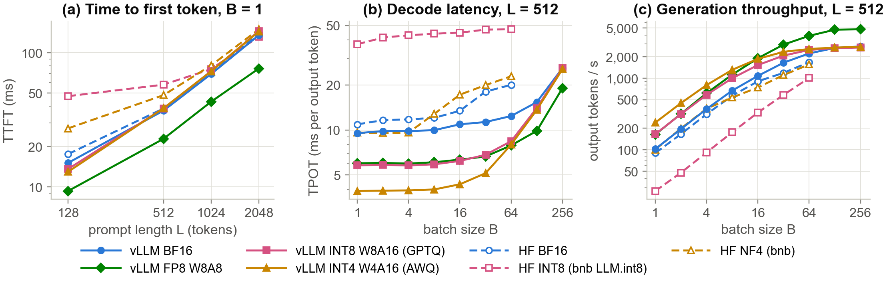
Q2 — Speed Depends on the Kernel
Qwen2.5-7B: same 4-bit weights, opposite outcomes on two software stacks
2.44× faster
3.4× slower
1.73×
AWQ-INT4 decode on vLLM (B=1)
Marlin kernel: fewer bytes = less time
LLM.int8() decode on HF (B=1)
outliers + kernel-launch overhead
FP8 W8A8 throughput at B=256
AWQ-INT4 there: no faster than BF16
Notes:
Left: prefill is compute-bound, so only formats that quantize activations (FP8) cut TTFT. Middle: decode at small batch is memory-bound; vLLM's fused kernels turn fewer bytes into speed, bitsandbytes does not. Right: at high batch only FP8 still raises throughput.

Slide 5
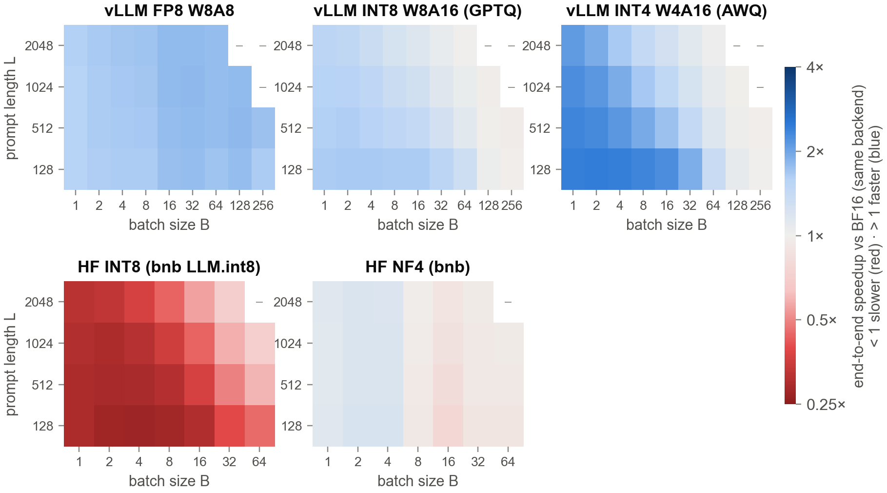
Q3 — When Does Lower Precision Pay Off?
End-to-end speedup over BF16 across batch size × prompt length (Qwen2.5-7B)
B ≈ 175
AWQ-INT4 stops winning (prompt 512)
decode turns compute-bound; dequant no longer hidden
1.59–1.80×
FP8 W8A8 faster in every cell
halves bytes and doubles tensor-core rate
0.27–0.71×
bnb LLM.int8(): slower in every cell
never pays off on this GPU
Notes:
Blue cells: quantized is faster; red: slower. Weight-only 4-bit wins big at small batches and short prompts and fades out with batch size; FP8 wins everywhere; LLM.int8 never wins.

Slide 6
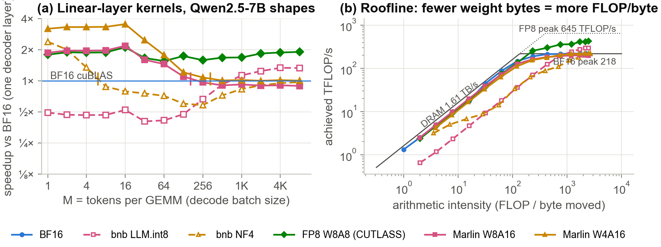
Why 4-bit Stops Winning
One decoder layer's GEMMs vs. tokens in the batch, and the same kernels on the measured roofline
3.2×
M ≈ 333
1.9×
Marlin W4A16 vs cuBLAS at M = 1
memory-bound: 4x fewer bytes
W4A16 advantage shrinks below 5%
compute-bound: dequant no longer hidden
FP8 W8A8 at M = 8192
8-bit tensor cores: 2x the BF16 rate
Notes:
Weight-only 4-bit cuts the bytes 4x, so at small M it climbs the bandwidth roof 4x faster. It also reaches the compute roof at a 4x smaller M; from there the math still runs in BF16 and dequantization is pure overhead. FP8 W8A8 raises the compute roof itself.

Slide 7
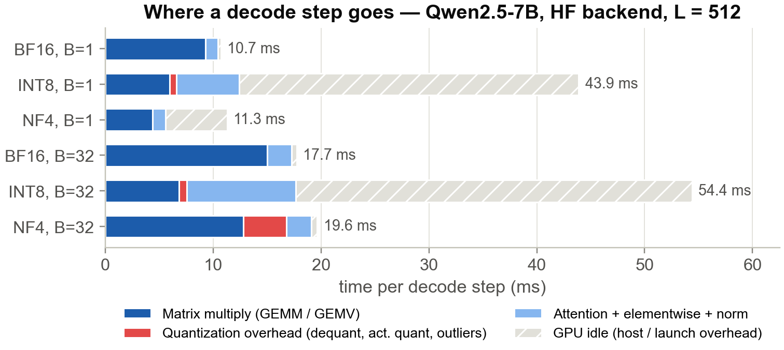
Why bitsandbytes Is Slow
One HF decode step of Qwen2.5-7B: GPU kernel time vs. time the GPU waits for the host
97% → 28%
GPU busy time per step: BF16 → INT8 (B=1)
the rest is host overhead
3.7×
more kernel launches per step with LLM.int8()
casts, outliers, quantize, 2 GEMMs per layer
1.13×
NF4 end-to-end vs BF16 (7B, B=1)
its GEMV kernel alone: 2.4×; GPU busy 49%
Notes:
LLM.int8() splits every matmul into casts, outlier extraction, INT8 quantization and two GEMMs. The GPU work is small; the Python and kernel-launch overhead dominates the step.

Slide 8
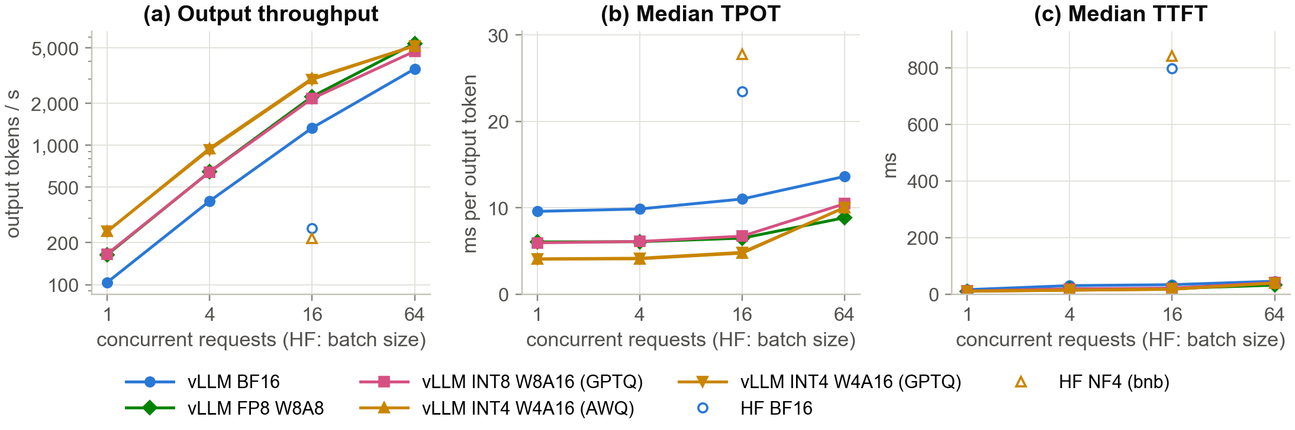
Real Workload: 300 ShareGPT Requests
Qwen2.5-7B served by vLLM (1–64 concurrent clients) vs. HF static batching (B = 16)
2.36×
5,388
5.3×
lower median TPOT with AWQ-INT4 (1 client)
4.1 vs 9.6 ms per token
tokens/s with FP8 at 64 clients
BF16: 3,537 · AWQ: 5,180
vLLM BF16 vs HF BF16 throughput at 16 in flight
the serving stack outweighs the bit-width
Notes:
Same 300 requests, same output lengths for every configuration. Continuous batching and fused kernels matter more than the number format; among vLLM formats FP8 scales best.

Slide 9
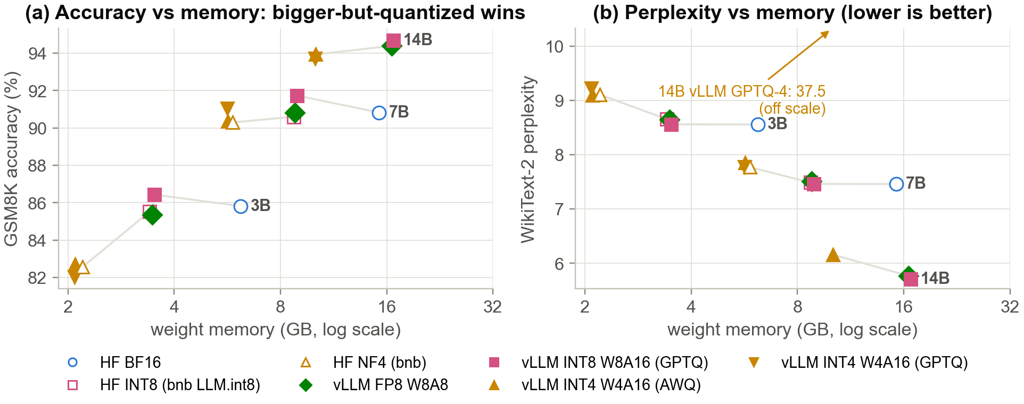
Q4 — Quality: What Do We Lose?
GSM8K accuracy (1,319 questions) and WikiText-2 perplexity vs. weight memory
-0.2 to +0.9 pp
GSM8K change with 8-bit formats (7B)
1 of 3 significant (McNemar p < 0.05)
-0.5 to +0.2 pp
GSM8K change with 4-bit formats (7B)
none significant (McNemar p ≥ 0.05)
93.9% vs 90.8%
14B AWQ-INT4 vs 7B BF16 on GSM8K
0.66× the weight memory of 7B BF16

Slide 10




Takeaways: When Does Quantization Pay Off?
Bit-width alone predicts little — the kernel and the regime decide
Plan memory with the real ratio
Few users: 4-bit + fused kernel
2.6×
4-bit weight saving on Qwen2.5-7B, not 4×; KV cache and activations stay 16-bit
2.4×
faster decode with AWQ-INT4 + Marlin at batch size 1
High throughput: FP8 W8A8
bitsandbytes: memory, not speed
1.7×
the BF16 throughput at batch 256, where 4-bit weight-only gains have vanished
3.4×
slower decode with LLM.int8() at batch size 1; NF4 wins only tiny batches of large models
Notes:
Four rules: plan memory with the real ratio; for interactive serving use 4-bit weights with a fused kernel; for throughput use FP8 W8A8; treat bitsandbytes as a memory tool, not a speed-up.

Slide 11



Team and References
Who did what, and what we built on
Sijia Zhong
Zheng Zheng
Haofei Sun
Baseline + memory (Q1)
Controlled sweeps (Q2)
Real workload + quality (Q3, Q4)
Benchmark harness, memory model, capacity
Precision × batch × length grids, kernels, profiling
ShareGPT serving, WikiText-2, GSM8K
References
Dettmers et al., LLM.int8(), NeurIPS 2022 · Dettmers et al., QLoRA (NF4), NeurIPS 2023
Frantar et al., GPTQ, ICLR 2023 · Lin et al., AWQ, MLSys 2024 · Xiao et al., SmoothQuant, ICML 2023
Frantar et al., MARLIN mixed-precision kernels, PPoPP 2025 · Kwon et al., vLLM / PagedAttention, SOSP 2023
Micikevicius et al., FP8 Formats for Deep Learning, 2022 · Williams et al., Roofline, CACM 2009
Qwen Team, Qwen2.5 Technical Report, 2024 · Merity et al., WikiText (ICLR 2017) · Cobbe et al., GSM8K, 2021
Code, data and report: github.com/zz9tf/6359-SYS-ARCHITECT-course-work
Notes:
Division of work as planned in the proposal; everyone shared analysis and writing.

